Slide 1
EC Aid and Funding modalities for
Social transfers
Hervé Busschaert
Cambodia, February 2013

Slide 2
Objectives of the presentation
1. The different EC aid modalities.
2. The different EC financial mechanisms
3. What is the best aid modality and financial mechanism to implement social transfers?
4. Some examples of good practices.

Slide 3
Part 1. Aid modalities
1. Direct support to projects.
2. Sector Policy Support Programmes.
3. Macro economic budgetary aid.

Slide 4
What is a project?
- Clearly identified stakeholders, including the primary target group and the financial beneficiaries.
- Clearly defined coordination, management and financing arrangements.
- A monitoring and evaluation system.
- An appropriate level of financial and economic analysis, indicating the opportunity cost.

Slide 5
What is a sector policy support approach?
- Led by the government. Ownership.
- Improve the efficiency and effectiveness with which internal and external resources are utilised.
- Increase coherence between sectoral policy, spending and results through greater transparency, through wider dialogue and ensuring a comprehensive view of the sector.
- Minimise transaction costs.

Slide 6
When do you do a project/a sector programme?
- Project is based on an identified specific need.
- Sector programme is based on:
A) An approved national sectoral policy document and overall strategic framework.
B) A sectoral medium term expenditure framework and an annual budget.
C) A coordination process amongst the donors in the sector, led by the Government.

Slide 7
Macro economic budgetary aid.
Change in vocabulary: General budget support.
Support to economic reforms; ad-hoc complementary support and emergency aid for stabilisation and rehabilitation.

Slide 8
When do you decide which aid modality to use?
At the programming stage, i.e. now for 2014-2020.
- It has huge implication on the way to organise the work:
A) logframe.
B) Analysis of the policy matrix including the six pillars assessments: 1) macro economic framework, 2) sector policy and overall strategic framework, 3) MTEF, 4) accountability and public management system, 5) Donor coordination, 6) performance monitoring, 7) institutional and capacity issues.
Notes:
Role of delegation + role of government + other donors.
This is an important moment for partners to be involved. Concentration sectors are already decided as presented by Andrea. Now we are at the nip stage.

Slide 9
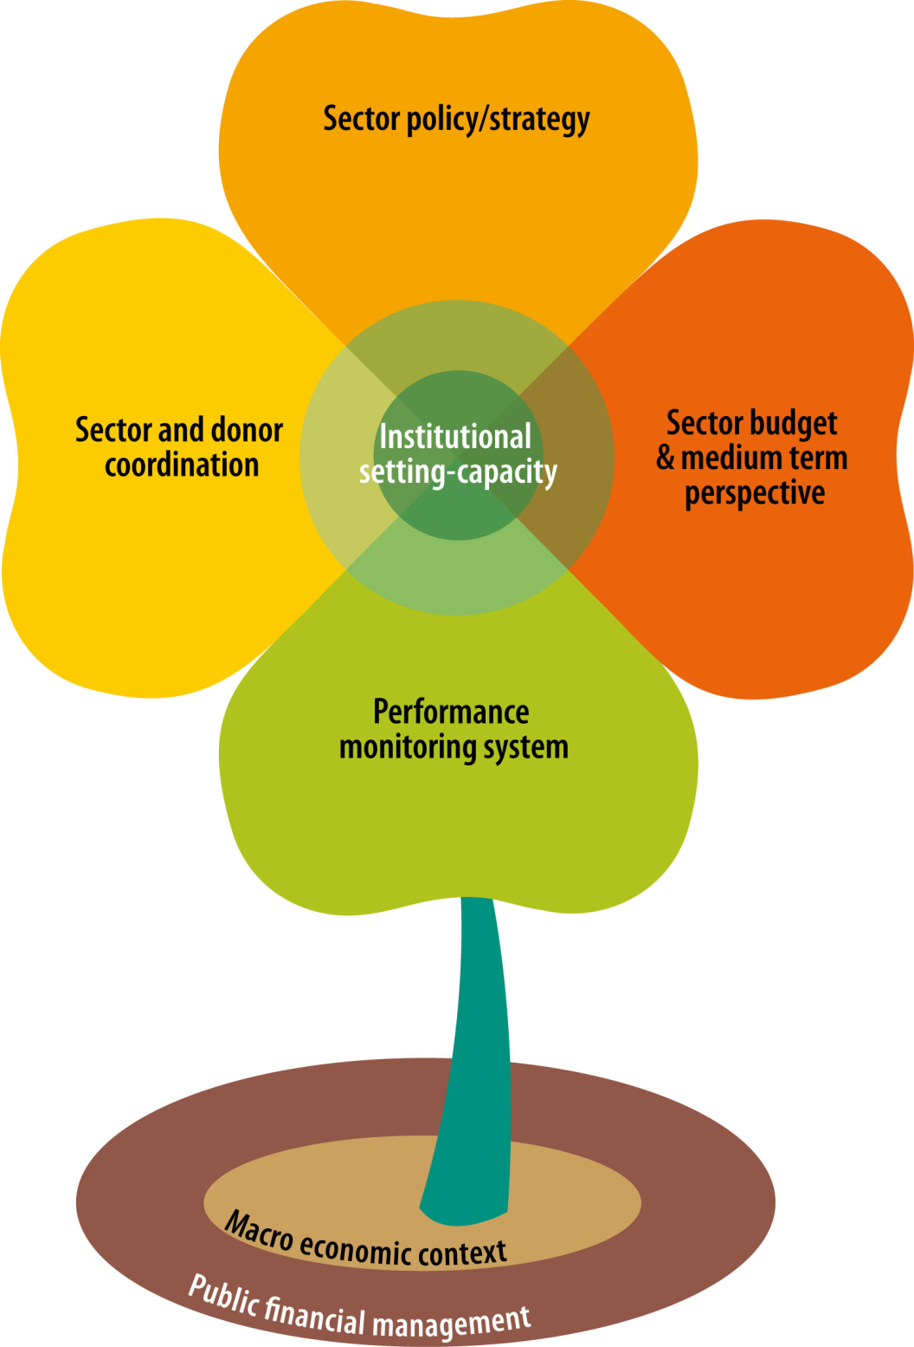
The sector flower
mlk

Slide 10
Part II: Funding modalities
Budget support.
Pool funds.
European commission contracts.

Slide 11
Budget support
Budget support is the preferred EC funding modalities because reinforcing local government is ensuring long term development. Enhancing national reforms such as fiscal reform to ensure funding of Social protection.
Used when the 7 pillar assessment is positive.
Bases on agreed general and specific commitments (conditionalities) and payment of fixe/variable tranches.
Management involves important sectorial knowledge in the Commission and high level political dialogue. It also involves knowledge in functioning of macro economics and public finances.
Notes:
positive evaluation of the macroeconomic situation,
the satisfactory implementation of a PFM (public finance management) improvement action plan and
satisfactory implementation of national strategy.

Slide 12
Pool funds
Pool funds are used when the 7 criterias assessment is not positive or when for effectiveness reason (need for speed, special technical knowledge, or capacities, or adapted procedure (CT).
Managed by international organisations in joint management (UN, WB) or delagted management.

Slide 13
EC procurement and grant award procedures
Used when from the start, for an initiative the project approach has been selected. This can be the case because institutions are weak, no prospect of having a national sectorial policy for example in food security, or when it is more efficient (innovation such as mobile phone, work outside de govt)
Used when the 7 pillar assessment is negative.
Significant limitations on the management of cash transfers (limited amount, risk of cascade funding)

Slide 14
Summary
Approach Funding modality
Project approach
EC procurement and
grant award procedures
Sector approach
Common pool funds
General/global approach
Budget support
Notes:
When I strated working for the commission, there were only two approach and two funding modalities, now you have 5 possibilities.

Slide 15
More EC procedures….
The management mode: direct centralised indirect centralised, decentralised, semi decentralised, delegated, joint, ex ante and ex post….. Don’t worry, trust EC staff in Delegation, they know it all!!

Slide 16
Part III: What is the best aid modality and financial mechanism to implement social transfers?
Social transfer can be utilised for many objectives, it is a tool.
It is a tool gaining interest from donors because:
- Economic growth is not sufficient to reduce poverty (EC mandate, Agenda for change, inclusive growth)
- Improve resilience (EC policy – post 2015 debate)
- Easy to explain to tax payers. We need to show where the money goes.
Notes:
The objectives would include social protection, food security, climate change you name it.

Slide 17
ST and budget support
Sector programmes, in particular using budget support are considered to be the best option, but for whom? Political dialogue and key disbursement indicators are key to make sure the ST benefit the most vulnerable.

Slide 18
BS examples - Peru
Peru: Sector budget support for the Peruvian nutritional programme.
An integrated strategy to fight poverty — Crecer. The Crecer strategycomprises several programmes tackling poverty, including mother and child health, nutrition, basic education and identity documents.
The PAN’s goal is to reduce undernutrition from 25% (in 2005) to 16% (in 2011) and the 2009 budget amounted to EUR 269 million.
One example specific conditions : the percentage of children under 24 months of age enrolled inthe integral health insurance with dietary iron supplement will be measured. The proportion is expected to increase from 4.5% (2009 baseline) to 59.5% in 2013.
Signed in 2009, € 61 million.

Slide 19
BS example - Niger
In 2012, payment of € 40 million to prevent a food security crisis (aspect of resilience).
Good national food security national policy, and strong institutional capacities (Dispositif National de Gestion et Prévention des Catastrophes et Crises Alimentaires).
Good level of political dialogue.
But other FS project are implemented.

Slide 20
PF- PSNP
The productive safety net programme is funded by various donors including DFID, WB etc…

Slide 21
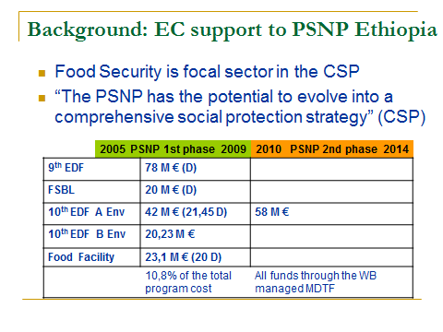

Slide 22
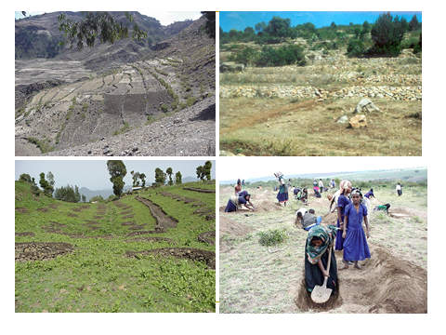

Slide 23
Project- Ujjibito.
Total value of the programme :EUR 168 052 635
EU contribution: maximum EUR 38 000 000 (22.6%).
Main implementation partners: Palli Karma-Sahayak Foundation (PKSF) Ultra-Poor Programme (UPP) and the Local Government Engineering Department (LGED).
No social protection national strategy.
Notes:
Means infused with new life

Slide 24
What is the best?
Sometimes you have no choices.
Is a bad Budget support better than a good project?
Still sustainability, impact and ownership are keys.

Slide 25
Further references
- BUDGET SUPPORT GUIDELINES, European Commission, September 2012.
- Support to Sector Programmes covering the three financing modalities: Sector Budget Support, Pool Funding and EC project procedures, European Commission, Guideline no 2, July 2007

