Slide 1

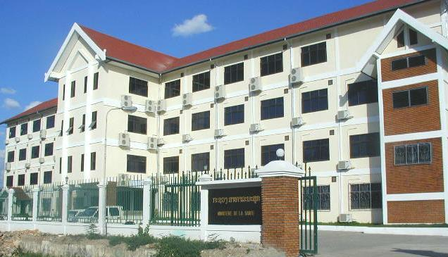

Social Transfer to the Fight against Hunger- Experiences of Health Sector in the Lao P.D.R
21-23 Feb 2013, in Phanom Phenh
Dr. Chandavone PHOXAY
Deputy Director General
Hygiene-Health Promotion Depart,
MoH Lao P.D.R
Sector Working Group for Health Policy Level:
21 November 2008
Donechan Palace

Slide 2
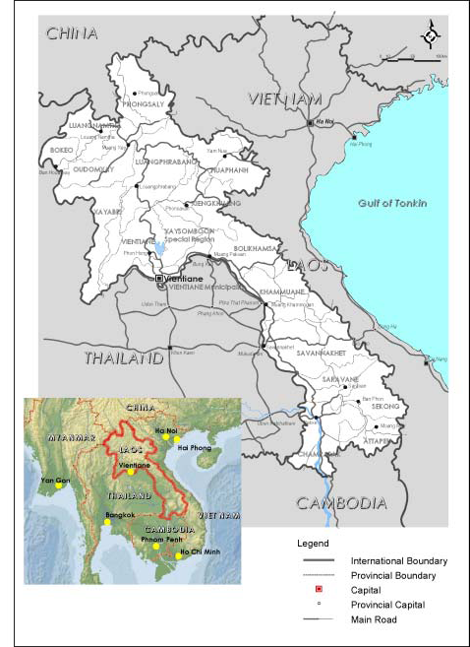
Socio-demographic indicators
Population 6,2 million inhabitant
Population in rural areas 72.8 % (2005)
16 Provinces and 1 capital city
IMR 68/ 1,000 live births
U5MR 73 /1,000 live births
MMR 357 /100,000 live births
LAO
Source: NSC, 2005; UNICEF 2006; The Government report 2009, Global Finance Estimation 2010

Slide 3
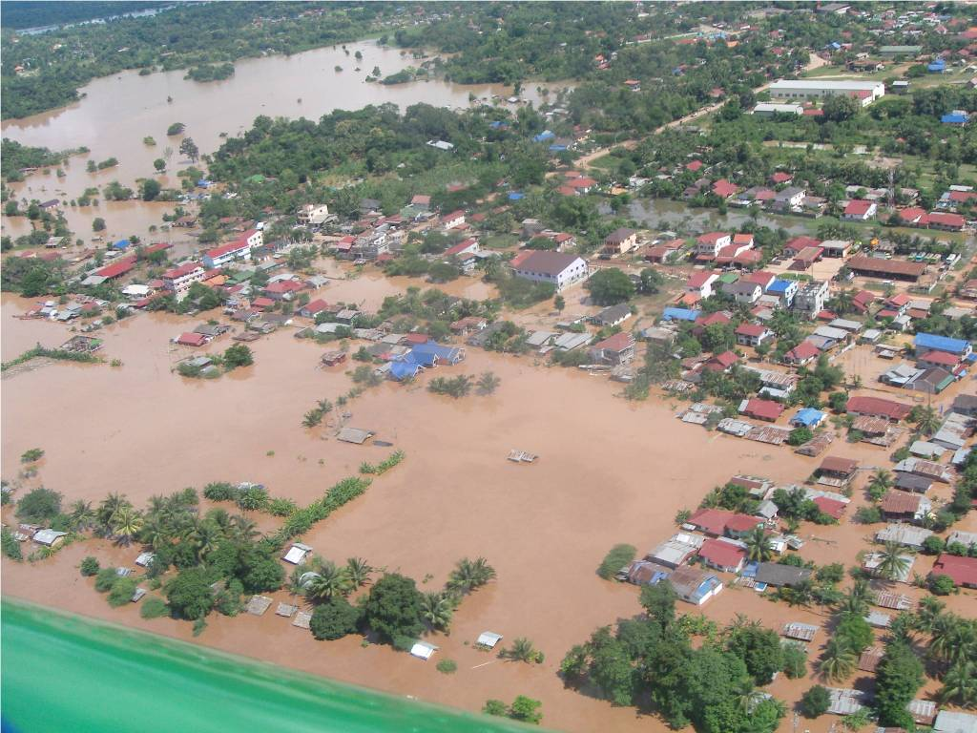

Slide 4

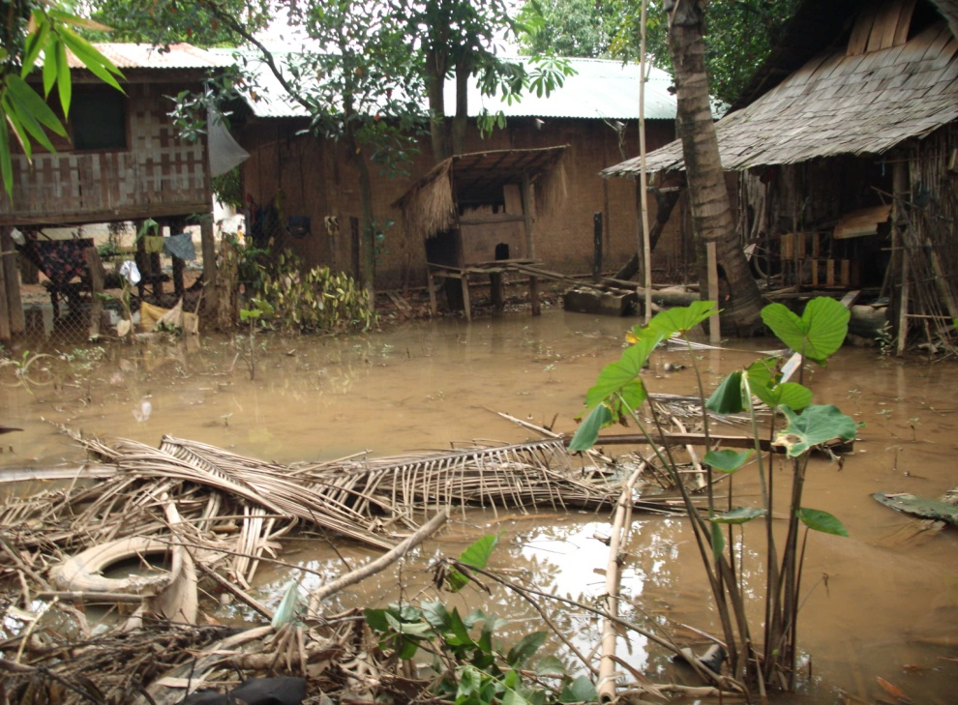
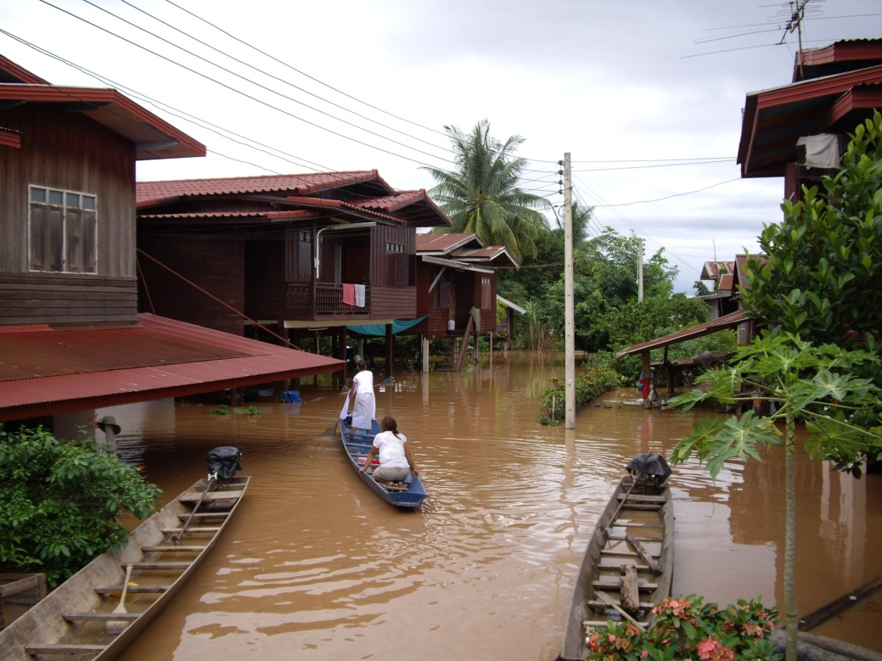
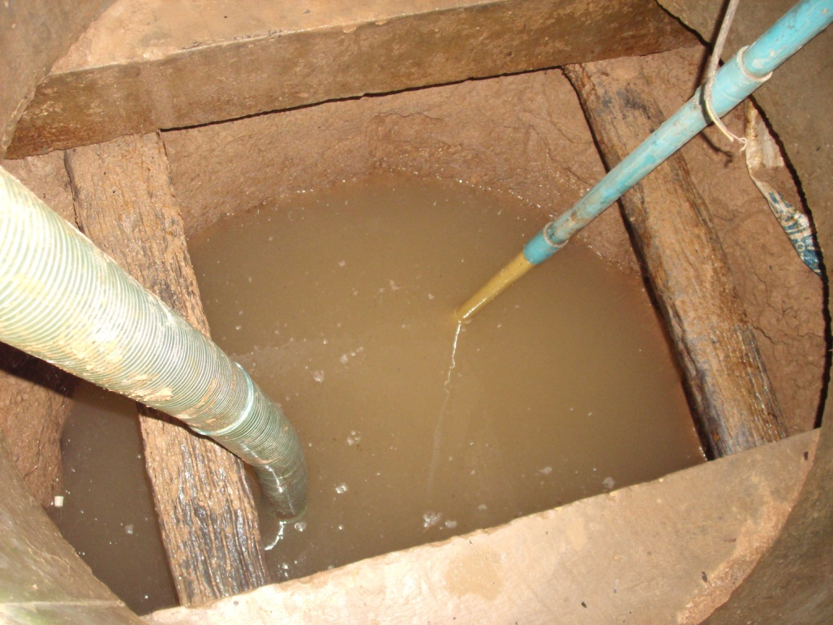
Flood in 2007

Slide 5
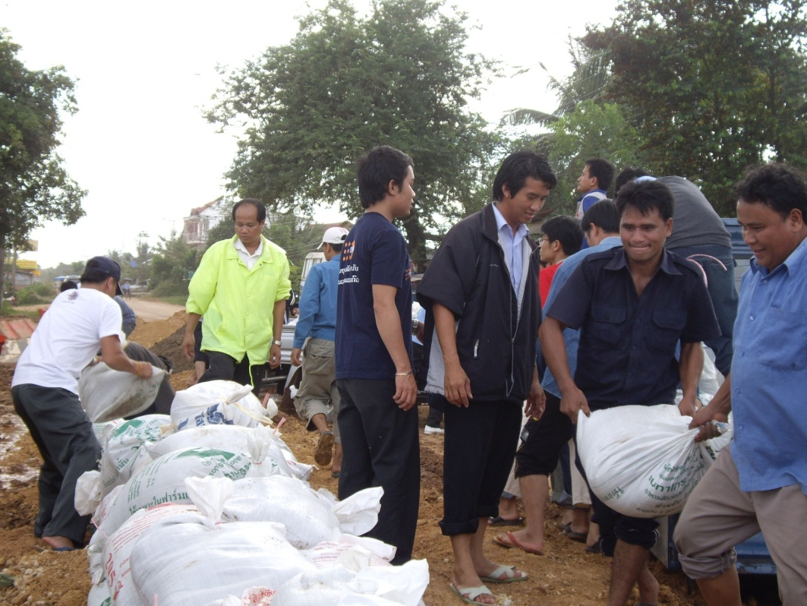
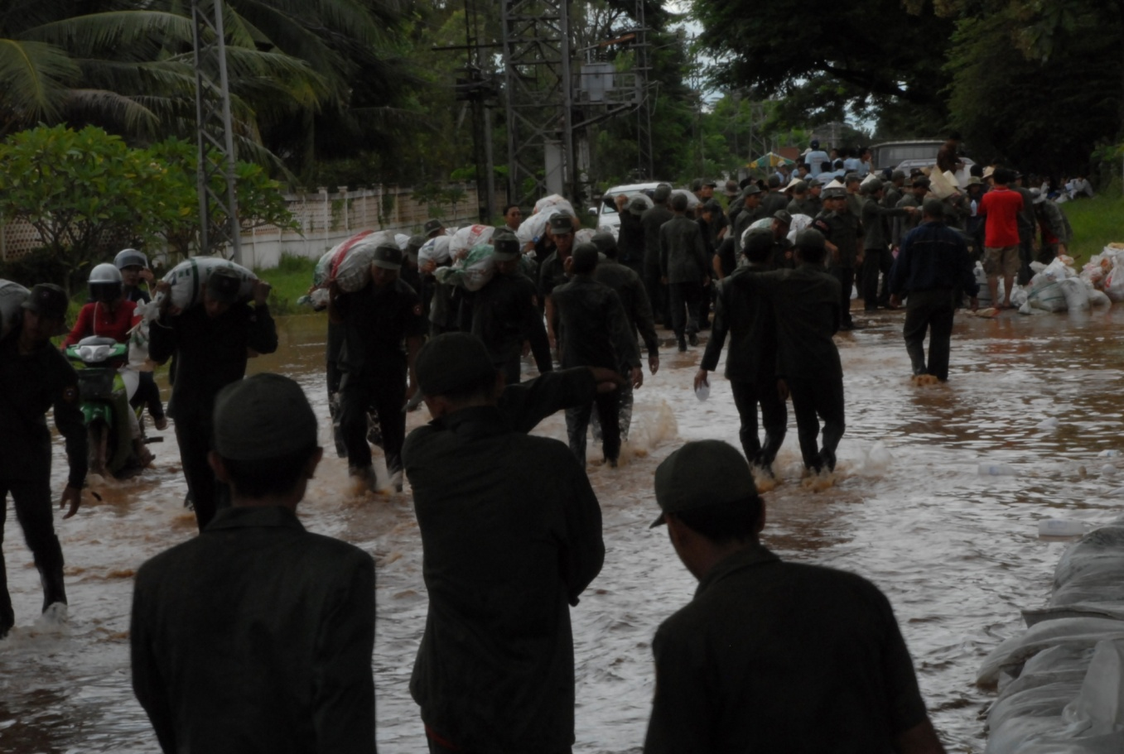

Slide 6
Poverty

Slide 7
Nutritional Status in Lao P.D.R
34
22
Source: the 7th National Health Congress report 2012

Slide 8
Opportunities
The 7th five year National Socio-economic development plan and poverty eradication strategy
Nutrition is one of the top national agenda and priority
Social protection including health financial scheme is one of key driven priority in health sector reformed in Dec 2012

Slide 9
Key Policy and Commitment
National nutrition policy (2008), strategy, operational plan 2010-2015, but no single common strategic plan on food and nutrition security
Health care services with fee exemption for:
  the poor
  pregnant women, delivery
  children < 5 year of age
National Assembly endorsed on increasing government budget for health sector to 9% of total government expenditure on December 2012.

Slide 10
Coordination Mechanism
Sector wide coordination for health at national to sub national levels
Round table - platform for governmental multi- sectoral and development partners coordination on resources mobilization and aid effectiveness
Country member of SUN movement – global coordination
On going for strengthening Multi-sectoral coordination in particular on nutrition and food security would engage line ministries & DPs

Slide 11
Multi-sectoral coordination on nutrition and food security
Objective:
  To have common plan on nutrition & food security
  Common result framework
  Fund raising
  Effective fulfilling gap for nutrition priority interventions
  To achieve MDG1 and graduate from the least developed country by 2020

Slide 12
Experiences on Social Transfers in other sector in Lao P.D.R

Slide 13
Social protection by Govern/donors
Voucher transfer
Target: the poor
Service delivery:
  Health care services
Outcome: utilization of health facility
Challenges:
  Identification the poor
  Huge paper work for PHC staff
  Limited government budget
Cash and Kind
Target: the poor living sparsely in mountain could not access to key services
Services: Land, Housing /shelter, facilities, health centers, schools, seed, agricultural equipments, livestock
Comprehensive rural development
Challenge: limited government resources

Slide 14
Experiences on Social Transfers in Health Sector in Lao P.D.R

Slide 15
Health Equity fund & HC fee exemption for the poor by Govern/Donors
Voucher transfer
Target: the poor
Service delivery:
  Health care services
Outcome: utilization of health facility
Challenges:
  Identification the poor
  Huge paper work for PHC staff
  Limited government budget
Cash and Kind
Target: the poor living sparsely in mountain could not access to key services
Services: Land, Housing /shelter, facilities, health centers, schools, seed, agricultural equipments, livestock
Challenge: limited government resources

Slide 16
Cash incentive: Community Nutrition project supported by WB - EU trusted fund from 2011-2013
Fee exemption :
Nutrition and MCH
supported by Government & others
Free exemption
Objectives: improve coverage of MCH services and improve health outcome of mother and children
Target:
  Pregnant and lactating women and children 2 YR old
Service delivery
  Conditional Cash Transfers (CCT)
  Community-based Nutrition
Objectives: scaling up coverage of MCH services and improve health outcome of mother and children
Target:
  Pregnant and lactating women and children 5 YR old
Service delivery
  MCH
  Community-based Nutrition

Slide 17
CCT
Fee exemption MCH supported by Government & others
Support for fee exemption for Antenatal care (ANC), delivery, postnatal care (PNC) & children < 2 Yrs
  Cash incentive for demand side with condition:
    Enrollment
    Utilization health services
    Package: transportation + opportunity costs
  Cash incentive for providing side:
    Subsidize fee for health facilities based services
Outcomes: increasing utilization uptake of women (ANC, PNC, medical professional assisted delivery) and children in health facilities - MDG 4-5
Full package and scaling up Support for fee exemption for Antenatal care (ANC), delivery, postnatal care (PNC) and children < 5 Yrs children
  Cash incentive for demand side with condition:
    Utilization health services
    Package: transportation + opportunity costs
  Cash incentive for providing side:
    Pay for fees for health facilities based services
Outcomes: increasing utilization uptake of women (ANC, PNC, medical professional assisted delivery) and children in health facilities - MDG 4-5

Slide 18
Nutrition programs
supported by Government & others
Free exemption
Objectives: to improve nutritional status of mother and children to achieve MDG1 by 2015
Target:
  Pregnant and lactating women and children 2 YRs old
Direct nutrition service delivery with free of charge
  Facility & community based screening for mal-nurished children < 5 yrs - synergy with MCH services & child well being check-up
  Community-based care for malnourished children
  Preventive supplementary feeding - the 1st 1000 days intervention: providing nutrient food for pregnant women in ANC, delivery, PNC, & children < 2 Yrs

Slide 19
In short: Social Transfers in Health Sector in Lao P.D.R
Cash-based social transfers
Cash transfers
Unconditional cash transfer
Conditional cash transfer
In-kind social transfers
Food transfers
School feeding
Targeted food distributions
Preventive supplementary feeding Livestock transfer Health equity fund Others
Universal
Targeting

Slide 20
Challenges
Fragmented Food and Nutrition security intervention at all level that needs to strengthen Multi-sectoral coordination
Inadequacy of fund at all level that needs to mobilizing fund from both government and donors through Multi-sectoral coordination
Sub-regional level: Lack capacity for
  Technical skill
  Design implementation
  Financial management
  Monitoring and impact evaluation, health management information

Slide 21
Lessons-learned
Alignment
Partnership
Ownership
Capability and capacity
efficient resources allocation and management

Slide 22
Thank you very much

