Slide 1
Seminar on Social Transfers for the Fight against Hunger
Phnom Penh, Cambodia
(21-22) February 2013
Social Transfer – The Myanmar Experience
Nan Ma Ma Myo
Ayeyarwaddy Delta Project Manager
Thadar Consortium, Myanmar
Notes:
Good morning/good afternoon ladies and gentlemen. First of all, I would like to introduce myself. I am Nan Ma Ma Myo from Myanmar
, I am working for Thadar Consortium as a PM. Now I am here to make a brief presentation about Social transfer of Myanmar. Before I make the presentation, let me say that this is a privilege to get such kind of chance to take about this topic on behalf of Myanmar civil society.

Slide 2
Presentation Outlines
Country context
Poverty rate
Current situations
Overview of Thadar Consortium social protection activity
New chapter of social security scheme in Myanmar
Notes:
Firstly, let me introduce you to the outline of this presentation. Generally, you will see five parts in this presentation. These are …

Slide 3
Country context;
Population: 60 millions
Literacy rate: 89.9%
Population growth rate: 1.084%
Birth rate: 19.31 births/1000 population
Death rate: 8.16 deaths/1000 population
Maternal mortality rate : 240 deaths/100,000 live births
Infant mortality rate : 49.23deaths/1000 live births
Stunting rate: 41 % of children under the age of five are stunted
Notes:
CIA burma facts: definition of literacy above age 15 and over can read and write

Slide 4
Country context;
Labor force – by occupation
agriculture: 70%
industry: 7%
services: 23% (2001)
Unemployment rate:
5.7% (2010 est.)
Unequal wages
Vast and untapped natural resources
Fluctuating market economy
Lift of economic sanctions – entry of INGOs/ MFI/business people
Notes:
MFI micro finance institution, natural resources:petroleum, timber, tin, antimony, zinc, copper, tungsten, lead, coal, marble, limestone, precious stones, natural gas, hydropower

Slide 5
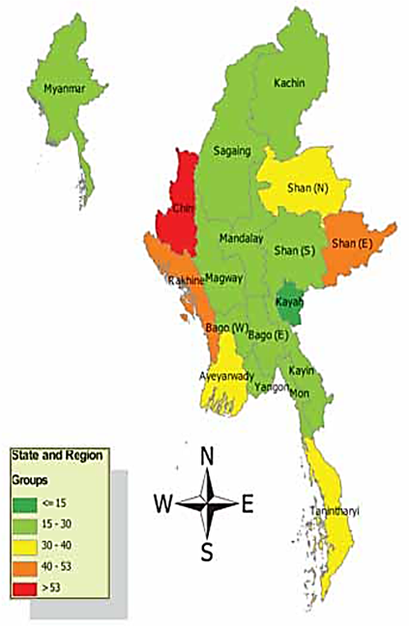
Regional Disparities of Poverty Incidence (source: IHLCA, 2009-2010)
National poverty incidence 32%(2005) to 26% (2010)
Regional disparities exist
Notes:
Now I am going to talk about the poverty incidence and regional disparities of poverty incidence in Myanmar.
Before going to regional figures , let me talk about the poverty incidence at the national level.
Integrated Household Living Conditions Surveys conducted in 2005 and 2010 by Ministry of National Planning and Economic Development updated the poverty incidence of the country.
In 2005 , the survey indicated that poverty incidence was 32% . In 2010, it was found that poverty incidence decreased to 26 per cent of the total population.
It was still high since one in every four persons is living under poverty line.
Regional disparity of poverty incidence is quite remarkable. Chin state is the poorest among the regions and states of the country with over 50% of poverty incidence followed by Shan (East) and Rakhine with over 40% of poverty. Most of the regions and states of the country are moderate in terms of poverty meaning that 15 to 30 per cent of the total population are living with poverty.

Slide 6
Current situations
“Although Myanmar has implemented the social security system, it is not a comprehensive one. It offers some types of benefits and its coverage of workers is limited. So, efforts are being made to be able to enact a new Social Security Law in order to implement a social security system that covers the whole population.” – Vice President speech on 1 May 2012.
8 Major Key Promises of the President to alleviate poverty in Myanmar :
Development of Agricultural Production
Development of Livestock breeding and Fisheries
Development of Small Scale Production and Domestic Production in village level
Development of Private Micro-finance Sector
Development of Co-operative Org
Development of rural Socio economy
Development of rural Energy sector
Environmental Conservation
Notes:
Excerpt from Vice president’ s speech on 1 May labor day 2012

Slide 7
Current Law needs to be amended in many aspects to be in line with the ILO Conventions
102, Social Security (Minimum Standard) Convention, 1952.
118, The Equality of Treatment (Social Security) Convention, 1962.
121, Employment Injury Benefits Convention, 1964.
128, Invalidity, Old-age and Survivors’ Benefits Convention, 1967.
130, Medical Care and Sickness Benefits Convention, 1969.
157, Maintenance of Social Security Rights Convention, 1982.
168, Employment Promotion and Protection Against Unemployment Convention. 1988.
183, Maternity Protection Convention, 2000.

Slide 8
The New Bill
“The Social Security Bill (2012)”
confirmed by
the Amyotha Hluttaw and
the Pyithu Hluttaw
shall be forwarded to the Pyidaungsu Hluttaw

Slide 9
Goal : To build civil society through the development of local NGOs and CBOs
in structures that support bottom-up development efforts that engender stronger local communities.

Slide 10
Currently, Thadar Consortium is implementing, “Building Local Capacities for a Livelihood Systems Approach in Ayeyarwaddy Delta ” project with LiFT funding

Slide 11
The Overall Goal of the project is to contribute to the increased security of livelihoods and household incomes for vulnerable rural households in the Ayeyarwaddy Delta
Capacity Building
Implementing of Livelihoods Model
Social Protection Model
Notes:
Social protection is a basic right of all people, rooted in the Universal Declaration of Human Rights (articles 22 and 25) and the International LabourOrganisation (ILO) Convention 102 (1952) on Social Security (Minimum Standards).
Social protection is to: reduce vulnerabilities/shocks, socio and economic risks, enhance Social status, ensure Access to social services

Slide 12
Current Planned Activities:
Food for families with no food security (for all food insecure families) Free food for dependants (Aged and PWDs) Food on credit for able bodied
Health emergency fund Interest free credit for hospitalization (For all the needy) Free allowance for pregnant women (Women from bottom 2 vulnerable categories of well being analysis)
Livelihoods protection (People in the bottom 2 wellbeing categories) 50% free and 50% interest free loan from communities
Education for children of women headed families and asset less families (Free Transport facilities)
Nutritious food for children below 6 years- early child care centers (for all children)
Cash for work programs during lean period (For all able bodied food insecure families)
Access to credit - crop and business investments (for small farmers and petty businesses)

Slide 13
The New Chapter of The Social Security Scheme In Myanmar
The new Social Security Scheme just been mentioned indeed opens the new chapter in the sector of social protection measure in Myanmar.
It will become a significant scheme especially reliable for workers at grass-roots level, women, and children who are extremely in need of social protection.
If necessary advice, technologies, monetary and material support, and aids are offered to the success of this significant change, they will be heartily welcomed.

Slide 14
Thank you for your attention!

