Slide 1

Social transfer programme in Nepal: an overview
Raj Kumar Pokharel
Chief
Nutrition Section
Child Health Division/DoHS
Ministry of Health and Population

Slide 2

Nepal- a small but diverse country
IMR ranges from 31 to 62 in highest to lowest wealth quintile
5 development regions
3 ecological region
  Mountain
  Hill
  Terai
MMR ranges from 153 in Okhaldhunga to 301 in Rasuwa
Far western
Mid western
HUMLA
DARCHULA
CHINA
BAJHANG
MUGU
BAITADI
BAJURA
DADEL-
JUMLA
Western
N
10 religion
125 caste/ethnic groups
123 languages spoken as mother tongue
DHURA
DOTI
ACHHAM
KALIKOT
DOLPA
KANCHAN-
DAILEKH
MUSTANG
PUR
JAJARKOT
KAILALI
RUKUM
MANANG
Central
SURKHET
SALYAN
MYAGDI
BARDIYA
ROLPA
B
A
G
L
KASKI
LAMJUNG
GORKHA
BANKE
PYUT-
U
N
G
PARBAT
RASUWA
Eastern
60 m above the sea level to highest peak in the world
The Mount Everest-8848 m
DANG
HAN
ARGHAK
GULMI
SYANGJA
TANAHU
SINDHU-
HACHI
PALPA
DHADING
NUWAKOT
PALCHOK
DOLAKHA
KAPIL-
RUPAN-
NAWAL
KATHM
BHAK
SULUK-
BASTU
DEHI
PARASI
MAKAWAN-
LALIT
KAVRE
A
P
HUMBU
SANKHUWA-
TAPLEJUNG
CHITWAN
PUR
M
E
C
H
H
SABA
PARSA
R
A
OKHAL-
SINDHULI
DHUNGA
KHOTANG
TERHA-
A
R
INDIA
BARA
RAUT-
BHOJ-
THUM
H
E
T
H
Life expectancy ranges from 42 years in Mugu to 75 years in Kathmandu
AHAT
SARLAHI
MAHO-
UDAYAPUR
PUR
DHAN-
P
A
C
TARI
KUTA
ILAM
DHANUSA
SIRAHA
SAPTARI
SUNSARI
MORANG
JHAPA

Slide 3
Nepal- SOCIO-DEMOGRAPHIC INDICATORS
Total population: 26.4 Million [M: 12.8m, F: 13.6m]
Population growth rate: 1.35 per annum
Urban population: 17 percent;
Working age population: 57 percent
Literacy rate: 65.9 percent [M: 75% vs. F: 57%]
Female-ownership of fixed assets: 19.7 percent
Firewood as fuel: 64 percent
HH having toilet: 62 percent
Population with improved water source 80 percent
25.4% Population
Below Poverty line

Slide 4
Significant improvement in reduction of mortality in mother and children

Slide 5
State has guaranteed the right of every citizen…
Section 35 (9) of the Interim Constitution of Nepal has stated that the state will follow a policy to pay special attention to protect the interest of women, orphans, children, old age people, the disabled, incapable and endangered race.

Slide 6
Nutrition Status of Children and Women in Nepal

Slide 7
CHILD Under-nutrition in Nepal
Prevalence of stunting
HUMLA
DARCHULA
CHINA
BAJHANG
FWDR
46.4%
MUGU
NEPAL
41%
BAITADI
BAJURA
MWDR
50.3%
DADEL-
JUMLA
N
DHURA
DOTI
ACHHAM
KALIKOT
DOLPA
KANCHAN-
DAILEKH
MUSTANG
PUR
KAILALI
JAJARKOT
SURKHET
RUKUM
MANANG
WDR
37.4%
BARDIYA
SALYAN
ROLPA
MYAGDI
KASKI
GORKHA
B
A
G
L
U
N
G
PARBAT
LAMJUNG
RASUWA
BANKE
PYUT-
DANG
HAN
ARGHAK
GULMI
SYANGJA
TANAHU
SINDHU-
HACHI
NUWAKOT
PALCHOK
PALPA
DHADING
CDR
38.2%
DOLAKHA
KAPIL-
RUPAN-
NAWAL
KATHM
BHAK
SULUK-
BASTU
DEHI
PARASI
MAKAWAN-
LALIT
KAVRE
A
P
HUMBU
SANKHUWA-
TAPLEJUNG
CHITWAN
H
H
SABA
PUR
R
A
M
E
C
OKHAL-
EDR
37%
PARSA
SINDHULI
DHUNGA
KHOTANG
TERHA-
R
INDIA
BARA
RAUT-
BHOJ-
THUM
H
E
T
H
A
AHAT
SARLAHI
MAHO-
UDAYAPUR
PUR
DHAN-
P
A
C
TARI
KUTA
ILAM
DHANUSA
SIRAHA
SUNSARI
MORANG
SAPTARI
JHAPA

Slide 8
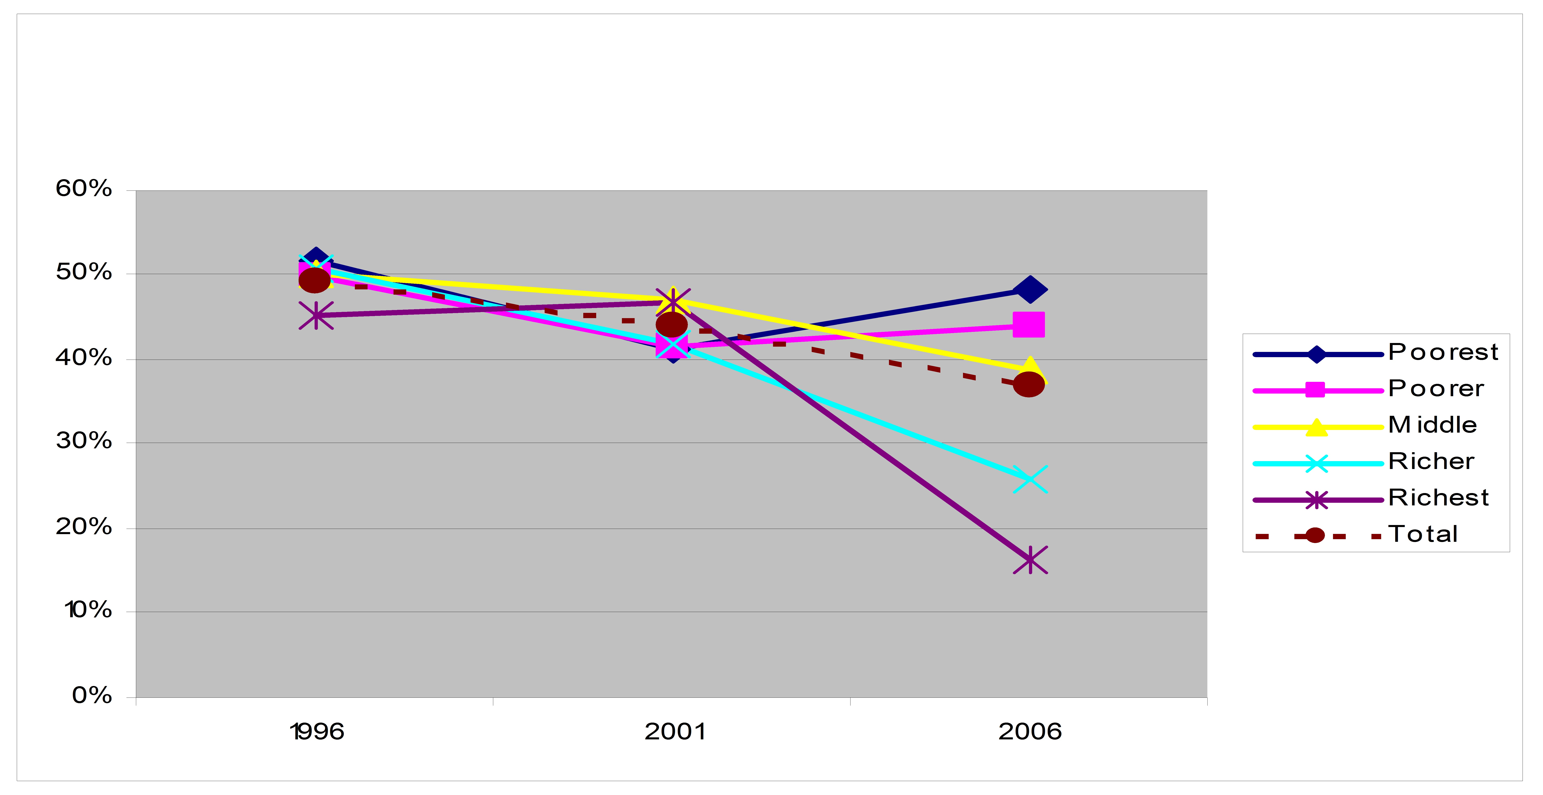
Trend in stunting prevalence by wealth index
12% increase in poorest quintile!
14% overall reduction
65% reduction in richest quintile!
Ref: DHS 2001 and 2006. Adapted from Ramu Bishwakarma. Social Inequalities in Child Nutrition in Nepal. August 2009 (Background paper for Nepal Nutrition Assessment and Gap Analysis, November 2009)

Slide 9
Women’s Under-nutrition is Declining
But Over-Nutrition is on the Increase

Slide 10
Anemia Prevalence High in < 5 Children:
The Problem is serious among 6-23 months children
70 %

Slide 11
Percentage of households consuming salt with 15 ppm or more iodine
Vitamin A supplementation to 6-59 children
A global success story in
micronutrient deficiency
disorders control programs
Iron and folic acid coverage 1999-2011

Slide 12
Social protection in Nepal
Overview of social transfer progrAMs

Slide 13
Mainly five type of social transfer programs in nepal
1. Cash transfer, social protection programme including safety net programs and in kind transfers (e.g. social pensions for senior citizens, children, people with disability, endangered indigenous people, scholarships and food for work, school meal programme) and conditional cash transfers (e.g. maternity benefits and school meal program)
2. Free social services i.e. Essential health care services – free drug, free antenatal check-up and incentives of transportation, free uterine prolapsed operation, free immunization and contraceptives etc. and basic education
3. Poverty reduction and social empowerment programs aimed at various marginalized communities and women (PAF, MoWCSW in collaboration with development partners)
4. Pensions and social insurance mainly focused on formal sector employees (Employees Provident Fund, Citizen Investment Fund)
5. Labour market interventions like labour legislations; vocational and skill development trainings; rural community infrastructure works and so on

Slide 14
Social protection in Nepal: social transfer programmes
Type | Primary Objective | Elements | Geographical area/ entitlement | Administration | Funding source
Food aid (Conditional in-kind transfer through food and cash) | Address extreme hunger and malnutrition | Food and cash or both is provided to highly food insecure households | Dependent on area affected (currently in 21 districts) | MoFALD | Government and aid agencies
School meal programmes | Address malnutrition and serve as incentive for school attendance | School children provided with nutritious mid day meals | Implemented in 11 districts of mid and far west regions | Ministry of Education/MoHP | Government and aid agencies
Child Protection Grant | Address child malnutrition | For Dalit children from birth till 5 years, two children under-5 children per family, in low Income households; for all families in Karnali Zone, (NRs.200 per month per child) | Karnali Zone | MoWCSW, MoFALD | Government MoFALD, MoWCSW
Karnali Fortified Food Distribution Program | Address child malnutrition | All children aged 6-23 months in Karnali are provided with a nutritious food supplement | 5 districts in Karnali Zone | MoHP | Government and aid agencies
Public Food Distribution System | To improve the situation of food security | Food storage/distribution in select districts | Limited capacity | MOAD,MOCS, NFC, | Government

Slide 15
Social protection in Nepal: social transfer programmes
Type | Primary Objective | Elements | Geographical area/ entitlement | Administration | Funding source
Safe Delivery Incentive Programme | Reduce maternal and infant mortality through birth assistance | Pregnant women receive Rs 500 in Terai, Rs 1000 in Hills and Rs 1500 in mountains as transportation costs plus Rs 300 provided to health professionals and Rs 1000 reimbursement to facilities. Also free delivery care in 25 low HDI districts. | National | MoHP, distributed by local health workers/midwives | Government and Aid agencies
ANC and PNC Incentive | Reduce maternal mortality through increased health seeking behavior | Rs 400 upon completion of 4 ANC and 1 PNC visits at SHP, HP, PHCC and district hospital | National | MoHP | Government and Aid agencies
Screening and operation of uterine prolapse problems | Reduce maternal mortality through reduced obstetric morbidity | Rs1,000–3,000 as transportation allowances for those having a surgical intervention. |  | MoHP and contracted provide providers
Free Health Program |  | Free health services for all in HFs beyond districts (40 listed drugs free), free health care services for FCHVs, senior citizen, ultra poor, poor, helpless, disabled | Expanding | MoHP | Government

Slide 16
Social protection in Nepal: social transfer programmes
Type | Primary Objective | Elements | Geographical area/ entitlement | Administration | Funding source
Formal sector social security and health insurance | Insurance against unemployment, sickness, accident and for old age | Covers only small segment of population in the formal sector – government civil servants, army, police, teachers | Formal sector, nationwide | Ministry of Labour | Government, employers, employees
Employment schemes | Rural employment and rural infrastructure; Karnali Employment Programme (KEP): ‘One family one job’ | Public or development agency-based public works – cash for work | Karnali Zone | Ministry of Labour/MoFALD | Government and aid agencies
District block grants and top up grants | Funds to finance local governance and community development | To promote local development activities and strengthen good governance at local level | All 75 districts of the country planned | MoFALD | Government

Slide 17
Social protection in Nepal: social transfer programmes
Type | Primary Objective | Elements | Geographical area/ entitlement | Administration | Funding source
Disability allowance | For persons living with disability or sight-impairedness, as per MLD criteria | 1000 rupees per month for fully disabled, Rs 300 for partially handicapped | All disabled above 16 years | Ministry of Federal Affairs and Local Development | Government
Social pensions | Security for the elderly | Entitlement for all citizens over age of 70, and over 60 in Karnali Zone, or if identified as Dalit community, currently rupee 500 per month | Legally, all eligible as per the categorical Targeting | Government, distributed by Local dministration of MoFALD, MoWCSW | Government
Single woman’s allowance | Social assistance | Widows over 60 | Eligible single women | MoFALD/MoWCSW | Government
Education grants | Social inclusion | For socially excluded groups – girl children, Dalit Children |  | Government, distributed by Local administration of MoE | Government

Slide 18
Social protection in Nepal: social transfer programmes
Type | Primary Objective | Elements | Geographical area/ entitlement | Administration | Funding source
Technical education Scholarship for girl children | Gender equality | For girl students in low-income families in disadvantaged regions and Communities | Targeted | MoE | Government
Categorical grant for ‘threatened ethnicities’ | Social inclusion and diversity | For all members of ethnic or language communities with small and declining numbers of people | Those who are eligible | MOWCSW/MoFALD | Government
 |  | Benefit of rupees 500 per month, and 1000 rupees for most at risk community to attend technical college
Geographical grant | Address remoteness | For disadvantaged groups such as Dalits, single women and people living in the Karnali Zone | Karnali Zone | MoFALD | Government

Slide 19
Social protection in Nepal: social transfer programmes
Type | Primary Objective | Elements | Geographical area/ entitlement | Administration | Funding source
Marriage allowance | Social inclusion | Grant for wedding expenses for widows from socially excluded groups and inter-caste marriages. | Legally eligible couple | MoFALD | Government
 |  | Benefit of rupees 50 000-100 000
Monthly allowances for ex-combatants | Political stability | Introduced as part of the Peace Agreement in 2006/7 | In the context of peace process | MoPR | Government
Subsistence allowance for families affected by the civil war | Political stability and social justice | Allowances (Rs 1000/month) to families of those who perished or became disabled during the civil war | Legally eligible target individual/group | MoPR | Government and Aid Agencies
Tax exemption and debt relief | Social relief from financial burden | For women, Dalits, disabled, poor farmers, disaster- and conflict-affected | Legally eligible target | MoF and national banks | Government
Transportation Subsidy on Iodized salt distribution | Promotion of consumption of adequately iodized salt | Improve coverage of adequately iodized salt in remote areas | 22 geographically remote districts with difficult terrain | MoHP and STC | Government

Slide 20
Target groups benefitted..social security expenditure
Estimated proportion of beneficiaries
Allowance to the different target groups
SN | Beneficiaries | Amount (P/M)
A | Senior citizen | 500
B | Single women | 500
C | Fully disabled | 1000
D | Partially disabled | 300
E | Endangered race | 500
F | Children (CCG*) | 200
Social Security Expenditure (1998/99-2010/11)
3% of total GDP

Slide 21
Delivery mechanism
MONITORING AND EVALUATION
Ministry of Local Development, Ministry of Women, Children and Social Welfare and
Ministry of Finance
CENTRE
DFCO
Social Security Coordination Committee
Social security
program fund
DDC
Progress Report with payment voucher within 7 days
Trimester Fund release
in advance
MUNICIPALITY
VDC
Fund/Allowance
Beneficiaries
DDC-District Development Committee, DFCO-District Financial Controller Office; VDC-Village Development Committee

Slide 22
Gaps and challenges
Limited institutional capacity
Ever rising aspirations of people
Accommodating needs of diverse groups, risks and vulnerabilities
Build checks against perverse incentives
Reaching out to the informal sector
Social security programs are implemented by various agencies, so some tend to benefit more while some are left out of the program
Due to the lack of awareness and education in the weaker sections, there is higher chance of being left out of the program
Not effective monitoring system (M&E indicators have not been developed)

Slide 23
FUTURE STEPS
Strict mechanism to identify the real beneficiaries for the reduction of misappropriation of funds
Preparing a judicious mix of preventive, protective and promotional measures
Decide on targeted or universal schemes and also on use or non-use of conditionalities
Establish a social protection floor along with clear prioritization of supplementary interventions
Articulate the role of state, market, communities, INGOs and development partners and spell out mechanism for effective coordination and harmonization

Slide 24
FUTURE STEPS….
Use of information technology
Strengthen monitoring and evaluation system at all levels
Develop viable and sustainable financial plan and strategies
Work out appropriate institutional strategy for delivery of SP benefits

Slide 25
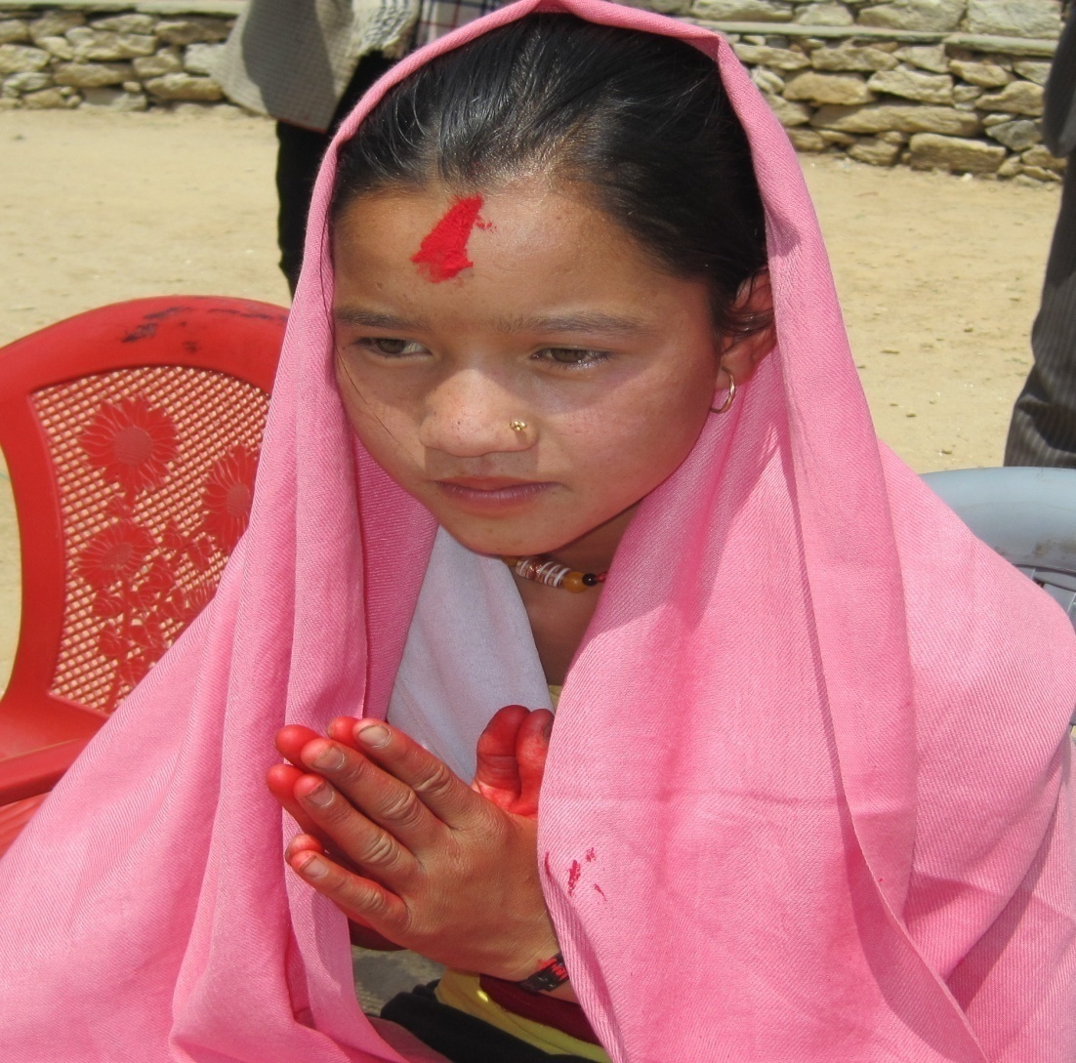
Background
IYCF PROMOTION LINKED WITH CHILD CASH GRANT
  Started in 2009/10 by GoN, Child Cash Grant (CG) (NRs 200/child for maximum 2 children) is provided for each child in Karnali and Dalit (low ethnic caste) families in rest of the country through Ministry of Federal Affairs and Local Development
  Disbursed through Local Government quarterly
  Improvement of nutritional status of the targeted children is expected.
  Complemented with Infant & Young Child Feeding (IYCF) training/BCC and Social mobilization through MoHP/Civil Societies

Slide 26
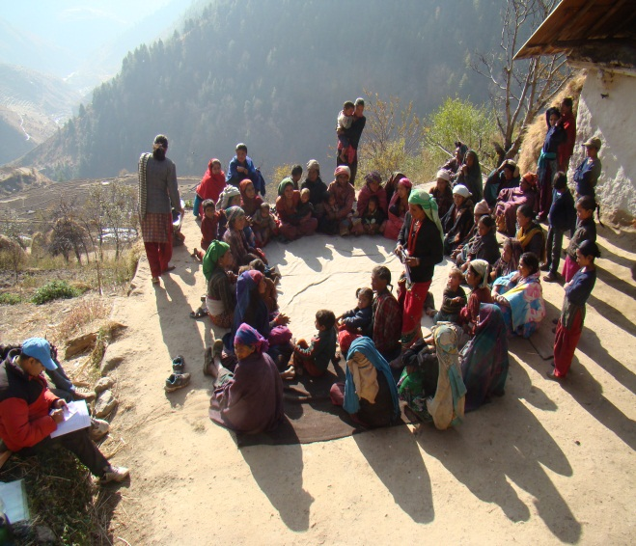
Objectives
  Improve Child Grant beneficiaries’ knowledge on IYCF, Hygiene and Sanitation and other key nutritional behaviours
  Assist mothers and caretakers to identify the best possible locally available food - to improve the nutritional status of the children
  Build capacity of health workers and volunteers on IYCF
Strategies
Advocacy: Capacity building on IYCF, Health and Hygiene (WASH) and Social Mobilization
Orientation: HWs, FCHVs, Mother’s group, Community Network – Child Club, women’s saving and credit groups, traditional healers, influential people (teachers, local leaders etc)
Monitoring – household visits
Behavior Change Communication – Food preparation demonstration, local Radio, street drama
Evaluation – base line, mid line and end line

Slide 27
Progress on 2012
Trainings: Have reached more than 16,000 mothers, 1000 traditional healers, 1200 influential people, 1200 FCHVs and 450 HWs in 5 Karnali districts
IYCF Process monitoring: Continuation of the process monitoring part of the IYCF training through the field supervisors.
BCC component: a number of BCC activities, through KIRDARC, CBOs : - street drama, demonstration of nutrition food preparation using the locally available foods and the airing of IYCF messages through the FM together with a social campaign. Complementary with IYCF training conducted.
Mid-line evaluation: December 2012- May 2013, Field Work on Feb - April
Refresher training on IYCF: Refresher training on IYCF through regular MoHP Quarterly FCHV Review meetings in the districts.

Slide 28
Multi-sector Nutrition Plan
Strategic Objective (SO) 1. National Planning Commission
Result (R) 1.1. Multi-sectoral commitment and resources for nutrition are increased
R 1.2. Nutritional information management and data analysis strengthened
R 1.3 Nutrition capacity of implementing agencies is strengthened
SO 4. Ministry of Education
R 4.1 Adolescent girl’s awareness and behaviours in relation to protecting foetal, infant and young child growth improved
R 4.2 Parents better informed with regard to avoiding growth faltering
R 4.3 Nutritional status of adolescent girls improved
R 4.4 Primary and secondary school completion rates for girls increased
SO 2. Ministry of Health and Population
R 2.1 Maternal Infant Young Child MIYC micronutrient status improved
R 2.2 MIYC feeding improved
R 2.3 IYC Malnutrition better managed
R 2.4 Nutrition related policies, standards and acts updated
SO 5. Ministry Federal Affairs and Local Development/ Social Protection
R 5.1 Nutritional content of local development plans better articulated
R 5.2 Collaboration between local bodies’ health, agriculture, and education sector strengthened at DDC and VDC level
R 5.3 Social transfer programmes corroborated for reducing chronic under nutrition
R 5.4 Local resources increasingly mobilized to accelerate the reduction of MCU
SO 3. Ministry of Urban Development
R3.1 All young mothers and adolescent girls use improved sanitation facilities
R 3.2 All young mothers and adolescent girls use soap to wash hands
R 3.3 All young mothers and adolescent girls as well as children under 2 use treated drinking water
SO 6. Ministry of Agriculture Development
R6.1 Increased availability of animal foods at the household level
R 6.2 Increased income amongst young mothers and adolescent girls from lowest wealth quintile
R 6.3 Increased consumption of animal foods by adolescent girls, young mothers and young children
R 6.4 Reduced workload of women and better home and work environment
Notes:
Role of each sectors and NPC- with clear strategic objectives for each sectors, with results.
Need to explain the zist of the logframe interventions in each sectors just to let them know that what they are exactly supposed to do
Tailoring and Adaptation at district level

Slide 29
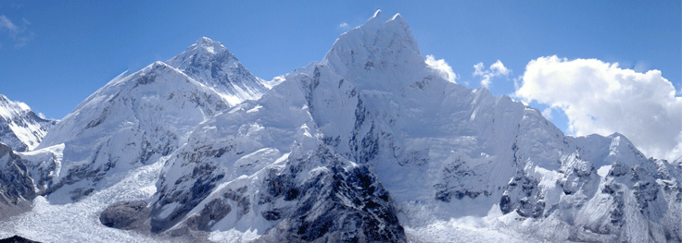
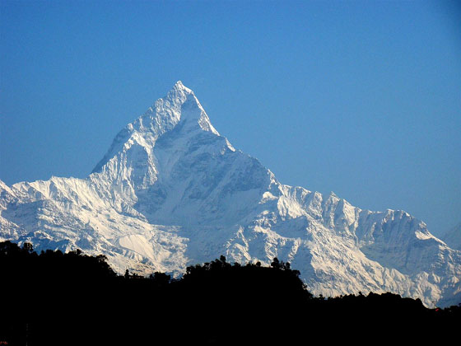
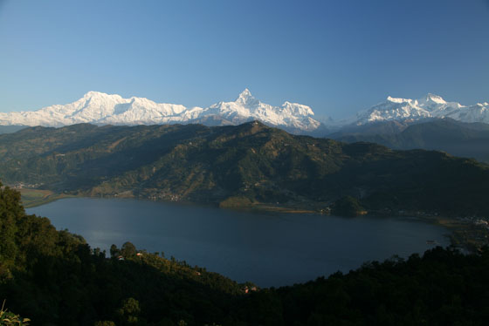


Slide 30

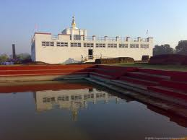
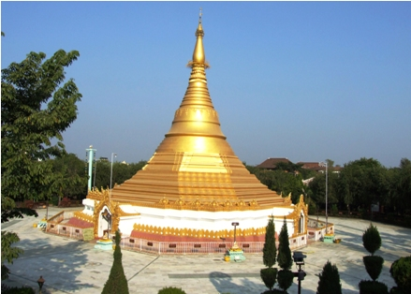

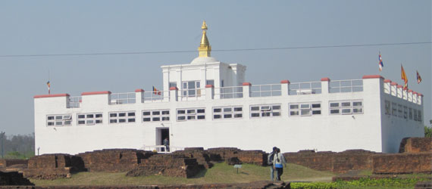
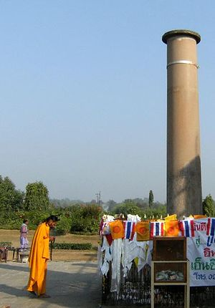

Slide 31
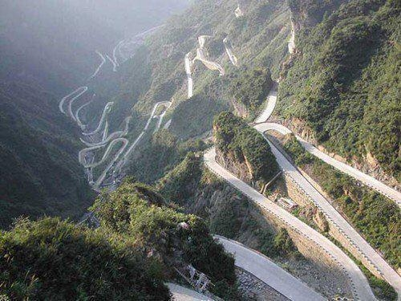

Slide 32

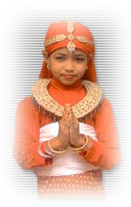
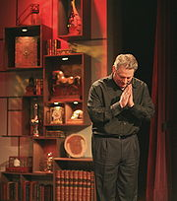
Thank you!
Namaskar

