Slide 1
Social Transfer Initiatives in Pakistan
Nadia Shah
Sarhad Rural Support Programme (SRSP), Pakistan
Thematic Seminar on ‘Social Transfers for the Fight Against Hunger’
(Feb 21-22, 2013 in Cambodia)

Slide 2
Contents
Brief Profile and Local Context of Pakistan
National Social Transfer Programme
Public-Private Partnership for Social Transfer Programme

Slide 3
Brief Profile and Local Context
Pakistan

Slide 4
Country Context
Total Population: 180 million
58% of the population is food insecure
Increase to 63% in the next five years

Slide 5
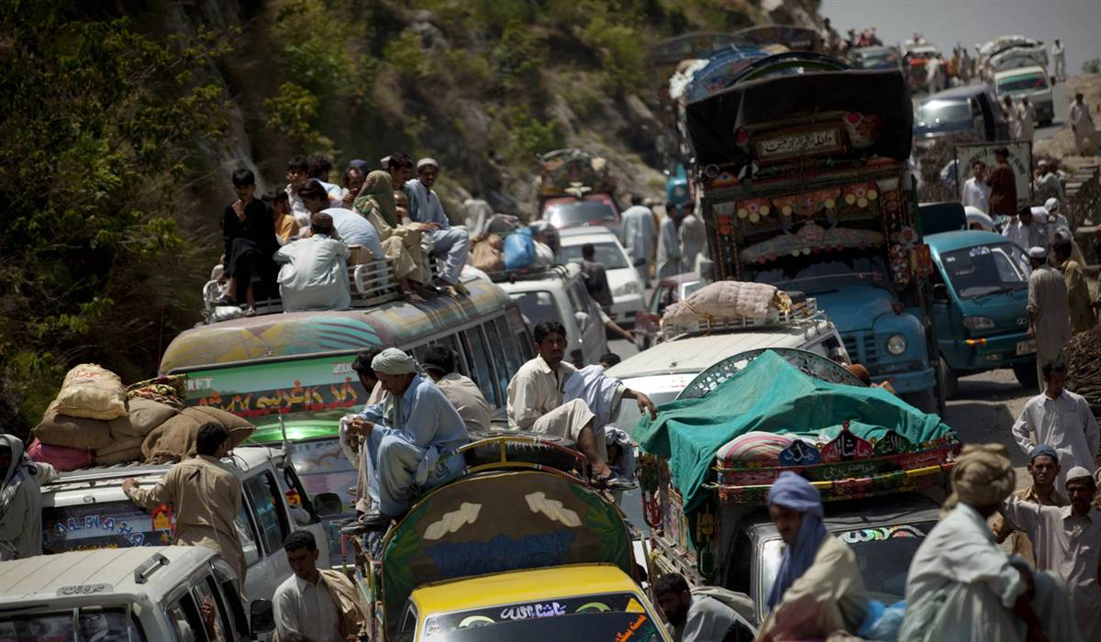
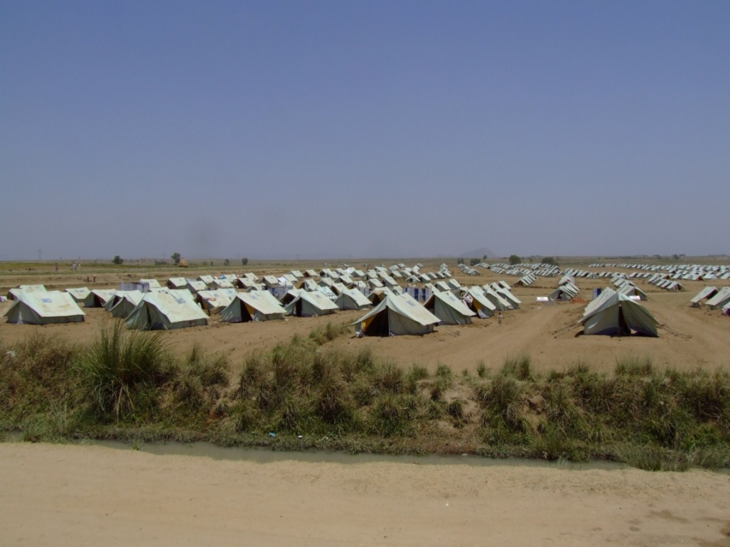
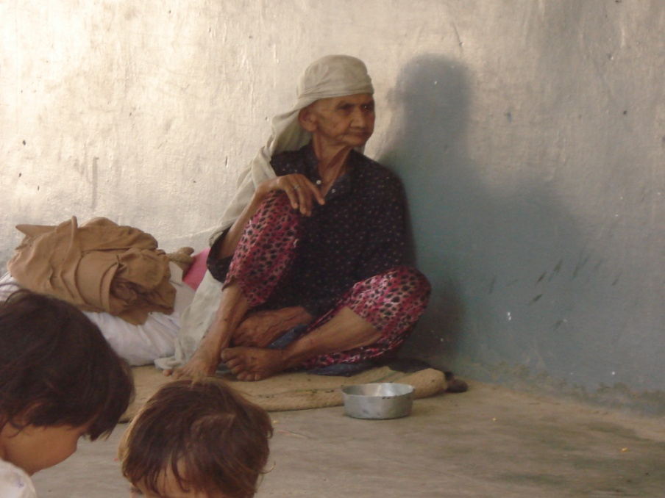
Complex Environment
-
Growing Inflation
Weak governance
Security Crisis
Natural Disasters

Slide 6
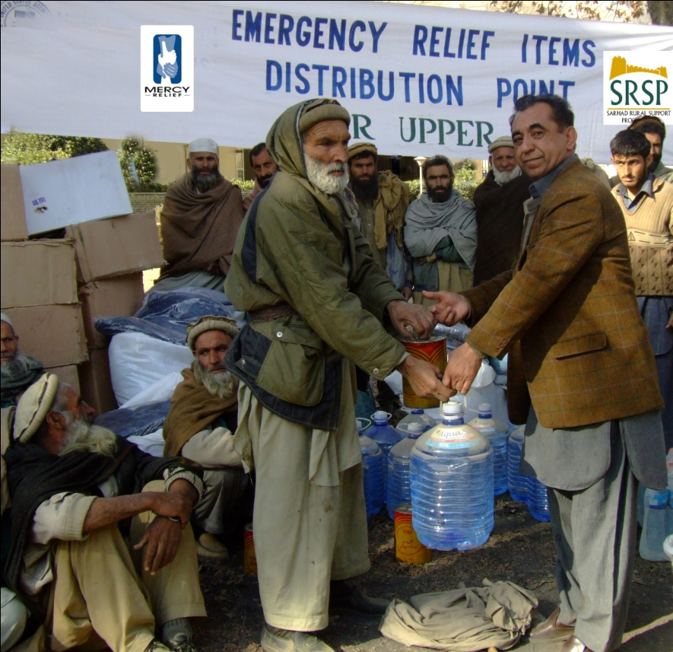
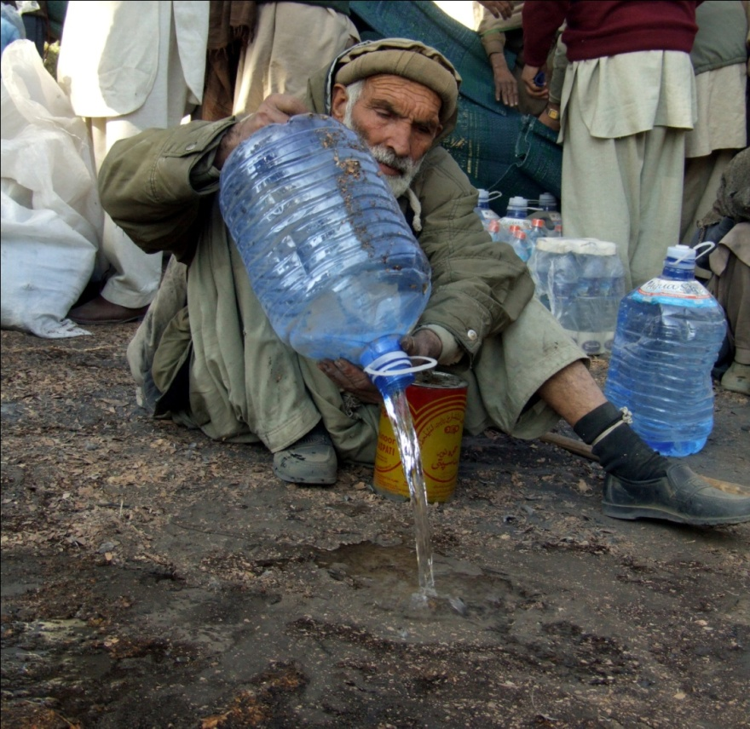
The importance of the local context
The story from DIR

Slide 7
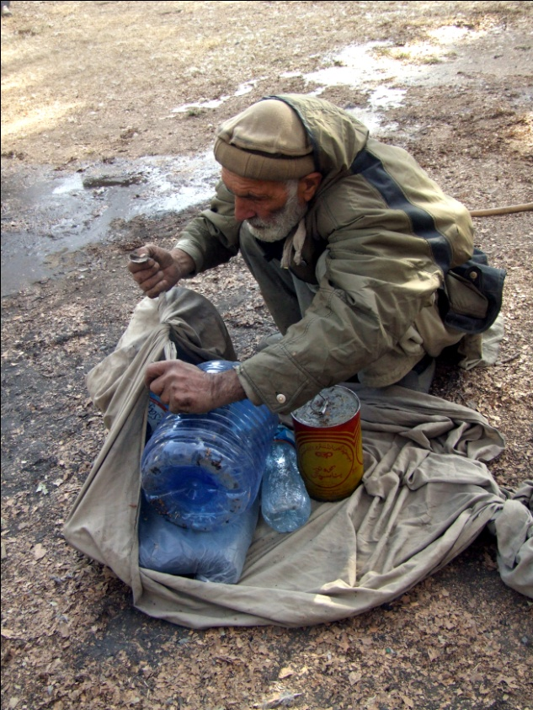
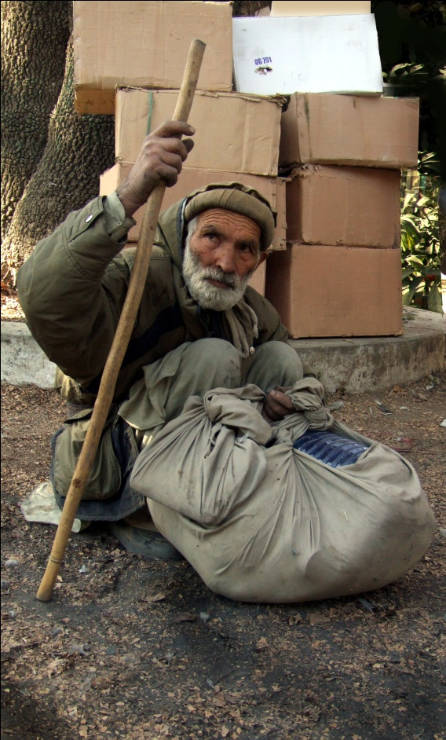
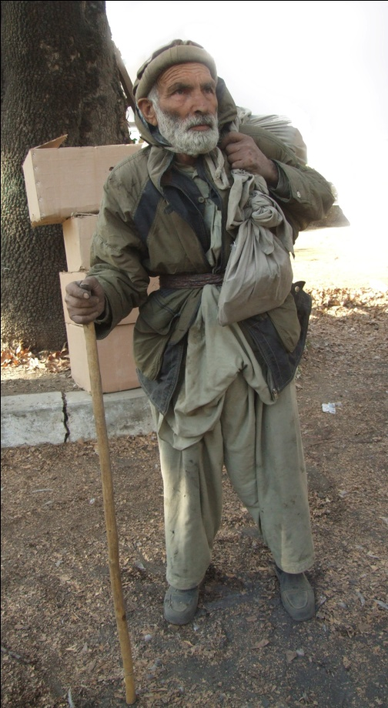

Slide 8
Military

Slide 9
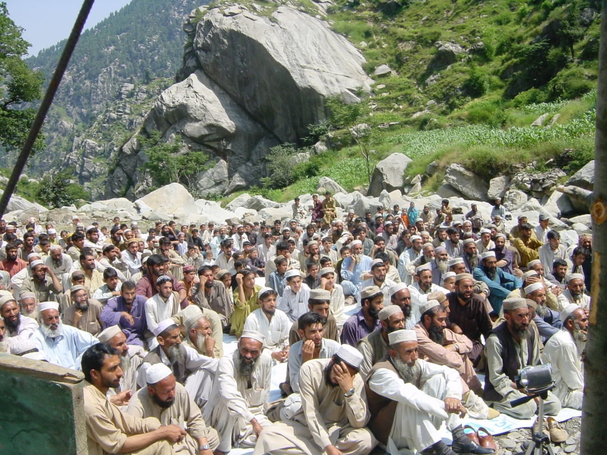
Strong Society
Potential for self-help
- Ties of reciprocity
- Social Networks
Instances of Collective Action

Slide 10
Description of Social Transfer Programme
Government of Pakistan’s
Benazir Income Support Programme (BISP)

Slide 11
What is BISP?
Started in 2008
Objectives to eradicate poverty and empower women
US$ 12 every month
Initial allocation of US $347million for reaching out to 3.5 million women living below the poverty line
Allocation in the last financial year was US$716 million to expand coverage to 5 million families (15% of the poor)
Breaks from past practices of building citizen-state relationship through the male head of the family
Social Assistance Programme
Cash Grants
Waseela-e-Haq
Waseela-e-Rozgar
Emergency Relief Package
Waseela-e-Taleem
Waseela-e-Sehat

Slide 12
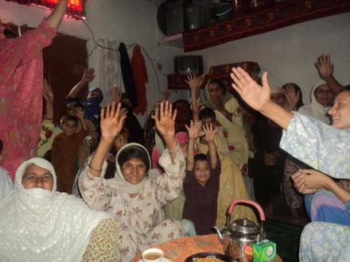
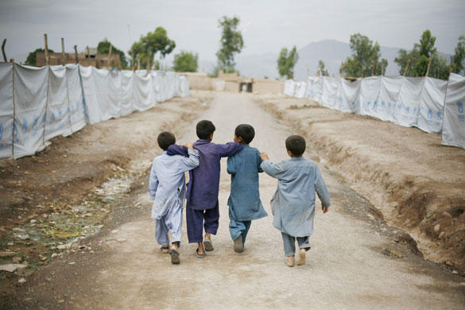
Targeting Mechanism(s)
Targeting through the use of National Database and Registration Authority (NADRA)
Elected Representatives
Poverty Score Card exercise
X
X
Verification by NADRA

Slide 13
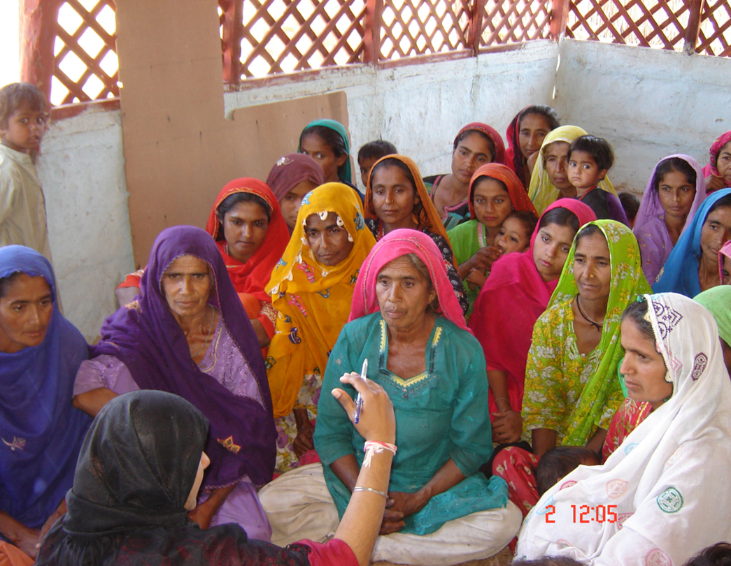
Delivery Mechanism(s): Management of BISP
Programme Management
BISP
Beneficiary Identification through PSC
Beneficiary Verification
Partner Organization
NADRA
Disbursement of Money
Post Office, Benazir Smart Card/Branchless Banking
6 Regional Offices
35 Divisional Directorates
550 Sub-District Offices

Slide 14
Public Private Partnership Programme
Government of Khyber Pakhtunkhwa and Sarhad Rural Support Programme’s Initiative for Social Protection

Slide 15
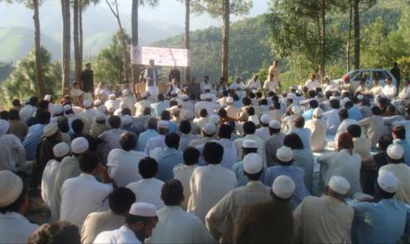
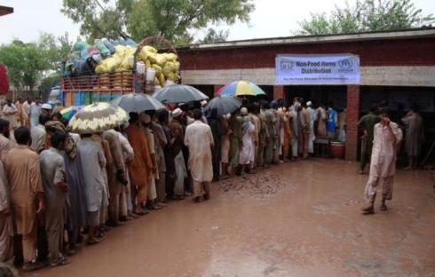
Development
SRSP Programmes
Humanitarian

Slide 16
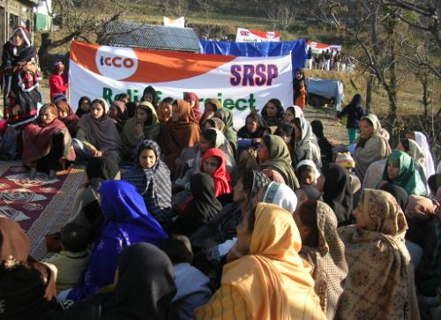
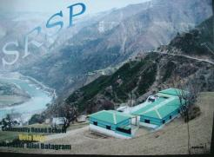
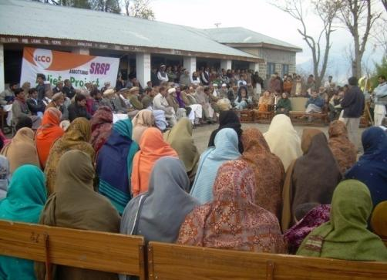
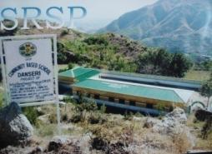
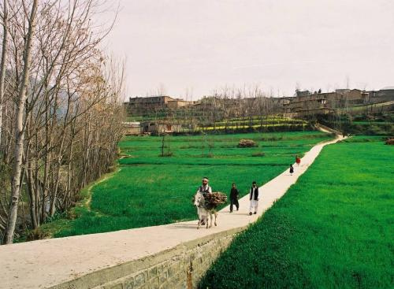
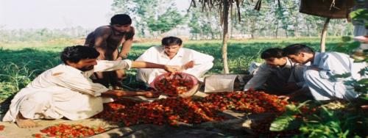
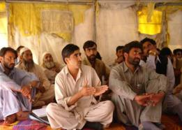
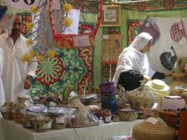
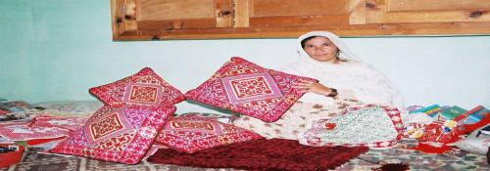
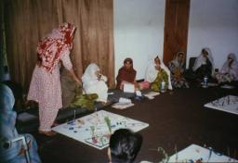
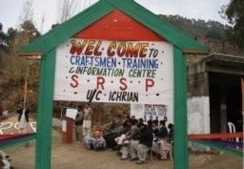
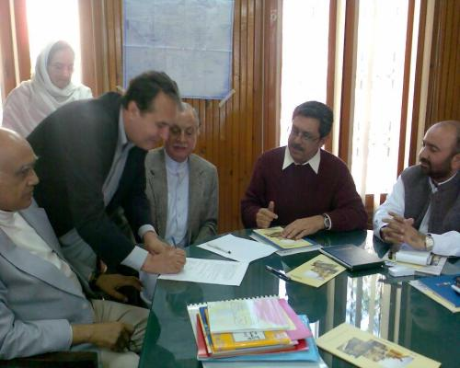
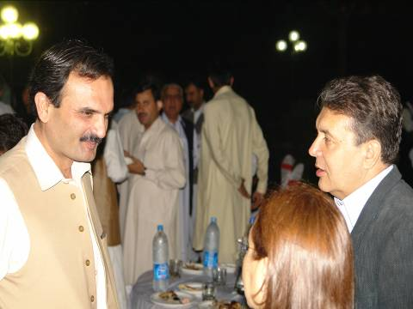
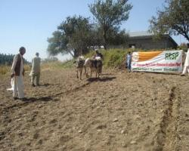
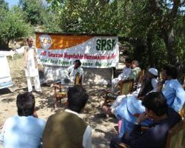
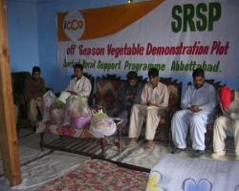
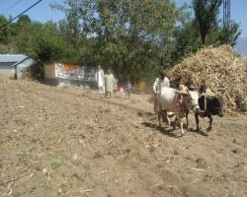
Community Mobilization
Gender & Development
Social Sector Services
CPIs and MHP
Human Resource Dev
Micro Finance and CIF
Improving Governance and Access to Justice Initiative
Nat. Resource Mgmnt
Enterprise Development and Value Chains
Policy Adv. & Linkages

Slide 17
Poverty Reduction & Resilient Communities
Poverty-Targeted
Universal Approach

Slide 18
Community Investment Funds
CIF aims to improve livelihoods of poor and vulnerable especially women in target areas
Social Collateral
CIF is a fund owned, run and managed by the community (village organizations) themselves.
So far, over 120 women VOs have been engaged in CIF delivery, benefiting over 5,000 rural households.

Slide 19
Community Investment Funds

Slide 20
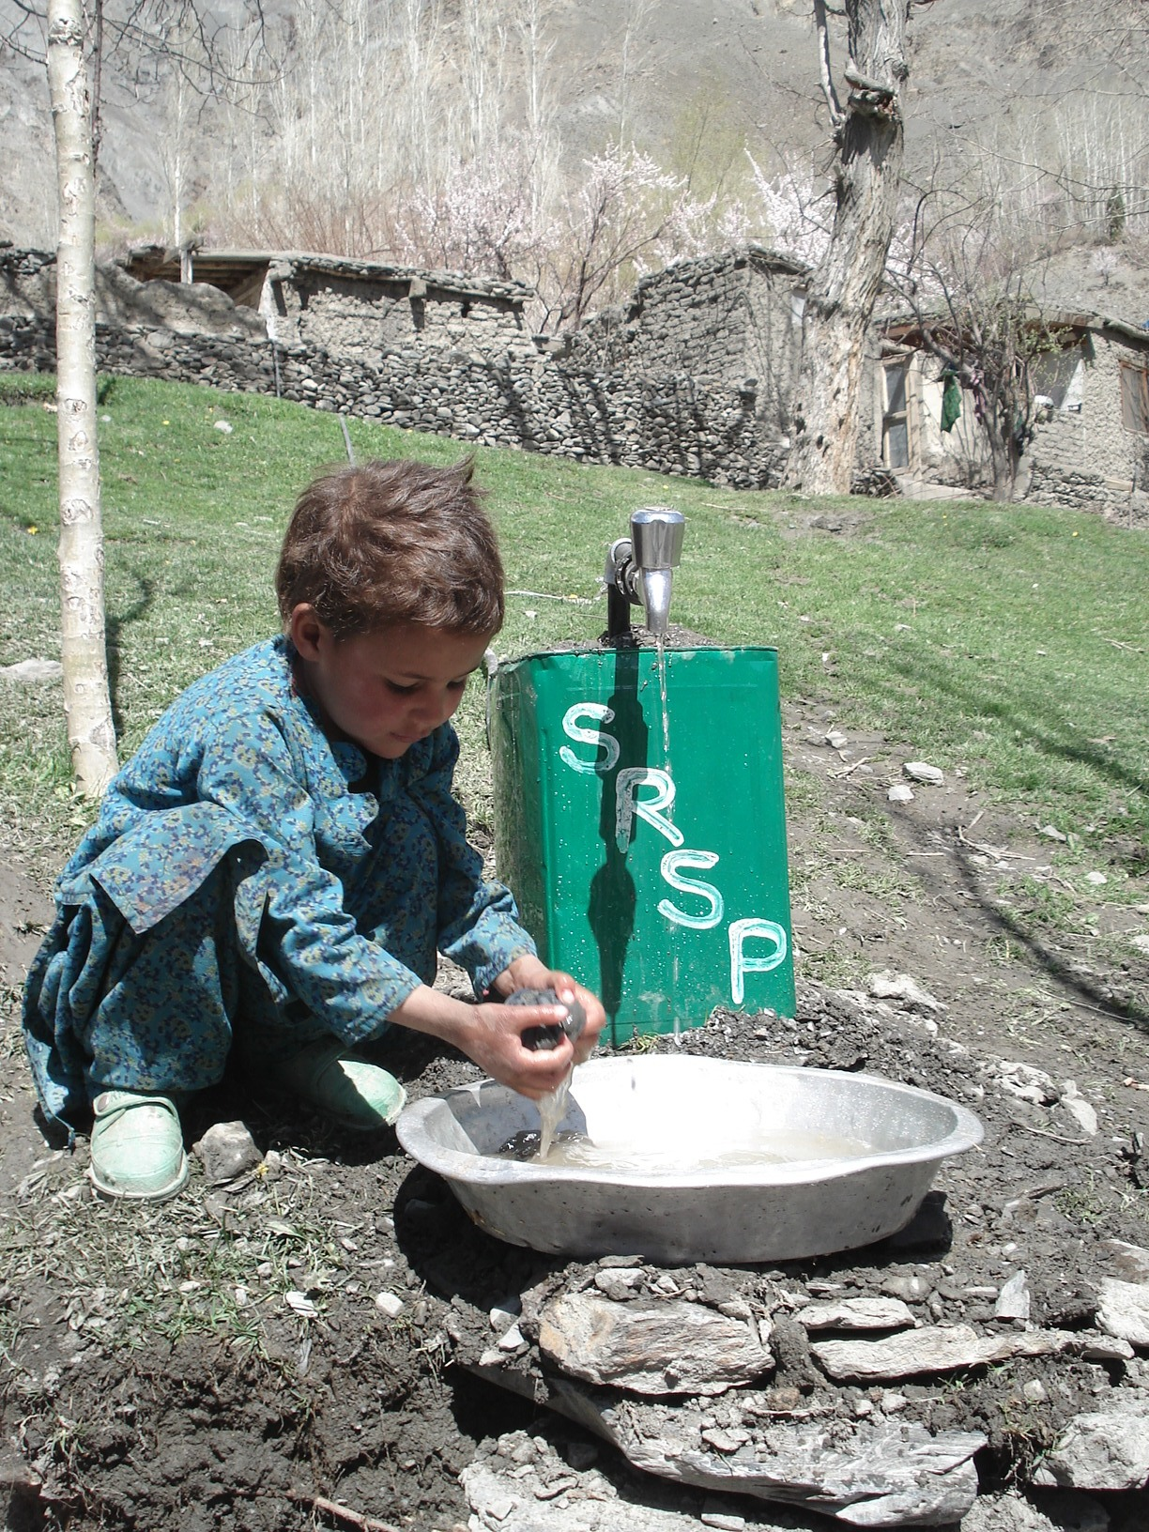
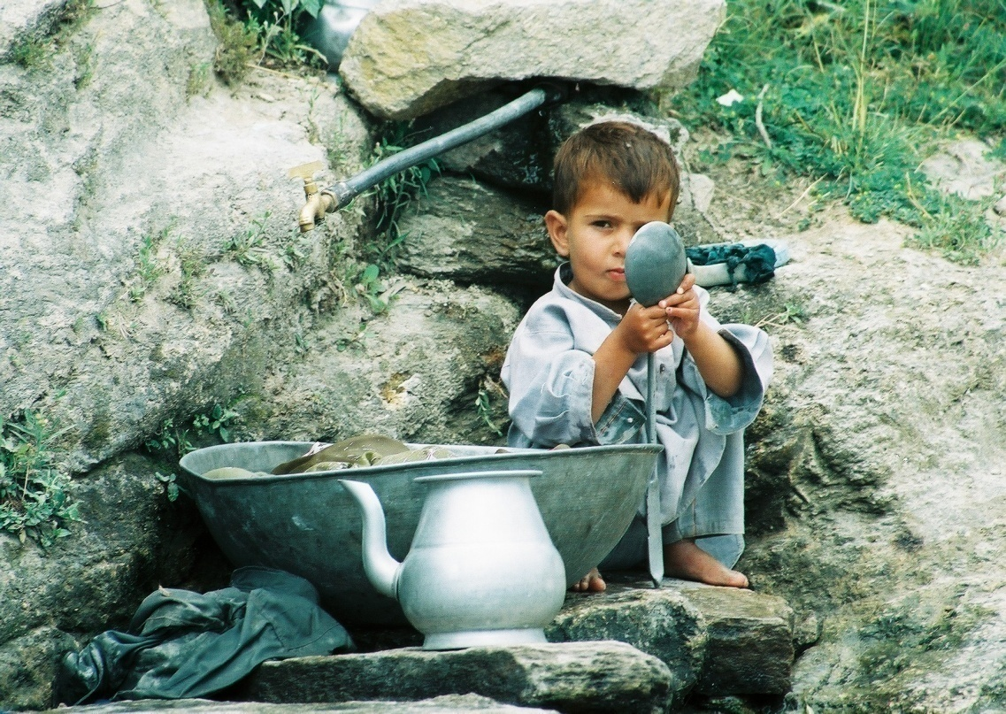
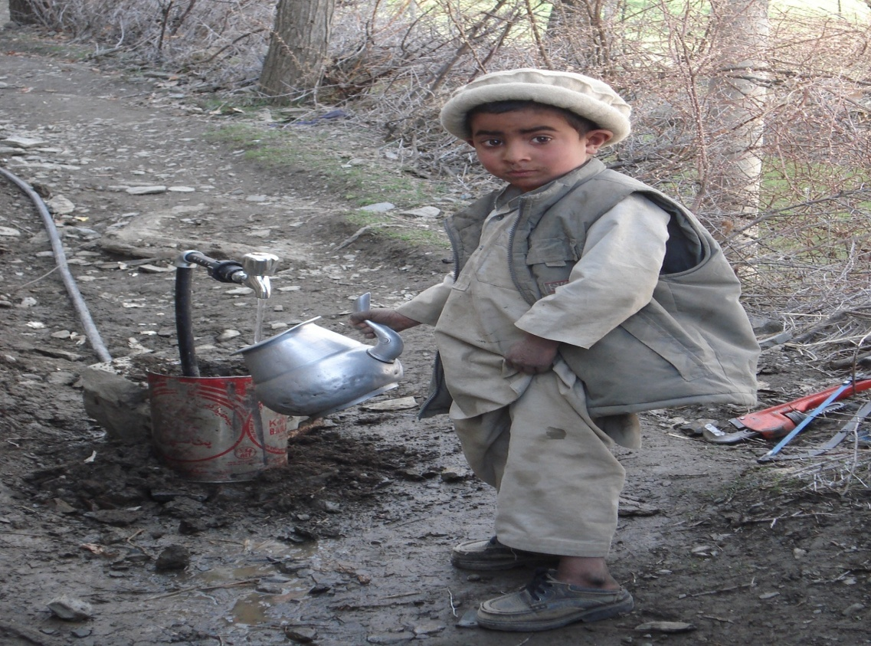
Thank You

