Slide 1

Social Protection:
Definitions, Objectives and Politics
Nicholas Freeland
Phnom Penh, February 2013

Slide 2
Contents
Background
Conceptual framework
Typology
[Impacts]
Myths
Politics…and why it matters!
Conclusion

Slide 3
Background
Hunger is increasing as a result of global crises, despite sustained economic growth
Achievement of MDGs is in doubt
Poverty is a product of inequality within countries (>50% of the poor in MICs)
Social protection is playing an increasingly important role in the response to vulnerability
Transfers are politically acceptable to donors

Slide 4
Social Protection: shifting the development paradigm
Traditional (the poor are the problem):
  Focus development on economic growth
  Wait for economic growth to reduce poverty
  Residual interim safety nets
  Donor (expensive) emergency assistance where necessary
… IS NOT WORKING
Emerging (the poor are the solution):
  Provide comprehensive social protection
  Social protection will help to generate economic growth
  This will reduce poverty and the cost of social protection
  Reduced emergency assistance, freeing donor resources

Slide 5
Social Protection
is a response to:
VULNERABILITY =
Poverty
Risk
Voice
Agency

Slide 6
SP responds to/through:
Poverty
Needs
Provision
Risk
Shocks
Prevention
Agency
Potential
Promotion
Voice
Rights
Trans-formation

Slide 7
using different interventions:
Poverty
Social assistance
Food aid
Supplementary feeding
Old age grant
Risk
Social insurance
Unemployment benefit
Weather insurance
Burial society
Agency
Social empowerment
Asset transfers
Public works
School feeding
Voice
Social justice
Labour laws
Health & safety
Anti-discrimination
Gender policy

Slide 8
with different drivers and players:
Poverty
Moral
Donors/ UN/ NGOs
Risk
Technical
Private sector/IFIs
Agency
Political
Govern-ment/IFIs
Voice
Ideological
NGOs/ civil society

Slide 9
but common objectives:
Poverty
Equity
Reducing food insecurity
Risk
Resilience
Improving resilience to shocks
Agency
Opportunity
Increasing productive capacity
Voice
?
Strength-ening human capital

Slide 10
Social Protection
thereby builds:
RESILIENCE =
Assets
Risk
Voice
Agency

Slide 11
Types of social transfer
Cash-based social transfers | In-kind social transfers
Cash transfers | Food transfers
Unconditional cash transfer | School feeding
Conditional cash transfer | Take-home rations
Cash-for-work/asset | Targeted food transfers
Labour-intensive public works | Food-for-work/asset
 | Food-for-training
 | Preventive supplementary feeding
Near-cash transfers | Commodity vouchers
Value-based vouchers | Food vouchers
 | Other commodity vouchers
Grants | Asset and input transfers
Lump sum grant | Livestock transfer
 | Agricultural input transfer
 | Asset transfer

Slide 12
The case for social transfers: multi-dimensional impacts
Direct impacts
Poverty
Hunger
Economic impacts
Livelihoods
Social impacts
Health
Employment
Equity
Local markets
Education
Gender equality
Wellbeing
Nutrition

Slide 13
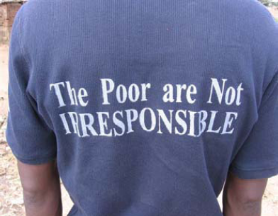
Busting the myths about social transfers
“Social transfers are not affordable in low income countries”
“Social transfers are an endless unproductive drain on the Exchequer”
“Social cash transfers fuel inflation”
“Social transfers create dependency and laziness”
“Social transfers should not ‘give something for nothing’”
“Social transfers encourage irresponsible behaviour”

Slide 14
Virtuous spiral

Slide 15
Politics: “poverty-targeted” social protection
Rooted in a C19th “Anglo-Saxon” worldview of “poor relief”
Poverty-targeted, with scant resources focussed on the poor
Beneficiaries should do something in exchange for receiving the benefit
Careful targeting, often through proxy means testing, community- or self-selection
Impose a condition: either work (as on a public works or employment guarantee scheme), or a set of behaviours (such as visiting a health clinic or sending a child to school)
Emphasis on “graduation” and “exit strategy”
Examples: Latin America’s CCTs; Bangladesh’s EGPP; Indonesia’s PKH

Slide 16
Politics: universal social protection
Universal approach, akin to a Nordic view of social security
Emphasis on tackling inequality as a means of combating poverty
Support much broader “vulnerable groups”: PWD, elderly, children
Benefits to all (or almost all) in identified groups, even those that are not poor
More inclusive, so more expensive approach; but more popular with stronger political appeal, so ultimately better funded and fiscally sustainable
Argument that the poor get a more valuable (and more sustainable) transfer than if a (much smaller) programme had been targeted exclusively at them
Tend not to be conditional, but entitlement-based
Less emphasis on graduation, since exiting happens naturally
Examples: South Africa’s social grants; Nepal’s and Thailand’s old age pension; India’s MGNREGA

Slide 17
Why does it matter?
Has major implications for:
  Targeting approach
  Conditionality
  Cost…
  …but also Affordability
These are essentially political decisions, not technical

Slide 18
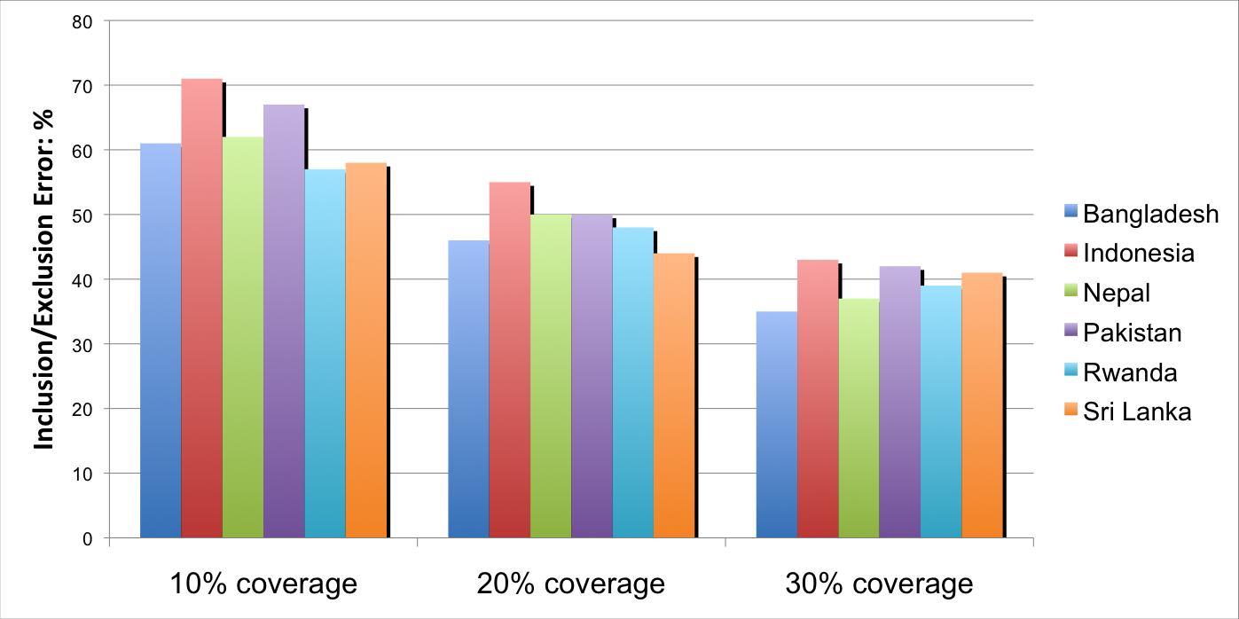
Poverty-targeting
Low accuracy
  Especially where programme coverage is narrow

Slide 19
Poverty-targeting
Low accuracy
  NB this is just the statistical error: targeting performance will be further compromised by:
    intrinsic sampling and non-sampling error
    arbitrary analytical choices (eg how equivalence is calculated; how missing variables are interpreted; and how sampling errors are treated)
    implementation errors
    households’ growing understanding of how to play the system.

Slide 20
Poverty-targeting
Low accuracy
  Especially where programme coverage is narrow
VERY difficult to do
  especially in contexts of high poverty/vulnerability
High administrative costs
Perverse incentives
Moral hazard
Social tension
Problems of equity

Slide 21



Leap-frogging
$8
$2
$4

Slide 22
Poverty-targeting
Low accuracy
  Especially where programme coverage is narrow
VERY difficult to do
  especially in contexts of high poverty/vulnerability
High administrative costs
Perverse incentives
Moral hazard
Social tension
Problems of equity
Need for: retargeting; grievance systems; etc

Slide 23
Poverty-targeting
THEREFORE:
Very limited political appeal
BUT don’t just take my word for it:
Amartya Sen (1995): “Benefits intended exclusively for the poor often end up being poor benefits”
World Bank (2005): “Where conventional wisdom suggests that at least some targeting should be used, we show that social welfare is maximized in political equilibrium only when all revenues are spent on universal transfers and none spent on targeted ones. Where conventional wisdom says that targeting should benefit the poor, have ambiguous effects on the middle income, and redistribute from the rich, we show that targeting redistributes from the poor, makes the middle income worse off, and benefits the rich in political equilibrium”
e.g.

Slide 24
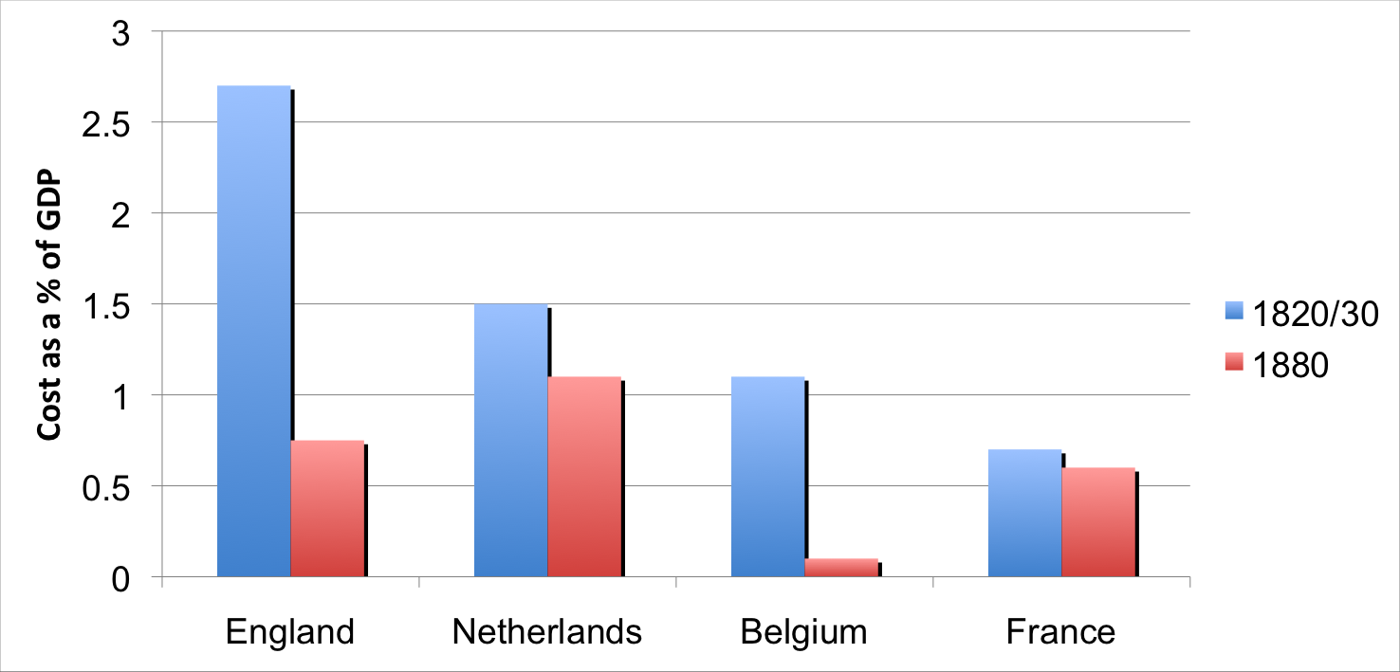
Poor Relief in 19th Century Europe
Fall in budgets as democracy expands
Source: Development Pathways

Slide 25
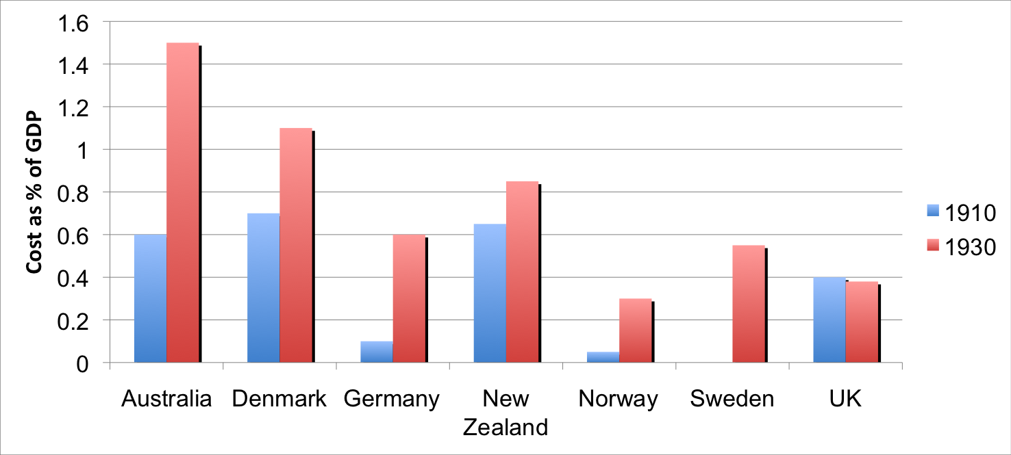
Late 19th and early 20th Century:
Growth in programs including middle class
State pension schemes:
Source: Development Pathways

Slide 26
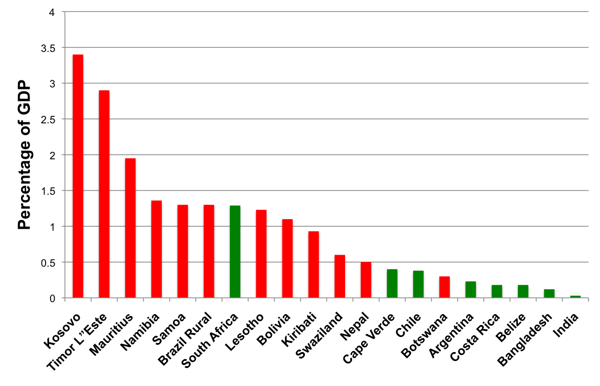
Non-contributory pensions:
Universal versus poverty targeted
Universal
Poverty targeted
Source: Development Pathways

Slide 27
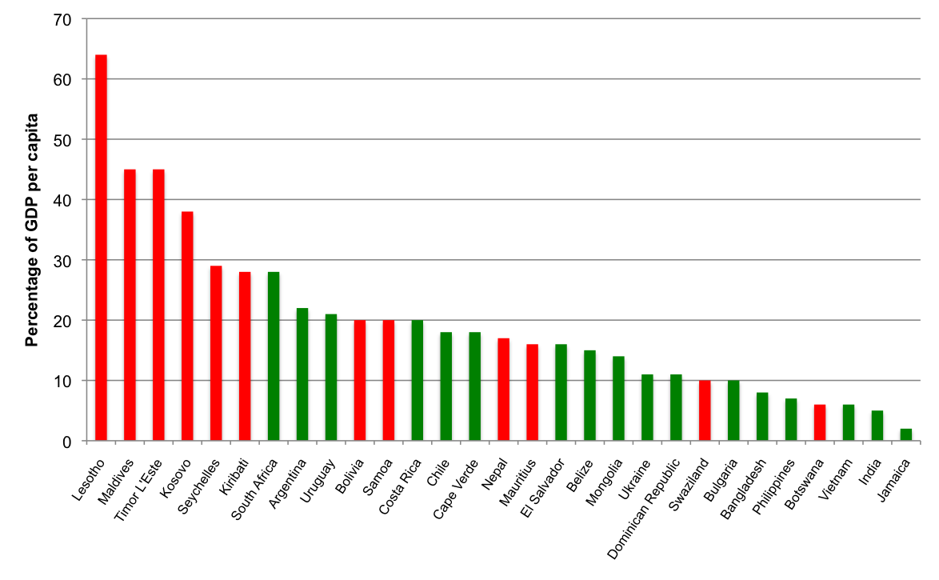
Benefit levels of non-contributory pension programs
Universal
Poverty targeted
Source: Development Pathways

Slide 28
The Bolsa Familia hype

Slide 29
Conditionality
No compelling international evidence that conditions increase the impact of transfers
Two justifications:
  if parents’ investment in the human capital of their children is sub-optimal, either privately or socially (this may be the case for “marginal” children – eg girls, young, lower ability)
  to make redistribution to the poor politically more palatable to the non-poor (but this is only relevant if progrmmes are poverty-targeted)

Slide 30
Conditionality
Administrative complexity
Additional cost
Need for institutional linkages with other Ministries (education/health)
Opportunity cost to teachers/health workers
Extra burden on mothers
Psychological burden on children
Possible perverse effects on attendance

Slide 31
Cost…and Affordability
Universal approach is more inclusive, so more expensive
BUT it is also more popular, so more affordable
Lifecycle programmes can be implemented incrementally, eg:
  Child grant: 0-2 (1,000 days); 0-5; 0-10; 0-16
  Pension: >80 (Vietnam); >70; >65; >60 (Thailand)

Slide 32
Conclusions
Social protection is as political as it is technical: Governments want to win elections
Poverty reduction cannot be done on the cheap: there is no international evidence of significant impact through small poverty-targeted programmes
To have a significant impact, you need bigger programmes, therefore a bigger budget
So you need the support of the middle classes (and the rich), through more universal programmes from which they also benefit
The best way to help the help the poor is not necessarily to target the poor: more expensive programs may be more sustainable
National social protection systems are not built in a day: we need a clear vision of where we want to be in 10-20 years
The programs we design now should be aimed at delivering long-term political support for significant social spending: poverty-targeted programmes will not achieve this!

Slide 33
Thank you!

Slide 34
Typology of social protection
Health
Free Basic Health
Social Justice
Social Development
Social Protection
Social Assistance
Social Transfers
Social Insurance
Education
Universal Education

Slide 35
Four characteristics of social transfers
SOCIAL
DEVELOPMENT
SOCIAL
PROTECTION
SOCIAL
ASSISTANCE
SOCIAL
TRANSFERS
Characteristic 1:
On-budget
Characteristic 2:
Pro-poor
Characteristic 3:
Non-contributory
Characteristic 4:
Predictable transfer

Slide 36
Universal approach and inequality
Quintile | Average Income | Tax (40%) | Transfers | Income after tax and transfers
5 | 1000 | 400 | 240 | 840
4 | 800 | 320 | 240 | 720
3 | 600 | 240 | 240 | 600
2 | 400 | 160 | 240 | 480
1 | 200 | 80 | 240 | 360
Ratio of 5:1 | 5/1 | (=1200) | (=1200) | 2.33/1

Slide 37
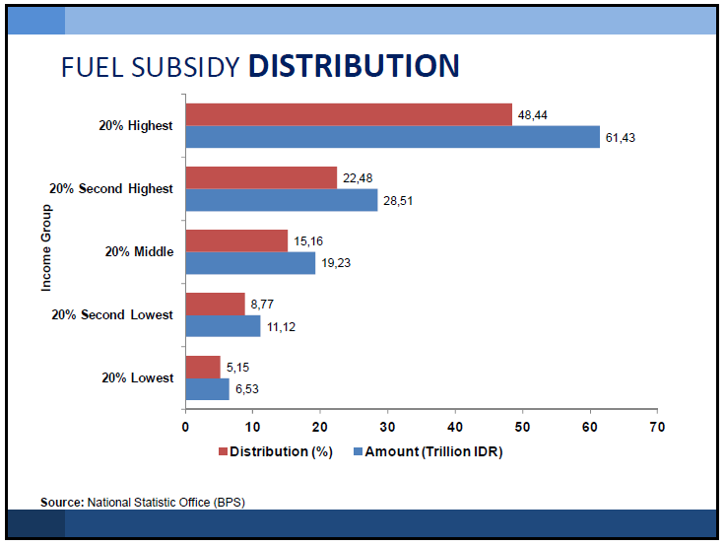
Indonesia

Slide 38
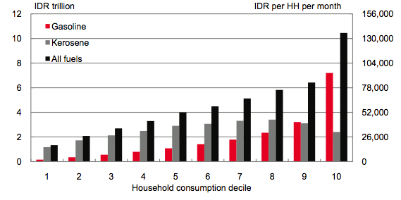
Indonesia fuel subsidy reform

Slide 39
Can it be done?
Iran, 2010
Removed US$60 billion a year (highest globally)
  US$30 billion distributed in cash - universally
  US$15 billion for corporate restructuring/investment
  US$15 billion for Govt operations/contingency
Advised reform was coming, but not when
  Raised awareness; allowed preparations
  Discouraged speculation
Credited beneficiary accounts before reform, but frozen
Messaging: not eliminating subsidies, but switching them from products to households

Slide 40
Malawi Income Distribution, by Decile
40

Slide 41
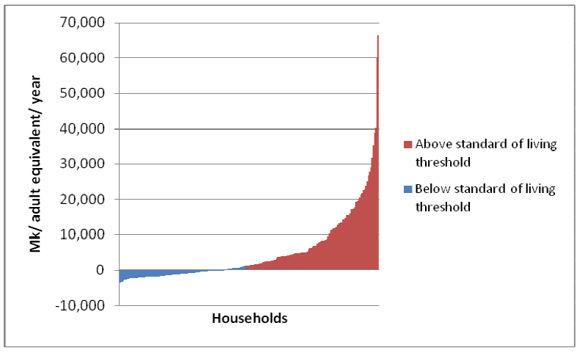

Slide 42
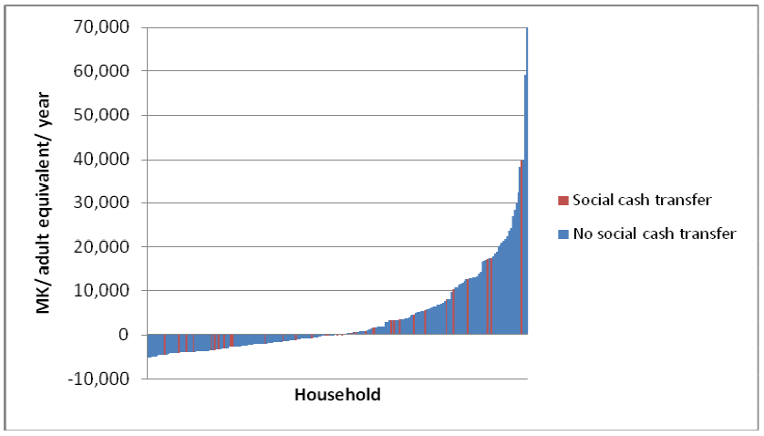

Slide 43
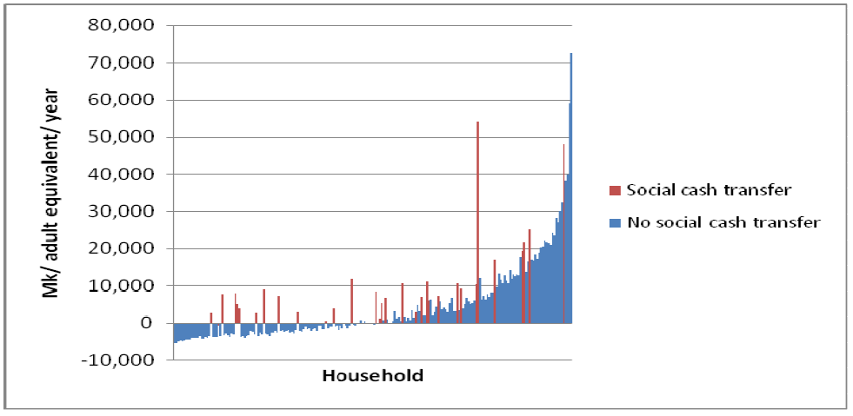

Slide 44
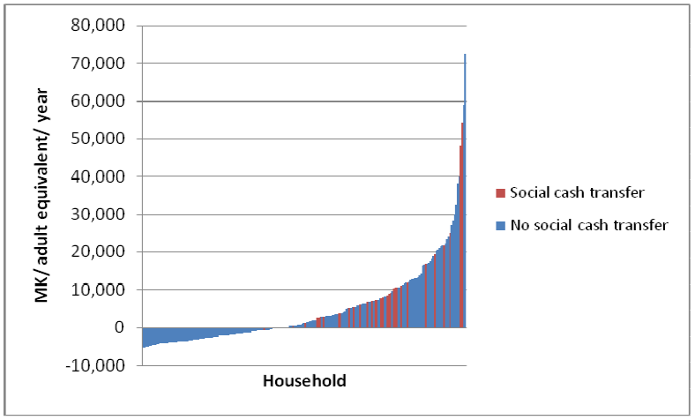

Slide 45
Comparison of targeting approaches
Approach | Self-targeted | Community | Means-tested | Categorical
Accuracy |  |  |  | 
Comprehensivity |  |  |  | 
All rows are on a scale of 1 to 4. In the rows above, the more symbols the better; in the rows below, the fewer symbols the better
Admin overhead |  |  |  | 
Private cost |  |  |  | 
Social tension |  |  |  | 
Moral hazard |  |  |  | 
Incentive risk |  |  |  | 
Political pitfalls |  |  |  | 

Slide 46
Pros and cons of targeting approaches
Approach | Self-targeted | Community | Means-tested | Categorical
Pros | Can be linked to skills development and income generation. Can generate improved infrastructure. | Can reflect local understanding of poverty and vulnerability. | Theoretically focused on the poor and vulnerable. | Easy to administer. Fair, objective, transparent selection criteria. High level of public and political support.
Cons | High exclusion errors (of those who cannot participate). Potential bias against women. Possible stigma. | Perpetuates local patronage structures and gender bias. | Difficult to construct valid proxy indicators. Requires regular and frequent retargeting. Administrative compliance results in exclusion errors. | Overall programme costs can be higher, because of inclusion of non-poor. Geographical targeting can encourage migration.
Suitability | Where working age poor represent a substantial target group. | Where the poor represent a distinct, identifiable group. | Where administrative capacity is high. | Where poverty and vulnerability are widespread.
Good practice | Prefer employment guarantee schemes. Ensure assets created add value at community level. | Avoid at national scale, unless administrative capacity and social integrity are high. | Avoid except where coverage rate exceeds 30%. | Assume as the default, against which other mechanisms should be judged.

Slide 47
EVIDENCE
See also:
RHVP Evidence paper
DFID Evidence paper
www.socialtransfersevidence.org

