Slide 1

Social Transfers for Food Security
Nicholas Freeland
Phnom Penh, February 2013

Slide 2
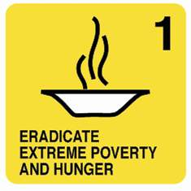
Food security is a situation that exists when all people, at all times, have physical, social and economic access to sufficient, safe and nutritious food that meets their dietary needs and food preferences for an active and healthy life.
MDG 1
Food Security
Utilisation
Access
Stability
Availability

Slide 3
Individual level
Food security
Food security
aspects often neglected:
Access
Nutritious food
Individual level
Caring practices
Stability
Food consumption
Household level
Household
food consumption

Care and feeding practices
Household income
Household livelihood strategy
National, sub-national and community level
Food supply chains
Food and agricultural system
Food availability
Food affordability
Food acceptability
Food
quality
Social-economic, political, institutional, cultural and natural environment

Slide 4
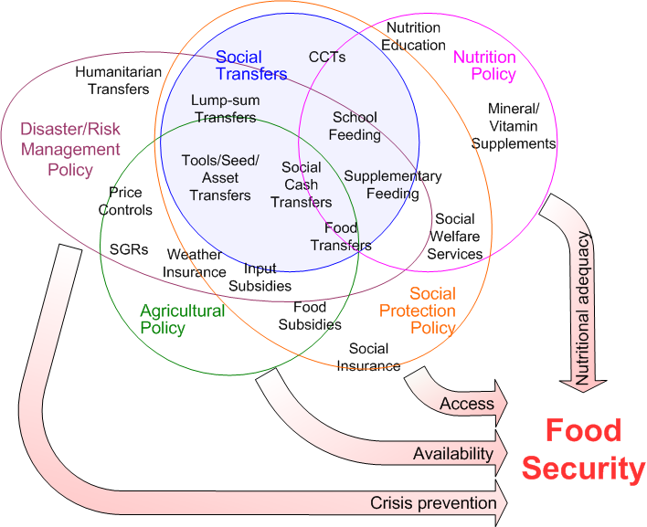
Social transfer links with food security

Slide 5
Social transfers and FS: availability
Seeds, tools and agricultural inputs
Vouchers and fairs
Asset/livelihood transfers
Agricultural input subsidy programmes
Public works programme assets:
  Irrigation
  Terracing
  Market/rural infrastructure

Slide 6
Impact on hunger
In Lesotho, between 50% and 80% of the old age pension is spent on food. The percentage of Lesotho’s old age pensioners who reported that they “never went hungry” increased from 19% before the pension to 48% after it was introduced.
In Malawi’s FACT Programme, 75.5% of the transfer was spent on basic needs (food and groceries)
An extensive assessment of Ethiopia’s Productive Safety Net Programme (PSNP) finds that three-quarters of participants consumed a higher quantity and quality of food compared to the previous year, and were less likely to sell assets in order to buy food.
In Zambia, as a result of receiving a cash transfer, 12% more households consumed proteins every day, and 35% more households consumed oil every day.

Slide 7
Impact on livelihoods
Under the Kalomo social cash transfer scheme in Zambia, 29% of income transferred was invested, either in purchases of livestock, farming inputs, or informal enterprises.
  seven times as many households owned goats
  ownership of chickens increased by 15 percentage points
  households making investments quadrupled from roughly 14% to 50%
  average value of investment doubled
  52% of households generated extra income
In a DFID-supported asset transfer programme for ultra-poor women in Bangladesh, the value of the livestock provided by the asset transfer is estimated to be doubling every 18 months.

Slide 8
Social transfers and FS: access
Short term
  “Food assistance” (food/vouchers/coupons)
  Cash transfers
Medium term
  Cash transfers
  Lump-sum grants
  Asset/livelihood transfers
  Public works/employment guarantee programmes
Long term
  School meals
  Conditional cash transfers (and unconditional!)
  Social policy instruments (fee waivers; free education)

Slide 9
Impact on poverty
The national poverty headcount in South Africa (using the US$1 per day benchmark) would be 5% higher without the old age pension (40% compared with 35%)
In South Africa, social security reduces the poverty gap by 47%; the child support grant (if extended to 18 year-olds) would reduce the poverty headcount by up to 35%, and the poverty gap by over 50%.
GAPVU cash transfer program in Mozambique was estimated to have contributed to a reduction in headcount poverty by 6%, and reductions in the poverty gap and poverty severity by 27 percent and 44 percent, respectively
In the Kalomo social cash transfer scheme in Zambia, average indebtedness of beneficiary households decreased from ZMK13,000 before the scheme to ZMK8,000 after it.

Slide 10
Impact on employment
An evaluation of the Mchinji cash transfer programme in Malawi, found that 50% of recipients reported being more likely to produce crops since receiving the cash transfer.
Research into the social pension in Lesotho shows that 18% of recipients spent part of their pension on creating jobs for other people.
The number of recipients of the Basic Income Grant in Namibia involved in income-generating activities increased from 44% to 55% in a year.

Slide 11
Impact on local markets
A study of the Dowa Emergency Cash Transfer (DECT) in Malawi showed that for every $1 made as a social transfer, a regional multiplier of 2.02 to 2.45 was observed in the local economy, benefiting traders, suppliers, services and other non-recipients within the community and beyond.
In Namibia the social pension has increased the volume of trade for grocery stores, and contributed to the growth of marketing infrastructure and trade nationwide.
In Zambia 70% of social transfers is spent on locally-produced goods, increasing incentives for local businesses and infrastructure to develop.
Positive effects on the market and stimulating the formation of new businesses have also been attributed to South Africa’s pension

Slide 12
Impact on education
Using data from the national household survey in 2000 in South Africa, modelled data shows that household receipt of an OAP or CSG is associated with a 20 to 25 percent reduction in the non-attendance gap.
In Lesotho, 50% of pensioners spend at least some of their transfer on education.
In Brazil, participants in the Bolsa Familia programme are 63% less likely to drop out of school and 24% more likely to advance an additional year than comparable children in non-participant households.
As a result of Namibia’s BIG pilot, school non-attendance due to financial reasons dropped by 42%, and drop-out rates fell from almost 40% to 5% in a year.

Slide 13
Social transfers and FS: utilisation
Important contribution to improved nutrition
  Improved nutritional status (focus on first 1000 days, inc supplements and training)
  Improved diet
  School meals/take-home rations (esp combined with deworming and micronutrients)

Slide 14
Impact on health
Incidence of illnesses reduced from 42.8% to 35% in the Zambia SCTs. Incidence of partial sightedness among beneficiary households reduced from 7.2% to 3.3% (potentially due to the fact that beneficiary households could afford minor eye surgery).
Monthly income at the local clinic in the Nambia BIG pilot area increased fivefold, from N$250 to N$1300.
In Malawi the DECT transfer allowed better purchasing power for health related expenses, and this was particularly important for groups with the weakest resistance to disease, such as those with HIV/AIDS.
In South Africa, positive correlations are observed between households containing a pensioner, and a flush toilet and access to piped water.

Slide 15
Impact on nutrition
South Africa’s child support grant increased the height of its beneficiaries by 3.5cm if it was paid during their first year and for two out of the three first years.
Recipients of Namibia’s BIG improved in WHO weight-for-age scores from 42% underweight (Nov 07) to 17% underweight (Jun 08) to 10% underweight (Nov 08).
In Bangladesh, BRAC’s Challenging the Frontiers of Poverty Reduction (CFPR) programme has led to an improvement in calorie intake from 1632 Kcal per day to 2236 Kcal per day

Slide 16
Social transfers and FS: stability
Response to sudden shocks
  Scale up existing programmes
  Importance of indexing to retain value
Response to cyclical stresses
  Seasonal transfers
  Employment guarantee schemes
Response to longer-term threats
  State-building and stability
  DRR: increased resilience/reduced risks
  Climate change adaptation

Slide 17
Impact on equity
Data from the South African 2000 Income and Expenditure Survey indicate that a full uptake of the state old age pension, disability grant, and child support grant would reduce the Gini coefficient (an indicator of the severity of income inequality in a country) from 63% to 60%.
From 1995 to 2004, Brazil’s Gini coefficient fell from 60% to 57% - 20.5% of this fall was attributed to the pensions, and 13.7% to Bolsa Familia.

Slide 18
Impact on gender equality
In South Africa, the effects of social transfers on the education of girls are strong. South Africa’s old age pension has also had particularly positive effects on girls’ nutritional status, with girls in recipient households an average of 3-4 centimetres taller than in non-recipient households.
In Brazil, the impact of Bolsa Familia on women’s labour market participation is very strong – 16% greater than for women in similar non-participating households.
In Bangladesh, the School Stipend programme has helped achieve gender parity in primary education.

Slide 19
Impact on social cohesion
In Zambia’s Kalomo scheme, evaluations have measured significant improvements in beneficiaries’ motivation: they think that they are considered less poor by the community, they look at the future more positively and they have plans for the future.
80% of Lesotho’s old age pensioners say their lives are ‘better’ or ‘much better’ now than before the pension was introduced.

Slide 20
Thank you!

