Slide 1
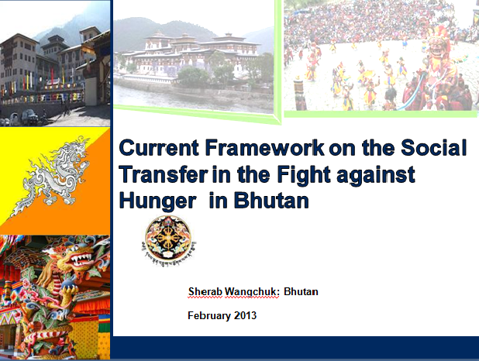



Sonam Pem

Slide 2

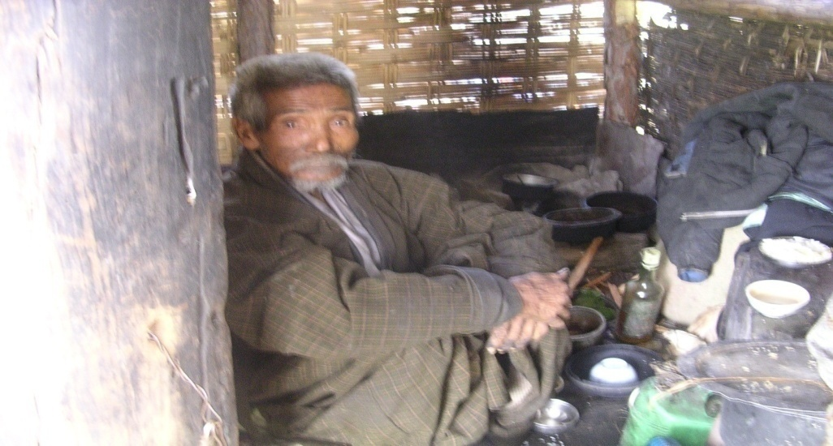
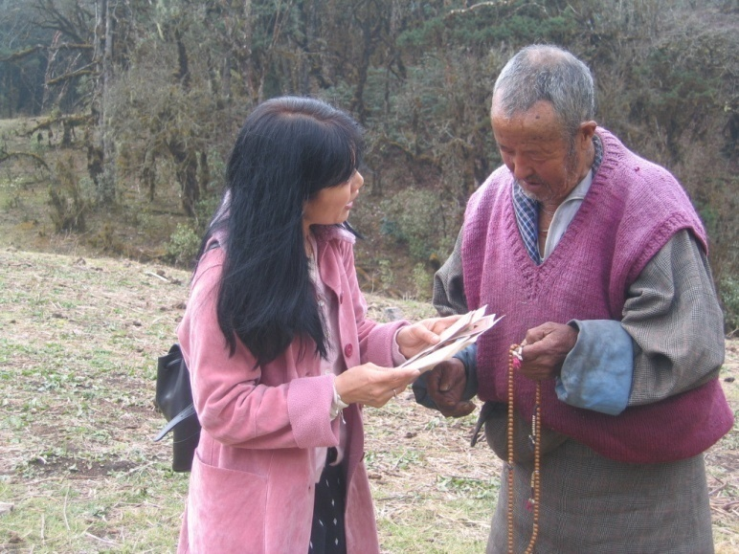
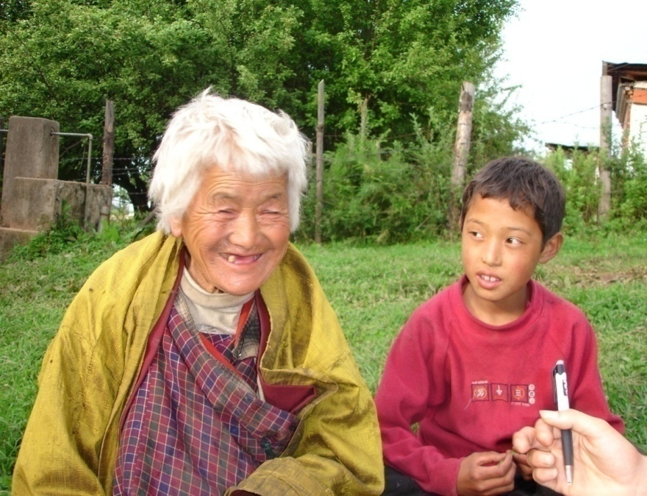
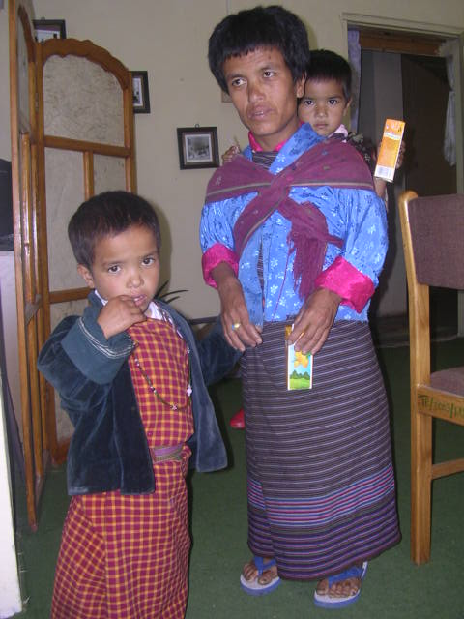
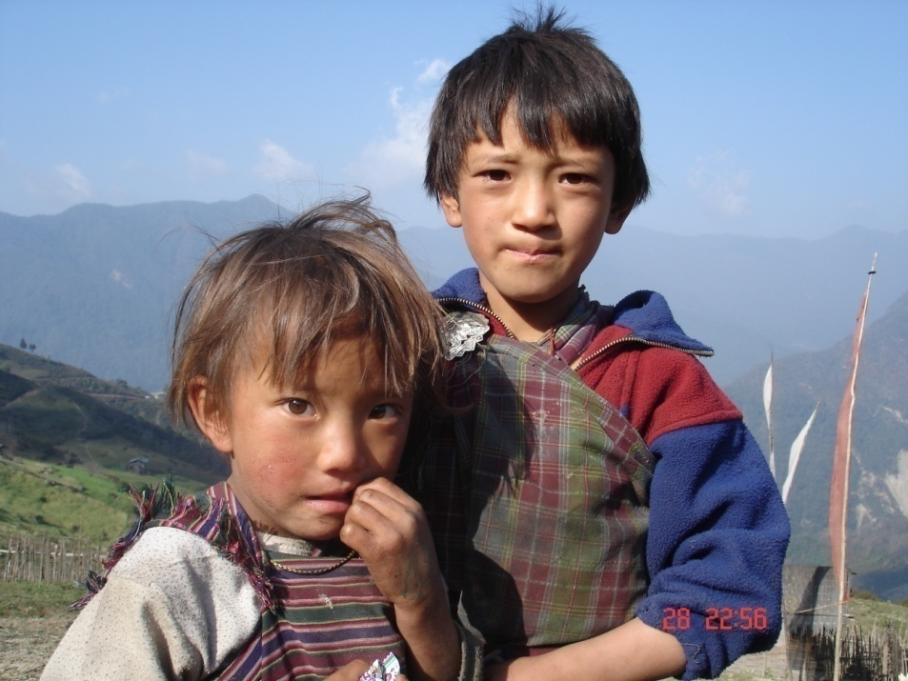
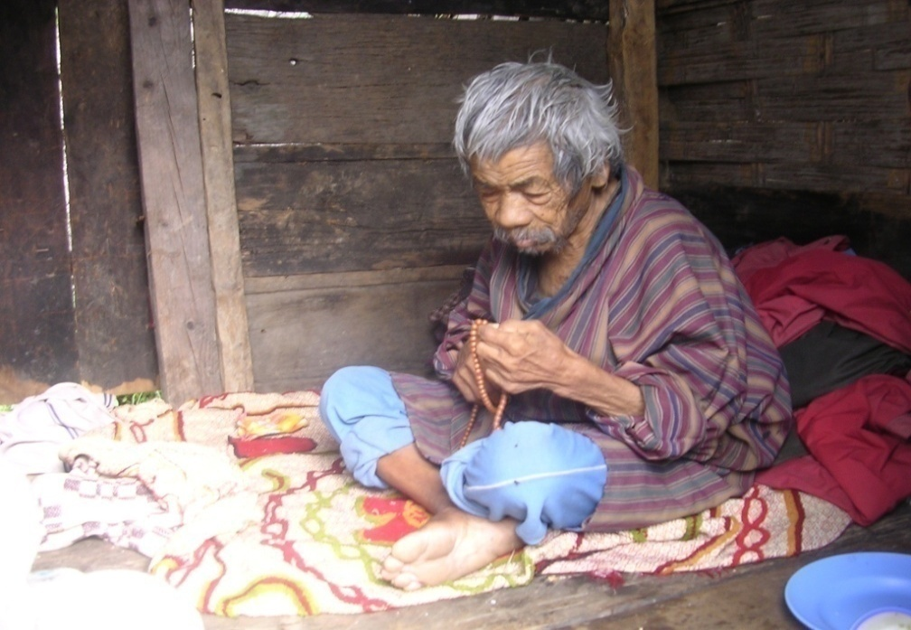
Presentation Content
  1. Country Context
  2. Types of Social Transfer
  3. Policy and Legal Framework
  4. Targeting and Delivery Mechanisms

Slide 3

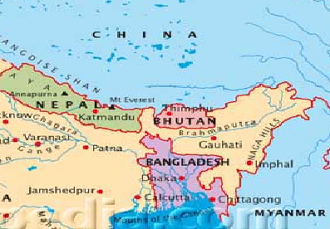
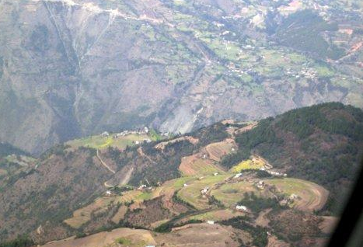
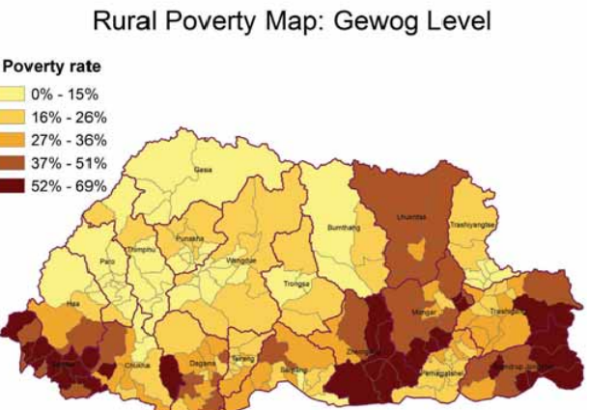
Country Context: Bhutan
Area: : 38,394 sq km Arable land : 2.8% Forest Cover : 72.8% | Population : 716,896 Population Growth Rate : 1.175% Sex Ratio at birth M (s)/F : 1.05
Economy: GDP (PPP) : $4.342 billion Agriculture : 16.7% Industry : 45.4% Services : 37.9% | Poverty Rate : 23.2% Stunting Rate : 37 % (under 5 yrs) Underweight : 11% Wasted : 5%

Slide 4

Types of Social Transfer
Social Transfer Network
Cash Based Social Transfer
In-kind Social Transfer
Cash Transfer:
Scholarship to un-employed youth
Food Transfer.
School Feeding Program
National Work Force (NWF)
Granting kidu
State welfare to poor: It is a social protection system, accorded by His Majesty the king and the government.
Asset and Input Transfer
Transfer of Agricultural and Livestock Inputs
Structure/Housing/OSFS
Land and NR (CF)
Grants:
Lump sum grant-time of disaster, accident

Slide 5



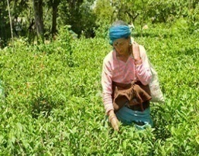
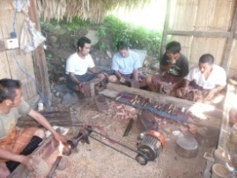
Objectives of Social Transfer
Social-Transfer | Objectives | Scale | Types of Transfer | Fund
Granting Kidu (State Welfare to Poor) | Social protection & security, Improve livelihood | Nationwide-Extreme poverty | Land, Cash, Food & Shelter | State/ kidu fund
Transfer of Agricultural & Livestock inputs | RNR sector (Economic) growth, Reduce poverty, Improve livelihood, Enhance production/productivity, Self sufficiency | Nation-wide, with special focus on poor groups | Improved cattle breeds, AI facilities, breeding bulls, seeds/seedlings, farm machineries, storage facilities One Stop Shop (building) NR/Community Forestry | State/Donor/ CSOs
School Feeding Program | To improve enrolment rates. Reduce short-term hunger & financial burden on poor parents. Alleviate certain micronutrient deficiencies | Nationwide/Mostly remote rural schools (primary education) | Food transfer | State/Donor

Slide 6
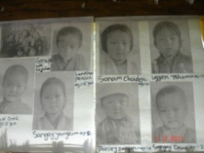
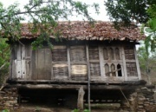
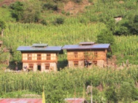
Objectives of Social Transfer Contd..
Social-Transfer Scheme | Objectives | Scale | Types of Transfer | Fund
Scholarship to un-employed youth | To address youth related issues | Nationwide/Very poor families and orphans | Cash, kind (clothing, tuition fee, stationeries) | State/ Kidu Fund/ YDF
Housing schemes | To improve the living condition | Nationalwide/Very poor groups | Cash and kind (labour, timber, other construction materials) | State/Donor/CSOs
Food/Cash Transfer-Public Works | To create job opportunities | National Work Force | Take home rations Cash | State

Slide 7
Policy and Legal Framework
Bhutan currently do not have any integrated/comprehensive policy/legal frame specific to social transfers. However, several enabling instruments support them.
Policies and legal | Main Elements of Social transfer
Constitution of Bhutan | Article 7: Fundamental Rights, Article 8: Fundamental Duties, Article 9: Principles of State Policy
Gross National Happiness (GNH), the overarching government policy | Guides all aspects of development and policy in the country. Advocates policies of good governance, and balanced and equitable socio-economic development
Vision 2020 (Bhutan) | Accords high priority on improving livelihood, enhancing cash income of poor farmers
Forest and Nature Conservation Act of Bhutan 1995 | Ensures access to natural resources including timber for rural housing by communities

Slide 8
Policy and Legal Framework for Social Transfer Contd..
Policies and legal | Main Elements of Social Transfer
National Food and Nutrition Security Policy of Bhutan, 2012 | Recognizes the fundamental right to have access to affordable and adequate, safe, nutritious and culturally acceptable food. Ensures that food and nutrition security is adequately prioritized and mainstreamed in all development plans and programs
National Health Policy of Bhutan, 2011 | Ensures nutrition/education and awareness on healthy food habits and dietary diversification including maternal, infant and young child feeding practices, drinking water and sanitation, prmotion of fruit and vegetables in diet
Cooperative Acts of Bhutan 2001 | Provides legal framework for formation of cooperatives and farmers groups to enhance the economy of scale
Livestock Act of Bhutan 2001 | Ensures distribution and regulation of livestock breeds, livestock health to enhance livestock productivity and prevent diseases

Slide 9
Targeting Mechanisms
  Poverty Targeting
    Poverty (geni-coefficient for equality)
    Access (remoteness to services e.g. high mountain areas)
    Income (low income levels)
    Family Situation (orphans, aged, unemployed youth, single parent families etc.)
    Areas with high rural out-migrations
  General Targeting
    Food for primary education
    Land for all land less

Slide 10
Delivery Mechanism
Who Delivers
Responsible Institutions: Office of the Gyalpoi Zimpon (HM Secretariat) Regional HM (Zimpoi) Office Central Agencies (MOAF, Health, Education etc…) Civil Society Organizations Local Government
Cash based and In-kind Social Transfer
How ?
Projects/Programs/Ad-hoc/(un)-planned Transfers
1. Rural Economy Advancement Program (REAP),
2. Rural Livelihood Project (RLP),
3. Remote Rural Communities Development Project (RRCDP),
4. Special support to High Altitude Mountain Areas of Bhutan
5. Others
Target Communities/ Groups/
Families

Slide 11

TRASHI DELEK
THANK YOU

