Slide 1
International Seminar
Implementation of Targeted Social Programmes and Protection from Hunger
B.M.Abdurakhmonov, Deputy Director, Agency of Social Protection, Employment and Migration of Population, Ministry of Labour and Social Protection of Population of Republic of Tajikistan.
Cambodia
21-23 February 2013.

Slide 2
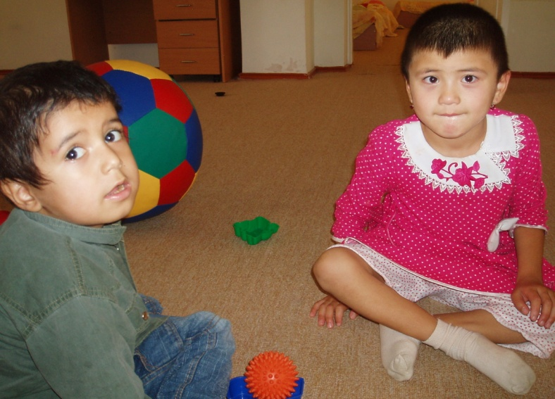
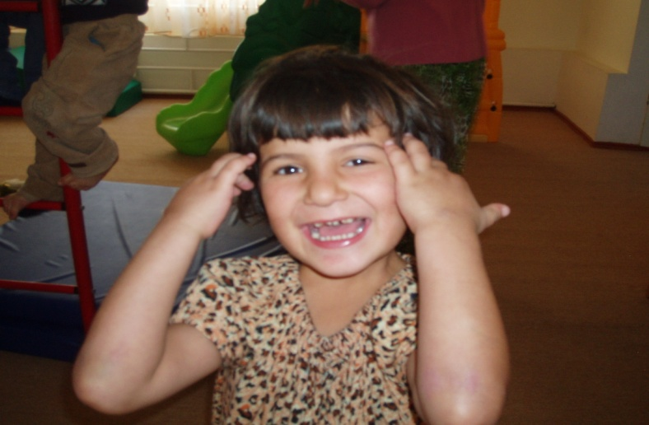
Republic of Tajikistan
Administrative territory of the country is 14 255 397 hectares or 142, 56 thousand km².
Population is 8 millions of people

Slide 3
STRATEGIC DOCUMENTS:
Millennium Development Goals (MDG)
National Development Strategy of the Republic of Tajikistan until 2015 (NDS RT),
Mid-term Programme (Document) Strategy on Poverty Reduction, Republic of Tajikistan (ДССБ РТ)
Concept on Social Protection of Population of the Republic of Tajikistan

Slide 4
SOCIAL PROTECTION SYSTEM IN THE Republic of Tajikistan:
State social insurance and pension provision
Employment and Labor migration
Protection of Family, Women, and Children’s Rights
System of social services
Elements of targeted social assistance:
- compensations to the vulnerable and poor population,
- benefits to children attending school

Slide 5
Main social benefits in RT
Benefit on temporary incapacity for work
Benefits to people, who have children
Unemployment benefits
Social burial allowance
Benefits to different categories of citizens, for example those, who suffered from disasters, poor people
Poor people

Slide 6
At the government level, social protection system is implemented in coordination with ministries and institutions:
Ministry of Education of RT
Ministry of Health of RT
Ministry of Labor and social protection of RT
State Committee on Family and Women issues
State Committee on Youth, Sport and Tourism issues in partnership with public, charitable and parental organizations.

Slide 7
Partner organizations:
International financial organizations – International IMF, WB, ADB, European Bank of Reconstruction and Development
GIZ
UNICEF
Other international organizations and donors
National NGOs

Slide 8
PRIOROTIES OF SOCIAL WORK:
Monitoring of the quality of social services
Development of social standards on social services
Mechanism of needs assessment on social services and financial assistance
Implementation of new mechanism of targeted social assistance to poor families

Slide 9
Thank you!

