Slide 1
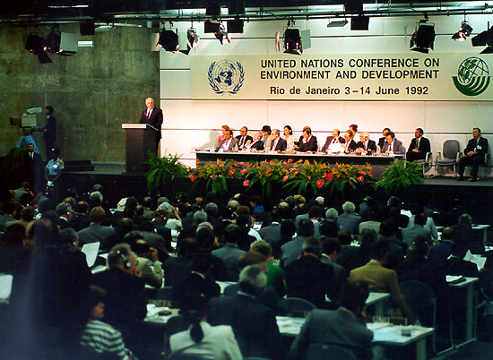

International Commitments
2002 - WSSD Plan of Implementation
1992 – Rio Declaration
Notes:
The Access Initiative has its roots in two international events.
1992
178 governments sign the Rio Declaration. Principle 10 mandated appropriate access to information, encouragement of public participation, and effective access to judicial proceedings.
2002
WSSD Plan of Implementation
calls on governments to implement
Principle 10.

Slide 2
Principle 10 of the Rio Declaration
Environmental issues are best handled with participation of all concerned individuals, at the relevant level. At the national level, each individual shall have appropriate access to information concerning the environment that is held by public authorities…
and the opportunity to participate in decision-making processes. States shall facilitate and encourage public awareness and participation by making information widely available. Effective access to justice and administrative proceedings, including redress and remedy, shall be provided.
Environmental issues are best handled with participation of all concerned individuals, at the relevant level. At the national level, each individual shall have appropriate access to information concerning the environment that is held by public authorities…
and the opportunity to participate in decision-making processes. States shall facilitate and encourage public awareness and participation by making information widely available. Effective access to justice and administrative proceedings, including redress and remedy, shall be provided.
Notes:
In the Declaration they signed – Principle 10 speaks about these same principles of partnership. I don’t expect you to read that but the three principles are there. The basis of partnerships for sustainability must also be openness, participation and accountability – the essence of Principle 10. (SLIDE 4).
Some facts that we have made progress. (slide Maps??) nearly 100 FOIA countries. 40 PRTR countries. 44 ECT countries. But there is still a huge gap to fill. We have to build the partnership fast. Time is running out. Sustainability is at stake. We need to harness the mind and heart of every man, woman and child.
Despite this progress there are many gaps to fill and a long way to go. We need to work harder to ensure that the principles of partnership are practiced at all levels

Slide 3
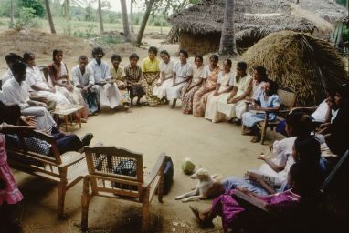
Principle 10..…
Inclusive
?
Accountable
?
?
Transparent
Notes:
Principle 10 is about decision-making that affects the environment.
It asks the questions of, “Whose voice is heard?” “What are the decisions being made?” and “Who is responsible for those decisions?”
It asks, are the processes “inclusive?” “transparent?” “accountable?”

Slide 4
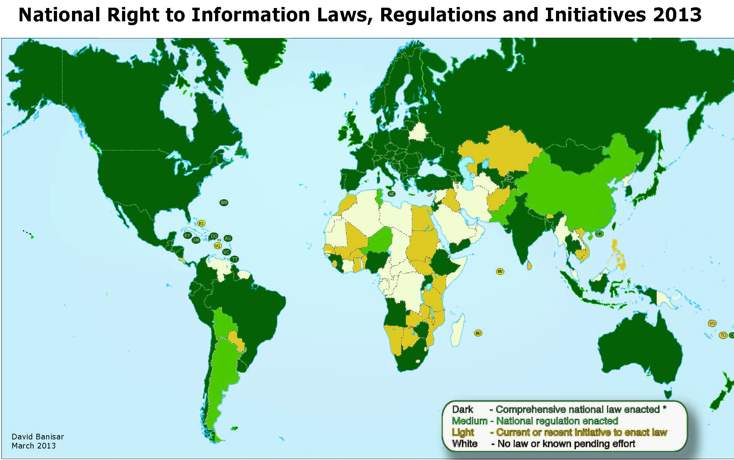
Freedom of Information Laws 2013

Slide 5
Spread of Pollution Release and Transfer Registers

Slide 6
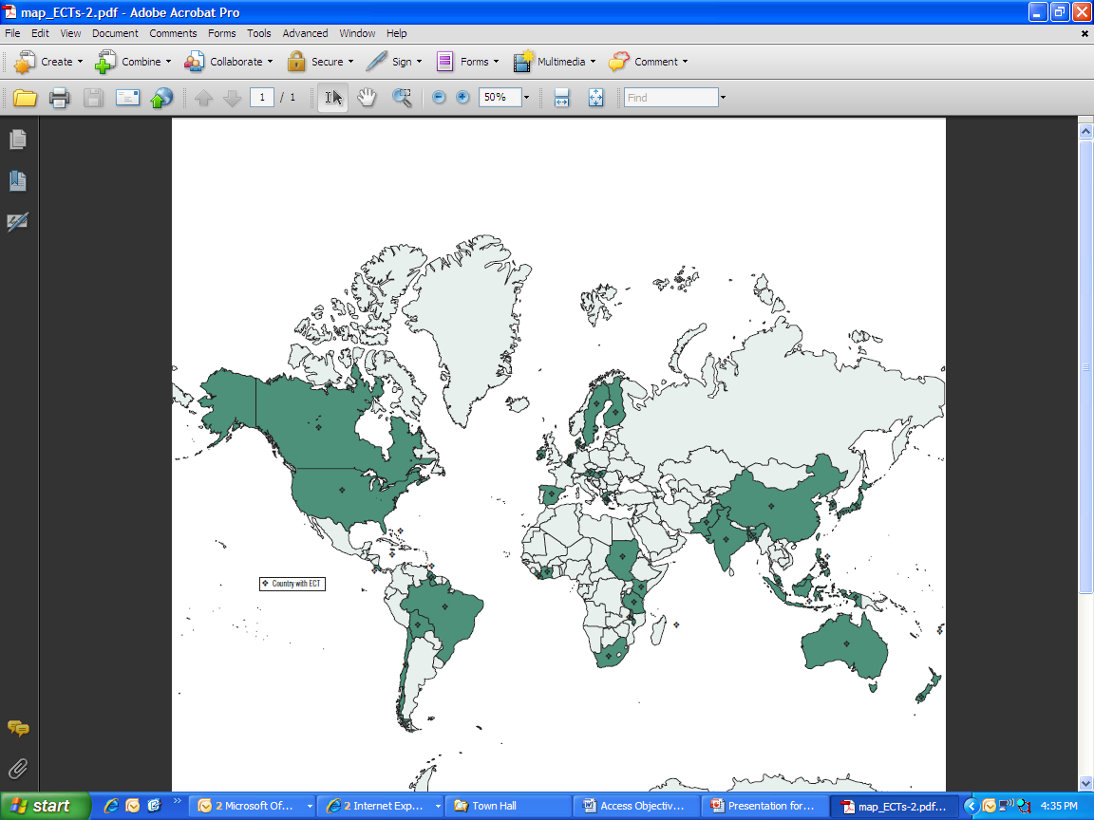
Spread of Environmental Courts

Slide 7
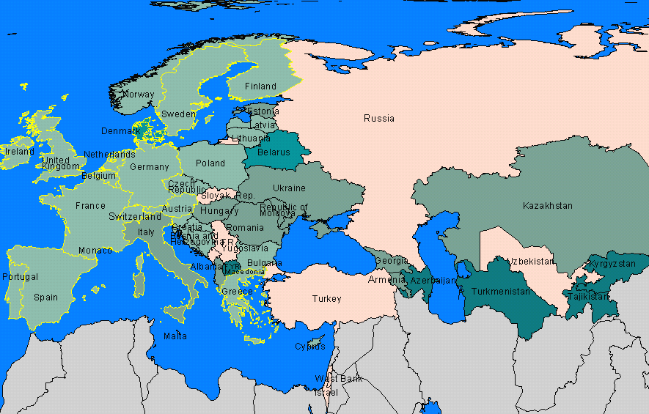
Aarhus Convention - UNECE

Slide 8
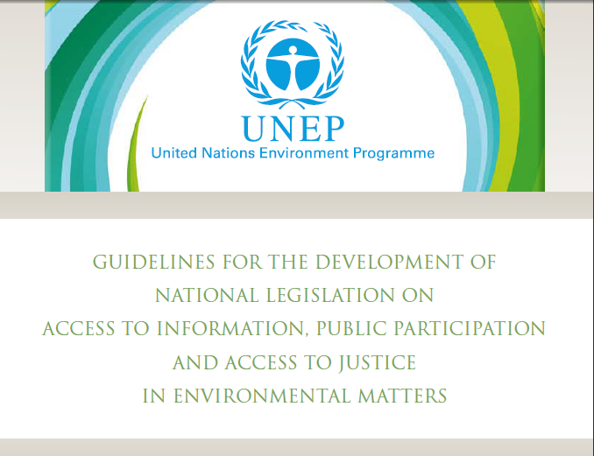

Slide 9
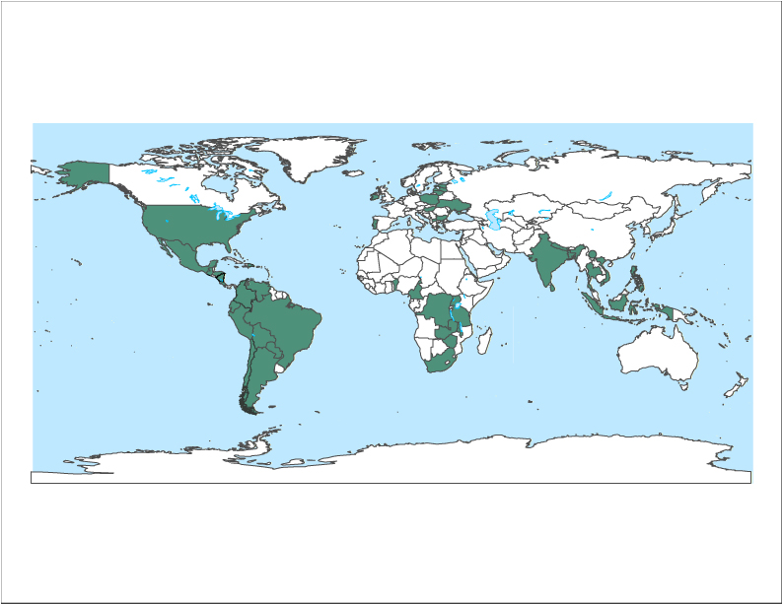
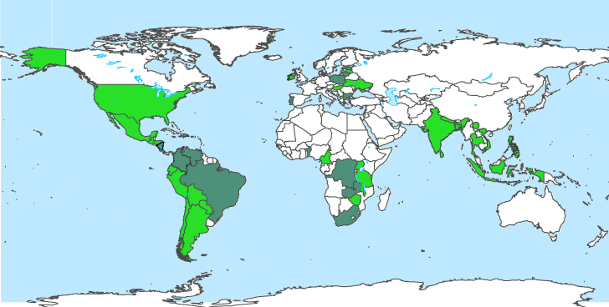
Access Governance Changes
2005-2010
45 countries assessed
29 documented changes with causal link to TAI

Slide 10
Practice Lags Behind Laws

Slide 11
Access Delivery Mechanism
Notes:
Latin America: All countries (14 countries) except Panama, Belize, Guyana, Suriname, Uruguay and Argentina. Argentina is involved in PP10 and TAI regional activities (general promotion) but not officially TAI.
Europe: Portugal, Ireland, Latvia, Lithuania, Estonia, Poland, Hungary, Bulgaria, Ukraine, Kazakhstan
South Asia: India, Sri Lanka, Bangladesh
Asia: Vietnam, Malaysia, Thailand, Indonesia, Philippines, Cambodia, Australia
Africa: Cameroon, Malawi, Kenya, Tanzania, Uganda, South Africa, Zimbabwe,
North America: US and Mexico
Not fully up to date 2-3 countries are not here.
Regionalization – CT leadership - decentralization

Slide 12
Rio+20: P10 Development
The Future We Want
14 LAC Nations Begin P10 Instrument Negotiations
UNEP/UNITAR – Bali Guidelines project
WRI – Environmental Democracy Legal Index

