Slide 1
Module 1
Understanding the basics: global environmental challenges and climate change science
Country-led environmental and climate change mainstreaming (specialist course)
Training materials developed with the support of the European Commission

Slide 2
Are we transgressing “planetary boundaries”?
During the Holocene, Earth’s environment has been stable for the past 10,000 years
Since the Industrial Revolution, human actions are leading to significant environmental change
  Are we moving into the Anthropocene?
  Could human actions lead to a rupture in the stability the planet has enjoyed for the past 10,000 years?
Two underlying drivers of change:
  Population: 4x increase in last 100 years, reaching 7 billion
  Economic activity: 20x GDP increase in last 100 years
Notes:
The concept of ‘Anthropocene’ was coined by the ecologist Eugene Stoermer, but popularised by atmospheric chemist Paul Crutzen (chemistry Nobel-prize winner in 1995).
The concept of “Planetary Boundaries” was proposed by scientists from the Stockholm Resilience Centre and the Australian National University. It was disseminated through a publication in Nature (2009).
The concept of carrying capacity can be useful to understand the perils of population growth and unsustainable resources use. In ecology, when population of a species grows beyond its carrying capacity, its population crashes; ecosystems can sometimes recover but may also be permanently altered.

Slide 3
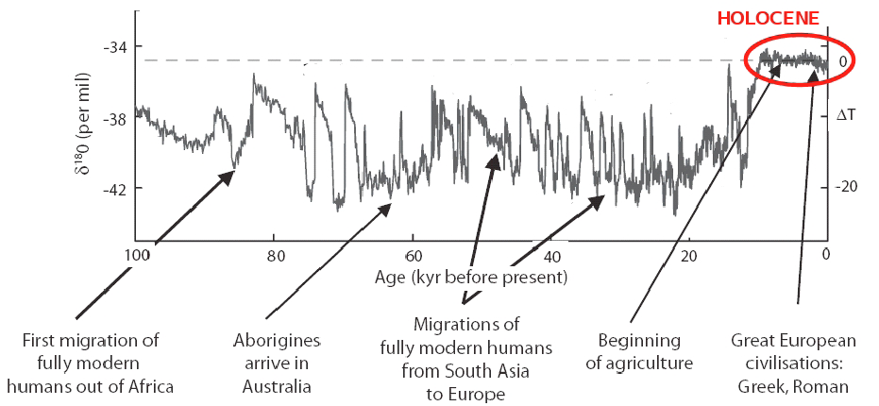
The Holocene
Source: Rockström et al (2009a).
Notes:
The Y-axis units are an indicator of temperature

Slide 4
Planetary Boundaries
9 key processes to stability:
  Climate Change
  Rate of loss of biodiversity
  Interference with nitrogen and phosphorous cycles
  Stratospheric ozone depletion
  Ocean acidification
  Global freshwater use
  Land use change
  Atmospheric aerosol loading
  Chemical pollution
Source for data and information on planetary boundaries: Rockström et al (2009a).
Notes:
Earth subsystems can react in a non-lineal fashion, particularly around threshold levels.
Changes can then be abrupt and if thresholds are crossed then important subsystems (e.g. monsoon system) can shift into new states with potentially significant adverse consequences.
The parameters proposed by Rockström et al (2009) are as follows:
1. Climate change: (i) atmospheric CO2 concentration; (ii) change in radiative forcing (W/m2)
2. Rate of biodiversity loss: extinction rate (no. species per million species per year)
3a. Nitrogen cycle (part of a boundary with the P cycle): amount N2 removed from atmosphere for human use (million T/yr)
3b. P cycle (part of boundary with the N cycle): quantity of P flowing into the oceans (million T/yr)
4. Stratospheric ozone depletion: O3 concentration (Dobson unit)
5. Ocean acidification: global mean saturation state of aragonite in surface sea water
6. Global freshwater use: consumption of freshwater by humans (km3/yr)
7. Change in land use: % of global land cover converted to cropland
8. Atmospheric aerosol loading: overall particulate concentration in the atmosphere, on a regional basis
9. Chemical pollution: e.g. amount emitted to, or concentration of POPs, plastics, endocrine disrupters, heavy metals and nuclear waste in, the global environment, or the effects on ecosystem and functioning of Earth system thereof
The boundaries for the last 2 parameters have not yet been determined, nor their pre-industrial baseline.

Slide 5
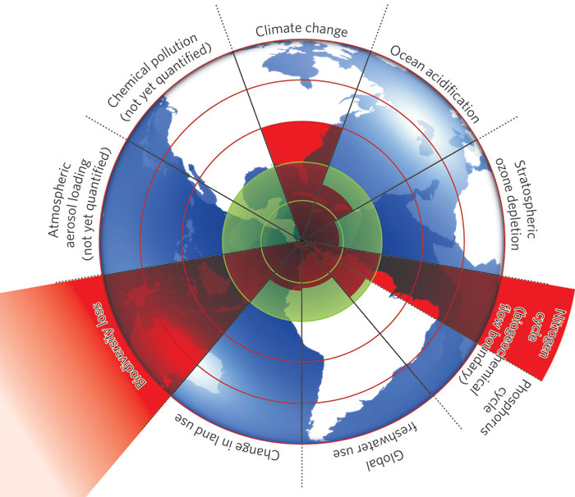
Source: Rockström et al,(2009b)
Notes:
The green inner shading represents proposed safe operating space.
Red wedges represent an estimate of the current position for each variable.
Boundaries in 3 systems: rate of biodiversity loss, climate change and human interference with the nitrogen cycle have already been exceeded.

Slide 6
Planetary Boundaries
Rate of loss of biodiversity
  Species becoming extinct at 100 to 1,000x natural rate – a rate not seen since the last global mass-extinction event
  A rich mix of species underpins ecosystem resilience
  Main cause is land use change, but also introduction of new species
Notes:
Rationale (from Rockström et al, 2009b):
Climate change:
Current climatic models may significantly underestimate severity of long-term CC for a given GHG concentration. Most models suggest a doubling in atmospheric CO2 concentration will lead to global temperature rise of about 3ºC (2-4.5ºC uncertainty range) once the climate has regained equilibrium. These models don’t include long-term reinforcing feedback processes that further warm the climate, such as decreases in distribution of vegetation. If these slow feedbacks are included, doubling CO2 levels gives an increase of 6ºC (4-8ºC uncertainty range), threatening ecological life-support systems and severely challenging viability of contemporary human societies.
CO2 concentrations were major factor in long-term cooling over past 50 million years, and the planet was largely ice-free until CO2 concentrations fell below 450 ppm (per volume), so there is a critical threshold around 350-550 ppm. The 350 ppm threshold aims at ensuring continued existence of large ice sheets.
There is evidence some Earth subsystems are being altered beyond stability, e.g. retreat of summer sea ice in Arctic ocean, retreat of mountain glaciers, loss of mass from Greenland and West Antarctic ice sheets, accelerating rates of sea level rise in past 10-15 years.
Rate of biodiversity loss:
Main cause is land use change (into agriculture and urban areas); changes in frequency, duration or magnitude of wildfires; introduction of new species.
Up to 30% of all mammal, bird and amphibian species will become threatened with extinction this century.
More research needed to pin down the boundary.

Slide 7
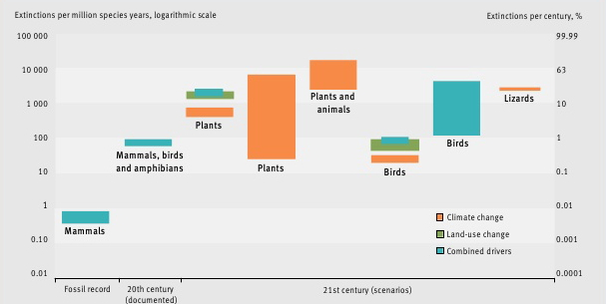
Scenarios of species change
Source: Pereira et al (2010)

Slide 8
Planetary Boundaries
Nitrogen and Phosphorous cycles
  Addition of N+P due to modern agriculture significantly perturbs global cycles
  Human processes responsible for conversion of 120 million tonnes N₂/year, more than effects from all natural processes combined
  About 20 million tonnes P mined every year – about 8x natural background rate of influx
  Most N and P ends up polluting waterways and coastal waters, with consequences on health
Notes:
Nitrogen and Phosphorous cycles:
Human processes (mainly manufacture of fertilisers and cultivation of leguminous crops) convert around 120 million T N2 from atmosphere per year into reactive forms, which is more than the combined effects from all Earth’s terrestrial processes. Most ends of pollution waterways and coastal waters, plus adding GHGs (e.g. N2O has large greenhouse gas effect).
P is a fossil mineral that accumulates as a result of geological processes.
Records of Earth history show that large-scale ocean anoxic events occur when critical thresholds of P inflow to oceans are crossed; this potentially explains past mass extinctions of marine life.
Tentative modelings suggest that if there is a greater than 10x increase in P flowing into oceans (compared to pre-industrial levels), then anoxic ocean events become more likely within 1,000 years.

Slide 9
Planetary Boundaries
Ocean acidification
  Affects marine carbon sink and challenge to marine biodiversity
  Impacts on coral reefs and associated ecosystems
  Surface ocean pH has decreased about 0.1 units since pre-industrial times – 100x than any other time in the last 20 million years
Stratospheric ozone depletion
  Stratospheric ozone filters UV radiation
  The Montreal Protocol has been effective in controlling CFC (also GHGs)
    Alternative substances (e.g. HCFCs are also GHG)
Notes:
- Oceans currently remove about 25% of CO2 emissions: CO2 dissolution into seawater and uptake by marine organisms
- Many marine organisms are vey sensitive to changes in CO2 chemistry, especially those that grow ‘shells’ or skeletal structures
Stratospheric ozone depletion
- Possibility that global warming (which leads to a cooler stratosphere) could cause an increase in formation of polar stratospheric clouds. If this happens in the Arctic region, it could trigger ozone holes over the N hemisphere continents.

Slide 10
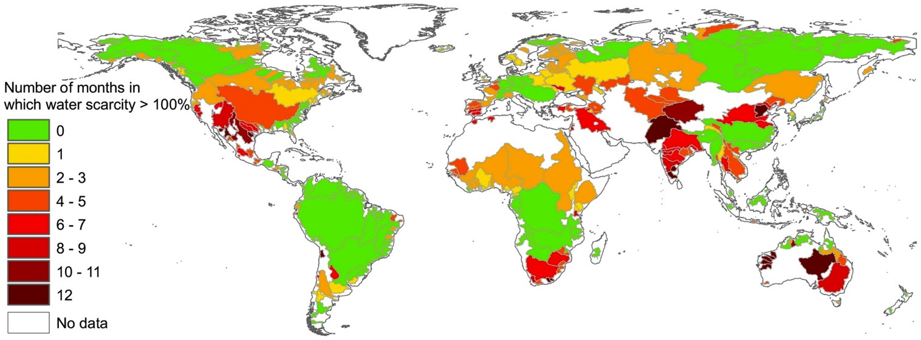
Global ‘blue’ water scarcity
Source: Hoekstra at al (2012).

Slide 11
Planetary Boundaries
Global freshwater use
  Humans now control most freshwater flows
  About 25% of river basins run dry before reaching the oceans due to freshwater use
  Green water flows influence rainfall events through moisture feedback and, thus availability of blue water resources (e.g. Sahel shifting from wet to dry some 5,000-6,000 years ago; risk of savannization of Amazon)
  Availability of freshwater is also being impinged upon by land use change, primarily deforestation
  Pressure on freshwater resources is growing rapidly, mainly related to food production
Notes:
Threats to human livelihoods include:
Loss of soil moisture resources (green water) due to land degradation and deforestation, threatening terrestrial biomass production and carbon sequestration
Use and shifts in runoff (blue water) volumes and patterns threatening human water supply and aquatic water needs
Impacts on climate regulation
Estimates indicate 90% of global green water are required to sustain critical ecosystem services, whereas 20-50% of mean annual blue water flows in river basins are required to sustain aquatic ecosystems

Slide 12
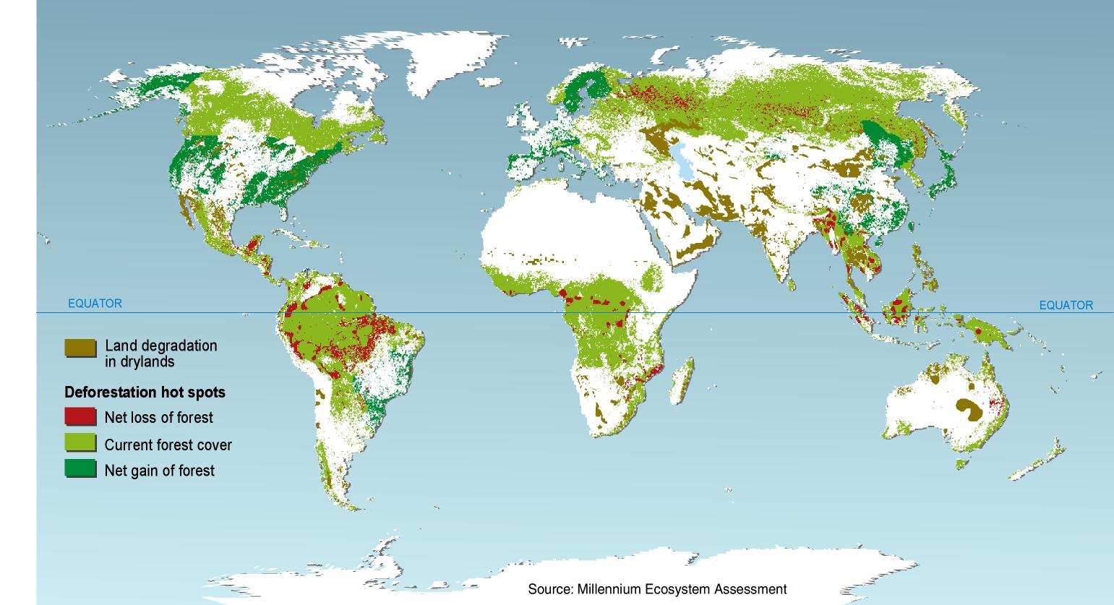
Land degradation and deforestation

Slide 13
Planetary Boundaries
Land use change
  Mainly driven by agricultural expansion and intensification
  Land use change into agricultural land has occurred at an average rate of 0.8%/yr over the last 40-50 years
Aerosol loading
  Influence the climatic system and have adverse effects of human health
  Human activities have doubled global concentration of most aerosols
  Influence radiation balance and hydrological cycle
Notes:
Land use change:
As a planetary boundary Rockströem et al (2009a) propose that no more than 15% of the global ice-free land surface should be converted to cropland.
Although effects of land-system change act as a slow variable that influences other boundaries (e.g. water, biodiversity, climate), they can also trigger rapid changes at the continental scale when land-cover thresholds are crossed. For ex. Conversion of the Amazon rainforest into cultivated or grazing systems may reach a level where an additional small amount of conversion could tip the basin into an irreversible transformation to a semi-arid savanna.
Aerosol loading:
Influence on radiation balance directly by scattering incoming radiation back to space, and indirectly by influencing cloud reflectivity and persistence
Aerosols can also influence hydrological cycle by altering mechanisms that form precipitation in clouds
Human-health perspective: PM2.5 is responsible for 3% adult cardiopulmonary disease mortality, about 5% tracheal, bronchial and lung cancer mortality and about 1% mortality from acute respiratory infection in children un urban areas
Other effects of aerosol components (e.g. particulates, O3, Sox, NOx): crop damage from exposure to ozone, forest degradation and loss of freshwater fish due to acidic precipitation…

Slide 14
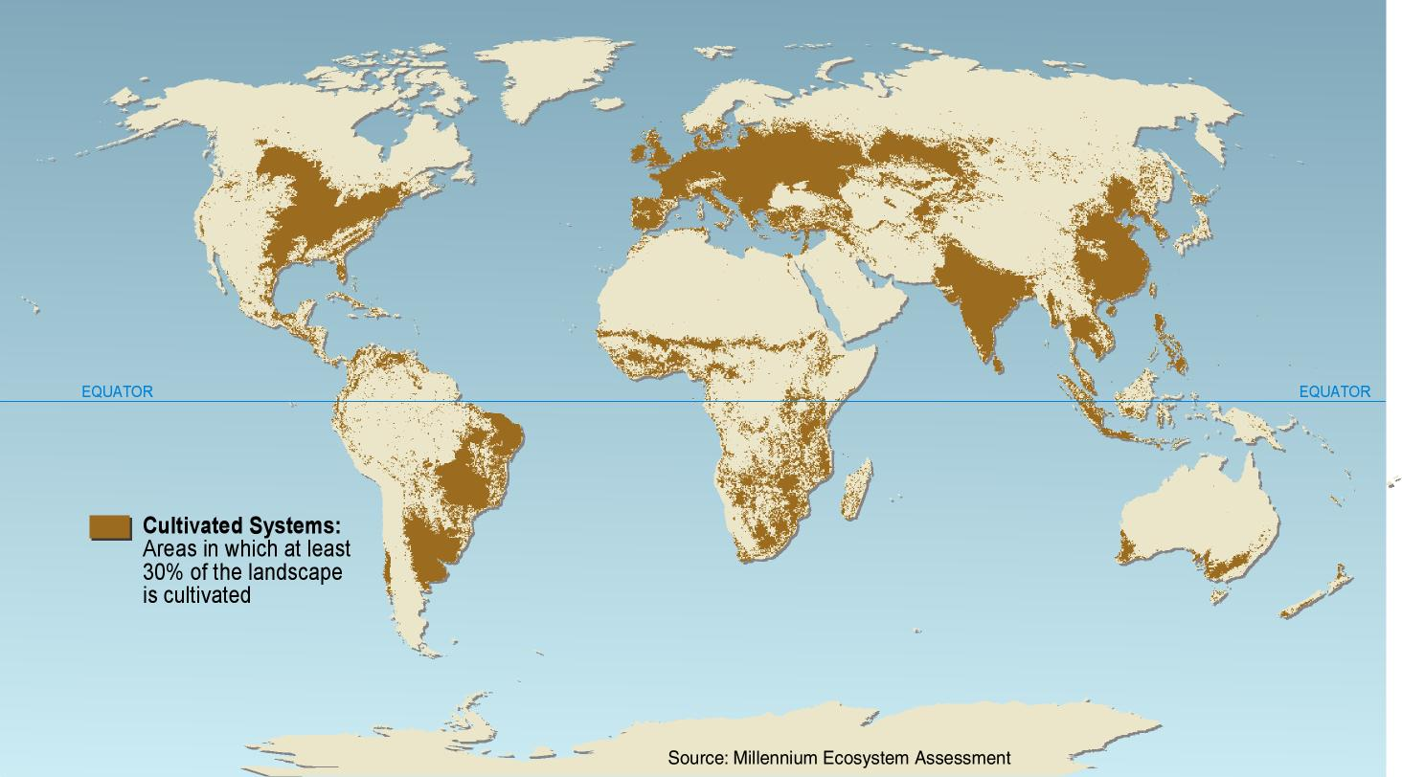
Cultivated systems

Slide 15
Planetary Boundaries
Chemical pollution
  Rationale
    Impacts on physiological development
    Slowly affects other boundaries
  More than 248,000 chemical products are commercially available
  Toxicity data available only for a few thousand, with virtually no knowledge of combined effects
  Chemicals get transported across the environment, some are especially dangerous due to their persistence and the fact they bioaccumulate (e.g. POPs and heavy metals)
Notes:
No threshold value has been defined
Chemical pollution may influence the biodiversity boundary by reducing abundance of species and potentially increasing organism vulnerability to other stresses (e.g. climate change).
Interaction with climate change boundary through release and global spread of Hg from coal burning, and fact that most industrial chemicals are produced from petroleum, releasing CO2 when degraded or incinerated…
Toxicity of few chemicals is known, as well as synergistic effects
Persistent Organic Pollutants (POPs) are a particular concern, as they don’t degrade, get transported to remote regions of the planet and bioaccumulate. Pesticides are a particular concern due to their large (and often inadequate) use, leading not only to soil and water pollution but also to health effects on community members.

Slide 16
Planetary boundaries
Climate Change
  CO₂ concentration approx. 387 ppm vs 350 threshold
  Change in radiative forcing: 1.5 W/m² vs 1 W/m² threshold

Slide 17
Is climate change real?
IPCC 4th Assessment Report:
  “Warming of the climate system is unequivocal, as is now evident from observations of increases in global average air and ocean temperatures, widespread melting of snow and ice and rising global average sea level”.
Observed trends:
  Recent years warmest on record
  Accelerating increase in global surface temperature and ocean temperature
  Accelerating rise in sea level
Notes:
Instrumental records started in 1850. GHG emissions have grown by > 2%/year since 2000 and are expected to continue to grow over the coming decades.
Physical manifestations of climate change:
* Increased average global surface temperature: +0.74°C over the past century (accelerating trend) – more in high-latitude regions.
* Increased average ocean temperatures.
* Widespread melting of snow and ice in mountain glaciers and polar/sub-polar regions.
* Average global sea level rise: +1.8 mm/year (1961-2003), +3.1 mm/year (1993-2003).
* More unpredictable rainfall patterns, more frequent and severe extreme weather events, shifts in seasons.
Resulting changes in physical systems:
* Changes in snow and ice cover.
* Melting of the permafrost => ground instability.
* Alterations in hydrological patterns and flows (e.g. increased number/size of glacial lakes, earlier and higher spring peak flows in glacier- and snow-fed rivers, changes in water temperature, salinity, oxygen levels)
* Changes in coastal processes (e.g. water circulation and related erosion pattern)
Resulting changes in biological systems:
Changes in terrestrial ecosystems (e.g. shifts in the range of some species, changes in the timing of lifecycle events, asynchrony in long-established predator-prey relationships)
Changes in marine and freshwater ecosystems (e.g. shifts in the range and abundance of plankton and fish, earlier fish migration in rivers).
Many other changes have been documented but may be attributable at least in part to other causes (e.g. losses of coastal wetlands, mangroves, coral reefs; alterations in wildfire patterns)

Slide 18
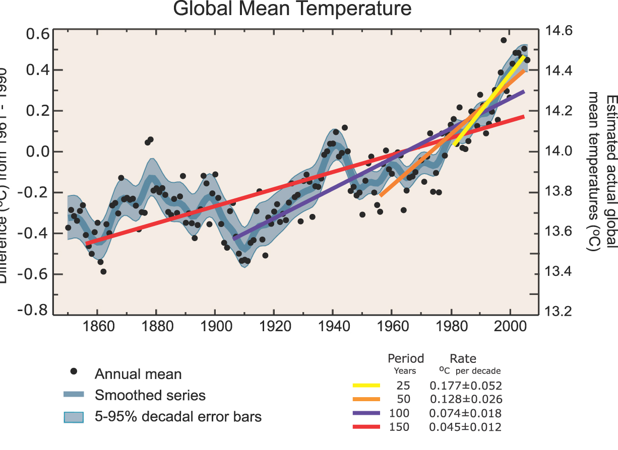
Some observations: trends in global mean temperature
Source: IPCC (2007b) 4th Assessment Report,
WG I – FAQ 3.1 Fig. 1
Notes:
IPCC 4AR, WG I report, p. 253 – Legend:
FAQ 3.1, Figure 1. (Top) Annual global mean observed temperatures1 (black dots) along with simple fits to the data.
The left hand axis shows anomalies relative to the 1961 to 1990 average and the right hand axis shows the estimated actual temperature (°C).
Linear trend fits to the last 25 (yellow), 50 (orange), 100 (purple) and 150 years (red) are shown, and correspond to 1981 to 2005, 1956 to 2005, 1906 to 2005, and 1856 to 2005, respectively. Note that for shorter recent periods, the slope is greater, indicating accelerated warming.
The blue curve is a smoothed depiction to capture the decadal variations. To give an idea of whether the fluctuations are meaningful, decadal 5% to 95% (light grey) error ranges about that line are given (accordingly, annual values do exceed those limits).
Results from climate models driven by estimated radiative forcings for the 20th century (Chapter 9) suggest that there was little change prior to about 1915, and that a substantial fraction of the early 20th-century change was contributed by naturally occurring influences including solar radiation changes, volcanism and natural variability.
From about 1940 to 1970 the increasing industrialisation following World War II increased pollution in the Northern Hemisphere, contributing to cooling, and increases in carbon dioxide and other greenhouse gases dominate the observed warming after the mid-1970s.

Slide 19
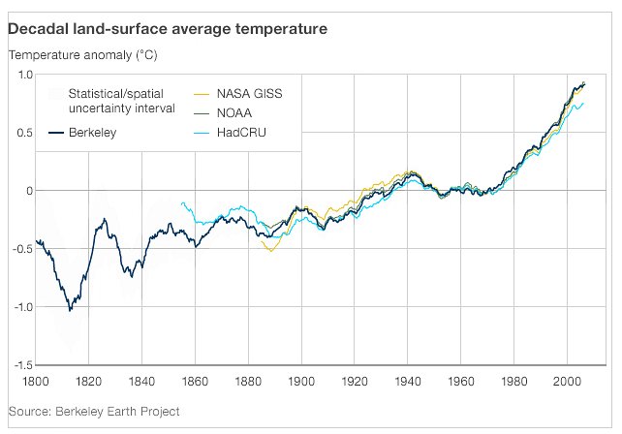
Berkeley Earth Surface Temperature
Project results (October 2011)
19

Slide 20
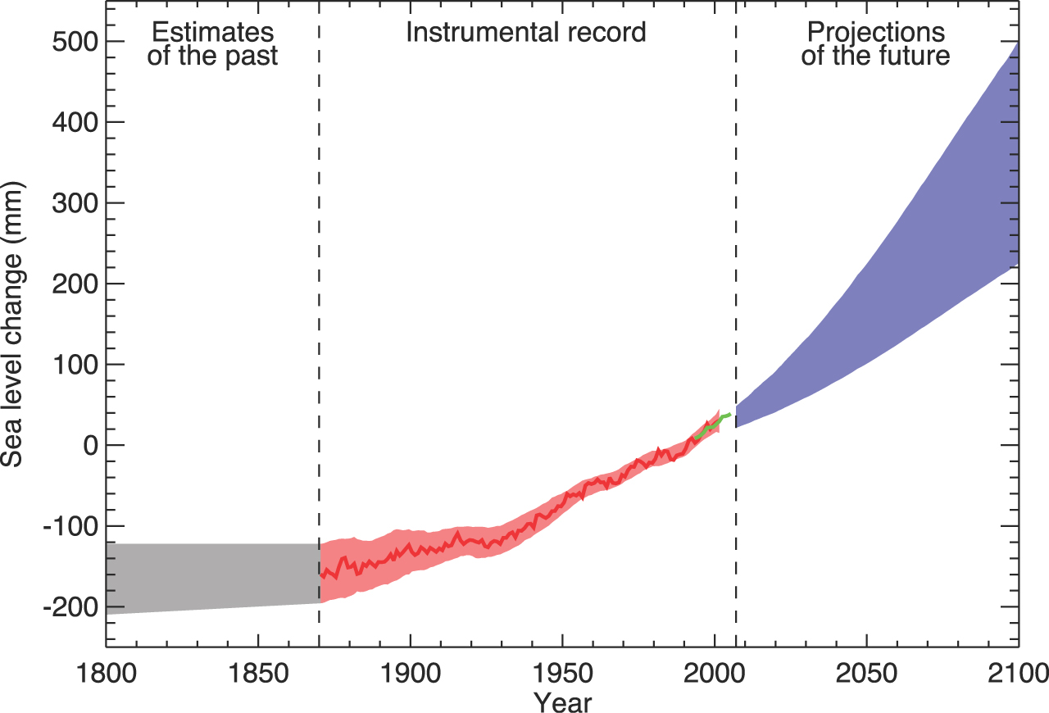
Observations and projections: global sea level change
Source: IPCC (2007b) 4th Assessment
Report, WG I –
FAQ 5.1 Fig. 1
Notes:
IPCC 4AR, WG I report, p. 409 – Legend:
FAQ 5.1, Figure 1. Time series of global mean sea level (deviation from the
1980-1999 mean) in the past and as projected for the future.
For the period before 1870, global measurements of sea level are not available.
The grey shading shows the uncertainty in the estimated long-term rate of sea level change (Section 6.4.3).
The red line is a reconstruction of global mean sea level from tide gauges (Section
5.5.2.1), and the red shading denotes the range of variations from a smooth curve.
The green line shows global mean sea level observed from satellite altimetry.
The blue shading represents the range of model projections for the SRES A1B scenario for the 21st century, relative to the 1980 to 1999 mean, and has been calculated independently from the observations.
Beyond 2100, the projections are increasingly dependent on the emissions scenario (see Chapter 10 for a discussion of sea level rise projections for other scenarios considered in this report). Over many centuries or millennia, sea level could rise by several metres (Section 10.7.4).

Slide 21
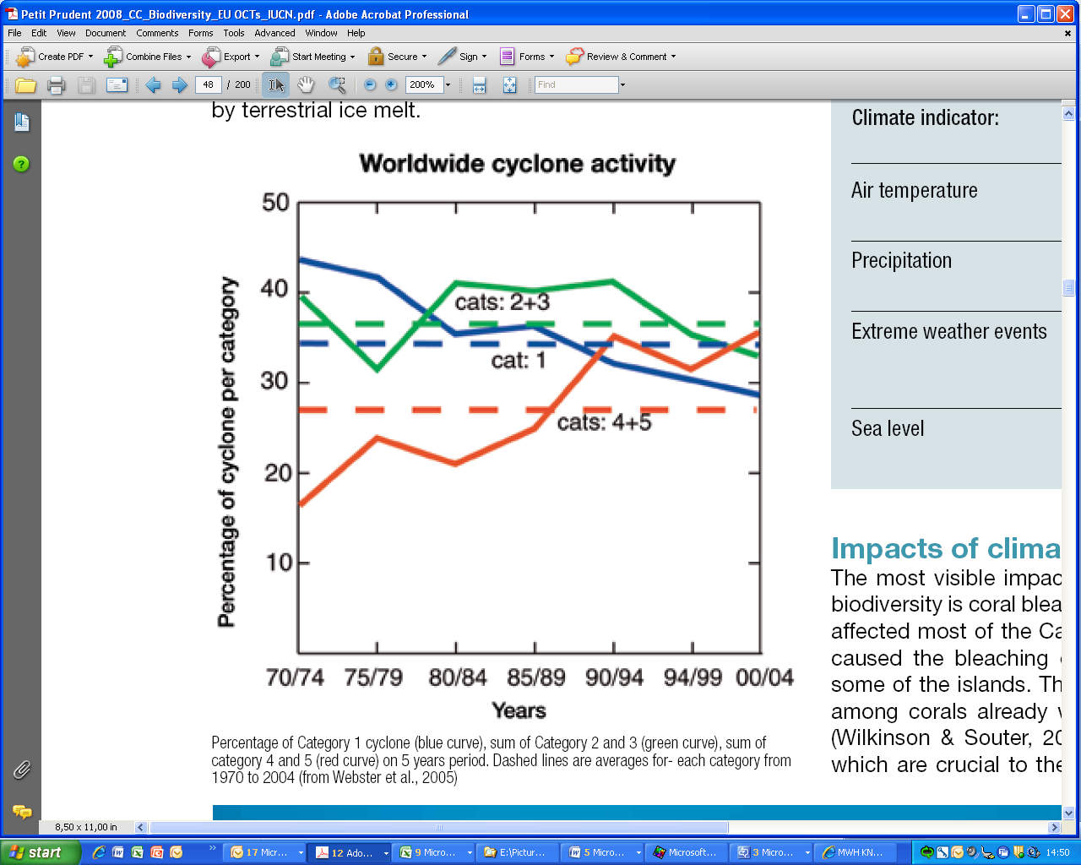
Observations: intensity of cyclones
Worldwide: %age of Category 1 cyclone (blue curve), sum of Category 2 and 3 (green curve), sum of category 4 and 5 (red curve) on 5 years period. Dashed lines are averages for each category from 1970 to 2004 (Source: Petit & Prudent 2008, p. 42, from Webster et al 2005)

Slide 22
What are the causes of climate change?
Natural variation is an inherent feature of the climate (e.g. driven by solar cycles, earth orbit, volcanoes)
But anthropogenic emissions of long-lived greenhouse gases in the atmosphere are a major cause of the changes now being observed
Notes:
Significant emissions started with the industrial revolution (fossil fuel use, 18th century) but considerably accelerated as from the 1970s (fossil fuel use, agriculture & land use changes). Atmospheric concentrations of the main GHGs now far exceed the natural range over the past 650,000 years.
e.g. CO2 atmospheric concentration: grew from 280 ppm (pre-industrial level) to 379 ppm (2005), with an acceleration in the accumulation rate
e.g. CH4 atmospheric concentration: grew from 715 ppb (pre-industrial level) to 1774 (2005), with a deceleration in the accumulation rate over the past few decades
e.g. N2O atmospheric concentration: grew from 270 ppb (pre-industrial level) to 319 ppb (2005).
OECD (2009a), Section 2: Natural causes of change include ‘the chaotic dynamics inherent to the climate system as well as changes in solar radiation, ocean circulation and reflectance of the earth’s surface.’ Natural shifts in the climate system include ‘phenomena as diverse as the last ice age (...) and fluctuations caused by the El Nino Southern Oscillation (...)’.
Dervis et al. (2009): carbon emissions have increased 145-fold globally since the industrial revolution – and are projected to increase another 54% by 2030.

Slide 23
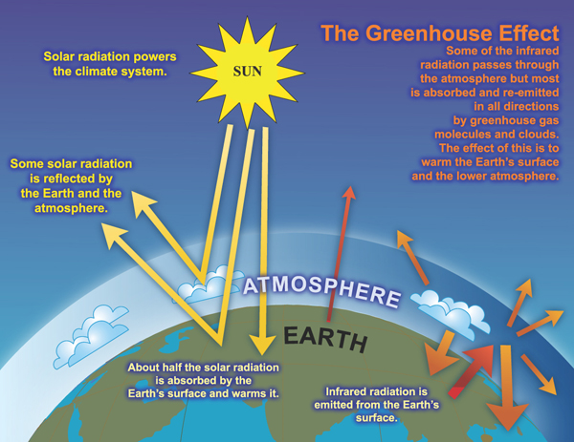
The greenhouse effect
Source: WWF/IPCC, http://wwf.panda.org/about_our_earth/aboutcc/how_cc_works/
Notes:
WDR 2010: «The climate of Earth is determined by the incoming energy from the Sun, the outgoing energy radiated from Earth, and exchanges of energy among the atmosphere, land, oceans, ice, and living things. The composition of the atmosphere is particularly important because some gases and aerosols (very small particles) affect the flow of incoming solar radiation and outgoing infrared radiation.»
* The earth receives a continuous flow of energy from the sun; some of it passes through the earth’s atmosphere and warms the earth’s surface
* Some of this energy is reflected or radiated (in the form of infrared radiation) back to the atmosphere and the space
* Greenhouse gases in the atmosphere act as a ‘blanket’: they trap part of the reflected heat and re-emit it to the earth
average global temperature of about 15°C, rather than minus 18°C otherwise

Slide 24
What are the main greenhouse gases?
By decreasing order of abundance:
  water vapour (H₂O)
  carbon dioxide (CO₂)
  methane (CH₄)
  nitrous oxide (N₂O)
  ozone (O₃)
  chlorofluorocarbons (CFC)
  other halogenated compounds (i.e. gases containing fluorine, chlorine, bromine or iodine) (e.g. hydrofluorocarbons – HFC, sulphur hexafluoride – SF₆)
Notes:
With the exception of CFC and other halogenated compounds, all these gases are naturally present in the atmosphere. WDR 2010: «The warming effect created by the natural levels of these gases is “the natural greenhouse effect.” (...) Gases released from human activities have greatly amplified the natural greenhouse effect. »
Note that ozone and CFCs form in the atmosphere as a result of chemical reactions; their emissions are no tracked as such in the context of the UNFCCC and Kyoto Protocol. Emissions subject to tracking/reporting under the UNFCCC are those of carbon dioxide, methane, nitrous oxide, hydrofluorocarbons (HFC), perfluorocarbons (PFC) and sulphur hexafluoride (IPCC 4AR).
Global warming potential:
GWP, expressed in tonnes of CO₂ equivalent or t CO₂e, is a measure of how much a given mass of a GHG is estimated to contribute to global warming, compared with the same mass of CO₂ (by convention, GWP of CO₂ = 1). It is used (notably in the context of the Kyoto Protocol) to estimate the potential future impacts of emissions of different gases upon climate, in a relative manner. The GWP depends on the time span over which the potential is calculated.
Radiative forcing:
Many factors influence the balance of incoming and outgoing energy in the earth-atmosphere system
Positive forcing tends to warm the surface (e.g. GHGs)
Negative forcing tends to cool it (e.g. some aerosols)
Radiative forcing (expressed in W/m²) is used to quantify and rank the anthropogenic and natural drivers of climate change. For instance, in 2005:
RF of CO₂ = 1.66 W/m²
RF of CH₄ = 0.48 W/m²
RF of N₂O = 0.16 W/m²

Slide 25
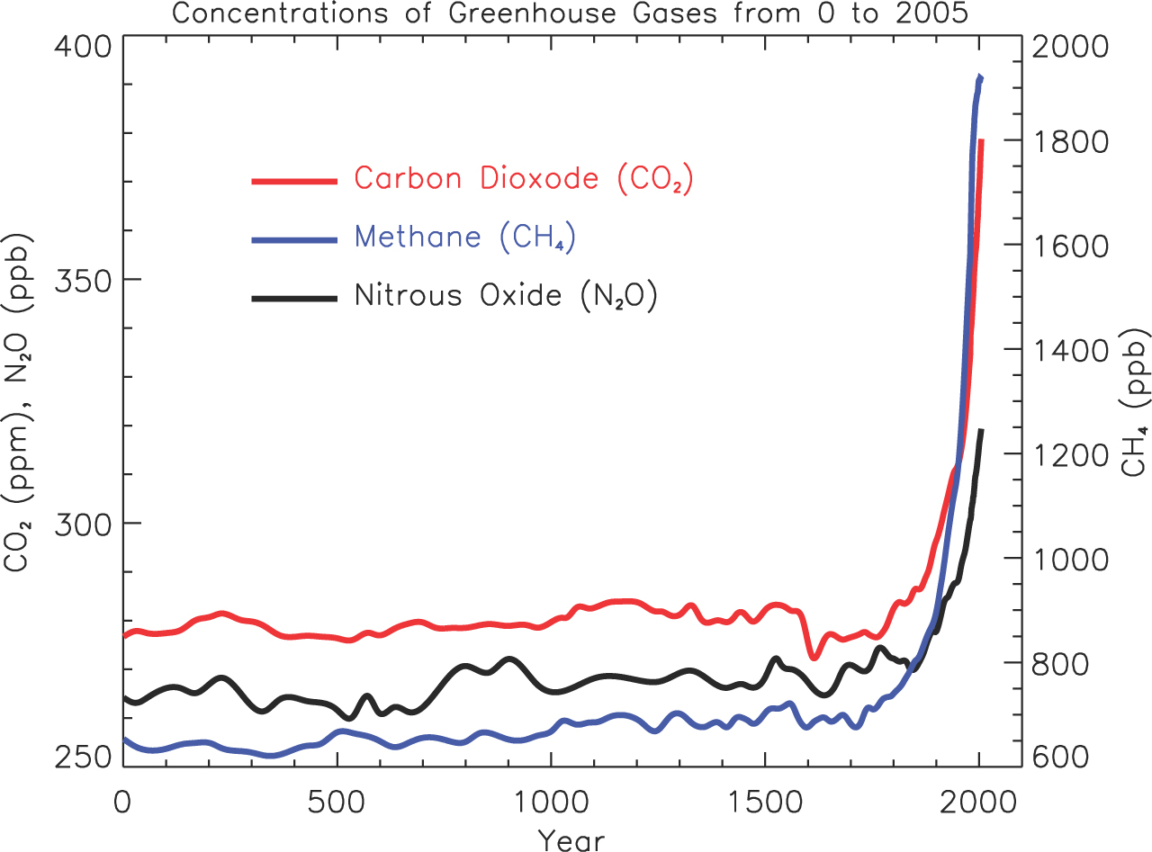
Evolution of GHG concentrations
Source: IPCC (2007b) 4th Assessment Report, WG I – FAQ 2.1 Fig. 1
Notes:
IPCC 4AR, WG I report, p. 135 – Legend:
FAQ 2.1, Figure 1. Atmospheric concentrations of important long-lived greenhouse
gases over the last 2,000 years.
Increases since about 1750 are attributed to human activities in the industrial era. Concentration units are parts per million (ppm) or parts per billion (ppb), indicating the number of molecules of the greenhouse gas per million or billion air molecules, respectively, in an atmospheric sample. (Data combined and simplified from Chapters 6 and 2 of this report.)

Slide 26
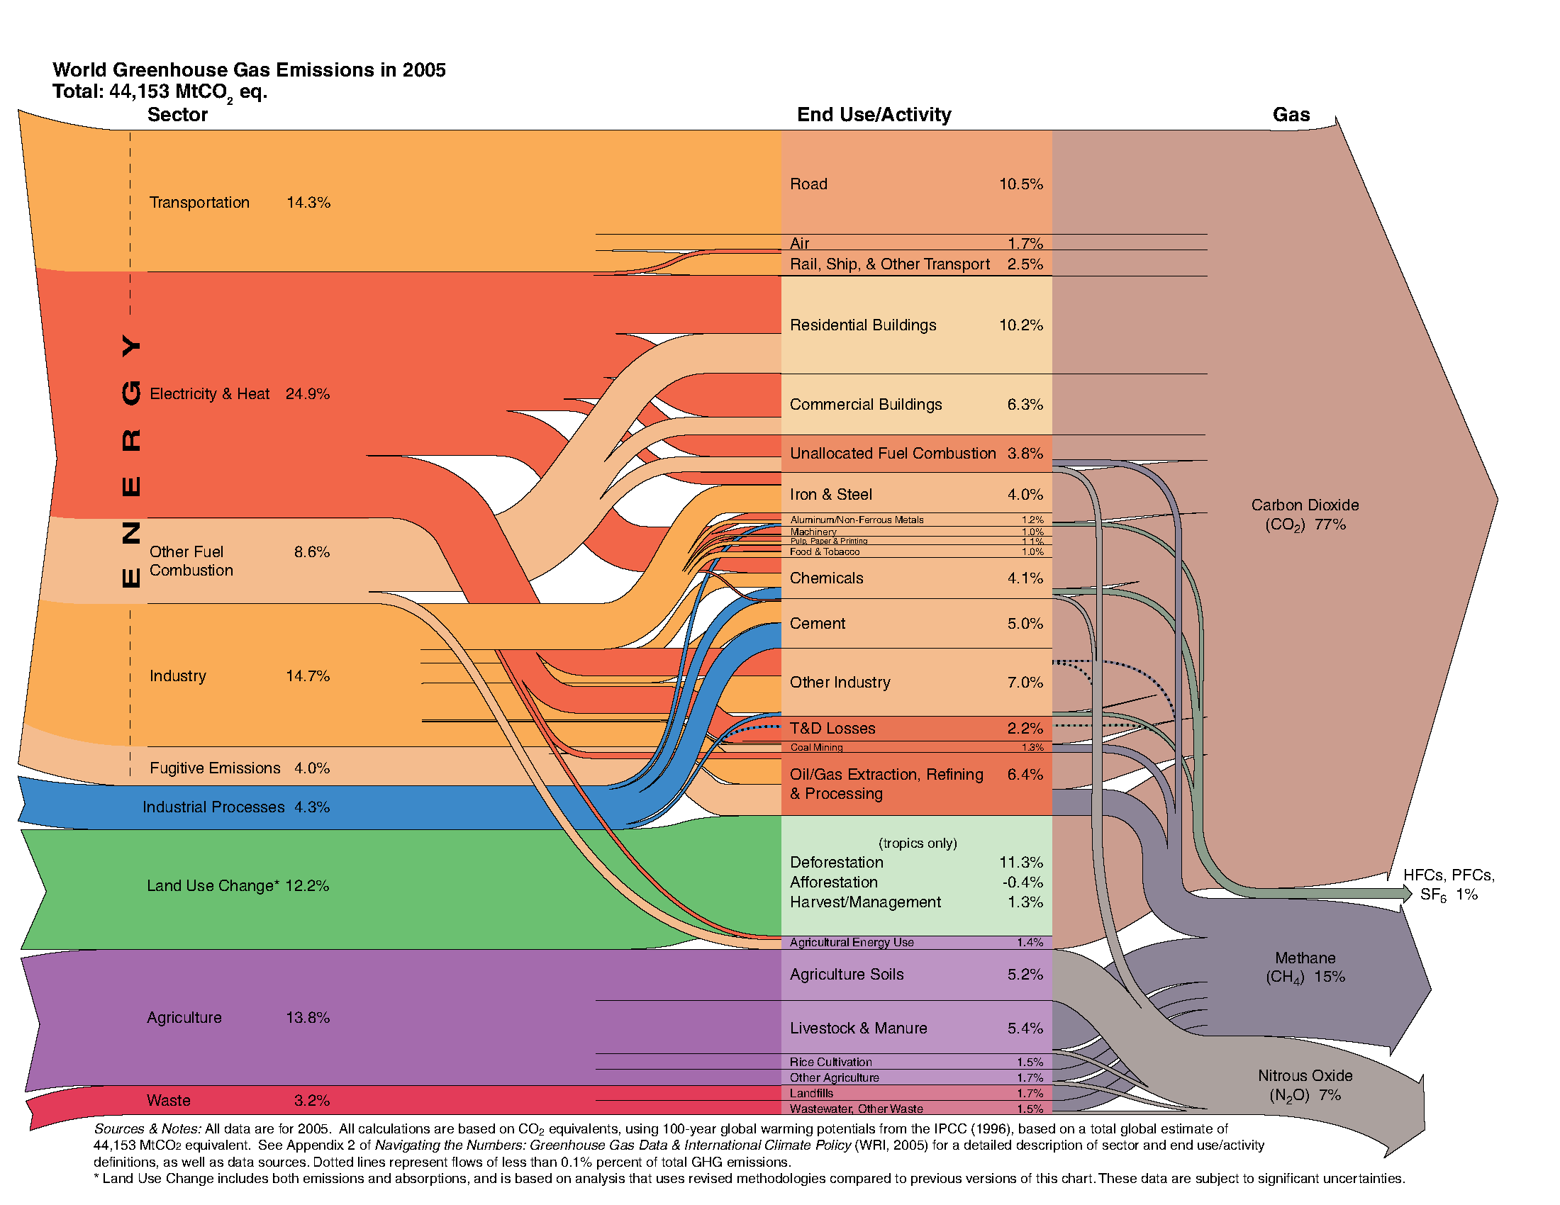
Globally, what are the main sources of GHG emissions?
Source: Herzog (2005) – World Resources Institute
Notes:
IPCC 4th assessment report:
Energy supply = 25.9% (vs. 24.9% here)
Industry = 19.4% (vs. 14.7% + 4.3% = 19.0% here)
Forestry = 17.4% (vs. 12.2% for ‘land use change’ here – difference explained by the fact that the WRI accounts for the net balance of emissions and absorptions, whereas the IPCC report accounts for emissions only)
Agriculture = 13.5% (vs. 13.8% here)
Transport = 13.1% (vs. 14.3% here)

Slide 27
What are the main consequences?
Biophysical impacts
Socioeconomic impacts
Changes in T°
Changes in rainfall patterns
Shifts in seasons
More frequent or severe storms, floods, droughts
Raised sea level
Erosion, desertification
Changes in water quality/availability
Changes in ecosystems
Biodiversity loss
Disease & pest outbreaks, ...
Damage to or destruction of infrastructure
Reduced food security, malnutrition
Economic disruption, loss of livelihoods, social disruption
Increased mortality and morbidity
Reduced availability of hydropower
Conflicts, population displacement, human migrations, ...

Slide 28
Recap – Key messages – Environment
The Earth has enjoyed a stable environment over the past 10,000 years, which is now being compromised due to human action (Holocene ➔ Anthropocene)
Thresholds in key variables are already being exceeded:
  Climate Change
  Loss of biodiversity
  Nitrogen cycle
Other variable are approaching safe limits, e.g.
  Phosphorous cycle
  Ocean acidification
For some we still don’t have enough data
  Chemical pollution
  Atmospheric aerosol loading

Slide 29
Recap – Key messages – Climate Change
Climate change is real, and is driven to a large
extent by emissions of greenhouse gases linked to human activities
  Fossil energy use, deforestation and agriculture are the main culprits
Climate change is notably characterised by rising temperatures, rising sea level, and more frequent/intense extreme weather events
Changes in climate system parameters generate a wide range of biophysical and socioeconomic impacts

Slide 30
Key references
UNEP (2012) Global Environment Outlook GEO5, Environment for the future we want. UNEP.
Millennium Ecosystem Assessment website: www.unep.org/meaweb/en/index.aspx
UNEP Environmental Data Explorer: http://geodata.grid.unep.ch/
IPCC (2007b) Climate Change 2007: The Physical
Science Basis. Cambridge University Press, Cambridge,
UK & New York, NY, USA
IPCC website: www.ipcc.ch
Volunteer-driven information website ‘CO₂ Now’: http://co2now.org/
WWF – Climate change explained: http://wwf.panda.org/about_our_earth/aboutcc/how_cc_works/

Slide 31
References
Berkeley Earth Surface Temperature Project: http://berkeleyearth.org
Hassan, R; Scholes, R; and Ash, N. (Eds.) (2005) Ecosystems and Human Well Being, Volume 1; Current State and Trends (Millennium Ecosystem Assessment). Island Press: Washington, Covelo, London.
Herzog T. (2005) World Greenhouse Gas Emissions in 2005. Working paper, World Resources Institute, Washington, DC. Available from: http://www.wri.org/publication/world-greenhouse-gas-emissions-in-2005
Hoekstra, A.Y. et al (2012) Global Monthly Water Scarcity: blue water footprints versus blue water availability. PLoS ONE /(2): e32688. doi: 10.1371/journal.pne.0032688.
IPCC (2007a) Climate Change 2007: Synthesis Report. Contribution of Working Groups I, II and II to the Fourth Assessment Report. [Core Writing Team, Pachaury R.K. & Reisinger A. (eds.)] Intergovernmental Panel on Climate Change, Geneva. Available from: www.ipcc.ch
IPCC (2007b) Climate Change 2007: The Physical Science Basis. Contribution of Working Group I to the Fourth Assessment Report of the Intergovernmental Panel on Climate Change [Solomon S., Qin D., Manning M., Chen Z., Marquis M., Averyt K.B. , Tignor M. & Miller H.L. (eds.)]. Cambridge University Press, Cambridge, UK & New York, NY, USA. Available from: www.ipcc.ch
Millennium Ecosystem Assessment (2005).
Pereira, H.M. et al (2010) Global biodiversity monitoring. Frontiers in Ecology and Environment, 8, 459-460.

Slide 32
References (2)
Petit J. & Prudent G. (eds) (2008, reprint 2010) Climate Change and Biodiversity in the European Union Overseas Entities. IUCN, Gland, Switzerland and Brussels, Belgium. Available from: http://data.iucn.org/dbtw-wpd/edocs/2010-064.pdf
Rockström et al (2009a) A safe operating space for humanity. Nature, Vol 461, 24 September, 2009.
Rockström et al (2009b) Planetary Boundaries: exploring the safe operating space for humanity. Ecology and Society, 14(2):32.
UNEP (2012) Global Environment Outlook GEO5, Environment for the future we want. UNEP.
WWF – Climate change explained: http://wwf.panda.org/about_our_earth/aboutcc/how_cc_works/

