Slide 1
Module 2
Understanding environment - climate change - development linkages
Country-led environmental and climate change mainstreaming (specialist course)
Training materials developed with the support of the European Commission

Slide 2
Environment, climate change and development

Slide 3
Development – Environment links
Climate,
environment &
natural resources
Mitigation
Adaptation
Human activities
Impacts
Opportunities, risks
& constraints
Notes:
Human activities (in context of development) can impact the environment and climate.
As well, the state of the environment and climate can offer opportunities, risks and constraints for development.
Sector-specific examples will follow.
When we are dealing with impacts from human activities, we have to mitigate such impacts. When facing opportunities, risks and constraints we have to adapt to these conditions.

Slide 4
Adaptation, mitigation and vulnerability

Slide 5
Vulnerability
Exposure
Sensitivity
Adaptive capacity
Age
Gender
Social group
Education
  Wealth
  Access to information and technology
  ‘Built’ and ‘green’ infrastructure
  Institutions
  Social organisation
  Culture
  Equity & (in)equality
  Development level
+
+
+
Resilience
-
Vulnerability
-
+
Adaptation
Maladaptation
Notes:
Indicate that the concept of vulnerability is normally used for the case of climate change, but it is equality valid for environment!
Exposure to climate change = the extent to which a system, individual or group is exposed to effects, considering that these effects may vary in nature and intensity across regions of the world.
Sensitivity to climate change = the degree to which a system, individual or group is affected, either positively or negatively, directly or indirectly.
Adaptive capacity = the extent to which a system, individual or group has the capabilities, and/or has access to the information, resources and institutions, required to adapt to climate change, notably through the adoption of risk prevention and mitigation measures; or: the property of a system to adjust its characteristics or behaviour, in order to expand its coping range under existing climate variability or future climate conditions (Brooks & Neil Adger 2004).
Resilience = the ability of a system, individual or group to absorb disturbances, and adapt to stress and change .
Vulnerability to climate change = the extent to which a system, individual or group of people is susceptible to, and unable to cope with, the adverse effects of climate change.
Maladaptation = an inadequate response to the challenge posed by climate change, by which ‘business-as-usual’ development interventions that overlook the implications of climate change inadvertently result in increased vulnerability to climate change; also, an inadequate adaptation response, which fails to reduce vulnerability to climate change and instead ends up increasing it.

Slide 6
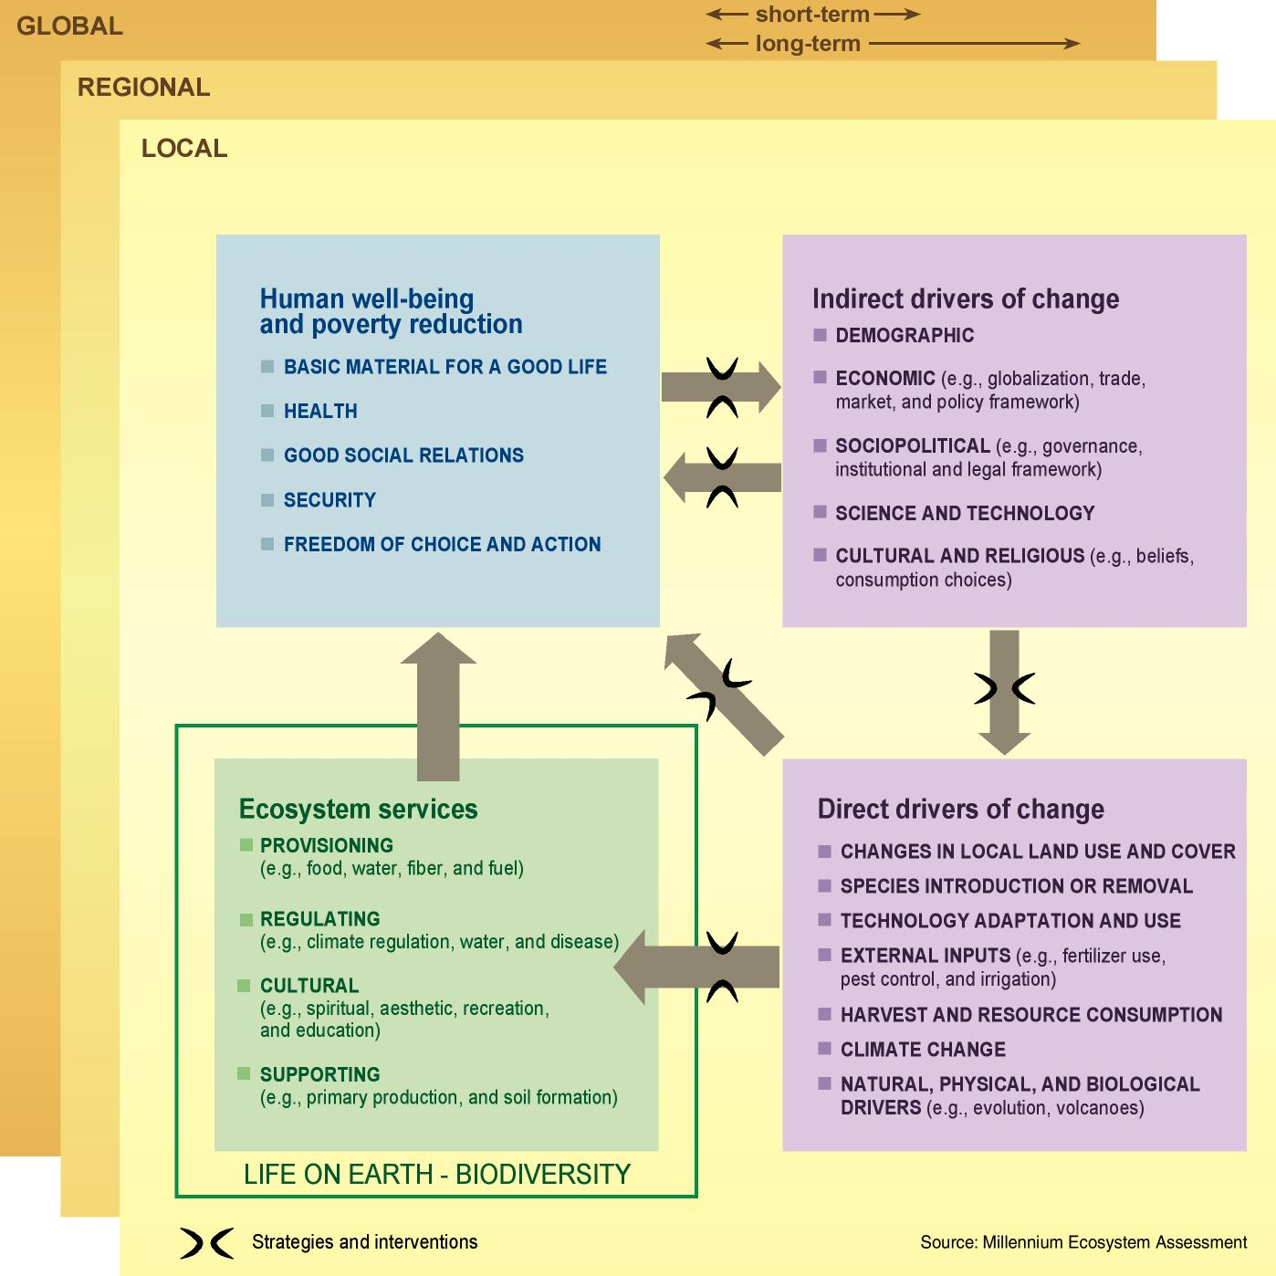
Environment – climate change –development linkages
Source: Millennium Ecosystem Assessment (2005) Figure B, p. 7.
Notes:
The concept of ecosystem services (as exposed here in this Millennium Ecosystem Assessment diagram) is very useful to begin understanding the relationship between a healthy state of the environment and social and economic ‘development’.
We have to keep in mind that this is an anthropocentric concept….and because of that a powerful one to make a case for environmental protection in the context of development.

Slide 7
Environment – climate change –development linkages
Climate change:
an environ-mental issue
- a development issue
Source: Millennium Ecosystem Assessment (2005) Figure B, p. 7.

Slide 8
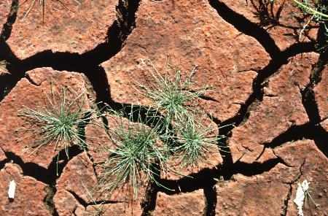
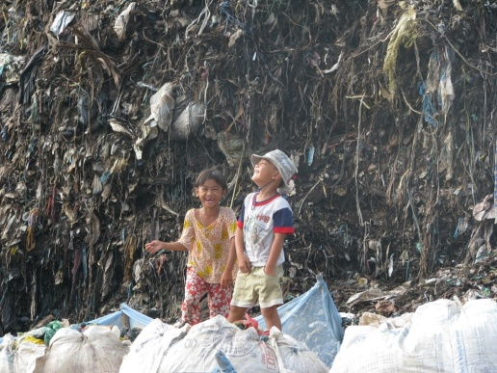
Climate change and environment
Climate change is a theme to be addressed
with other environmental issues:
  Climate change exacerbates certain environmental trends and problems
  Environmental management has an impact on climate change
Credit: Proyecto Rio Hurtado, EuropeAid Photo Library
Credit: Vietnamese journalist, EuropeAid Photo Library
Notes:
Climate change exacerbates certain environmental trends and problems:
e.g. desertification, freshwater scarcity, loss of biodiversity, air pollution
Environmental management has an impact on climate change:
e.g. waste management, soil management, land use planning and management

Slide 9
Sustainable development
Intimate links between state of environment – economic development and social development
Reflected in the concept of “sustainable development”
Which development path are we following?
Environment
Environment
Sustainable development
Economy
Social dimension
Social dimension
Economy
Notes:
Sustainable development as a concept was popularised with the Brundtland Report “Our Common Future” (1987). There are various definitions of “sustainable development”, but the current common understanding (certainly within the EU) is that sustainable development implies giving equal importance to the three dimensions of development: social, environmental and economic.
In practice this is seldom the case, and often environmental protection is downplayed.
We can make the audience reflect on what ‘development path’ their country/region is following and promoting? Normally the economic dimension will be more prominent, in detriment of the social and (lastly) the environmental.

Slide 10
For example…
AGRICULTURE
…does it impact on the environment and climate change?...

Slide 11
Agriculture
Contributes 13-15% of global carbon emissions (rising to 30-32% if we include land use change, land degradation and deforestation) (EC, 2012)
Is the main driver behind deforestation
Contributes to pollution of soil, air and water, and loss of biodiversity
  Leads to adverse health effects (direct and indirect)

Slide 12
AGRICULTURE
…is it affected by environmental degradation and climate change?...

Slide 13
Agriculture
Soil erosion and land degradation limit agricultural productivity in many developing countries
Freshwater availability and quality affect crop yields. Climate change is exacerbating these downward trends
Drought intensity and frequency are increasing in various countries due to climate change
Nearly 1 billion people live in chronic hunger, and by 2050 there will be a need to produce to to 70% more food globally (EC, 2012)

Slide 14
What about health?
In least developed countries, 1/3 of death and disease is a direct result of environmental causes (WHO, 2010)
Environmental factors influence 85 out of the 102 categories of disease and injury listed in The World Health Report (WHO)
Climate change that has occurred since the 1970s has caused over 140,000 excess deaths each year, and climate change is estimated to add at least US$2-4 billion in annual health sector costs (WHO, 2012)

Slide 15
…education?
In 1 out of 3 countries in sub-Saharan Africa with available data, more than half of the schools have no toilet and more than 50% of schools don’t have access to potable water (UNESCO UIS, 2012)
Malaria causes between 4-10 million days of school absenteeism per year (Partnership for Child Development et al, 2009)
In the year 2000 floods in Cambodia, at least 1,000 schools were destroyed and about 500,000 primary and secondary school children affected (ADPC, 2008)

Slide 16
Environment, Climate Change and MDGs
Soil erosion, salinisation, land degradation
Polluted water and air…
Reduce child mortality
Eradicate extreme poverty & hunger
Scarcity/quality of NR managed by women
e.g. Increased incidence of waterborne diseases
e.g. Adverse effects on food security
Promote gender equality & empower women
e.g. effects on school attendance
Achieving universal primary education
Potential impacts on MDGs
e.g. Dependence on livelihoods put at risk by CC
Environmental causes of disease
Improve maternal health
Ensure environmental sustainability
Combat major diseases
e.g. Higher incidence of anaemia resulting from malaria
e.g. Increased stress on ecosystems and biodiversity
e.g. Heat-related mortality & illnesses
Source: OECD (2009a)
Notes:
Environment and climate change are both related to MDGs, and thus require attention.

Slide 17
The continuum of issues
Vulnerability
Response to impacts
Addressing drivers of vulnerability
Building response capacity
Managing risk
Specifically confronting impacts
safeguarding NR e.g. biodiversity, forests, ecological water flows
e.g. awareness raising, institutional strengthening, capacity building, enhancing land use planning; IWRM, ICZM, IPM, EMS in industry
e.g. industrial risk management (OHSAS), emergency response systems
end-of-pipe solutions, does not address source of problems
environ-ment
e.g. measures aimed at human development; investment in education
e.g. drought resistant crop varieties, relocation, infrastructure
e.g. DRR, climate risk screening
climate change
adaptation benefits, developmental benefits as ‘side effect’
developmental and climate adaptation benefits
developmental benefits
adaptation benefits only
100
For measures targeting CC: benefits in the absence of climate change
0
Inspired on and Adapted from: McGray et al (2007), OECD (2009a), Olhoff & Schaer (2010)
Notes:
This continuum is equally relevant to environment as it is for climate change.
CLIMATE CHANGE:
Addressing the drivers of vulnerability:
e.g. Any measures aimed at reducing poverty and enhancing human development
Building the response capacity:
e.g. Awareness raising on climate-development linkages, institutional building, development of weather and climate monitoring systems, improvements in natural resource management and land use planning practices
Managing climate risk:
e.g. Development of disaster risk reduction plans, climate risk screening and assessment, resulting climate proofing of projects and infrastructure
Specifically confronting climate change:
e.g. Relocation in view of expected sea level rise, building of dikes
ENVIRONMENT
Addressing drivers of vulnerability:
Safeguarding ecosystem services, e.g. keeping minimum forest cover, maintaining ecological water flows in rivers, maintaining biological corridors, protecting biodiversity and genetic resources (including crop varieties).
Building response capacity
Same as for climate change
Managing risk
Does not necessarily address the source of problems.
Specifically confronting impacts
Waste water treatment
Waste disposal
Air filters
Use of fertilisers to compensate for soil degradation
Drilling of wells to compensate for drops in freshwater availability from river flows or polluted water

Slide 18
Positive and negative poverty-environment linkages
Win-Lose
Environmental management that excludes local communities (e.g. lack of benefit-sharing, dislocation of communities)
Win-Win
Sustainable livelihoods (e.g. sustainable agriculture, forestry, fisheries, ecosystem management, adaptation to climate change)
Environmental preservation
Lose-Lose
Lack of or inadequate environmental management negatively affecting the poor (e.g. lack of adaptation to climate change, poor environmental health conditions)
Lose-Win
Short-term livelihoods (e.g. overgrazing, overfishing, deforestation)
Poverty reduction
Source: UNDP-UNEP (2009), p.8

Slide 19
Moving to green, climate-resilient and
low-emission development

Slide 20
Green development
Planning within constraints of environmental carrying capacity
  Q: If we take away the external inputs, will the system sustain itself?
Protection of ecosystem services
Consistency between sectoral development objectives
Environmental resilience-building requires actions on the social and the environmental spheres
  Decreased vulnerability of humans and ecosystems increases resilience
Notes:
The concept of resilience is potentially very useful to guide policy-making and planning processes, although it can be difficult to translate into practice. Nevertheless it sets the requirement to look for thresholds that should not be exceeded, e.g.
Ecological water flows in river systems (e.g. in relation to dams, water use rights….)
Biological corridors (e.g. in relation to system of protected areas and biodiversity protection)
Air quality standards
Water quality standards
Effluent discharge standards

Slide 21
Climate-resilient development
Biophysical impacts
Socioeconomic impacts
The develop-ment path addresses current and future vulnerability, risks and impacts
Vulnerability
factors
Climate risk management
Development (vulnerability reduction) activities
Climate risk management
Specific adaptation measures
Specific adaptation measures
Response capacity building

Slide 22
Low-emission development
Generally, the three ‘sectors’ that are the biggest contributors to GHG emissions are also the main targets for emission reductions:
Country-specific emission patterns and development objectives should be considered to determine national mitigation priorities
The development path addresses sources of emissions
Energy (fossil-fuel burning)
Agriculture
Land use change esp. deforestation
22
Notes:
Generally speaking, the largest potential for curbing GHG emissions lies in:
* improving energy efficiency (across all uses/sectors)
* relying more significantly on low-emission technologies to generate heat and power
* opting for more sustainable modes of transport
* curbing deforestation (and stopping desertification)
* modifying agricultural practices, e.g.
- more efficient use of nitrogen-based fertilisers
- improved management of manure
22

Slide 23
Building on Multilateral Environmental Agreements’ commitments
MEAs require elaboration of diagnoses and Action Plans, e.g.
  Convention on Biological Diversity (CBD); Desertification (UNCDD); wetlands (Ramsar); POPs (Stockholm Convention); etc.
These are a good starting point for addressing the environmental challenge
They require COORDINATION and HARMONISATION amongst them and with national and sectoral policy-making and planning processes
Notes:
Mitigation priorities for developing countries include:
promoting energy efficiency
including in urban development and transport policies
Including dismantling of fuel subsidies and other barriers/disincentives
opting for low-emission, renewable sources of energy
designing policies that balance competing objectives:
sustained economic growth
improved access to energy for the poor
enhanced energy security
improved environmental outcomes
considering land-use related options, if relevant in view of national circumstances

Slide 24
Building on NAPAs and NAMAs
Many developing countries have now
submitted their NAPAs (& NAMAs) to the UNFCCC
  NAPAs = national adaptation programmes of action
    Help LDCs build national capacities and identify priority adaptation projects with developmental benefits
  NAMAS = nationally appropriate mitigation actions
    These voluntary mitigation measures are consistent with a country’s development strategy, and are meant to put it on a more sustainable development path
These are a good starting point for addressing the climate challenge without compromising development objectives
Notes:
Mitigation priorities for developing countries include:
promoting energy efficiency
including in urban development and transport policies
Including dismantling of fuel subsidies and other barriers/disincentives
opting for low-emission, renewable sources of energy
designing policies that balance competing objectives:
sustained economic growth
improved access to energy for the poor
enhanced energy security
improved environmental outcomes
considering land-use related options, if relevant in view of national circumstances

Slide 25
Moving to green, climate-resilient and low-emission development
Environmental and climate-resilient development and low-emission development result from mainstreaming in policymaking and planning
Environmental mainstreaming
Green development
The three approaches are complementary
Climate change adaptation mainstreaming
Climate-resilient development
In all cases, focus on co-benefits
Mainstreaming of climate change mitigation
Low-emission development
25
Notes:
.
25

Slide 26
Seizing opportunities
Green growth
  ‘A way to pursue economic growth and development, while preventing environmental degradation, biodiversity loss and unsustainable natural resource use’
Green jobs
Adaptation and mitigation as ‘opportunities’: development co-benefits
  e.g. renewable energy
  e.g. clean technologies
  e.g. forestry (REDD+)
  e.g. agricultural productivity
Source: OECD (2010b)
Notes:
OECD (2010b) – Green growth strategy:
* ‘Aims at maximising the chances of exploiting cleaner sources of growth, thereby leading to a more environmentally sustainable growth model’
* Green growth is relevant to both developed and developing countries
‘Green jobs’:
jobs associated with the deployment of clean technologies and the adoption of improved environmental practices
may be related to both adaptation and mitigation
possible sectors include renewable energy, public transport, clean technologies, building and construction industry, recycling, retail, agriculture (e.g. soil conservation, water efficiency), forestry (e.g. afforestation, reforestation, sustainable forestry, agroforestry)
active training and capacity building policies required
Dervis et al., The Brookings Institution (2009):
* ‘As long as the problem is perceived as a trade-off between improving living standards and the health of the planet, then the ability of countries to alleviate climate change will be severely constrained’
* We must ‘devise strategies to revitalize the global economy that can be both climate conscious and climate resilient’
* Trade-offs will always exist, but in a long-term perspective, the transition towards a low-emission economy can accelerate sustainable growth

Slide 27
Developing synergies: green development - climate change adaptation & mitigation
Quite frequently measures aimed at green development, adaptation and mitigation
reinforce each other
  e.g. reduced tillage agriculture enhances carbon sequestration in soils while supporting soil moisture retention - increasing resilience to dry spells – and reducing soil erosion
  e.g. sustainable reforestation may simultaneously enhance carbon stocks, enhance the adaptive capacity of local communities (by offering new livelihood opportunities), act as protection against soil erosion, enhance water capture, and increase biodiversity

Slide 28
Developing synergies: green development - climate change adaptation & mitigation
Mitigation should:
  Be compatible with adaptation policies and requirements
  Rely on environmentally sustainable practices
    e.g. unsustainable agrofuels may be a threat to food security, water availability and ecosystems
  Not result in increased vulnerability to climate change
Adaptation should:
  Consider emissions and environmental impacts, e.g.
    agricultural intensification addressing food security may increase GHG emissions from use of fertilisers and increase water pollution
    increased adoption of air conditioning to adapt to heat waves may result in increased emissions from fossil energy use
    water capture to address drought periods may affect biodiversity, and irrigation systems may lead to soil salinisation
28
Notes:
28

Slide 29
Recap – Key messages
Environment and climate change are intimately related to development
  development initiatives affect the environment and contribute to climate change
  state of the environmental and climate change affect development
There is a continuum of responses to address environmental sustainability and climate change, from addressing drivers of vulnerability to specifically confronting impacts

Slide 30
Recap – Key messages (2)
The path to development should be planned so as to be green, climate-resilient and low-emission
Environmental sustainability, adaptation and mitigation are complementary responses with potential to generate significant ‘co-benefits’ in terms of development

Slide 31
Key references
European Commission (2009) Guidance on the Integration of Environment and Climate Change in Development Cooperation. EuropeAid Tools and Methods Series, Guidelines No 4. Available from: http://ec.europa.eu/europeaid/infopoint/
IPCC (2007c) Climate Change 2007: Impacts,
Adaptation and Vulnerability. Cambridge University Press, Cambridge, UK & New York, NY, USA. Available from: www.ipcc.ch
IPCC (2007d) Climate Change 2007: Mitigation of Climate Change. Cambridge University Press, Cambridge, UK & New York, NY, USA. Available from: www.ipcc.ch

Slide 32
References (1)
ADPC (2008) A study on impact of disasters on the education sector in Cambodia. Available from: http://www.adpc.net/v2007/ikm/ONLINE%20DOCUMENTS/downloads/2008/Mar/MDRDEducationCambodiaFinal_Mar08.pdf
European Commission (2009) Guidance on the Integration of Environment and Climate Change in Development Cooperation. EuropeAid Tools and Methods Series, Guidelines No 4. Available from: http://ec.europa.eu/europeaid/infopoint/
European Commission (2012) Integration of environment, climate change and the green economy in the agricultural sector. Unpublished draft.
IPCC (2007c) Climate Change 2007: Impacts, Adaptation and Vulnerability. Contribution of Working Group II to the Fourth Assessment Report of the Intergovernmental Panel on Climate Change [Parry M.L., Canziani O.F., Palutikof J.P., van der Linden P.J. & Hanson C.E. (eds.)]. Cambridge University Press, Cambridge, UK & New York, NY, USA. Available from: www.ipcc.ch
IPCC (2007d) Climate Change 2007: Mitigation of Climate Change. Contribution of Working Group III to the Fourth Assessment Report of the Intergovernmental Panel on Climate Change [Metz B., Davidson O.R., Bosch P.R., Dave R. & Meyer L.A. (eds.)]. Cambridge University Press, Cambridge, UK & New York, NY, USA. Available from: www.ipcc.ch
McGray H., Hammill A. & Bradley R. (2007) Weathering the Storm: Options for Framing Adaptation and Development. World Resources Institute, Washington, DC. Available from: http://pdf.wri.org/weathering_the_storm.pdf
Millennium Ecosystem Assessment (2005) Ecosystems and Human Well-being: Synthesis. Island Press, Washington, DC. Available from: http://www.maweb.org/en/Synthesis.aspx

Slide 33
References (2)
OECD (2009a) Integrating Climate Change Adaptation into Development Co-operation: Policy guidance. OECD Publishing, Paris. [Read-only, browse-it edition] Available from: http://browse.oecdbookshop.org/oecd/pdfs/browseit/4309171E.PDF
OECD (2010b) Interim Report of the Green Growth Strategy: Implementing our commitment for a sustainable future. Meeting of the OECD Council at Ministerial Level, 27-28 May 2010. C/MIN(2010)5. Organisation for Economic Cooperation and Development, Paris. Available from: http://www.oecd.org/document/3/0,3343,en_2649_37465_45196035_1_1_1_1,00.html
Olhoff A. & Schaer C. (2010) Screening tools and guidelines to support the mainstreaming of climate change adaptation into development assistance: A stocktaking report. Environment & Energy Group, United Nations Development Programme, New York. Available from: http://www.undp.org/climatechange/library_integrating_cc.shtml
Partnership for Child Development; London School of Hygiene and Tropical Medicine; Kenya Medical Research Institute-Wellcome Trust Research Programme and The World Bank (2009). Malaria Control in Schools, a toolkit on effective education sector responses to malaria in Africa. Available from: http://www.schoolsandhealth.org/Documents/Malaria%20Toolkit%20for%20Schools%202009.pdf
UNESCO UIS (2012) School and teaching resoures in sub-Saharan Africa, Analysis of the 2011 UIS regional data collection on education. Available from: http://www.uis.unesco.org/FactSheets/Documents/ib9-regional-education-africa-2012-en-v5.pdf

Slide 34
References (3)
WHO (2006) Preventing disease through healthy environments – towards an estimate of the environmental burden of disease. WHO.
WHO (2010) WHO Fact File: 10 facts on preventing disease through healthy environments. Available from: http://www.who.int/features/factfiles/environmental_health/en/index.html
WHO (2012) WHO Fact File: Climate change and health. Available from: http://www.who.int/mediacentre/factsheets/fs266/en/

