Slide 1
Module 4
Understanding and planning under uncertainty
Country-led environmental and climate change mainstreaming (specialist course)
Training materials developed with the support of the European Commission

Slide 2
Sources of uncertainty in relation to climate change

Slide 3
Socio-economic uncertainties
Socio-economic uncertainties (e.g. related to future population growth, economic growth, technological choices, societal choices, international relations):
  influence the level of future emissions and thus the magnitude of climate change
  also, create uncertainties about future vulnerability to climate change

Slide 4
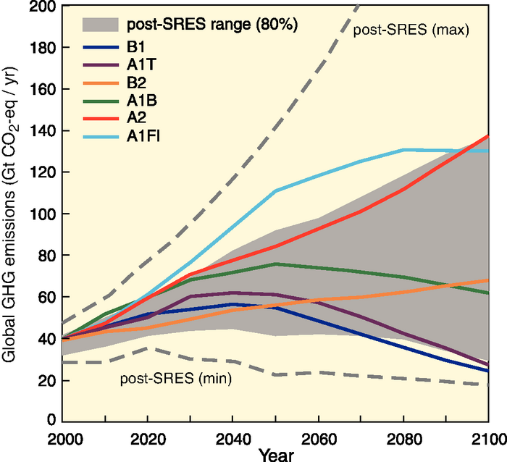
IPCC GHG emission scenarios
Source: IPCC (2007a) 4th Assessment report – Synthesis report, Fig. 3.1
Notes:
IPCC Special Report on Emission Scenarios (SRES, 2000): 4 scenario families using different assumptions on the evolution of emission drivers:
* A1: rapid economic growth, population stabilising in 2050, rapid introduction of more efficient technologies (with 3 sub-scenarios: A1FI = fossil-intensive, A1T = non-fossil energy, A1B = balanced use of energy sources).
* A2: rapid population growth, slower & more fragmented economic development, slow adoption of new technologies.
* B1: similar to A1 but more rapid transition to a service and information economy, and reduction in material intensity.
* B2: intermediate population and economic growth, local solutions to economic/social/environmental sustainability.
Higher end of the range: A1FI and A2. GHG concentrations does not stabilise.
Middle-range scenarios: A1B and B2. GHG concentrations stabilise at, respectively, 750 and 650 ppm.
Lower end of the range: B1 and A1T. GHG concentrations stabilise at, respectively, 550 and 650 ppm.

Slide 5
Climate uncertainties
For any given emission scenario, different atmosphere-ocean general circulation models (AOGCMs) provide different projections of future change – sometimes very different ones
Due to the complexity of the climate system, many uncertainties prevail and will persist over the evolution of climate
Notes:
AOGCMs = mathematical representations of the earth’s climatic system, which link the atmosphere, ocean, land, and biosphere both vertically and horizontally in a series of 3-dimensional grid boxes that partition the earth into layers and grids (Jones & Mearns 2004). They simulate future climate change by gradually increasing the level of radiative forcing.
WDR 2010: «Uncertainty: An expression of the degree to which a value (such as the future state of the climate system) is unknown. Uncertainty can result from lack of information or from disagreement about what is known or even knowable. It may have many types of sources, from quantifiable errors in the data to uncertain projections of human behavior. Uncertainty can therefore be represented by quantitative measures, for example, a range of values calculated by various models, or by qualitative statements, for example, reflecting expert judgment. However, in economics, uncertainty refers to Knightian uncertainty, which is immeasurable. This is in contrast to risk, wherein the occurrence of certain events is associated with a knowable probability distribution. »

Slide 6
Uncertainties in climate change projections
Temperatures and sea levels:
  consensus that they will increase
  magnitude of the increase quite uncertain
Rainfall:
  expected to increase overall
  but some regions are likely to get more and some less
  for many regions in the world, uncertainty about the direction of change
Changes in extreme parameters:
  average future conditions are easier to project than extremes
Notes:
These uncertainties arise from:
Uncertainties in the amount of future emissions;
Uncertainties about the relationship between the rate of GHG emissions and their concentration in the atmosphere;
Uncertainties about the extent of the warming that results from any given change in atmospheric GHG concentration;
The complexities of the climate system.
OECD (2009a), Section 2:
‘In general, high-latitude areas will see increased precipitation; mid-latitude areas will see a mix of changes, many subtropical areas will see a decrease in precipitation, and many equatorial areas could have increased precipitation. There are likely to be substantial variations in changes in precipitation patterns in particular regions within these latitudinal ranges. The seasonality of precipitation patterns is also likely to change in many locations.’

Slide 7
Problems associated with downscaling
AOGCMs produce projections of future climate change for large areas (e.g. 200x200 km) – but used alone, do not allow the downscaling of projections to local and regional scales (e.g. 10x10 km, 100x100 km)
Downscaling requires extra data and efforts
  In developing countries, the data needed to downscale projections of climate change to the local or regional level are often missing
  The level of uncertainty is greater at downscaled levels than at large scales
Notes:
AOGCMs: grid box resolutions in the order of 100-500 km per side.
World Bank – WDR 2010:
Downscaling requires extra data and efforts:
* Dynamic downscaling uses high resolution models for a particular region run within a large-scale global model .
* Statistical downscaling uses statistical relationships that link the large-scale atmospheric variables with local or regional climate variables.

Slide 8
Planning in the face of climate change uncertainties

Slide 9
The cost of inaction
The uncertainties surrounding climate change are often invoked to justify inaction
In a medium- to long-term perspective, however, inaction now is likely to be more costly:
Failure to adapt
Failure to reduce emissions
*Wasted investment
*Increased vulnerability
*More harmful impacts
*Higher adaptation costs
Notes:
Adaptation – OECD (2009): “The effect of discounting would normally favour a delay in adaptation (...). However, there is also a class of adaptations where early action is cheaper. They include adjustments to long-term development plans and long-lived infrastructure investments (...). In each of these cases, it will be cheaper to make adjustments early, in the design phase of the project, rather than incur the cost and inconvenience of expensive retrofits.” The same applies to land use policies and long-term development plans.
Mitigation – Stern Review: «The benefits of strong, early action on climate change considerably outweigh the costs». What we do in the next 10 or 20 years can have a profound effect on the climate in the second half of this century and in the next. Mitigation must be viewed as an investment to avoid the risks of very severe consequences in the future.
The social cost of carbon under the business-as-usual scenario is about $85/tonne of CO2 – well above marginal abatement costs in many sectors.
If a path towards stabilisation of atmospheric concentration of GHGs at 550ppm CO2e is adopted, then the net present value of benefits over costs is around $2.5 trillion. With a target of 450-550 ppm CO2e, then the social cost of carbon is in the region of $25-30 per tonne of CO5 – about one-third of the cost under the BAU scenario.
The social cost of carbon is likely to increase steadily over time because marginal damages increase with the stock of GHGs in the atmosphere. Policies should thus aim for a gradual intensification of marginal abatement efforts, while supporting the development of technologies that reduce abatement costs.
The annual costs of stabilisation at 500-550ppm CO2e are estimated to be around 1% of GDP by 2050 - a level that is significant but manageable.

Slide 10
The benefits of action
Some climate adaptation and mitigation
measures are expected to provide developmental benefits, regardless of the scope and magnitude of climate change or, as far as mitigation is concerned, regardless of carbon prices
Even in the face of uncertainty, some types of measures are justified

Slide 11
Justified measures in the face of uncertainty (1)
‘No-regret’ measures:
  those expected to produce net benefits for society
  even in the absence of climate change (adaptation) or independently of any ‘reward’ for mitigation (zero or negative net cost at a zero carbon price)
‘Low-regret’ measures:
  those expected to have a cost for society, but an acceptable one in view of the benefits they would bring if climate change turns out to produce significant effects (adaptation), or to have a low net cost at zero or low carbon prices (mitigation)
Notes:
World Bank (2010c):
(No- and) low-regret measures include most of the ‘soft’ adaptation measures, which enhance development and welfare across all or most climate change scenarios including the no-change scenario.

Slide 12
Justified measures in the face of uncertainty (2)
‘Robust’ measures:
  those that produce net benefits or deliver good outcomes across various possible climate change or carbon price scenarios and economic development scenarios (rather than just under the ‘most likely’ scenario)

Slide 13
Adaptive management
Adaptive management: a flexible and
pragmatic type of management, aimed at continually improving management policies and practices, on the basis of ‘learning by doing’
  Uses pilot projects and experiments; results and outcomes are analysed and lessons learnt before scaling up or adjusting responses
  Involves robustness as a decision criterion, the inclusion of safety margins in investment and the choice of reversible/flexible options
Well suited to situations involving uncertainties
Notes:
WDR 2010 – Glossary – Definition of ‘adaptive management’: “A systematic process for continually improving management policies and practices by learning from the outcomes of previously employed policies and practices, through an explicitly experimental approach.”
WDR 2010 – Other characteristics of adaptive management:
Adaptive management has a long time horizon for planning and capacity building
Uses forward-looking scenario analysis and an assessment of strategies under a wide range of possible futures, with periodic review of investment, policies and practices based on iterative learning.
Entails continuous information development, flexible and robust planning and design, participatory implementation, and monitoring and evaluation of feedback.
Stresses management informed by scientific and local knowledge, as well as policy experiments that develop understanding, set learning as an objective, and improve the ability to make decisions under uncertainty.
Involving stakeholders in planning increases ownership and the likelihood that actions will be sustained. Adaptive management involves broad stakeholder participation (including research centers and non-government organizations) in problem solving and decision making.

Slide 14
Scenario-based planning (1)
To support the choice of adaptation measures, scenarios reflecting prevailing uncertainties can
also be developed, e.g.
1) No change
2) Moderate change
3) High change
1) No change
2) Temperatures up, rainfall up
3) Temperatures up, rainfall down
Notes:
* ‘No change’ (= baseline): based on continuation of historical weather patterns.
* ‘Moderate change’: based on average forecasts of climate change, using available studies and expert knowledge.
* ‘High change’: based on the outer range of climate change forecasts, using available studies and expert knowledge.
* Higher temperatures combined with an increase as well as a decrease in rainfall.
UNDP (2004) – Adaptation Policy Frameworks “Assessing future risks”:
A scenario is ‘a coherent, internally consistent and plausible description of a possible future state of the world’. ‘Scenarios can range from the simple to the complex, and from the qualitative to quantitative, encompassing narrative descriptions of possible futures to complex mathematical descriptions combining mean climate changes with climate extremes.’

Slide 15
Scenario-based planning (2)
Contents of scenarios
Scenario development
Changes in climate conditions
Key experts with a range of technical skills
Resulting biophysical effects
Other national stakeholders
for their knowledge of local conditions
(e.g. government and civil society organisations)
Resulting socio-economic impacts

Slide 16
Scenario-based planning (3)
Once scenarios have been designed:
1) Identify potentially suitable adaptation or mitigation options
2) Calculate costs and benefits for each chosen scenario
3) Compare costs and benefits across the various scenarios
4) Identify no-regret, low-regret and robust options/measures

Slide 17
Illustration and discussion

Slide 18
Recap – Key messages
Many uncertainties prevail and will persist over
the evolution of the climate
  Combination of socioeconomic uncertainties and climate-related uncertainties / modelling limitations
  Downscaling of projections remains difficult
Uncertainties do not justify inaction
  Look for no-regret, low-regret and robust measures
Adaptive management and scenario-based planning support planning under conditions of uncertainty

Slide 19
Key references
Economics of Climate Adaptation Working Group
(2009) Shaping climate-resilient development: a framework for decision-making. Climate Works Foundation, Global Environment Facility, European Commission, McKinsey & Company, The Rockfeller Foundation, Standard Chartered Bank & Swiss Re
World Bank – Climate Change Knowledge Portal: http://sdwebx.worldbank.org/climateportal/

Slide 20
References
Economics of Climate Adaptation Working Group (2009) Shaping climate-resilient development: a framework for decision-making. Climate Works Foundation, Global Environment Facility, European Commission, McKinsey & Company, The Rockfeller Foundation, Standard Chartered Bank & Swiss Re. Available from: http://www.mckinsey.com/clientservice/Social_Sector/our_practices/Economic_Development/Knowledge_Highlights/Economics_of_climate_adaptation.aspx
IPCC (2007a) Climate Change 2007: Synthesis Report. Contribution of Working Groups I, II and II to the Fourth Assessment Report. [Core Writing Team, Pachaury R.K. & Reisinger A. (eds.)] Intergovernmental Panel on Climate Change, Geneva. Available from: www.ipcc.ch

