Slide 1
Module 6
Mainstreaming in national, sector and sub-national policies, strategies and programmes
Country-led environmental and climate change mainstreaming (specialist course)
Training materials developed with the support of the European Commission

Slide 2
Why mainstream environment and climate change at the national, sector and sub-national levels?

Slide 3
Why mainstream at strategic planning levels?
National level
State of the Environment
Sector coordination
Sector 1
bio-physical
impacts
More: -integrated -effective-efficient-sustainable responses
Climate
Change
Sector 2
Allocation of resources across sectors
socio-economic impacts
Sector 3
Socio-economic situation
Notes:
The State of the Environment and the Socio-economic situation both affect performance of different sectors (e.g. eroded grazing lands affect agriculture [e.g. critical in Lesotho]; large out-migration affects agricultural productivity [e.g. critical in Moldova]).
Sector development (planned and unplanned) also have impacts on the state of the environment and on the socio-economic situation (e.g. increase in use of pesticides as a policy for agricultural development can lead to water pollution and health impacts; construction of roads can fragment habitats and biological corridors).
The state of the environment also affects the socio-economic situation, and vice versa (e.g. low agricultural productivity is an incentive for migration and can also be an incentive for deforestation; water pollution affects health).
Linkages between the biophysical and socio-economic impacts of climate change are such that any specific effect tends to have implications in multiple sectors.
Any response, to be effective, thus also requires intersectoral coordination and integrated approaches.
Scarce resources must be allocated across sectors in the most efficient possible manner.
More integrated responses
* based on a more comprehensive understanding of linkages, opportunities, risks and constraints
More effective responses
* through better coordination across sectors and between various levels of governance
More efficient responses
* through more enlightened prioritisation and allocation of resources
Resulting in more sustainable responses

Slide 4
Why mainstream at strategic planning levels?
National level
Sector level
Overall guiding policy framework
Operationalisation and implementation of national policies
National legislation/regulation
Sector-specific legislation/regulation
Exercise of some key functions
Own initiatives, development of capacities & good practices
Management of international relations
Transboundary cooperation on environment and climate-relevant issues
Wider pool of resources
Wider ownership of response
More widespread capacity and institution building
Adapted from: OECD (2009a)
Notes:
Mainstreaming at strategic levels complements adaptation/mitigation projects and supports better integration than standalone climate action plans (although a climate action plan may be an outcome of the mainstreaming process).
The national level provides the overall guiding policy framework within which “lower” levels (sectoral and sub-national) operate.
Sector policies and programmes directly contribute to the operationalisation and implementation of national policies/strategies.
Some key functions are best exercised at national level (e.g. collection and analysis of climate-related data, setting up of early warning systems, overall disaster risk reduction planning).
In the absence of a national-level response to climate change, sector-level initiatives may start developing capacities and good practices.
National as well as sector-specific legislation/regulations: (i) affect vulnerability and adaptive capacity, and (ii) create incentives and disincentives to engage in climate adaptation and mitigation.
The national level manages international relations. This is important for shared resource management (e.g. cross-border river basins), for the implementation of international treaties including the UNFCCC, for aid coordination, ...
Sector-specific bodies are sometimes involved in transboundary cooperation on climate-relevant issues (e.g. river basin management).

Slide 5
Why mainstream at lower levels of governance?
Best levels for observing / understanding development, environmental and climate change impacts
Vulnerability and adaptive capacity are context-specific
Sub-national and local levels
Most options to respond to environmental degradation and adapt to CC require local implementation
Potential for piloting / pioneering initiatives
Adapted from: OECD (2009a)

Slide 6
Key stakeholders and cross-level interactions

Slide 7
Key stakeholders
Ministries of Finance, Planning, Development
Ministries with sector-specific competences
Sector management agencies
Donor agencies
Members of Parliament
Sub-national / local governments
Civil society organisations
Local citizens
& organisations
Private sector
Research
organisations
Local private sector
Media

Slide 8
Approaches to respond to environmental degradation and adapt to climate change
National policies & strategies
National level incl. sectors
Model- and scenario-driven
Focused on physical impacts and ‘biophysical vulnerability’
Stakeholder approach
Focused on prevailing socio-economic & environmental conditions and on ‘social vulnerability’
Response to environmental degradation
Top-down
Bottom-up
Adaptation to climate change
Subnational levels (local in particular)
Community-based response, pilot projects
Freely adapted from Dessai & Hulme (2004)

Slide 9
Main entry points for mainstreaming in
strategic policy and planning processes

Slide 10
Main entry points in the national and sector policy cycles
Recognise environment-development links and climate risks
Allocate funding for environmental and climate-specific actions
Include env’t and climate considera-tions in project selection criteria
Policy cycle stage | National level | Sector level
Policy formulation | National long-term vision National policies and strategies | Sector policies and strategies
Planning | Multi-year development plan | Sectoral plans
Resource allocation | National budget Environment and climate-related fund(s) | Sector budget envelopes Resources from fund(s)
Programming & implementation | Sector-level development plans and budgets | Sector programming
Include environment- and climate-related programmes/ projects (sectoral and cross-sectoral)
Incorporate environment and climate-related activities
Relocate funding to vulnerable or priority sectors/ regions
Adapted from: Olhoff & Schaer (2010) Fig. 1, p. 10

Slide 11
Tools for mainstreaming environment and climate change in strategic policy and planning processes

Slide 12
Tools supporting awareness raising...
... are also useful for influencing policies and informing planning processes
Integrated ecosystem assessments
Vulnerability and adaptation assessments
Awareness raising
Macro and meso economic analysis
Influence on policies
Demonstration projects
Knowledge, communication and advocacy strategy
Adapted from: UNDP-UNEP (2009, 2011)

Slide 13
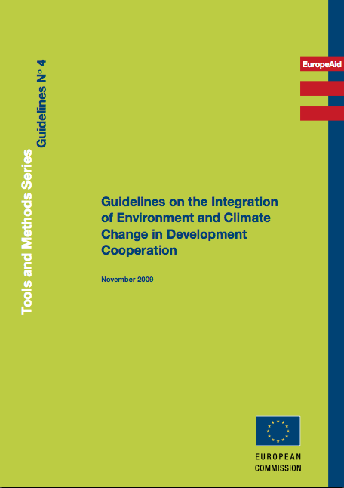
EuropeAid’s Guidelines on integration of environment and climate change
Annex 1
  General environmental issues in cooperation focal areas
Annex 3
  Guidance for integrating environmental and climate-related aspects in SPSP formulation studies
Annex 9
  Guidelines for integrating environmental and climate related aspects in project formulation studies

Slide 14
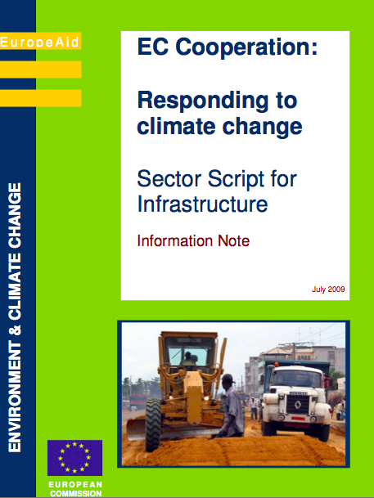
EuropeAid’s climate change sector scripts
Agriculture and rural development
Ecosystems and biodiversity management
Education
Energy supply
Health
Infrastructure
Solid waste management
Trade and investment
Water supply and sanitation

Slide 15
Strategic environmental assessment (SEA)
An iterative and participative process:
  aimed at analysing the potential environmental consequences of proposed policies/plans/programmes, as well as the main environmental opportunities, risks and constraints to be taken into account
  taking into consideration the expected effects of climate change
  for the purpose of promoting more sustainable development
Ensures that environmental considerations are taken into account EARLY in the policy & planning process
Notes:
A policy is a general course of action or proposed overall direction (“road map”) that a government is pursuing or intends to pursue, and which guides all “downstream” decision making; it usually reflects a long-term vision, defines high-level objectives and sets a number of priorities and rules.
A plan is a purposeful, forward-looking strategy, setting more precise objectives and coordinated priorities, that elaborates a policy and provides a framework for its implementation; it should ideally link objectives and priorities with the identification of required resources.
A programme is a coherent, organised agenda or schedule of commitments, investments, projects and/or activities that elaborate and implement a plan and/or policy; it is the operational translation of a strategy, and will usually include a more detailed allocation of resources, as well as specific objectives to be achieved during a given time frame.
A project is a coherent set of activities that together, based on a detailed design, are expected to lead to the achievement of a specific objective.

Slide 16
Approaches to SEA
Ideally SEA prepared as an integral component of the policy-making or planning process, or in parallel
Often SEA prepared once draft P/P/P is ready
For a model of ToR, see handout or EC Guidelines on the Integration of Environment & Climate Change (2009), Annex 5

Slide 17
SEA once draft P/P/P is ready
Initiation
Draft P/P/P
SEA
Screening
Scoping
Consultations
Consultations
Adoption
Inputs into decision-making
Adapted from: GTZ (nd)
Notes:
This situation is not ideal, but it is often found, especially when the environment has not been well mainstreamed into the planning processes. Many SEA regulations provide for this format, and the SEA is carried out on legal (or donor-) requirement.
Disadvantages: it can be very late to influence key components and focus of the P/P/P in question.
However, if there is political will, even this format can have an impact in enhancing the environmental performance of the P/P/P in question.

Slide 18
SEA parallel to P/P/P elaboration
Initiation of the P/P/P
Screening
Scoping
Draft P/P/P
SEA
report
Consultations on P/P/P
Consultations
Adoption of the P/P/P
Final inputs
Adapted from: GTZ (nd)
Notes:
SEA experts work separately but concurrently with the planners
Various assessments/inputs presented to the planning team during elaboration of the P/P/P – briefing notes in the various stages of P/P/P formulation
Does not necessarily prolong elaboration of the P/P/P
Requires effective communication between planning team and SEA team (e.g. SEA TL participates as observer in planning team sessions and vice versa)
SEA report brings all this information together and summarises key open issues for decision-making

Slide 19
SEA fully integrated into P/P/P formulation
Public access to information and
consultation with wider public
SEA experts
Planning
experts
Key
authorities
and
stakeholders
concerned
Adapted from: GTZ (nd)
Notes:
SEA team are integral part of the planning team
SEA experts jointly carry out the various assessments with planners
Increases understanding of SEA amongst planners
SEA experts need clear mandate and role within planning team
Systems for review of conflicting views need to be in place
Requires effective internal communication with planning team
SEA report documents the entire assessment process

Slide 20
SEA Screening
Recommended when dealing with an environmentally-sensitive sector
Checklists can be used to help decide
  EuropeAid Guidance for Integration of Environment and Climate Change in Development Cooperation (2009)
For an SEA screening questionnaire see: EC Guidelines on the Integration of Environment & Climate Change (2009), Annex 3

Slide 21
Outcomes of SEA screening
Potential environmental impacts and on cc vulnerability of P/P/P implementation
None or low
No specific action, or limited measures
Re-formulate P/P/P so as to minimise potential environmental impacts, aided by analysis under an SEA
High
Degree to which state of environment and effects of cc limits development and/or offers opportunities
Insignificant
No specific action, or limited measures
Reformulate P/P/P so as to address environmental / cc limitations and opportunities, analysed under SEA
Significant (*)
(*) In proportion to the size/scope of the intervention

Slide 22

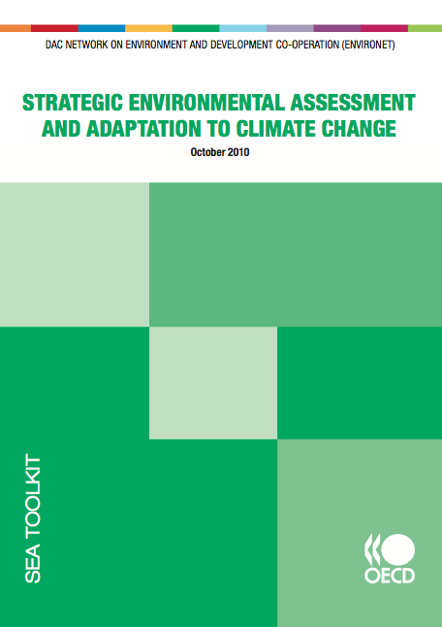
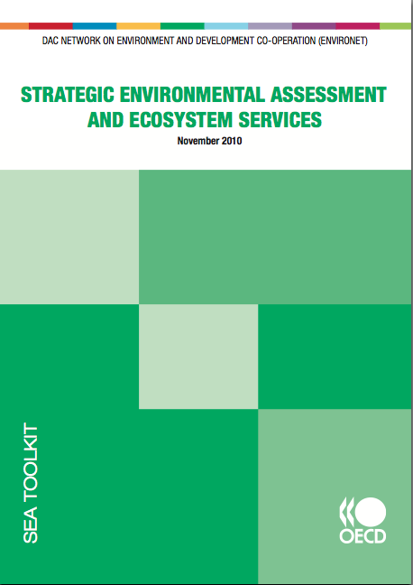


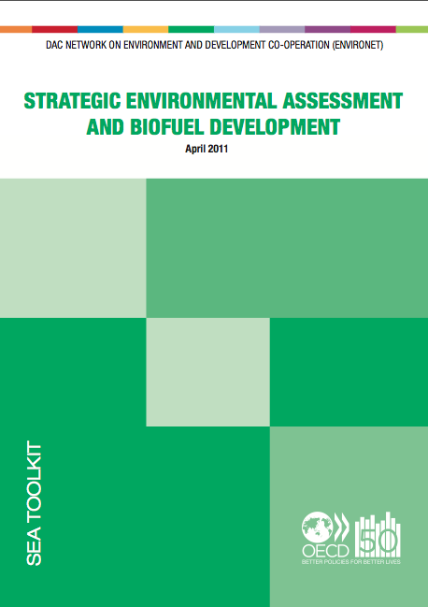
Guidelines for SEA

Slide 23
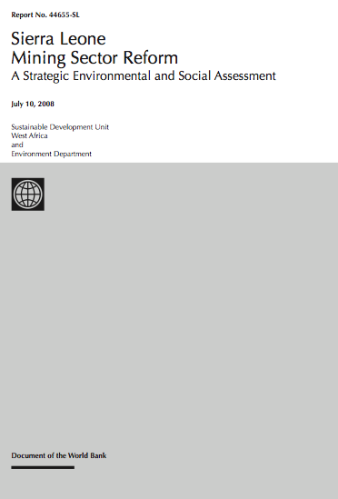
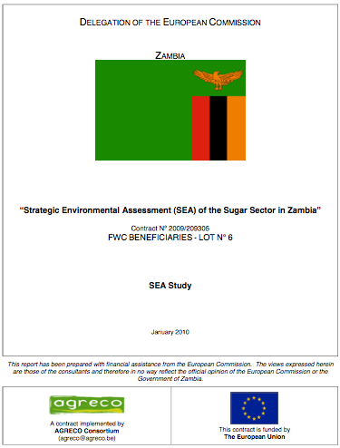
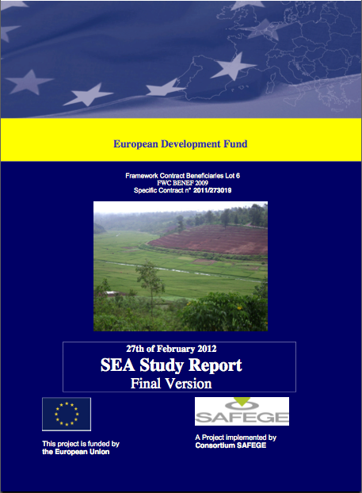
Examples of SEAs
SEA of Sierra Leone’s mining sector reform
SEA of Zambia’s sugar sector reform
SEA of Rwanda’s Agricultural Policy

Slide 24
Basic concepts for analysing climate change: Hazard and Risk
Probability of occurrence
Hazard
Risk
Severity of consequences
Notes:
Hazard:
a potentially damaging physical event, action, situation or phenomenon
-> a ‘climate hazard’ is a specific type of climate event with the potential to cause harm
Risk: the combination of:
the probability (or frequency) of occurrence of a defined hazard resulting in adverse consequences
the magnitude of these consequences, given the interaction of the hazard with the properties of the exposed system

Slide 25
Climate risk screening
Identifies potential risks for a programme or project by assessing, in its specific context:
A standard screening questionnaire can be developed to support this exercise
Exposure to the effects of CC
Maladaptation risk
Sensitivity to such effects
Impacts on climate
(GHG emissions/ emission removals)
Response & adaptation capacity

Slide 26
Climate risk screening
Various tools available, e.g.
  ADAPT (World Bank)
  CRISTAL (SDC, IISD, SEI, IUCN)
  Climate-FIRST (ADB)
  ORCHID (Dfid)
  CRISP (Dfid)
  NAPAssess (SEI)
  Adaptation Wizard (UK climate impacts programme)
  Danida Climate change screening matrix
See, e.g.
  UNDP (2010)
  UNDP, UNEP, UNEP Riso Centre (2011)

Slide 27
Climate risk screening: key factors to consider
Location
Sector
Relationship of the planned intervention to livelihoods
Socio-economic conditions (current – projected)
Adaptive capacity of various stakeholder groups
  Including current coping mechanisms / autonomous adaptation measures
Lifetime of the considered investments/activities

Slide 28
Outcomes of climate risk screening
None or low
No specific action, or limited measures
Vulnerability to the effects of CC
Medium
Further investigation, adaptation measures
High
Further investigation, redesign for reduced vulnerability/enhanced adaptive capacity, or even abandonment
Risk of maladaptation
No
No specific action
Yes
Further investigation, redesign for reduced maladaptation risk, or even abandonment
GHG emissions or emission removals
Insignificant
No specific action, or limited measures
Significant (*)
Further investigation and enhancement of mitigation potential
(*) In proportion to the size/scope of the intervention

Slide 29
Climate risk assessment
Climate risk assessment (CRA) is a dedicated study aimed at:
  assessing in further detail the risks identified during climate risk screening
  identifying possible risk prevention, risk mitigation and other adaptation measures
  assessing these options
  formulating concrete recommendations with regard to the design of the programme or project
The assessment of future climate risks should be anchored to an assessment of current risks

Slide 30
Role of SEA in supporting climate change mainstreaming
With adequate ToR, SEA can:
  identify elements of the considered policy or programme that are sensitive to or at risk from climate change
  identify elements that may result in increased vulnerability to the effects of climate change
  assess direct and indirect GHG emissions
  identify options for risk management, adaptation and mitigation
  and make recommendations on alternatives, on institutional aspects, capacity building, etc.
For guidance on integrating climate change in SEA see: OECD DAC (2010) Strategic Environmental Assessment and Adaptation to Climate Change
Notes:
Benefits of using SEA in support of climate change mainstreaming:
*Supports consideration of climate change in a strategic perspective
including consideration of the merits of various alternatives under various scenarios
*Supports ‘seamless’ integration of climate-related and other environmental aspects
key role of natural systems in adaptation and mitigation
*If conducted according to SEA good practices, supports active stakeholder consultation and participation in assessing climate-related issues

Slide 31
Is the assessment linked to:
Integrated ecosystems assessment
A specific policy, strategy, programme or project?
No
Vulnerability and adaptation assessment
Yes
A specific policy or strategy?
Yes (†)
Strategic environmental assessment (*)
No
A specific programme?
Yes (†)
Climate risk assessment
No
A specific project?
Yes (†)
Environmental impact assessment (*)
(†) Climate risk screening can be applied before undertaking a more detailed assessment
(*) With ToRs adapted to include climate-related considerations

Slide 32
Action planning

Slide 33
Turning words into action
Mainstreaming environment and climate change in national and sector policies, strategies and programmes
What can be done and what are the institutional and capacity needs in your country/ sector of responsibility?

Slide 34
Recap – Key messages
Mainstreaming environment and climate change at strategic planning levels supports more integrated, effective, efficient and sustainable responses
  But top-down and bottom-up approaches are complementary and mainstreaming is also justified at local level
Multiple tools and approaches are available to support environmental and climate change mainstreaming in policies, strategies, programmes and projects
Both ad hoc studies and assessments, and integration of environmental and climate-related considerations in feasibility / formulation studies, support this mainstreaming process

Slide 35
Key references
EC (2009a) EC Cooperation: Responding to Climate
Change – ‘Sector scripts’ series. European Commission, Brussels
EC (2009b) Guidelines on the Integration of
Environment and Climate Change in Development Cooperation. European Commission, Brussels
OECD DAC (2006) Applying Strategic Environmental Assessment, good practice guidance for development co-operation. OECD: Paris.
UNDP (2010) Screening tools and guidelines to support the mainstreaming of climate change adaptation into development assistance – a stocktaking report

Slide 36
Key references
UNDP-UNEP (2011) Mainstreaming Adaptation to Climate Change into Development Planning: A Guide for Practitioners. UNDP-UNEP Poverty-Environment Initiative
UNDP, UNEP, UNEP Riso Centre (2011) Climate risk screening tools and their application. CC DARE.

Slide 37
References
Dessai S. & Hulme M. (2004) Does climate adaptation policy need probabilities? Climate Policy, vol. 4 (2) 107-128. Available from: http://www.mikehulme.org/wp-content/uploads/2007/04/2004-dessai-hulme-probabilities.pdf
EC (2009a) EC Cooperation: Responding to Climate Change – ‘Sector scripts’ series. A series of information notes comprising an introduction and sector-specific notes. European Commission, Brussels
EC (2009b) Guidelines on the Integration of Environment and Climate Change in Development Cooperation. European Commission, Brussels. Available from: http://ec.europa.eu/europeaid/infopoint/publications/europeaid/172a_en.htm
GTZ (nd) Strategic Environmental Assessment, a practice-oriented training for policy-makers, administration officials, consultants and NGO representatives. Powerpoint presentation.
OECD DAC (2006) Applying Strategic Environmental Assessment, good practice guidance for development co-operation. OECD: Paris.
OECD (2009a) Integrating Climate Change Adaptation into Development Co-operation: Policy guidance. OECD Publishing, Paris. [Read-only, browse-it edition] Available from: http://browse.oecdbookshop.org/oecd/pdfs/browseit/4309171E.PDF
OECD DAC (2010) Strategic Environmental Assessment and Adaptation to Climate Change. OECD: Paris.

Slide 38
References (2)
Olhoff A. & Schaer C. (2010) Screening tools and guidelines to support the mainstreaming of climate change adaptation into development assistance: A stocktaking report. Environment & Energy Group, United Nations Development Programme, New York. Available from: http://www.undp.org/climatechange/library_integrating_cc.shtml
UNDP-UNEP (2011) Mainstreaming Adaptation to Climate Change into Development Planning: A Guide for Practitioners. UNDP-UNEP Poverty-Environment Initiative. Available from: http://www.unpei.org/knowledge-resources/publications.html
UNDP-UNEP (2011) Mainstreaming Adaptation to Climate Change into Development Planning: A Guide for Practitioners. UNDP-UNEP Poverty-Environment Initiative. Available from: http://www.unpei.org/knowledge-resources/publications.html

