Slide 1
Module 7
Costing, assessing and selecting options and measures
Country-led environmental and climate change mainstreaming (specialist course)
Training materials developed with the support of the European Commission

Slide 2
Linking policy, costing and budgeting
Mainstreaming of environment and climate change in policies, strategies & programmes
Identification of environmental integration and climate change adaption & mitigation options
Costing, assessment and selection of options
Resource allocation: Integration of environmental and climate change (adaptation & mitigation) measures in budgets

Slide 3
Tools for costing and assessing
environmental and climate change options

Slide 4
Common types of costs
e.g. removal of subsidies
costs e.g. training, recruitment, …
Reform measures
Transitional costs
e.g. protected areas
costs e.g. salaries, recurrent costs…
Management measures
Operational costs
e.g. sanitation facilities
costs e.g. construction, ongoing operations…
Infrastructure measures
Capital costs

Slide 5
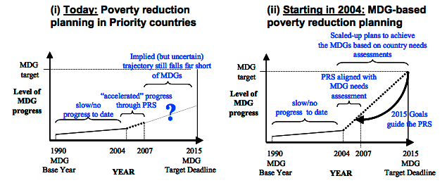
Costing Tools / MDG needs assessment
Starting point: the target
  Work backwards to identify what is needed to achieve it
  Identify necessary interventions, priorities and bottlenecks for achievement of the target
Source: MillenniumProject (2004)

Slide 6
Costing tools /
MDG needs assessment methodology
1. Develop list of interventions
What needs to be done?
(from planning processes)
2. Specify targets for each set of interventions
3. Develop investment model, estimate resources needs
Excel-based investment models to project gradual scaling-up of investments and resources required
4. Estimate synergies across interventions
Accounts for potential cost savings from synergies across interventions
5. Develop financing strategy
Distinguishes: (i) out-of-pocket expenditure by households, (ii) domestic government resources, (iii) external finance
Adapted from: MillenniumProject (2004)

Slide 7
Costing tools
MDG Needs Assessment Tools including:
  Environment Tool
  Energy Tool
  Water and Sanitation Tool
Limitations: designed taking into account the MDGs as well as defined set of interventions
However, useful as a guide

Slide 8
Cost-benefit analysis: identifying costs and benefits
Environmental and CC adaptation/
mitigation measures
Costs: extra costs incurred compared with the ‘business-as-usual’ scenario, reduced economic growth opportunities
Benefits:
Avoided damage and losses
Extra developmental benefits compared with ‘business-as-usual’ scenario
Energy cost savings
Sales of carbon credits
Positive environmental and related health/livelihoods outcomes (including health expenditures savings)
Strategic and competitive advantage (e.g. organic products)
Can you think of some examples?
For environmental measures, internalisation of externalities is a MUST, but can often be complex to achieve
[risk of simplification in detriment of environment]
Notes:
Niang-Diop & Bosch (2004): costing requires identification, quantification then valuation.
The costs potentially associated with climate mitigation include:
* investment in new technologies and infrastructure, possibly more expensive than other, more emission-intensive available options;
* in some cases, increased operation & maintenance costs associated with new technologies/infrastructure (however, the opposite may be true);
* reduced economic growth opportunities, and the foregone benefits and jobs of development options abandoned or downscaled for the purpose of reducing emissions.
On the other hand, the following benefits may arise from the adoption of mitigation measures:
* cost savings (e.g. from energy efficiency);
* positive environmental outcomes (where mitigation options are also ‘greener’ than alternatives) and associated health outcomes;
* reduced dependence on imported fuels/energy;
* earlier adoption of the technologies of the future (=> competitive advantage and higher growth and employment in the medium- to long-term);
access to additional financial resources (carbon finance).
When costing environmental measures, CBA can act as a double-edged knife. For it to be effective it must internalise external costs which are often not monetised (e.g. effects on health, value of scenic beauty, potential value of genetic resources, cultural values, etc.)….often in light of complexities involved, these externalities are ignored, and thus results of CBAs are not realistic and result in an appreciation in detriment of the environment. Finding expertise in such assessments is also a big challenge.
For example, the question ‘how much are you willing to pay so your sources of water remains clean?’ Is based on an underlying assumption that the user does not have the right to clean water, whilst the polluter has a right to pollute.
Even reversing the question (e.g. ‘how much are you willing to receive in compensation if the water becomes polluted?’) does not solve the dilemma, as it still neglects the right to a clean environment. Under conditions of extreme poverty, people may be willing to give up clean water in exchange for basic subsistence.
It also becomes more complicated when attempting to cost potential value, e.g. value of genetic resource pool for potential future production of medicines…
Large expertise in environmental economics is difficult to come across.

Slide 9
Cost-benefit analysis (1)
Cost-benefit analysis (CBA):
  Quantifies all the costs and benefits (*) of an intervention (with benefits including both ‘positive’ benefits and avoided losses) over the entire lifetime of the intervention
  A ‘discount rate’ is applied to all costs and benefits to represent ‘preference for the present’ or simply the opportunity cost of capital -> calculation of ‘present value’
    The higher the discount rate, the smaller the present value
    The further away in the future, the smaller the present value
    Significant controversies over the ‘right’ discount rate for assessing long-term options
(*) Actually the ‘incremental’ costs and benefits, i.e. the difference in costs/benefits between a ‘with intervention’ and a ‘no intervention’ scenario

Slide 10
Cost-benefit analysis (2)
Outputs of cost-benefit analysis:
Cost-benefit ratio (CBR)
Ratio of costs to benefits calculated at their present value (the smaller, the better – should be <1)
Net present value (NPV)
Benefits minus costs calculated at their present value (the larger, the better)
Internal rate of return (IRR)
The discount rate at which NPV = 0
A measure of the ‘benefit-generating power’ of the option or intervention (the larger, the better)

Slide 11
Cost-effectiveness analysis (1)
Cost-effectiveness analysis (CEA):
  Costs are valued in monetary terms, and benefits (*) quantified in ‘physical’ units, over the entire lifetime of the intervention; a discount rate is applied to both
  This allows calculating unit costs, as the ratio of total discounted costs to total discounted benefits obtained
  The obtained unit costs support :
    the comparison of several options
    comparison with ‘benchmark costs’ for similar interventions, where available
(*) As in cost-benefit analysis, ‘incremental’ rather than absolute costs and benefits should be taken into account

Slide 12
Cost-effectiveness analysis (2)
Compared with CBA, CEA:
  is suitable where it is difficult to assign a monetary value to benefits
  but requires identifying a single, all-encompassing measure of benefits – which may be both difficult and reductive

Slide 13
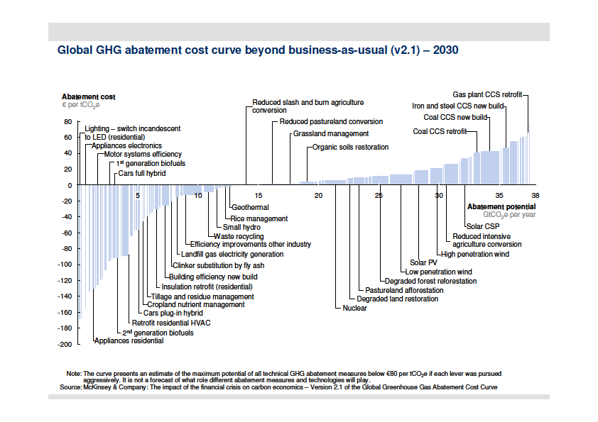
Illustration of CEA: Global GHG abatement cost curve
Source: McKinsey (2009), Exhibit 8, p. 17
Notes:
Summarises technical options for reducing GHG emissions in 3 areas:
* energy efficiency;
* low-carbon energy supply;
* terrestrial carbon (avoided emissions/sinks).
Options are ranked from the least expensive (per tonne of CO₂e abated) to the most expensive.
* The cost range is from –90€ to +60€ / tCO₂e.
* All options with a negative cost are ‘no-regret’ since the savings they generate are greater than their costs.
The width of the bar corresponding to each option indicates the abatement potential of this option (in gigatonne CO₂e per year), compared with ‘business-as-usual’, if implemented at full potential.
The curve shows that emissions ~11 Gt CO₂e/year could be avoided only by implementing options that provide a net financial benefit.
Reducing emissions just enough to contain global warming below 2°C could cost only €200-350 billion/year until 2030, i.e. <1% of global GDP.

Slide 14
Example: land-based mitigation options
Typically cost-effective and requiring low upfront investment
Significant mitigation potential for developing countries
Atmosphere
CO₂
CO₂
CH₄
N₂O
Forests
Net sink (tree biomass + soil organic matter)
Peatlands
Largest & most efficient terrestrial store of carbon biomass
Grasslands
  Net carbon sink if not degraded
Cultivated systems
Both a sink and a source of GHGs, net balance depends on cultivation methods
Improved ecosystem management also supports adaptation
Notes:
Curbing deforestation is considered one of the most cost-effective ways of reducing GHG emissions. So is the conservation and restoration of peatlands.
According to McKinsey (2009):
*approx. 33% of total potential for reducing GHG emissions at a cost not exceeding €60 per tCO₂e is related to land use (forestry and agriculture)
*90% of the abatement opportunities associated with these sectors are located in developing countries
*agriculture- and forestry-related measures generally have low capital intensity (i.e. do not require particularly high extra upfront investment), while also entailing low (sometimes negative) abatement costs

Slide 15
Financial and economic analysis
Basis for private sector decision making
Both CBA and CEA support:
  financial analysis: considers the ‘monetary’ costs and benefits (or equivalent) accruing to parties directly concerned by a project or programme, at their ‘face value’
  economic analysis: broadens the analysis to more accurately reflect costs and benefits to society
Basis for public sector decision making

Slide 16
Complementary tools
For the assessment of robustness and the integration of uncertainty, CBA/CEA can be combined with:
  the use of multiple scenarios (e.g. ‘no change’ scenario and various climate change and development scenarios)
  sensitivity analysis (i.e. testing of the effect of changes in scenario assumptions on the CBR, NPV, IRR or unit costs)
  risk analysis (-> risk probability analysis includes the probability of occurrence of various cost and benefit outcomes in calculations... assuming probabilities are known)
Notes:
More sophisticated tools exist but they usually include CBA/CEA approaches.
CBA/CEA both support the prioritisation and selection of measures that offer the best ‘value for money’ – a key aspect in situations of budgetary constraints.
CBA/CEA support the financial and economic assessment of adaptation options; other types of assessment (e.g. technical, social, environmental) may be required to fully inform decision makers.

Slide 17
Tools for prioritising and selecting measures

Slide 18
Supporting decision making
CBA/CEA support the financial and economic assessment of options
  They help identify measures that offer the best ‘value for money’ – a key aspect in situations of budgetary constraints
Other types of assessment and other criteria (e.g. technical, social, environmental) are required to fully inform decision makers
Must take into account pro-poor implications
Multi-criteria analysis (MCA) helps integrate various criteria

Slide 19
Multi-criteria analysis (1)
An approach to decision support that uses
more than one criterion to assess performance and rank various options or interventions
The term actually covers a wide range of methods
Typically:
  various options or interventions are assessed against a pre-determined set of criteria
  qualitative ratings or quantitative scores are given
  rules are then applied to rank options/interventions
    Numerical scores can be added up to calculate a total score (with the possibility of applying different weights to different criteria)

Slide 20
Multi-criteria analysis (2)
MCA is a useful complement to CBA/CEA
Allows combining financial/economic criteria with technical, environmental and social ones
It can be used on its own, or in combination with CBA/CEA:
MCA before CBA/CEA
Allows reducing the number of options to which CBA/CEA is applied
MCA after CBA/CEA
CBA/CEA helps eliminate financially or economically unviable options, then MCA allows for final selection based on extra criteria

Slide 21
Example of MCA grid
Option | Effective-ness | Cost or CBR ^{(*)} | Technical feasibility | Social & cultural acceptability | Env’l impacts | Total score
Option 1
Option 2
Option 3
Option 4
Scores: from 1 (poorest performance) to 4 (highest performance). As far as cost is concerned, a scale should be established, with scores corresponding to a given cost range or cost/unit range.
^{(*)} CBR = cost-benefit ratio
Adapted from USAID (2007), Exhibit 12, p. 18

Slide 22
Action planning

Slide 23
Turning words into action
Costing, assessing and selecting environmental and climate change adaptation & mitigation options and measures
What can be done and what are the institutional and capacity needs in your country/sector of responsibility?

Slide 24
Recap – Key messages
Cost-benefit analysis and cost-effectiveness
analysis support the identification of financially and economically viable adaptation and mitigation options/measures
  Help prioritise actions based on financial/economic criteria
Multi-criteria analysis, used alone or in combination with CBA or CEA, supports the assessment and prioritisation of options based on multiple criteria
  Technical, environmental and social criteria can be considered alongside financial/economic ones
Pro-poor implications must be taken into consideration when prioritising measures

Slide 25
Key references
Economics of Climate Adaptation Working Group
(2009) Shaping climate-resilient development: a framework for decision-making. Climate Works Foundation, Global Environment Facility, European Commission, McKinsey & Company, The Rockfeller Foundation, Standard Chartered Bank & Swiss Re
MDG Needs Assessment Tools:
  http://www.undp.org/
World Bank – Economics of Adaptation to Climate Change web pages: http://climatechange.worldbank.org/content/economics-adaptation-climate-change-study-homepage

Slide 26
References
Economics of Climate Adaptation Working Group (2009) Shaping climate-resilient development:
a framework for decision-making. Climate Works Foundation, Global Environment Facility, European Commission, McKinsey & Company, The Rockfeller Foundation, Standard Chartered Bank & Swiss Re. Available from: http://www.mckinsey.com/clientservice/Social_Sector/our_practices/Economic_Development/Knowledge_Highlights/Economics_of_climate_adaptation.aspx
McKinsey & Company (2009) Pathways to a Low-Carbon Economy: Version 2 of the Global Greenhouse Gas Abatement Cost Curve. Available from: http://www.mckinsey.com/globalGHGcostcurve
MillenniumProject (2004) Millennium Development Goals Needs Assessment Methodology. Available online from: http://www.unmillenniumproject.org/ [Accessed 20 February 2013]
UNDP MDG Needs Assessment Tools, available from:
  http://www.undp.org/content/undp/en/home/librarypage/poverty-reduction/mdg_strategies/mdg_needs_assessmenttools/mdg_needs_assessmenttools.html
USAID (2007) Adapting to Climate Variability and Change: A guidance manual for development planning. United States Agency for International Development, Washington, DC. Available from: http://pdf.usaid.gov/pdf_docs/PNADJ990.pdf

