Slide 1
National Employment Policy
Strategic framework and areas of support for development cooperation

Slide 2
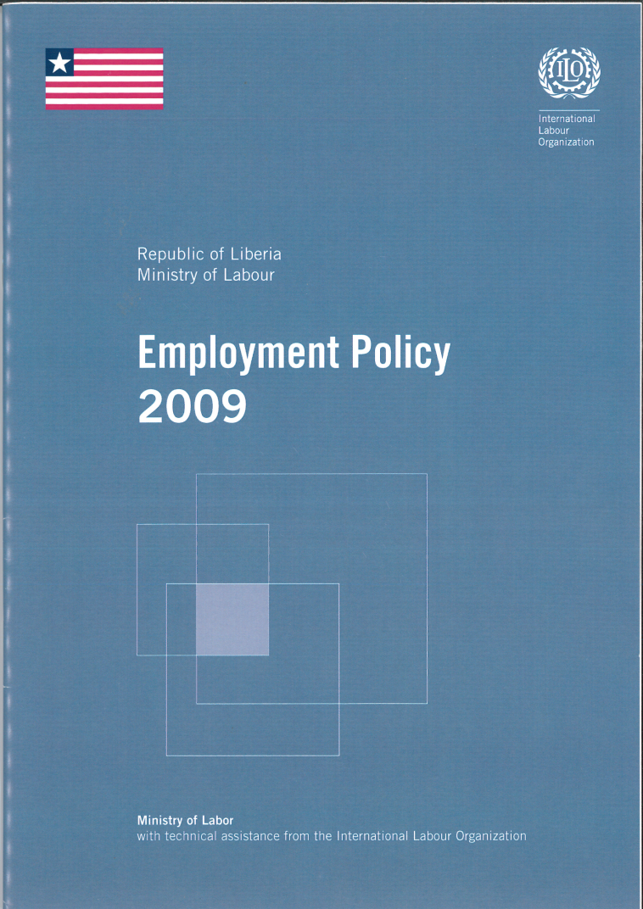
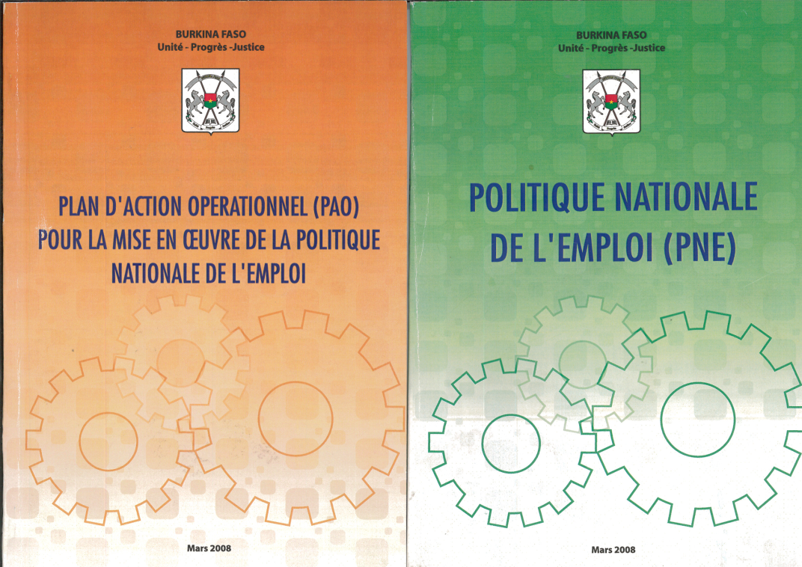
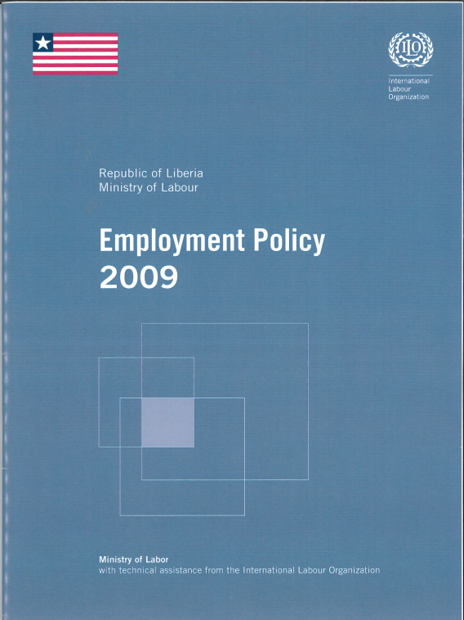
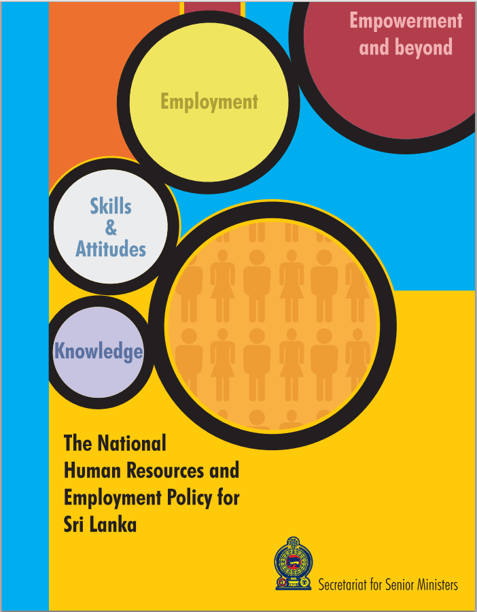
Key questions
What is an employment policy?
Why do countries need a comprehensive employment policy?
How can development cooperation support inclusive employment policy-making?

Slide 3
An increasingly complex employment situation...
  Uneven distribution of gains from economic growth
  Slow decent job creation
  Increasing economic instability
Slow shift from subsistence household economy to wage work
Wage employment and own-account workers and contributing family members in the world, 1999-2009
Employment by economic class, 1991-2011, developing world
Source: ILO 2011
Source: Kapsos & Bourmpoula 2013
Notes:
1. Inefficient growth shares out gains unevenly
Income inequality and wage polarization are rising
Poverty is declining, and the gender pay gap is narrowing, but both very slowly
2. More and better jobs remain a distant reality
Half of the people at work are unvoluntary self-employed
Persistence of informal employment
Rising levels of non-standard employment
200 million unemployed today; youth unemployment rate is 2.5 times the adult rate
Global employment deficits, both in “levels” and in “quality”, are of major concern.
The global economic and financial crisis has aggravated and revealed these job deficits and highlighted the need to address structural imbalances.
It is now commonly acknowledged that economic growth, while necessary, is by no means sufficient to engender sustainable and productive employment
3. The economy has become more unstable
Shrinking share of wages in total income
Rising profits are not translating into higher investment
Share of profits from finance at 42%, up from 25% in the 1980s

Slide 4
… creates a new momentum for employment policies to redress these social and economic imbalances
Promoting social dialogue
International policy agendas
MDG target 1B
National policy agendas
National development
frameworks
G20
IFIs
Crisis response and
role of economic policies
Post-2015 Agenda
Creating Jobs
Extending social protection
Guaranteeing rights at work
Notes:
Renewed commitment to employment at international level
Employment is having a prominent role in the international policy agenda.
In 2008, the Millennium Development Goals (MDGs) were expanded to include four new employment indicators under a new target. The inclusion of these new indicators represents a renewed commitment to employment promotion
The G20 leaders are increasingly recognizing the role of employment policies in addressing the human dimension of the financial and economic crisis.
The Seoul development consensus on shared growth unveiled during the November 2010 G20 represents an important step forward towards pro-employment macroeconomic frameworks.
Renewed commitment also at national level: policy responses to the crisis disrupted dominant consensus on macro policy
Employment is also high in political agendas at national level. Policy responses to the crisis have disrupted the dominant consensus on macroeconomic policy and extraordinary fiscal stimulus measures have been effective in stimulating output and employment. A rethinking of macroeconomic policy frameworks is taking place, in part triggered by the need to accommodate more employment-oriented growth.
Efforts are needed to integrate employment policy into overall development frameworks, requiring a systematic incorporation of employment targets and policies in national policy and development frameworks, including quantitative and qualitative targets in national monitoring mechanisms.

Slide 5
The ILO’s response: the decent work agenda
Creating Jobs – an economy that generates opportunities for investment, entrepreneurship, skills development, job creation and sustainable livelihoods.
Guaranteeing rights at work – to obtain recognition and respect for the rights of workers. All workers, and in particular disadvantaged or poor workers, need representation, participation, and laws that work for their interests.
Extending social protection – to promote both inclusion and productivity by ensuring that women and men enjoy working conditions that are safe, allow adequate free time and rest, take into account family and social values, provide for adequate compensation in case of lost or reduced income and permit access to adequate healthcare.
Promoting social dialogue – Involving strong and independent workers’ and employers' organizations is central to increasing productivity, avoiding disputes at work, and building cohesive societies.
Notes:
The Decent Work concept was formulated by the ILO’s constituents – governments and employers and workers – as a means to identify the Organization’s major priorities. It is based on the understanding that work is a source of personal dignity, family stability, peace in the community, democracies that deliver for people, and economic growth that expands opportunities for productive jobs and enterprise development.
Decent Work reflects priorities on the social, economic and political agenda of countries and the international system. In a relatively short time this concept has forged an international consensus among governments, employers, workers and civil society that productive employment and Decent Work are key elements to achieving a fair globalization, reducing poverty and achieving equitable, inclusive, and sustainable development.
The overall goal of Decent Work is to effect positive change in people’s lives at the national and local levels. The ILO provides support through integrated Decent Work Country Programmes developed in coordination with ILO constituents. They define the priorities and the targets within national development frameworks and aim to tackle major Decent Work deficits through efficient programmes that embrace each of the strategic objectives.

Slide 6
Decent work: a priority and a commitment in international policy agendas
UN frameworks:
  1995 social development world summit
  2000 millenium summit
  2005 world summit
  2006 ministerial declaration
  2008 Commission for Social Development
  2008 new target for MDG 1
  Post-2015 framework
G20 summits – from London in 2000 to the Seoul consensus in 2010
Bretton Woods Institutions
Notes:
Au cours des deux dernières décennies, l’Assemblée Générale des Nations Unies a reconnu et souligné l’importance de l’emploi productif et du travail décent à l’occasion de plusieurs conférences, réunions et sommets internationaux.
En 1995, le sommet mondial de Copenhague pour le développement social s’est efforcé de placer la personne humaine au cœur de la politique internationale. En désignant la pauvreté, le chômage et l’exclusion sociale, dans leur interdépendance, comme les cibles d’une stratégie mondiale de justice sociale, il a marqué un tournant dans l’action multilatérale ;
En 2000, au cours du sommet du millénaire à New-York, les dirigeants politiques du monde ont engagé la communauté des nations dans une action concertée et coordonnée pour atteindre les Objectifs du Millénaire pour le Développement (OMD) qui sont un ensemble de huit objectifs internationalement convenus concourant à la réduction de la pauvreté sous ses multiples dimensions. L’objectif N° 8, relatif au partenariat mondial pour le développement, couvre plusieurs aspects dont la formulation et la mise en œuvre de stratégies permettant aux jeunes de trouver un travail décent et productif (objectif 8, Cible 16 et indicateur 45) ;
En 2005, au cours du Sommet mondial tenu en septembre à New- York, des décisions importantes ont été prises pour faire du plein emploi productif et du travail décent pour tous, y compris pour les femmes et les jeunes, un objectif central des politiques nationales et internationales ;
La Déclaration ministérielle de 2006 du Conseil Economique et Social des Nations Unies (ECOSOC) sur la création d’emplois et le travail décent pour tous exhortait les gouvernements, la communauté internationale et toutes les organisations internationales pertinentes, y compris le Système des Nations Unies, à contribuer, dans le cadre de leurs programmes, mesures et activités, à la création d’un contexte propice à la concrétisation de ces objectifs aux niveaux national et international. Des résolutions ultérieures de l’ECOSOC, notamment en 2007, 2008 et 2009, ont souligné l’importance d’approches multidimensionnelles de l’emploi productif et du travail décent à plusieurs niveaux ;
En 2008, les 0MD ont été étendus pour englober quatre nouveaux indicateurs d’emploi dans une nouvelle cible (encadré N° 1.2), représentant un engagement renouvelé envers la promotion de l’emploi (voir encadré ci-contre). Les indicateurs demandent à tous les pays de communiquer tout progrès et de fournir des données ventilées par genre et villes/ zones urbaines dans la mesure du possible ;
La Commission du développement social, lors de sa 46ème session, a approuvé un texte consensuel intitulé «promouvoir le plein emploi et le travail décent pour tous» qui recommandait, entre autres, que l’ECOSOC appelle de toute urgence les gouvernements à poursuivre les efforts en vue de la ratification et l’application totale des conventions pertinentes de l’OIT et des principes fondamentaux énoncés dans l’Agenda du travail décent, et qu’il plaide pour l’établissement et l’application de politiques et stratégies intégrées favorisant la possibilité, pour les jeunes, y compris des régions rurales, de suivre une préparation, trouver et conserver un emploi à temps plein et productif, convenablement rémunéré, et l’intégration de l’emploi des jeunes aux stratégies nationales de développement.
A ces actions menées dans le cadre de l’ONU, il faut ajouter le soutien actif réaffirmé par les pays développés et les institutions financières internationales à œuvrer pour la concrétisation de ces engagements internationaux. Ainsi, les dirigeants du G20, le groupe des 20 pays les plus industrialisés, ont à plusieurs occasions, démontré leur volonté et leur engagement à placer la question de l’emploi décent au centre de la résolution de la crise économique et financière et de la mise en œuvre de réformes de politiques macroéconomiques et sectorielles. Ils ont mis en relief le rôle que jouent des politiques actives du marché du travail dans la prise en compte de l’aspect humain de la crise économique et financière. (Sommet de Londres en avril 2000, Sommet de Pittsburg en septembre 2009, Réunion des ministres du travail et de l’emploi du G20 à Washington en avril 2010, Sommet de Toronto en septembre 2010, le Consensus de Séoul au cours de la réunion du G20 de novembre 2010)
Signe d’une évolution idéologique notoire, les Institutions de Bretton Woods (FMI et Banque mondiale) ne sont pas restées en marge de cette prise de conscience internationale quant au rôle et à l’importance de l’emploi. Ainsi, au cours de la conférence historique d’0slo en septembre 2010, le FMI et l’OIT ont appelé la communauté internationale à axer résolument la reprise économique sur la création d’emplois.

Slide 7

ILO definition and frameworks
What is a National Employment Policy?

Slide 8

What is an employment policy?
Vision: long-term – where do we want to be in 5-10 years?
Concerted: based on broad tripartite dialogue to arrive at a common platform
Coherent: the inter-relationships are clear and policy coherence is ensured
A vision and a concerted and coherent framework
linking the policy interventions and the stakeholders having a role in achieving the employment target
Notes:
Example of vision: More women and men have access to productive employment, decent work and income opportunities

Slide 9
What is an employment policy? (Cont’d)
A vision and a concerted and coherent framework
linking the policy interventions and the stakeholders having a role in achieving the employment target
Interventions: a set of multidimensional interventions spanning quantity and quality of jobs
Stakeholders: goes beyond the Ministry in charge of employment to include trade unions, employers’ organisations, Ministries of Finance, other line ministries, etc.
Employment target: an explicit commitment to achieve a given employment result in a given time period

Slide 10
A national employment policy can take a variety of forms
General declaration in the Constitution (Nicaragua, Panama, Indonesia, …)
Secondary legislation and policy instruments (Burkina Faso, Sri Lanka, China, …)
Integration in national development plans (Indonesia, Honduras, …)
Notes:
A stand-alone policy document adopted by the highest political authorities is the most ambitious model. The alternative models are less ambitious but might be very effective in integrating key policy messages of NEPs in NDF.
Indonesia
1945 Constitution, article 27, clause 2: every citizen has the right to have decent work and decent life
Since 2004, elements of a national employment policy can be found in the Medium Term Development Plan (RPJM).
basic rights or entitlement approach (right to decent work)
2004-2009 RJPM: one strategy for poverty reduction in the 2004-09 RPJM was the fulfilment of citizen rights to full and productive employment. Key development targets included to reduce the unemployment rate to 5.1% by 2009.
The RPJM 2010-14 consists of 11 main national priorities. To achieve these priorities, the development plan is categorized into 9 development fields. The economics chapter contains, among others, sections on ‘manpower competitiveness’ and ‘social security’. The manpower section in the economics chapter recognizes that the main problem of employment is the limited opportunities for the labour force to obtain decent work. Therefore, the first directive of the manpower development is to “enhance the creation of decent work, which is productive employment with the adequate protection and social security”.

Slide 11
The ILO’s normative framework
NEP
Quantity - Work for all who want to work
Quality - Such work is as productive as possible
Non-discrimination - There is freedom of choice of employment and fullest possibility for each worker to utilise her/his skills, irrespective of race, gender, age, religion, political opinion, social origin, etc.
The three guiding principles of an employment policy
Employment Policy Convention, 1964 (No. 122)

Slide 12

The ILO’s policy framework
The Global Employment Agenda (2003/2006)
Employment expansion
Skills, technology and employability
Enterprise development
Labour market institutions and policies
Governance, representation and advocacy
Social protection
Gender equality and informality are mainstreamed
Notes:
Major ILO global policy frameworks articulate the importance of employment policies.
The Global Employment Agenda (2003) underscores the importance of employment policy development and implementation to promote full, decent, productive and freely chosen employment. Six policy areas.
The Declaration on Social Justice for a Fair Globalization (2008), the Global Jobs Pact (2009) further emphasize the key role of employment policy and give guidance for development and implementation.

Slide 13
The ILO’s policy framework (cont’d)
Resolution on employment at the 2010 International Labour Conference
Institutional level
Integrated and well-designed policy interventions
Policy coordination and coherence
Policy level
Pro-employment macroeconomic policies
Employment targeting
Social dialogue
Non discrimination and gender equality policies
Enabling environment for enterprise development
Notes:
The resolution and conclusions of the International Labour Conference’s general discussion on the strategic objective of employment (2010) provides the ILO’s comprehensive approach to national employment policies.
In order to foster both the quality and quantity of employment, a coherent, integrated and well designed national employment policy, which cuts across both macro and microeconomic dimensions and addresses both labour demand and supply, is of utmost importance.
Such integrated approach to employment policy, however, can only be effective where there is close coordination among central banks, ministries of finance and economic affairs, line ministries and the Ministry of Labour. Integrated approach only effective if multiple stakeholders involved.
An informed and effective social dialogue on employment policy is key for gaining consensus on the best way to achieve employment gains in a given context. Continuous social dialogue on employment is most effective way to achieve consensus on the policy priorities and policy options
Integration of employment policy into development frameworks: quantitative and qualitative targets in national monitoring mechanisms
Rights based and gender equality

Slide 14
Employment objectives and National Development frameworks
Why are national development frameworks the place to be ?
To operationalize the crosscutting nature of the NEP and meet the ambitious targets that countries announce
It offers space for putting employment and decent work at the centre of national debates
It provides opportunities to institutionally embed social dialogue in the formulation of social and economic policy
In most developing countries, national development frameworks play a fundamental role as a basis for policy-making and resource allocation

Slide 15
Areas of support for development cooperation
The Employment Policy Intervention Model

Slide 16
The employment policy cycle
Alignment with other national policy processes
Be inclusive
1. Preparation
2. Issue identification
3. Formulation
4. Adoption
5. Programming
6.Implementation
7. Evaluation
Inter-ministerial coordination
Build partnerships
Integration in the NDF
Notes:
Preparation: attribute responsibilities and accountability for the formulation of the NEP
Issue identification: Employment situation analysis, including broad-based consultations
Formulation: Priority setting and generation of policy interventions + Operational planning and drafting of the document
Adoption: validate and submit for adoption
Programming: prepare for implementation
Implementation
Evaluation: monitoring and evaluation of the NEP
A detailed checklist for each of the elements indicated above will be provided in a table

Slide 17
1. Building knowledge
The issue identification phase
Areas for support:
in-country research – analysis of economic and labour market data; policy reviews; thematic analysis
Reviews of programmes and projects
Reviews of institutional frameworks (audits)
Public expenditure reviews
Broad-based consultations
Good practices
use existing tools to integrate the employment analysis in poverty diagnostics and other on-going knowledge-building exercises
establish strategic partnerships with other ministries, think tanks, universities, civil society, IOs and bilaterals
do not limit research to areas implemented by MoE

Slide 18
2. From situation analysis to strategic planning
The policy formulation stage
Of all the problems identified in the situation analysis, which ones is the NEP going to address?
What are the relevant policy areas?
What policy interventions to choose?
Should involve many actors - Social dialogue
Priorities need to be defined based on:
  National circumstances
  Availability of resources
  Coherence with national priorities
Notes:
Policy formulation
Step 3 (‘formulation phase’): CEPOL works with constituents to ensure an interface with national development and planning processes and governmental economic teams. CEPOL’s role as a facilitator includes that of ensuring social dialogue throughout the process, i.e., making sure that governments, employers and workers participate in an active and substantial manner to the process. Where necessary, CEPOL, with the technical field specialists – including ACTRAV and ACTEMP, will provide capacity development for those constituents who have not undertaken similar exercises, as to enable them to meaningfully contribute to the drafting process. In addition, CEPOL makes sure the policy is formulated in a coherent, coordinated and integrated manner. Involving sectoral ministries and agencies entrusted with macroeconomic management – such as the Central Bank, finance ministries and national planning agencies – is key. Finally, CEPOL provides technical advice to operationalize the document (formulation of objectives and outcomes, choice of monitoring indicators, coordination mechanism, M&E framework, budget, etc.).
Where possible, the policy is drafted by the relevant unit in the labour ministry. However, in practice, this has proven to be difficult in countries where institutional capacity is weak. In such cases CEPOL provides financial assistance to pay an external consultant, whose main task consists in putting all the information compiled through the consultations together into a coherent policy.

Slide 19
Coherence with national priorities
The various plans that define priorities at national level are:
  Presidential Programme /party manifesto
  “ Vision” document (long term 15-20 years)
  National Development Framework (5 to 10 years)
  Sectoral policies
  The national budget
Link the NEP formulation process with the national planning process
  Timing
  national procedures
  policy coherence
  key stakeholders

Slide 20
Example from Viet Nam
Objectives of the SEDS 2011-2020 | Decent Employment implications
“Accelerate economic restructuring, knowledge economy” | Shifting labour market and employment shares, growing demand for skilled labour, dealing with the informal economy
“Quality, productivity, efficiency and competitiveness as first priorities” | Labour productivity through skills and income policies; sustainable enterprises
“Improve the quality of human resources” | Education and training for labour market needs, matching of labour supply and demand
“Ensure social equity; Reduce poverty; Social welfare, social security and community health care provided” | Minimum wages and fair incomes from work; non-discrimination; gender equality; social protection; attention to the working poor and vulnerable groups
“Vigorous development of productive forces at increasingly higher scientific and technological levels while improving production relations” | Enabling environment for sustainable enterprises; value chains; harmonious industrial relations
“Proactive engagement in far-reaching and efficient international integration” | Skills for trade; labour productivity and labour rights in global integration; migration policy
“Improve environmental quality, cope proactively and efficiently with climate change | Green jobs and greener enterprises

Slide 21

HOW to support social dialogue?
The workshop approach
  Brings all actors together over two-three days, preferably away from usual workplace
  Enables brainstorming, dialogue and consensus building
Bosnia Herzegovina, Indonesia, Mongolia
The national dialogue approach
  Comprehensive dialogue spread over a few months with monthly thematic meetings
  Brings a chorum of actors together and invites specific actors over specific topics
Uruguay

Slide 22
3. From strategic to operational planning
Policy coordination, implementation and monitoring
Goal
The action plan
M&E system
Objectives
Employment targets
Outcomes
Outputs
Timeframe
Activities
Implementing partners
Employment indicators
Resources

Slide 23
Who will be responsible for implementation of the NEP?
Are the necessary structures in place?
Does the intervention fit within the existing institutional framework?
Does a new structure need to be created?
Is it feasible within the NEP timeframe?
Won’t it add unnecessary additional layers of government (for example)?
Notes:
If the intervention fits within the existing institutional framework, does it entail increasing budget, hiring staff, etc.? Is that feasible given the national procedures, budget constraints, etc? If more than one structure could be responsible for implementation, how to choose between them? Or enhance partnerships or convergence?

Slide 24
Support institution building
Important implementation institutions:
Labour market information analysis system
Coordination mechanism (tripartite inter-ministerial council)
Public and private Employment Services
M&E system
Link the NEP monitoring system with the national monitoring system (Bureau of statistics, Statistical Master Plan, watch the perodicity of review, etc)
Link with the budget cycle: being out of the loop (in terms of timeframe, procedures, existing tools, etc.) can result in missed opportunities in a context of highly competitive budgets
Notes:
Strong coordination systems needed because of multiple stakeholders
Interministerial, tripartite bodies
Avoid institutional proliferation – existing structures can be used; rationalise and strengthen existing mechanisms
Link with structures that are influencial in the country

Slide 25
How to integrate employment in national budgets?
Social protection
Security
Agriculture
Employment is among the many issues seeking a larger place in national budgets
Infrastructure
Education
Health

Slide 26
Ministries of Finance allocate ressources based on the quality of the request for funds
Advocate for funds based on a solid argument (results-based management)
Make effective use of the national budgeting system
Work closely with the Ministry of Finance
Ministries of Finance allocate resources based on NDFs priorities
Work on integrating employment policies in NDFs
Ensuring policy coherence between the NEP and the NDF’s objective
Collaborate with the Ministry of Finance /Planning/Economy

Slide 27
Indicative timeline of an employment policy process
Full process may take up to 24 months
Prepare: 1 month
Formulate: 12 months
Validation and adoption: 6 months
Operationalise: 8 months
(but overlaps with adoption)
Notes:
In Malawi, the first two stages of the NEP process took 2 years, from 2010-2012 (policy research, dialogue, formulation, validation), however it is still not adopted.
Total amount spent: between 180’000-200’000$ including mission costs.
In Sri Lanka, the full process took 2 years (2011-2012)

Slide 28
Good and enabling practices
conduct a good stakeholder analysis and draw up an institutional map
Work with well-established research institutes or universities in the country
create an inter-ministerial committee from the outset
emphasize the participation of local stakeholders
think about the technical and financial feasibility of the NEP’s implementation
develop a coherent communication strategy to ensure visibility of the NEP, raise awareness
Notes:
It is essential to conduct a good stakeholder analysis and draw up an institutional map so as to understand from the outset where influence lies in each country, and to identify the key decision-making actors. This is crucial, since involving such actors throughout the process will ease its adoption and implementation.
Working with well-established research institutes or universities in the country can help strengthen the legitimacy of research outcomes.
The preparation of highly technical and analytical materials does not necessarily result in immediate endorsements or buy-in from government ministries. It is necessary to dedicate time, resources and efforts to “sell” them. In this sense, creating an inter-ministerial committee from the outset can help minimize reluctance, and can smooth policy validation.
National ownership of the policy is crucial.
Work at the local level is crucial in the policy process: consequently, there is a need to emphasize the upstream work and participation of local stakeholders from the very beginning in order to ensure that the employment policy is inclusive.
While developing the policy, it is also necessary to think about the technical and financial feasibility of its implementation. Involving other line ministries from the outset of the exercise, such as the ministry of finance, helps to address this issue in a timely manner.
Implementation does not follow if the policy is not popular, or if people don’t know about it. It may hence be useful to develop a coherent communication strategy to ensure visibility from the outset, and to inform people that the policy is being developed, raise awareness of its importance, and advocate its content.

Slide 29
Challenges and obstacles
Insufficient planification of the complete policy cycle from the outset
Areas where additional capacity-building may be needed
capacity to collect data, disseminate reports, and influence policy making
Availability of adequate expertise
Capacity of Ministry in charge of employment to take the lead and draft the policy
Capacity/will to ensure an inclusive process
Cost and time
Notes:
The need to improve the knowledge base at regional and country levels is a key issue. Furthermore, identifying and working with institutions and individuals who have the capacity to collect data, disseminate reports, and influence policy making can take time. Exploring and establishing wider networks requires a fairly long period of initial interactions, with some risks of non-delivery.
The policy is often drafted by an external consultant. However, CEPOL knows this does not always allow for full ownership. Ideally, the policy should be drafted by the relevant unit in the ministry in charge of employment. But in some countries where CEPOL works, such units suffer from various weaknesses, such as numbers of staff or poor recognition, or simply do not exist. CEPOL is increasingly working to build the capacity of such ministries to undertake such tasks.
Often the policy development cycle is not planned at the outset. Rather, spaced activities are planned. This makes it very difficult to estimate the resources and time needed to develop a policy.
Work at the local level is crucial in the policy process: consequently, there is a need to emphasize the upstream work and participation of local stakeholders from the very beginning in order to ensure that the employment policy is inclusive.
Developing a policy is not cheap and easy, and can be expensive and very time consuming. Expectations should be clear from the initial steps of developing a policy.
While in some countries CEPOL can rely on national consultants’ expertise, in others it cannot. This should be considered from the outset, as it will have an impact on the budget.

