Slide 1
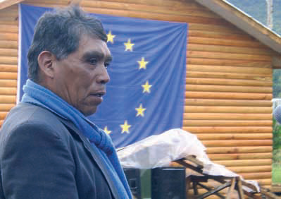
EU support to
Parliaments and
Political Parties
George Dura
DEVCO B1
Democracy Sector

Slide 2
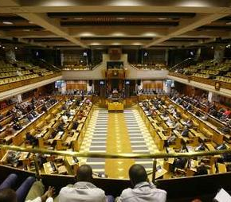
Parliamentary Support
Parliaments are a key component of every democracy
Important entry point for popular participation and domestic accountability
Strengthening Parliamentary Functions
  Legislative
  Representative
  Oversight
  National Budget

Slide 3
Parliamentary Support
Relatively young field in democracy support
Support through capacity building and/or budget support programmes
Traditional parliamentary support focused on:
  Capacity building of MPs and administrative staff
  Strengthening internal organization
  Strong focus on Lawmaking

Slide 4
Parliamentary Support Today: The Way Forward
Need to refocus support on strengthening oversight, outreach and representation
  Areas of attention: National budget process, security sector
Connect Parliament with citizens: CSOs & Media
EIDHR: support to parliamentary monitoring, watchdog CSOs, thinks thanks – facilitating interaction CSOs & Parliamentary Committees
Need to integrate parliamentary support in broader democratic and/or transitional processes (+ newly elected parliaments)

Slide 5
An EU project strengthens the involvement of Morocco’s parliamentarians in the state’s budgetary process and serves to help them better understand technical issues behind it as well as strengthen their involvement in the Ministry of Finance’s ongoing reform of Morocco’s finance law.

Slide 6
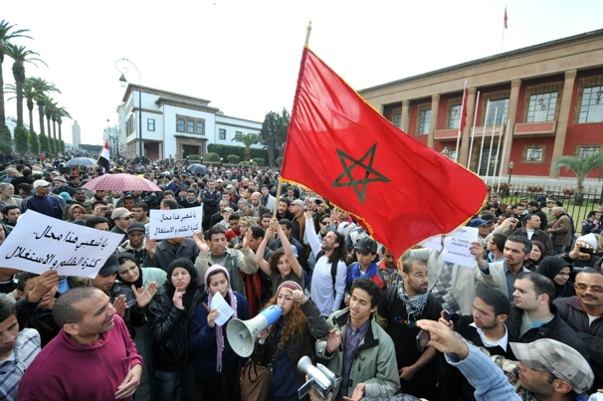
Morocco
Specific project on strengthening domestic accountability and Morocco’s parliament – through EIDHR with only 100000 EUR
Aim: strengthening Morrocan MPs’ involvement in the national budgetary process and their involvement in the reform of Morocco’s finance law, by
  Targeting 30 MPs from different political parties
  Training activities, analytical reports, reflexion workshops
Main project outcomes:
  Authoritative multi-party report, serving as a reference manual and outlining the Parliament’s vision on budget reform.
  Proposed legislation
  political enhancement of the Moroccan Parliament and strengthened the balance of political institutions.
  Senegal, Kyrgyzstan

Slide 7
Several models of parliamentary strengthening
1. Short-term, ad hoc to develop the capacity of parliament (MPs + staff) on functions, procedure and duties.
2. Multi-year programmes focused on focused on institutional and organisational reform.
3. Integrated multi-year democracy programmes with parliaments as only one element of the programme and also including support to other democratic institutions and organisations.
4. Issue-based programmes to achieve more targeted, policy objectives, either as a project or as a broader sectoral programme.
  Need to work on outreach of parliaments to CSOs, media, political parties and constituencies.
Notes:
EU consensus on Development, Cotonou revision II, Council conclusions on democracy support
Paris & Accra Aid effectiveness commitments and related new aid modalities require also a different approach (i.e. ownership in policy making beyond executive, Direct Budget Support & mutual accountability and domestic accountability systems)
All this requires more involvement of parliaments and more and better support to Parliaments
7

Slide 8
Effective parliament support programmes
understand political economy of the parliaments and use PEA in programming
driven from within – either by MPs/staff/CSOs – with interventions tailored according to needs/demand
treat parliaments as part of the broader political system and domestic accountability mechanisms
work around specific policy issues rather than generic activities
encourage south-south learning
long-term approach and realistic about what can be achieved
Notes:
EU consensus on Development, Cotonou revision II, Council conclusions on democracy support
Paris & Accra Aid effectiveness commitments and related new aid modalities require also a different approach (i.e. ownership in policy making beyond executive, Direct Budget Support & mutual accountability and domestic accountability systems)
All this requires more involvement of parliaments and more and better support to Parliaments
8

Slide 9
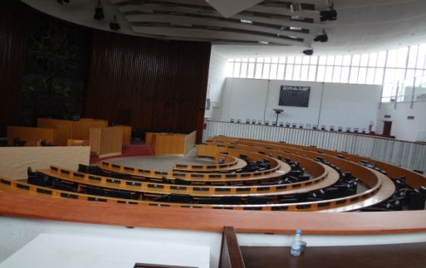
EU support to the National Assembly of Senegal
Assessment of Parliament’s needs (political economy)
High-level buy-in and support (Speaker – President) – push for adoption of broad reform strategy (R&P)
Ownership of reform agenda
Timing – new legislature, 90% new MPs (clean slate)
45% women MPs – tailor programme to their needs
Oversight budgetary process: increase interaction with SAI, MinFin, MinGov (DA strengthening)
Outreach – create links with CSOs providing policy input to various Cttees + promoting broader debate on media law
Election follow-up
Cross-party issues – anti-corruption caucus, women’s group
Support staffing and revision of career structure
infrastructure, interpretation services (entry-point)

Slide 10
2010 Reference Document: ‘Engaging and supporting Parliament worldwide’
Review of EU policy framework and past experiences in parliamentary support worldwide
Guidelines and Strategies for Programming and Implementation
Importance of preconditions and assessment phase: Parliamentary Assessment Framework
Notes:
EU consensus on Development, Cotonou revision II, Council conclusions on democracy support
Paris & Accra Aid effectiveness commitments and related new aid modalities require also a different approach (i.e. ownership in policy making beyond executive, Direct Budget Support & mutual accountability and domestic accountability systems)
All this requires more involvement of parliaments and more and better support to Parliaments
10

Slide 11
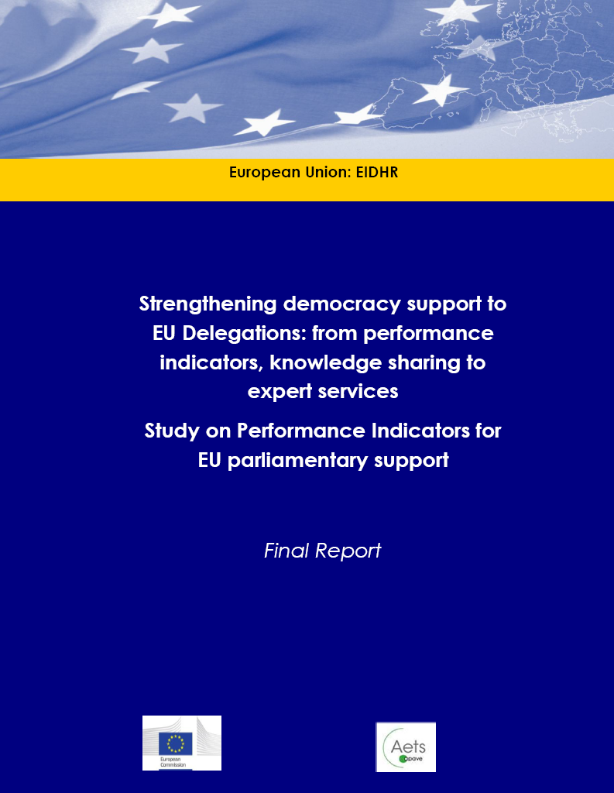
Performance Indicators
for EU Parliamentary Support (2012)
Improve the design and implementation of parliamentary support projects
Seven theme areas of parliamentary support: Legislation, Oversight, Budget, Representation, Administration, Inclusivity and Institution-building
Identify positive impacts of parliamentary support projects on the effectiveness of parliaments in carrying out their functions
Notes:
Electoral cycle and its integration into broader democracy support
Cost of election issue; use of ICT
Training and practical guidance tools for EMBs and electoral support community of practice
Costs of elections & Use of ICT in elections

Slide 12
EU support to political parties
Often the weakest link in emerging democracies
Too often neglected by international aid
Yes, it is delicate business, but multiparty support should be considered as an essential part of democracy support
Focus on
  Legal framework
  Capacity building: internal organisation, internal democracy, agenda setting, campaigning
  Party-to-party dialogue
Integrated as part of electoral and parliamentary support
EIDHR: while indeed we cannot fund specific parties, we can support parties through political foundations and CSOs (e.g. Tunisia)

Slide 13

An EU project implemented by the Konrad Adenauer Foundation and local partners strengthens emerging political parties. The project has been key in promoting dialogue surrounding issues such as the electoral process, freedom of expression and political tolerance through the organization of debates and trainings, bringing together the key concerned actors, be they political parties, NGOs or institutions. It has also supported more pragmatic, but pivotal, aspects for political parties such as the role of a party and its organizational structure in a democracy, covering topics such as the selection of candidates, the role of women, and keeping MPs and party leaders in touch with the electorate.

Slide 14
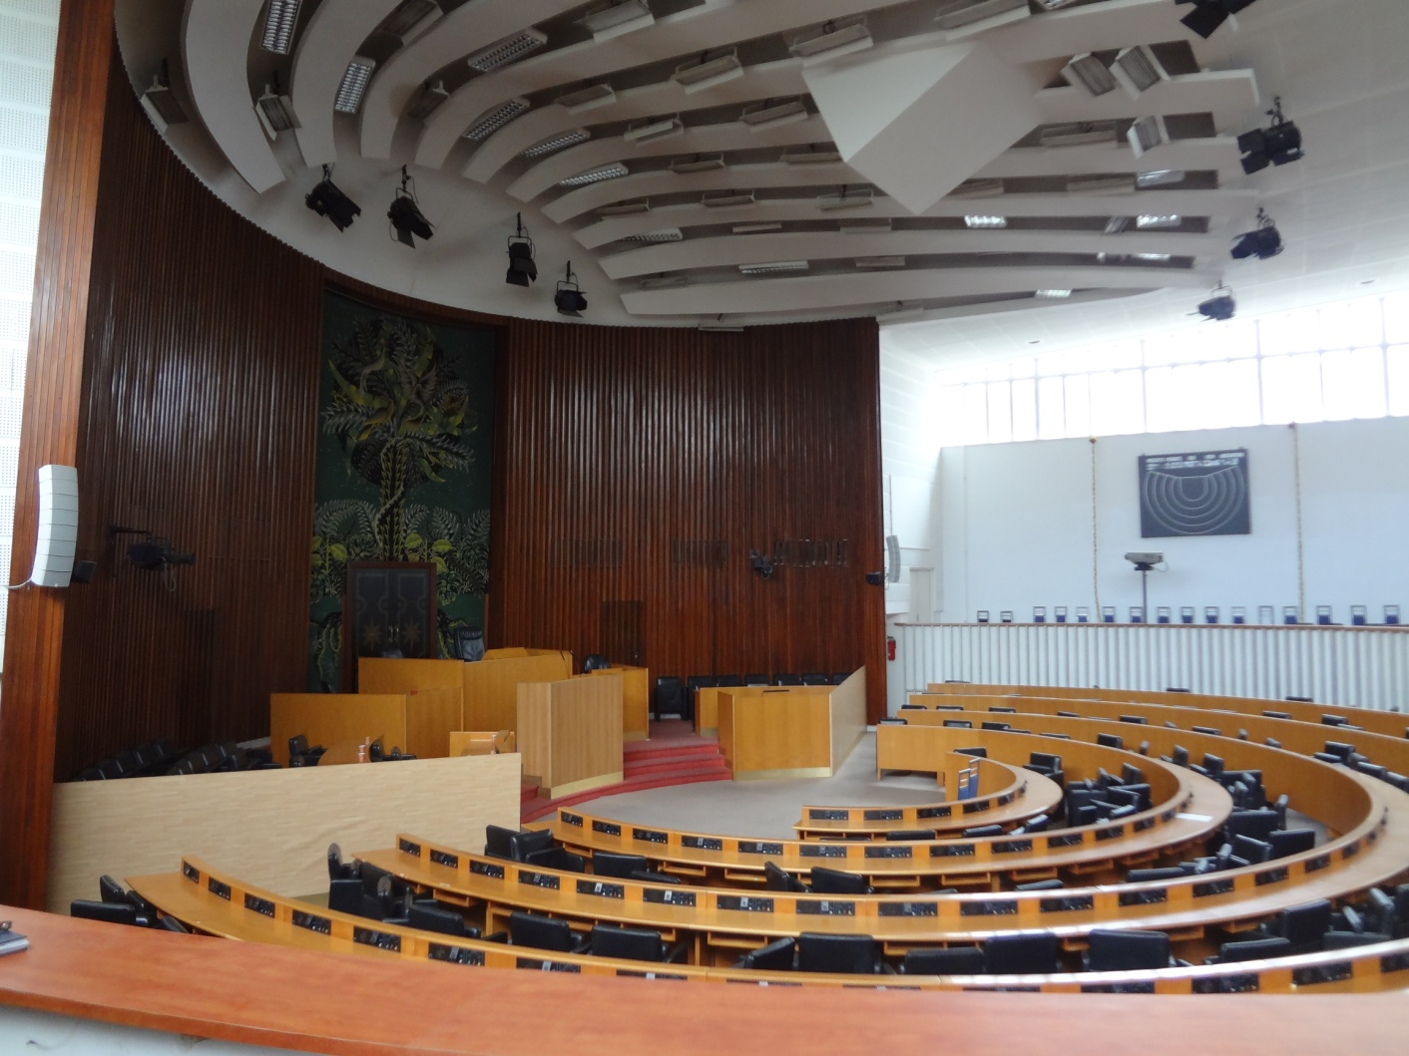
Thank you for your attention

