Slide 1




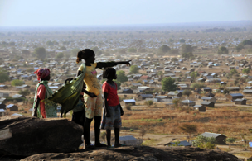
Joint Programming
Policy & Practice

Slide 2

What we’ll cover
What it is
Why it helps
What we’ve agreed
What’s happening on the ground
Some challenges

Slide 3
What we’ll cover
What it is
Why it helps
What we’ve agreed
What’s happening on the ground
Some challenges

Slide 4
How would YOU define it?
Notes:
Ice-breaker: give participants a couple of minutes to write down, in one sentence, what they think JP means. Then collect and read out (anonymously).

Slide 5





1. Joint Country Analysis
2. Joint EU Programming Document
Response to national plan, aligned to its duration. Format up to HoMs but including: priorities, common positions, DoL, indicative sector funding
3. Individual bilateral implementation plans
(not strategies)
How each will implement in their sectors. Own format but duration aligned to Joint EU Programming Document. EU’s is the MIP.
Notes:
Mention that synchronised timing of the JP Doc and BIPs with the nat plan / electoral cycle is key.

Slide 6
“The strategy would not go into details of how individual DPs carry out their work, i.e. aid modalities, individual initiatives to be pursued… instead left to bilateral implementation plans”
Notes:
Emphasis that you still get to decide the details of what you do in your own way.

Slide 7

Top Five Fears
✗
1: Brussels will decide what we do
2: EU MS not present on the ground will decide what we do
3: We’ll have to use EU templates, procedures & timetables
4: I’ll have to scrap my bilateral implementation plan
5: All our projects will have to be implemented jointly & simultaneously
Notes:
Explain why each of these common misconceptions about JP is not true.

Slide 8
What it is
Why it helps
What we’ve agreed
What’s happening on the ground
Some challenges
Notes:
Transition slide: we’ve covered ”What it is “ and now we’re going to look at “Why it helps”. But first ask if there are any questions on the preceding section.

Slide 9
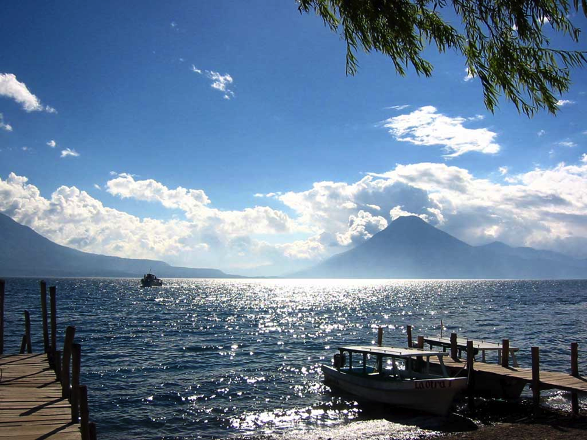
Any ideas?
Notes:
Ask participants to suggest ideas and then write them up on a flip chart, etc. Could ask them to prepare it in pairs, giving them 5 minutes to do so.

Slide 10
P a r t n e r C o u n t r y
Ownership & alignment ⬆
Predictability & transparency ⬆
Aid fragmentation ⬇
Transaction costs ⬇
D o n o r s
Influence ⬆
Ability & willingness to do DoL ⬆
Pressure to do everything myself ⬇
Bang per buck ⬆
Visibility ⬆

Slide 11

The Aid Effectiveness Argument in Practice
Laos
How many projects do European donors have in Laos?
300 (total 1,200)
What % of donor projects are under $1m ?
91%
And under $100,000 ?
65%
Notes:
So, having outlined the potential advantages of JP, this and the next slide look at how you might “sell” those advantages in practice. This slide is demonstrating aid fragmentation in Laos – and was used to convince donors they did have a problem, one that JP could help solve. For the questions (“How many projects? etc.), ask participants to guess the answers before you show them.

Slide 12

The Influence Argument in Practice
Cambodia
EU vs. China: Share of Aid
Notes:
One of the other advantages of JP is giving donors a stronger voice, joint policy positions etc. This slide was used in Cambodia to help convince donors that a joint voice, one that JP could help provide, was needed in light of the increasing influence of China in the country.

Slide 13
What it is
Why it helps
What we’ve agreed
What’s happening on the ground
Some challenges
Notes:
Transition slide: we’ve covered ”Why it helps“ and now we’re going to look at “What we’ve agreed”. But first ask if there are any questions on the preceding section.

Slide 14
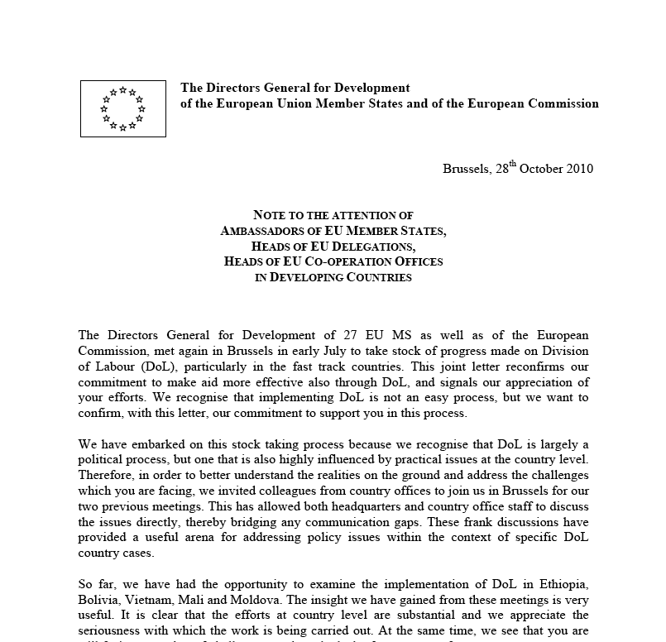

Commitments
1974 on…Various commitments & Council Resolutions promoting JP
2007
2009
2010
Code of Conduct on Division of Labour: 3 sectors each and towards JP.
Lisbon Treaty: can do common development policy.
Operational Framework on Aid Effectiveness: JP based on national strategies by 2014 in priority countries.
Letter from all EU Development DG’s to all EU Ambassadors
“increase the participation in joint multi-annual programming based on partner countries' development strategies…. advance division of labour...
“selected number of countries…fully operational by 2014”
“progressive synchronisation of EU and national programming cycles at partner country level."
Notes:
I have not gone through every single commitment – this will be boring, they will not remember them, + we can give them the two page summary of all the commitments as a hand-out.

Slide 15

The Study - 2011
How ready are the EC and EU MS to synchronise their programming?
What’s the situation on the ground?
3. What should we do next?
Notes:
This is what EU Ministers asked the study find out.

Slide 16
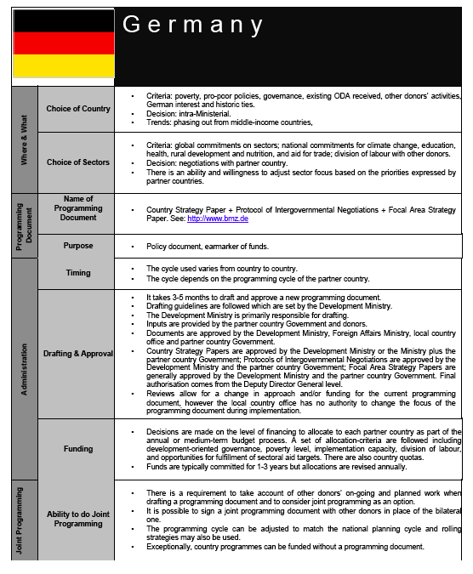
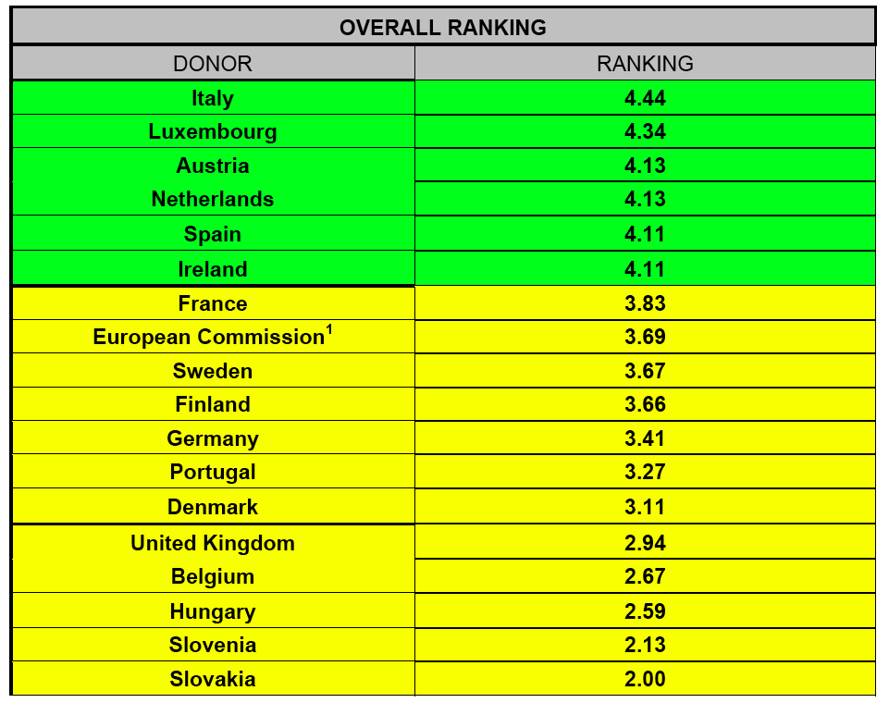
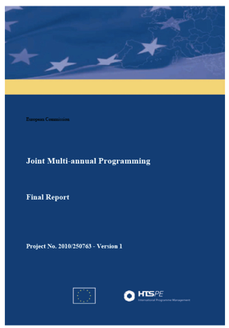
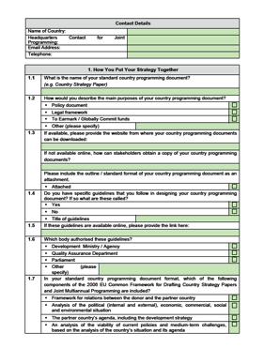
The Study - 2011
We have enough commitments….we need to be reminded of them
Clarify what JP is and isn’t
A JP should = change on the ground, so far so bad
Common timing is key BUT local not global
No templates please
Enabling environment, not diktat; high-level endorsement then bottom up
★ 68% can change their programming cycle to country’s
★ 67% could sign a JP document that “that sets out shared analysis & objectives, then divides implementation activities”
Notes:
So we finished the study in 2011 (pictured), following an extensive questionnaire (pictured) to MS, and interviews with donors on the ground in partner countries. We produced a fiche showing how each MS does their programming and their ability to do JP (pictured) and even tried to rank donors (pictured) to show their readiness for JP. Then the key findings are given.

Slide 17

Busan High Level Forum 2011
EU Common Position commits to joint programming and urges others to do the same. Defines it as:
Synchronisation to national cycle
Alignment to national plan
Response to national priorities
Identification of priority sectors
Division of labour
Indicative financial allocations per sector & donor
+ the EU Transparency Guarantee

Slide 18
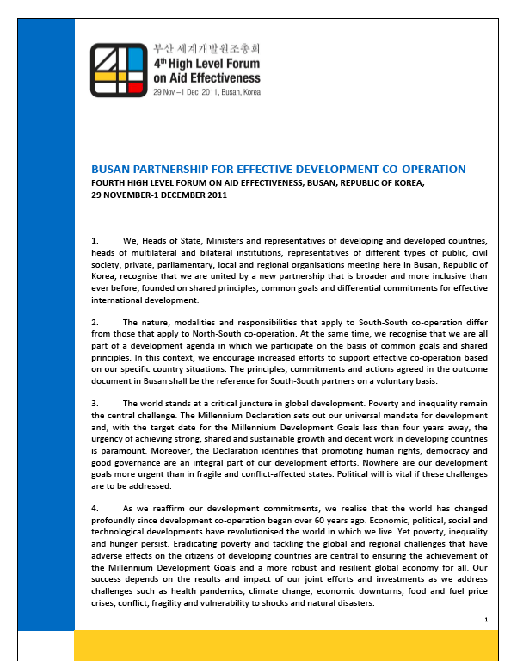
Busan also agreed on:
More inclusive partnership – new donors, private sector, CSOs, etc.
Move from aid to development effectiveness
New “Global Partnership for Effective Development Cooperation” – agreed indicators & monitoring in July 2012
More locally agreed compacts, less top down global commitments

Slide 19


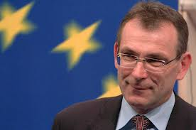
Commissioners’ Letter to Ministers
Jan 2012
Joint programming at partner country level
Synchronise cycles
Agree on analysis, priorities, DoL, €
Brussels only adopts the EU part
Pilots: Afghanistan, Bangladesh, Ethiopia, Ghana, Guatemala, Laos, Mali, Moldova, Rwanda, Tunisia, Ukraine – HoMs Reports

Slide 20

Agenda for Change 2012
“JP to reduce fragmentation and increase impact”
“Programming process… largely carried out on the ground”
“Synchronised with the strategy cycles of partner countries”
“Single joint multi-annual programming document…sectoral division of labour and financial allocations per sector and donor.”
“The EU and Member States should follow the document when devising their bilateral implementation plans”
“Concentration of EU activities in each country on a maximum of three sectors”

Slide 21
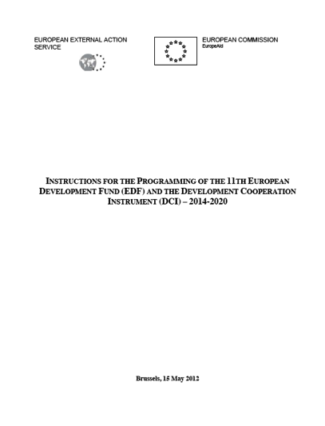
New EU Programming Guidelines
No CSP – base on national strategy
Synchronise to the national cycle “a requirement for launching a JP process” – strategy + MIP
FIRST agree an analysis of the national plan / JP document
SECOND formulate a MIP
JP document: analysis, rationale, DoL, indicative €
Open: consult, invite other donors, ensure Gov involvement, build on existing joint work
Only 3 Sectors “in the narrow sense” and budget support counts…

Slide 22
What it is
Why it helps
What we’ve agreed
What’s happening on the ground
Some challenges
Notes:
Transition slide: we’ve covered ”What we’ve agreed“ and now we’re going to look at “What’s happening on the ground”. But first ask if there any questions on the preceding section.

Slide 23
Commissioners’ Letter to Ministers
Jan 2012
Afghanistan, Bangladesh, Ethiopia, Ghana, Guatemala, Laos, Mali, Moldova, Rwanda, Tunisia, Ukraine
Notes:
So, going back to the pilot countries and saying that the ones in green have JP going ahead, the ones in red don’t, Mali is a special case. Then mentioning additional countries that have come up and that more are expected.

Slide 24
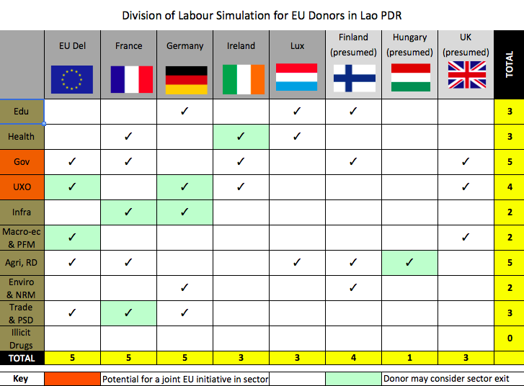


 | 2011 | 2012 | 2013 | 2014 | 2015 | 2016 | 2017 | 2018 | 2019 | 2020
GoL | NSEDP-7 |  |  |  |  | NSEDP-8
EU | <<
Finland
France | <<
Germany
Ireland
L'bourg
Australia | <<
Japan
Korea
Switzerland | <<
UN
L a o s
Notes:
JP in practice in Laos. First, what programming cycles looked like and thus the rationale for going for a transitional strategy first to take us up to the start of the new national strategy, at which point we plan a full JP doc. Then showing DoL ideas – as per the key, green shaded cell shows where donor is considering sector exit due to other donors’ presence. Orange shaded cell shows where a joint EU initiative in terms of implementation is being considered due to multiple donors in the sector.

Slide 25
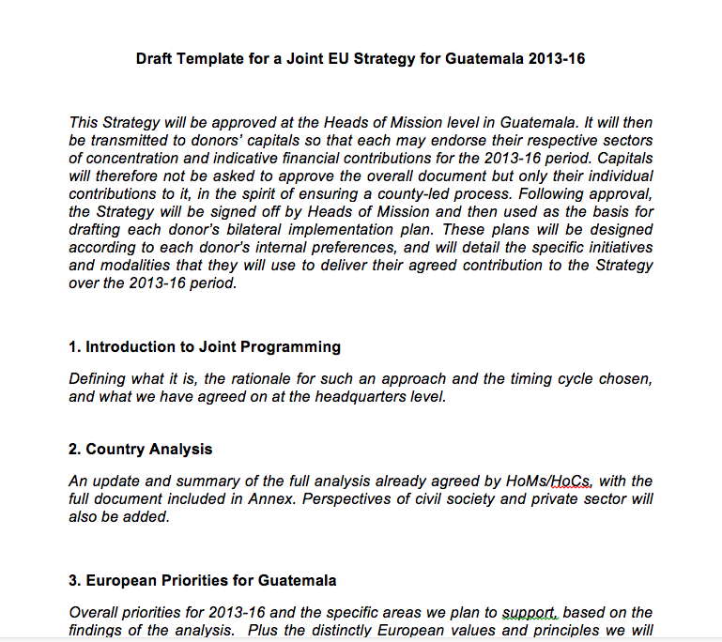


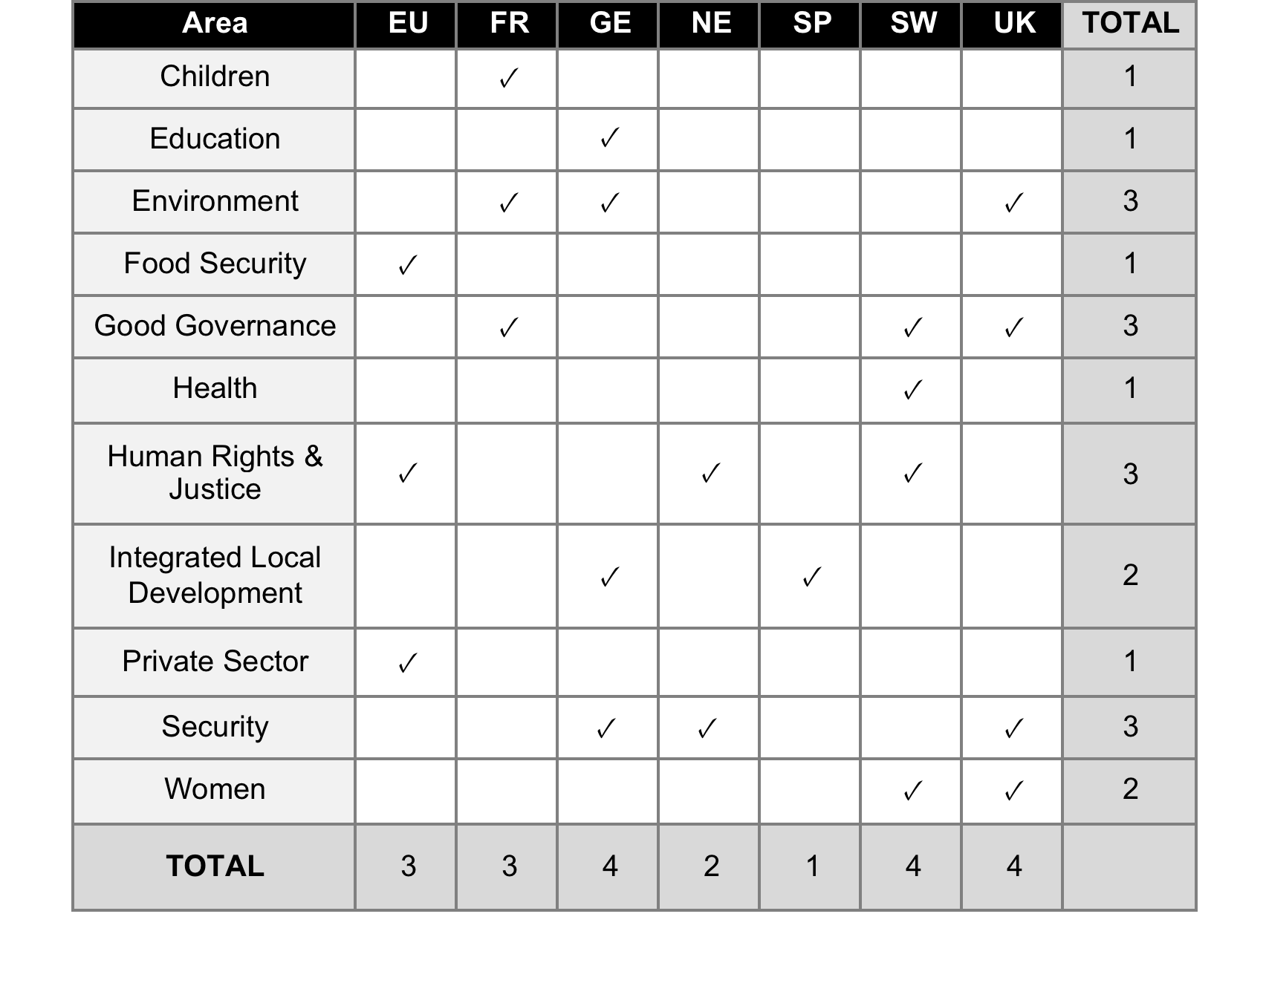
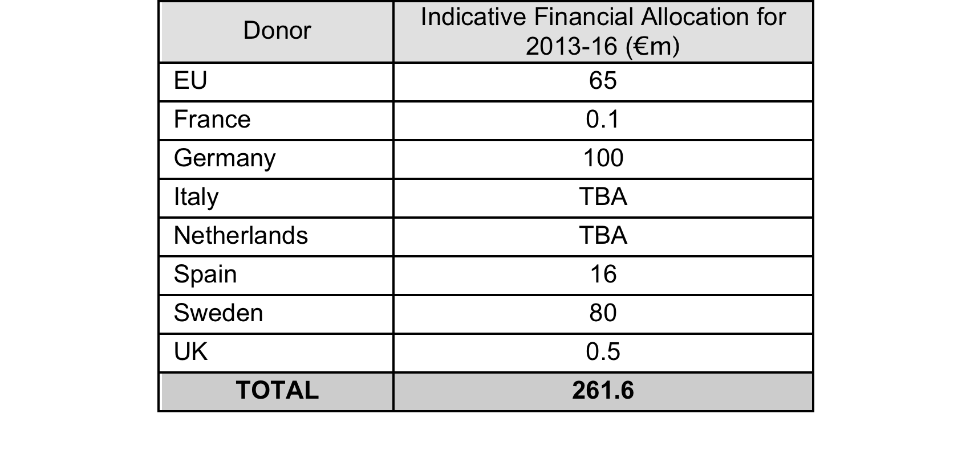
G u a t e m a l a
Notes:
First showing DoL that was agreed, then JP template - read out section headings which were: Introduction to Joint Programming; Country Analysis; Perspectives of Congress, Emerging Donors, Civil Society and the Private Sector; European Priorities for Guatemala; Common Positions; Division of Labour; Development Effectiveness; Monitoring and Reporting. Then indicative financial allocations.

Slide 26


R w a n d a
Strong Gov
Existing Division of Labour
Want all donors sync’d to better support national strategy
Notes:
Example of country where Government has led the process.

Slide 27


S o u t h S u d a n
Donor & Juba led
One Strategy with priorities, sectors, leads & financials
Synchronised to national plan
Some involvement of non-EU donors
Doesn’t cover all sectors
Some work to do on DoL
Some MS still have country strategy papers

Slide 28
Joint Programming State of Play (1)
  West Africa: Benin, Burkina Faso, Ghana, Ivory Coast, Liberia, Mali, Mauritania, Niger, Senegal, Sierra Leone, Togo
  Central Africa: Burundi, Chad, Rwanda
  Eastern Africa: Comoros, Ethiopia, Kenya, Somalia, South Sudan, Tanzania, Uganda.
  Southern Africa: Malawi, Mozambique, Namibia, Zambia, Zimbabwe.

Slide 29
Joint Programming State of Play (2)
  Asia/Pacific: Afghanistan, Bangladesh, Myanmar, Cambodia, Laos, Nepal, Pakistan, Philippines, Vietnam, Yemen, Timor Leste.
  Latin America and Caribbean: Bolivia, Guatemala, El Salvador, Haiti, Honduras, Nicaragua, Paraguay
  Neighbourhood East: Armenia, Georgia, Moldova, Ukraine.
  Neighbourhood South: Algeria, Egypt, Jordan, Libya, Morocco, Occupied Palestinian Territories, Tunisia.

Slide 30
Joint programming progressing
(end June 2013)
  In total 55 countries assessed:
  - 12 countries JP process started
  - 25 countries where JP agreed (short- mid- or long-term)
  - 15 countries with potential (but we wait for 4 HoMs reports, reply or new developments in another 11
  - 3 have no potential now…..

Slide 31
What it is
Why it helps
What we’ve agreed
What’s happening on the ground
Some challenges
Notes:
Transition slide: we’ve covered ”What’s happening on the ground “ and now we’re going to look at “Some challenges”. But first ask if there are any questions on the preceding section.

Slide 32
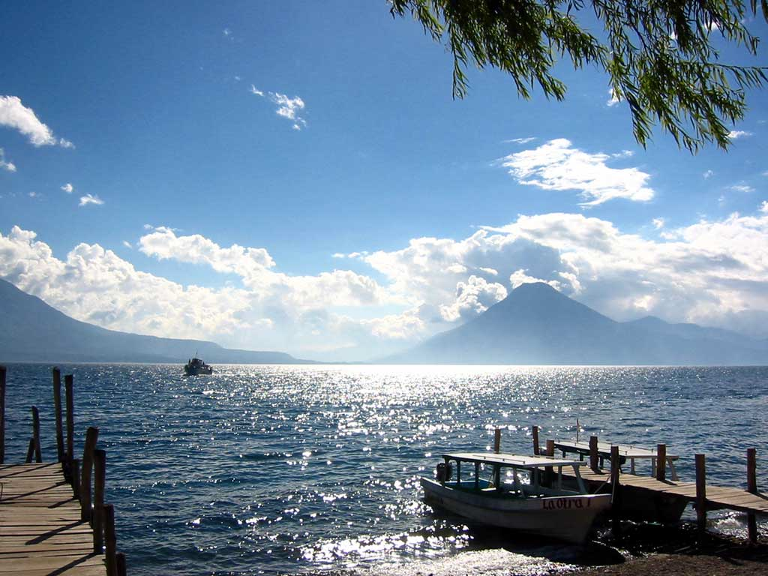
Challenges
Any flaws in the plan?
Notes:
Ask participants what they believe may be the challenges, including their practical experiences, if any.

Slide 33
Challenges
Centre vs. local gap – perspective, communications
Control, interests, visibility, personalities
Joint vision?
Willingness to change cycle
De-linking planning from financing
Bureaucratic hurdles
Information & sector definitions
Out of control aid – thematic funds etc.
Government – risk management

Slide 34
Joint Programming
Policy & Practice
Thank you! For more please see:
http://capacity4dev.ec.europa.eu/joint-programming/

