Slide 1
The European Employment Strategy for non-Europeans
Robert Strauss
Employment Analysis
DG Employment, Social Affairs and Inclusion

Slide 2
Context
Many shared experiences between EU and other, developed and developing, countries
Employment essential for growth and social cohesion
Challenges: demographics; sustainability (low carbon); globalisation
EU 2020 goals and the Annual Growth Survey
The European Employment Strategy aims to:
  More and better jobs
    Support job creation
    Restore the dynamics of labour markets
    Strengthen the governance of employment policies
Notes:
Shared experiences includes the financial crises, resulting recession, and general social unrest resulting from too much unemployment.
Employment is a necessary precondition for a healthy economy as well as for well-functioning, prosperous and happy societies.
Youth Unemployment is a major problem that effects both developing countries as well as the EU
As will be outlined in this presentation, the EU set targets for 2020 which include employment targets. Every year an Annual Growth Strategy is made to set out the priorities aligned with the EU 2020 strategy. The European Employment Strategy work in tandem with these policies all aimed at boosting employment.
Through the measures mentioned in this presentation, and particularly those concerned with the Employment Package of the European Employment Strategy, initiatives are being implemented to support employment through:
Supporting job creation: reducing taxes on labour, using hiring subsidies effectively, and exploiting the potential of key sectors, such as green economy, ICT, or health and care sector.
Restoring labour market dynamics: helping workers succeed when changing jobs or getting back into work, mobilising all actors to implement the reforms required, investing in skills based on better forecasting and monitoring of needs, promoting the free movement of workers
Governance of Employment Policies: reinforcing their monitoring with the EU countries so that employment and social concerns do not lag behind economic ones.

Slide 3
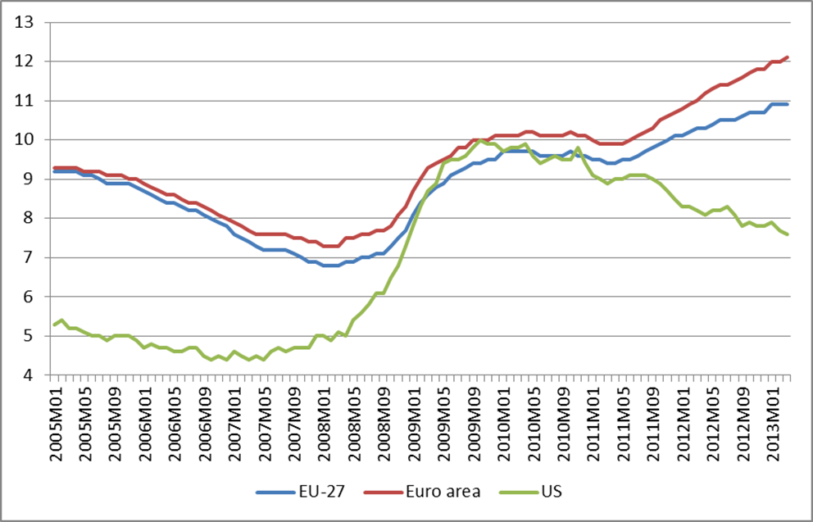
Rising unemployment, especially in euro area
Unemployment rates in the EU and the US

Slide 4
Europe 2020: the EU’s growth strategy
Strengthened EU economic governance
Macro-economic & fiscal surveillance
Regulation of
financial services
Targets and guidance
for structural reforms
Flagships for smart, sustainable and inclusive growth
Digital
Agenda
Youth
on the Move
Innovation
Union
New
Industrial Policy
New Skills
and new Jobs
Platform against
Poverty
Resource
Efficiency
Modernised EU levers for growth and jobs
Single Market Act
Trade and
external policies
Structural Funds
and future EU budget
Notes:
To ensure that the Europe 2020 strategy delivers, a strong and effective system of economic governance has been set up to coordinate policy actions between the EU and national levels. At the heart of these is a yearly cycle of economic policy coordination (European Semester) with EU level policy guidance by the European Commission and Council, reform commitments by the Member States and country-specific recommendations prepared by the Commission and endorsed at the highest level by national leaders in the European Council. These recommendations should then be taken on board in the Member States' policies and budgets.
Seven ‘flagship initiatives’ provide a framework supporting the Europe 2020 priorities. Three fall under the areas of employment, social affairs and inclusion :
-Youth on the move: to improve young people's chances of finding a job by helping students and trainees gain experience in other countries, and improving the quality and attractiveness of education and training in Europe;
-An agenda for new skills and jobs: aims to give fresh momentum to labour market reforms to help people gain the right skills for future jobs, to create new jobs and overhaul EU employment legislation;
-European platform against poverty and social exclusion: aims to bolster work at all levels to reach the agreed EU headline target of lifting at least 20 million people out of poverty and exclusion by 2020.
.

Slide 5
EU targets agreed for 2020
EMPLOYMENT 75% of the population aged 20-64 should be employed
INNOVATION 3% of the EU's GDP should be invested in R&D
CLIMATE/ENERGY A reduction of greenhouse gas emissions by 20%
A share of renewable energies up to 20%
An increase in energy efficiency by 20%
EDUCATION The share of early school leavers should be under 10%
At least 40% of the younger generation should
have a degree or diploma
POVERTY At least 20 million people lifted out of poverty
Notes:
The strategy is focused on five ambitious goals in the areas of employment, innovation, education, poverty reduction and climate/energy.

Slide 6
Annual Growth Strategy
The AGS communication sets out the economic and social priorities for the EU in 2013.
Launches the next European Semester.
Provides guidance to Member States, which they can use to prepare their national reform programmes.
Includes two annexes, the Macro-economic Report and the Draft Joint Employment Report.
Accompanied by the separate publication of the Alert Mechanism Report and Single Market Report.
A Blueprint for a deep and genuine EMU
Notes:
AGS sets out priorities at the EU level and for member states, and signals the beginning of the European Semester.
Of particular important for the purposes of this presentation however is the annex to the AGS entitled the "Draft Joint Employment Report" This will be delved into in the following slides.

Slide 7
Joint Employment Report-
Current labour market challenges
Boost job creation that has been subdued and decreasing in recent years
Improve the resilience of the labour market to ensure adjustments
Improve the job matching process
Maintain the labour market attachment of long-term unemployed
Improve the transitions from school to work of young people
Improve the efficiency of social protection systems to combat poverty and social exclusion
Notes:
Labour market conditions have shown some weaknesses post-recession. Job creation is clearly a major objective of the European Commission and there is no doubt that there is still work to do in this area.
Matching jobs across the EU is vital, especially with an eye to encouraging cross-border employment opportunities which is a key priority of the Commission. Preventing disenchantment and seeking to prevent the long-term unemployment trap is vital. There is a need to make sure keep searching for jobs and in the labour force while working to facilitate new employment opportunities for this group. As far as youth unemployment, a very important policy area that will be expanded on later, rapid transition from school to work is essential.
Finally it is important to briefly mention social protection systems. Though employment is the focus of this presentation social protection goes hand in hand with employment policies and efficiency should be stressed to guarantee schemes that alleviate poverty and social exclusion.

Slide 8
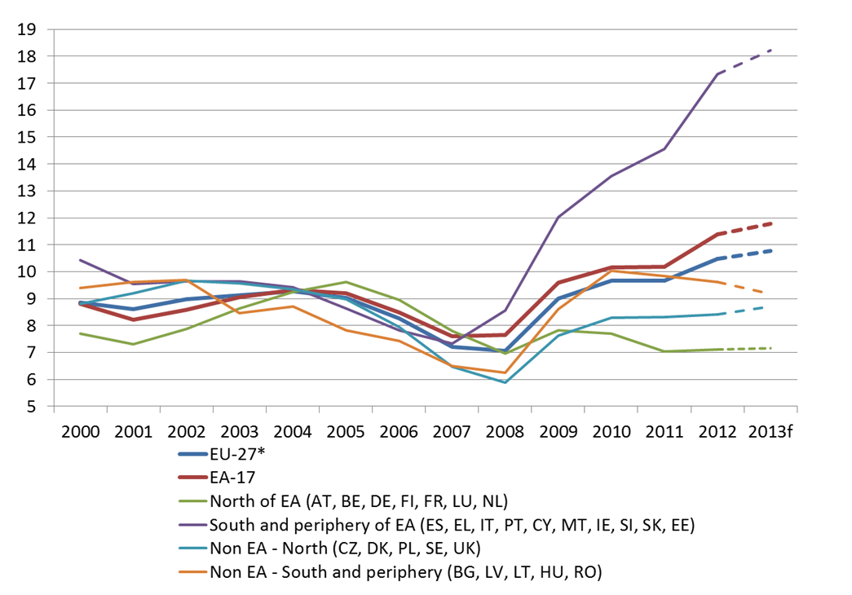
Divergence accelerating in the EA
Striking North / South Divide

Slide 9
What is the Employment Package?
It is a medium-term agenda for EU and Member States' action. It lays down proposals for employment to be a driver for growth, by:
Stimulating labour demand through well-designed measures (e.g. green economy, white jobs, ICT)
Balanced reforms for more inclusive, dynamic, competitive and resilient EU labour markets
Investing in skills policies to enhance workforce mobility and adaptability prospects
Strengthening the employment & social dimension in EU governance, by involving Social Partners more closely in decision making
Notes:
To underpin and sustain the focus on medium and long term employment challenges of the Europe 2020 strategy, the Commission on 18 April 2012 adopted the Employment Package "Towards a job rich recovery".
The Employment Package is a clear message on the need for a stronger accent on job creation, in particular through shifting taxation away from labour and making a more effective use of hiring subsidies and by exploiting the potential of some key sectors, such as ICT, green jobs or healthcare sector.
-The Employment Package also calls for a balanced approach to labour market reforms so that they become more dynamic and inclusive. Fostering competitiveness by increasing the problems of segmentation and in-work poverty is not the right way. Decent and sustainable wages, providing incentives to make transitions pay and offering individual's means to maintain their employability, are essential.
-investment in skills is also considered as essential together with ways to identify the right skills and better forecast labour market needs and by trying to avoid skills mismatches through a rationalisation and integration of monitoring tools at the EU level.
Finally, the Employment Package also aims to create a genuine European Labour Market by improving labour mobility removing remaining obstacles to the free movement of workers transforming the EURES network into a true European placement and recruitment tool that will match and place jobseekers across borders
The Employment Package underlines the importance of mutual responsibilities to support transitions from unemployment towards employment. While taking into account the strained budgetary situation in most Member States, it is essential that benefits coverage is increased or maintained while the crisis is still having an impact. Activation requirements should be part of a mutual responsibilities approach that maintains incentives for work whilst ensuring income, providing personalised job-search assistance and guarding against the risk of poverty.

Slide 10
Priorities in Employment Package "Support Job Creation"
Stimulating labour demand, through:
  Targeting hiring subsidies towards new net recruitment
  Reducing the tax wedge on labour in a budgetary neutral way by shifting towards environmental, consumption or property taxes
  Promoting and supporting self-employment, social enterprises and business start-ups
  Transform informal or undeclared work into regular employment
  Boost 'take home' pay to fight in-work poverty or to encourage the take-up of work
  Modernise wage-setting systems to align them with productivity developments and support aggregate demand
Notes:
As far as the practical steps that to be taken to create employment opportunities there are many. Hiring subsidies to incentivize employers is one way. Shifting taxes away from labour to other forms of taxation can help lead to higher labour demand as well as other positive spill-over effects. For example, carbon taxes result in a "positive externality" of a cleaner environment as well as potentially shifting the tax burden from labour.
Informal and undeclared work is a problem in the EU but is even more pronounced in developing countries. Transferring this into regular employment is a goal because this group in addittion to being outside of taxation, also lacks the social protection and workers' rights of regular employees making them particularly vulnerable. Increasing pay is necessary to make sure that employees receive enough money for a basic standard of living, as well as ensuring that employment is enticing to all potential employees.

Slide 11
Questions
Thank you for your attention

