Slide 1
From NAPAs to NAPs
and LEDS, Green LECRDS to NAMAs –
Frameworks to scale-up, coordinate
and mainstream climate action
Stephen Gold, Head, Green LECRDS Team,
Principal Technical Advisor - UNDP
Global Climate Change Alliance
European Commission
Brussels, 18 September 2013

Slide 2
Presentation Outline
Key trends and challenges
CC strategies as basis of integrated planning
Examples of capacity building initiatives that support CC strategy development
  NAP Support Programme
  Low Emission Capacity Building Support Programme
Green LECRDS
  Coordination and Mainstreaming
  Multi-Stakeholder Decision Making Processes

Slide 3
Trends
Countries are:
increasingly preparing LEDS, LECRDS, NAPS, NAMAs and other cross-cutting strategies to support their transitions to a low emission and climate resilient economy
recognizing inter-sectoral nature of adapting to “new reality” , i.e., role of key line ministries and other partners to reduce risks and mitigate emissions in integrated manner
facing critical challenges in implementing these strategies and actions: capacity, coordination, mainstreaming into development policy, financing

Slide 4
Key Challenges
National capacities are required to navigate complex landscape and allow countries to access different forms of relevant finance and deliver integrated development benefits
Funding mechanisms not widely established to deliver integrated CCA and CCM benefits; focus on one or another
Need to catalyze private finance: public finance alone is insufficient to meet demands of climate challenge, must catalyze greater volumes of private finance
Limited alignment between climate and development: to drive economy-wide transformation, and to mainstream climate expenditures into planning and development policy

Slide 5
Green LECRDS, NAPs, LEDS, NAMAs
A Basis of Integrated Planning
Strategic Planning
Assess needs and priorities, and identify barriers to investment
Directly access finance
Coordinated Implementation
Implement and execute project, programme, sector-wide approaches in integrated manner
Accessing Resources
Monitor, Report & Verify
Identify policy mix and sources of financing
Blend and combine finance
Monitor, report, and verify flows
Performance-based payments
Formulate project, progamme, sector-wide approaches to access finance
Build local supply of expertise and skills
LECRDS, LEDS,
NAPs, NAMAs
Supporting national systems to integrate climate and development helps countries to plan effectively and allocate finance, as well as identify appropriate sources of finance and policy mechanisms – LECRDS, LEDS, NAMAs, NAPs can form basis

Slide 6
NAPAs
NAPA follow-up projects under implementation
NAPA follow-up projects under development
Supported/supporting 34 NAPAs – 31 completed
Funded by the Least Developed Countries Fund – LDCF/GEF
Notes:
6

Slide 7
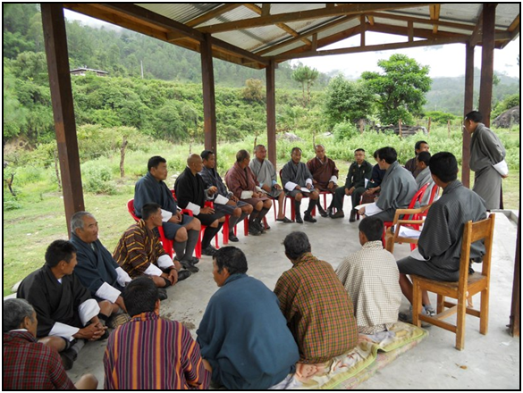
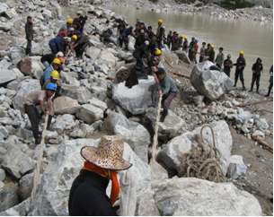
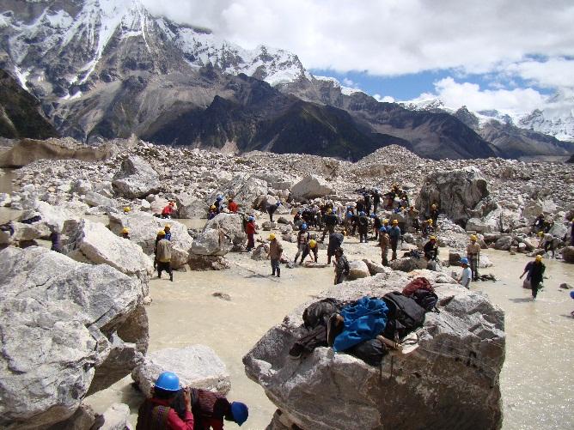
From supporting countries to prepare NAPAs to accessing finance to implement urgent priorities
Reducing Climate Change-induced Risks and Vulnerabilities from Glacial Lake Outburst Floods in Punakha-Wangdi and Chamkhar Valleys
Bhutan NAPA Process
31 countries- Supported to prepared NAPAs
50 LDCs – Supported to access climate finance to address adaptation needs

Slide 8
Capacity building support for
Enabling and foundational initiatives
Low Emission Capacity Building Programme (LECB)
  EC, Germany - BMU/ICI, Australia
National Adaptation Plan Support Programme (w/ UNEP)
  LDCF
National Communications Support Programme (w/UNEP)
  GEF
National Adaptation Programmes of Action (NAPAs)
  GEF
Climate Public Expenditures and Institutional Reviews (CPEIR)
  Canada-SIDA, multiple partners, LDCF, SCCF
Climate Finance Options website (w/ World Bank)
  World Bank, UNDP
NIE Accreditation Support Programme - AF Direct Access
  UNDP
GCF Readiness Programme (w/ UNEP, WRI)
  Germany

Slide 9
Capacity building support for
Enabling and foundational initiatives
Low Emission Capacity Building Programme (LECB)
  EC, Germany - BMU/ICI, Australia
National Adaptation Plan Support Programme (w/ UNEP)
  LDCF
National Communications Support Programme (w/UNEP)
  GEF
National Adaptation Programmes of Action (NAPAs)
  GEF
Climate Public Expenditures and Institutional Reviews (CPEIR)
  Canada-SIDA, multiple partners, LDCF, SCCF
Climate Finance Options website (w/ World Bank)
  World Bank, UNDP
NIE Accreditation Support Programme - AF Direct Access
  UNDP
GCF Readiness Programme (w/ UNEP, WRI)
  Germany

Slide 10
NAP Support Programme
  Project developed by UNEP and UNDP
    Together with GEFSEC, IFAD, WFP, UNITAR, WHO, GIZ
  $2 M USD, duration 2 years, financed by LDCF
  Leveraging and building on other ongoing initiatives
  Designed with inputs and suggestions made by LDCs, LEG and several key donors and is consequently establish a support mechanism around three main pillars
    Institutional support
    Technical support
    Knowledge brokering

Slide 11
NAP Support Programme
  To support LDCs to commence process of integrating medium- to long-term planning for adaptation to climate change within, or aligned with, current development planning and budgeting processes
    Identification of gaps (information, capacity [technical and functional], institutional)
    Making linkages to other ongoing initiatives
    Making tools and approaches available to LDCs to support key steps in NAP process
    Exchanging lessons learned and knowledge through South-South and North-South Cooperation.

Slide 12
Low Emission Capacity Building (LECB) Programme:
Objective: Build capacities to design and implement Low Emission Development Strategies and national mitigation actions in the public and/or private sectors
Five main work areas
  GHG inventory management systems
  Nationally Appropriate Mitigation Actions (NAMAs)
  Low-Emission Development Strategies (LEDS)
  Measurement, Reporting and Verification (MRV)
  Mitigation actions in selected industries/private sector
Funding: $40 million covering 25 countries; funded by European Commission, Germany and Australian Government.
Implementation period: 2011-16
Sectors: Energy, transport, industries, waste, agriculture. Industries include cement, fertilizers, mining, construction, chemicals

Slide 13
LECB Contribution to Addressing Capacity/Coordination/Financing Challenges
Design strategic, long-term national vision for
low-emission development aligned with national development goals
Remove technical, financial and institutional barriers to scaled-up mitigation action
Improve GHG emission scenarios and the underlying information base to ensure well-informed decision making and a business case for climate change mitigation
Assess sustainable development impacts (co-benefits) of NAMAs & LEDS and design systems to capture these impacts
Support climate finance “readiness” efforts, including how to catalyse public finance to attract private sector investments

Slide 14
LECB Contribution to Addressing Capacity/Coordination/Financing Challenges
Put in place a multi-stakeholder framework for coordination with relevant institutions, national steering committee, technical working groups
Maximise use of national experts with tailored technical assistance provided, based upon country needs
Focus on institutional capacity building to support a country-driven process to enhance the skills required for accessing finance and implementation
Learn from diverse capacities and experiences, ranging from LDCs to medium-income countries and large emerging economies

Slide 15
LECB – Implementation challenges
A country-driven process subject to political changes
Priority setting for NAMAs are very lengthy and complex due to competing agendas among sectoral ministries
Scope of work (i.e. number of sectors and NAMAs) tends to be overambitious
Implementation of mitigation actions and MRV politically charged in many countries
Incipient institutional support to NAMAs and LEDS
Weak technical capacities to undertake thorough NAMA formulation and implementation

Slide 16
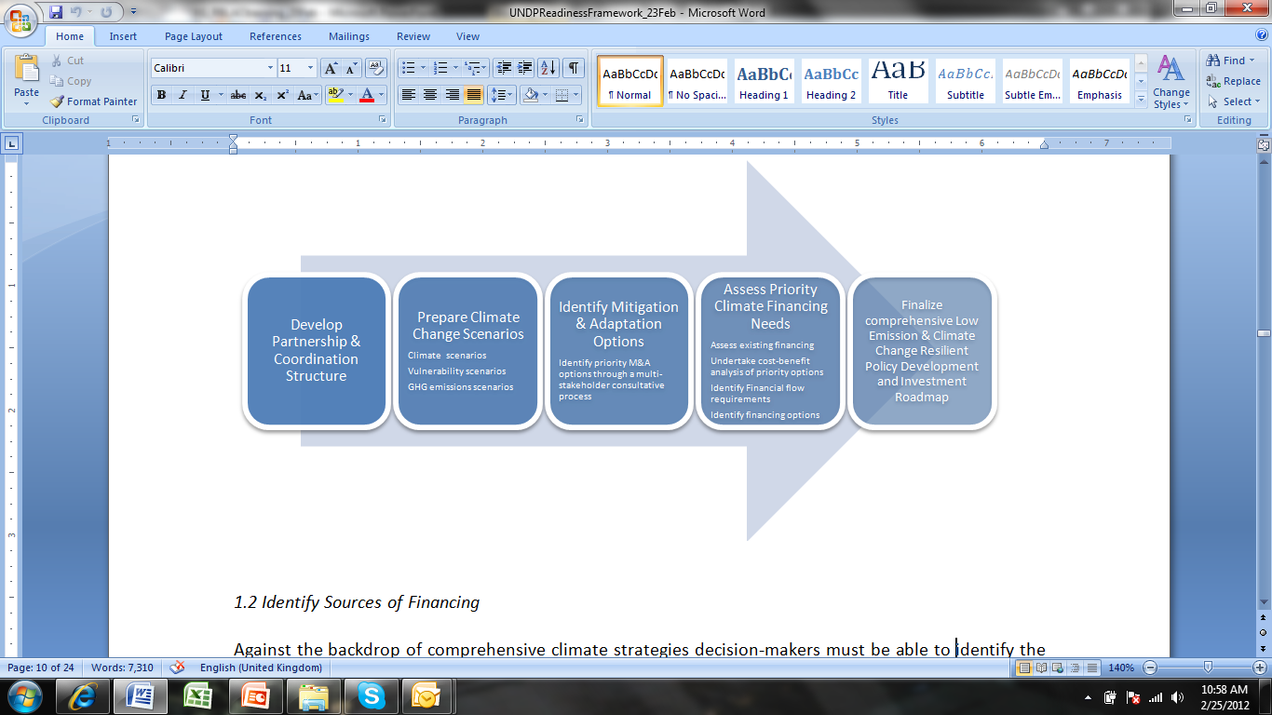
Planning framework - Green Low-Emission Climate-Resilient Development Strategies (Green LECRDS)
Bottom-up national ownership
Bridging needs assessments and priority setting processes
Incorporate human development goals
Long term integrated planning
Notes:
An umbrella for this planning work is the preparation of green, low-emission and climate-resilient development strategies. These strategies provide a vehicle for bringing needs assessments and priority setting processes together. They aim to bring about bottom-up national ownership, incorporate human development goals and take a long-term outlook.

Slide 17
Green LECRDS
View CCA and CCM actions in a holistic manner
  Embedded in national/sectoral development processes
  Longer term while addressing short term needs
  Transformational
  Enabling environments
Assist countries to leverage funding from public & private sources
Involve a wide range of sectors, target public and private sectors, and build on relevant initiatives
Assist countries to build the institutional capacities for implementation and to support a transformational vision

Slide 18

Coordination and Integration -
Elements to Consider
Multi-Stakeholder Decision Making Processes

Slide 19
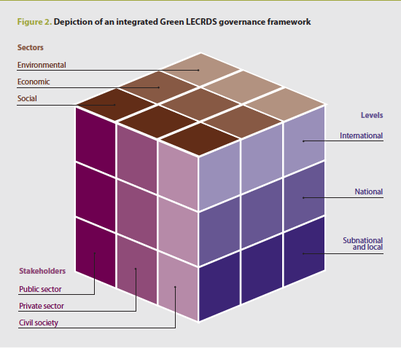
Multi-level, multi-sector, multi-stakeholder
governance framework
Notes:
This figure illustrates the interconnectedness among social, economic, and environmental sectors; local, national, and international levels; and public, private, and civil society stakeholders that the Green LECRDS governance framework aims to capture.
The extensive consultation processes involved at all levels can lead to increased public awareness of climate change science and policy, sustainable development priorities and planned actions.
The first step in establishing a Green LECRDS governance framework is to identify the different actors across levels of government: international, national and subnational (regional, cities, communities).
The second step uses a multi-sector approach to assess existing policies, regulations, financial flows, etc. to determine how to best integrate climate change and sustainable development policy and planning.
The third step focuses on the identification of multi-stakeholder groups—public sector, private sector and civil society—who should be consulted and actively engaged in the planning process.
The scale and quality of stakeholder involvement in the elaboration of a Green LECRDS is important and can determine the legitimacy of the resulting strategy, the feasibility of its financing, and the viability of its implementation. This is due to the eminently political nature of the Green LECRDS process, which can bring together competing interests and sectors that require concessions and trade-offs among actors.

Slide 20
Multi-Level Approach
International level – important in funding and informing projects, especially UNFCCC decisions
  Partners include multilateral and bilateral organizations, international NGOs, foundations and research institutions
National level – national leadership essential by high-level elected officials, legislators, civil servants to support overall process – complemented by broad consultation with stakeholders to identify priority issues, contribute to research and information gathering, influence policymaking, ratify strategy development
  Partners include key elected government officials and legislators; private sector groups and civil society organizations
Subnational level - where policies are consulted and implemented, results experienced by people living and working in cities, towns, and communities
  Partners include government authorities, elected officials, legislators in provinces, states, and municipalities; citizens and communities
Notes:
The Green LECRDS process involves coordination and participation at the international, national, and subnational levels to create a holistic strategy that is inclusive and integrates climate change and sustainable development policy and planning.
Each level offers insight and drives policy and planning development from a different perspective. It is essential to consult and engage actors from
each of the levels throughout the process.

Slide 21
Green LECRDS planning:
Identification of key sectors and stakeholders
Conduct preliminary mapping of climate economy to identify key sectors and linkages across sectors where actions could have significant impact
Conduct policy, regulatory, legal, financial, and governance scans across sectors to understand policies, regulations, finance and governance systems are already in place, improve coordination going forward, and increase efficiency of funding and resources
Prepare stakeholder analysis matrix to identify relevant stakeholders to include in dialogues, taskforces, working groups and consultations

Slide 22
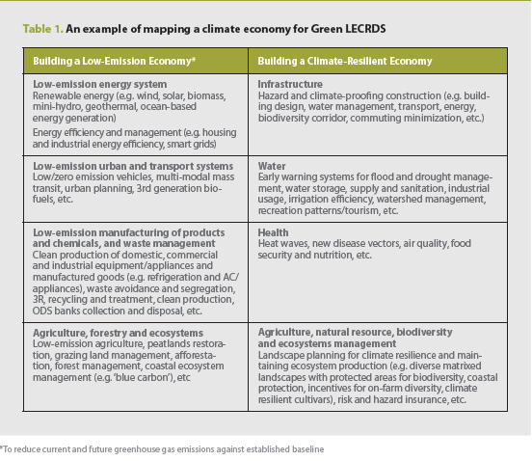
An initial mapping of the climate economy
Notes:
The initial climate economy mapping results in a preliminary list of key sectors, actions and stakeholders.
This table is an example map that includes areas of intervention to support the building a low-emission and climate-resilient economy.
The exercise aimed to identify actions in one sector in relation to another—rather than in isolation—and, where possible, to highlight intersecting sectors.

Slide 23
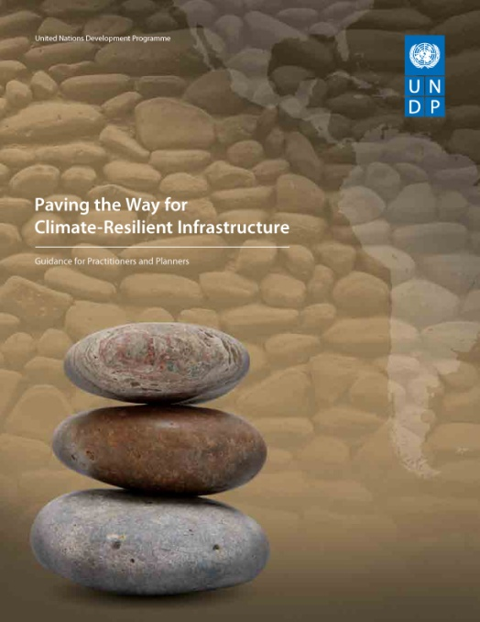
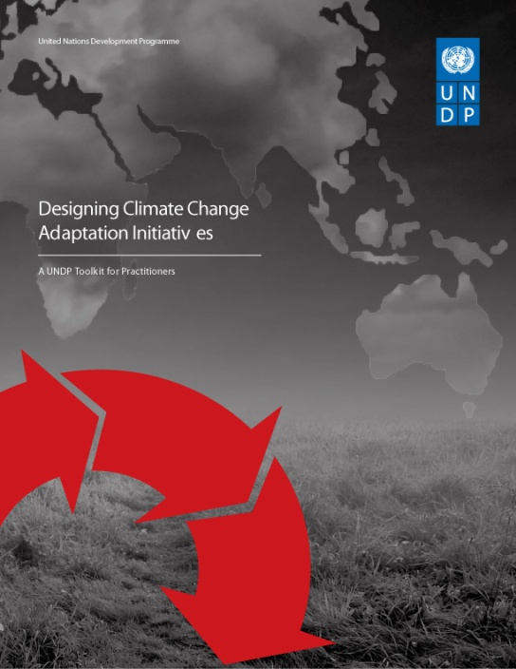
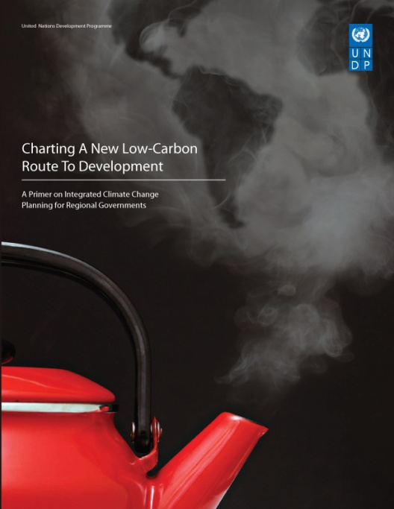
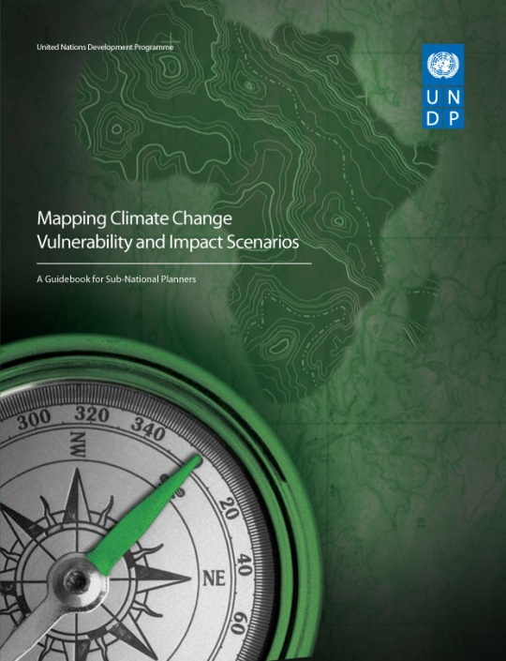
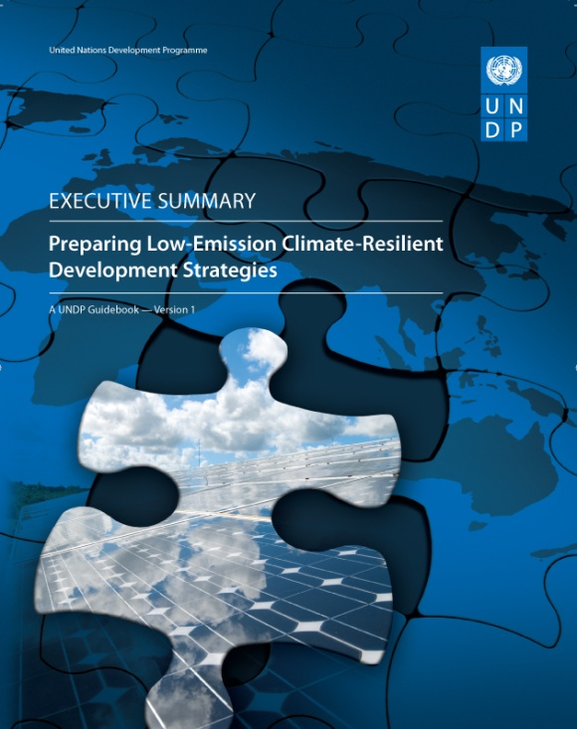


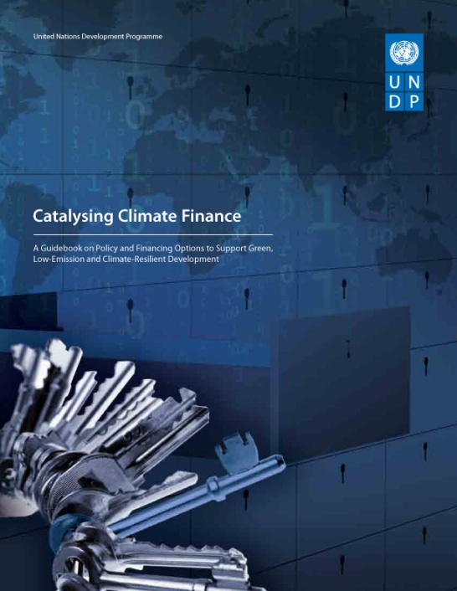
Existing UNDP Tools and Guidance in English – some available in French, Spanish, Russian
http://www.undp.org/climatestrategies
Notes:
To support national policy-makers move forward, this paper also highlights a number of tools and examples available to overcome barriers identified in the paper and build ready systems at the national level. For example, UNDP has developed a suite of technical guidebooks that are referred to throughout the text and for which this paper serves as a chapeau, including:
Preparing Green, Low-emission, Climate-Resilient Development Strategies: Executive Summary
Catalyzing Climate Finance
Catalyzing Finance-Financial Model and Technical Annexes
Sector-Wide Approaches to Climate Finance (forthcoming)
National Climate Funds
MRV Systems for Climate Finance and Actions (forthcoming)

Slide 24
Thank you

Slide 25
Robust, strategic, integrated planning must underpin financial decision-making
Develop Green LECRDS, LEDS, NAPs, NAMAs
UNDP provides
Technical and Policy Advice
Developing and Applying Methodologies
Oversight and Financial Management
Training
Multi-stakeholder Dialogues
Convening and Coordination
Determine appropriate “policy mix” and financing options
Generate & Share Knowledge
Establish Enabling Environment to Catalyze Capital
Catalyze Finance

