Slide 1
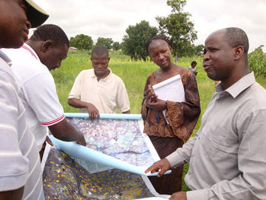





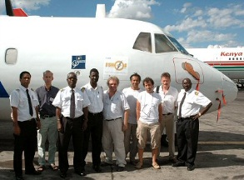
Satellite navigation in Africa
A satellite infrastructure for regional integration and economic growth
Addis Ababa, 30 September 2013
Stefano Scarda
stefano.scarda@ec.europa.eu
European Commission
Directorate-General for Enterprise and Industry

Slide 2

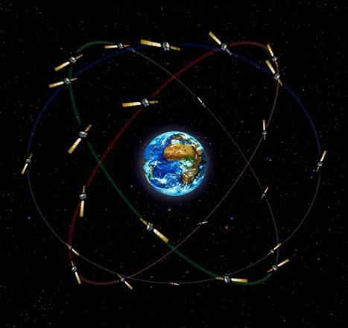

EGNOS
Satellite navigation in Europe
‘It’s there, use it’
EGNOS
  European
  Geostationary
  Navigation
  Overlay
  System
Autonomous infrastructure
Performances similar to GPS
Global coverage
Improves GPS over Europe
Major stepping-stone towards Galileo
Operational since October 2009
EGNOS is Europe’s first step towards independent satellite navigation

Slide 3
EGNOS: the technical principles
3 geostationary EGNOS satellites: relay error corrections to users
GPS and GLONASS satellite constellation
1
5
EGNOS position accuracy
4
GPS position accuracy
2
Navigation Land Earth Stations (NLES):
uplink error corrections to EGNOS satellites
Ranging and Integrity Monitoring Stations (RIMS):
receive GPS data and send it to MCC
3
Mission Control Centres (MCC): process GPS data to determine errors

Slide 4
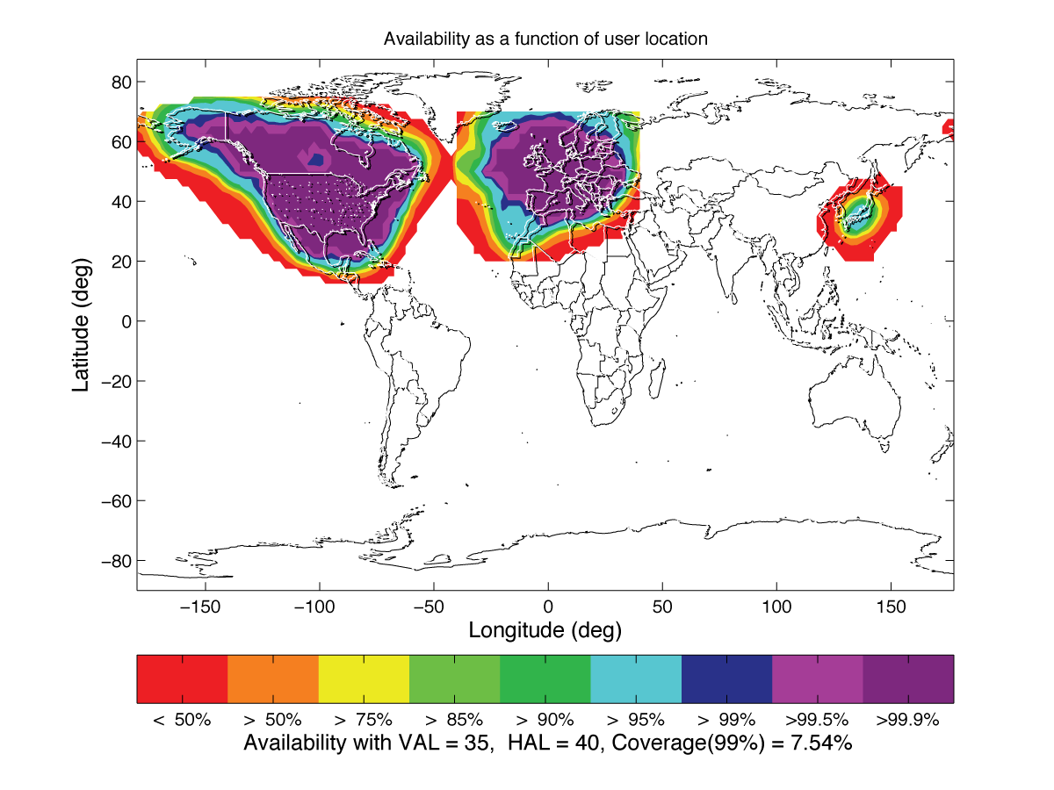
The potential coverage of Africa
WAAS
EGNOS
Already available and operational today in Europe
Possible extension with deployment of ground infrastructure (stations) in Africa
EGNOS
Service Area
SDCM
MSAS
GAGAN
Satellite coverage
area
Source: Stanford University

Slide 5
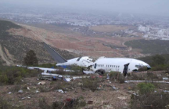
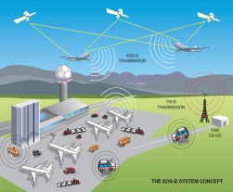
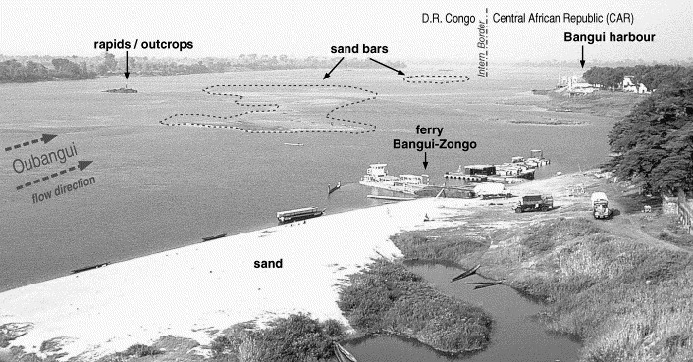

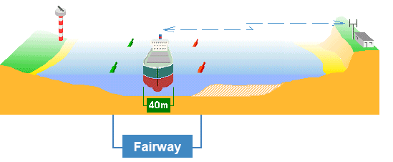
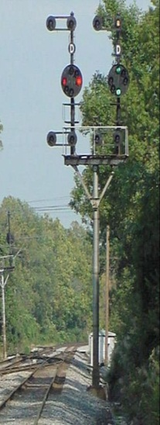
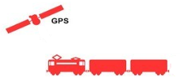
Rivers and inland waterways
Aviation
  Instrumental vertical guidance, reduces accident probability (Safer landing, fewer accidents)
Route optimisation (Fuels savings, CO2 emissions reduction)
  Phasing out of current ground-based equipment for aid to nav (Costs reduction for airports)
  All-weather landing (Less delays, diversions and cancellations)
Rail
W
Satellite-based replaces balises
Costs savings on track control, signalling equipment, maintenance, investments
  Socio-economic benefits: potential expansion of the rail network, safety, capacity and reliability
EGNOS can support navigation and dredging vessels operations through the ‘shallow’ areas, allowing all season navigation
7 October, 2013
Notes:
Railway network: is poor, mostly on single line and with low traffic
Extremely high costs of classical safety equipment along the line
Ground-based control systems (balise) are expensive and normally not economically advantageous for low traffic railways
A demonstration of the use of EGNOS for advanced rail traffic management, especially on low-density rail lines
South Africa, Gauteng on 24 November 2005
Undertaken in collaboration with Spoornet, South Africa
The demo highlighted the capabilities that will be provided by the planned operational extension of EGNOS for Africa, and gave the participants a glimpse at future technologies in rail control systems
There are also often cases (in rural/remote areas the world) of balises and copper cables being removed and stolen.

Slide 6
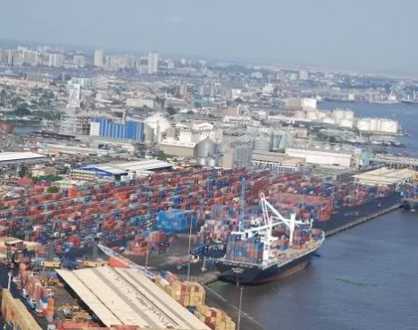
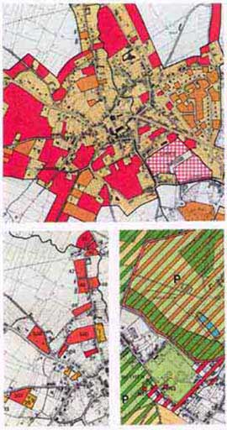

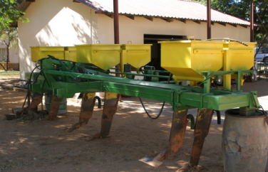

Land management
Tracking and tracing
Cadastre (High accuracy, free of charge, for rural parcels measurements)
Cartography (High accuracy, low-cost service, for hydrographical survey and geographic data collection)
Multimodal and container transport (low cost services for freight applications, Container tracking in Inland Container Depot)
Precision Agriculture
Energy and mining industry
  Efficient irrigation and water management
  Precise spraying for better use of pesticides and fertilizers
  Reduces environmental impact , increases agriculture productivity and cost savings to the farmers, contributes to food security
  Routine surveying, maintenance
Notes:
Cadastre
High accuracy, free of charge
Particularly useful for rural parcels measurements
Supports land reform programmes and helps solving land disputes

Slide 7
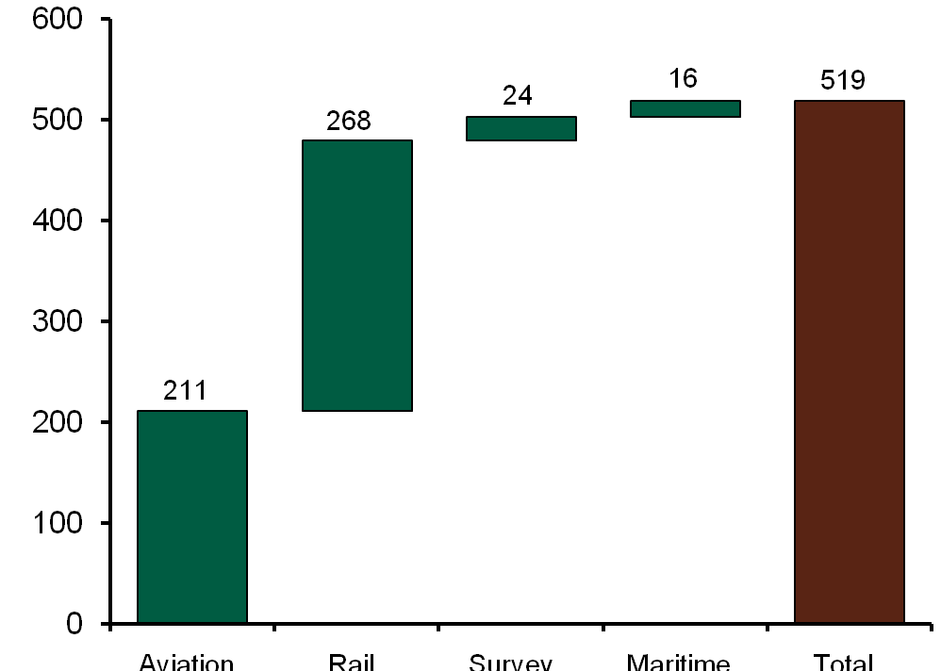
A largely positive Net Present Value
EGNOS in Africa cumulative undiscounted net benefits on a 30 years timeframe will amount to c. €1.7b versus investments of c. €360m for the aviation sector
Total Net Present Value (NPV) surpass 500€m on a 30 years timeframe
Total Net Present
Value (NPV)*
~520 €m
Millions of Euro
* With a 8% discount rate
Notes:
Detailed CBA for aviation sector available.

Slide 8
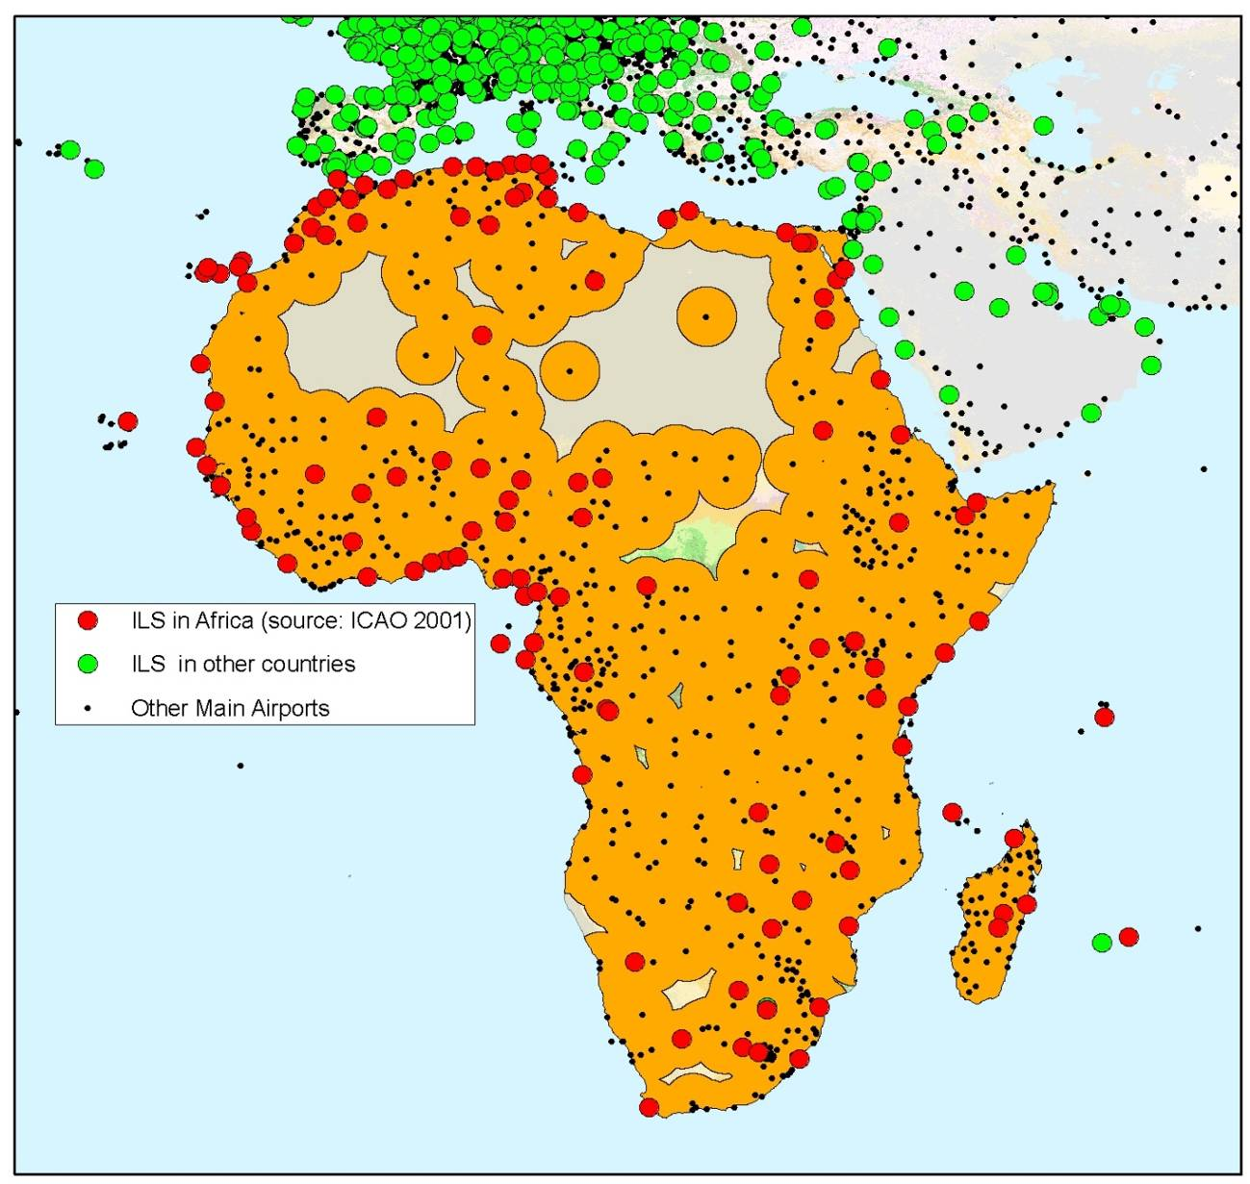
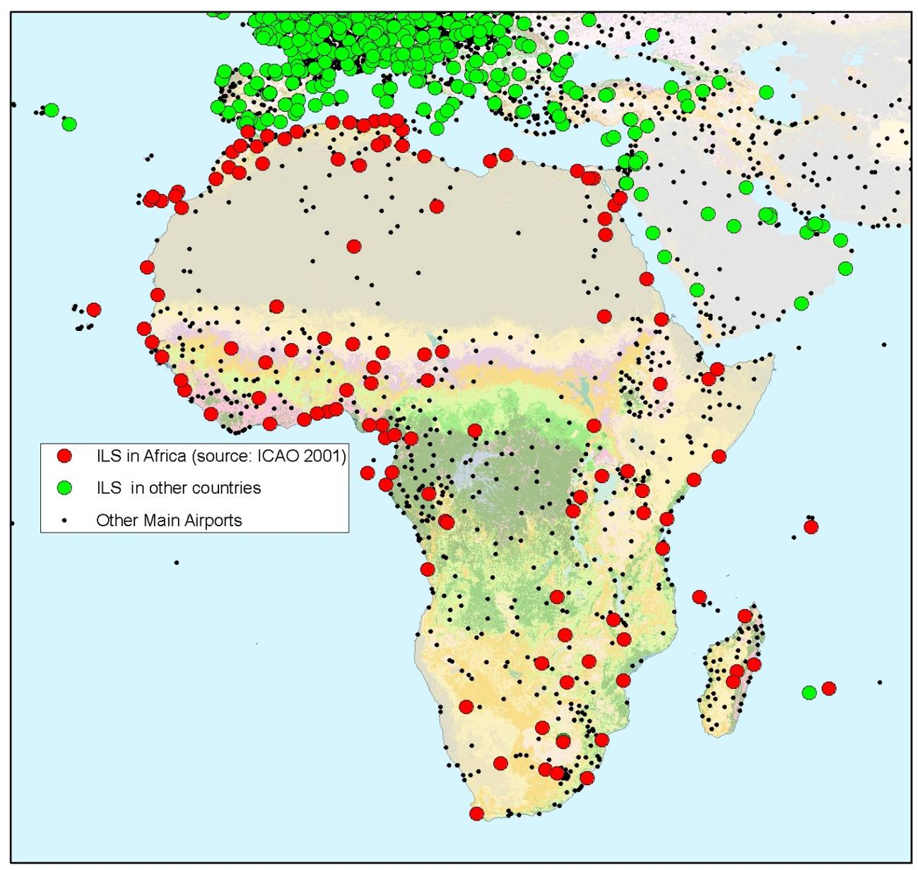
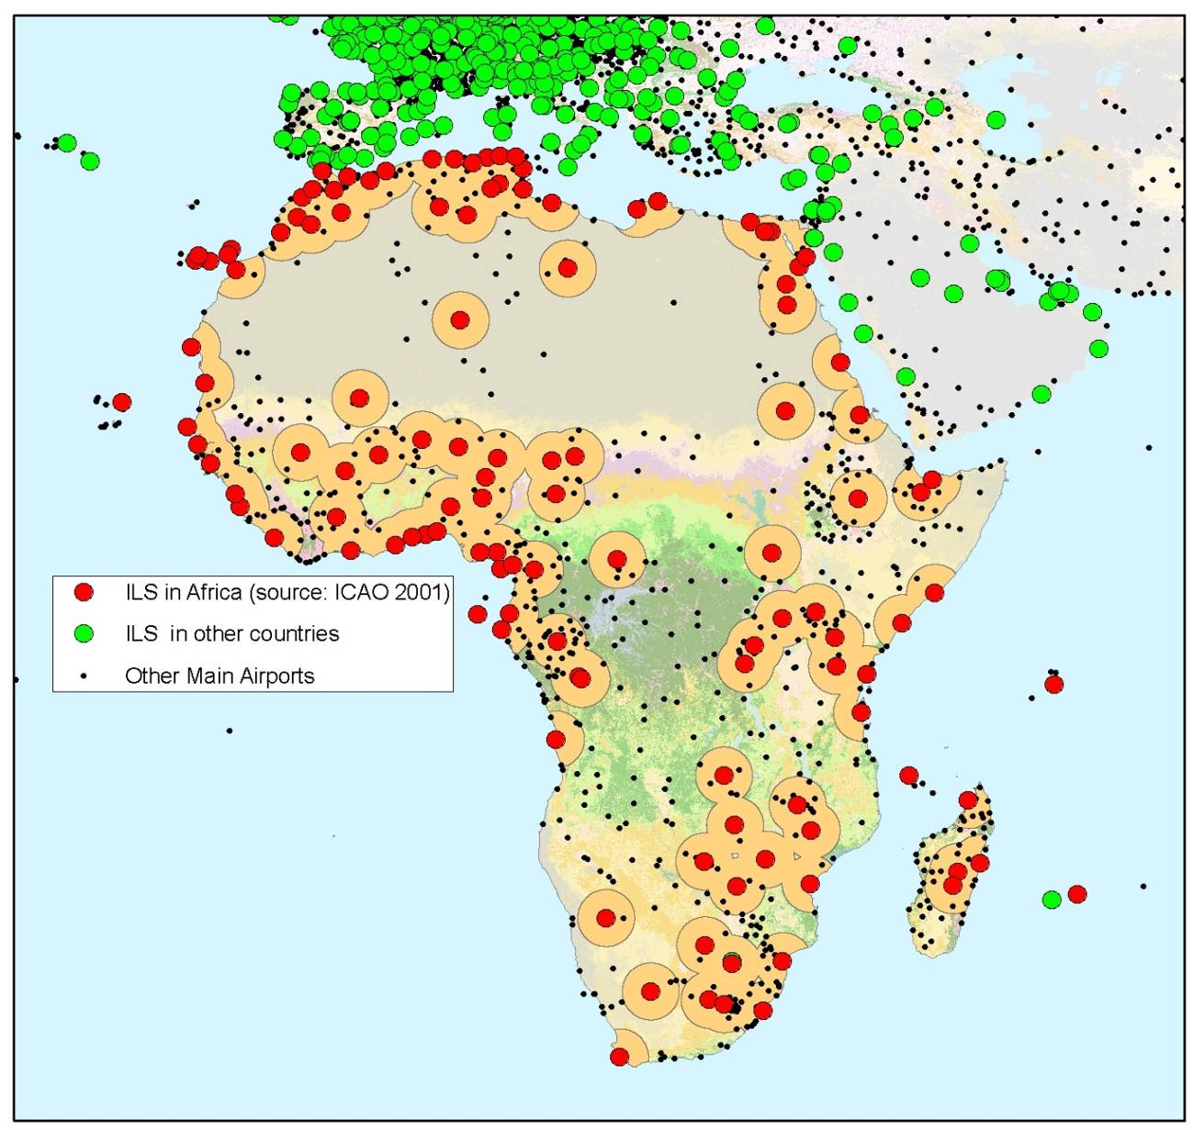
Potential for regional integration
37 % of Africa
is 250km from
An instrumental landing-equipped airport
87 % of Africa
is 250km from
a main or regional airport
MDGs
goal 8.C
Address the special needs of landlocked developing countries and small islands developing states
Notes:
There are also other non-quantifiable benefits. E.g.
REGIONAL INTEGRATION
Today only 37% of African territory is reachable within 1 day of road travel (250km) from an airport equipped with instrumental landing ground equipment.
Considering the potential for instrumental landing (assisted by satellite), many more airports would be accessible and 87% of the territory would be within 1day of road travel.

Slide 9






Widespread political support to satellite navigation in Africa
  Partnership between the European Union and Africa. Connecting Africa and Europe: working towards strengthening transport cooperation COM(2009)301, June 2009
  Action Plan on Global Navigation Satellite Systems (GNSS) Applications COM(2010)308, June 2010
  Space for the African citizens, High-level Meeting under the Belgian EU Presidency, September 2010
  7th Space Council, Resolution on "Global challenges: taking full benefit of European space systems", Brussels, November 2010
  Declaration of the 4th EU-Africa Business Forum, Tripoli, 27-28 November 2010
  3rd Partnership: Regional Economic Integration, Trade and Infrastructure - Second Action Plan adopted at the Africa-EU Summit (November 2010) - Priority No 2: Support to Air Transport Sector and Satellite Navigation
ICAO 12th Navigation Conference (Montreal, November 2012), AU Member States resolved to embrace GNSS
Resolution of the ASECNA* Admin Council (July 2011): encourage EGNOS implementation and mandate the DG to cooperate with EU
ACAC (Arab Civil Aviation Commission) formally expressed (May 2013) the intention to discuss institutional, financing and technical aspects.
(*) Agence pour la Sécurité de la Navigation aérienne en Afrique et à Madagascar (Benin, Congo, Madagascar, Chad, Burkina Faso, Ivory Coast, Mali, Togo, Cameroun, Gabon, Mauritania, Central Africa, Guinea Bissau, Niger, Comoros Islands, Equatorial Guinea, Senegal)
Notes:
SPACE COUNCIL
An agreement between the EU and the ESA in force since 2004 provides a common basis for
developing a European space policy. The agreement establishes regular joint and concomitant
meetings of the EU and the ESA at ministerial level within a “Space Council”, for coordinating and
facilitating cooperative activities.

Slide 10
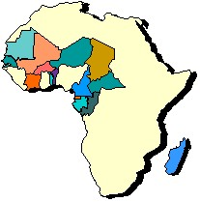





Preliminary activities already funded:
Technical studies
1
Funds: ITF and own resources
  ASECNA is launching a preliminary architecture definition study with use of own resources and a grant from the Infrastructure Trust Fund, through the European Investment Bank.
  The Republic of South Africa should launch soon a preliminary architecture definition study, involving the South African National Space Agency, on own funds.
c.€6M
Notes:
RIMS have been installed in Nouachkott (Mauritania), Djerba (Tunisia), Alexandria (Egypt), Golbasi (Turkey), funded by the EU GNSS budget. They function well, though sometimes we experience logistical problems

Slide 11


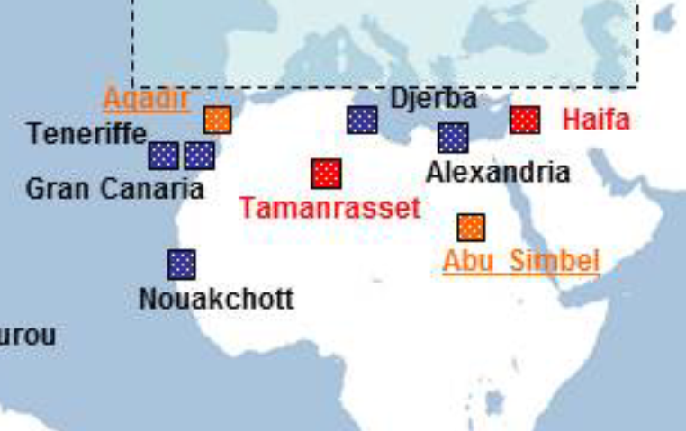
Preliminary activities already funded:
Infrastructure deployment
2
Funds: ENPI (European Neighbouring Policy Instrument)
Euro-Mediterranean Partnership (EUROMED)
Euromed GNSS I (2006-09): €4.5M
Euromed GNSS II (2012-14): €4.5M
  Installations of EGNOS ground stations (RIMS) to improve the coverage of southern EU countries, the Mediterranean basin and Northern African coast
  Implementing actions aimed at preparing the Northern African countries towards the utilisation of EGNOS in civil aviation and other transport and non-transport domains
Notes:
RIMS have been installed in Nouachkott (Mauritania), Djerba (Tunisia), Alexandria (Egypt), Golbasi (Turkey), funded by the EU GNSS budget. They function well, though sometimes we experience logistical problems

Slide 12


Preliminary activities already funded:
Capacity Building
3
Funds: Intra-ACP 10th EDF
(€9M)
PROGRAMME STEERING COMMITTE
(AUC, RECs, ACP Sec, EC)
Aviation Safety
Aviation Security
Deployment of a regional sub-Saharan Joint Programme Office (5 recruitments on-going + 5 recruitments planned in 2014)
Set-up and support for working sessions of stakeholders to address Governance, Liability & Certification, Services Roadmap, etc.
Training of the Office staff by UNESCO/ICTP (training on managerial and technical aspects)

Slide 13
EGNOS in Africa: a turning point
In 2014, the on-going activities will have provided:
  An operational and trained Joint Programme Office
  Technical elements from technical studies on system architecture for specific regions
  An initial infrastructure partially covering Northern Africa
The EU MS and the Commission shall take a major programmatic decision on the extension of EGNOS over the African continent in 2014
The programming exercise for financing instruments (EDF, DCI) is on-going
Governance and funding schemes shall now be consolidated
Players involved: AUC, ACP secretariat, RECs, Member States,
Space agencies, ANSPs, Inter-governmental and continental organisations, Financing institutions
Notes:
Multi-country project
Delocalised
African ownership of policy, project management and physical infrastructure
Mix of sectorial and horizontal socio-economic benefits

Slide 14
Funds needed for a full pan-African service provision
Budget need
2014-20 (€ m)
Continuation of the African GNSS office and capacity building, with a ramp-up until 20 people in 2020
Management and technical assistance
c. 60
Technical assistance (incl. ESA/GSA)
for Design and Deployment phases
Design and Deployment of Early Services in Northern Africa
c. 20
Design and Deployment of Early Services in
Western and Central Africa
c. 30
Infrastructure design and deployment
Design and Deployment of Early Services in Southern Africa
c. 20
Design and Deployment of full
pan-African services
c. 120
Support to Users adoption
Users adoption
250+

Slide 15
Expenditure profile

Slide 16
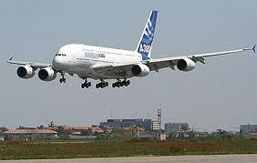

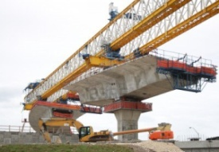
Need for public investments
Satellite navigation as a public good ('the fifth utility') for economic growth and regional integration
Huge socio-economic benefits (e.g. in aviation safety, land management, agriculture) but low monetary returns
No feasible cost-recovery scheme from the users
The failure of the PPP (Public-Private Partnership) scheme for Galileo in Europe
Notes:
other 4 utilities being: electricity, water, gas and sewer

Slide 17
Next steps
The Joint Programme Office will carry out stakeholders consultations towards the definition of the appropriate governance and service provision schemes, under the supervision of the Programme Steering Committee (AUC, RECs, EC, ACP Sec).
Dialogue with financing institutions and donors (EIB, AfDB, Kfw, AFD, etc.) to define a viable funding scheme based on blending of grants and loans.
EGNOS project
≈ € 250 m
Equity
Financing institutions
Grants
Beneficiaries:
ASECNA, ACAC, …
Loans

Slide 18
Setting-up the appropriate financing scheme
Main issues
Set up the project financing with various borrowers presenting different characteristics
(e.g. borrowing power, debt limits, total own capital/ funds)
Set up a project with different beneficiaries located in different geographies: eligibility
Different public and private players
Notes:
Multi-country project
Delocalised
African ownership of policy, project management and physical infrastructure
Mix of sectorial and horizontal socio-economic benefits

Slide 19


Event on financing Satellite Navigation Infrastructure in Africa
1st October 2013, Addis Ababa, Ethiopia
Hilton Hotel
Event at the margin of the EU Continental Seminar on Infrastructure in Africa 2013.
Financing institutions will participate.
The outcome shall be included in a declaration of intent to adhere to the initiative and to be engaged in the set-up of the financing scheme.
08:00 – 09:00 | Registration and welcoming coffee
 | Rendezvous to the Ibex and Nyala conference rooms
09:00 – 09:15 | Opening Ceremony
 | Welcoming to the participants (ASECNA, European Commission, Ethiopian Civil Aviation Authority)
09:15 – 09:30 | Introduction to the event
 | by ASECNA
09:30 – 10:15 | Session 1 – Satellite Navigation in Europe and Africa
 | By European Commission, ASECNA, ACAC and South Africa
10:15 – 10:45 | Session 2 – Financing needs to support the initiative
 | By European Commission and ASECNA
10:45 – 11:15 | Coffee break
11:15 – 12:45 | Session 3 – Towards a financing scheme
 | Open discussions
12:45 – 13:15 | Session 4 – Conclusions and way forward
 | By chairperson
13:15 – 13:30 | Closing ceremony
 | by European Commission, ASECNA and ECAA
13:30 – 15:00 | Working lunch
15:00 – 17:00 | Informal complementary session
- | -
18:00 – | Cocktail dinner
For networking and further dicussion, a cocktail with enlarged participation will be held at the Hilton at 18.00
Notes:
ASECNA (Agence pour la Sécurité de la Navigation aérienne en Afrique et à Madagascar) has organised, at the margin of the seminar on infrastructure an event dedicated to the financing of EGNOS in Africa.

