Slide 1
EU-Africa cooperation on ICT in MFF 2014-2020
Joint Africa-EU Strategy
P3-Continental Seminar 2013
Addis Ababa, 30 September 2013
Vlassios Venner
European Commission
DG Communications Networks, Content & Technology
International Unit

Slide 2
MFF 2014-2020: Why ICT for Africa?
Africa's "mobile decade": From less than 10 million fixed-line phones in 2000 to around 650 million mobile subscriptions by 2012
Impact on growth (2011): > 5 million jobs; around €11 billion direct government revenues (sales and import taxes, regulatory fees)
Africa's GDP: 7% by ICT
Solutions/Challenges: education (e-learning vs. illiteracy/innumeracy); health (e-health vs. infectious diseases like HIV/AIDS); agriculture (e.g. Esoko in Ghana); services (e.g. online financial services like M-PESA in Kenya); government (transparent and open, e.g. Kenya's Open Data Initiative)
ICTs can empower the lives of Africans and drive entrepreneurship, innovation and income growth

Slide 3
MFF 2014-2020: EU ICT Priorities for Africa
Priority 1: Approximation of the e-communications and media policies and regulatory environments
Objective: an improved global regulatory system, fair and transparent
Priority 2: Interconnection of the research and education network infrastructures – e-infrastructures
Objective: increased R&D cooperation, generating scientific excellence, fighting 'brain drain' and contributing to economic and social well-being
Priority 3: ICT capacity building – ICT uptake, broadband, resilient systems, free and open access to the Internet
Objective: solutions adapted to local needs and environment

Slide 4
Priority 1: Approximation of the enabling regulatory environments
EU regulation: Framework directive, authorisation, access, universal service, competition, ePrivacy, radio spectrum (dec.), e-commerce, re-use of public sector info, e-signatures
Objective: an improved global regulatory system, fair and transparent
  Example: - HIPSSA-Harmonised policies for the ICT market in Sub- Saharan Africa (ending Sep-13)
  ? HIPSSA-type project; Transition from analogue to digital broadcasting and related spectrum policy issues, e.g. Digital Dividend; Cyber-Security Convention for Africa ?

Slide 5
Priority 2: Interconnection of e-infrastructures
GÉANT: the pan-European Research and Education Network (speeds at 100Gbps; up to 500Gbps)
Objective: increased R&D cooperation and sharing of scientific knowledge, generating scientific excellence, fighting 'brain drain' and contributing to economic and social well-being
  Example: - AfricaConnect, interconnecting the Southern and Eastern Africa with GÉANT (155Mbps-1.4Gbps)
  ? Expansion to the Central and Western Africa (ongoing feasibility study); to the whole of the Sub-Saharan Africa in the longer term ?

Slide 6
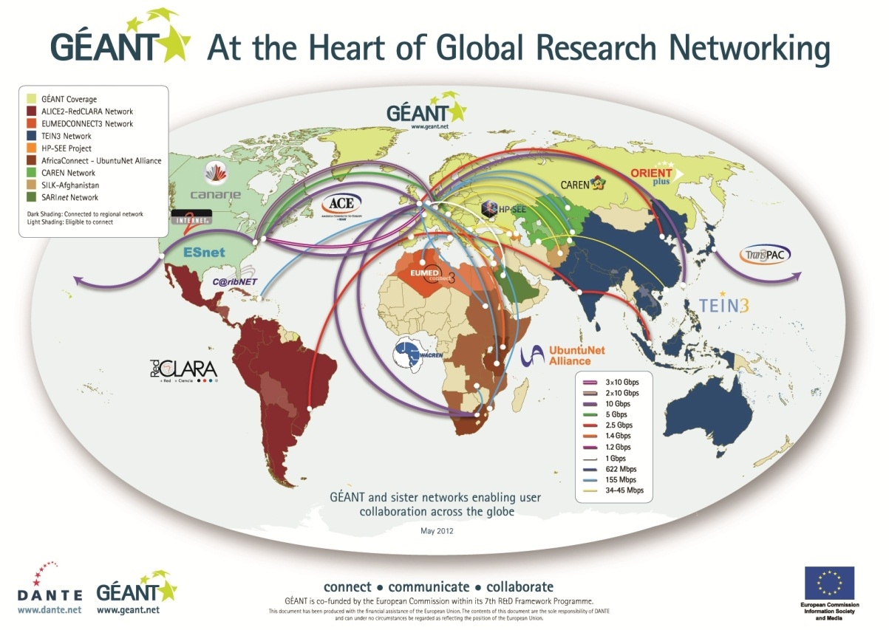
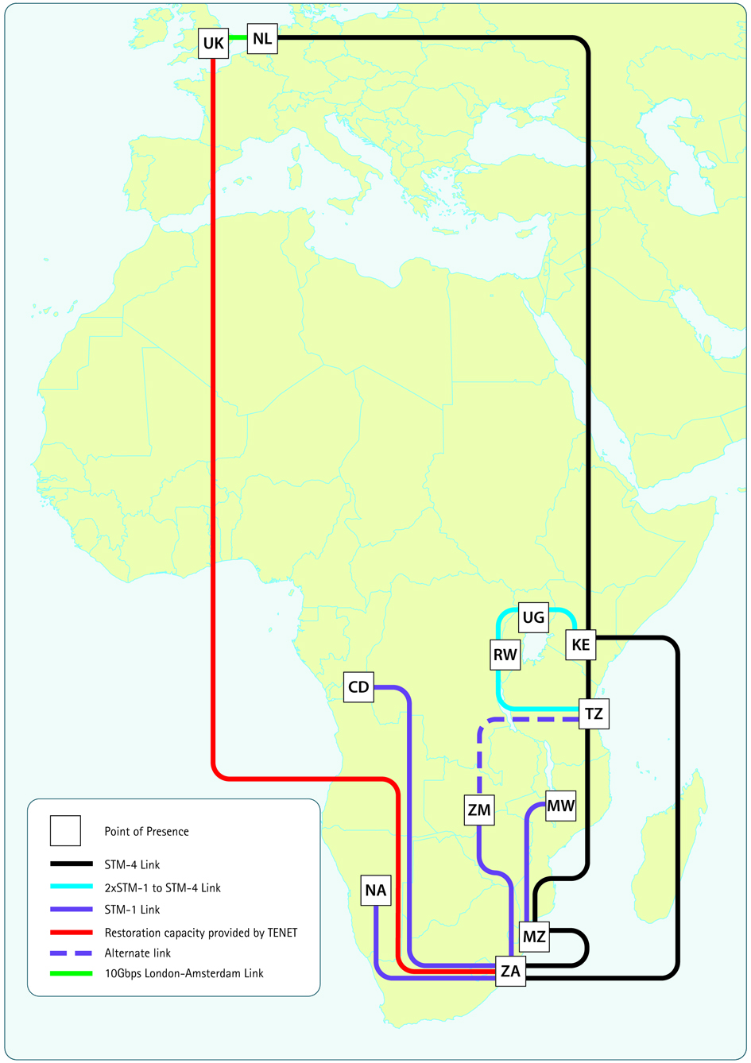
GÉANT: At the heart of the Global R&E Village
Future configuration of the South-East African network

Slide 7
Priority 3: ICT capacity building
Means: ICT uptake, broadband, resilient systems, free and open access to the Internet
Objective: ‘ICT research and innovation’-based solutions adapted to local needs and environment (e.g. in e-health, e-learning, e-government, cyber-security, civil protection, Living Labs)
  Example: - FP7-ICT projects IST-Africa 2012-13, EuroAfrica-P8
  ? IST-Africa 2014-15; specific objectives in H2020 ICT Work Programmes; more University graduates in telecom engineering and computational sciences; training on broadband network management; training of women; African Network of LL (ANoLL); targeted actions in the African CSPs, RSPs ?

Slide 8
"innovation action" means an action consisting primarily of actions such as prototyping, testing, demonstrating, piloting, experimental development, market replication activities, service innovation and/or non-technological innovation.
International cooperation
European Research Area
H2020 – ICT R&D
Shared objectives and principles
Tackling Societal Challenges
  Health, demographic change and wellbeing
  Food security and the bio-based economy
  Secure, clean and efficient energy
  Smart, green and integrated transport
  Climate action, resource efficiency, including raw materials
  Inclusive, innovative and secure societies
  EIT and JRC will contribute to addressing these challenges
Creating Industrial Leadership and Competitive Frameworks
Leadership in enabling and industrial technologies
  Information and Communication Technologies (ICT)
  Nanotechnology, Materials, Manufacturing and Processing
  Biotechnology
  Space
Access to risk finance
Innovation in SMEs
ICT
ICT
ICT
ICT
ICT
ICT
Excellence in the Science Base
Frontier research (ERC)
Future and Emerging Technologies (FET)
Skills and career development (Marie Curie)
Research infrastructures
ICT
ICT
Simplified access
Common rules, toolkit of funding schemes
Coherent with other EU and MS actions

Slide 9
EU-Africa cooperation on ICT: 'Win-Win'
2014 Africa-EU Summit:  Connected Africa
Thank you
vlassios.venner@ec.europa.eu

