Slide 1
PIDA: Africa’s Time for Action
Interconnecting, Integrating, and Transforming a Continent
PIDA Presentation to EU Continental Seminar on Infrastructure
Addis Ababa, 01st October 2013

Slide 2
Content
1
PIDA RATIONALE
2
PIDA OUTCOMES
3
IMPLEMENTATION STRATEGY
4
CONCLUSION

Slide 3
Content
1
PIDA RATIONALE
2
PIDA OUTCOMES
3
IMPLEMENTATION STRATEGY
4
CONCLUSION

Slide 4
PIDA RATIONALE - African Infrastructure
Critical role of infrastructure in Africa widely recognized
Deficit in Africa infrastructure also widely recognized
Multiple regional and continental initiatives to close the gap
But
Overwhelming evidence that these efforts are not fully successful
We need to
Enhance African integration
Expedite the development process
Focus our approach to address the real, causal factors

Slide 5
Rationale for the merger
Common platform for infrastructure development in Africa in four sectors: transport, energy, ICT and transboundary water
Rationalisation of a plethora of regional/continental initiatives
Harmonise donor intervention
Fast tracking Africa development and integration

Slide 6
Vision from the AUC 2004 Strategic Plan : Build an integrated, prosperous and peaceful Africa, driven by its citizens and representing a dynamic force in the International Arena
PIDA RATIONALE - PROCESS
STRATEGIC FRAMEWORK
DIAGNOSIS OF EXISTING SITUATION
OUTLOOK 2040
PIDA 2040
+
+
=

Slide 7
Content
1
PIDA RATIONALE
2
PIDA OUTCOMES
3
IMPLEMENTATION STRATEGY
4
CONCLUSION

Slide 8
PIDA OUTCOMES
PIDA Economic Outlook- GDP projections to 2040
PIDA’s macro and sector outlooks to 2040 are grounded on a 6.2% annual overall rate of growth of African GDP.
The main drivers of this growth are population, technology absorption and education.
Results show a six fold GDP increase by 2040 and a per capita income above $10,000

Slide 9
PIDA OUTCOMES
From GDP projections 2040 to Sector Forecasts
If the 6.2% average GDP growth is achieved:
Power demand will increase at an average annual growth rate of nearly 6%.
Transport volumes will increase 6–8 times, with a particularly strong increase of up to 14 times for some landlocked countries…

Slide 10
PIDA OUTCOMES
From GDP projections 2040 to Sector Forecasts
If the 6.2% average GDP growth is achieved:
Water needs will push some river basins - including the Nile, Niger, Orange and Volta basins - to the ecological brink.
Information and Communications Technology (ICT) demand will swell by a factor of 20 before 2020 as Africa catches up with broadband.
THIS INCREASED DEMAND WILL REQUIRE ADEQUATE REGIONAL INFRASTRUCTURE THAT PIDA PROPOSES

Slide 11
PIDA OUTCOMES
STUDY PROCESS
DEVELOPMENT PROGRAMME
PIDA PAP (Priority Action Plan)
STRATEGIC FRAMEWORK
2040
DIAGNOSIS
AFRICA OUTLOOK 2040
RECS MASTER PLANS
OTHER EXISTING PROJECTS

Slide 12
Transport: work toward an integrated continent where the transport infrastructure and services enable the free movement of goods and people
PIDA OUTCOMES: Findings per sector
Improving the connectedness of African capitals and major centers with modern paved roads
Satisfying demand at the least economic cost, with priority for landlocked countries, while minimizing the environmental impact
Developing modern ARTIN corridors and air transport services to bring the performance up to best world practice in efficiency, cost, reliability, and safety

Slide 13
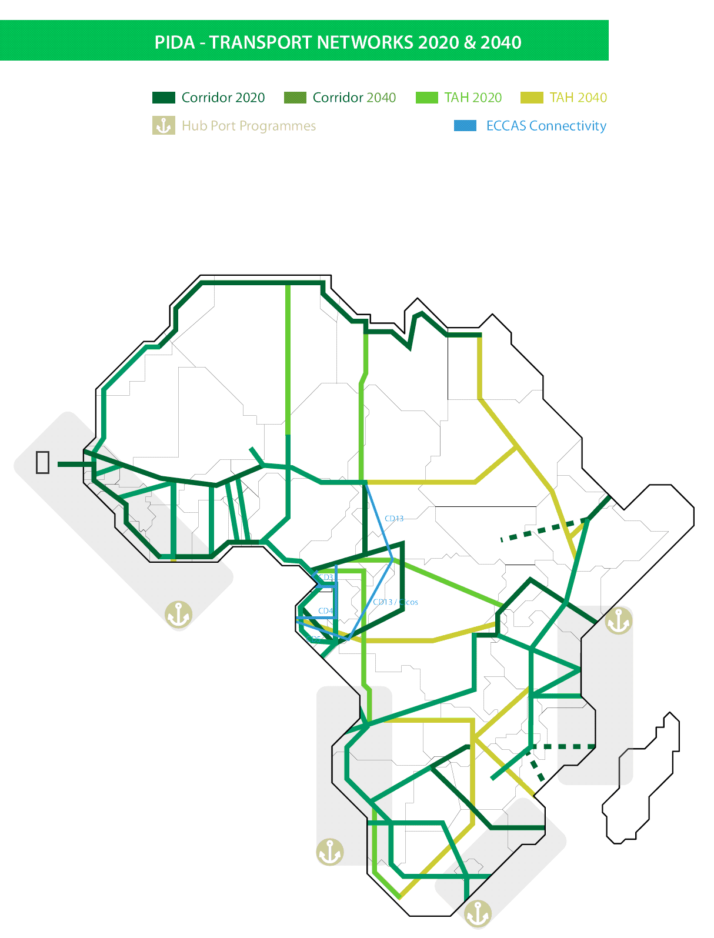
Transport Networks: 2020&2040
PIDA OUTCOMES
The transport program links the major production and consumption centers, provides connectivity among the major cities, defines the best hub ports and railway routes, and opens the land-locked countries to improved regional and continental trade.

Slide 14
Energy: develop efficient, reliable, cost-effective, and environmentally friendly infrastructure; and, enhance access to modern energy services
PIDA OUTCOMES: Findings per sector
Developing major regional and continental hydroelectric projects
Implementing high-capacity oil refineries and oil and gas pipeline projects
Developing renewable energy resources

Slide 15
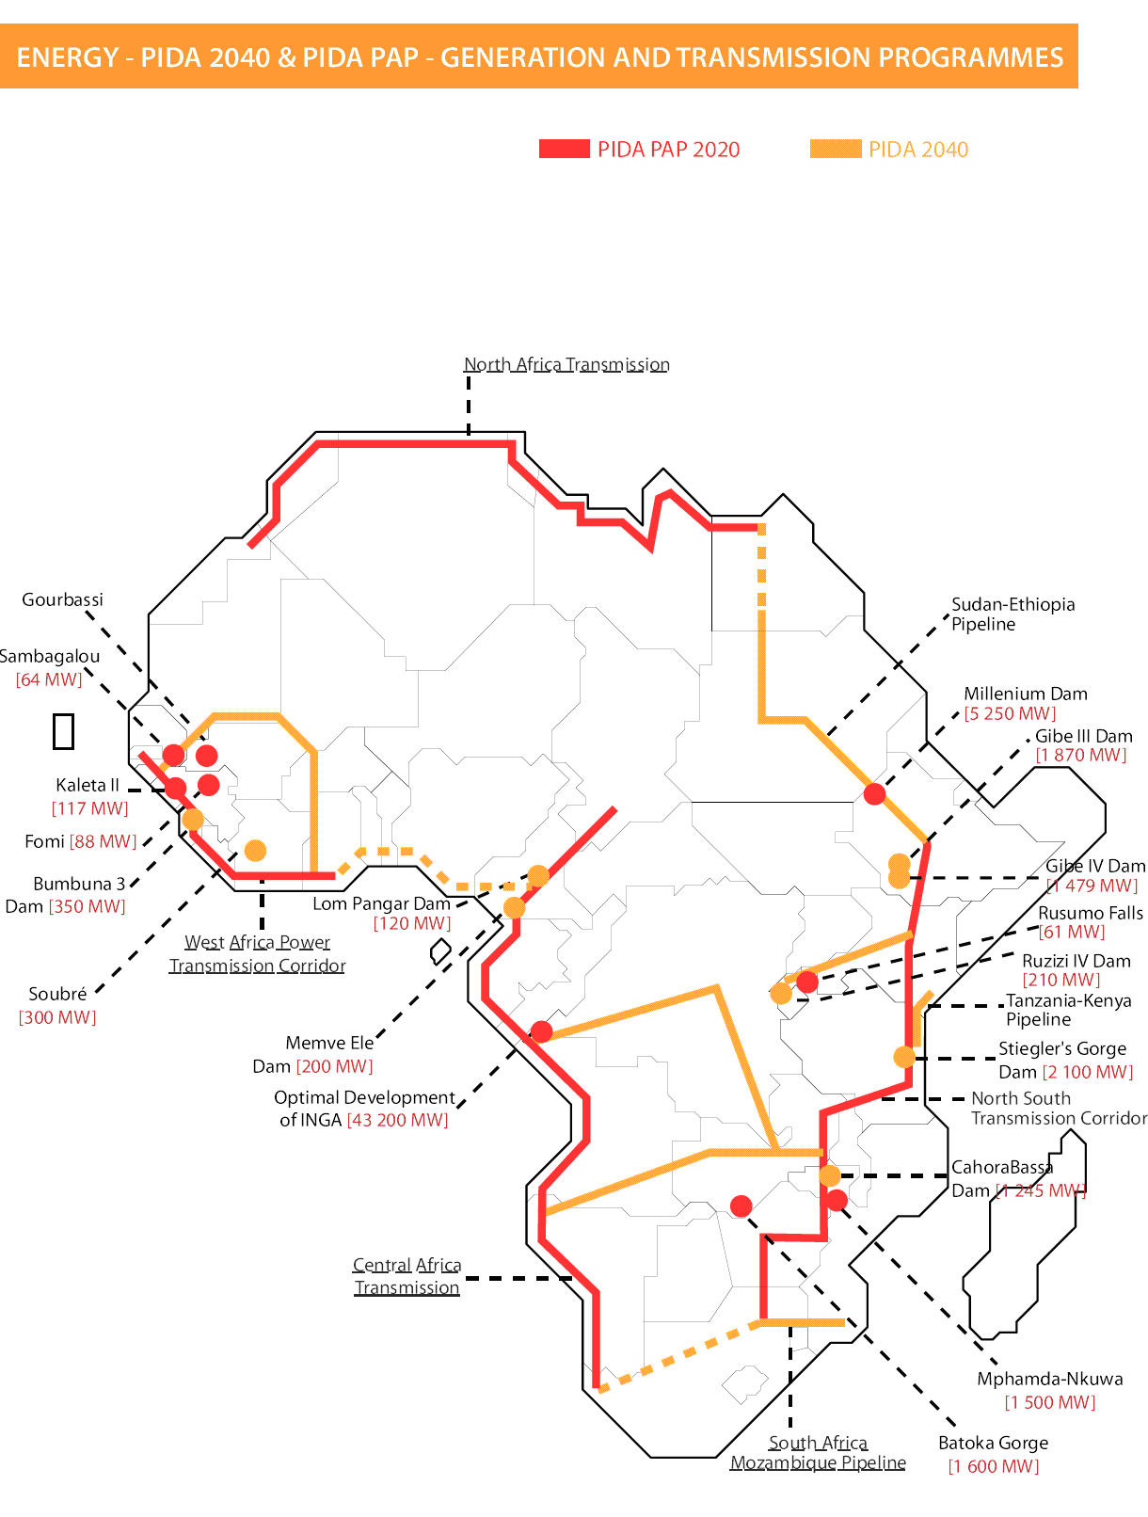
Generation & Transmission: 2020&2040
PIDA OUTCOMES
The energy infrastructure program focuses on major hydroelectric projects and interconnects the power pools to meet the forecast increase in demand. One regional petroleum products pipeline is also included.

Slide 16
TWR: develop projects, strengthen resource management frameworks, and ensure water security for socioeconomic development
PIDA OUTCOMES: Findings per sector
Strengthening institutions for efficient cooperation on shared water resources
Developing transboundary water infrastructure to meet increasing water demands while protecting people and the environment
Strengthening finances for transboundary water development and management
Improving knowledge on transboundary water basins and shared aquifers.

Slide 17
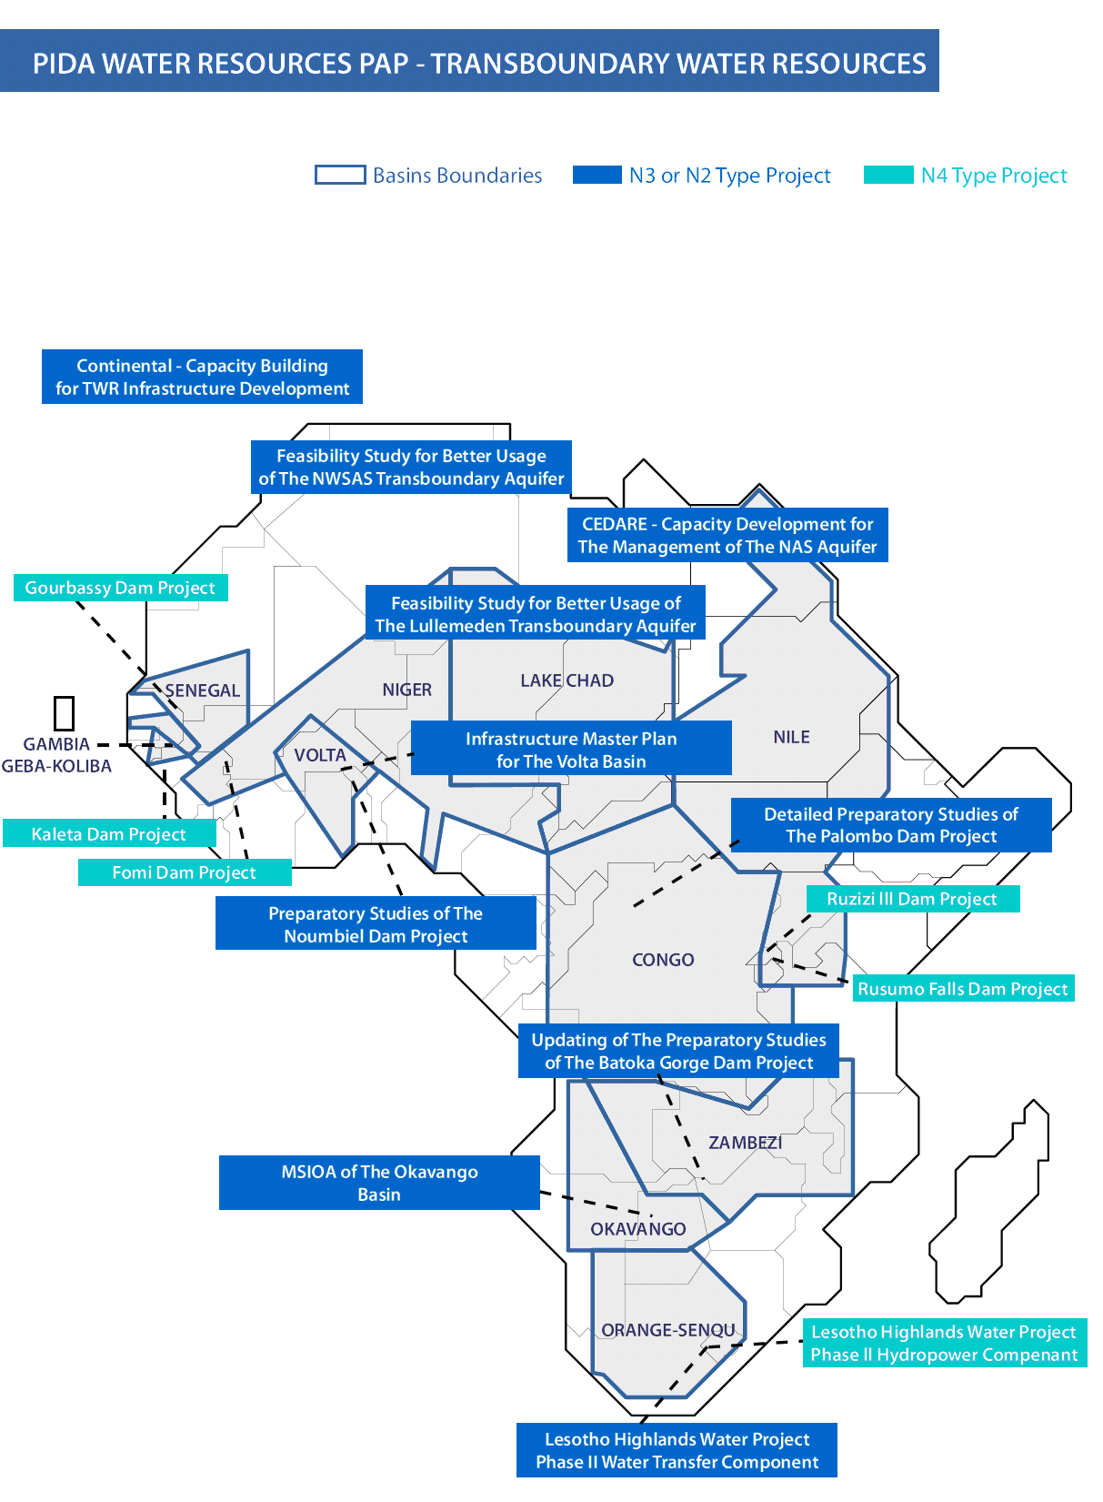
Water Resources: 2020&2040
PIDA OUTCOMES
The transboundary water program targets the development of multipurpose dams and builds the capacity of Africa’s lake and river basin organizations so that they can plan and develop hydraulic infrastructure. The program would also help address the looming food deficit.

Slide 18
ICT: enable an information society and integrated digital economy in which all actors have access to reliable and affordable ICT networks
PIDA OUTCOMES: Findings per sector
Transform Africa into an e-society
Satisfy African broadband demand – at least cost
Increase accessibility and security of access for all country
Provide uniformly accessible services to develop social and regional integration

Slide 19
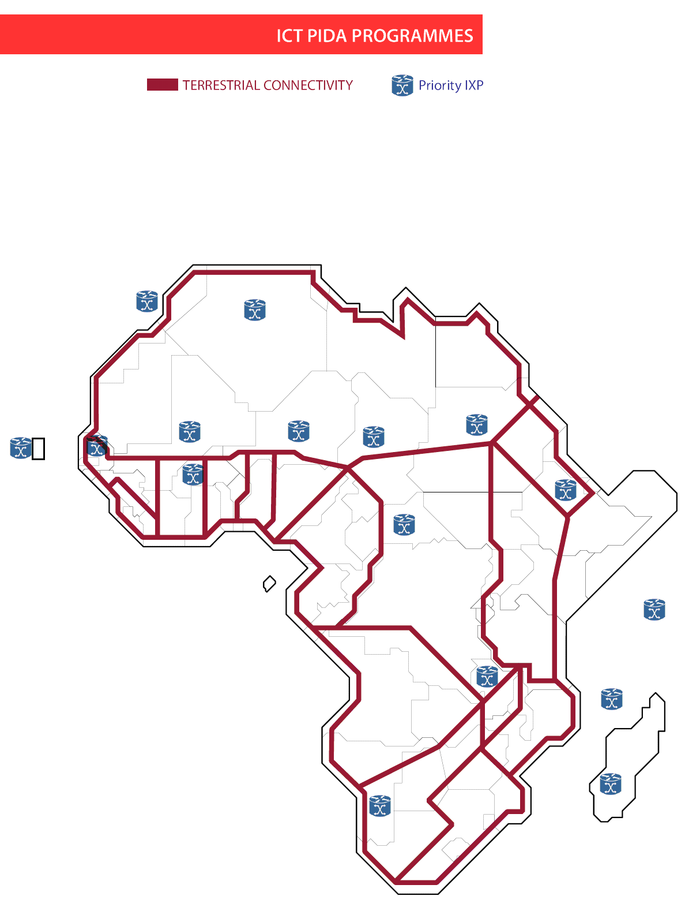
ICT: 2020
PIDA OUTCOMES
The ICT program will establish an enabling environment for completing the land fiber optic infrastructure and installing Internet exchange points in countries without them. It will connect each country to two different submarine cables to take advantage of the expanded capacity.

Slide 20
PIDA OUTCOMES
Total PIDA capital cost is $360bn to 2040 and will deliver
Indicators | PIDA 2040
Modern highways | 37 300 KM
Modern railways | 30 200 KM
Port Added ton capacity | 1,3 billion tons
Hydroelectric power generation | 61 099 MW
Interconnecting power lines | 16 500 KM
New water storage capacity | 20 101 hm³
PIDA – Ambitious, but affordable!

Slide 21
PIDA PAP broken down into 51 projects/programs
PIDA OUTCOMES: The PAP
24 transport
15 energy
3 ICT
9 TWR

Slide 22
PAP Investment Cost: $68 bn - 2012-20
PIDA OUTCOMES: The PAP
BY SECTOR
BY REGION

Slide 23
PAP Investment ($68 bn)
PIDA OUTCOMES: The PAP
AMBITIOUS BUT AFFORDABLE
Mainly from domestic sources (50% in ’20 to 75% in ‘40)
PROJECT PREPARATION
Less than 0,2% of 2011 GDP, or 1% of national budgets, or 5% of Investment budgets
RESOURCE MOBILIZATION
Needs are estimated to 5 - 8% of total investment cost
Private sector, ICA members & emerging partners

Slide 24
Financing will need to come mostly from domestic sources (public & private)
PIDA IMPLEMENTATION STRATEGY
Domestic Bond Markets, inc. remittances
Sovereign Wealth Funds
Enabling environment for more private participation
PUBLIC MIX PRIVATE

Slide 25
Content
1
PIDA RATIONALE
2
PIDA OUTCOMES
3
IMPLEMENTATION STRATEGY
4
CONCLUSION

Slide 26
PIDA IMPLEMENTATION STRATEGY
Operationalization of Institutional Architecture for PIDA Implementation
IAIDA defines responsibilities of Continental, Regional institutions (AUC, NPCA, RECs) and Member States.
Builds on principles of subsidiarity.
Allows high level advocacy.
Provides a mechanism for reviewing performance and rolling over the PAP with access to the highest levels of the AU, RECs and Member States.

Slide 27
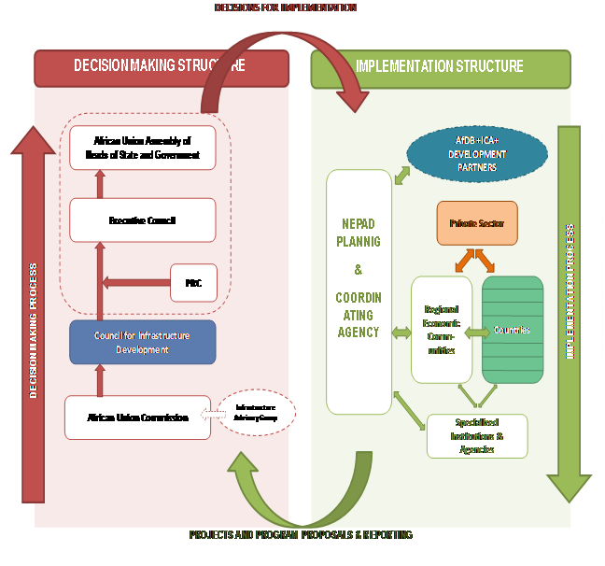
Implementation Strategy & Process

Slide 28
Country role in PIDA implementation
PIDA IMPLEMENTATION STRATEGY
Projects are implemented by countries on whose territory they are located and by their agencies (public or private)
Countries are critical and efficient players
Implement “soft” components (harmonisation of continental and regional policies)
Financing project preparation, capital investment, operation and maintenance

Slide 29
Content
1
PIDA RATIONALE
2
PIDA OUTCOMES
3
IMPLEMENTATION STRATEGY
4
CONCLUSION

Slide 30
CONCLUSION
Next steps
Implement quick wins in the PIDA-PAP and prepare all projects for implementation
Support targeted capacity building for AUC, NPCA, RECs, Spec. Institutions & Agencies
Develop a resource mobilization strategy
Mobilize finance for project preparation
Monitor progress and report on delivery

Slide 31
CONCLUSION
Acknowledging PIDA as the African-owned and African-led programme
Tackling soft governance issues necessary for true regional integration - harmonization, facilitation, monitoring, and evaluation
Keeping strong political commitment
Advocating for strong partnerships (Donors, PPP…)

Slide 32
MERCI
OBRIGADO
THANK YOU
شكرا

Slide 33
ANNEXES PIDA PAP PROJECTS AND PROGRAMS

Slide 34
ANNEX 1 PIDA PAP: Transport 24 ITEMS = US$ 25.4bn

Slide 35
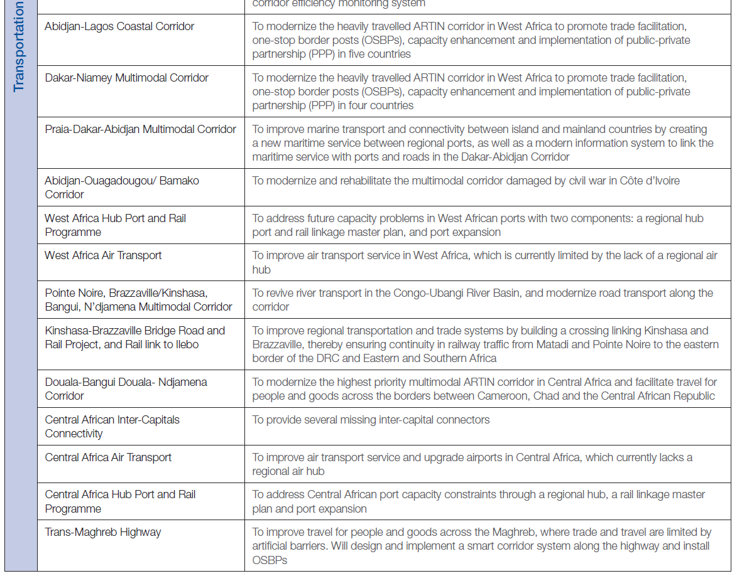

Slide 36
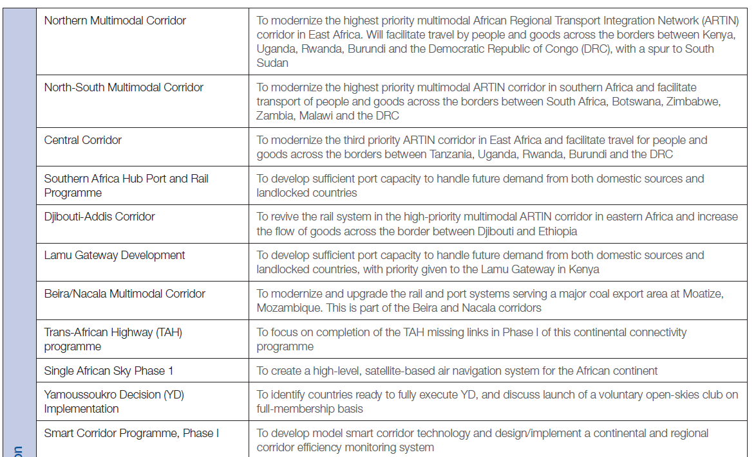

Slide 37
ANNEX 2: PIDA PAP: Energy 15 ITEMS = US$ 40.4bn

Slide 38
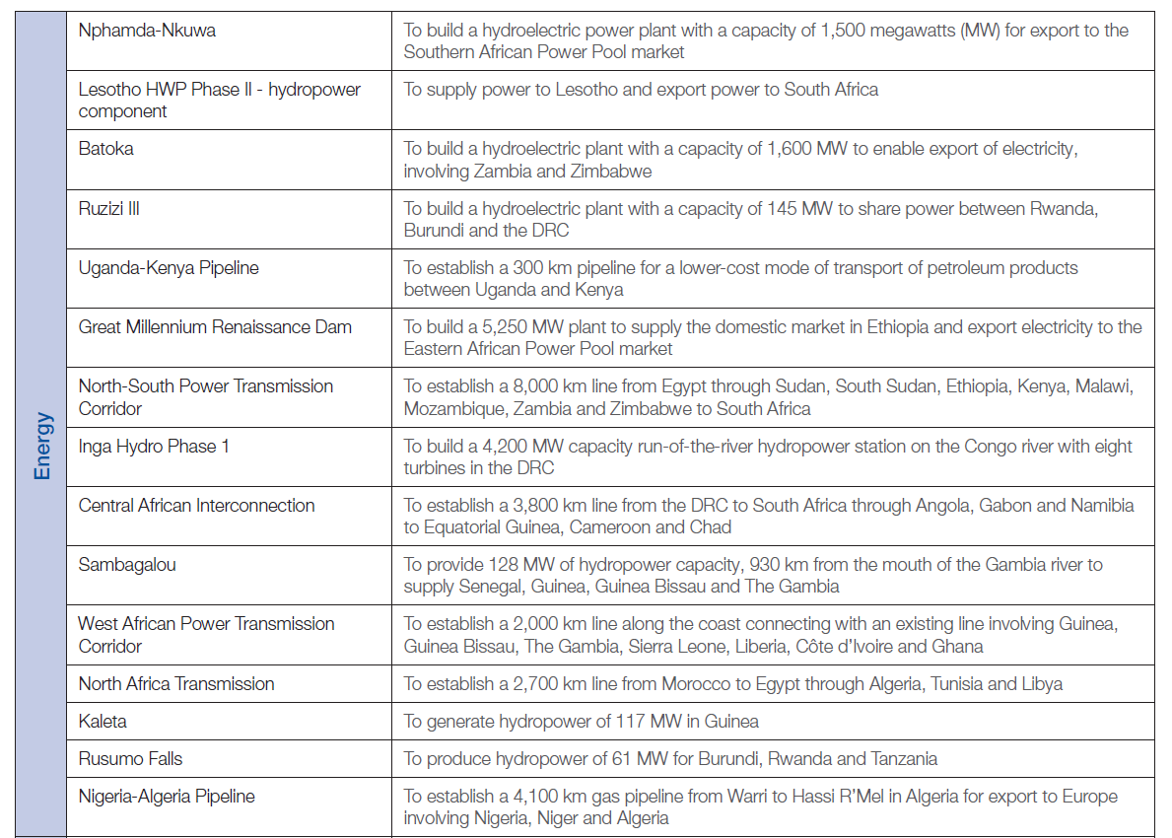

Slide 39
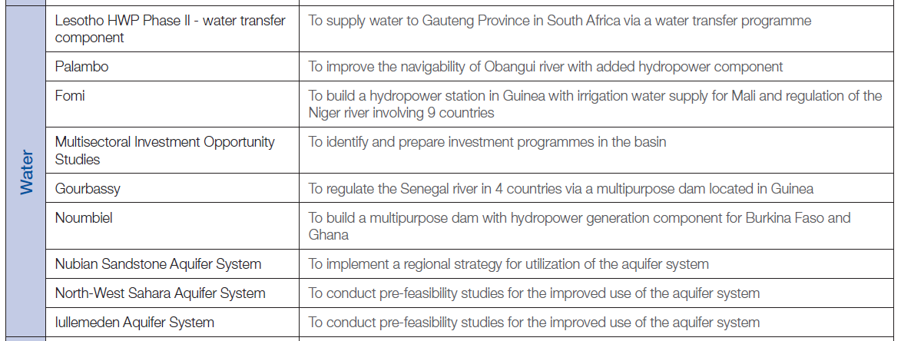
ANNEX 3: PIDA PAP: Transboundary Water 9 ITEMS = US$ 2.0bn

Slide 40
ANNEX 4: PIDA PAP: ICT 3 ITEMS = US$ 0.5bn

