Slide 1
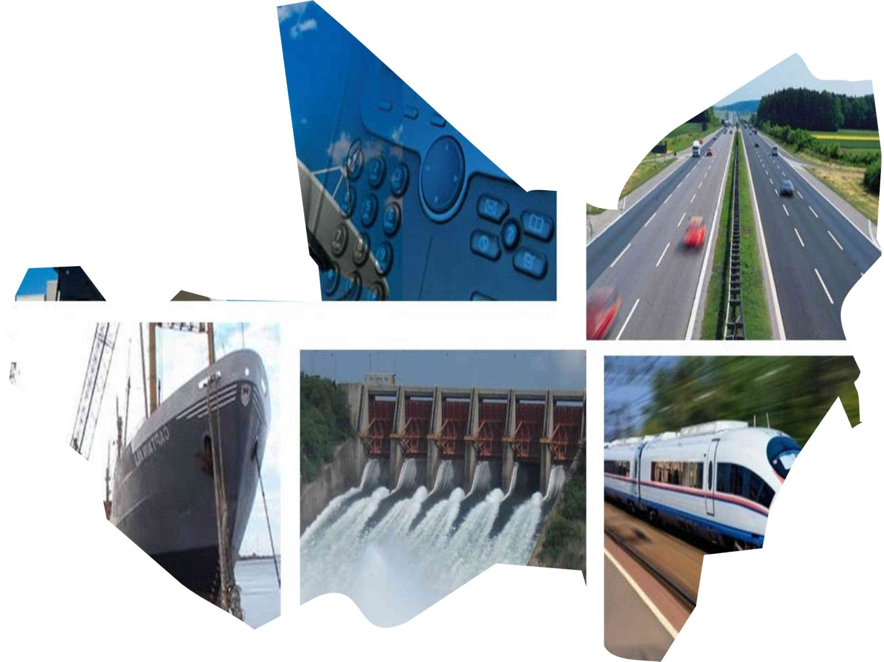
ECOWAS Regional Networks and Sector Governance Challenges
EC Continental Seminar on Infrastructure In Africa,
Oct 1-4, Addis-Ababa, Ethiopia
David Kamara
Director, Transport & Telecoms

Slide 2
OUTLINE
Introduction
Challenges
  Finance and resource mobilization
  Institutional and capacity
  Infrastructures
Responses: Priority Interventions
  ECOWAS 5 - year strategic plan
  Finance and resource mobilization
  Project Preparation and Development
  Infrastructure projects (Energy, ICT, Transport)
Critical Success factors

Slide 3
Introduction
The Infrastructure development agenda is guided by Goal 2 of the ECOWAS regional strategic plan, “To facilitate the development of infrastructure for the attainment of a Competitive Business Environment and Investment Capacities”
Programmes, projects and activities are tailored towards achieving this goal to promote integration and support growth in regional trade and free movement.
These projects are in tandem with continental infrastructure development agenda such as the African Union (AU), PIDA (Programme for Infrastructure Development in Africa) for which ECOWAS is the designated coordinator of projects in West Africa

Slide 4

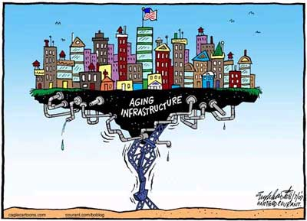
Challenges
  Infrastructure challenges affect competitiveness of the region and presents major impediments to economic growth due to high production cost
  – ECOWAS Strategic Plan 2011-2015

Slide 5
Challenges: 1. Finance & Resource Mobilization
Inadequate investment finance for infrastructure development especially transport and energy sub-sectors, caused by:
  Inadequate Government budgets and prioritisation;
  Weakness in projects development, packaging and marketing;
  Poor policy, institutional, legal and regulatory frameworks to attract large regional and international private sector finance (through PPPs)
Limited mobilization of potential investment financing from the vast regional natural resource base
  Fragmented resource mobilization
  Lack of value addition
  Inadequate knowledge base of the true resource base

Slide 6
Challenges: 2.Institutional & Capacity
Inefficient Management Structures and Discordant Frameworks
  Policy, legal and regulatory frameworks and processes.
  Institutional structure and functioning;
  Resources management and operational inefficiency;
  Lack of requisite technical human resources for infrastructure development
Limited regional dimensions to national infrastructure development strategies
  Low national interest in regional infrastructure projects
  Inadequate technical capacity for regional infrastructure development and management
  Project preparation and development

Slide 7
Challenges: 3.Infrastructure
Gaps in infrastructure development:
  Missing or undeveloped links along major regional (and national) infrastructure networks;
  Infrastructure needed to make investment possible in hitherto “locked up” or underexploited resources or economic potential, for example in minerals, agriculture, tourism, manufacturing and processing industries; and
  Insufficient intra and inter-regional transport access
Poor utilisation of existing infrastructure, in respect of:
  Standards and quality of infrastructure (harmonisation, establishing and application of requisite common standards and specifications);
Backlog maintenance resulting from:
  Inefficient maintenance management systems;
  Inadequate and unreliable financing;
  Inadequate capacity to carry out maintenance works.

Slide 8
Challenges: Infrastructure cont’d…
Energy infrastructure and services are unevenly distributed and resources highly under exploited, with very low access rates and highly fragmented markets
  WAPP demand forecast is 8.9%, requiring additional 90GW
  Per capita consumption projected to 67% due to access increase
Road transport haulage cost relatively high compared to other regions with inadequate multi-modalism;
  Non-existence of cheaper alternatives like railways and regional maritime and coastal services.
Slow and sporadic implementation of the Yamoussoukro Decision on Air Transport liberalization.
  Poor Air connectivity between major capitals,
  Non-viable airlines & High cost of air tickets
  Inadequate airport infrastructure with periodic safety concerns
Low international connectivity and high costs to telecommunication consumers.
  Continental ICT demand projected to grow 20 times before 2020 due to broadband growth.

Slide 9



Responses!!!
Priority Interventions
Regional Strategy
Finance & Resource Mobilization
Project Preparation & Dev’t
Infrastructure Development
  Energy
  Transport
  ICT

Slide 10

5-year ECOWAS Strategic Plan: Infrastructure Development
Reduce cost and enhance provision of infrastructure services
Increase involvement of the private sector and public-private-partnerships in infrastructure development
Secure adequate funding for infrastructure projects - facilitate member states access to funds, secure foreign capital and expertise
Improve rural access to energy and energy services
Focus on multimodal transportation systems to improve connectivity between member states

Slide 11
1. Finance & Resource Mobilization
FODETE
  Fund for the development and financing of regional Transport and Energy projects which is expected to be fed from a levy on the key export resources within the region.
  Feasibility study for the establishment of the fund underway (project prioritization criteria, fund mechanism and Management, sustainability etc).
  Donor Engagements & Meetings
  Coordinated donor inflows and interventions
  Harmonized project and programme intervention/ selection

Slide 12
2. Project Preparation & Development
  Preparation of ECOWAS Regional Infrastructure Development Master Plan
    Provide a development framework for infrastructure to meet requirements and targets for 30-year (2015 – 2045) period
    Define benchmarks, minimum and ultimate regional requirements and development targets in the area of Transport, ICT, Energy & Water Resources?
  Establish the Programme Preparation and Development Unit (PPDU) - Staff recruitment underway
    Prepare and develop bankable regional infrastructure projects
    Increase and promote private sector participation in the implementation of infrastructure projects within the ECOWAS region.
  Programme for Infrastructure Development for Africa (PIDA)
    AUC/NPCA/AfDB project preparation, development & implementation capacity building

Slide 13
2. Project Preparation & Development:
Priority Studies for 2013
  Procurement process ongoing
ECOWAN Study on market analysis and business model
ECOWAS Regional Infrastructure Development Master Plan
Lagos-Dakar Corridor missing links
Development of airport infrastructure in West Africa
Development of rural and peri-urban electrification in West Africa
Development of a postal service Master Plan in West Africa
Feasibility Studies for Railways new links
  To be launched
Procurement of Construction Works: Joint Border Posts between Ghana and Cote d’Ivoire
Study for Extension of gas pipeline project
Study for ECOWAS Energy Policy
Feasibility Study for new Joint border posts construction
Feasibility study for the construction of the regional broadband infrastructure including right of way for landlocked countries to submarine cables

Slide 14
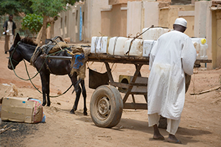
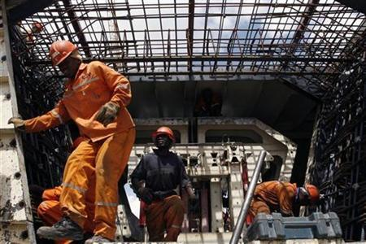

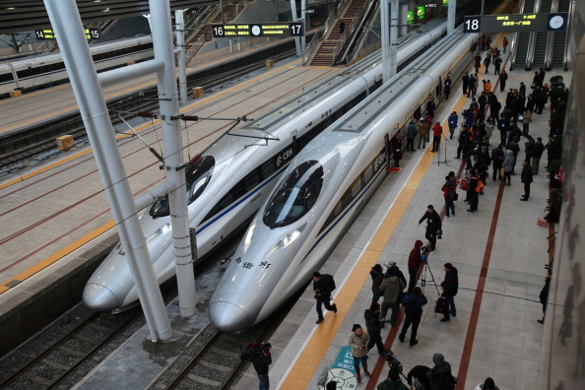
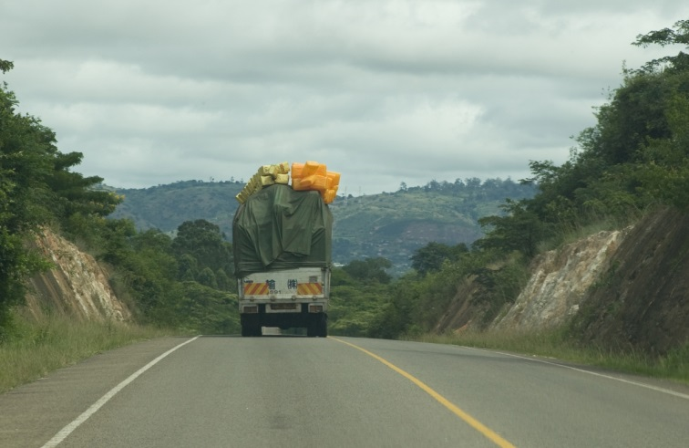
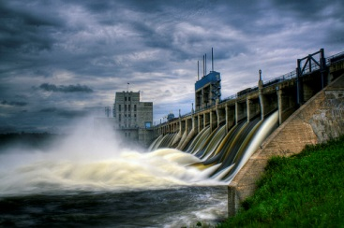
  3. Infrastructure Development….
  “With regional spending needs of $1.5 billion a year, catching-up on infrastructure could boost economic growth by five percentage points” – AICD study

Slide 15

ENERGY

Slide 16
Infrastructure project under the
West African Power Pool (WAPP)
To integrate the national power systems of ECOWAS Member States into a unified regional electricity market, with the objective to provide citizens with a stable and reliable electricity supply at affordable cost.
WAPP comprises the development of generation and transmission capacities
Construction of 6,700 km of transmission lines. Cost US$6.5Billion:
  Sub-programme 1: coastal trans backbone (Cote d’Ivoire-Ghana-Benin/Togo-Nigeria)
  Sub-programme 2: Inter-zonale trans hub (Burkina Faso, OMVS via Mali, Mali via Cote d’Ivoire, LSG via Cote d’Ivoire)
  Sub-programme 3: Northcore trans (Nigeria, Niger, Burkina Faso, Benin)
  Sub-programme 4: OMVS/OMVG electric networks development (Gambia, Guinee, Guinee Bissau, Mali, Senegal)
  Sub-programme 5: Cote d’Ivoire-Liberia - Sierra Leone - Guinee (CLSG) system (funding obtained from World Bank)
33 power plant projects for a total of 11,000 MW (Cost – US$20.6 Billion)
  OMVG Project: Hydroelectric sites at Kaleta (240MW) and Sambagalou (128 MW)

Slide 17
Infrastructure project (WAPP)…Cont’d
330kV Volta (Ghana) – Lome “C” (Togo), US$149m. Completion 2014, AfDB, KfW, WB
225kV Bolgatanga (Ghana) – Ouagadougou (BF), US$111m AFD, EIB, WB
60MW Felou Hydropower Facility (OMVS-SOGEM) – Implementation level, US$236m, WB & EIB
225kV Cote d’Ivoire-Liberia-Sierra Leone-Guinea Interconnection Project:WB, EU, EIB, 7.62
450 MW WAPP Maria Gleta (Benin) Regional Power Generation Facility –us$564m. At the Implementation level - completion 2017
MV Cross Border Projects:
  Cote d’Ivoire-Liberia (1st ACP-Energy Facility): Electrification of 18 Communities in Liberia from Cote d’Ivoire, €9.6m. completion 2013
  Ghana-Southern Togo (2nd ACP-EU Energy Facility), Electrification of 15 Communities in Southern Togo from Ghana €2.3m. completion 2014
  Benin-Northern Togo (2nd ACP-EU Energy Facility), Electrification of 10 Communities in Northern Togo from Benin €2.3m. completion 2014
  450 MW WAPP Aboadze/Domunli (Ghana) Regional Power Generation Facility, us$564m, land Secured and commissioning expected in 2018
  330kV Aboadze-Prestea-Kumasi-Bolga (Ghana) Transmission Line Project, US$174.8m secured from AfD, commissioning expected in 2016

Slide 18
Inter Zonal
coastal trans backbone
Inter-zonale trans
Northcore trans
OMVG/OMVS
CLSG
North Corridor
MALI
SENEGAL
NIGER
GAMBIE
GUINEE
BISSAU
BURKINA FASO
GUINEE
  NIGERIA
OMVG-OMVS
BENIN
SIERRA
LEONE
CÔTE
D’IVOIRE
TOGO
GHANA
CLSG
LIBERIA
Coastal transmission line
WAPP implementation sub programme
Notes:
18

Slide 19
Specific Regional Energy Intervention Projects
Construction of 40 small hydro dams – UNIDO/ECREEE
Extension of the West African Gas Pipeline: to supply gas to Côte d’Ivoire, Liberia, Sierra Leone, Guinea, Guinea Bissau, Gambia, Senegal, Niger, Burkina Faso and Mali
Emergency Energy supply programe (2008 OHoSG Summit)
  Programme for energy supply and generation Guinea, Guinea Bissau, Sierra Leone, The Gambia
Regional programme for Power Regulation capacity building
  Assistance for the creation and installation of national bodies in charge of electricity sector regulation

Slide 20
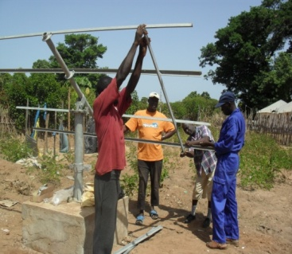
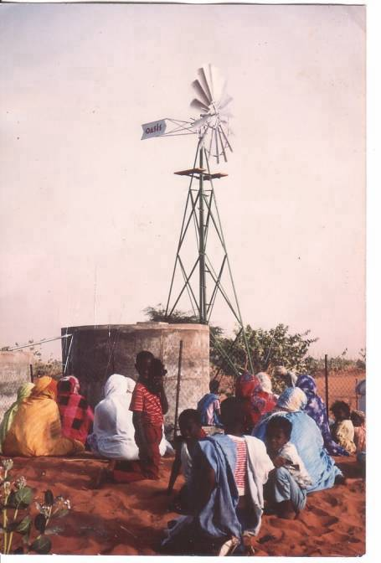
Energy access/ rural electrification
Rural and peri-urban electrification in West Africa (Phase 1)
Objective
Increase access to electricity by about 200 million people in the ECOWAS region by providing electricity supply to 5,000 villages.
Cost: US$2.5 Billion
Next Steps
Detail studies to be undertaken for the whole programme.
Fund mobilization
Follow-up the projects implementation.
The ECOWAS/UEMOA White Paper for Access to Energy Services
Objective
Increase by four fold, access of energy services to 36 million households and 49,000 localities by 2015
Cost: US$12.7 Million
Key components
Creation of an energy access unit,
Creation of a data base,
Final evaluation of energy investments programmes and energy fund mobilization
Waya (Nigeria) Small hydro power reservoir and intake structure
Setting up a PV system
Guinea Bissau

Slide 21
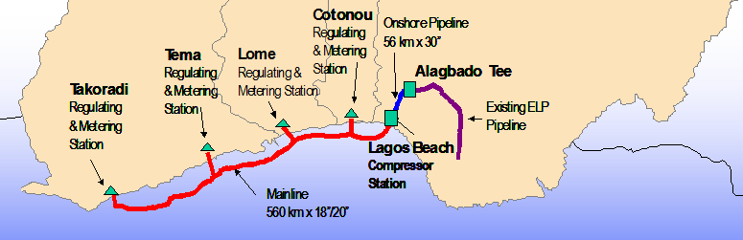
FEASIBILITY STUDY FOR THE EXTENSION OF THE WEST AFRICA GAS PIPELINE
Study Objective:
To analyze the possibilities of extension of the West African Gas-Pipeline to Dakar through Abidjan, Monrovia, Free Town, Conakry, Bissau and Banjul and also to feed the inland countries without proven Gas reserves
Study Cost : US$2million
Current WAGP Description
620 km of 20-inch pipeline extending from Lagos to Takoradi in Ghana; Capacity: 474 MMBtu / day with a potential to generate 2,500 to 3,000 MW
Financed by a consortium ie WAPCo (Chevron / Texaco, Shell, NNPC, VRA, Sobegaz & Sotogaz) – US$2billion
Free flow since May 2009

Slide 22
TRANSPORT

Slide 23
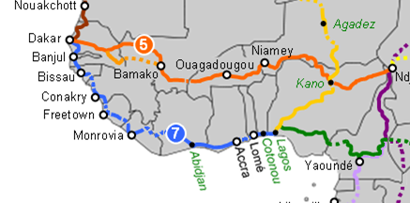
TRANS-West African HIGHWAY
Trans Coastal, Dakar-Lagos corridor missing links (PIDA) Nigeria ; Benin ;Togo ;Ghana; Cote d’Ivoire; Liberia; Sierra Leone; Guinea Bissau; Guinea; The Gambia; Senegal
  Improvement of existing roads Boke(Guinee) – Quebo (Guinee Bissau), 112 km
Trans Sahelian - Dakar – Niamey-N’Djamena multimodal corridor (PIDA)
  Senegal 315 km
  Mali 375 km
  Burkina Faso 109 km
  Niger 598 km

Slide 24
Missing Links Improvement
Construction of bad sections on the Abidjan-Lagos Section – World Bank
    Phase I - Ghana 110km; Benin 17km; Togo 8km. Supervision, Technical Assistance & Road Safety
  Rehabilitation of the Cotonou-Lome road – AfDB
  Construction of the Trans-Gambia Bridge – AfDB
    Construction of two roads in Senegal
    Construction of two Joint Border Posts (Senegal & Gambia)
  European Union 10th EDF Regional Indicative programme
    Construction of the Bandajuma to the Moa river bridge (45,2 km) – S. Leone-Liberia
    Improvement/Construction of 3 bridges located over the Sewa, Waanje and Moa rivers in Sierra Leone
    Construction of Zinder- Nigeria Border Road (Niger-Nigeria)
    Koupela Piega-Fada Gourma-Niger Border (Burkina Faso-Niger)
  ECOWAS-AUC-AfDB Champion Infrastructure Program
  Dakar-Lagos missing links - Road
  Cotonou-Niamey-Ouagadougou-Abidjan railway links
  Dakar-Bamako-Ouangolodougou and Dosso(Niger)-Northen Nigeria railway links
  Sambagalou dam and interconnection lines – OMVG
  Fomi multipurpose dam – Guinea

Slide 25
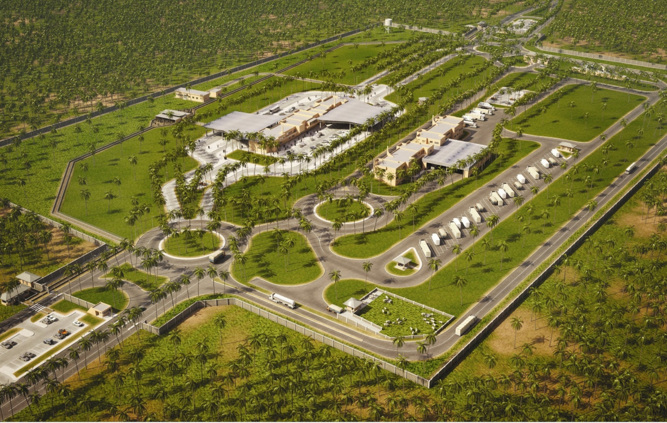
Construction of Joint Border Posts (JBPs)
OBJECTIVES
To enhance movement of persons, vehicles and goods within the Community joint controls in a single location
To enhance the effectiveness of border controls
BENEFITS
Average border crossing time reduced to 3 hours
Clearances for buses and passenger cars halved
Freight times reduced quite dramatically.
Pre-clearance possible through information & equipment sharing

Slide 26
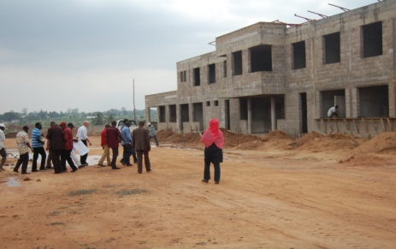
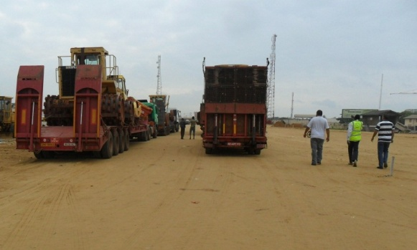
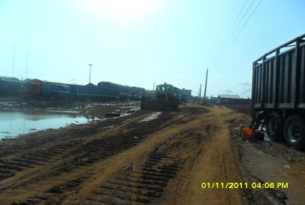
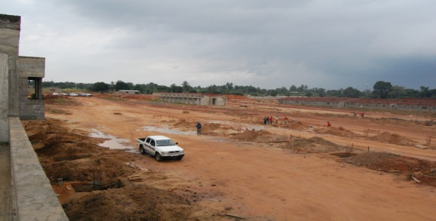
Update on the construction of the JBPs
Project Update
Architectural and engineering designs completed
Construction ongoing on three (3) sites: Nigeria/Benin border, Togo – Ghana and Benin – Niger border.
Next Steps
Secure funding for remaining JBPs
  Bénin-Togo €16.00m
  Ghana-Côte d’Ivoire €20.00m
  Guinée-Mali €16.00m
  Ghana-Burkina Faso €16.00m
ECOWAS Regional Supplementary Act for JBPs submitted to ECOWAS Parliament
Undertake study on detailed JBP operational procedures manuals customized for specific JBPs
Undertake detailed baseline studies of existing borders controls to inform the development of modified manuals
Undertake detailed training programmes for border control officials on the JBP scheme

Slide 27


AIR TRANSPORT- Projects
Establishment of an Air Transport Legal Framework for ECOWAS region
  Publish, awareness campaign and follow up of the implementation of the Air Transport Supplementary Acts to sustain a Community Air Transport Market
Enhancement of Aviation Safety and Security
  Pooling of resources for Civil Aviation Authorities (CAA) capacity building through an Unique Regional Aviation Safety Oversight Organization (RSOO) and a Regional Pool of Experts for Aviation Security Regional in ECOWAS region
Facilitating of a Viable Airline Industry in the region
    Projects for the viability of the airline industry such as Aircraft Leasing Company, Aircraft Maintenance Facility, Regional Air Transport Data Base, enhance airport infrastructure and the creation of ECOWAS Airlines cooperation (joint ventures, mergers, alliances, etc).
  Aeronautical Cooperation
    Implementation of the MoU of July 2012 with ECAC, the Technical Agreement signed on 17 October 2012 with WFP and Finalize draft Air Services Agreements with EU and Brazil.

Slide 28
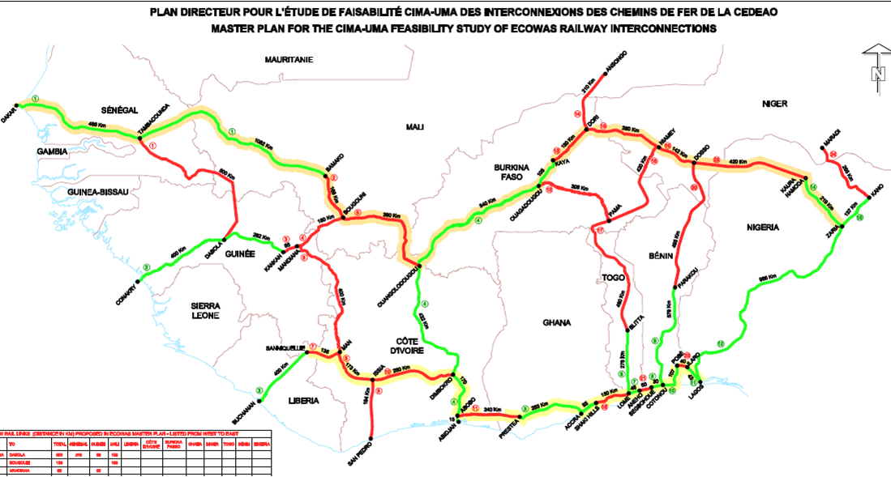

ECOWAS RAILWAY MASTER PLAN
OBJECTIVE
To enhance competitiveness of economy in the region by providing affordable transport costs for agriculture and mining products and goods.
Master plan details
ECOWAS Railway Master Plan developed in 2009, identifying 17 priority links
Rehabilitation of 3,300 km existing railways
Construction of 6,700 KM of new lines
Update
Railway Route (Cotonou-Niamey-Ouagadougou-Abidjan Railway- 2,681 km)

Slide 29
ECOWAS RAILWAY MASTER PLAN
Trans Coastal New Links
Ilaro - Pobé 23 km; Segbohoue - Aného 49 km; Lomé - Téma 147 km; Prestea - Abidjan 222 km
Rehabilitation link
Cotonou- Segbohoue 50 km
Aného-Lomé-Blitta 334 km
Dakar - Bamako 1,150 km
Interconnection New links
Blitta-Pama-Fada Ngourma-Ouagadougou 783 km; Blitta- Sokodé-Fada Gourma- Niamey 839 km; Bougouni-Mandiana-Kankan 261 km; Tambacounda - Dabola 646 km; Man -Mandiana- Kankan 576 km; Dimbokro -Diléya-Man- Sanniquellie 535 km; Ansongo - Dori-Kaya 363 km; Man -Diléya- San Pedro 399 km
Next Steps
Feasibility and detailed studies to be undertaken
Funds Mobilization

Slide 30
Information & Communication Technology (ICT)

Slide 31
ICT - ECOWAN Project
ECOWAS WIDE AREA NETWORK (ECOWAN) - public sector e-governance computer network, connecting all ECOWAS institutions, Governments and affiliated organizations. Cost - US$130m
Benefits to ECOWAS
Enhance knowledge sharing and regional integration
Secure communication, administration and financial transactions portal.
The Project comprises:
  Fibre-optic connectivity within a country (Middle Mile connectivity)
  Cross-border connectivity
  Last Mile (end-user) connectivity
  Capacity building
Core Applications to be deployed
  THE REGIONAL CONTROL, COMMAND AND COMMUNICATION (R3C) – The connectivity of the Heads of State and Government, Foreign Affairs ministries, ECOWAS Institutions
and fee paying applications
  ALISA – Customs connectivity and transaction support
  RVAIS – Regional Vehicle Administration Information system
  WAMI – connectivity for national central banks enabling real-time financial transaction support
Update
The Gambia and Sierra Leone have both signed loan agreements with the Islamic Development Bank (IsDB) for the implementation of the project .
  IsDB has also indicated interest to finance the implementation project in other IsDB member countries

Slide 32
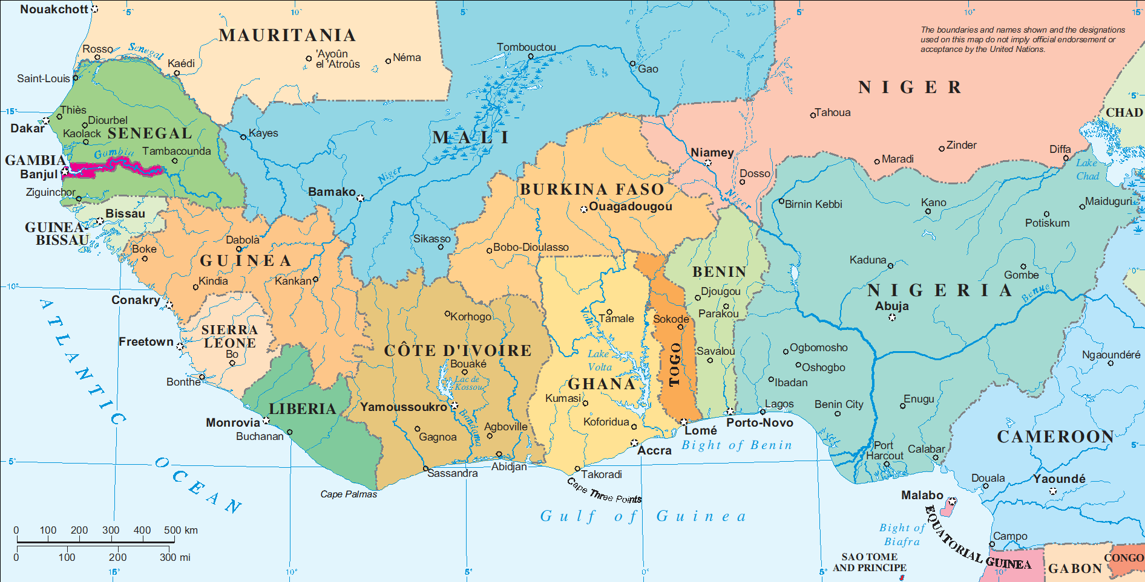
ECOWAN Implementation plan
Individual country
Senegal-Mali-B/Faso-Togo link
Coastal corridor
Niger-Benin link
CV-Senegal-Mali-Cote d’Ivoire link

Slide 33
Critical Success Factors
  Need to respect the Regional mandate accorded ECOWAS by the 15 Member States
    ECOWAS procurement process
    Active participation needed even in national level implementation
  Requisite Capacity Needs (Departments, Agencies, technical Assistance, etc)
    Staffing requirements and resources
    Training
  Member States
    Capacity building
    Commitment (preparation, implementation, operations, etc)
    Sensitization
  Funding Funding Funding

Slide 34















Thank you for
your kind attention
-----

