Slide 1
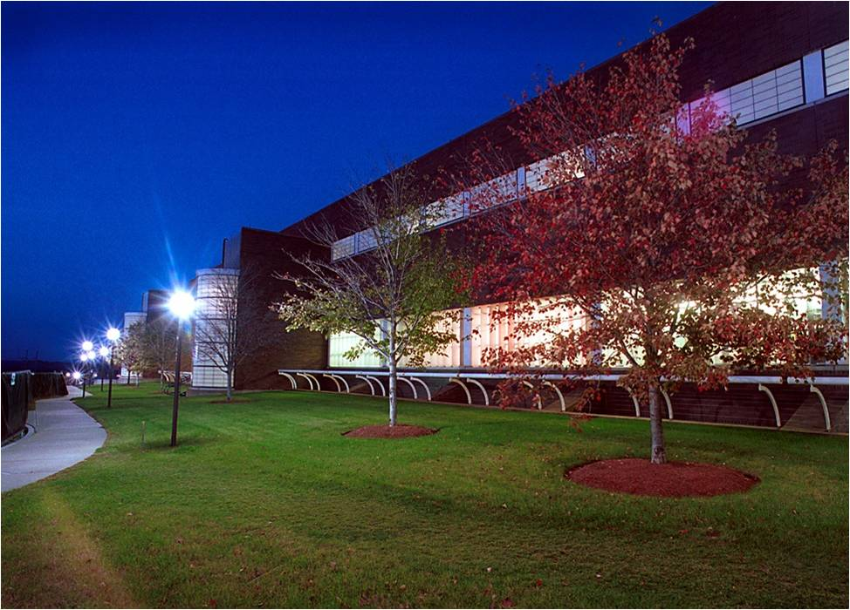
Youth Green Jobs
Cathy Cronin
Environmental Engineer
Green Jobs – Energy Management System Intel Ireland
Green Jobs – Communications
Green Jobs - Research
http://www.youtube.com/watch?v=0kbMqkmj-eU
Notes:
1

