Slide 1
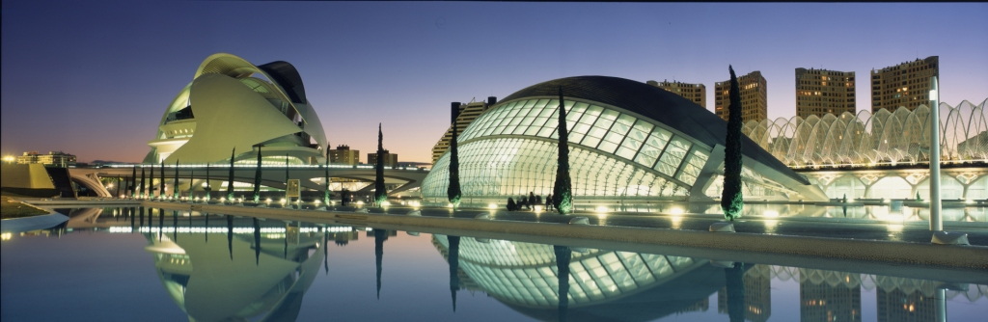

Department of Education, Culture and Sport
Brussels, 8th October 2013

Slide 2
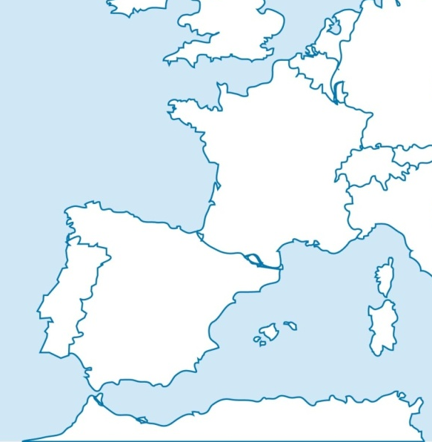

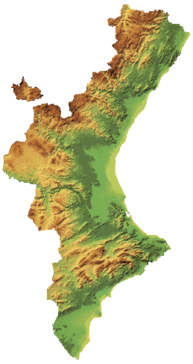
Castellón
BEST PRACTICE IN YOUTH TRAINING FOR THE GREEN JOBS
Valencia
Alicante

Slide 3
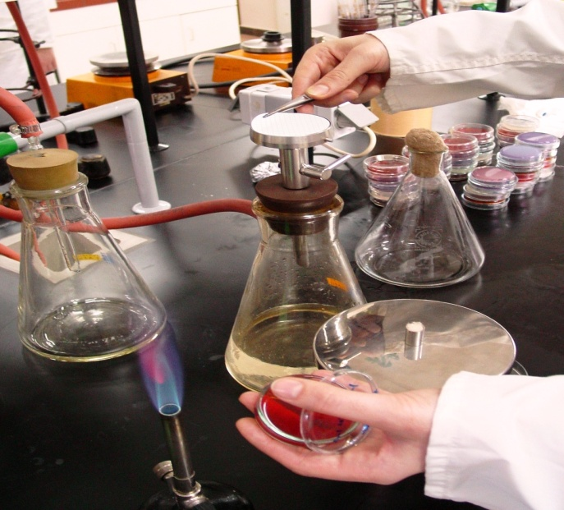
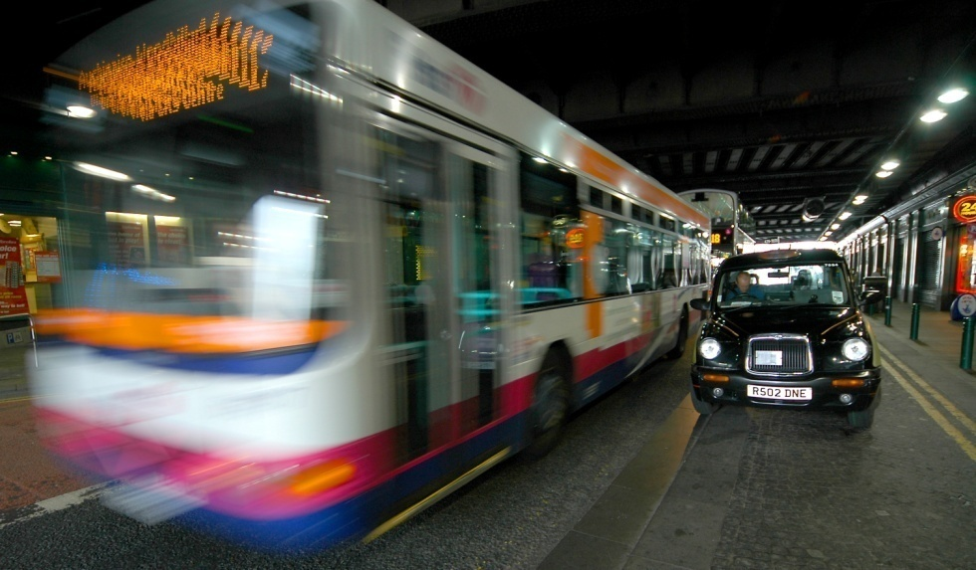
Our approach to Best Practice in Valencia involves vocational training in:
Skills associated with renewable energy
Employability + productivity in the green economy

Slide 4
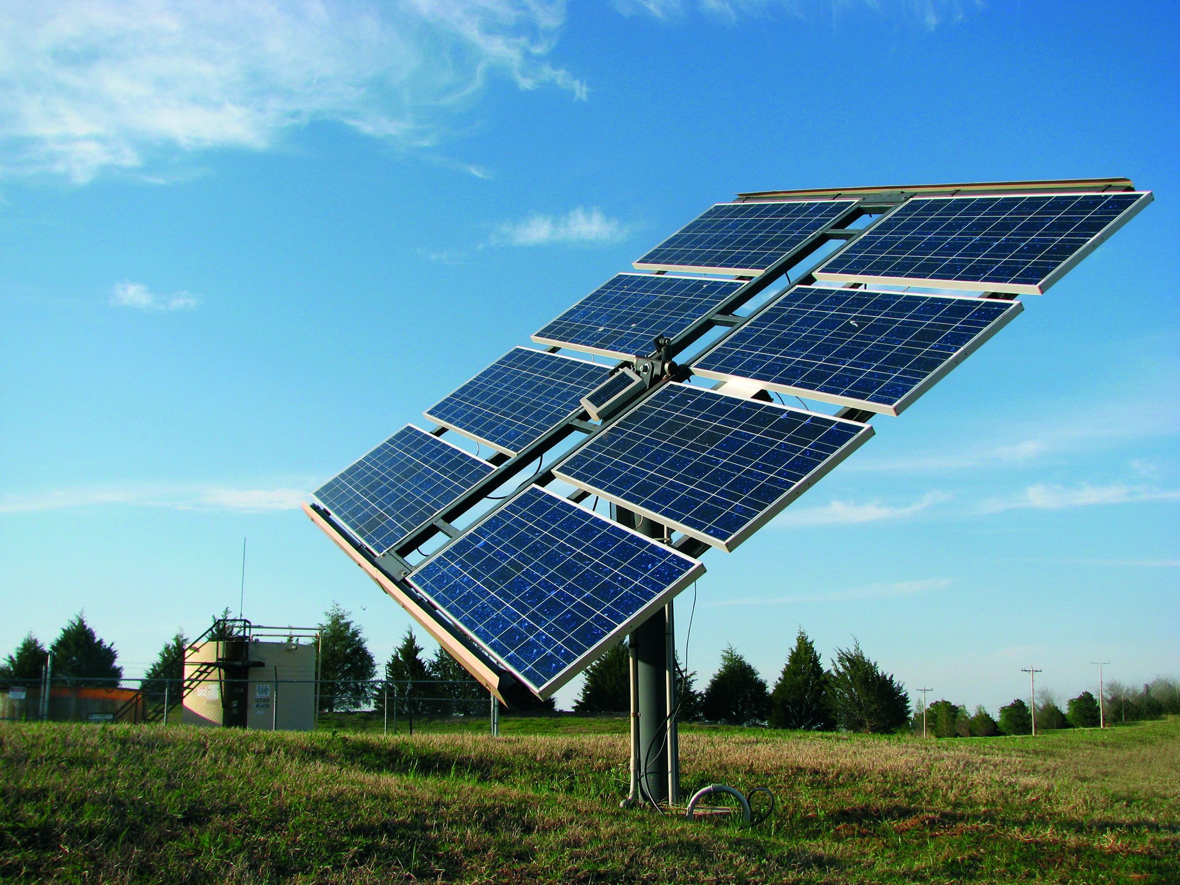
We focus on these areas
Expert in Power Plants.
Senior in Technical Efficiency and Solar Thermal Energy.
Renewable Energy Technician.

Slide 5
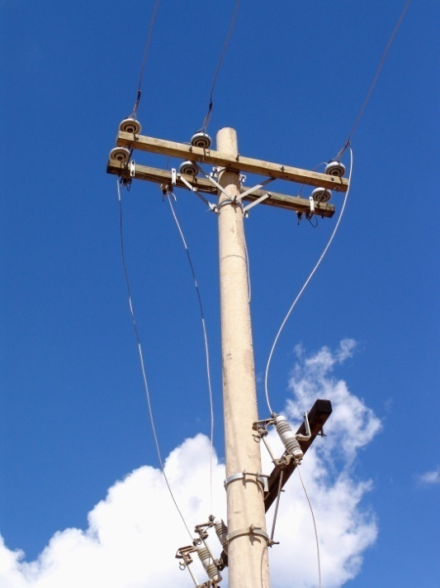
Relevant aspects of professional
profiles and curriculum development:
The European framework on energy policy and
sustainability, with the implementation of content and learning that
take into account efficiency measures.
The use of renewable energy.
Reducing thermal losses.
Other awareness campaigns that connect with some of the areas
listed in the “Action Plan for Energy Efficiency”, of the European
Commision.

Slide 6
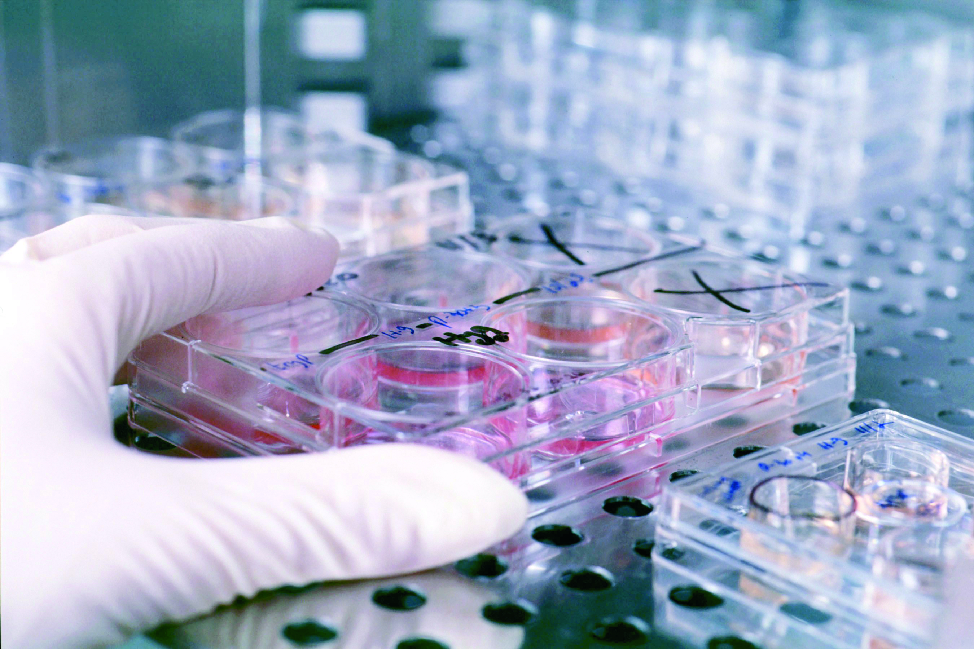
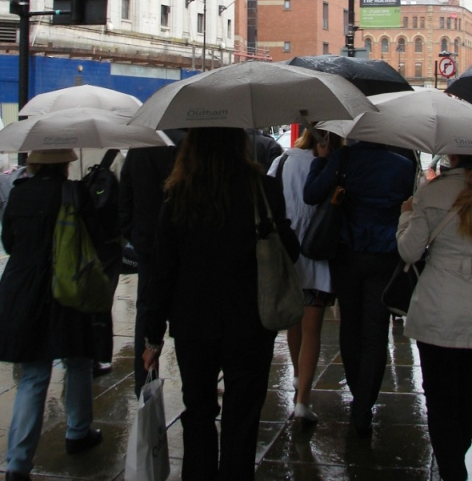
First educational experience
Vocational Training Centre “ Cotes Baixes” (Alcoy. Alicante)
Three projects designed by students of higher level training cycle “Renewable Energy” as the end of there training activity during the year 2012-2013.

Slide 7
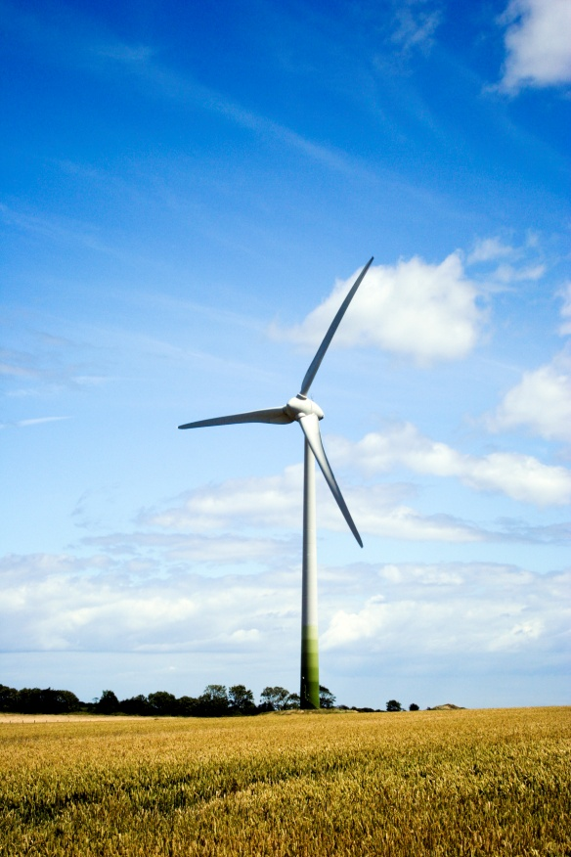
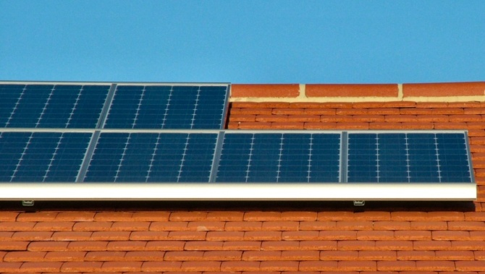
Projects
1- “Wind Installation” to design, measure and test the
feasibility of installing a wind turbine to supply energy
demands for basic electrification of a house situated in
the Secondary School “Cotes Baixes” (Alcoy), through
the use of wind energy.
2- “Isolated photovoltaic solar installation network” to
analyze and calculate the consumption of an installation
of a mains isolated house basic electrification, for
specifying of the electrical system by using renewable energy sources. Mainly photovoltaics.
3- “Solar thermal installation” to perform installation and sizing a DHW (Domestic Hot Water) for the Secondary School sports facilities.

Slide 8
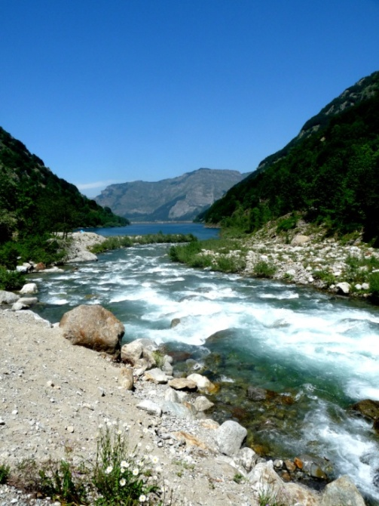
Second educational experience
Integrated public training Centre “Canastell”.
San Vicente del Raspeig (Alicante).
Study and creation of an “ecodomotica” house
with solar air conditioning system by absorption.
Performed by students of various Inicial Professional Qualification Programmes. It is carried out in the school
and with the support of students from middle-level
vocational training and higher professional from
Installation and Maintenance.

Slide 9
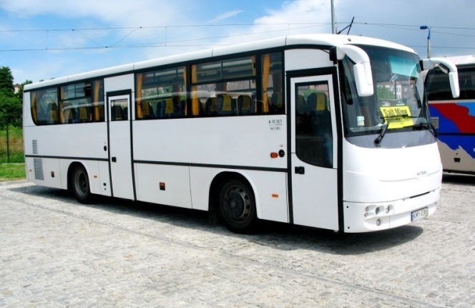
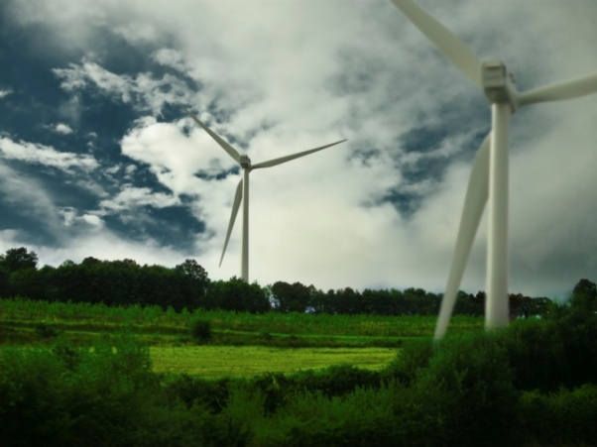
Example of an interconnection between economy and
environment.
We rank 2nd out of 40 most innovative centres for youth
training in Spain, such “Mercados 21”
Renewable energy is one of the sector with increasing investments and employment generation.

Slide 10
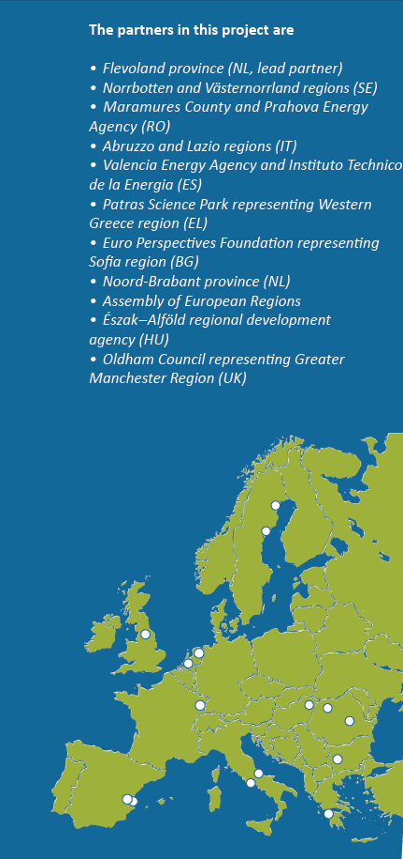




Regional policy instruments and approaches for improving access to finance and speeding up investments in sustainable energy.
Overall objective: to equipe these regions with regional policy instruments, mechanisms and approaches to improve access to finace for and speed up investments in sustainable energy projects in their territories. It will be a significant contribution to sustainable economic growth and employment generation.
How to boost investments
in sustainable energy?
By collecting and exchanging good practices
By analysing the specific challenges related to financing
sustainable energy projects in each region
By developing policy instruments and approaches to boost
investments in sustainable energy projects
Total budget: 2.090.576,58 €
ERDF funding (75%): 1.621.841,26 €
Duration of the project: Jan 2012-Dec 2014
Nº total partners: 15 (10 countries)
+ 2 collaborators (EURISY+FCVRE)
Activities and methodology
Collection of good practices
Organisation of 13 peer reviews, leading to 13 actions plans to improve investments
in sustainable energy
Improvement of at least 7 local/regional policies
3 DE-on Master classes, developing 3 DE-on blueprints
Communication activities to share the results with a larger public ( website,
newsletters, conferences, brochures)
Contact: Marta Esteve
esteve_marnav@gva.es
+34 963 13 10 80
Valencia (Spain)
www.regions4greengrowth.eu

Slide 11
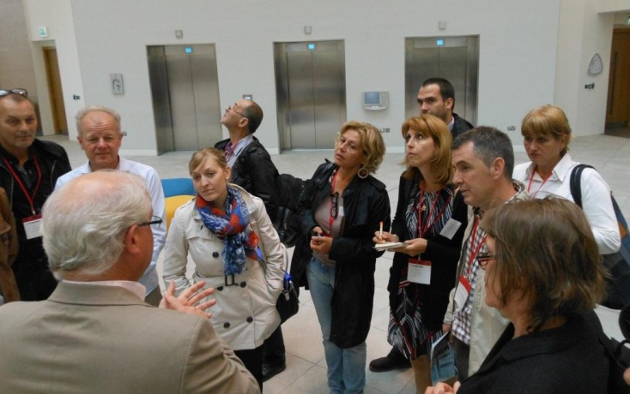
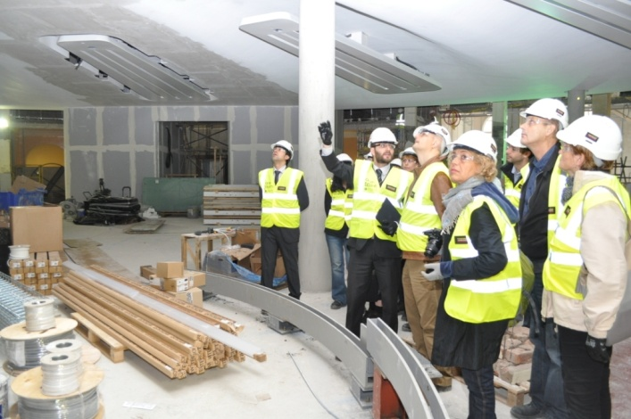
What are Regions4GreenGrowth
peer reviews about?
www.regions4greengrowth.eu
A peer review is a mentoring visit to a host region, undertaken by a group of international experts
To asses the region’s strategy, policy and actions in the field of investments in sustainable energy
Peer reviews help regions to understand how well their policies and practices are working and support them in making improvements, proposed by the group of experts

Slide 12
Regional policy instruments and approaches for improving access to finance and speeding up investments in sustainable energy.
Overall objective: to equipe these regions with regional policy instruments, mechanisms and approaches to improve access to finace for and speed up investments in sustainable energy projects in their territories. It will be a significant contribution to sustainable economic growth and employment generation.
How to boost investments
in sustainable energy?
By collecting and exchanging good practices
By analysing the specific challenges related to financing
sustainable energy projects in each region
By developing policy instruments and approaches to boost
investments in sustainable energy projects
Total budget: 2.090.576,58 €
ERDF funding (75%): 1.621.841,26 €
Duration of the project: Jan 2012-Dec 2014
Nº total partners: 15 (10 countries)
+ 2 collaborators (EURISY+FCVRE)
Activities and methodology
Collection of good practices
Organisation of 13 peer reviews, leading to 13 actions plans to improve investments
in sustainable energy
Improvement of at least 7 local/regional policies
3 DE-on Master classes, developing 3 DE-on blueprints
Communication activities to share the results with a larger public ( website,
newsletters, conferences, brochures)
Contact: Marta Esteve
esteve_marnav@gva.es
+34 963 13 10 80
Valencia (Spain)
www.regions4greengrowth.eu

Slide 13
Thank you for your attention!
Victoria Palau (DG European Affairs)
dgrue@gva.es

