Slide 1


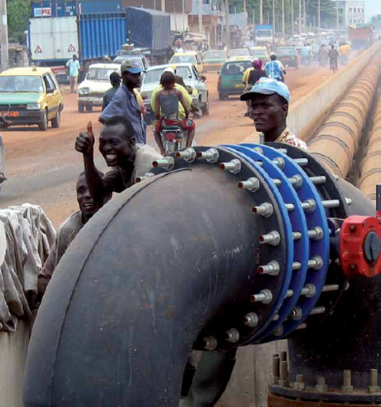
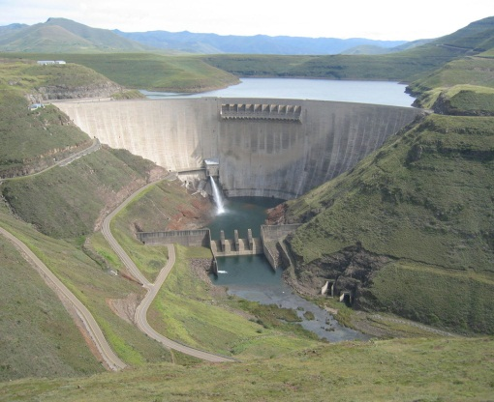
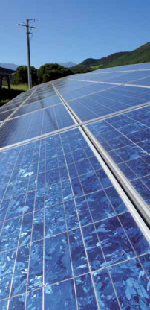
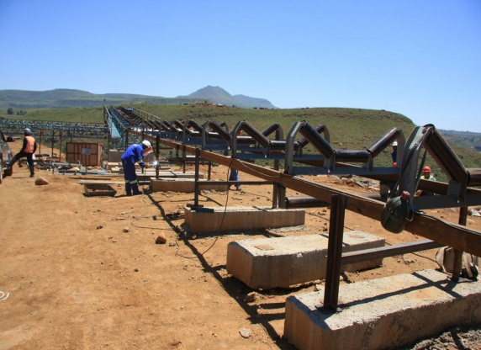
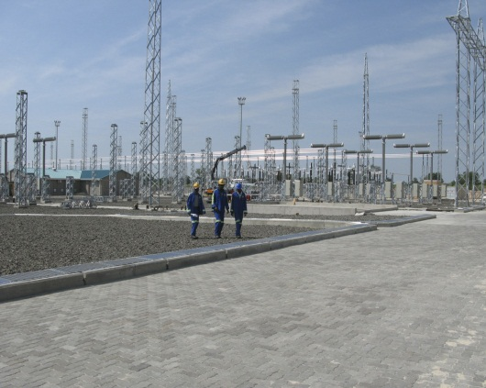
Project Cycle and Bankability
of Infrastructure Projects
Continental Infrastructure Seminar
Addis Ababa, 1-3 October 2013
Heike Ruettgers, ACP-IF Department

Slide 2
EIB signatures by section by region
Africa - 2003-2013* (EUR m)
Infrastructure sectors represent 63% of the total signed portfolio
* to end June 2013

Slide 3
Resources and amounts
European Development Fund
(EU Member States’ budgetary funds)
European Union |  | European Investment Bank
►Grants ►Tenders |  |  | Investment Facility |  | Subsidies |  | Own resources
• National and regional indicative programmes |  |  | ►Loans* |  | ►Interest rate |  | ►Senior loans
 |  |  | ►Equity |  | ►Technical assistance
 |  |  | ►Guarantees
• Intra-ACP and inter-regional cooperation |  |  | Revolving fund
 |  |  | Total capital endowment under 9th,10th and 11th EDFs |  | Amounts available under the 11th EDF 2014-2020
 |  |  | • ACPs EUR 3 637m |  | · ACPs EUR 634m |  | • ACPs up to EUR 2 500m
 |  |  | • OCTs EUR 48.5m |  | · OCTs EUR 1.5m |  | • OCTs up to EUR 100m
* Senior, junior, subordinated and intermediated loans, as well as quasi-equity operations.

Slide 4
Financial Instruments
EIB Own Resources
Funds raised on the capital markets (EU Member States guarantee)
Senior loans
Intermediated loans
Interest rate subsidies
Technical assistance
Widely traded currencies
Junior or subordinated loans
Quasi-equity funding
Equity funding
Guarantees
Local currencies
Investment Facility

Slide 5
Own Resources versus Investment Facility
OR & IF resources complement each other
EIB own resources:
Public sector investments: sovereign/sub-sovereign borrowers
Private sector projects covered by a third party guarantee
IF resources:
Private sector investments requiring risk-bearing instruments
e.g.: conditional loans/ subordinated loans/guarantees/equity
  June 2013: new EUR 500m envelope for the IF approved by the ACP-EU Joint Council of Ministers
    => ‘impact investing’ = more risk for more development

Slide 6
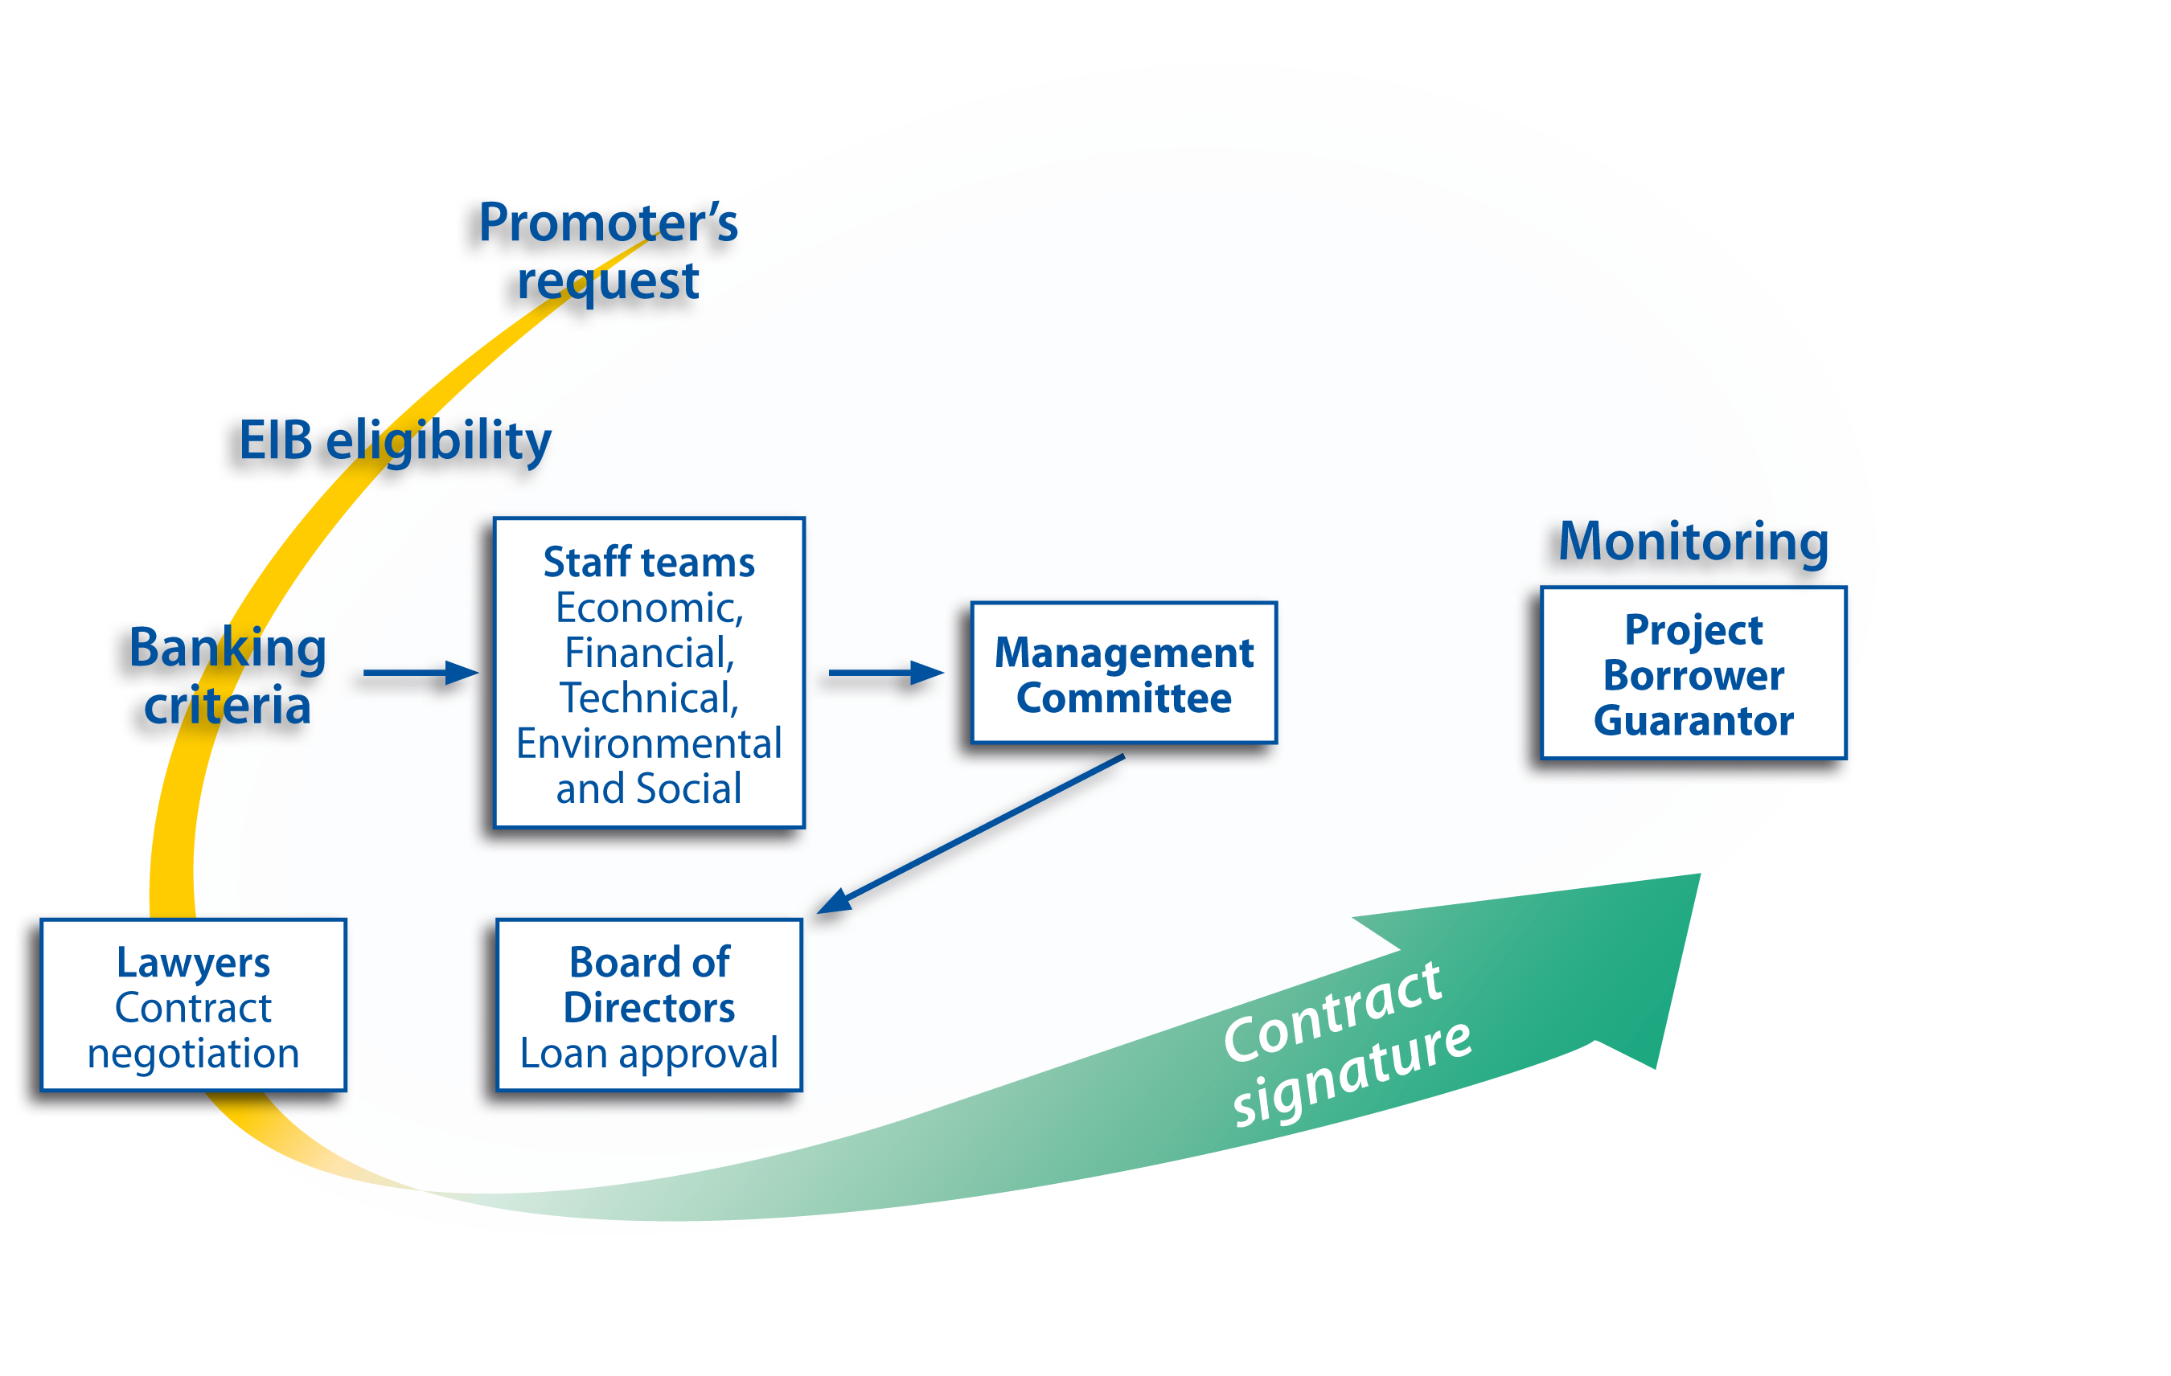
The EIB project cycle
- Strong ownership of project promoters, support provided if required
- Opinion from Partner Country and Commission sought before appraisal

Slide 7
What is an eligible project?
Must contribute to EU development policy objectives and should be:
  Technically sound
  Financially viable
  Produce measurable development results:
  ⇒ Results Measurement framework (ReM)
  Comply with environmental protection and procurement regulations:
  ⇒ “EIB environmental and social guidelines”
Significant financial contribution from promoter
Co-financiers (EIB maximum 50% of project cost)

Slide 8
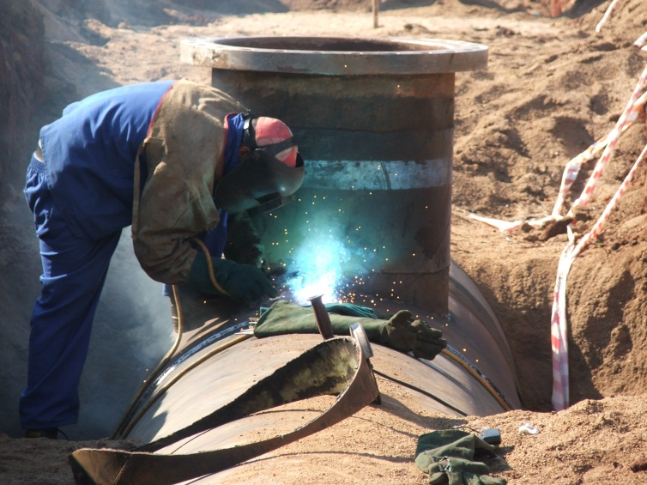
How is project quality assessed?
Technical soundness, risks and mitigation measures, capacity for products/services
Promoter capability to implement, operate and maintain project
Timing, employment, operating and maintenance costs, comparison with costs of similar projects
Compliance with applicable legislation and EIB guidelines on procurement and environmental impact
Analysis and market and demand
Economic and financial profitability
(e.g. rate of return)

Slide 9
Measuring project impact
January 2012: Introduction of a Results Measurement Framework (ReM) enabling an analysis of aggregate results as data build up
Pillar 1 | Expected contribution to lending objectives | An assessment of a project’s consistency with EIB mandate objectives and its contribution to EU priorities and country development objectives, going beyond a focus on eligibility alone.
Pillar 2 | Quality and soundness of the operation, based on expected results | A series of sector-specific standardised indicators to capture a project’s economic, social, environmental and institutional outcomes. It continues to measure project quality and its ability to achieve the expected results.
Pillar 3 | Expected financial and non-financial additionality | An assessment of the EIB additionality over market alternatives in terms of financial product, technical, structuring and sector contribution and standards and assurance.

Slide 10
EU blending mechanisms for the ACP
ACP Investment Facility (IF) – a risk-bearing revolving fund for private sector development managed and operated by EIB
EIB Cotonou subsidy envelope (11th EDF € 634m for IRS and TA)
Global Energy Efficiency and Renewable Energy Fund (GEEREF)
EU-Africa Infrastructure Trust Fund (ITF)
Infrastructure Investment Programme for South Africa (IIPSA)
(under Development and Cooperation Instrument – DCI)
Caribbean Investment Facility (CIF)
Investment Facility for the Pacific (IFP)

Slide 11

EU-Africa Infrastructure Trust Fund (ITF)
EU initiative in partnership with the African Union launched in 2007
Main objective: promotion of regional infrastructure projects in sub-Saharan Africa
Blending loans with grants to leverage EU donors’ funding
Budget of EUR 747 million (incl. EUR 329 million pledged by European Commission for SE4All* initiative)
Donors: European Commission + 12 EU Member States
Instruments: interest rate subsidies, technical assistance, direct grants, Insurance Premia
To date: EUR 385m approved for 77 operations
*SE4All = Sustainable Energy for All
Eligibility criteria
A contribution to poverty reduction
A contribution to economic development
Provisions for sustainable operation and maintenance
African ownership

Slide 12
Why blending?
Achieving EU policy goals more effectively
  « Aid effectiveness » and « aid coherence »
  Efficiency and best use of resources
  Bridging a financial gap when resources are scarce
  Project quality and impact
Optimising service to beneficiaries
Promoting donor cooperation in particular between European aid actors
Grants: “Adding further value”

Slide 13
What is blending?
Finance
Institutions’
resources
EU
resources
other resources
Instruments:
Investment grants
Interest rate subsidies
Technical assistance
Risk Capital
Guarantees

Slide 14
Interest rate subsidies
Available to increase concessionality for:
Infrastructure projects in Least Developed Countries, post-conflict and post-natural disaster countries, HIPC countries
projects with substantial and clearly demonstrable environmental or social benefits
restructuring operations in the framework of privatisations
General rule applied :
Interest rate subsidy: maximum 3 %
Final rate of loan: cannot be less than 50% of the reference rate
In the case of HIPC countries, the interest rate may be reduced by such amount as required to comply with the level arising from the HIPC initiative
Between 2003 and 2012, 40 projects benefited from over EUR 330m in interest rate subsidies in the ACPs

Slide 15
Technical assistance
TA grant funding covering the whole project cycle
Project-related
Strategic initiatives
Capacity building:
Infrastructure projects
Microfinance undertakings
Focus on project preparation and implementation
enhancing project quality and success rate
increasing the efficiency of EIB’s investment activities
complementing other EIB products

Slide 16
Procurement: what is it for?
The DFIs will ensure that there funds are employed as rationally as possible.
The objective of procurement: procure in the economically most advantageous way works, goods and services to implement a project.
6 pillar assessment: compliance with EU procurement
Why are there strict and formal rules for public procurement?
  The promoter is using public money. Therefore, the proccess must be:
    Transparent
    Fair and non-discriminatory
    Traceable
Full access of international firms to procurement

Slide 17
DFI and Promoter respective roles
Promoters are fully responsible for all aspects of the procurement process.
The DFI’s involvement is confined solely to verifying whether or not the conditions attached to its financing are met.
The DFI may advise or assist promoters, but is not a party to the resulting contracts.
For EIB: the EIB Guide to Procurement is NOT a legal framework, and therefore the national legislation is the framework governing procurement procedures.

Slide 18
Joint Co-financing
Various degrees of reliance possible:
  Use the procurement procedures of the co-financing institution
  Entrust the co-financing institution with the supervision of procurement
  Entrust the co-financing institution to appraise and/or monitor the project on its behalf: “Mutual Reliance”

Slide 19
Mutual Reliance
The Lead Institution is fully in charge of procurement and applies its own rules and procedures, as long as they meet the Bank’s minimum requirements.
Mutual Reliance Initiative with AFD and KfW: one counterpart for project promoter; reliance on project appraisal, procurement rules, monitoring by Lead Institution

Slide 20
Case study: Southern Africa
Caprivi Interconnector
Connects the Namibian, Zambian and Zimbabwean transmission networks, and thus creates the first western backbone of the SAPP
The first stage of the project comprises a ±970km 350kV (200 MW) HVDC transmission line
The second stage (not included) entails upgrading and adding a 280km 400kV AC transmission line and associated substation extensions (600 MW).

Slide 21
Case study: Southern Africa
Caprivi Interconnector (2)
  EUR 35 m OR loan, co-financed with matching amounts from AFD and KfW
  one of the first operations to benefit from an EU-Africa Infrastructure Trust Fund interest rate subsidy - EUR 15 m to enhance financial viability of project
  close cooperation with local power companies and renewable energy firms
  first application of HVDC Light technology on transmission lines, providing industrial scale reference project for this application
  stabilising supply across southern Africa and boosting regional energy trading

Slide 22
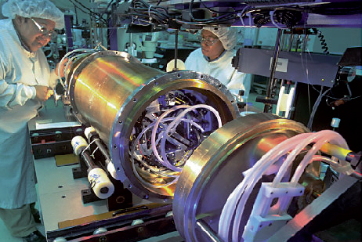
Enhancing communications for regional benefit
Case study: Seychelles Submarine Cable
  EUR 8 m EIB loan for the installation and operation of the first submarine fibre optic cable for international connections to the Seychelles
dramatically improving telecommunications and internet access, reducing the emigration of skilled workers
Fostering modern e-services in healthcare and education, for the benefit of the whole region
international transmission capacity estimated at being
7 times cheaper than current prices for satellite-based links
EUR 4m EU-Africa Infrastructure Trust Fund grant to support shareholding by the Seychelles government in a public-partnership partnership
mandatory equity dividend to be used for social development e.g. free internet access for schools, libraries, hospitals

Slide 23
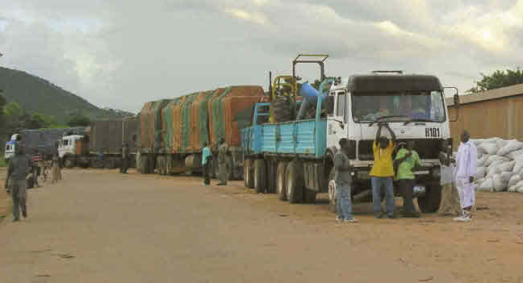
Transport
Developing regional trade and integration through road and railway networks, ports, maritime and river routes, air transport, etc.
Example: Great East Road Rehabilitation (EUR 38 m)
part of the regional integration agenda
supports the rehabilitation of the Great East Road linking Zambia to Malawi, and further to the deep sea port of Nacala in Mozambique
developing trade axis for the
movement of services, goods and people
contributing to a safe and reliable
road network in Zambia
EUR 1 m ITF grant to enhance Zambian
Road Development Authority’s capacity to
implement and monitor the project

Slide 24
Major Stages of an Infrastructure Project
Months
Project Development 0
Early management Review
Appraisal
Board Approval +12 months(average)
Negotiations
Signature Finance contract
Implementation of Conditions Precedent
First Disbursement + 21 ( average)
Last Disbursement (approx. Physical Completion)+ 30 (average)
PCReport + 15 (average)
Supervision
Closing (last reimbursement) +14.5 years after first disbursement

Slide 25
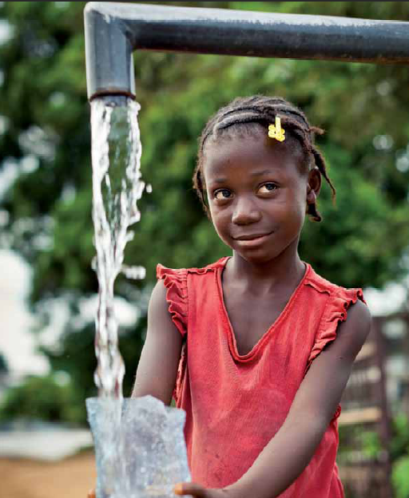
http://www.eib.org/acp

