Slide 1
Instruments to Finance Infrastructure Projects
The case of the African Development Bank

Slide 2

The Bank's unique role in facilitating infrastructure development
2001 – Heads of State request the Bank to provide technical assistance & advisory services to support implementation of NEPAD Initiative
2005 – G8 Gleneagles Summit, renewed commitment to Africa & launched ICA which African stakeholders delegated the Bank to hostto ensure consensus on priorities & one voice
2010 – AU Summit mandates Bank Group as Lead Agency for infrastructure development on the continent and Executing Agency for PIDA
Notes:
The NEPAD initiative was adopted by the Summit of the African Heads of States and Governments in July 2001 as basis for global partnership for Africa’s economic development and integration into the global economy. Poor infrastructure base leads to slower economic growth and poverty reduction due to decrease in industrial and commercial activities, and higher transactions costs compared to other developing regions.
In November 2001, the Heads of State and Government Implementation Committee (HSGIC) of NEPAD requested the Bank to provide technical assistance and advisory services to support implementation of the NEPAD Initiative. They specifically mandated the Bank Group to be the lead agency for infrastructure development.
The ICA was launched at the G8 Gleneagles Summit in 2005; with the mission of improving the livelihoods and economic well being of million of people across Africa through support to scaling up investment for infrastructure development from both public and private sources and the Bank was delegated to host its Secretariat by virtue of its unique position in facilitating the development of infrastructure on the continent and its role in supporting the NEPAD Initiative.
African Stakeholders, comprising AUC, RECs, Specialised Regional Infrastructure Institutions and representatives of Member Countries meet annually before the commencement of ICA Meetings in order to discuss priorities and reach consensus on issues to be brought to the attention of Development Partners. These meetings are convened by the Bank, and ensure that all stakeholders speak with one voice on regional and continental infrastructure priorities.

Slide 3
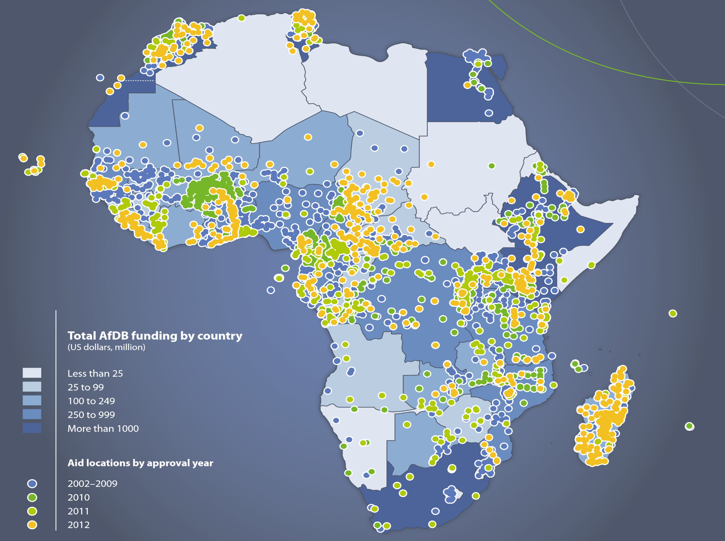
Catalytic funding for infrastructure:
€27.5 billion from 2008-12
53% directly in infrastructure

Slide 4
AfDB Group supports a variety of clients through tailored instruments

Slide 5
General
Low Income Countries
Private Sector
Middle Income Countries
EURo, USDollar, JPYen, ZAR and
Differentiated products by category
Currencies
Selected local currencies on case by case
Grants, concessional loans, market loans and guarantees

Slide 6
Products for PRIVATE SECTOR without sovereign guarantee
Funding Window: African Development Bank
Commercial loans with fixed risk-based spread
Loan terms (interest and maturity) specific to each project
Volumes constrained by a Sustainable Lending Limit calculated annually for each country

Slide 7
Products for MIDDLE INCOME COUNTRIES, with Sovereign Guarantee
Funding Window: African Development Bank
17 countries deemed creditworthy and with income levels above USD 1,350 per capita
Cost of funds: (EURIBOR/LIBOR/JIBAR) + variable lending spread (currently 0.6%)
Maturity up to 20 yrs & Grace period up to 5 yrs
No incentive mechanism for Regional Projects but discussions initiated with Management
Notes:
Eligible countries for Public Sector Sovereign Guaranteed Loans are regional member countries (RMC) from the Bank’s Category C and Category B or blend countries; currently Angola, Algeria, Botswana, Cape Verde, Egypt, Equatorial Guinea, Gabon, Libya, Mauritius, Morocco, Namibia, Nigeria, Seychelles, South Africa, Swaziland, Tunisia and Zimbabwe

Slide 8
Products for LOW INCOME
COUNTRIES, with sovereign guarantee
Funding Window: African Development Fund
41 countries, inc. 4 that can also access ADB
If debt unsustainable: grants
Else: concessional loans (service charge of 0.75%, no interest, maturity 50 yrs, grace 10 yrs)
Can be used for equity participations in SPVs
Incentive mechanism for Regional Projects
Notes:
Benin , Burkina Faso , Burundi , Cameroon , Central African Republic , Chad , Comoros , Congo Republic** , Congo, Democratic Republic , Côte d’Ivoire , Djibouti , Eritrea , Ethiopia , Gambia , Ghana , Guinea , Guinea-Bissau , Kenya , Lesotho , Liberia , Madagascar , Malawi , Mali , Mauritania , Mozambique , Niger , Rwanda , Sao Tomé and Principe , Senegal , Sierra Leone , Somalia , Sudan , Tanzania , Togo , Uganda , Zambia
Blend
Angola***, Cape Verde, Nigeria, Zimbabwe

Slide 9
An innovative incentive mechanism to promote regional intervention
Each country has a “Performance Based Allocation” based on governance indicators agreed with Donors and population size.
For Regional projects:
  40% contributed from PBA (33% for fragile states)
  60% additional from a dedicated envelope
  Small countries can benefit from even larger leverage (contribute only 10% of PBA) to avoid bottlenecks in regional undertakings
Regional Public Goods are special cases where countries do not have to contribute

Slide 10
Guarantees are also offered through all funding windows
ADF guarantee is particularly attractive
Guarantee offered to private banks lending to sponsors transacting with governments or parastatals
Guarantees contractual obligations are met (payments under PPA, minimum toll revenue…)
Leverage of 4 times, fees limited to service charges of 0.75%)
With counter-guarantee from government

Slide 11

Grant based Project preparation through a dedicated vehicle and collaboration, notably with EU-ITF
Dedicated facility for preparation of regional infrastructure projects – public & private
  To date 13 project reached financial close
  Leveraged US$5.5bn in investment
Critical role recognized in G20 Cannes Declaration November, 2011
NEPAD IPPF role recognized in the AU Head of States and Government Declaration on PIDA implementation
Scaling Up resources and delivery to meet PIDA PAP demand
  Business Plan – US$200m over 4yrs
+AWF in water sector

Slide 12

ICA – Infrastructure Consortium for Africa
The ICA acts as a platform (not financing agency) to broker knowledge and financing of projects and programs in African infrastructure
The ICA aims to fill Africa’s infrastructure deficit in support of economic growth and development by increasing the amount of finance going to sustainable infrastructure in Africa, from both public and /or private sources
Recognition for the need to coordinate efforts of all stakeholders
Membership is expanding from G8 to G20

Slide 13
Support to the Sustainable Energy for All (SE4All) Initiative
SE4All Africa Hub hosted by AfDB in partnership with AUC, NPCA and UNDP with mission to coordinate and facilitate SE4All implementation in Africa (CEMA Nov. 2012)
The Sustainable Energy Fund for Africa (SEFA) is one of AfDB's instruments for mobilizing resources towards the SE4All objectives
SEFA is an AfDB-managed Multi-donor Trust Fund seeded with USD 60 million from the Governments of Denmark and United States.

Slide 14
SEFA operates through three components / financing windows
Project preparation grants to bring RE/EE projects to bankability
Equity Investments in RE through a Private Equity Fund
Grants for enabling environment activities in the energy sector
SEFA
Notes:
Component I: #3 Grants approved totaling USD 3.8 million / #4 Grants to be approved by the end of 2013 totaling USD 3.9 million / Significant Pipeline potential
Component II: SEFA and AfDB co-sponsors of the “African Renewable Energy Fund” - a USD 150m Private Equity Fund - for a combined USD 50m anchor investment (USD 25m each) / Fund manager identified and first fund close with other DFIs expected by Dec 2013 / SEFA to provide USD 10m in TA for project development
Component III: New component (as of Sept 2013) / ongoing pipeline origination and development of operational guidelines / SE4All engagement

Slide 15
Capacity Building and
Policy Dialogue
Grant funding is challenging
Countries do not want to borrow for such activities as stand alone projects
→Blend with investment projects
  Developed in partnership with sector departments
  Retrocession to regional entities
  Synergies between investment and policy reforms
  Measurable results
  (that feed into resource mobilization efforts)

Slide 16

A comprehensive approach, capitalizing on AfDB’s experience
African owned
Credible and apolitical
Agile, efficient and commercially-run
Distinct DNA
A new vehicle incubated by AfDB
Structure

Slide 17
African capital working for Africa
African Countries
African Development Bank
African Institutional Investors
EQUITY
USD 3bn paid-in
USD 7bn subscribed
International Financial Markets
BONDS
Development Partners
Power investors
Revolving Fund for Project Development
TARGET : “A” rating and USD 100bn leveraged

Slide 18
CONCLUSION
Project Preparation for Bankability
Capacity Building for Sustainability
Collaboration leveraging on instruments of each institution
Coordination of interventions throughout Tunnel of Funds

Slide 19
شكرا
MERCI
OBRIGADO
THANK YOU
Ralph
Olayé
Manager NEPAD
r.olaye
@
afdb.org

