Slide 1
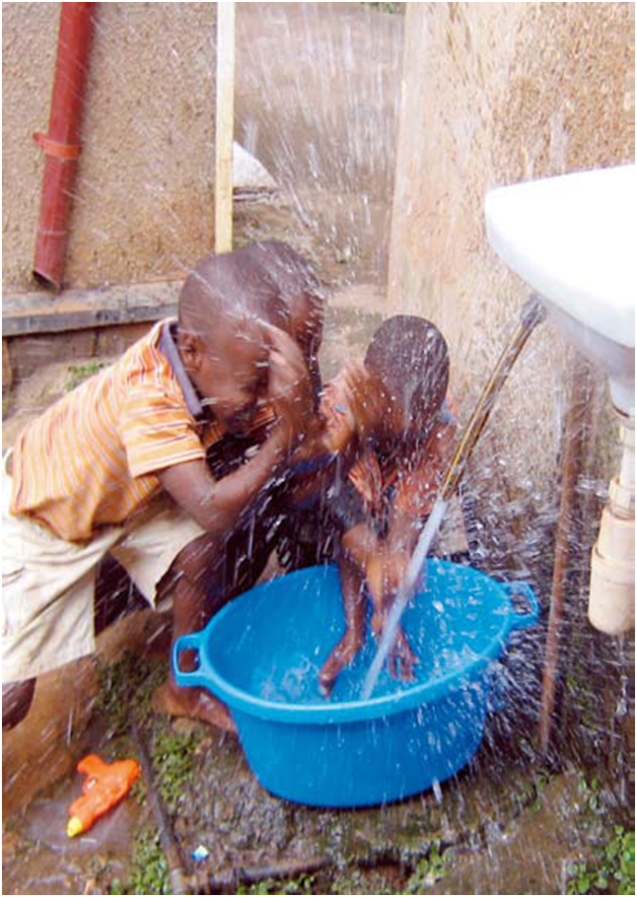
www.amcow-online.org
AMCOW’s Water and Sanitation Priorities at Regional and Continental Levels
By
Bai-Mass Taal
Executive Secretary, AMCOW
Notes:
1

Slide 2
Outline
Background:
What is AMCOW
Water and Sanitation Prioritisation in AMCOW
Overview of Africa’s Water and Sanitation Challenges
AMCOW Work Programme
Key Considerations underlying future Priorities
AMCOW Priorities for 2014 – 2016

Slide 3
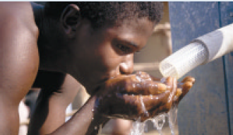
What is AMCOW
NEED for AMCOW
AIM and MISSION
STRUCTURE and FUNCTIONS
NEED
FORMATION
PROVIDE:
Political Leadership
Policy direction
Advocacy
ACHIEVE MDGs for
Water and Sanitation
and Beyond
LAUNCHED APRIL 2002
Secretariat
Regional Str.
TAC
EXCO
Notes:
Regional scores.
Benchmarking of service delivery pathways done in each subsector in each country
Policy (Targets in PRSPs, subsector policies, defined institutional roles)
Expansion and uptake; Budget (sufficient, comprehensive, identifiable); Equity (criteria for matching need with resources, participation in planning, monitoring of equity)
Ingredients – that depend on each other

Slide 4
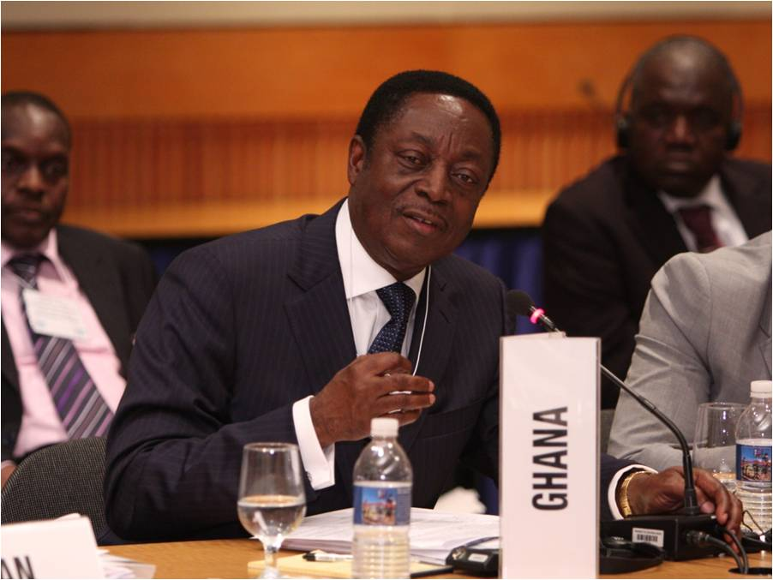
Cooperation Through AMCOW
Technical Advisory
Committee (TAC)
SECRETARIAT
PARTNERS
Secretary
AU
AfDB
UNEP
UNHABITAT
UNICEF
UNWATER
EU
EUWI
SIWI
GIZ
DFID
USAID
etc
Prog. Coordination.
Regional Prog. Officers
EXCO
Ministers resp. for
Water
Decisions
UNICEF/Marvin Jones
IMPLIMENTATION
Notes:
Regional scores.
Benchmarking of service delivery pathways done in each subsector in each country
Policy (Targets in PRSPs, subsector policies, defined institutional roles)
Expansion and uptake; Budget (sufficient, comprehensive, identifiable); Equity (criteria for matching need with resources, participation in planning, monitoring of equity)
Ingredients – that depend on each other

Slide 5
Overview of AMCOW Water and Sanitation Prioritisation
Water and Sanitation
Food and Energy Security
Infrastructure
Climate Change
Institutional Reform
Financing
Political Will and Commitments
SOURCE OF POLICY
CHALLENGES
CONTINENTAL
Sharam-el-Sheik Declarations
eThekweni Declarations on Sanitation
Africa Water Vision 2025
GLOBAL
MDGs
Post 2015
PRIORITIZATION
Notes:
Regional scores.
Benchmarking of service delivery pathways done in each subsector in each country
Policy (Targets in PRSPs, subsector policies, defined institutional roles)
Expansion and uptake; Budget (sufficient, comprehensive, identifiable); Equity (criteria for matching need with resources, participation in planning, monitoring of equity)
Ingredients – that depend on each other

Slide 6
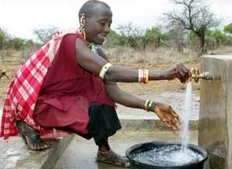
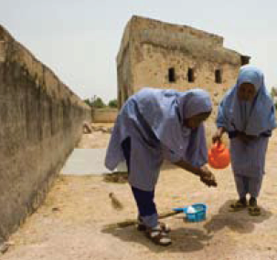
African Water and Sanitation Challenges
Water Supply and Sanitation
Ensuring all have sustainable access to safe and adequate water supply and sanitation
Notes:
Regional scores.
Benchmarking of service delivery pathways done in each subsector in each country
Policy (Targets in PRSPs, subsector policies, defined institutional roles)
Expansion and uptake; Budget (sufficient, comprehensive, identifiable); Equity (criteria for matching need with resources, participation in planning, monitoring of equity)
Ingredients – that depend on each other

Slide 7
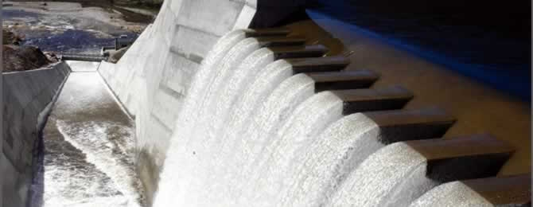
Africa’s Water and Sanitation Challenges
Manage water resources to achieve food and energy security
Notes:
Regional scores.
Benchmarking of service delivery pathways done in each subsector in each country
Policy (Targets in PRSPs, subsector policies, defined institutional roles)
Expansion and uptake; Budget (sufficient, comprehensive, identifiable); Equity (criteria for matching need with resources, participation in planning, monitoring of equity)
Ingredients – that depend on each other

Slide 8
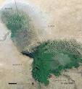
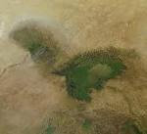
Africa’s Water and Sanitation Challenges
Developing effective and reliable strategies for coping with climate variability and change, growing water scarcity, and the disappearance of water bodies
1972
LAKE CHAD
Recent
Notes:
Regional scores.
Benchmarking of service delivery pathways done in each subsector in each country
Policy (Targets in PRSPs, subsector policies, defined institutional roles)
Expansion and uptake; Budget (sufficient, comprehensive, identifiable); Equity (criteria for matching need with resources, participation in planning, monitoring of equity)
Ingredients – that depend on each other

Slide 9
Africa’s Water and Sanitation Challenges
Reforming water resources institutions for:
good governance
sustainable management of national and trans-boundary water basins
effective systems and capacity for research and development
Securing and retaining skilled and motivated water professionals
Notes:
Regional scores.
Benchmarking of service delivery pathways done in each subsector in each country
Policy (Targets in PRSPs, subsector policies, defined institutional roles)
Expansion and uptake; Budget (sufficient, comprehensive, identifiable); Equity (criteria for matching need with resources, participation in planning, monitoring of equity)
Ingredients – that depend on each other

Slide 10
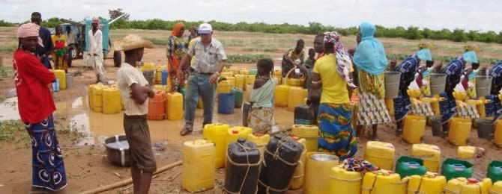
Africa’s Water and Sanitation Challenges
Achieving sustainable financing for investments in water supply, sanitation, irrigation, hydropower and other uses
Notes:
Regional scores.
Benchmarking of service delivery pathways done in each subsector in each country
Policy (Targets in PRSPs, subsector policies, defined institutional roles)
Expansion and uptake; Budget (sufficient, comprehensive, identifiable); Equity (criteria for matching need with resources, participation in planning, monitoring of equity)
Ingredients – that depend on each other

Slide 11
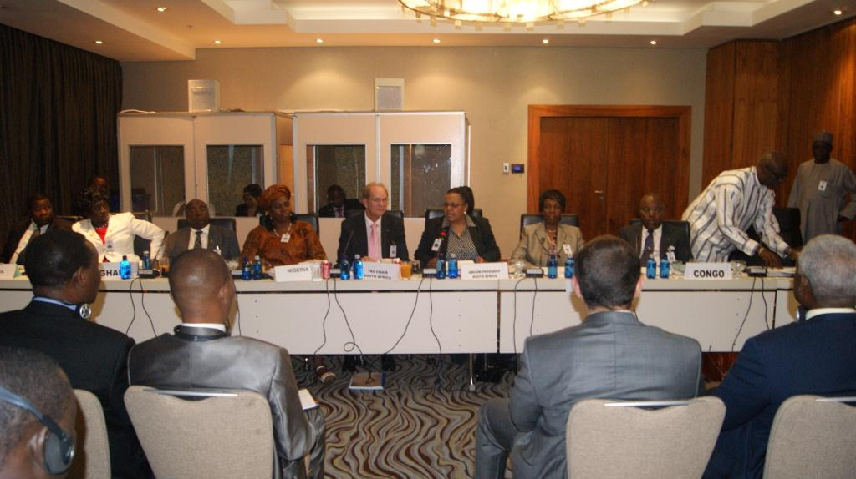
Africa’s Water and Sanitation Challenges
Mobilizing political will, creating awareness and securing commitment among all with regard to water issues
Notes:
Regional scores.
Benchmarking of service delivery pathways done in each subsector in each country
Policy (Targets in PRSPs, subsector policies, defined institutional roles)
Expansion and uptake; Budget (sufficient, comprehensive, identifiable); Equity (criteria for matching need with resources, participation in planning, monitoring of equity)
Ingredients – that depend on each other

Slide 12
The AMCOW Work Programme
Outcome of AMCOW’s Vested Responsibility as STC of AU to Track and Report Implementation of Sharm-el-Sheikh Declarations, AWV2025, MDGs, and eThekwini Commitments.
Developed through a wide range consultative process
Outlines actions to be taken at continental, regional, trans-boundary, national level
Requirements to deliver AWV estimated at US$20 billion each year over 20-years (AWV, 2000)
Notes:
Regional scores.
Benchmarking of service delivery pathways done in each subsector in each country
Policy (Targets in PRSPs, subsector policies, defined institutional roles)
Expansion and uptake; Budget (sufficient, comprehensive, identifiable); Equity (criteria for matching need with resources, participation in planning, monitoring of equity)
Ingredients – that depend on each other

Slide 13
Initiatives for Implementing the AMCOW Work Programme
Rural Water Supply and Sanitation Initiative (RWSSI)
To accelerate access to water supply and sanitation services in rural Africa.
To attain 80% coverage
Requires Investment of US$14.2billion.
The African Water Facility (AWF)
Aims to facilitate the availability of financial resources
African Network of Basin Organisations (ANBO)
To promote integrated water resources management at basin level
Africa Civil Society Network on Water (ANEW) to promote dialogue, learning and cooperation on water issues
Notes:
Regional scores.
Benchmarking of service delivery pathways done in each subsector in each country
Policy (Targets in PRSPs, subsector policies, defined institutional roles)
Expansion and uptake; Budget (sufficient, comprehensive, identifiable); Equity (criteria for matching need with resources, participation in planning, monitoring of equity)
Ingredients – that depend on each other

Slide 14
Initiatives for Implementing the AMCOW Work Programme
European Union Water Initiative (EUWI)
to help countries achieve water and sanitation targets
supporting sustainable delivery of water and sanitation and improve water governance in ACP countries
Estimated at €500 million.
Water and Sanitation Programme (WSP)
World Bank program focused on developing policies, finding innovative solutions, promoting best practices and developing capacity for sustained service access.
Water and Sanitation for African Cities Programme
the objective of creating and enabling environment and capacity building for pro-poor investment in water and sanitation in urban areas.
Notes:
Regional scores.
Benchmarking of service delivery pathways done in each subsector in each country
Policy (Targets in PRSPs, subsector policies, defined institutional roles)
Expansion and uptake; Budget (sufficient, comprehensive, identifiable); Equity (criteria for matching need with resources, participation in planning, monitoring of equity)
Ingredients – that depend on each other

Slide 15
Initiatives for Implementing the AMCOW Work Programme
Works through both formal an informal partnerships. Some partners are:
UN-Water Africa – water and sanitation, cross cutting themes
AfDB – financing water
GWP – climate change, youth, gender
ANEW – Youth, gender, civil society engagement
WaterAid – Water and sanitation
ANBO – cooperation with river and lake basin organisations
SWA – water and sanitation
Support from EU, GIZ, USAID, Gates Foundation
Notes:
Regional scores.
Benchmarking of service delivery pathways done in each subsector in each country
Policy (Targets in PRSPs, subsector policies, defined institutional roles)
Expansion and uptake; Budget (sufficient, comprehensive, identifiable); Equity (criteria for matching need with resources, participation in planning, monitoring of equity)
Ingredients – that depend on each other

Slide 16
The AMCOW Work Programme 2011 – 2013
It is the 2nd AMCOW triennial workplan in on-going efforts to:
Implement the Sharm el-Sheikh Declaration for accelerating the achievement of water and Sanitation goals in Africa; and,
Actualise the Africa Water Vision 2025 of: An Africa where there is an equitable and sustainable use and management of water resources for poverty alleviation, socio-economic development, regional cooperation, and the environment

Slide 17
The AMCOW Work Programme 2011 – 2013
It provides an elaborate action programme at AMCOW (continental), regional, transboundary and national level.
Interventions categorised into 7 themes namely:
Water Infrastructure for economic growth
Managing WR (transboundary)
Meeting the Sanitation, Hygiene & Water MDG targets
Global changes & risk mgmt: Climate variability & change

Slide 18
The AMCOW Work Programme 2011 – 2013
Themes cont’d
Governance and Mgmt
Financing
Education, knowledge and capacity development
Its execution currently under review as part of the process to develop the successor work programme

Slide 19
The AMCOW Work Programme 2011 – 2013
Observations from review process:
Advances have been made towards achieving water & sanitation goals as highlighted by
increased funding to the sector
creation of an enabling environment and institutions at all levels
improved governance systems, accountability & transparency
improved water coverage & access statistics
That said, major challenges still abound particularly in mobilising the investment required to meet the targets of the AWV2025

Slide 20
The AMCOW Work Programme 2011 – 2013
Observations from review process cont’d:
Specifically, its imperative to develop/strengthen programmes for:
improving basic sanitation in Africa
enhancing water storage capacity & water related disaster risk mgmt
assuring sustainable funding
human & institutional capacity dev’t for effective water mgmt
ascertaining trends and status of WR availability and use at national and regional level
defining water quality objectives & resource conservation
establishing a permanent reporting mechanism on the state of Africa’s WR as a basis for informed decision making in AMCOW

Slide 21
Additional Considerations
Formulation process of the programme for 2014 – 2016 also predicated on the fact that freshwater resources systems are critical to unleashing Africa’s dev’t potential, in particular:
productivity of the agricultural sector and the rural economy on which the majority of Africa’s populations depend for their livelihoods
energy production
sanitation and hygiene delivery vital for the wellbeing & productivity of the population
regulating climatic conditions

Slide 22
Additional Considerations
However
Africa’s population is growing at a rate that is much higher than the global average
rapid urbanisation is observed across the continent
Africa’s environmental and natural resources are faced with severe degradation
many of the threats from the negative impacts of climate change and increasing climate variability anticipated to operate thru WR systems, thus threatening the performance of the agricultural sector and rural economy on which the livelihoods of most of Africa’s population depend

Slide 23
Additional Considerations
Thus, making fundamental changes to the way Africa’s water and related resources are utilised and managed is an important step towards climate change adaptability and mitigation; disaster risk reduction and management; and sustainable environment and natural resources management – not to mention the attainment of the aspirations for water, food and energy security.

Slide 24
Additional Considerations
It should also be recalled that AMCOW led the Africa water community thematic consultation process for the post-2015 dev’t agenda that resulted in:
a clarion call for:
the inclusion of a distinct goal on ensuring a water secure world for all in the global post-2015 development framework; and,
ensuring that the targets and indicators for the water goal focus on promoting all-inclusive and equitable socio-economic growth and transformation.

Slide 25
Additional Considerations
The process also resulted in a Decision of the Executive Committee of AMCOW (EXCO/11/2013/CAIRO/12), committing to a target date of 2030 for:
ACHIEVING universal access to safe water, improved sanitation and hygiene in Africa;
INCREASING to 40% of harvest potential, the productive use of Africa’s water resources under managed conditions; and,
ASSURING AND SAFEGUARDING water quality for all uses

Slide 26
AMCOW Priorities for 2014 - 2016
Against the background of the foregoing, the AMCOW Work Programme 2014 – 2016 is themed: Water as a catalyst for Growth and Socio-economic Development in Africa
It is aimed at placing water as the engine for growth, which if not made central to dev’t planning will undermine the desired outcomes of ongoing efforts for dev’t in Africa; and,
emphasising the need for the dev’t of climate resilient water infrastructure; & capacity dev’t programmes responsive to the multitude of challenges faced by the water sector in Africa

Slide 27
AMCOW Priorities for 2014 - 2016
Strategic focus for WRM will be on:
ascertaining trends and status of WR availability and use at national and regional level
increasing investment in water management for socio-economic growth and transformation including:
water for boosting production in agric; & assuring food security
increasing HEP production
developing multi-purpose infrastructure for increasing water storage capacity & managing scarcity among others
making improvements in water use efficiency
making improvements in water related disaster risk management capability

Slide 28
AMCOW Priorities for 2014 - 2016
Strategic focus for WASH will be on:
assuring drinking water safety
consolidating gains and redressing inequalities in access to safe drinking water
assuring social, financial and env’t sustainability of WASH services
improving basic sanitation in Africa particularly overcoming informal settlement and rural household sanitation deficiencies

Slide 29
AMCOW Priorities for 2014 - 2016
Strategic focus for waste water and water quality mgmt will be on:
adoption of relevant policy, legal and institutional frameworks
promulgation of appropriate wastewater treatment technologies and measures for storm water collection and management including:
resource recovery and re-use focusing on recovery of nutrients, water & energy from domestic & agro-industrial waste streams
the sanitation-agriculture interface
cost recovery

Slide 30
AMCOW Priorities for 2014 - 2016
Strategic focus for water and environment mgmt will be on:
promoting implementation of existing policy & legislative frameworks as well as IWRM&D plans
fostering water security and climate resilient dev’t
optimising the use of WR for growth & dev’t without undermining environmental integrity
strengthening mechanisms of connectivity between regional processes & national ownership, as well as cooperation between water agencies & other sectoral agencies incl. economic planning, agric, health, education

Slide 31
AMCOW Priorities for 2014 - 2016
Other cross-cutting strategic areas:
strengthening the water management function at sub-regional level through the operationalisation of AMCOW’s sub-regional structures
developing a Human Capacity Development Programme aimed at addressing junior professional and technician level capacity challenges in the water sector
consolidating the establishment of a more regular, objective, evidence-based reporting system on the water sector in Africa in order to create a benchmark for measuring progress towards the attainment of Water and Sanitation Goals in Africa

Slide 32
በጣም አመስግለሁ
Thank You
Merci!

