Slide 1

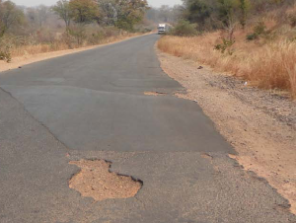
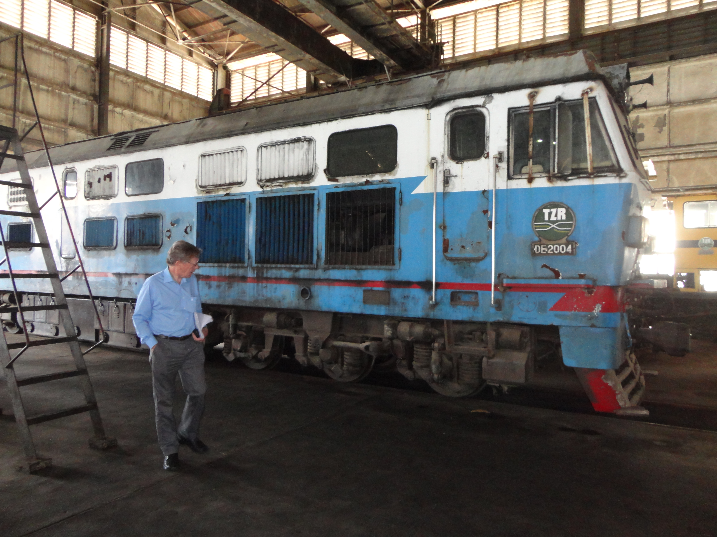
Infrastructure, Project Preparation and Trade Facilitation
Mark Pearson
Programme Director
TradeMark SA
Continental Infrastructure Seminar
Addis Ababa
1-4 October 2013

Slide 2
Content
The Trademark Southern Africa Programme
Infrastructure and Project Preparation Activities
Trade Facilitation
Conclusion and Lessons Learned
Notes:
Who we are
Our partners
Broad Focus Areas
Where we work

Slide 3




The Trademark Southern Africa Programme
£100m , 5 years
November 2009 to October 2014
£30,6 million
Technical Assistance
COMESA Fiduciary and Administrative Oversight (Zambia)
PMU implements projects (SA, Lusaka, Gaborone)
£67 million Capital
Tripartite Trust Account
DBSA Fund Manager
TMSA supports the COMESA-EAC-SADC Tripartite regional integration process (all TA funds presently coming from DFID but project preparation funds coming from DFID, AfDB and EDF10) – it’s work programme is directly derived from the Tripartite vision, strategy and programme.
Notes:
DFID funded (£100 million) over 5 years - ending October 2014.
Two implementation mechanisms:
Technical Assistance - £33 million
Capital - £67 mllion
Follow-on from Regional Trade Facilitation Programme which ended in October 2009
DFID and DBSA Strategic Partnership to implement both mechanisms between November 2009 to April 2010
Technical Assistance mechanism moved to COMESA from April 2010 at the request of the COMESA-EAC-SADC Tripartite Task Force
DBSA retained Fund Manager role of £67 million, managed through the Tripartite Trust Account
COMESA has MoU with DFID to manage GBP30.6m. The balance of the GBP3m was retained by DFID to cover transitional costs and costs of evaluations

Slide 4
Tripartite Strategy:
Design and implementation of the Tripartite FTA that involves the preparation of a draft Tripartite Agreement and the negotiation of the implementation modalities of the TFTA.
The preparation of a Trade and Transport Facilitation Programme and the implementation of this Programme along transport corridors.
A regional industrialisation programme.
The design and implementation of trade and transport infrastructure projects along corridors.
Free movement of business persons across the RECs.
All of these programmes, implemented in sequence, should reduce the costs of cross-border trade, leading to higher economic growth, job creation and poverty alleviation.

Slide 5
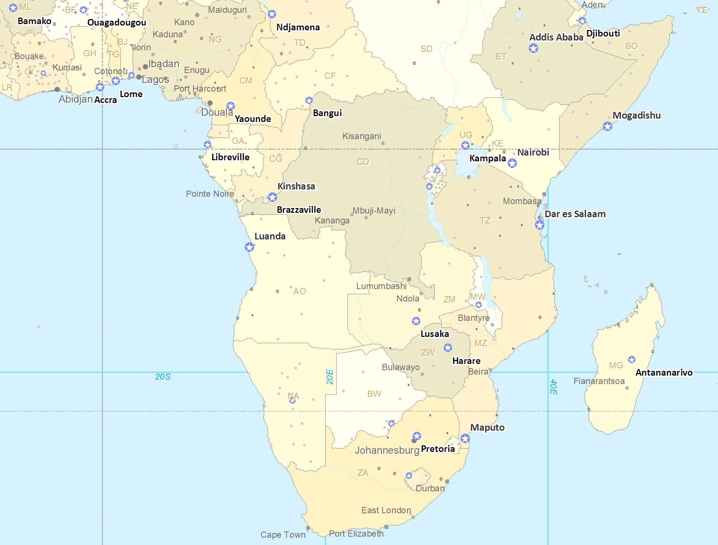
Infrastructure – Planning and implementation is done on the basis of transport corridors which are then also clustered
Ethiopia - Djibouti
Northern
EAC Cluster
Western Cluster
Central
Dar es Salaam
Malanje
Lobito-Benguela
Namibe
Nacala
Trans-Caprivi
Trans-Cunene
Beira
North-South
Trans-Kalahari
Maputo
Eastern Cluster
N-S Cluster

Slide 6
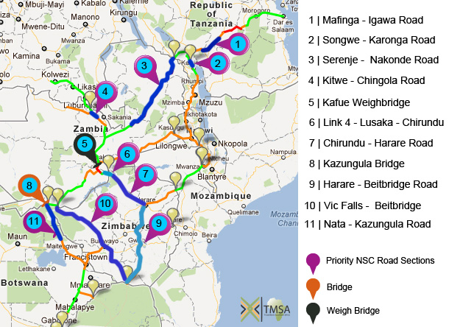
Infrastructure Status - NSC Roads being funded or prepared for funding

Slide 7
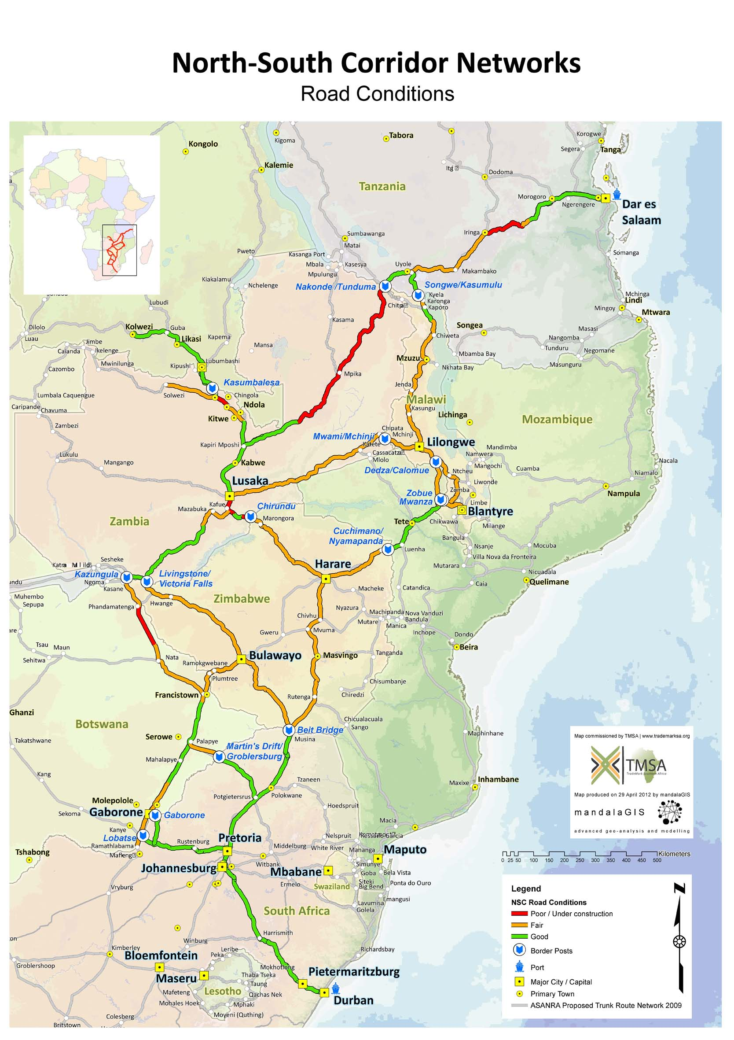
With current costs, tariffs and efficiencies, road transport is the most economical mode of transport in SSA and on the NSC. Despite this, except for a few sections, mainly in South Africa, the total costs of road maintenance and rehabilitation cannot be borne solely by the user.
The HDM4 analysis has generated an economic rationale of upgrading and maintaining the entire NSC-AFT road network to a good condition. The costs of rehabilitating and then maintaining the entire NSC-AfT road network to a “good” standard was calculated as US$9.1b, of which US$5.9b was for capital investment and US$3.2b was for recurrent costs. The economic rationale of upgrading and maintaining the NSC-AfT road network is, therefore, clear.

Slide 8
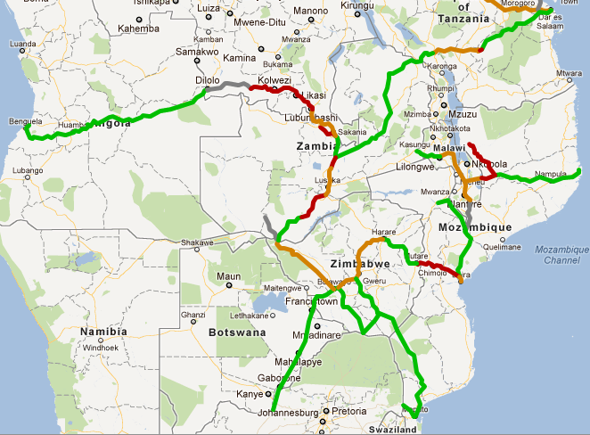
The track between Kolwezi and Dilolo is believed to be overgrown and not in use.
TMSA Rail Track Assessment
Lobito Railway –Being reconstructed by Chinese. Should link to DRC and to Solwezi in Zambia
The TAZARA railtrack is generally in fair condition with some work needed to repair a section where there has been a landslide and sections where there are burns and dips between rails.
The ZR line is generally in a poor condition and there are speed restrictions on the entire ZR network.
Malawi network in poor to fair condition apart from the section closed owing to a wash-away at Bangula and south to the border.
Nacala to Cuambo is in good condition but the rest of the Nacala railway line is in very poor condition.
The Beira-Machipanda section of the Beira Corridor in poor condition.
Sena line from Moatize to Beira has recently been upgraded and in good condition
The Zimbabwe (NRZ and BBR) rail network is generally in a fair condition.
Notes:
RSZ – concession stopped. GRZ has announced plans to invest in the railways
TAZARA – investments to be made by GRZ and GoT; Chinese 14th Protocol; TA to workshops; Considering access agreements; agreements with main customers; arranging for working capital;
NRZ – 12mt in 1992 – 1.7mt in 2011
DRC - $600m railway line renovation in SE of country (World Bank and China)
Angola - Sinohydro Corp. should finish restoring the 1,344-kilometer Benguela by end 2012
Malawi – concession agreements for a new line and restoration of the CEAR line signed with Vale
Nacala – Vale intends to rehabilitate this line
Sena – renovated to take 6mtpa

Slide 9
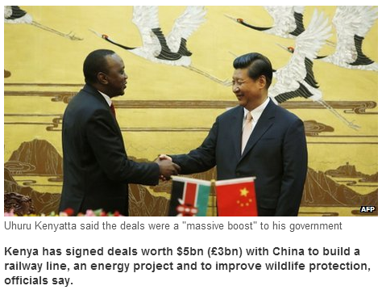
Ethiopia’s new rail is standard gauge, financed by China’s Eximbank - partly dual track, and electrified. The Ethiopian railway is wholly financed by government, US$ 4 billion, 15 % equity, 85% loan (state guarantee). ERC has stated that 95% of the corridor freight will move from road to rail, to provide a rail a base of about 12 mtpa.
The proposed new Standard gauge railway line in Kenya (which has not had financial closure as yet) will link the Kenyan border town of Malaba with the port of Mombasa, one of the busiest in Africa. However, there is no standard gauge link on the other side of the border in Uganda. The standard gauge (1.435m or 4’ 8½ “) line is to be financed by the state with sovereign guarantees.

Slide 10
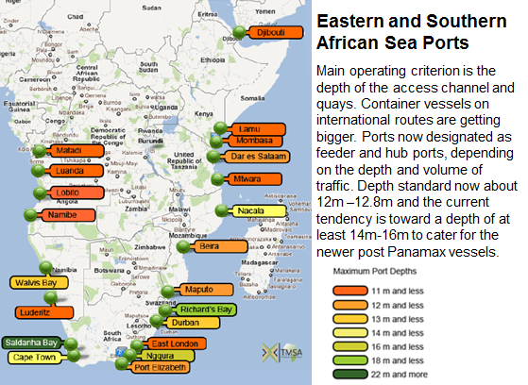

Slide 11
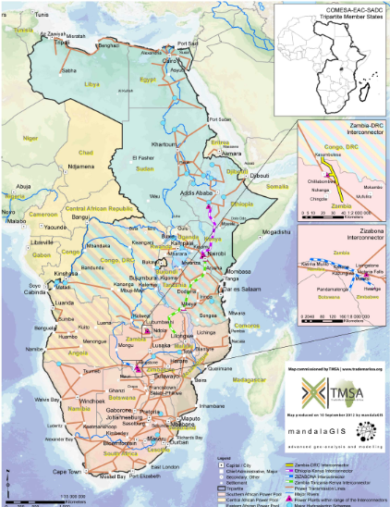
DRC-Zambia – links DRC to SAPP
Ethiopia-Kenya - 1,068km DC 500 kV to be commissioned late 2013. Power transfer capacity of up to 2,000 MW. Finance from AfDB, WB, ADF and governments.
Zambia-Tanzania-Kenya (ZTK) – links EAPP to SAPP
Malawi-Mozambique – links Malawi to SAPP
Namibia-Angola – links Angola to SAPP
ZIZABONA – upgrades the links between Zimbabwe, Zambia, Botswana and Namibia
Main New Regional Power Interconnectors

Slide 12
Project Preparation Activities:
TMSA, through COMESA, has established the COMESA-EAC-SADC Tripartite Project Preparation Unit, based in Lusaka. This was necessary as there was a need to prepare projects to a “bankable” stage. All funds for the operation of the PPIU are coming from DFID through TMSA but there is now a need to seek additional funding.
The PPIU has funds from EDF10 (€10m), DFID (£5m) and AfDB ($4.5m) for actual project preparation, being used as follows:
Funding Organization | Projects | Preparation Amount (US$ million) | Financing Amount (US$ million)
DFID | Kafue WB, Link 4, DRC-Zambia Interconnector, Sir Otto Beit Bridge, Karonga-Songwe, VicFalls-Bulawayo (link 1 and 2) | $ 7.5 | $ 470
EDF | Serenje-Nakonde Links 1,2,3 | $ 6.5 | $ 523
 | ZTK Interconnector | $ 5.2 | $ 1,236
AfDB | 18 roads projects on the NSC | $ 7.7 | $ 1,058
TOTAL |  | $ 27 | $ 3,300

Slide 13
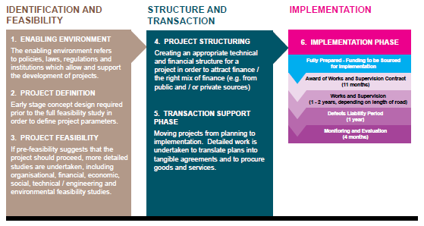
Project Preparation Stages & Activities
Notes:
Explains different stages of project preparation

Slide 14
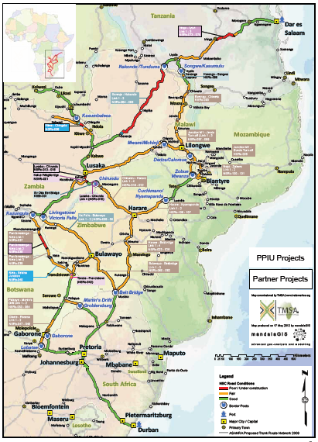
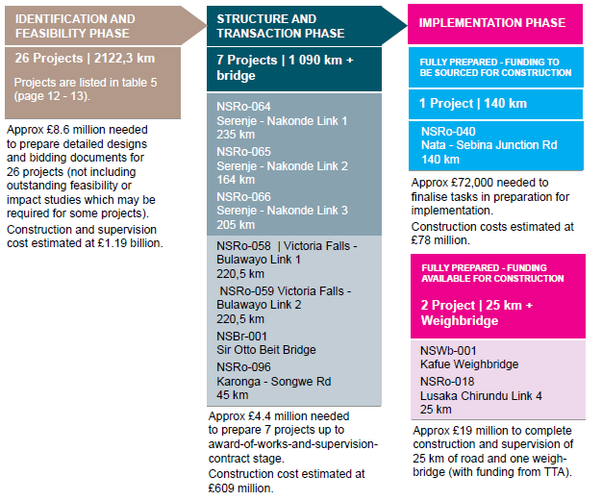
North South Corridor Road Transport Priority Projects
Notes:
The PPIU’s on-going (1,295 km) and planned / identified (2,122.3 km) road projects currently span a distance of 3,417.3 km (nearly 40% of the 8,746.3 km NSC Aid-for-Trade road network, excluding South Africa). These include
• The preparation of twenty-six projects of 2,122.3 km, which are in the “identification and feasibility” phase. Approximately £8.6 million would be required to prepare detailed designs and bidding documents for these projects by mid-2014 (assuming adequate capacity in PPIU, road agencies and other stakeholders). Approximately £1.19 billion is required for subsequent construction (based on approximately £550,000 / km for construction and additional supervision costs).
• The preparation of seven projects which are in the “structure and transaction” phase (six road projects of 1,090 km and the rehabilitation of Sir Otto Beit Bridge). For the three Serenje-Nakonde road links, totalling 604 km, detailed design and bidding documents are being prepared. For three other road projects, totalling 486 km, together with the Sir Otto Beit Bridge project, the process to award the design contract is now underway. An amount of £4.4 million would be required to complete these seven projects up to an award-of-works-and-supervision contract stage (implementation phase). An estimated £609 million would be required for their construction and supervision.
In addition, two projects in the implementation phase are financed by the TTA to an amount of approximately £19 million, i.e. the Kafue Weighbridge and the Lusaka-Chirundu Link 4 project of 25 km. TMSA / PPIU provided support in preparing these projects up to award-of-works-and-supervision-contract stage. Another project of 40 km between Francistown and Tonota in Botswana has been fully prepared and implementation is being funded by the Government of Botswana. For another fully prepared project, the Nata-Sebina Junction Road of 140 km, funding must be secured. Construction will cost about £78 million. A small amount of less than £100 000 would be required for completion of a final stage PIM, contracting and other tasks in preparation for construction.
TMSA is also supporting a number of partners to rehabilitate the remaining 411 km of roads of the 1,040 km so-called “red road” category. These projects are in the implementation phase. The World Bank is financing construction of 73.6 km of the road between Lusaka and Chirundu in Zambia. The tender process to award the works and supervision contracts is currently underway. DANIDA is financing the on-going construction of two road sections in Tanzania totalling 145 km. The Government of Tanzania is financing the rehabilitation of a short section along the same route (7.4 km). The Government of Botswana is financing construction of a 135 km road section between Pandamatenga and Nata, now underway. There is also a fully prepared project of 50 km between Kitwe and Chingola in Zambia for which funding has to be sought from partners. Other parties are also involved in the preparation and implementation of a number of “amber road” projects.

Slide 15
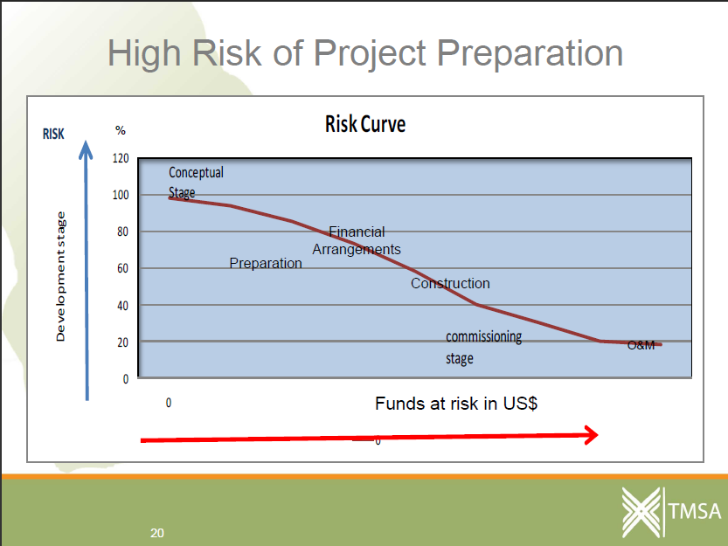
“”The biggest challenge is to raise enough funds to do project preparation” But it is not just preparation – it is the follow-up after preparation in terms of implementation of contracts.

Slide 16
Project Preparation:
Preparation of the SADC Infrastructure Masterplan (after this was started using EDF funding).
The SADC Infrastructure Masterplan resulted in the establishment of an Infrastructure database which was used as the base for the Tripartite Infrastructure Database (TRIPDA).
The database generates project fiches to an agreed format and also has an on-line record of all other documents and information relevant to each project (Note that the project fiche is generated by TRIPDA from the database on demand so does not need to be updated individually – will be updated with the database update).
The front-end of TRIPDA is a GIS system that allows users to access project information from the GIS map.
TMSA has recently started to work closely with the NEPAD Planning and Coordination Agency (NPCA) to dove-tail TRIPDA into PIDA. PIDA is at a higher level than TRIPDA but there are already (obviously) many synergies – 2 of the 10+4 PIDA priority projects are TRIPDA priorities -ZTK and Serenje – Nakonde Road – both being prepared using EDF financing.

Slide 17
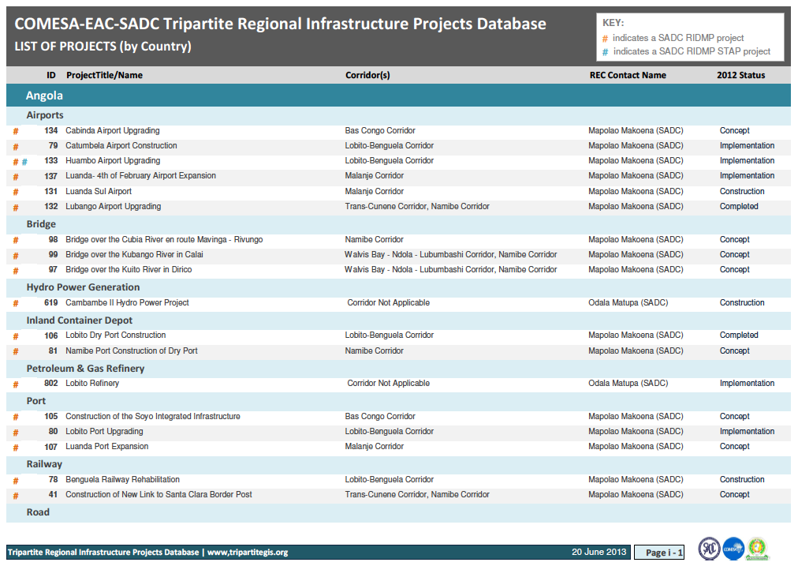
Projects List

Slide 18
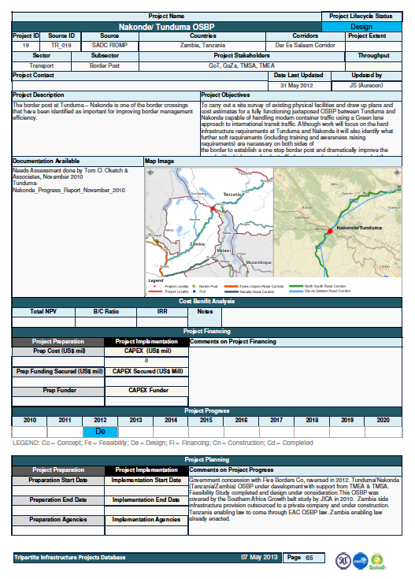
Project Fiches

Slide 19
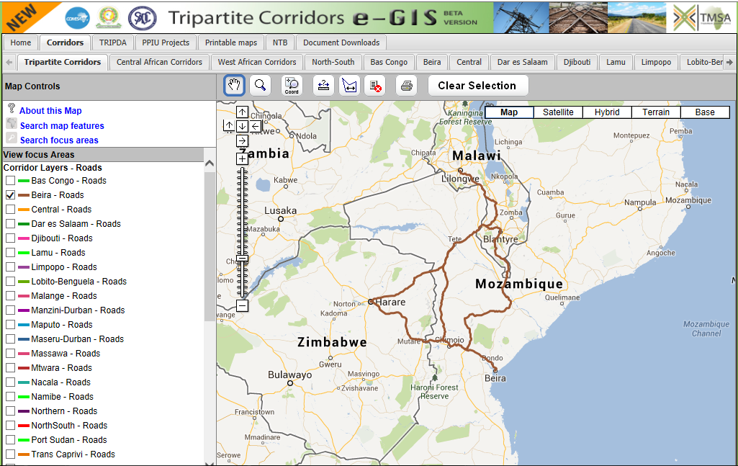

Slide 20
Trade Facilitation:
It is clear that one of the major constraints to the economic development, poverty alleviation and job creation in the region is the high cost of doing business across borders. COMESA, EAC and SADC all have programmes that aim to facilitate trade and many of these programmes are already harmonised between the RECs, but there are a number of programmes that are not harmonised across the region and some that do not cover the entire Tripartite region.
Working with the Tripartite Task Force and the three Regional Organisations, TMSA is developing a Trade and Transit Facilitation programme that will be implemented as a common programme across the three RECs and along corridors. This common programme has customs harmonisation and transport harmonisation elements.

Slide 21
Transport and Transit Corridors - the absolute importance of correct sequencing – not enough to just build the infrastructure
Ring Road – US$1m/km
One-Stop Border Post – buildings, computers, etc US$10m
Start of journey
Toll Bridge
US$3m
OSBP
Road rehabilitation – 50mm surface overlay – US$750,000/km
Road construction – US$1m/km
Port Upgrade –
Dredging, New container terminal, management system. – US$30m

Slide 22
Transport and Transit Corridors – need to also put in trade facilitation measures and ensure transport is regulated and then goods will flow smoothly.
Ring Road – US$1m/km
One-Stop Border Post – buildings, computers, etc US$10m
Start of journey
Toll Bridge
US$3m
OSBP
Road rehabilitation – 50mm surface overlay – US$750,000/km
Road construction – US$1m/km
Port Upgrade –
Dredging, New container terminal, management system. – US$30m
Trade Facilitation and Trade Regulation Measures

Slide 23
Integrated Border Management Systems:
State interests at the border include protection of national security, enforcement of immigration requirements, enforcement of import and export restrictions and prohibitions, collection of revenue, recording cross-border statistics, and enforcement of International Health Regulations. The responsibility for protecting these interests is vested in several state agencies. They include Police, Security, Customs, Immigration, those responsible for Sanitary and Phyto-sanitary regulations, and the bureau for standards.
Typically, the border management agencies in the Tripartite region that need to co-operation within an IBM framework include: Immigration; Customs; Bureau of Standards; Environment Management Agency; Health, Food Safety and International Health Regulations Enforcement
To improve the efficiency of border crossings it is advisable to do as many clearance functions “behind the border” as possible. This reduces waiting times at the border and reduces the number of agencies that require a physical presence at the border.
The trend in the Tripartite is to implement Coordinated or Integrated Border Management systems coupled with improved computerised systems. Good examples of the trends taking place can be found in Zimbabwe (based on ASYCUDA World), Kenya (based on SIMBA) and South Africa (based on TATIS).

Slide 24
The Tripartite Programme on Customs:
Programme activities are aimed at:
synchronising customs laws, procedures, documentation and practices - conform to international conventions and best practices;
systematic removal of trade facilitation bottlenecks;
elevate trade facilitation as one of customs key functions;
share modernisation experiences and learn from others;
common risk management capabilities and strategies;
common guidelines for conducting post clearance audits;
regional toolkits e.g. management of border posts, risk management, establishment of one-stop border posts, etc.;
joint training programmes and building capacity in pertinent customs and related areas; and
raising the levels of customs administrations’ integrity and adoption of a pro-customer care culture.

Slide 25
One Stop Border Posts:
An OSBP allows people, vehicles and goods to exit one country and enter another country through a single facility staffed and operated jointly by adjoining countries. The main advantage is a quicker border clearance process and limit the duplication of border agency interventions. Transport time and costs are reduced, transit times become more predictable, logistical efficiency increases and countries’ trade competitiveness is enhanced. Economic benefits can be significant.
OSBP concept is tried and tested for over 40 years - between the USA and Canada; in developing regions of Asia; and South America. There is no single OSBP model – usually straddling the border or, where traditional two stop facilities already exist in both states these can be converted to one stop use (“juxtaposed” OSBP).

Slide 26
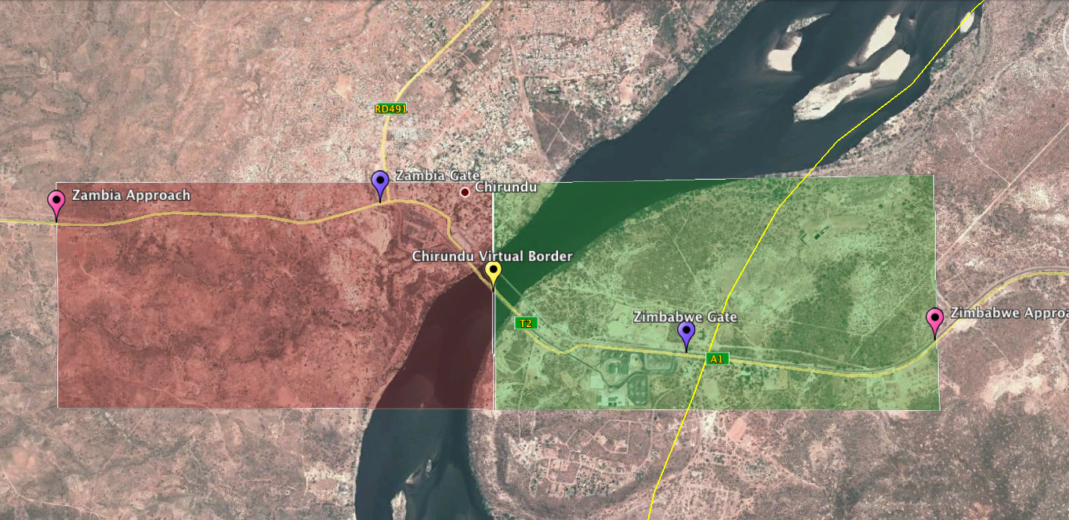
Border Crossing Monitoring:
Have relatively sophisticated border monitoring processes based on a GPS truck tracking system. The system tracks “queuing” times as well as border clearing times.
Before the one stop border post was operational clearing times were between 3-5 days. Now with the OSBP in operation, clearance is done on the same day. An average of 480 trucks cross at Chirundu every day so a total of 960 to 1,920 travel days per day are being saved, which translates, as a conservative estimate, to between US$288,000 and US$576,000 in savings every day.

Slide 27
Regional Customs Bond:
The challenge is to take the best of the SADC and COMESA systems and merge them into one system for the benefit of the entire region. A study on how this can be done has been undertaken but implementation needs to take place.
Regional Transit Management System:
Within the Tripartite region, and because many of the Tripartite countries are land-locked, management of goods in transit is an important trade facilitation instrument which, if not implemented appropriately, results in excessive delays for transporters and losses to governments as goods in transit get diverted to customers that are in countries which ostensibly the goods are supposed to be transiting through.
Computerised Immigration Systems:
TMSA is currently working with one country on a computerised immigration system that could be used as a standard for other countries that require it.
Transport Procedures:
The Tripartite is addressing market liberalisation of the transport sector by carrying out work on carriage of international road freight; introduction of international regulatory mechanisms; and regional harmonisation of road traffic legislation.

Slide 28
Legal and Regulatory Framework for Road Transport:
Road transport in the region is largely unregulated. No regulation does not equal deregulation. Regulation can assist in enforcement (such as withdrawing a carrier’s licence for overloaded vehicles). The current situation in the region could be characterised as benign neglect. A lack of regulation can:
Improve competition - small and large operations competing but this also compromises service quality and safety as maintenance is deferred to lower costs;
Allow other government agencies to dictate transport policy (revenue authorities licensing transit vehicles to reduce illegal imports but also restricting back loads);
Allow countries to license foreign trucks as a protectionist measure and restrict commercial presence of foreign trucking companies.
In Southern Africa there is open competition in road transport but with some protection such as cabotage rules (the transport of goods on the domestic market by foreign registered operators) and restrictions on third country operators (transport along routes not passing through the country of registration).
A lot of progress being made in harmonising vehicle regulations with obvious advantages to uniform GVM regulations and abnormal and dangerous loads legislation.

Slide 29
Third Party Vehicle Insurance:
The Tripartite region has three different third party vehicle liability insurance schemes: Cash Payments; Fuel Levy System; and COMESA Yellow Card. Work is on-going to harmonise these systems.
Vehicles Standards and Regulations:
Harmonised standards for fitness of vehicles, such as smoke emissions, vehicle registration standards, training of examiners, bus overloading, etc. are being developed.
Self-Regulation of Transporters:
Many of the region’s transport delays can be attributed to bureaucratic delays caused by the need to check on compliance (such as customs inspections, weighing trucks, document checks at police road blocks, etc.). These delays can be reduced through the introduction of a transporter accreditation system in which a transporter undertakes to comply with a specified package of regulations. In doing so the transporter will be exempt from the usual compliance checks. There would, however, be a system of spot checks which would also apply to accredited transporters and if an accredited transporter was caught contravening the regulations he would face severe penalties and lose his accredited status.

Slide 30
Overload Controls:
Given the high costs of transport in the Tripartite region it is not difficult to understand the economic attractiveness of overloading vehicles to reduce the unit cost of transport to an importer. However, vehicle overloading not only significantly accelerates the rate of deterioration of road pavements but, when coupled with inadequate funding for road maintenance, it contributes significantly to poor road conditions and high transport costs. The indicative cost of overloading in East and Southern Africa has been estimated at more than US$4 billion per annum (Mike Pinard 2010). This exceeds the amounts being spent on road rehabilitation. Therefore, unless the problem is tackled head on, it will negate the expected benefits from the huge amounts of resources that countries and donors are investing into improved road infrastructure across the continent. Significant progress has been made to standardise the axle load limits and Gross Vehicle Mass across the region, with the latter set at 56 tonnes for a 7-axle inter-link.
Harmonised Road User Charges:
Efforts are underway to harmonise cross-border road user charges in the Eastern and Southern Africa region. COMESA and EAC are to review the 2007 SADC Road User Charges study findings and recommendations with a view to examining whether these recommendations could be extended to cover all Tripartite member States.

Slide 31
Air Transport Liberalisation:
Yamoussoukro Decision: - e.g. implementation of 5th freedom rights – pick up and drop off passengers in 3rd countries – led to significant reduction in inter-regional travel and improved utilisation of aircraft.
Communications Navigation System/Air Traffic Management (CNS/ATM) Systems and Projects. Seamless management of the region’s air traffic – both upper and lower air spaces.
Co-operative Development of Safety and Continuing Airworthiness Programme (COSCAP) Project - harmonisation of safety, aviation security and aerodromes regulations.

Slide 32
A Few Trade Facilitation and TF-related Challenges:
Legal issues – MoUs and Agreements for OSBPs and management structures for corridors.
Design and roll-out of OSBPs – essential to start with process and then move to infrastructure not vice versa
Harmonisation of trade facilitation measures – Implementing the Comprehensive Trade Facilitation Programme and implementing it along pilot corridors as a harmonised, sequenced, multi-faceted programme.
Single window or community platforms and computerisation.
Harmonisation of border agencies – or single Border Agency.
The need to have effective monitoring mechanisms.
Lack of viable railways, leading to congestion at road border posts and transport of dangerous good by road.

Slide 33
Planning into the Future:
In Africa, as a general rule, we export everything we produce and import everything we consume – we are not part of a global value nor do we have regional value chains.
Africa’s population will double in about 30 years and its GDP/capita is expected to go to US$10,000.
Most policy analysts expect Africa to continue to export commodities – the Australian model, but in Australia they have a service industry to employ people and few people in the interior.
The commodity export (no value addition) model may result in very high levels of unemployment, a few very rich and the majority poor.
A more compelling economic model would be where African producers are part of the global value chain –where minerals are beneficiated and agricultural produce is processed in Africa.
For this to happen we will need to start to build our regional markets and reduce the “thickness” of our borders.

Slide 34
Value chain (iron and steel)
Ore
Pelletize
Smelt
Convert
$140/t
Semis
Cold Roll
Hot Roll
Cast
$1000/t
$800/t
$700/t
$500/t
Manufactured products
White Goods $6000/t, Mining equipment $15,000/t

Slide 35
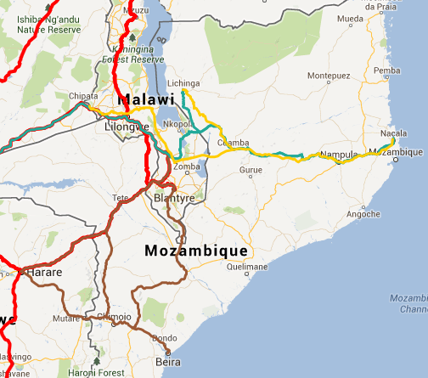

Slide 36
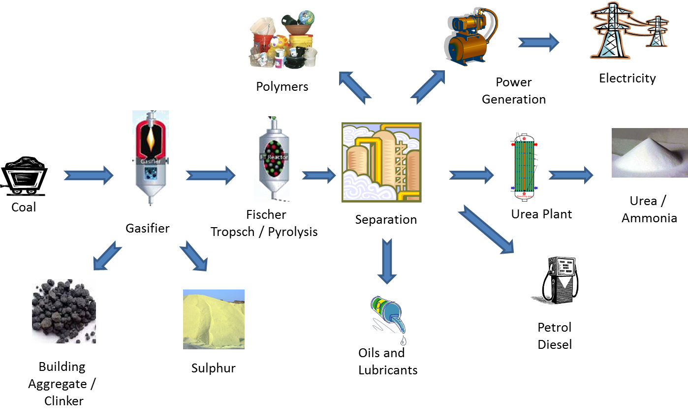
Potential Growth Pole Based on Moatize Coal
Source: Hausberger (2013)

Slide 37
Conclusions:
Infrastructure is important for Africa’s economic development but are we planning for the right infrastructure?
The key to Africa’s growth is to improve competitiveness and to do this improved Infrastructure together with Trade Facilitation is key.
Paraphrasing GIZ on Day 1:
  Preparation of trans-boundary projects is the championship league of project preparation;
  Need dedicated units to do project preparation; and
  The biggest challenge is to raise enough funds to do project preparation.
  The only way to address Africa’s infrastructure needs is through reducing risk (blending and leveraging) so that the private sector and concessionary financiers can play their role.

Slide 38
Thank You
Mark Pearson
Programme Director
mpearson@trademarksa.org
www.trademarksa.org

