Slide 1
EU FAO FLEGT Programme: Experiences working with governments
Brussels, Belgium
9 October 2013
Robert Simpson, FAO
Notes:
EU FAO FLEGT Programme is a new mechanism funded by the European Commission and implemented by FAO.

Slide 2
Content
Programme background and context
Types of interventions
Observations

Slide 3
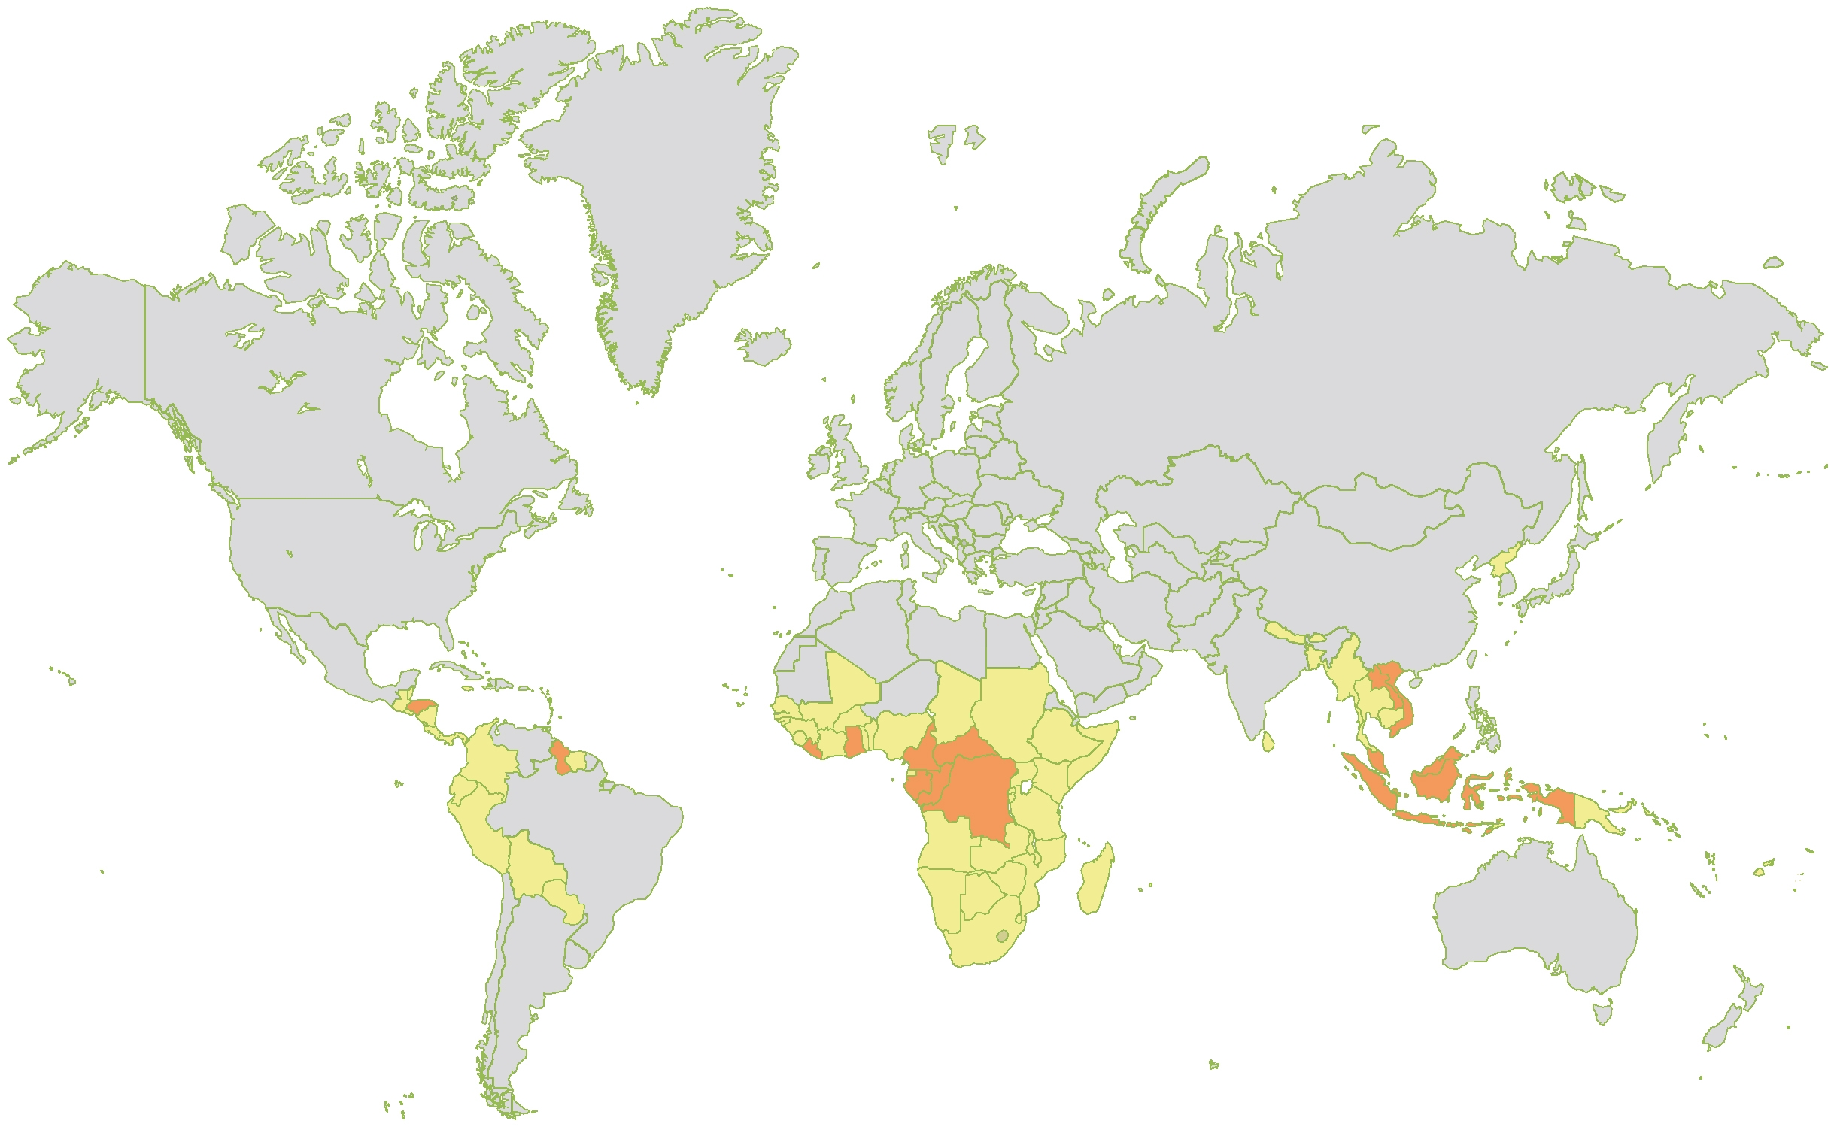
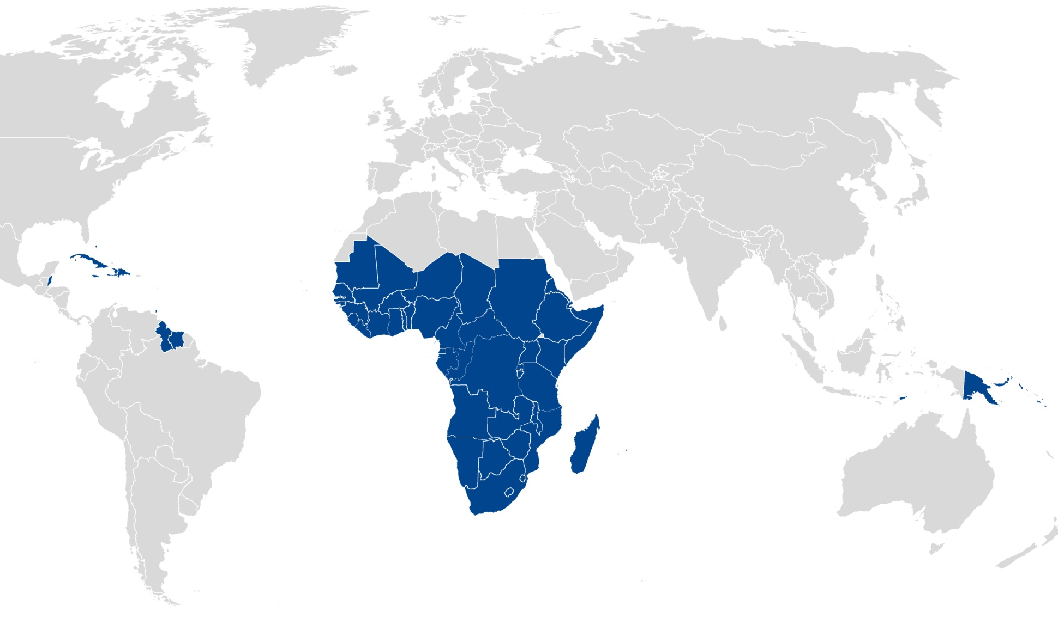
ACP and EU FAO FLEGT
ACP FLEGT
Four year programme
10 million Euro
79 ACP countries
3 Stakeholder groups
EU FAO FLEGT Programme
4 year programme – May 2012
10 million Euro – EC
Includes Latin America and Asia
3 Stakeholder groups

Slide 4
ACP and EU FAO FLEGT
Challenges facing governments in the VPA process (relative to other stakeholders):
Slow to react or take on change
Strong hierarchy to make decisions
Sometimes antiquated methods
Mentality against consultation processes
Poorly equipped
Always champions for change / status quo/ corruption
However:
Governments are a change agent: they are empowered to formalize new structures and systems
Legitimize the processes
They are sovereign bodies;
The FAO member body

Slide 5
Interventions
Projects with governments supported by FAO:
32 projects under ACP out of 90 projects implemented
20 projects under EU FAO FLEGT out of 41 current projects
13 In VPA countries
7 In Non-VPA countries

Slide 6

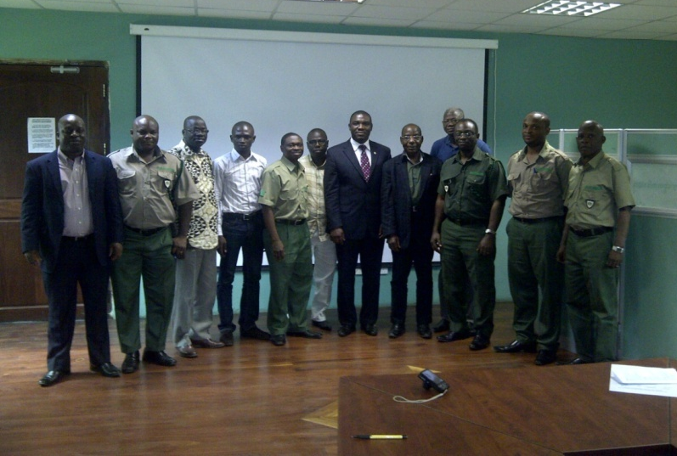
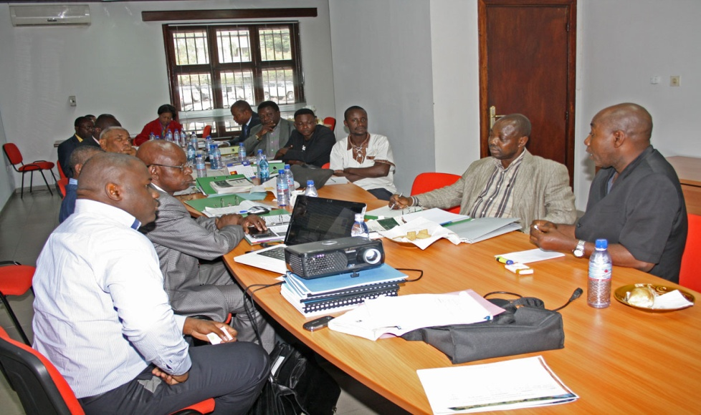

Interventions
VPA country project support;
Development of manuals, guides, regulations, policy, etc
Information sharing, regional events, country exchanges
Chain of custody studies
Support to VPA facilitation units

Slide 7
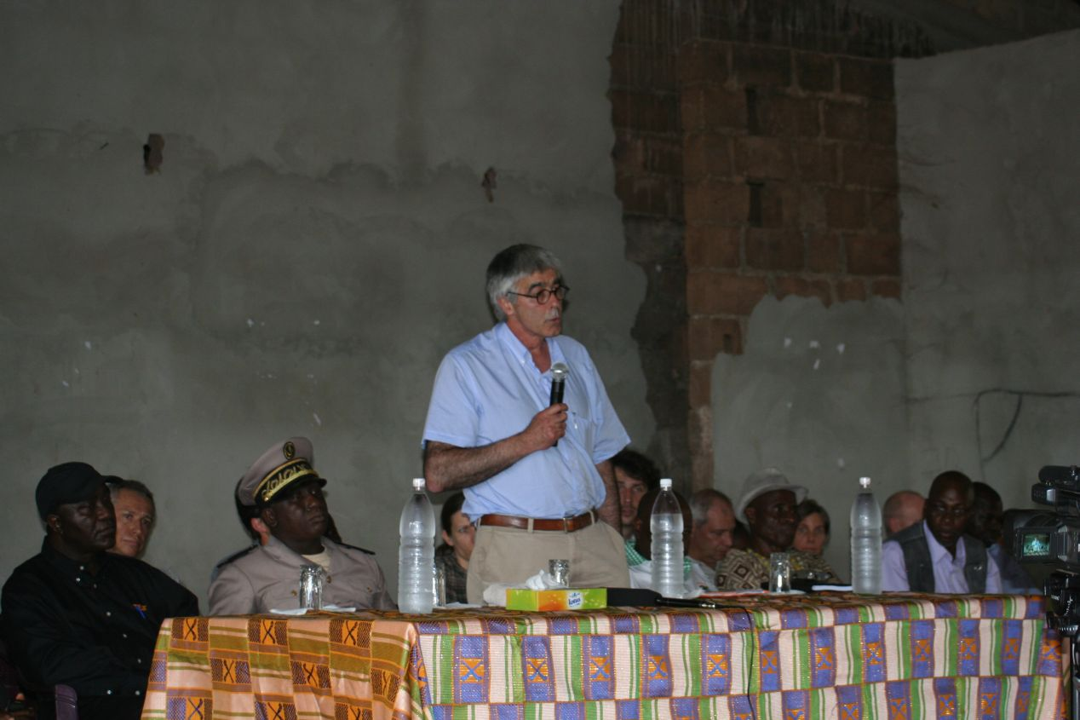
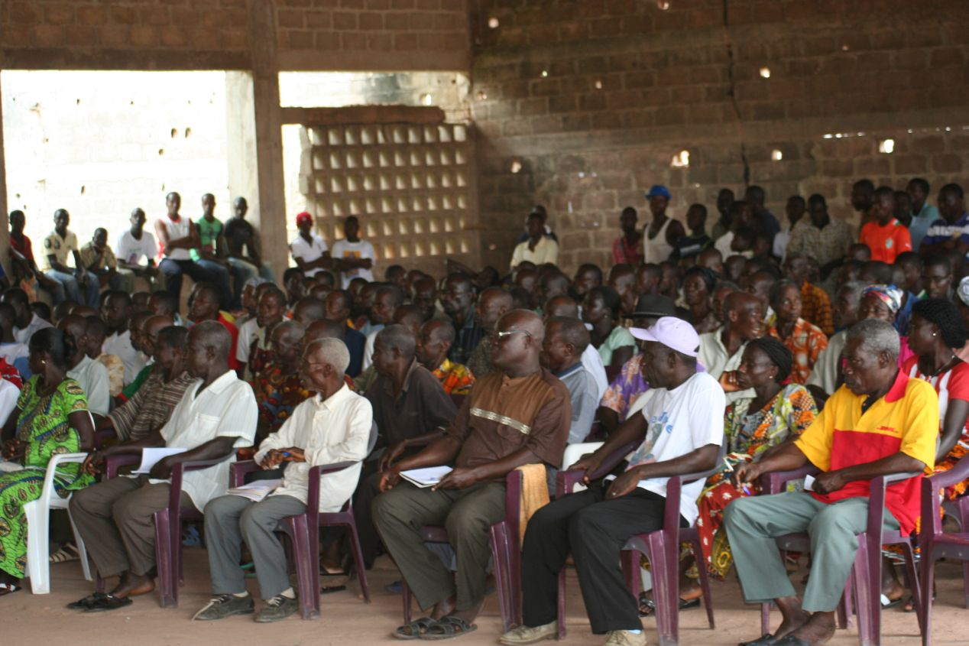
Interventions
VPA Country Direct Assistance:
Cote d’Ivoire – Support for consultations and VPA policy consensus building
Guyana – Consultation processes, impact assessment, support to attend the second negotiation session in Brussels
Honduras – Consultation processes and support to participate in the second negotiation session in Brussels
Cameroon – TLAS support to ministries
Vietnam – Bi-lateral dialogue with Laos and TLAS annex development

Slide 8
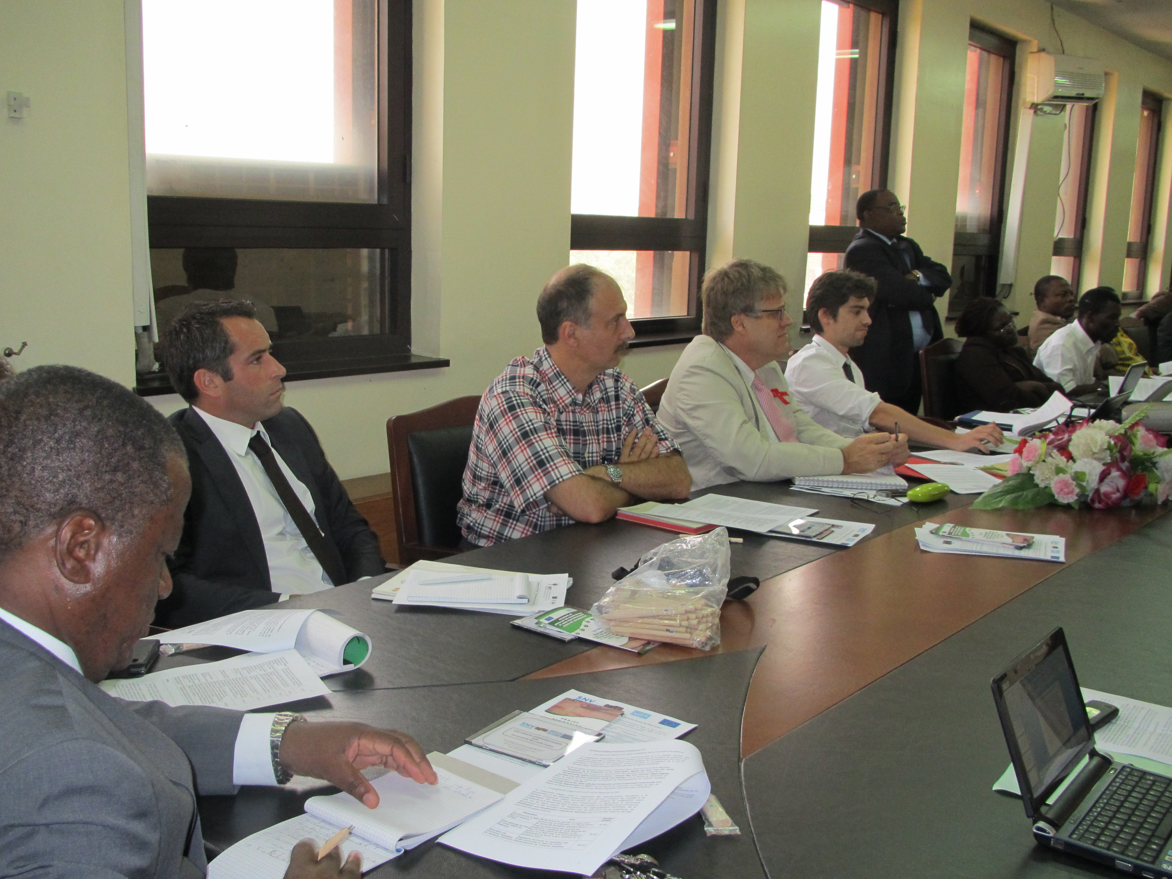
Interventions
Coordination meetings:
Where significant number of projects - Cameroon, CAR, Ghana and Liberia
Support government to take the lead – empower their role as leader
All projects funded through EU, MS or FAO invited
Opportunity for exchange and future coordination

Slide 9
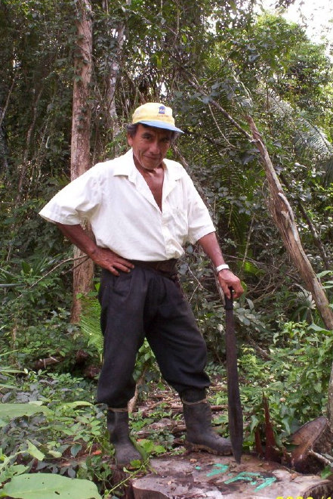
Interventions
Non-VPA - Guatemala
Context:
Developed and approved a multi-sector, national illegal logging strategy in 2010
Objective:
Support to government to reinvigorate strategy dialogue - sensitize stakeholders about national strategy and international schemes to promote legal timber
Build consensus on next steps for legal timber program
Pilot test aspects of national online timber monitoring system
Stimulate momentum towards better governance
Notes:
FAO work is to revise national strategy

Slide 10
Observations
Programme learning process:
Correlation between knowledge of FLEGT and quality of proposals
Knowledge gap between VPA and Non-VPA
Non-VPA countries benefited from FLEGT learning sessions
Challenges identifying greatest VPA priorities
Developed collaborative project identification process
More supportive to develop projects

Slide 11
Observations
Contribution to process:
Supporting government leadership
Address projects in the VPA workplan per country
Non-VPA countries – Building on bigger initiatives
Fill gaps in funding or where funds were not anticipated
Provide support in areas of weakness in governments
Maintain or support momentum
Coordination meetings
Ownership of actions through project implementation
Changing behavior
Consultation processes
Training for staff on new procedures
Dialogue on new technical processes – chain of custody

Slide 12
Observations
Gaps – continued issues:
Projects identified support by EU Delegations or EFI – what other issues could be addressed?
Projects in only 6 of the 15 VPA countries
Projects do not necessarily leverage any additional funding on the side of government?
Very prescriptive support vs. autonomous implementation

Slide 13
Thank you!

