Slide 1
Overview of VPA processes: opportunities and challenges for projects to advance FLEGT
Julia Falconer
FLEGT Project coordination meeting
October 9, 2013
Brussels

Slide 2
Different governance interests frame VPA dialogue and decisions
GOVERNMENT
    Realize full economic value of the resource
    Reinforce national forest management objectives
    Formalize/legalize informal sector
    Domestic market
    Improve country image and sector credibility
    Advance forest sector reform agenda
PRIVATE SECTOR
    Secure and expand markets
    Level the playing field by reducing unfair competition from illegal logging
    Small forest operators want to be able to compete with big companies
    Clarify requirements and control procedures to reduce possibilities for corruption
    CIVIL SOCIETY
    Voice and participation
    Community rights & indigenous peoples rights
    Enforce existing legislation
    Clarify user rights and operator responsibility to communities
    Collection and redistribution of forestry related fees to communities
    Accountability and transparency in decision making (land use allocation)

Slide 3
How are these interests framed in and by the VPA?
    VPA process : national, regional, international
    Embedded directly in the Agreement
    Platform for governance issues beyond VPA commitments
        Increased accountability on permit allocation (Liberia and Ghana)
        JIC provide platform for dialogue on forest conversion for oil palm (CAM)

Slide 4
VPA Process

Slide 5
Steps in building Agreement
Opportunities for input throughout all stages in the process
Country consensus building
Information
Bilateral Negotiation
Negotiations with EC
Negotiations AMONG stakeholder groups in VPA producer country
Agreement Ratification
VPA initialled
Negotiations WITHIN stakeholder groups
Stakeholders discussion
Country debate and analysis of challenges
System Development
Tracking systems created
Reforms adopted
Licensing created
Independent auditor selected
System
Operational
FLEGT Licenses
IA reports
JIC meetings
Timber controlled at EU borders
Impacts monitored
Capacity established
VPA Signed
VPA ratified by EU + country Parliaments
Enters in force
National political engagement
Notes:
Clarification of institutional responsibilities
→ better understanding of specific roles
→ minimization of overlap
→ clarity on accountability

Slide 6

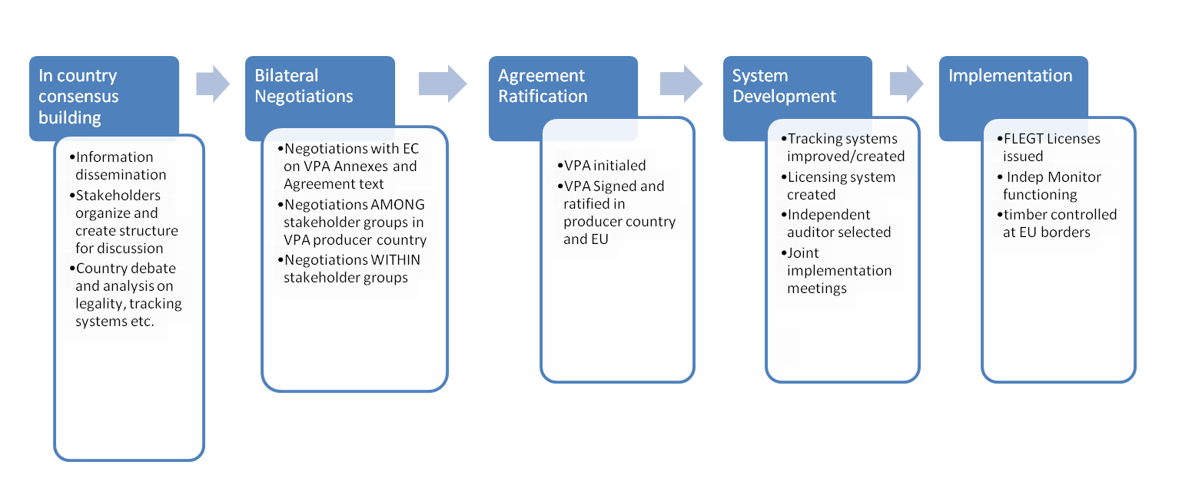
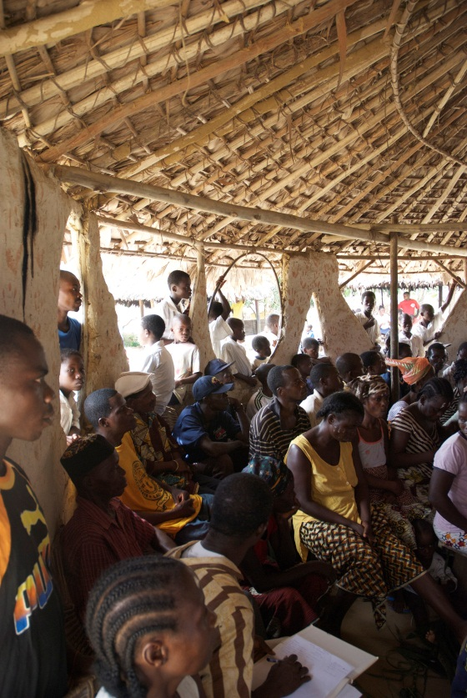
In country consensus building
Analysis of forest sector, trade, governance, law, etc
stakeholder identification and consensus building on key positions formation of national platforms & representation structures
National workshops to ensure the VPA is the right tool & to understand challenges that might be addressed
Multi-stakeholder team / representatives (preferably self-designated by CSO and PS) for process
Build from on going reform agenda, existing systems and project work
The quality of the future VPA depends on effective stakeholder engagement and understanding
Notes:
5

Slide 7
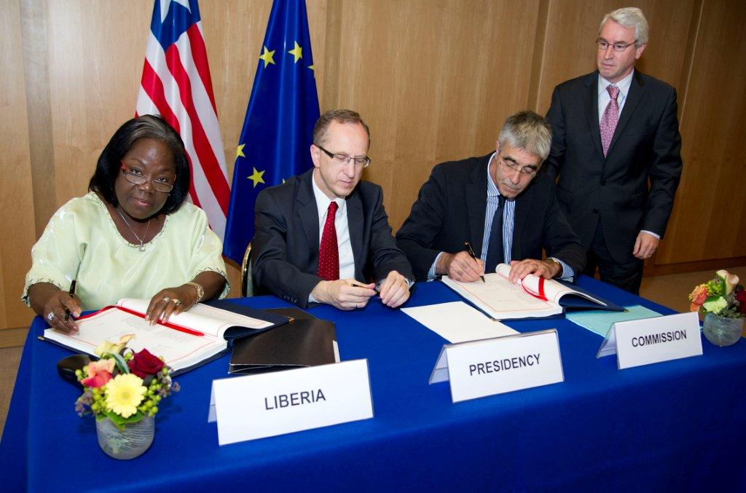
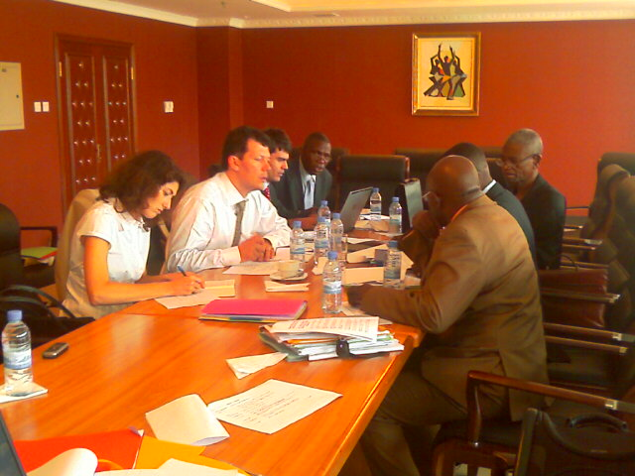
Negotiations
    Structured development of ideas and reforms framed in legally binding treaty
    Structures that inform negotiation : working groups, steering committees, negotiation sessions, national consultations, de briefing sessions, stakeholder platforms/ associations
    Roadmap – sets stages for development VPA & timing of issues to be discussed
    Informing reform agenda,legality definition, transparency, legality assurance system, monitoring and reporting.
    Timing is important
Notes:
6

Slide 8
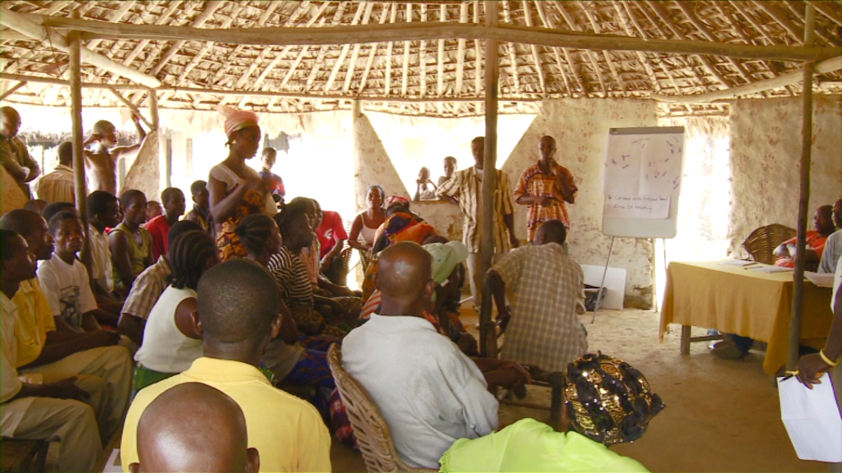
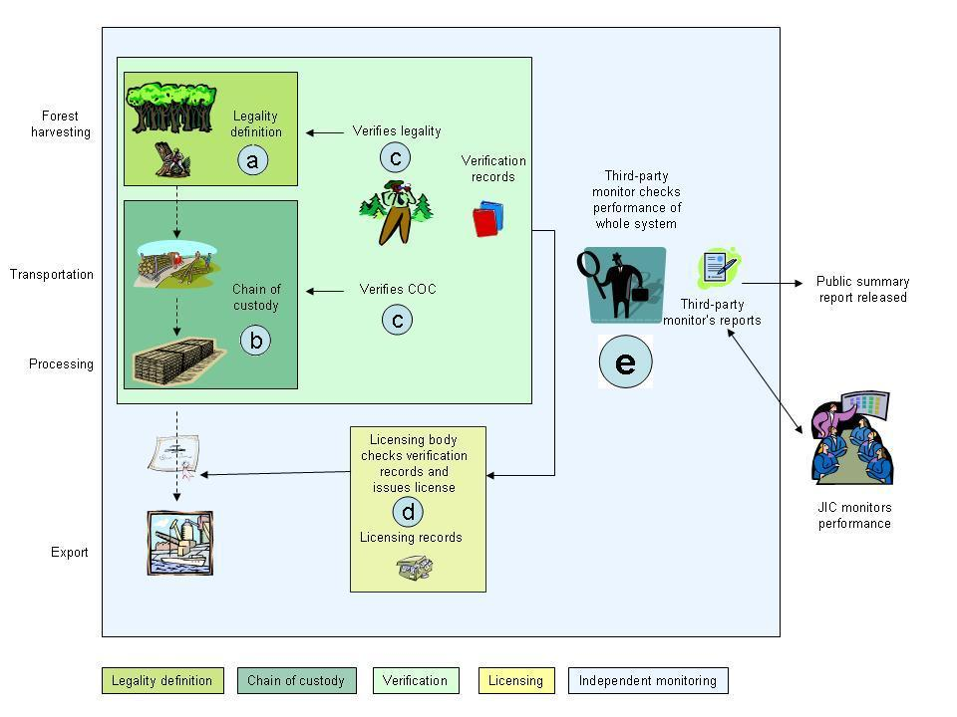
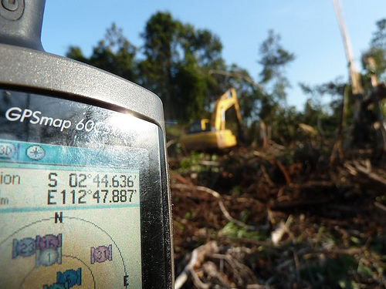
Systems development: start implementation
    Structures: Joint Implementation Committees, national committees, national platforms,
    Aim improve and develop systems: domestic market, new technical systems
    Further reforms and new laws
    Raise awareness and visibility
    Building capacity
    Use the space !! offering ideas and projects
    Annual workplans & JIC milestones
    Understand timing and strategy framed in these plans and tailor project actions to advance and contribute to the key milestones where possible
Notes:
7

Slide 9
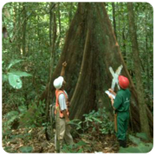
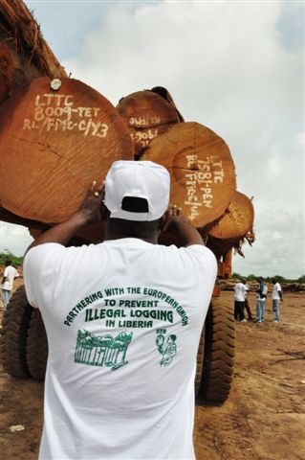
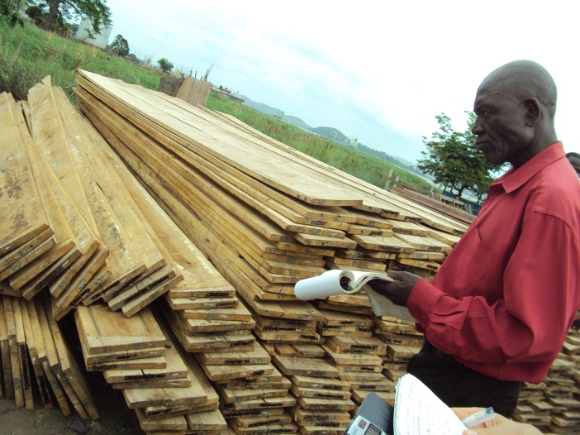
Full implementation: All systems go
    JIC: addressing new challenges, oversight
    FLEGT licenses
    Independent audit
    Transparency measures in place
    Impacts monitored, in the EU and partner
    Monitoring & whistle-blowing
    Managing complaints
    Market visibility of FLEGT licenses
    Stakeholders driving implementation
Notes:
8

Slide 10
Embedded in the VPA

Slide 11
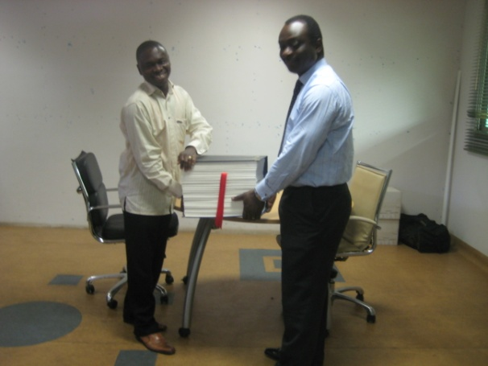
What is IN THE vPA?
How are interests framed?

Slide 12
Embedded in the Agreement: Broader VPA Governance Commitments
Making information public
      Annex reflecting different stakeholders views on what to put in public domain. Opportunity to make process/procedures/decisions transparent
Legislative and policy reform
      fixing incoherence, bringing clarity, securing stakeholder interests
Independent observation:
      Securing participation and oversight to ensure accountability (IDN, ROC)
TLAS: timber legality verification:
      provides the evidence of legal compliance & link to law enforcement

Slide 13
Embedded in the Agreement:
FLEGT Licenses: what stands behind them
Consensus on legality definition VOICE, PARTICIPATION, LEGISLATIVE CLARITY
Responsibilities and procedures with various government agencies and other TLAS actors developed and adopted INSTITUTIONAL CLARITY/ ACCOUNTABILITY
New legislation drafted, consulted and enacted for FLEGT licensing LEGISLATIVE CLARITY
Government and private sector capacity to verify legal compliance strengthened CAPACITY BUILDING
All businesses engaged in harvesting/producing/transporting/exporting being verified for legal compliance LEVEL PLAYING FIELD
Legality assurance system is audited by third party CREDIBILITY
Violations addressed and treated ENFORCING THE LAW,
Civil society observations addressed ACCOUNTABILITY
Notes:
Clarification of institutional responsibilities
→ better understanding of specific roles
→ minimization of overlap
→ clarity on accountability

Slide 14
Timing and political savvy are important
For VPAs national political dynamics: elections, key people, business cycles all influence process
Understand VPA process dynamics & tailor analysis and information to the stages in process for maximum impact
When, what and who matter in your actions -- timing, quality and representation are key- this has opened the space for broad engagement

Slide 15
Reflections
Anticipate how the results of your projects are going to be used or influence national FLEGT processes adding value to VPA process
The VPA relies on national stakeholders contributing effectively to the process: local counterparts therefore are key to ensure lessons from projects influence the shaping of VPA
People matter and are a key constraint (whether in government, business or civil society).
Capacity is a constraint for all – but very different from one context to another – we need tailored strategies for building across stakeholder constituencies
Joined up project work provides stronger messages and influence and makes easier for national partners – less complexity

Slide 16
How to follow the process: important sources of information
EU Delegation FLEGT contact in country
FLEGT Facilitators, envoys, champions
FLEGT team in Brussels: the trees
National focal points FLEGT
EFI FLEGT VPA team (Othman&Pichet):country focal pts
Each country FLEGT VPA webspace
Capacity4Dev
EFI FLEGT website
Logging off website (NGO Forum)

Slide 17
Questions for discussion
The VPA creates a voice for national stakeholders: how have you been able to work with and through national partners?
How has your project contributed to advance the VPA?
Joined up working sounds good on paper: tips to make it happen in practice?

Slide 18
Thank you
EU FLEGT Facility

