Slide 1
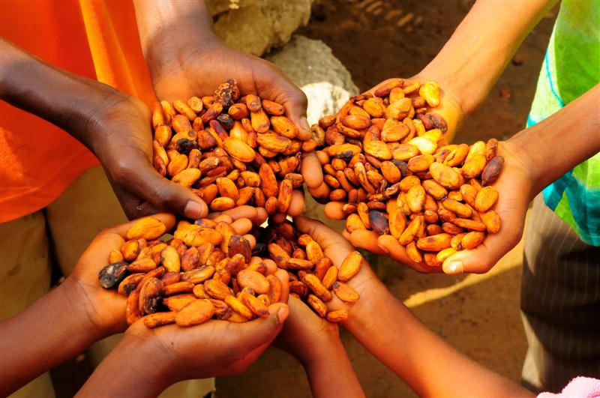

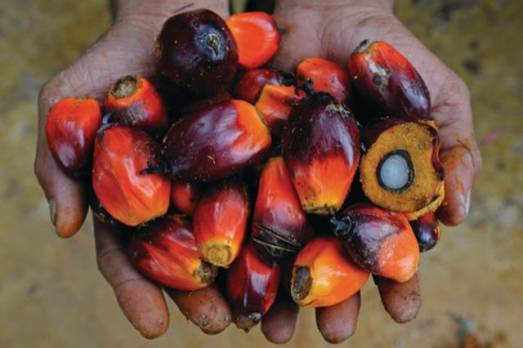
FLEGT and its impact on other drivers of deforestation

Slide 2
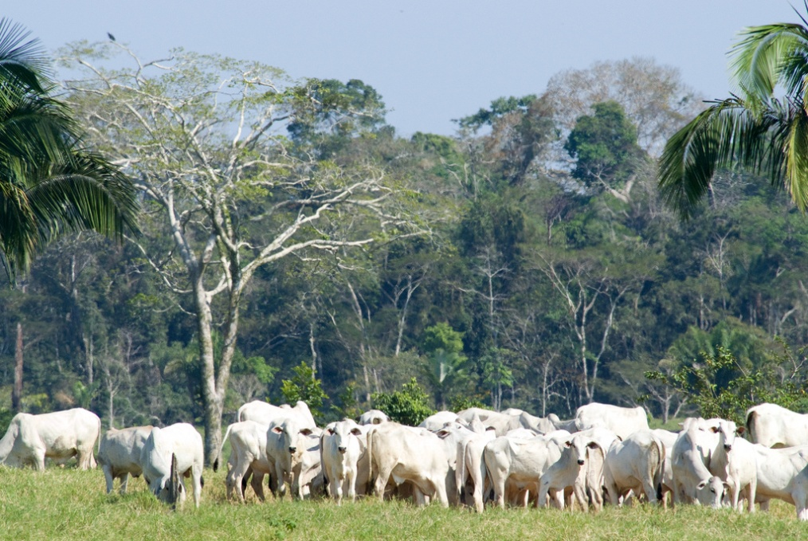
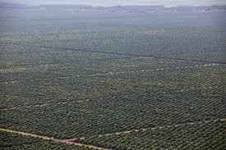
An evolving landscape for REDD+…
Carbon markets / the promotion of forest carbon as a new commodity was seen by many as the main avenue to engage the profit-driven sector in the fight against deforestation. People are realising this may not happen as quickly as foreseen or be as influential as foreseen
At the same time, the role of global commodity markets in driving deforestation and forest degradation is important and will continue to rise
Agricultural expansions accounts for about 55-80% of total deforestation, often a few well known commodities: soy, palm oil, cocoa, etc.

Slide 3
An evolving landscape for REDD+…
Greening supply chains is an additional way in engaging private sector in REDD+: creating an enabling environment to attract private sector investment and stimulate public-private partnerships
Ongoing efforts on REDD+ (strategic planning, improving the knowledge base, stakeholder engagement, legal reforms, monitoring and information systems) are contributing to developing this enabling environment
Timely: e.g. Cameroon and Gabon becoming target countries for large-scale oil palm and other commodity development by international investors due to (1) the availability of cheap land, (2) relative political stability and (3) willingness of governments to develop their agricultural sectors

Slide 4
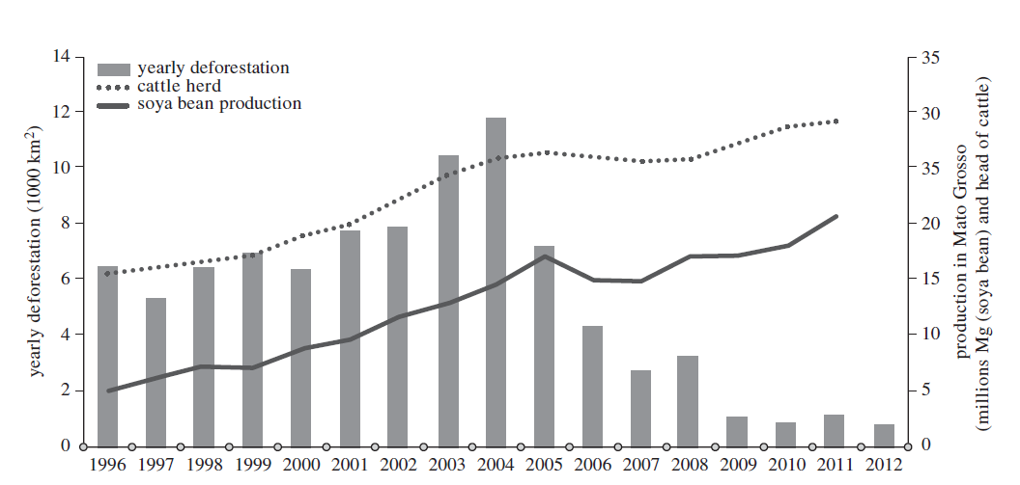
An evolving landscape for REDD+…
Growth in the agricultural sector can be decoupled from deforestation if other indirect drivers addressed (land tenure, land use planning, law enforcement...)
Addressing these key agricultural driver requires policies and measures at both the supply and demand side

Slide 5
Inspired by the EU FLEGT Action Plan
FLEGT Action plan as a policy approach can be used/replicated/inspire efforts to address other drivers of deforestation, such as agriculture and mining:
    By linking supply side with demand side measures:
        Supply side: integrated land use planning, improving governance, incentives to land users (ex. PES), MRV, etc. to facilitate supply of deforestation-free commodities
        Demand-side: preferential access to commodity markets, increased consumer demand for sustainable/deforestation-free products, regulations (e.g. EUTR, EURED, Lacey Act), public procurement, etc
    By building on the political space created by the FLEGT VPA process in VPA countries and expanding it to other sectors impacting forests and land-use

Slide 6
FLEGT Action Plan, May 2003
Support to timber-producing countries
Trade in timber (VPAs)
Additional options (legislation)
Public procurement
Private sector initiatives
Financing and investment
Existing legislative instruments
Conflict timber

Slide 7
Support to producer countries (supply side)
Coordinated EU support on sustainable land use, improved governance, legal reforms…
Importance of support for private sector, civil society, government institutions
Commodity production often highly concentrated, but pressure increasing in other regions
      Palm oil: Indonesia, Malaysia
      Soy: Argentina, Brazil
      Beef: Brazil
      Cocoa: Côte d’Ivoire, Ghana
  A few examples:
      Encouraging multi-stakeholder dialogues on forest risk commodities
      Transparency/planning tools providing clarity on the allocation of plantations/concessions (based on socio-economic and environmental criteria)
      VPA type of approaches for other commodities such as clarifying legality of allocation of land use for agricultural commodities

Slide 8
New and existing legislation (demand side)
Demand side measures to support the consumption and/or imports of deforestation-free commodities
A few examples
      Extension of sustainability criteria for biofuels for other uses of the same crops (food, feed, product, materials)
      Due diligence approaches for companies importing commodities impacting deforestation
      Mandatory labeling requirements
      Binding reporting criteria for public and private companies on deforestation risk – forest footprint disclosure (perhaps by building on or extending EU Transparency and Accounting Directives)

Slide 9
Public procurement (demand side)
Public sector is a major purchaser of good and services (up to 30% of the market share): construction and furniture (timber), office supplies (paper) and food and catering services (agricultural commodities)
As with timber procurement, this highlights the need for clear standards and effective certification systems or similar systems that can prove compliance
An example
    UK now introducing procurement policy for sustainable palm oil in food – aim for 100% by 2015 (UK government’s Food and Catering Government Buying Standard)

Slide 10
Encouraging private sector initiatives (both supply and demand side)
Large corporations start seeing some competitive advantages of sustainability in their supply chains: securing supply and markets, mitigation of risk linked to land tenure conflicts...
Clear standards, certification, (independent) monitoring, (MRV) information systems and tools, due diligence systems can support private companies in greening supply chains ( some of these could possibly be developed with public support)
Due diligence approaches for private (and public) financial institutions: criteria for risk assessment

Slide 11
Encouraging private sector initiatives (both supply and demand side)
Number of initiatives are already underway. A few examples:
    Global Consumer Goods Forum and the Tropical Forest Alliance
    Round table on Sustainable Palm Oil (RSPO)
    The Sustainable Trade Initiative – The Netherlands
    The Belgian Alliance for Sustainable Palm Oil
    The French Alliance for Sustainable Palm Oil
    German Forum Sustainable Palm Oil
    Central Point of Expertise on Timber (CPET), supporting business and public buyers on Legal and Sustainable Timber and Palm Oil
    Investment Guidelines for the Norwegian Government Pension Fund Global

Slide 12
  FLEGT and REDD+ intersect in practice to improve land use governance
  Synergetic: provincial facilitators for FLEGT and REDD+ processes in DRC; joint civil society platform in Ivory Coast
  Complementary: development of a planning tool for the establishment of legal palm oil plantations
  Strategic: independent monitoring of finance flows in the forestry sector in Indonesia
  Country specific: FLEGT and REDD+ interaction to be assed on a country-by-country case
  Country ownership is crucial for activities to be mutually supportive to both processes

Slide 13
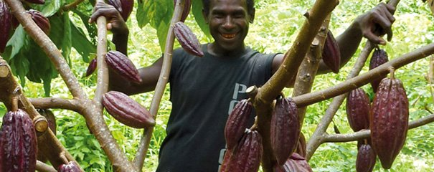
Thank you for your attention
christophe.vanorshoven@efi.int

