Slide 1
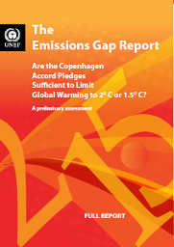
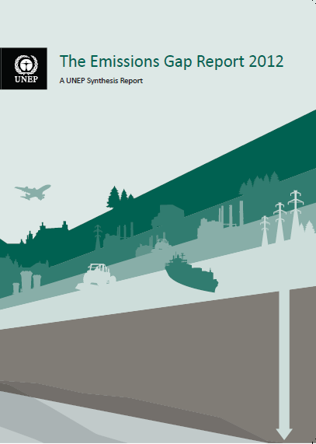

The Emissions Gap reports
2010 Cancun Climate Summit UNEP “Emissions Gap” report
United Nations Environment Programme with the European Climate Foundation & National Institute of Ecology, Mexico
2011 Durban Climate Summit UNEP “Bridging the Emissions Gap” report
United Nations Environment Programme with the European Climate Foundation & Ministry of Environment, South Africa
2012 Doha Climate Summit UNEP “Emissions Gap 2012” report
United Nations Environment Programme with the European Climate Foundation
55 scientists, 43 institutions, 22 countries
2013 Warsaw Climate Summit UNEP “Emissions Gap 2013” report
United Nations Environment Programme
70 scientists, 44 institutions, 17 countries
Notes:
This UNEP Gap 2013 report is the latest in a series of UNEP Gap reports. They all address the key question, whether the pledges made by countries are on track to meet the two degree target. The reports were always released before the climate summits (Cancun, Durban, Doha) and the coming Warsaw climate summit.
This report is based on contributions from 55 scientists from 43 institutions and 22 countries.

Slide 2






The emissions gap idea
  Two policy developments …
  A target (or limit) …
  Staying below an increase of 2 degrees Celsius (1.5º C)
  A means to get there …
  > 58 states/countries pledge to control emissions (pegged to 2020)
  Two questions …
  Is there a gap between …
  What we are aiming for … and where we are heading ?
  How can the gap be bridged?
Notes:
The emissions gap in 2020 in this gap report and the earlier ones is defined as the difference between emission levels in 2020 consistent with meeting climate targets, and levels expected in that year if country pledges and commitments are met.
(There are two policy developments:
The Parties have agreed on a climate target: staying the average global temperature increase below 2° C, compared to pre-industrial levels.
Around 57Parties/countries, including 27 EU member states, have made a commitment and pledge to reduce their economy-wide emissions with a quantified impact for 2020.
Then we deal with the following two key questions:
Is there a gap between what we are aiming for and where we are heading? More specifically, is there a gap between the 2020 emission levels consistent with least-costs scenarios aiming at meeting the 2 degree climate target, and the 2020 emissions resulting from the pledges and commitments.
Next, how can we gap bridge or narrow the two degree emissions gap? )

Slide 3
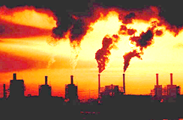
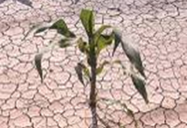
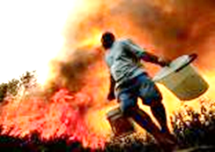
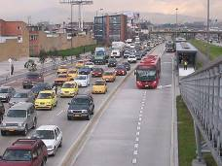
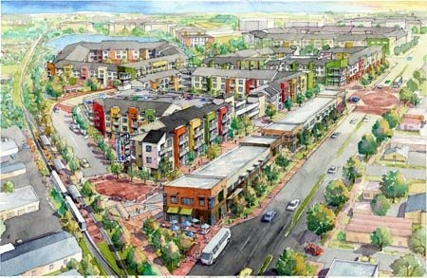

The Emissions Gap Report 2013
Regional Launch ♦ ECF
Brussels ♦ 5 November
  UNEP with ECF ♦ 43 scientific groups ♦ 22 countries
Michel den Elzen
PBL Netherlands Environmental Assessment Agency
Notes:
Thank you Bert Metz. I will talk on behalf of my organisation, PBL Netherlands Environmental Assessment Agency, which is an independent research institute. I was lead author on all earlier UNEP gap reports, and now lead author of Chapter 2. I am also an IPCC Lead Author for the Fifth Assessment Report.

Slide 4
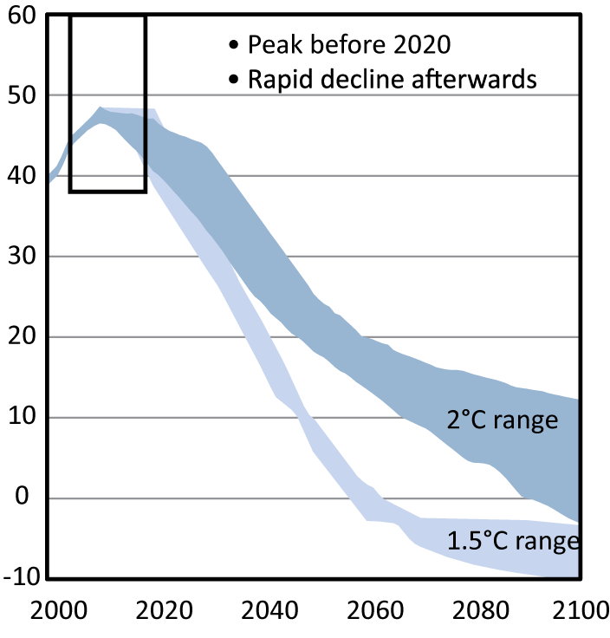
What are we aiming for? Post-2020 goals for
staying within 2ºC target based on least-cost scenarios
Global Greenhouse Gas Emissions
Gt/year
CO₂-equiv.
Peak before 2020
In 2020 ≈ 44GtCO₂e/yr (38-47)
≈ - 10% rel. to 2010 emissions
In 2030 ≈ 35 GtCO₂e/yr (32-42)
≈ - 28% rel. to 2010 emissions
In 2050 ≈ 22 GtCO₂e/yr (18-25)
- 55% rel. to 2010 emissions
Now (2010) ≈ 49 GtCO₂e/yr
39 least-costs emission pathways with a likely chance of meeting the 2ºC target
Year
Notes:
What are we aiming for?
This graph shows the large set of least-cost emission pathways collected from more than 10 different groups and models.
Here, we focus on cost efficient pathways, which are climate mitigation scenarios that assume emission reductions start immediately after the model base-year, typically 2010, and are distributed costs-effectively over time, in such a way that the mitigation costs over the whole century are minimised.
To address the first question – What emissions level are we aiming for beyond 2020 to stay within the 2 degree climate target with a likely chance (higher than 66% chance)?
Now at 49, in 2020 we need to be around 44 Gigatones CO2equivalent (about 10% below 2010 levels), in 2025 around 40 Gigatones (about 18% below 2010) , in 2030 around 35 Gigatones (about 28% below 2010 levels), in 2050 around 22 Gigatones (about 55% below 2010 levels).
Least-cost emission pathways typically peak before 2020.
The 1.5 degree emission pathways have global emissions by 2020 even lower, 37-43 Gigatones CO2equivalent in 2020, and show deeper and faster reductions after 2020.

Slide 5

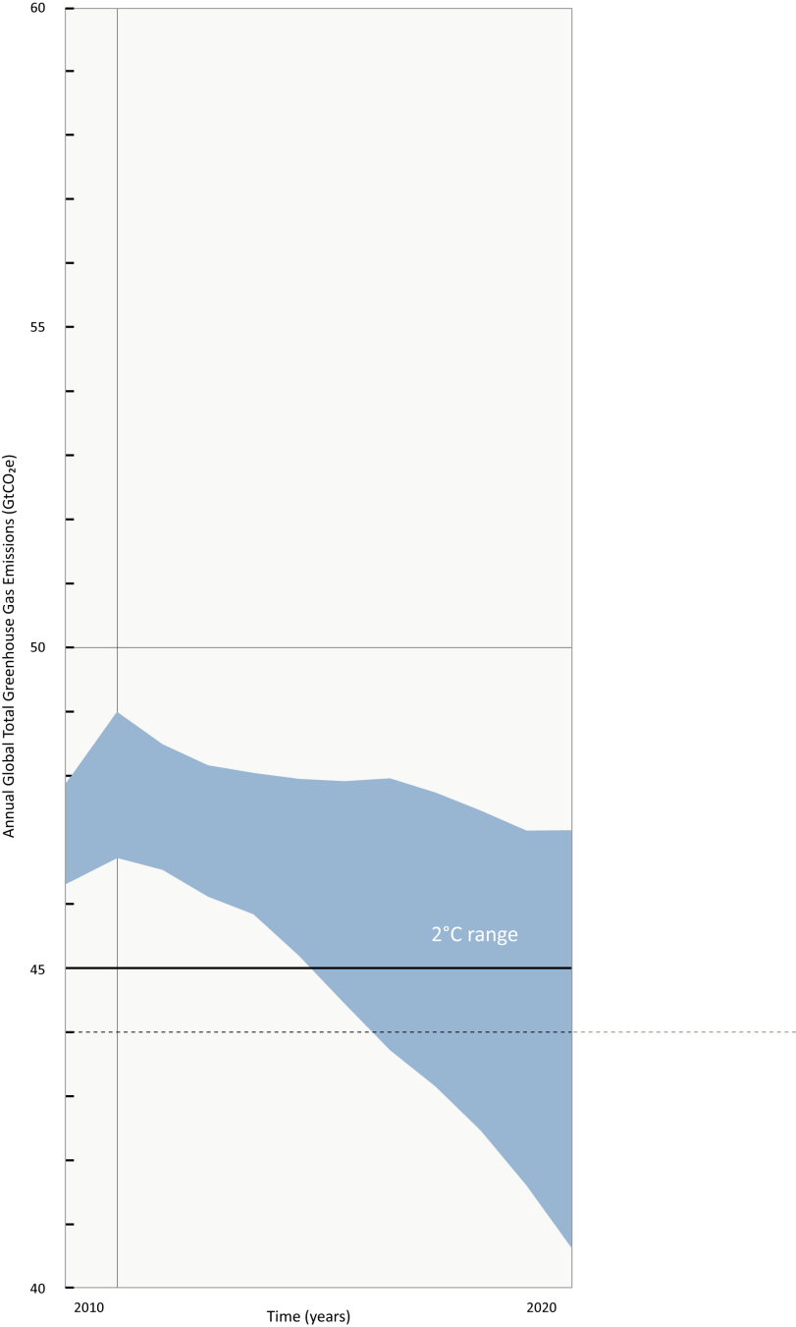
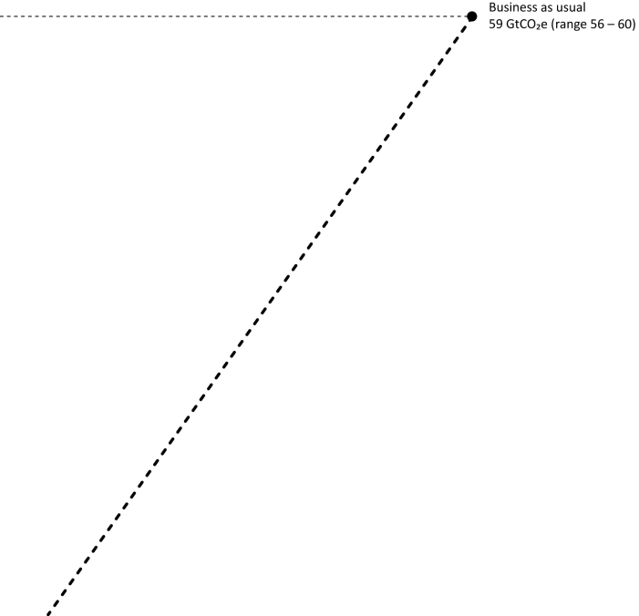
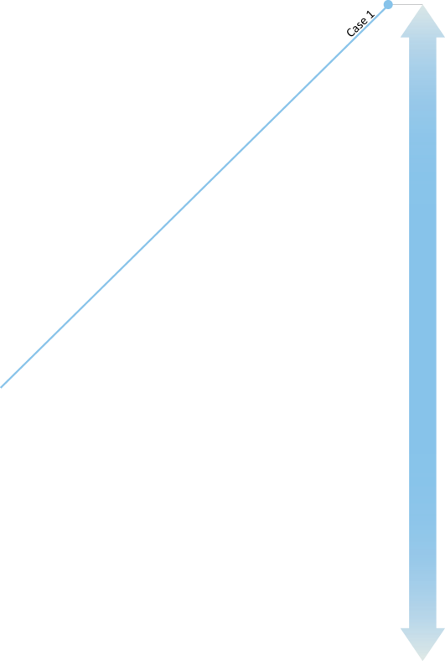
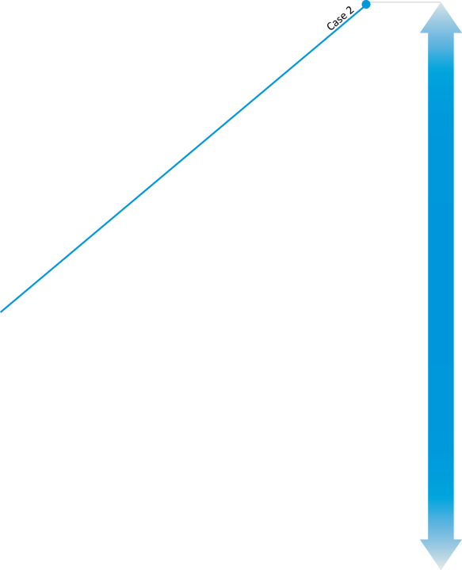
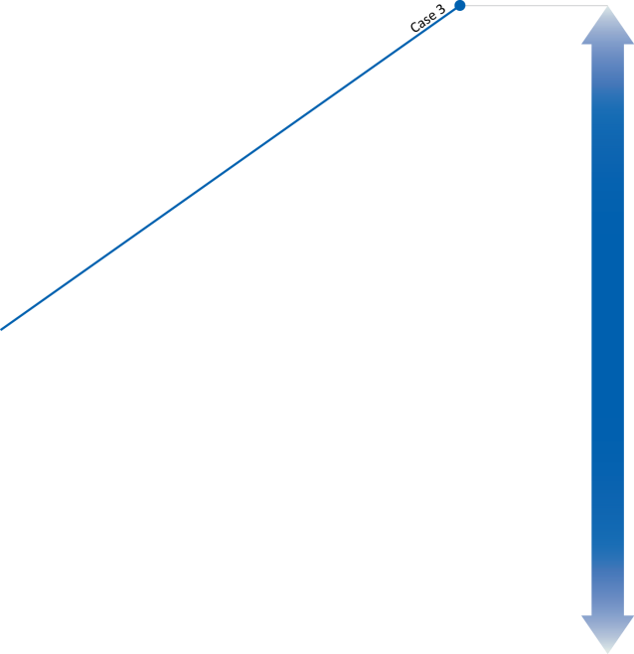
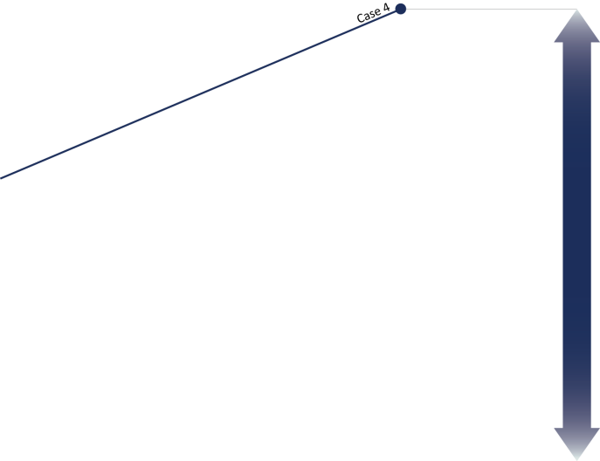
Is there an emissions gap -- between what we are aiming for and where we are headed in 2020?
Total Global Greenhouse Gas Emissions
Business as usual, Gap = 15
Under Business-as-Usual
Gap = 15 GtCO₂e/yr
(Gt/year CO₂ equiv)
55
Under different cases of country pledges:
Gap = 8 – 12 GtCO₂e/yr
Under the most ambitious case:
Gap = 8 GtCO₂e/yr
50
Pledge cases
Now:
≈ 49
Gt/year
The Gap
Pledges not enough to meet the 2ºC climate target according to current least-cost mitigation scenarios
Big emissions gap to close by 2020
45
45
~44 Gt/year
To be on pathway of staying within 2ºC limit
12
11
10
8
Different pledge cases GtCO₂e/yr Gap
2010
YEAR
2020
Notes:
Let’s look at nearer future – 2020
As mentioned, there is the climate target of 2 degree, and countries’ pledges and commitments under the Kyoto Protocol to reduce emissions by 2020.
The key question is: Is there a gap between emission levels consistent with 2 degree and emission levels expected once pledges and commitments are implemented?
We are now at 49 Gigatones CO2equivalent, we are aiming for 44 to be on least-cost pathway of staying within 2 degree
But, depending on how pledges and rules are interpreted, emissions are expected to go in opposite direction – increase up to 52 to 56 Gt/yr.
Under BAU emission projection, the Gap = 15
Under different pledge cases, Gap = 8 to 12 Gt/yr.
If countries meet their unconditional pledges (doing it no matter what others are doing) under lenient accounting rules for surpluses, land use credits and double counting, it would be 12 Gt. Lenient account rules mean maximum use of land use credits and surplus emission units by Annex I countries, and maximum impact of double counting.
If countries implement their most ambitious pledges (the conditional ones) under strict accounting rules, with no impact of the use of surpluses, land use credits and double counting, the gap becomes 8 Gt/yr
→ This is about the total greenhouse gas emissions from industry in the world, a big number.
Summarized: Pledges are not enough to meet the 2 degree target according to the information from least-cost mitigation scenarios.
We cannot wait any further to close or narrow the gap.
It should be noted that the concept of the emissions gap becomes increasingly hypothetical as time progresses, and more and more of the mitigation options assumed in the least-cost scenarios (which typically assume reductions starting immediately after 2010) are already foregone.

Slide 6
Surplus emissions units and offsets
  Rules adopted in Doha reduce the impact of surplus emissions in 2020
  unconditional pledges: 0.05 GtCO₂e
  conditional pledges: 0.55 GtCO₂e
  before Doha: 1.8 GtCO₂e
  Offsets can affect pledge emissions levels in two ways
  double counting (conditional: 0.4 GtCO₂e ; unconditional: 0.55 GtCO₂e)
  additionality (conditional: 0.1 GtCO₂e ; unconditional: 0.15 GtCO₂e)
  combined potential impact: 0.5–0.7 GtCO₂e
Notes:
At the climate summit in Doha (2012) the governments have agreed on more stringent international rules for surplus emissions (the so-called hot air). This resulted in lower impact of the surpluses for the unconditional pledges and conditional pledges of 0.05 and 0.55 Gigatones CO2equivalent in 2020. This is much lower compared to the 1.8 Gigatones CO2equivalent, based on a maximum use of surpluses before the Doha climate summit, which was used in the UNEP Gap 2012 report.
We have also estimated a lower impact for double counting of offsets, like CDM credits. Offsets could affect the 2020 emission levels in two ways: first double counting of offsets could arise where emission reductions in developing countries achieved through offsets are counted towards meeting the pledges of both countries. Second, some of the offsets may actually not achieve the intended, additional emission reductions.
The total impact is estimated at 0.5 to 0.7 Gigatones CO2equivalent by 2020.

Slide 7
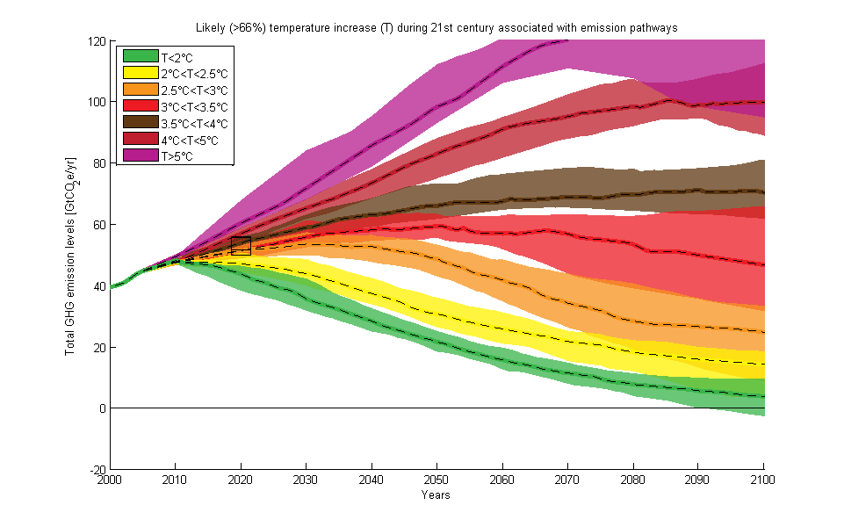
What will we have to adapt to?
Notes:
What will we have to adapt to? this is a illustration of the trajectory we are on.
If we assume an extrapolation of the emissions trends resulting from the pledges, and countries do not increase their pledges, we are heading to temperature increase levels of 3 to 4 degrees Celsius
In general temperature increase projections highly depend on the cumulative emissions up to 2100, and not on the 2020 emissions from the pledges.

Slide 8
Can we still stay below 2 ºC if we do not
close the gap?
  More studies on later-action pathways, i.e. starting emission reductions from 2020. These scenarios have negative consequences compared to least-cost scenarios:
  much higher rates of global emission reductions in the medium term
  greater lock-in of carbon-intensive infrastructure
  greater dependence on the whole range of technologies in the medium-term
  stronger reliance on negative emissions from the energy and industry sector
  greater costs of mitigation in the medium- and long-term, and greater risks of economic disruption
  greater risks of failing to meet the 2° C target.
  But keeping warming to 1.5 degrees will become extremely difficult.
Notes:
What will happed if we do not close the gap?
Based on a much larger number of studies than in 2012 this is analysed in so-called later-action scenarios , which start emission reductions from 2020, and assume higher emissions over near term, which require shaper reductions afterwards. They have lower short-term costs, but negative consequences compared to least-costs scenarios:
much higher rates of global emission reductions in the medium term (6-8%/yr compared to 2 – 4.5%/yr for the least-cost scenarios)
greater lock-in of carbon-intensive infrastructure due to a continued construction of high-emission fossil-fuel infrastructure.
greater dependence on the whole range of technologies in the medium-term. We need the full package of mitigation options, and implemented in all countries and sectors
stronger reliance on negative emissions from the energy and industry sector in particular on large-scale use of biomass and CCS.
untested and potentially damaging net-negative emission technologies (such as bioenergy with carbon capture and storage) and less flexibility of not using certain technologies
More reliance on negative emissions from energy and industry sector. You need large scale sustainable biomass and CCS.
greater costs of mitigation in the medium- and long-term, and greater risks of economic disruption; if serious action after 2030: cost are comparable to financial crisis
greater risks of failing to meet the 2° C target.
Given the risks associated with later action, these scenarios may fail to meet the 2ºC target in 2100.

Slide 9
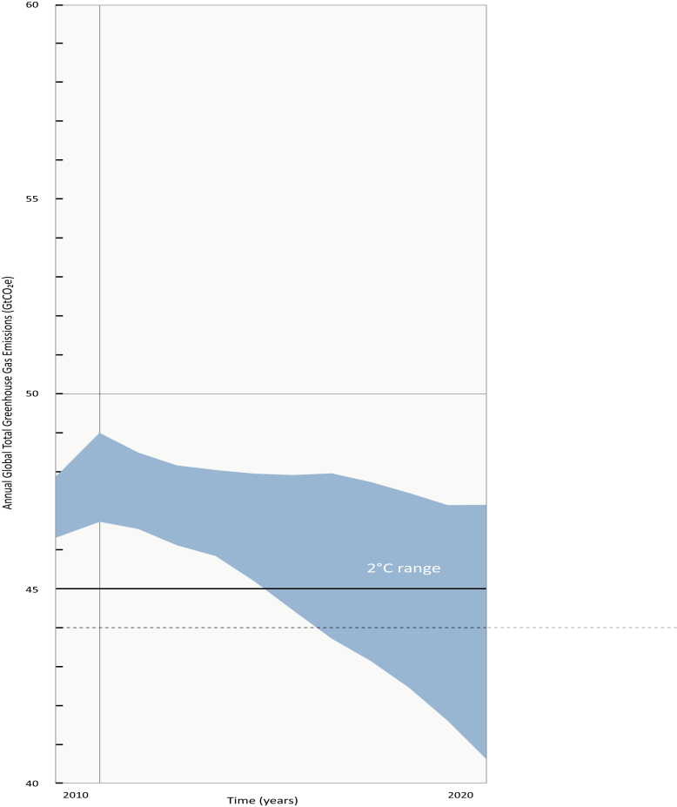
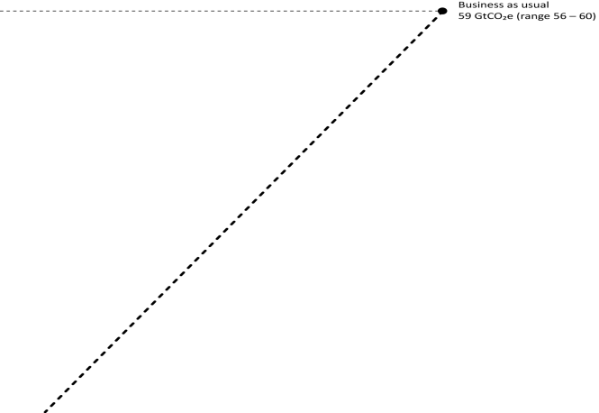









Can the 2020 gap be bridged?
Bottom-up sectoral studies
Total Greenhouse Gas Emissions
  Emission reduction potential in 2020
  (Gt/year equivalent CO₂)
Power
2.2 – 3.9
Industry
1.5 – 4.6
Business-as-usual
1.7 – 2.5
Transport**
Buildings
1.4 – 2.9
Waste
≈ 0.8
Forestry
1.3 – 4.2
Agriculture
1.1 – 4.3
Total Emission Reduction Potential
= 17 ± 3
Gt/year CO₂e
2010
YEAR
2020
The Gap in 2020 = 15
(relative to business-as-usual)
Gt/year CO₂e
  Potential in sectors big enough to bridge the gap.
**incl. shipping and aviation
Notes:
Good news is that the emission reduction potential is greater than the largest estimate of the gap.
New estimates from bottom sectoral studies show that the technical reduction potential is still estimated at 17 Gigatones CO2equivalent at marginal abatement costs of below 50-100 US Dollar per tonne of CO2 equivalent. But this means almost all potential needs to be used in all sectors and countries!!
This reduction potential is enough to reach the least-costs target of 44 Gigatones CO2equivalent by 2020, and thus to bridge the gap.

Slide 10
International cooperative initiatives
  An increasing number of international cooperative initiatives
  Complement, and potentially overlap with, pledges
  Climate change mitigation may not be the primary aim
  Four areas seem to hold most potential
  Energy efficiency (up to 2 GtCO₂e by 2020)
  Fossil fuel subsidy reform (0.4–2 GtCO₂e by 2020)
  Methane and other short-lived climate pollutants (0.6–1.1 GtCO₂e by 2020)
  Renewable energy (1–3 GtCO₂e by 2020)
  Ways to increase the effectiveness of the initiatives
  a clearly defined vision and mandate
  the right mix of participants
  stronger participation from developing country actors
  sufficient funding and institutional support
  incentives for participants
Notes:
Who: Groups of countries and/or other entities have organised international cooperative initiatives outside the Climate Convention , which can complement, and potential overlap with, the pledges
How many: At least three categories can be identified: global dialogues (G8, G20), formal multilateral processes (ICAO, Montreal Protocol), implementation initiatives (Clean Energy Ministerial, Renewable Energy and Energy Efficiency Partnership)
Why: They cooperate to promote technologies and policies that have climate benefits, even though climate change mitigation may not be the primary goal of the initiative
Four areas seem to have the most potential: Energy efficiency; Fossil fuel subsidy reform ; Methane and other short-lived climate pollutants; Renewable energy
There are ways to increase the effectiveness of the initiatives: a clear vision, stronger participation, sufficient funding and international support and incentives for participation.

Slide 11
Summing up
  Even if pledges are fully implemented, there is an emissions gap in 2020
  the gap is 8-12 GtCO₂e per year for the 2°C target
  the gap is 2-5 GtCO₂e per year wider for the 1.5°C target
  Closing the gap on a least-cost pathway is possible, but difficult
  emissions in 2020 and 2030 should be about 10% and 28% below emission levels in 2010
  reliance on untested, potentially risky net-negative emission technologies may be unavoidable
  Closing the gap on a later-action pathway may not be feasible
  later-action scenarios have greater costs, reduced technology choices and greater risks of economic disruption
  future decision-makers would be left with a more difficult task, to be done in less time and with reduced choices
  The available technical potential is still enough to bridge the gap
  emission reductions in 2020 could be reduced by 17±3 GtCO₂e…
  …but time is running out
11
Notes:
Summing up
Even if pledges are fully implemented, there is an emissions gap with the cost-efficient pathways in 2020
the gap is 8-12 GtCO₂e per year for the 2°C target
the gap is 2-5 GtCO₂e per year wider for the 1.5°C target
Closing the gap on a least-cost pathway is possible, but difficult
emissions in 2020 and 2030 should be about 10% and 28% below emission levels in 2010
reliance on untested, potentially risky net-negative emission technologies may be unavoidable
Closing the gap on a later-action pathway may not be feasible
later-action scenarios have greater costs, reduced technology choices and greater risks of economic disruption
future decision-makers would be left with a more difficult task, to be done in less time and with reduced choices

Slide 12
All options have to be brought to play
12
Notes:
Many opportunities to narrow the emissions gap…
strict accounting rules (1-2 GtCO₂e)
moving from conditional to unconditional pledges (2-3 GtCO₂e)
increasing the scope of the pledges (1.8 GtCO₂e)
…complemented by international cooperative initiatives
some areas are particularly promising for international cooperative initiatives: energy efficiency, fossil fuel subsidy reform, methane and other short-lived climate pollutants and renewable energy hold most potential
international cooperative initiatives overlap to some extent with pledges, which makes their individual impact hard to distinguish

Slide 13
Summing up (continued)
  Many opportunities to narrow the emissions gap…
  strict accounting rules (1-2 GtCO₂e)
  moving from conditional to unconditional pledges (2-3 GtCO₂e)
  increasing the scope of the pledges (1.8 GtCO₂e)
  …complemented by international cooperative initiatives
  some areas are particularly promising for international cooperative initiatives: energy efficiency, fossil fuel subsidy reform, methane and other short-lived climate pollutants and renewable energy hold most potential
  international cooperative initiatives overlap to some extent with pledges, which makes their individual impact hard to discern
13
Notes:
Many opportunities to narrow the emissions gap…
strict accounting rules (1-2 GtCO₂e)
moving from conditional to unconditional pledges (2-3 GtCO₂e)
increasing the scope of the pledges (1.8 GtCO₂e)
…complemented by international cooperative initiatives
some areas are particularly promising for international cooperative initiatives: energy efficiency, fossil fuel subsidy reform, methane and other short-lived climate pollutants and renewable energy hold most potential
international cooperative initiatives overlap to some extent with pledges, which makes their individual impact hard to distinguish

Slide 14
Reducing emissions from agriculture through development related policies
  An often-overlooked emissions-producing sector
  Agriculture is seldom included in pledges or commitments
  The sector contributes by 11% to global greenhouse gas emissions
  Some development-oriented practices can help reduce emissions…
  Conversion of tillage to no-tillage practices
  Improved nutrient and water management in rice systems
  Agroforestry
  …but certain policy design elements cannot be overlooked
  demonstrating and financing new technologies through PPPs, while building stakeholder capacities
  identifying synergies between environmental, economic and social goals from the outset
  introducing financial incentives, such as tax offsets, subsidies or credits
  tailoring technology diffusion efforts to local contexts
14
Notes:
Composition of agricultural emissions: nitrous oxide from soils (38%), methane from enteric fermentation (32%), biomass burning (12%), rice production (11%), manure management (7%)
Globally, 80 percent of deforestation and forest degradation is believed to be related to agriculture
Direct emissions account for some 11% of global GHG emissions. If indirect emissions are included, the figure reaches 19-29%. Indirect emissions include food-pre-production, production and processing, as well as storage, packaging, transport, refrigeration and disposal of food waste.

