Slide 1

FLEGT Action Plan
FLEGT Training Event
7-8 October 2013
John Bazill
DG Environment
Notes:
1

Slide 2

Origins
1992 Rio Conference – no Forest convention > voluntary forest certification
Conflict timber: Liberia, Cambodia
G8 Action Plan on Forests, illegal logging component
2001 East Asia FLEG conference + declaration “joint responsibility of consumers and producers”
EU challenged to respond > 2003 FLEGT Action Plan Communication 2003
2003 Africa FLEG, 2005 Europe and North Asia FLEG conferences
2005 FLEGT Regulation and VPA negotiating mandate adopted
Notes:
2

Slide 3
Why combat illegal logging, improve forest governance?
Environment: compliance with legislation a basis for sustainable management: biodiversity, climate benefits
Social: worker protection, local participation, greater livelihood security
Economic: income to state, opportunities for local communities, level playing field for responsible operators allowing for long term planning
Rule of Law: combat corruption, promote the rule of law and transparency
Notes:
3

Slide 4

What did the FLEGT Action Plan say?
Capacity-building through development cooperation
Private sector initiatives
Public procurement policies
Finance and investment policies
Bilateral FLEGT Voluntary Partnership Agreements
Conflict timber
Look at additional legislative options (> EU Timber Regulation)
Notes:
4

Slide 5
Development Cooperation
Joint efforts with Member States: BE, DE, ES, FI, FR, NL, SE, UK
EU Funding: geographic + thematic (ENRTP)
FLEGT likely to be a flagship programme in 2014-2020 programming
2011 FLEGT review report suggested over €600 M spent on FLEGT and related activities
Increasing coordination with US
Notes:
5

Slide 6
Private sector policies
Codes of conduct
Purchasing policies
Business to business links
European Timber Trade Federation
But uneven coverage of sub-sectors; SMEs outside federations
Notes:
6

Slide 7
Public procurement policies
Possibility of favouring environmental criteria in tenders permitted under EU Directives
Around 8 Member States with such policies, most favouring sustainable timber. UK policy also favours FLEGT timber
Government procurement = 16% GDP – powerful lever
Implementation needs lots of support and training
“Green” building codes emerging
Green public procurement policies emerging in some emerging economies
Notes:
7

Slide 8
Finance and investment
Some banks include specific checks for companies in forest sector – illegal timber = higher risk
Legal wood a contract condition for mortgages for one state owned bank in Brazil
Least developed component of FLEGT AP
Notes:
8

Slide 9
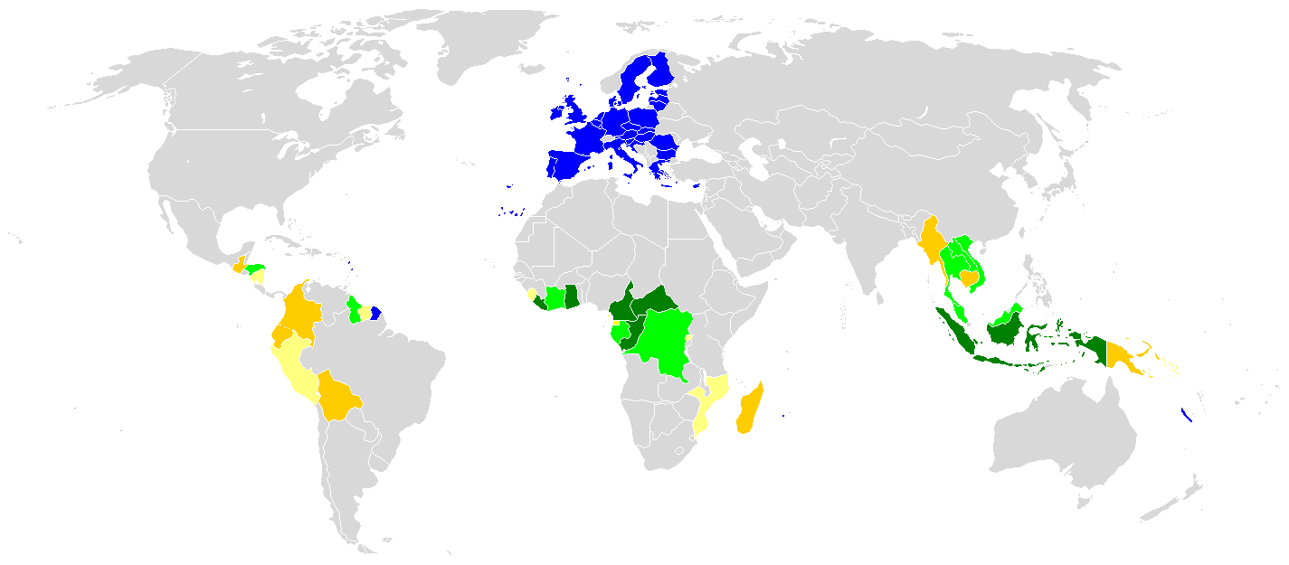















FLEGT licenses (not yet)
System development
Formal negotiations
Entering into negotiations
Preparation, in-country consensus building
Introduction to VPAs
FLEGT VPA partner countries
Oct 2013
Laos
Honduras
Vietnam
Guyana
Malaysia
Thailand
Liberia
Indonesia
Cote d'Ivoire
Congo
C.A.R.
Cameroon
Ghana
Gabon
DRC

Slide 10
Other dialogues
China – bilateral coordination mechanism on FLEG
Russia – FLEGC sub-group
Brazil, India, part of environment dialogue
Australia, US, Japan, Korea – ad hoc
Trade agreements: Central America, Peru and Colombia
Notes:
10

Slide 11
European Actors
Council of Ministers (Member States)
  Co-legislator FLEGT Regulation and EU Timber Regulation
  Negotiation mandate to European Commission
  Approves VPAs
Notes:
11

Slide 12
European Actors
FLEGT Committee/ Expert Group
  Approves secondary legislation
  Approves amendments to VPA annexes
  Coordination of implementation of FLEGT and EU Timber Regulations
Notes:
12

Slide 13
European Actors
European Parliament
  Co-legislator FLEGT Regulation and EU Timber Regulation
  Role in approval of some secondary legislation
  Parliamentary Questions and hearings
Notes:
13

Slide 14
European Actors
NGOs and private sector federations
  Inputs in formal consultation processes
  Influence positions of Member States and European Parliament
  Not allowed to be part of EU negotiating teams
  Important interlocutors with FLEGT partners
Notes:
14

Slide 15
FLEGT – 10 years on
Unique construction – trade as an entry point for forest governance reform
Moving away from donor-recipient relationship
ENV-DEVCO co-lead
FLEGT Action Plan not just VPAs
Trade, environment, human rights, international law, EU implementation
Process is important and enriching, but time consuming
After 10 years – need to show FLEGT licensed timber!
Stay for FLEGT project coordination Weds and Thurs..
Notes:
15

