Slide 1
Challenges in building national support and agreement
How to support stakeholders
to organise themselves

Slide 2

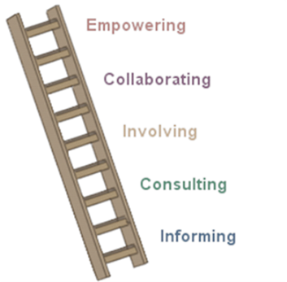
The objective
Consultation?
Participation?
Getting stakeholders together to inform them about the process (and to ask them what they think) does not automatically lead to meaningful engagement
‘Participation ladder’ as adapted by FERN from Arnstein, Sherry R. "A Ladder of Citizen Participation," JAIP, Vol. 35, No. 4, July 1969, pp. 216-224.

Slide 3
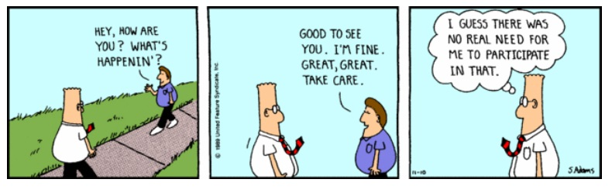
Dos and Don’ts and Challenges
 Encourage
understand the context
- build trust
 Open the political space
 Support (financially, but also technically!!)
How will groups be fairly represented?
Which individuals/groups will develop drafts for different VPA elements?
How will drafts allow for stakeholder input? What stakeholders? What process?
Will each stakeholder group be responsible for their own draft/list of priorities? Or will they provide ideas on existing drafts?
How do internal stakeholder processes and discussions link to formal VPA negotiations? How are positions developed? What happens if there is disagreement?
What are the timeframes to complete the work?
How are final decisions communicated?
 Lead/organise/tell how to organise
 Underestimate time needed
 Influence positions (be wary of who are your partners)

Slide 4
Thank you for your attention

