Slide 1
Broader Governance in the VPAs
FLEGT Training
October 8, 2013
Brussels

Slide 2
REALITY CHECK
AMBITIOUS AGREEMENTS
DIFFICULT TO IMPLEMENT
TAKES SO LONG FOR FLEGT LICENSES
        ..... Look what is behind the license

Slide 3
Changes in governance take time
Monumental changes in the way of doing business : political process, rules of the game changing, space for dialogue and new voices, capacities being strengthened for newcomers to participate in dialogue
No annex on governance – depends on the ingenuity of stakeholders to agree and integrate
Unbelievable potential – if armed with knowledge : need to organize voice and know where are the opportunties

Slide 4
Different governance interests frame VPA dialogue and decisions
GOVERNMENT
    Realize full economic value of the resource
    Reinforce forest management objectives
    Formalize/legalize informal sector
    Domestic market
    Improve country image and sector credibility
    Advance forest sector reform agenda
PRIVATE SECTOR
    Secure and expand markets
    Level the playing field by reducing unfair competition from illegal logging
    Small forest operators want to be able to compete with big companies
    Clarify requirements and control procedures to reduce possibilities for corruption
    CIVIL SOCIETY
    Voice and participation
    Community rights /indigenous peoples rights
    Enforce existing legislation
    Clarify user rights and operator responsibility to communities
    Collection and redistribution of forestry related fees to communities
    Accountability and transparency in decision making (land use allocation)

Slide 5
How are these interests framed in the VPA?
    Intricately embedded directly in the Agreement
    VPA process : national, regional, international
    Platform for governance issues beyond VPA commitments
        Increased accountability on permit allocation (Liberia and Ghana)
        JIC provide platform for dialogue on forest code reform (CAM)
        Forest conversion for oil palm (CAM)

Slide 6
Embedded in the Agreement:
FLEGT Licenses: what stands behind them
Consensus on legality definition VOICE, PARTICIPATION, LEGISLATIVE CLARITY
Roles, responsibilities and procedures with various government agencies and other TLAS actors developed and adopted INSTITUTIONAL CLARITY/ACCOUNTABILITY
New legislation drafted, consulted and enacted in order for FLEGT licensing to occur LEGISLATIVE CLARITY
Government and private sector capacity to verify legal compliance strengthened CAPACITY BUILDING
All businesses engaged in harvesting/producing/transporting/exporting being verified for legal compliance LEVEL PLAYING FIELD
Legality assurance system is regularly audited by third party CREDIBILITY
Violations addressed and treated ENFORCING THE LAW,
Civil society independent observation reports addressed ACCOUNTABILITY
Notes:
Clarification of institutional responsibilities
→ better understanding of specific roles
→ minimization of overlap
→ clarity on accountability

Slide 7
Legislative clarity - example
INDONESIA: 900+ forest laws: confusing, duplication, incoherences
Substantial clarification of forest legality because of the development of legality definitions in VPA negotiations which have condensed complex laws down to simpler auditable indicators of legality.
Thus FLEGT legality definitions now even being adopted by SFM schemes, and by most private sector legality verification schemes.
This FLEGT interpretation of legality focused on the core indicators of legal harvesting, and as such it is a huge help to the trade which they have largely welcomed.

Slide 8
Embedded in the Agreement: Broader VPA Commitments
Making information public
      Annex reflecting different stakeholders views on what to put in public domain. Oppportunity for different stakeholders to make process/procedures/decisions transparent and hold sector to account.
Legislative and policy reform
      fixing incoherence, bringing clarity, securing stakeholder interests
Independent observation:
      Securing participation and oversight to ensure accountability (IDN, ROC)

Slide 9
Legislative Reform - Examples
Ghana
Policies to address illegal logging on the domestic market developed and agreed
Liberia:
5 regulations being developed: chainsaw logging; abandoned logs; transit, imported and confiscated timber; third party access and use of resources in the concession areas
Cameroon:
Legal texts developed and signed to address verification, licensing, non compliances)
Min of Labor/environment procedures – legislation awaiting signature
Reform of the forest law ongoing in Cameroon
RoC
legislative reform process on-going; new support being mobilized to push for a better process and more stakeholder participation

Slide 10
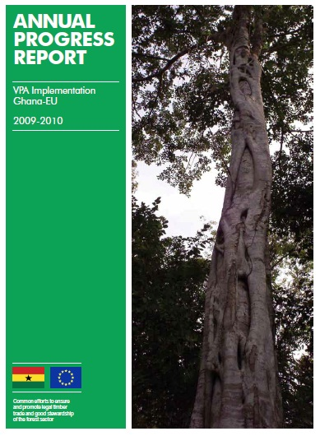
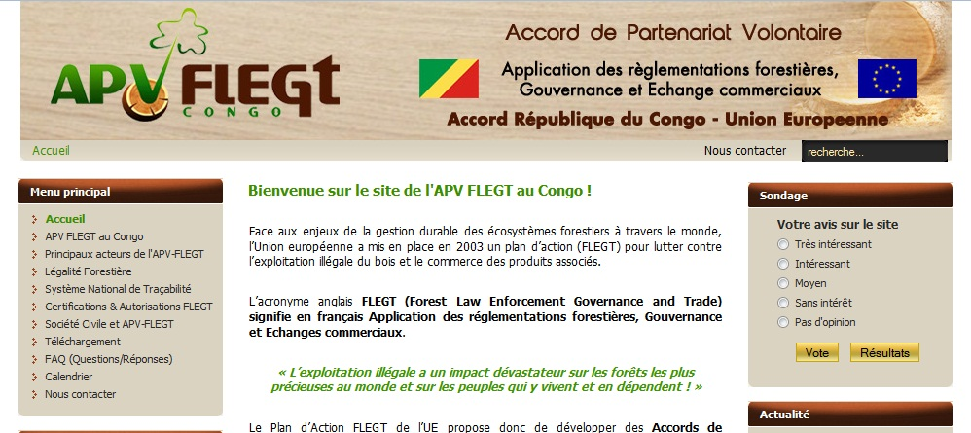
Transparency and accountability
Governments communicating more/better towards stakeholders and the public:
    VPA website and bi-monthly newsletter in Republic of Congo;
    Annual report in Ghana and pre-annual report in Cameroon;
    VN and DRC putting legality grids online

Slide 11
VPA Process
Opens up & legitimates new political space for voices with no influence before
Visibility of process increases pressure for more transparency, balanced representation, decision making process
Process reaches beyond national borders →Peer review and regional dialogue
Bilateral nature of VPA : visibility, raises the stakes
Mechanism to raise governance issues beyond VPA reach --JIC
Notes:
Generates space
Raises the stakes
Transparent
Member of a club – peer review and pressure
National and international

Slide 12
Broader Governance needs space/support
The process is political and framed by political stakes (not a project)
Power relationships changing
Not a project that one oversees or controls
Accompanying a process as a partner
Management more complex
Takes time and resources
Governance needs space to evolve

Slide 13
Thank you
EU FLEGT Facility

