Slide 1
V-Legal/FLEGT Shipment Test
Key lessons from processing FLEGT licences in the EU
Thomas PICHET, EFI
October 2013
Based on a study by Gunther Hentschel

Slide 2
Shipment test details
17 Indonesian exporters and 29 EU importers
  Plywood, joinery, mouldings, paper, furniture
5 participating EU Member States
  Cyprus, Denmark, Germany, Netherlands, UK
Competent Authorities, Customs, Agents, Forwarding Agents, Importers
Test-run only, legal provisions will apply once the VPA is operational
Objective: Assess processes, capacity and effectiveness of actors involved in handling FLEGT licences

Slide 3





Issuance of V-Legal/FLEGT licences
Min. of Trade
Verification Body
EU Customs
Customs
SVLK/TLAS online
Competent Authority
Exporter
Importer
Notes:
Based on LIU chart. Annex IV of the VPA actually specifies 6 licences (not 7)

Slide 4
Role of the importer
Forward the “Original” and “Copy for EU Customs Authority” to the FLEGT Competent Authority for verification of the validity and authenticity of the licence
Insert "FLEGT" and the licence number in box 44 of the Single Administrative Document for customs declaration
Most likely forwarding agents will handle this administrative process on behalf of the importer

Slide 5
Role of the Competent Authority
Verification of the validity and authenticity of the FLEGT licence
Where necessary, physical checks will be carried out (may be delegated to customs in certain cases)
Communication with LIU Indonesia in case of any concerns regarding the validity of the licence or missing information
Provision of the FLEGT Licence approved by the Competent Authority to the Customs Authority
CAs need 1-3 days to process the licences

Slide 6
Role of EU Customs
Verification of the import consignments being accompanied with FLEGT licences
Verification of the FLEGT Competent Authority having approved the FLEGT licence
Potential physical checks initiated by the CA
Release products for free circulation according to normal procedures

Slide 7
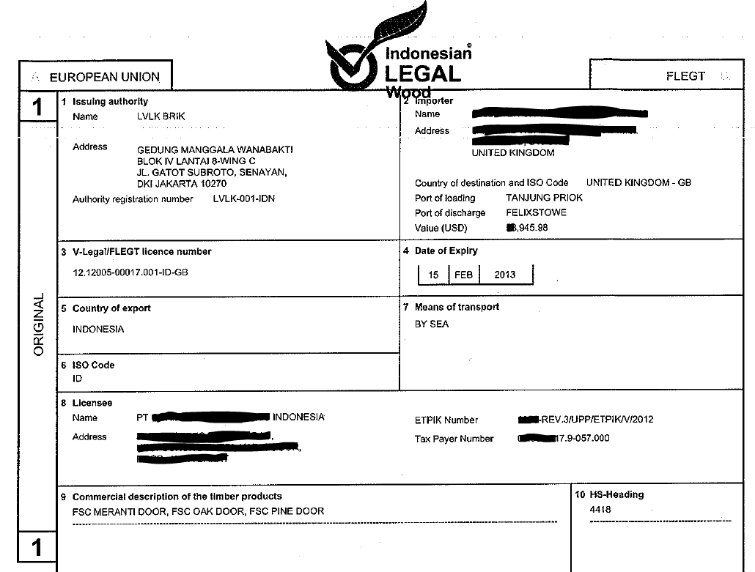

Slide 8
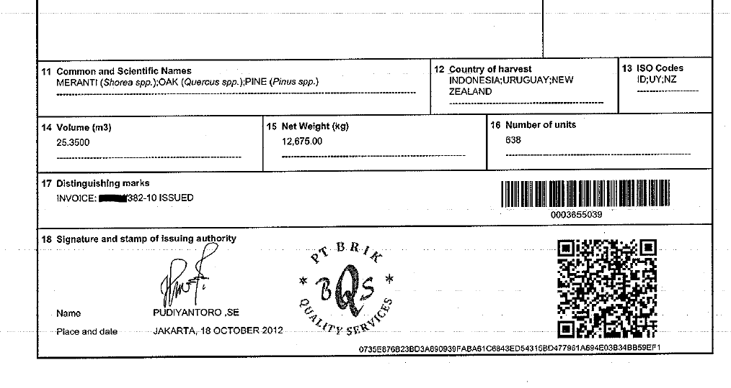

Slide 9
Issues with the shipping process
Consignment being split up into different vessels/ transport batches (→ volumes do not match, 1 licence for 2 Custom declarations)
The recipient of the goods changes during the shipping (→ the importer does not match)
The port of destination changes (→ the port and/or country of destination do not match)

