Slide 1
Environment and climate change in development cooperation
Integrating through monitoring and evaluation – module 8
Notes:
Module 9: Addressing environment and climate change through monitoring and evaluation
- About monitoring and evaluation (Terminology/key elements)
- Key areas of interventions (Key aspects to monitor, Selection of indicators, Institutional and capacity issues, Performance based monitoring)
- Targeting the key areas of interventions through the cycle and different aid modalities (Programming – mid-term review, SPSP, BS, projects) [possibly address these as going through the key areas of interventions and then wrap up]
- Tools and approaches (e.g. Rio Markers)
- Resources

Slide 2
Structure
Monitoring & evaluation – terminology - concepts
What to monitor and why
How to monitor and examples of indicators
Rio markers
Resources
Notes:
Expansion
Examples:
Groupwork / discussion:

Slide 3
Terminology
Monitoring – linked to results based management – linking outcomes to outputs
Evaluation – looking at impact and effects
Rio markers – a special means of monitoring commitments to the 3 RIO conventions
Notes:
Expansion
Monitoring can be defined as a continuing function that aims primarily to provide the
management and main stakeholders of an ongoing intervention with early indications
of progress, or lack thereof, in the achievement of results. An ongoing intervention
might be a project, programme or other kind of support to an outcome. (UNDP)
E v a l u a t i o n is a selective exercise that attempts to systematically and objectively assess
progress towards and the achievement of an outcome. Evaluation is not a one-time
event, but an exercise involving assessments of differing scope and depth carried out at
several points in time in response to evolving needs for evaluative knowledge and learning
during the effort to achieve an outcome. All evaluations—even project evaluations
that assess relevance, performance and other criteria—need to be linked to outcomes as
opposed to only implementation or immediate outputs. UNDP
Examples:
Groupwork / discussion:

Slide 4
Mainstreaming backbone
Policy
Budget
Action
Monitoring
Notes:
Expansion
Examples:
Groupwork / discussion:

Slide 5
Monitoring
Not all that can be counted.. counts
Not all that counts…
can be counted
Albert Einstein
Notes:
Expansion
Examples:
Groupwork / discussion:

Slide 6
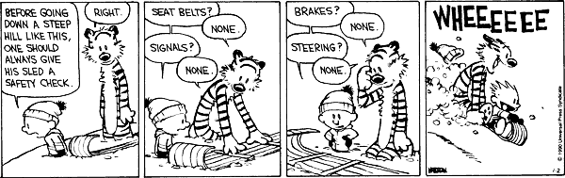
Good intentions on M&E
Notes:
Expansion
Examples:
Groupwork / discussion:
Ask – who has ever seen a baseline done?
Who has been involved in M&E with no Baseline or where one was foreseen but not completed?

Slide 7
The big picture – domestic accountability
Ministry of Finance
Line / Sector
Ministries
Cabinet
Front Line
Service
Providers
Parliament
Donor
Client/Citizen
Notes:
Expansion
Examples:
Groupwork / discussion:
Example of Anthrax Vaccine in Zambia
Where was the problem: was is that there was no money at MoA ..why had they asked MoF but not got? Did MoF not get approved by the Cabinet due to budget costs? Of if there was money was it not directed as planned by MoA or the front line Agencies? Or did it get purchased but not distributed? Or was there a mistake in the ordering of supplies (wrong type or too late) ? Where does the accountability lie?
We also have the small picture

Slide 8
Monitoring- domestic accountability
Better when
Inclusive (watch power relation)
Feedback loop
Jointly done to reduce costs/incentive for action
Linked to accountability (voting with your wallet systems)
Notes:
Expansion
a) Securing inclusive performance monitoring: Civil society can play an important role in strengthening sector performance. However, power relations affect performance monitoring in the ENR sector. Disputed claims over valuable environmental assets (such as forests and mineral wealth) can constrain monitoring. Gender issues need to be highlighted in the performance monitoring system in recognition of the important gender dimension of natural resources use and management. Systematic reporting to the multilateral environmental agreements can sometimes help in enhancing national approaches. Monitoring should lead to improvements in sector management and enhanced accountability. Performance monitoring is different to environmental monitoring; although at the impact level there is a convergence in indicators. Development of sector performance indicators requires the involvement of all sector stakeholders, under the leadership of government.
b) Support joint monitoring databases not only as a means towards reducing the transaction costs of aid, but also as a vehicle towards improved inter-sectoral coordination. This is
especially relevant in rural development, which depends on coordinated action and synergies across sectors.
C) Lessons learnt from establishing and maintaining M&E systems: One lesson to be learnt is to make the maximum use of existing reporting systems, such as those established under the Convention on Biological Diversity (CBD). Similarly, much can be gained from experience with sector programmes in other sectors. Perhaps the most relevant is the agriculture and rural development sector.
Securing inclusive performance monitoring
Role of civil society
Influence of power relations on monitoring
Incentives to measure and feedback
Strengthening accountability from below
Supporting joint monitoring
Reduces transaction costs
Allows inter-sectoral coordination
Examples:
Groupwork / discussion:

Slide 9
What to monitor, and why?
Aspect to monitor | Rationale for monitoring
State of the environment – natural resources and environmental pollution | Make well informed decisions
Climate variability and change, impacts and vulnerabilities | Make well informed decisions Support adaptive management
Policy and institutional change | Promote the institutionalisation of climate change mainstreaming Enhance the transparency and accountability of the mainstreaming process
Policy/Strategy implementation and outcomes | Strengthen commitment to the objectives set in policies and strategies Stimulate the achievement of tangible outcomes
Notes:
Expansion
Monitoring climate change – strengthen the meteorology systems; note the new patterns emerging and new tools
Monitoring environment – strenghten env systems; note institutional performance and collaboration – SOE reports
Monitoring policy and insitutional change – integration in policies, plans and practice; Look at institutional aspects the 7 ”s”
Monitoring policy outcomes – follow the money (what more is being spent?); look at regulatory practices; impacts are in areas such as criteria of the SOEs; resiliance and green jobs
Examples:
Groupwork / discussion:

Slide 10
What to monitor and why - Role of PAFs in relation to budget support
Progress measured against the PAF’s criteria and targets provides opportunities for policy dialogue in the context of budget support
  Increasingly, the PAF associated with development and poverty reduction strategies is likely to include indicators and targets associated with climate change adaptation, disaster risk reduction, energy efficiency, green economy etc.
  In the case of EC budget support, performance against a chosen sub-set of criteria and targets also determines the final amount of disbursements
  Performance Assessment Framework
Notes:
Expansion
Examples:
Groupwork / discussion:

Slide 11
What to monitor and why - Levels of measurement
Indicators/ milestones in PAF of climate change/ environment but also in:
National and sectoral development strategies and programmes
Sub-national (e.g. regional, local) development plans
Individual projects (logical framework)
Ultimate objective of integration!
Notes:
Expansion
Examples:
Groupwork / discussion:

Slide 12
How to monitor - Integration in the national monitoring systems
Environment and climate monitoring should be integrated into wider national and specific development monitoring systems
Strengthen and adapt existing monitoring systems (incl. statistical systems) to integrate climate change and environment
Build on existing institutions and sources of information...
... but adapt where necessary statistical systems and data sources
Notes:
Expansion
Examples:
Groupwork / discussion:

Slide 13
Illustration: Seychelles Climate Change Support Programme (1)
Overall objective:
‘Enhance the sustainability of Seychelles development
and economic reforms through mitigation policies and building resilience for adaptation to climate change impacts’
Expected results:
effective mainstreaming of climate change in national development policies and in key sector strategies and action plans
a solid institutional and legal framework in the energy sector integrating the Clean Development Mechanism
EU support provided under GCCA framework in addition to existing GBS
Notes:
Expansion
Info. from GCCA Action Fiche – GBS of 2 million Euro in addition to 16 Million already provided.
CDM integration aims to ‘enable wide participation and investment in renewable energies, innovation and access to / transfer of technology, improved energy efficiency, and the establishment of an active carbon credits market in Seychelles’.
The EU disburses its second tranche under the three-year-long Climate Change Support
Programme (SCCSP) financed by the EU Global Climate Change Alliance. The approval was made against
the backdrop of significant steps undertaken by the government in 2011 in the
implementation of the National Climate Change Strategy including mainstreaming of the Climate Change Strategy through
development and adoption of key sector strategies and action plans and formulation of
the Seychelles Energy Bill which is scheduled to be enacted this year.
Alessandro Mariani, head of delegation and ambassador, expressed his satisfaction with
Seychelles’ capacity to mainstream sustainable development in the economic reform
agenda.
Examples:
Groupwork / discussion:

Slide 14
Illustration: Seychelles Climate Change Support Programme (2)
The EU disburses its second tranche under the three-year-long Climate Change Support Programme (SCCSP).
The approval was made against the backdrop of significant steps undertaken by the government in 2011 in the implementation of the National Climate Change Strategy including mainstreaming of the Climate Change Strategy through development and adoption of key sector strategies and action plans and formulation of the Seychelles Energy Bill which is scheduled to be enacted this year.
Alessandro Mariani, head of delegation and ambassador, expressed his satisfaction with Seychelles’ capacity to mainstream sustainable development in the economic reform agenda.
The Seychelles Nation newspaper 20.07.2012
Performance monitoring and criteria for disbursement:
Tranche | Criteria
2010 | Approval by Cabinet of the National Climate Change Strategy. Approval by Cabinet of the Energy Policy.
2011 | Climate change mainstreamed in at least 3 key sectors of EMPS. Approval by Cabinet of Energy Bill allowing for CDM projects.
2012 | Climate change mainstreamed into all sectors of EMPS. Amendments to the Town and Country Planning Act and Environment Protection Act coherent with the SNCCS, approved by Cabinet. Enactment of the Energy act.
Examples of how
EMPS = Seychelles Environment Management Plan
SNCCS = Seychelles National Climate Change Strategy
Notes:
Expansion
Examples:
Groupwork / discussion:

Slide 15


Examples of indicators
Good governance
Improved media coverage of environment
Improved participation of public and environmental civil society in decision-making
Number of corruption cases related to the management of natural resources (forests, protected areas), licensing of concessions and issuance of permits of exploitation
Energy
% of energy produced which is renewable
Existence and level of subsidies in fossil fuel (USD)
Greenhouse gas emission per capita divided by the Human Development Index
Notes:
Expansion
Energy
-% of energy produced which is renewable
-Existence and level of subsidies in fossil fuel (USD)
-Existence and level of incentives for renewable energy (USD)
-Greenhouse gas emission per $1,000 GDP
-Greenhouse gas emission per capita divided by the Human Development Index
-Energy use (kg oil equivalent) per $1,000 GDP
-Proportion of population (women/men) using solid fuels
Examples:
Groupwork / discussion:
One or perhaps two sectors are chosen, then for those, participants are asked to suggest indicators – these can be compared to the short and long list

Slide 16
Buzzing - Indicators
Define good indicators for the following themes
Governance
Energy
Agriculture
Water
Food security
Transport
Health
Education
Notes:
Expansion
Energy
-% of energy produced which is renewable
-Existence and level of subsidies in fossil fuel (USD)
-Existence and level of incentives for renewable energy (USD)
-Greenhouse gas emission per $1,000 GDP
-Greenhouse gas emission per capita divided by the Human Development Index
-Energy use (kg oil equivalent) per $1,000 GDP
-Proportion of population (women/men) using solid fuels
Examples:
Groupwork / discussion:
One or perhaps two sectors are chosen, then for those, participants are asked to suggest indicators – these can be compared to the short and long list

Slide 17
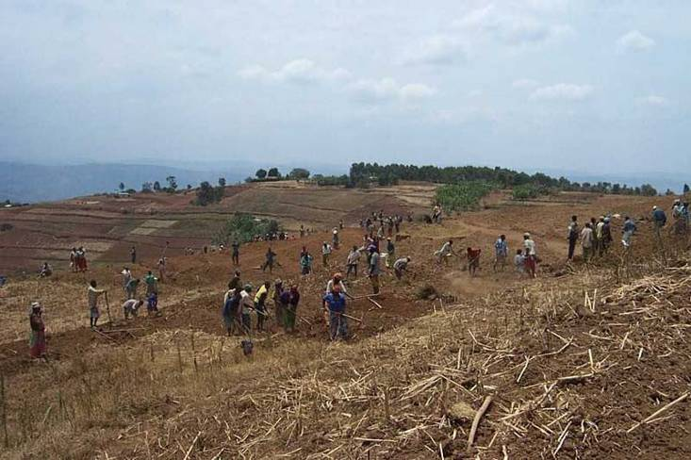
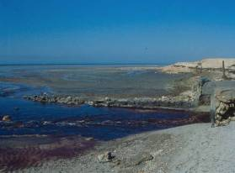
Examples of indicators
Agriculture
Economic losses in agricultural productivity due to environmental degradation (soil erosion or desertification)
Agriculture-related greenhouse gas emissions (CO2 equivalent-tons/year)
Intensity of use of water in agriculture
Intensity of pesticide and fertiliser use
Fish stocks
Surface of land used by agriculture
Share of area occupied by organic farming in total utilised agricultural area
© EC
Notes:
Expansion
Economic losses in agricultural productivity due to environmental degradation (soil erosion or desertification)
Agriculture-related greenhouse gas emissions (CO₂ equivalent-tons/year)
Intensity of use of water in agriculture
Intensity of pesticide and fertiliser use
Fish stocks
Surface of land used by agriculture
Share of area occupied by organic farming in total utilised agricultural area

Slide 18
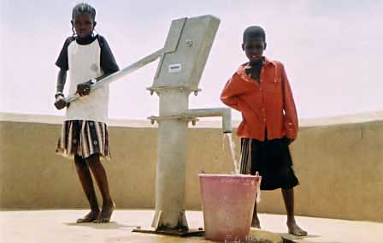
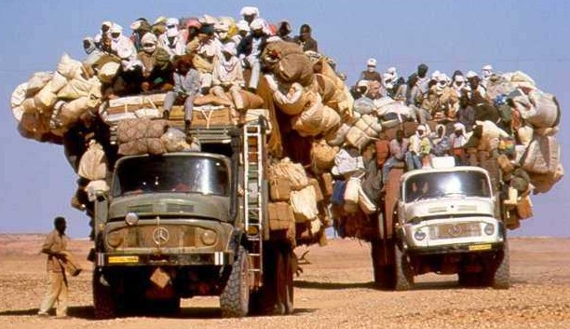
Examples of indicators
Water
Water efficiency in domestic water supply and agricultural water use
Extent of waste treatment through septage management and sewerage plants
Adoption of the Integrated Water Resources Management (IWRM) approach
Transport
Greenhouse gas efficiency of the transport sector (T.km/CO2 emitted)
Level of Investment in public transport (USD/year)
Number of km of roads that are climate proofed
Notes:
Expansion
Maintenance of roads is much related to how well they will later cope with climate change/ floods
Examples:
Groupwork / discussion:

Slide 19
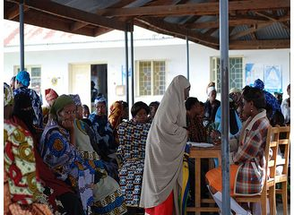

Examples of indicators
Health
Prevalence of vector-borne diseases (malaria and dengue fever) in areas previously not affected due to climate change
Number of victims of natural disasters and climate related extreme events (floods, droughts, heat waves)
Proportion of hospitals with an adequate waste management system
Education
% of school children with access to a water/sanitation in schools (1:40, separate girls/boys)
Number of school teachers trained in environment and climate change integration
Integration of environment, climate change and disaster risk reduction in school and university curricula
Notes:
Expansion
Examples:
Groupwork / discussion:

Slide 20
Rio markers (donor perspective)
Since 1998 OECD/DAC has monitored commitments to supporting the 3 Rio conventions : Biodiversity; Desertification; Climate
All aid activity is marked as either
targeting the Conventions as a 'principal objective' or
a 'significant objective', or
not targeting the objective.
A key concern is that the measurement should not inadvertently work against integration/ mainstreaming by encouraging standalone activities.
Principal = UNFCCC objectives are stated and the activities would not otherwise have been undertaken.
Significant = have other prime objectives, but they have been formulated or adjusted to help meet climate concerns.
more
Handbook on climate markers: http://www.oecd.org/dataoecd/56/18/48785310.pdf
Notes:
Expansion
CRIS = common Relax Information System
(please say in comments that all projects/programmes should mark these in CRIS!)
Examples:
Groupwork / discussion:

Slide 21
Definitions of Rio markers - adaptation
It intends to reduce the vulnerability of human or natural systems to the impacts of climate change and climate-related risks, by maintaining or increasing adaptive capacity and resilience.
e.g. information, capacity development, planning and the implementation of climate change adaptation actions.
An activity should be
classified as adaptation related
(score Principal or
Significant) if:
the climate change adaptation objective is explicitly indicated in the activity documentation;
And
b) the activity contains specific measures targeting the definition above.
Carrying out a climate change adaptation analysis, either separately or as an integral part of agencies’ standard procedures, facilitates this approach.
CRITERIA
FOR ELIGIBILITY
An activity is eligible for the climate change adaptation marker if:
Source: Oecd CRS directives February 2010
Notes:
Expansion
Note also for biodiversity
Examples:
Groupwork / discussion:

Slide 22
Definitions of Rio markers - mitigation
An activity should be
classified as mitigation related
(score Principal or
Significant) if:
It contributes to the objective of stabilisation of greenhouse gas (GHG) concentrations in the atmosphere at a level that would prevent dangerous anthropogenic interference with the climate system by promoting efforts to reduce or limit GHG emissions or to enhance GHG sequestration.
The activity contributes to (one or more) :
a) the mitigation of climate change by limiting anthropogenic emissions of GHGs, including gases regulated by the Montreal Protocol; or
b) the protection and/or enhancement of GHG sinks and reservoirs; or
c) the integration of climate change concerns with the recipient countries’ development objectives through institution building, capacity development, strengthening the regulatory and policy framework, or
research; or
d) developing countries’ efforts to meet their obligations under the Convention.
CRITERIA
FOR ELIGIBILITY
An activity is eligible for the climate change mitigation marker if:
Source: Oecd CRS directives February 2010
Notes:
Expansion
Examples:
Groupwork / discussion:

Slide 23
Rio markers in CRIS
The Common External Relations Information System
The role of Rio Markers in CRIS
Notes:
Expansion
Examples:
Groupwork / discussion:

Slide 24
Examples of what counts
Examples of activities that qualify for score “principal” under the climate change adaptation marker
Enabling activities
Improving weather and climate information systems.
Supporting climate change adaptation-specific policies, programmes & plans.
Policy and legislation
Strengthening the capacity of national institutions, including Finance and Planning Ministries, responsible for coordinating and planning adaptation activities and the integration of adaptation into planning and budget processes.
Making Disaster Risk Reduction (DRR) information and tools more accessible for climate change adaptation negotiators and managers – promoting the role of DRR in climate change adaptation policies, strategies and programmes.
Encouraging systematic dialogue, information exchange and joint working between climate change and disaster reduction bodies, focal points and experts, in collaboration with policy makers and development practitioners.
Notes:
Expansion
Examples:
Groupwork / discussion:

Slide 25

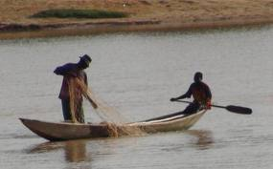

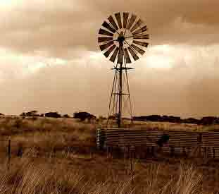
Examples of what counts (2)
Agriculture
Fisheries
Forestry
Water and Sanitation
Health
Energy
Notes:
Expansion
Examples:
Groupwork / discussion:

Slide 26
Activity 1
Mainstreaming environment and climate change in M&E
In small groups around a particular country/ sector:
Task 1 – Look at the indicators of your particular country/sector
Task 2 – do they take advantage of the opportunity to integrate environment and climate change – do they look at green economy
Task 3 –What action can still be taken to further integrate environment and climate change into the performance management system?
Notes:
Expansion
Examples:
Groupwork / discussion:

Slide 27
Key Messages on M&E systems
Keep it simple: Only when working for 3 years it can be made more sophisticated
Improve rather than replace existing systems and data sources
Consider to select indicators where there is quality data
Ensure cost effectiveness: M&E needs to be in proportion
Strengthen accountability: Allocate responsibilities
Systems should be independent to enhance credibility
Focus on the end use
Notes:
Expansion
Management needs to make time
Examples:
Groupwork / discussion:

Slide 28
Module 9 - recap
Setting indicators and monitoring is one of the main tools for mainstreaming environment and climate change
Monitoring reveals the difference between words (plans) and actions – it is an accountability tool
What to monitor – SOE – Climate – Policy /institutional change – policy outcomes
Systematically use Performance Assessment Frameworks
Rio markers are an important tool ... and mandatory
Notes:
Structure
Monitoring and evaluation – terminology - Concepts
Monitoring for accountability
What to monitor and why
Examples of how to monitor
Rio markers
State of the environment – natural resources and environmental pollution
Climate variability and change, impacts and vulnerabilities
Policy and institutional change
Policy/Strategy implementation and outcomes

Slide 29
Resources
General information on integration and indicators
Special Publications on Impact Assessment – IAIA
http://www.iaia.org/publications-resources/downloadable-publications.aspx
Mainstreaming and indicators – IIED
http://pubs.iied.org/pdfs/17504IIED.pdf
Indicators covering all sectors – WB
http://data.worldbank.org/indicator
Specific M&E indicators for adaptation – WB
http://climatechange.worldbank.org/content/note-8-selection-specific-me-indicators-adaptation
Results based M&E – OECD
http://www.oecd.org/dataoecd/23/27/35281194.pdf
Rio markers tool kit
Reporting on the Rio Conventions – facilitating national reporting
http://rioconventionsreporting.net/category/reporting/

Slide 30
Examples of what counts
Agriculture
Promoting diversified agricultural production to reduce climate risk (e.g. growing a mix of different crops and different varieties of each crop).
Soil and water management to increase water availability in areas experiencing increased water stress due to climate change.
Water and sanitation
Monitoring and management of hydrological and meteorological data for decision making on impacts of climate change (possible synergy for early warning systems or agro-meteorological information systems).
Strengthening capacity for integrated planning and management of water resources, in response to climate change, including supply, demand and water quality issues.
Promoting water conservation and rainwater harvesting in areas where enhanced water stress due to climate change is anticipated.
Notes:
Expansion
Examples:
Groupwork / discussion:

Slide 31
Examples of what counts
Fisheries
Mapping changes in the range of fish species and strengthening the monitoring of fish stocks to determine the impacts of climate change.
Forestry
Restoration of former forest areas utilising natural seed banks and existing plants, in order to reduce vulnerability to the impacts of climate change.
Securing local and indigenous people’s rights and systems for a sustainable and long-term utilisation of the forest in order to increase resilience to climate change.
Promoting sustainable forest management and adopting harvesting techniques that reduce soil erosion and exposure to wildfires, and promote the conservation of biodiversity in order to safeguard forest ecosystems from the impacts of climate change.
Notes:
Expansion
Examples:
Groupwork / discussion:

Slide 32
Examples of what counts
Health
Developing or enhancing systems for monitoring drinking water, food and air quality, in areas affected by higher temperatures, floods and rising sea level.
Strengthening food safety regulations, notably in terms on microbiological quality, avoidance of contact with pest species, conservation duration and conservation temperatures, in areas affected by higher temperatures.
Energy
Strengthening of energy transmission and distribution infrastructure to cope with the impacts of climate change.
Design and construction of measures to protect critical energy infrastructure from the impacts of floods and storms.
Notes:
Expansion
Examples:
Groupwork / discussion:

Slide 33
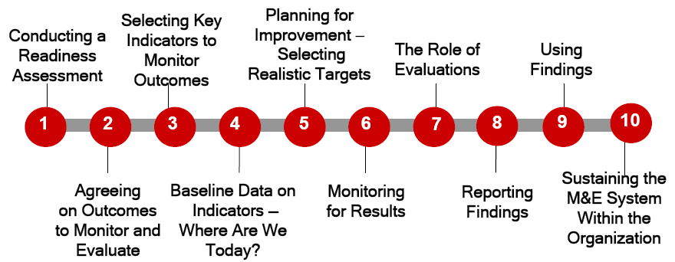
Ten step process for results based M&E theory is easier than practice
Plan
Implement
Source: http://www.oecd.org/dataoecd/23/27/35281194.pdf
Notes:
Expansion
Examples:
Groupwork / discussion:

Slide 34
Assessing an M&E system
  Is there clarity over the integration objectives that will be monitored ?
  Have the links between sector inputs and outputs, outcomes and impacts been mapped?
  What is the involvement of non-state actors in performance monitoring of the sector?
  What can be learned from existing monitoring and evaluation systems?
  What feedback loops exist between performance monitoring and sector performance?
  Is the performance monitoring framework producing information sector actors are calling for?
Notes:
Expansion
Examples:
Groupwork / discussion:

