Slide 1
Environment and climate change in development cooperation
Approaches and Tools
Module 5

Slide 2
Structure of module 5
Greening the operations cycle
Process related tools
Selected key tools for economic analysis
Selected key tools for environmental assessments
Notes:
Expansion
Examples:
Groupwork / discussion

Slide 3
Operations cycle
Cross cutting approaches
Programming
Evaluation
Closure, Follow-up, Future Dialogue
Identification
Policy dialogue
Awareness raising
Increasing institutional capacity
Implementation
Formulation
Notes:
Expansion
Examples:
Groupwork / discussion

Slide 4
A menu of mainstreaming actions
Policy dialogue – consultations
Awareness raising at all levels
Increasing institutional capacity
Applying specific Tools
Policy and sector Reviews
Fund studies for data/ information
Institutional incentives to mainstream
CEP / SDA
Economic analyses – CEA, CBA, TEEB
EIA - Environmental Impact Assessment
SEA - Strategic Environmental Assessment
CRA - Climate Risk Assessment
Others
National – Sector Indicators
Fund activists and civil society
Fund capacity development
Budgets
Fund activities to demonstrate benefits
Provide TA to strengthen capacity
Notes:
But first
understand the context
Understand the incentive environment and the political economy

Slide 5
Tools supporting awareness raising and partnership building
Assessing evidence
Engaging key actors
Awareness raising & partnership building
Vulnerability and adaptation assessments
Communication & advocacy strategy
Source: GCCA; adapted from: UNDP-UNEP (2010)
National consensus on and commitment to climate-resilient and low-emission development
Macro and meso economic analysis
Demonstration or pilot projects

Slide 6
Assessing evidence/Vulnerability and adaptation assessment
Typically focus on three units of analysis:
  Places: land, water, ecosystems, ‘natural capital’ and ‘built infrastructure’
  People: individuals, communities, ‘human capital’, livelihoods
  Institutions: sectors, organisations, how they relate to each other, ‘social capital’
It should assess both current & future vulnerability to determine possible adaptation measures
Assessing evidence
Engaging key actors
Vulnerability and adaptation assessments
Awareness raising & partnership building
Macro and meso economic analysis
Communication & advocacy strategy
National consensus on and commitment to climate-resilient and low-emission development
Source: Downing & Patwardhan (2004)
Demonstration or pilot projects

Slide 7
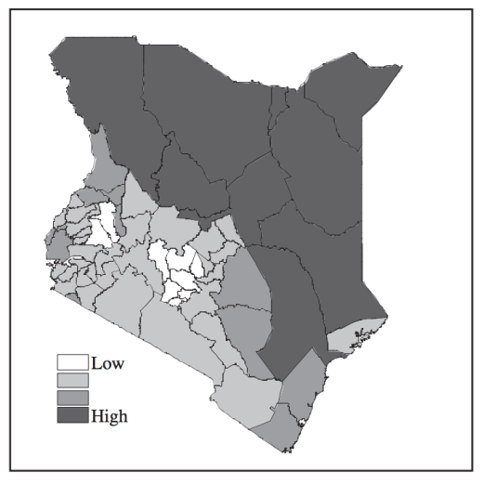
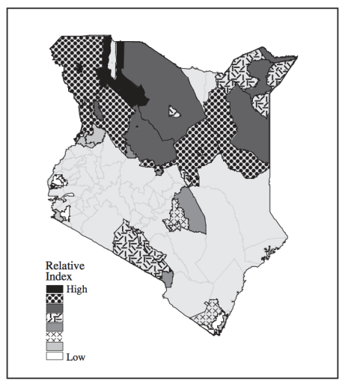
Vulnerability and adaptation assessment – Kenya food security
High food insecurity
Arid districts nothern Kenya
Low literacy
Low non-farm income
Low market access
Etc.
Relative drought risk by livelihood zone
Huge variation even within the more vulnerable districts
Source: Downing & Patwardhan (2004)

Slide 8
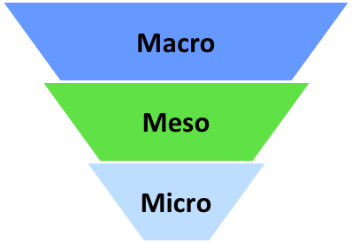
Assessing evidence / Economic analysis
A powerful tool for motivating policy makers to take action
  Macro level: Impact of present policies and alternatives; potential impact of ENV and CC on the economy and vice versa
  Meso level: Sub national governments, key and subsectors of the national economy
  Micro level: Analysis of project specific alternatives
The costs of inaction (climate-related losses) are compared with the net benefits of taking action (costs minus avoided losses)
The analysis should also consider the distribution of losses and benefits (among social groups, regions...)
Notes:
Macro level: e.g. GDP growth, public deficit and debt
Meso level: e.g. value added and employment in the tourism sector, impacts on some key infrastructure, impacts on health

Slide 9

Selected key tools for economic analysis
The Economics of Ecosystems and Biodiversity - TEEB
Cost Effectiveness Analysis - CEA
Cost Benefit Analysis – CBA
Public Expenditure Review (module 7)
Assessing evidence
Engaging key actors
Vulnerability and adaptation assessments
Awareness raising & partnership building
Macro and meso economic analysis
Communication & advocacy strategy
National consensus on and commitment to climate-resilient and low-emission development
Demonstration or pilot projects
Notes:
Expansion
Examples:
Groupwork / discussion

Slide 10
The Economics of Ecosystems and Biodiversity - TEEB
TEEB helps decision makers recognize, demonstrate and capture the values of ecosystems and biodiversity
TEEB acknowledges the plurality of values (including monetary, non monetary, ethical, aesthetic) which people hold for nature.
Ideally, TEEB will catalyst the development of a new economy reflec-ting the values of nature in public and private decision-making.
In Baoxing County, China, an ecosystem service mapping and modeling tool was used to design development zones that avoid areas of high ecosystem service provision and importance for conservation. This is helping local policy makers to integrate biodiversity and ecosystem service status into cross- sectoral, multi-objective land-use plans.
Notes:
The Economics of Ecosystems and Biodiversity (TEEB) is an international initiative to draw attention to the benefits provided by biodiversity (encompassing ecosystems, species and genes).
TEEB presents an approach that can help decision makers recognize, demonstrate and, where appropriate, capture the values of ecosystems and biodiversity (TEEB Synthesis, summarized in Box 1.4 below). TEEB acknowledges the plurality of values (including monetary, non monetary, ethical, aesthetic) which people hold for nature. Illustrated through the broad compilation of numerous country examples, TEEB illustrates many different options for better incorporating nature’s values in decision making: the objective of TEEB is to highlight the importance of sustainable use and conserv- ation of nature rather than reducing it to a commodity.

Slide 11
The Economics of Ecosystems and Biodiversity - TEEB
Review relevant policy initiatives and tailor TEEB to the country
Engage stakeholders, use policy makers’ priorities as starting point
Consider all relevant ecosystem services, prioritise
Carefully consider the study: Scope, parameters, assumptions, time horizons, scale
Biophysical information form the basis for socio-economic value data
Carefully choose policy options for analysis, outline pros and cons
Be a fair facilitator, consider all implications in a balanced manner
Use reviewers from different stakeholder groups, highlight omissions
Connect with ongoing debates on policies and plans for translating study results into relevant arguments.
Notes:
The Economics of Ecosystems and Biodiversity (TEEB) is an international initiative to draw attention to the benefits provided by biodiversity (encompassing ecosystems, species and genes).
TEEB presents an approach that can help decision makers recognize, demonstrate and, where appropriate, capture the values of ecosystems and biodiversity (TEEB Synthesis, summarized in Box 1.4 below). TEEB acknowledges the plurality of values (including monetary, non monetary, ethical, aesthetic) which people hold for nature. Illustrated through the broad compilation of numerous country examples, TEEB illustrates many different options for better incorporating nature’s values in decision making: the objective of TEEB is to highlight the importance of sustainable use and conserv- ation of nature rather than reducing it to a commodity.

Slide 12
The Cost-Effectiveness Analysis - CEA
The economically most efficient way to fulfil an objective.
Focus on the key result of an activity – for example climate impact mitigation.
Compares policies, programmes or projects.
Identifies the option to achieve a result at least cost.
Define the conditions for use of CEA (clear outcomes)
Evaluate the total cost of the programme
Measure the impact of the programme
Establish a costs-to-effectiveness ratio
Notes:
A presentation and discussion of the socio-economic context and the objectives
The first logical step for the appraisal is a qualitative discussion of the socio-economic context and the
objectives that are expected to be attained through the investment, both directly and indirectly. This
discussion should include consideration of the relationship between the objectives and the priorities
established in the Operational Programme, the National Strategic Reference Framework and consistency
with the goals of the EU Funds. This discussion will help the Commission Services to evaluate the
rationale and policy coherence of the proposed project.
􀀹 The clear identification of the project
Identification means that the object is a self-sufficient unit of analysis, i.e. no essential feature or
component is left out of the scope of the appraisal (half a bridge is not a bridge); indirect and network
effects are going to be adequately covered (e.g. changes in urban patterns, changes in the use of other
transport modes) and whose costs and benefits are going to be considered (‘who has standing’?).
􀀹 The study of the feasibility of the project and of alternative options
A typical feasibility analysis should ascertain that the local context is favourable to the project (e.g. there
are no physical, social or institutional binding constraints), the demand for services in the future will be
adequate (long run forecasts), appropriate technology is available, the utilisation rate of the infrastructure
16
or the plant will not reveal excessive spare capacity, personnel skills and management will be available,
justification of the project design (scale, location, etc.) against alternative scenarios (‘business as usual’,
‘do-minimum’, ‘do-something’ and ‘do-something else’).
􀀹 Financial Analysis
This should be based on the discounted cash flow approach. The EC suggests a benchmark real financial
discount rate of 5%. A system of accounting tables should show cash inflows and outflows related to:
- total investment costs;
- total operating costs and revenues;
- financial return on the investment costs: FNPV(C) and FRR(C);
- sources of finance;
- financial sustainability;
- financial return on national capital: FNPV(K) and FRR(K);
- the latter takes into account the impact of the EU grant on the national (public and private) investors.
The time horizon must be consistent with the economic life of the main assets. The appropriate
residual value must be included in the accounts in the end year. General inflation and relative price
changes must be treated in a consistent way. In principle, FRR(C) can be very low or negative for
public sector projects, but FRR(K) for private investors or PPPs should normally be positive.
􀀹 Economic Analysis
CBA requires an investigation of a project’s net impact on economic welfare. This is done in five steps:
- observed prices or public tariffs are converted into shadow prices, that better reflect the social
opportunity cost of the good;
- externalities are taken into account and given a monetary value;
- indirect effects are included if relevant (i.e. not already captured by shadow prices);
- costs and benefits are discounted with a real social discount rate (suggested SDR benchmark values:
5.5% for Cohesion and IPA countries, and for convergence regions elsewhere with high growth
outlook; 3.5% for Competitiveness regions);
- calculation of economic performance indicators: economic net present value (ENPV), economic rate
of return (ERR) and the benefit-cost (B/C) ratio.
Critical conversion factors are: the standard conversion factor, particularly for IPA assisted countries;
sector conversion factors (sometimes leading to border prices for specific tradable goods e.g. agricultural
products) and marginal costs or willingness-to-pay for non-tradable goods (e.g. waste disposal); the
conversion factor for labour cost (depending upon the nature and magnitude of regional unemployment).
Practical methods for the calculation of the economic valuation of environmental impacts, the shadow
price of time in transport, the value of lives and injuries saved and distributional impacts are suggested in
the Guide.
􀀹 Risk Assessment
A project appraisal document must include an assessment of the project risks. Again, five steps are
suggested:
- sensitivity analysis (identification of critical variables, elimination of deterministically dependent
variables, elasticity analysis, choice of critical variables, scenario analysis);
- assumption of a probability distribution for each critical variable;
- calculation of the distribution of the performance indicators (typically FNPV and ENPV);
- discussion of results and acceptable levels of risk;
- discussion of ways to mitigate risks.

Slide 13
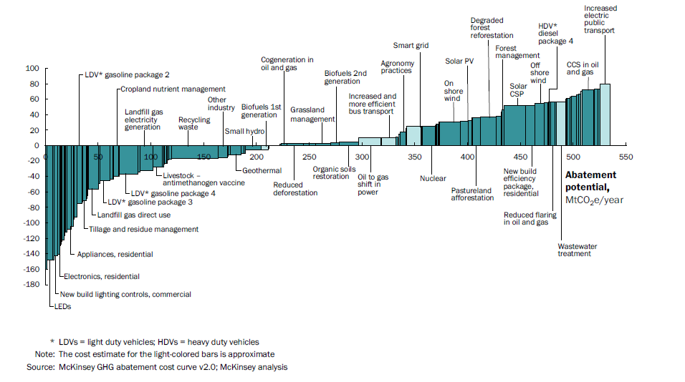
BIG wins Cost-Effectiveness Analysis Energy - Mexico
National carbon abatement cost curve for Mexico
GHG abatement cost curve for Mexico in 2030
Cost, US$/tCO2e
Source: McKinsey, Centro Mario Molina: “Low Carbon Growth: a Potential Path for Mexico”
Notes:
Expansion
Examples:
Groupwork / discussion

Slide 14
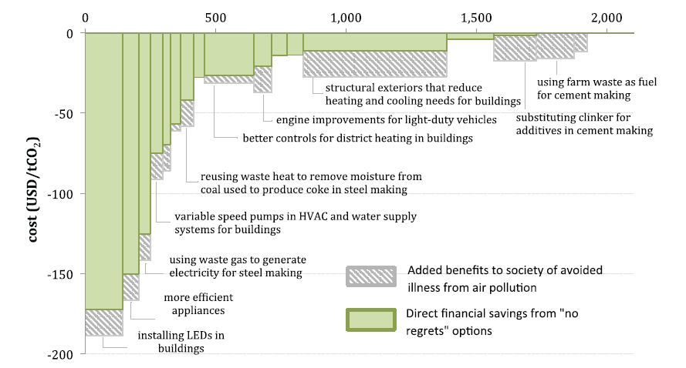
No Regrets Options for reducing CO2 emissions in China, 2030
Source: World Bank (2012)

Slide 15
BIG WINS Cost Effectiveness Analysis
Private Sector - Fishery
New vessels, increased livelihood
Cost-effectiveness analysis of sub-options:
New fish boxes, 10 % less waste, 4 months payback time
New steam system in fish processing enterprise, 40 % less energy consumption (two months payback time)
New enterprise cleaning procedures – 60 % less water consumption (1 month payback time)
Reduced need for waste water treatment (huge societal benefit)
New oil extraction technology – enables discharge of residual waters on farm land
Notes:
Expansion
Examples:
Groupwork / discussion

Slide 16

BIG WINS Cost-Effectiveness Analysis Governance & Energy, Morocco
Energy subsidies 2011: 5.5% of GDP, 17% investment budget
Low fossil fuel prices make renewable energy less competitive
No action due to fear for voters
Survey showed little resistance towards cutting subsidies
Mainly the wealthy opposed
a reform
Energy subsidy reform now
on track
Notes:
Expansion
Examples:
Groupwork / discussion

Slide 17
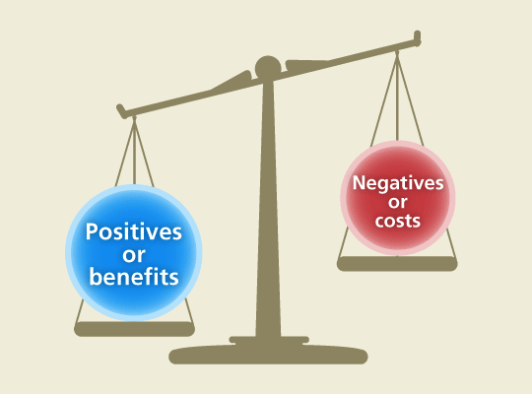
The Cost-Benefit Analysis - CBA
Compares costs and benefits for investment appraisal
Discussion of the socio-economic context and project objectives
Clear identification of the project
Feasibility and option analysis, potential constraints and solutions
Financial analysis – investment, operational costs, financial return, sources of finance, financial sustainability etc.
(Socio-)Economic analysis – externalities, indirect effects
Risk assessment
EU Guideline for CBA analysis 2006
Notes:
A presentation and discussion of the socio-economic context and the objectives
The first logical step for the appraisal is a qualitative discussion of the socio-economic context and the
objectives that are expected to be attained through the investment, both directly and indirectly. This
discussion should include consideration of the relationship between the objectives and the priorities
established in the Operational Programme, the National Strategic Reference Framework and consistency
with the goals of the EU Funds. This discussion will help the Commission Services to evaluate the
rationale and policy coherence of the proposed project.
􀀹 The clear identification of the project
Identification means that the object is a self-sufficient unit of analysis, i.e. no essential feature or
component is left out of the scope of the appraisal (half a bridge is not a bridge); indirect and network
effects are going to be adequately covered (e.g. changes in urban patterns, changes in the use of other
transport modes) and whose costs and benefits are going to be considered (‘who has standing’?).
􀀹 The study of the feasibility of the project and of alternative options
A typical feasibility analysis should ascertain that the local context is favourable to the project (e.g. there
are no physical, social or institutional binding constraints), the demand for services in the future will be
adequate (long run forecasts), appropriate technology is available, the utilisation rate of the infrastructure
16
or the plant will not reveal excessive spare capacity, personnel skills and management will be available,
justification of the project design (scale, location, etc.) against alternative scenarios (‘business as usual’,
‘do-minimum’, ‘do-something’ and ‘do-something else’).
􀀹 Financial Analysis
This should be based on the discounted cash flow approach. The EC suggests a benchmark real financial
discount rate of 5%. A system of accounting tables should show cash inflows and outflows related to:
- total investment costs;
- total operating costs and revenues;
- financial return on the investment costs: FNPV(C) and FRR(C);
- sources of finance;
- financial sustainability;
- financial return on national capital: FNPV(K) and FRR(K);
- the latter takes into account the impact of the EU grant on the national (public and private) investors.
The time horizon must be consistent with the economic life of the main assets. The appropriate
residual value must be included in the accounts in the end year. General inflation and relative price
changes must be treated in a consistent way. In principle, FRR(C) can be very low or negative for
public sector projects, but FRR(K) for private investors or PPPs should normally be positive.
􀀹 Economic Analysis
CBA requires an investigation of a project’s net impact on economic welfare. This is done in five steps:
- observed prices or public tariffs are converted into shadow prices, that better reflect the social
opportunity cost of the good;
- externalities are taken into account and given a monetary value;
- indirect effects are included if relevant (i.e. not already captured by shadow prices);
- costs and benefits are discounted with a real social discount rate (suggested SDR benchmark values:
5.5% for Cohesion and IPA countries, and for convergence regions elsewhere with high growth
outlook; 3.5% for Competitiveness regions);
- calculation of economic performance indicators: economic net present value (ENPV), economic rate
of return (ERR) and the benefit-cost (B/C) ratio.
Critical conversion factors are: the standard conversion factor, particularly for IPA assisted countries;
sector conversion factors (sometimes leading to border prices for specific tradable goods e.g. agricultural
products) and marginal costs or willingness-to-pay for non-tradable goods (e.g. waste disposal); the
conversion factor for labour cost (depending upon the nature and magnitude of regional unemployment).
Practical methods for the calculation of the economic valuation of environmental impacts, the shadow
price of time in transport, the value of lives and injuries saved and distributional impacts are suggested in
the Guide.
􀀹 Risk Assessment
A project appraisal document must include an assessment of the project risks. Again, five steps are
suggested:
- sensitivity analysis (identification of critical variables, elimination of deterministically dependent
variables, elasticity analysis, choice of critical variables, scenario analysis);
- assumption of a probability distribution for each critical variable;
- calculation of the distribution of the performance indicators (typically FNPV and ENPV);
- discussion of results and acceptable levels of risk;
- discussion of ways to mitigate risks.

Slide 18
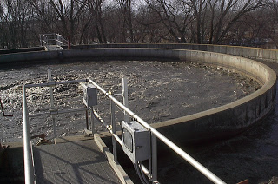
CBA of a Wastewater Treatment Plant
 | Year 1 | Year 10 | Year 30
Sales
Wastewater treatment external benefits | 0 | 6 | 9
Benefit due to improvement of the production in the well irrigated area | 0 | 29 | 39
Savings in groundwater resources | 0 | 9 | 11
Positive externalities | 0 | 44 | 59
Operating costs
Investment
Negative externalities
Net Economic Benefits
Notes:
EU Guideline p. 189

Slide 19
Assessing evidence/Demonstration projects
Support lesson drawing for adaptive management
Test what works and does not work (relevance, effectiveness)
Mobilise communities, local/regional authorities & other stakeholders
Demonstration/pilot projects
Help foster interest and commitment of national authorities & other stakeholders
Create motivation and knowledge for replication/ scaling-up
Assessing evidence
Engaging key actors
Vulnerability and adaptation assessments
Awareness raising & partnership building
Macro and meso economic analysis
Communication & advocacy strategy
National consensus on and commitment to climate-resilient and low-emission development
Source: UNDP-UNEP (2010)
Demonstration or pilot projects
19

Slide 20
Buzzing 10 mn
Have you experience with the three types of evidence: Vulnerability and adaptation assessment; Economic analyses; Demonstration projects?
Which specific tools have you worked with?
What was the outcome of the efforts?
How can challenges concerning the three types of evidence and governance capacities be addressed in a developing country context?

Slide 21
Engaging key actors
  Identify and mobilise key organisations involved in development at the national and sector levels
  Identify and prioritise stakeholder interests
  Identify and mobilise ‘champions’
Who might be good champions?
How do we create win/win?
Assessing evidence
Engaging key actors
Vulnerability and adaptation assessments
Awareness raising & partnership building
Macro and meso economic analysis
Communication & advocacy strategy
National consensus on and commitment to climate-resilient and low-emission development
Demonstration or pilot projects

Slide 22
Communication strategy
Developing and implementing a communication
and advocacy strategy in support of mainstreaming
  Define the objective of the communication efforts
  Define the target audience to be informed or influenced
  Develop policy-relevant messages and materials based on evidence collected (e.g. policy briefs, radio programmes)
  Select and use appropriate communication channels for the various target groups (e.g. media, sector working groups)
Assessing evidence
Engaging key actors
Vulnerability and adaptation assessments
Awareness raising & partnership building
Macro and meso economic analysis
Communication & advocacy strategy
National consensus on and commitment to climate-resilient and low-emission development
Demonstration or pilot projects

Slide 23
Policy Dialogue support
The Essential
The obvious
BEFORE
Source: Negotiation skills for EU Policy Dialogue – Training course

Slide 24
Policy Dialogue support, 10 principles /1
Principle 1
Relationship
BEFORE
Any other action
Preparation
BEFORE
Action
Process
Problem
BEFORE
Creativity
Reality check
BEFORE
Active listening
Active speaking
BEFORE

Slide 25
Policy Dialogue support, 10 principles /2
Principle 1
Value creation
BEFORE
Value claiming
Search for information
BEFORE
Search for solutions
Internal consensus
External meeting
BEFORE
Evaluation
Decision
BEFORE
Validating commitments
Adjourning
BEFORE

Slide 26
EU support to Policy Dialogue
General roles
Neutral… at least, Impartial
Empowering the parties
Coach, Helper, Facilitator, Convener
External witness, bringing objective reference points
On the process dimension
Appraising possibilities
Gaining participation of stakeholders
Setting rules
Improve information exchange
Summarise
On the people dimension
‘Bridge’, organising productive exchange of information
Supporting mutual understanding
Avoid misunderstandings
Support establishment of trust
On the problem dimension
Keep focus
Invent and support solutions
Help discover win/win
Help in making informed choices
Capture agreements and prepare for implementation

Slide 27
Buzzing ten minutes
We take departure in a Fiche or a theme described by a participant.
How can you work with the tools in the specific context:
Vulnerability assessment
Macro – meso – micro economic assessment
Economic tools – TEEB, CEA, CBF
Pilot projects
Engaging key actors
Communication strategy
Policy dialogue
Write down comments to each option on a card
Notes:
Expansion
Examples:
Groupwork / discussion

Slide 28

Selected key tools for environmental assessments
Notes:
Expansion
Examples:
Groupwork / discussion

Slide 29
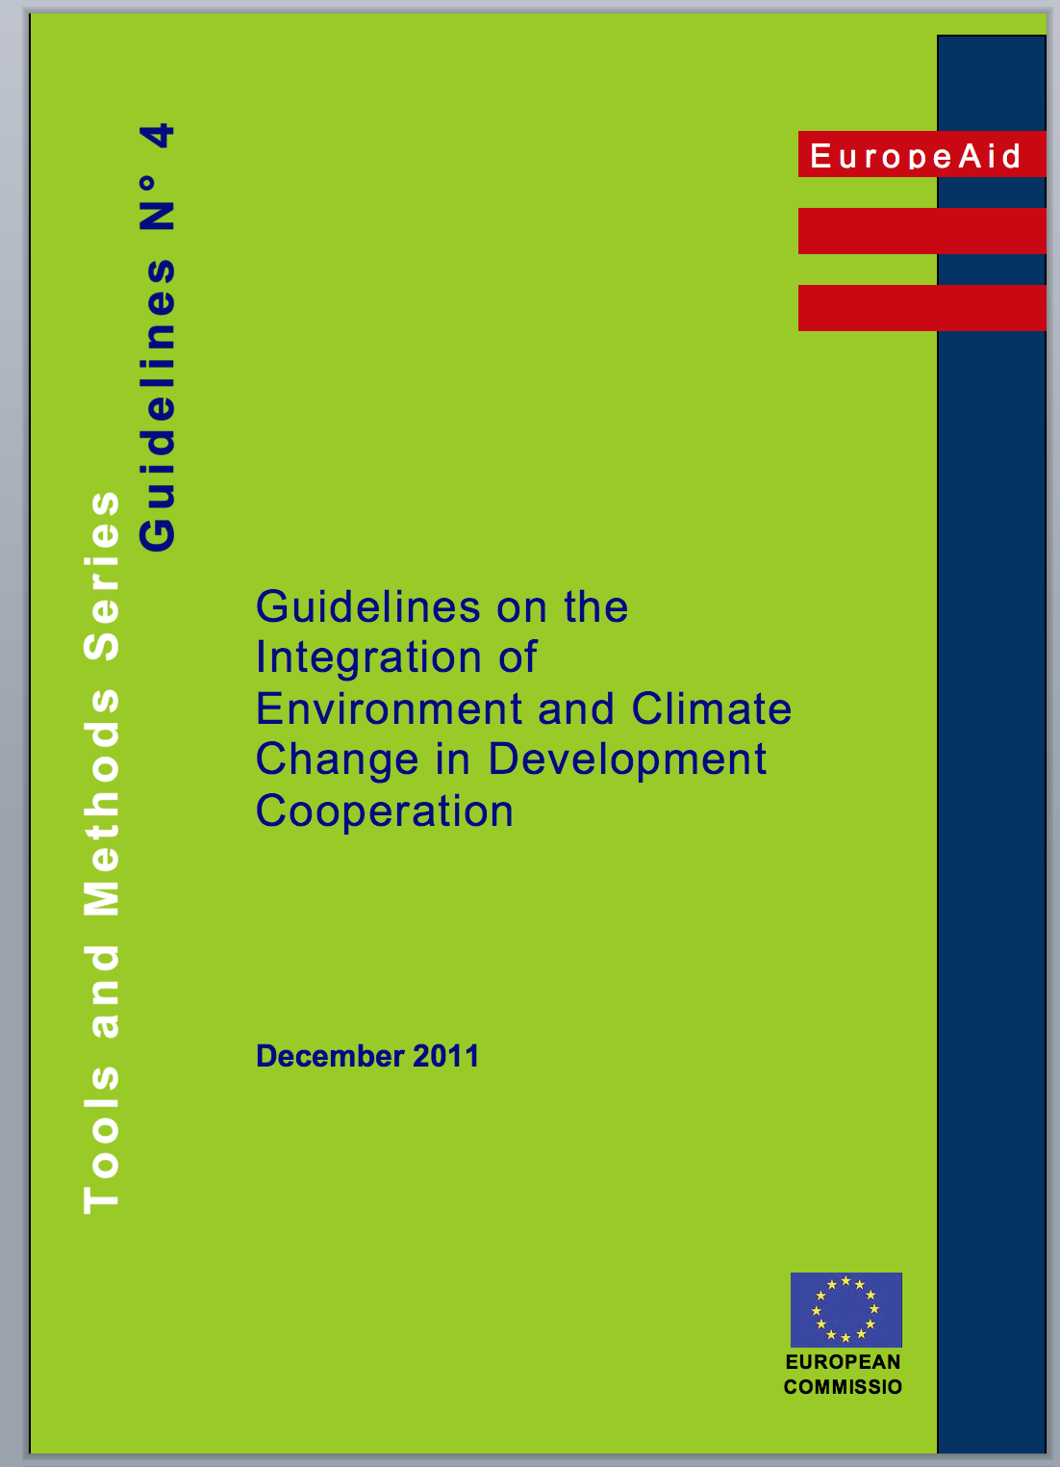
Guideline No 4
Notes:
The competent authority makes the final decision.
Expansion
Examples:
Groupwork / discussion

Slide 30

Environmental Impact Assessment and Climate Risk Assessment
EIA and CRA are ex ante assessments (EIA specified in legislation, CRA a new tool)
To reduce the project’s vulnerability to climate change;
To reduce environmental and climate damage by preventive measures
To optimise positive impacts
Through technical/scientific studies and
stakeholder consultations
Notes:
EU guidance on TOR for SEA, EIA, CRA – and on the substance
Ex ante = before the event
Traditionally, EIA assesses the potential (positive and negative) environmental impacts of the project on the environment (“impacts generated”)
As a complement, either the EIA or the feasibility/formulation study should include provisions for the analysis of the (positive and negative) environmental and natural resource-related conditions that may affect the effectiveness, efficiency, sustainability or impact of the project (“opportunities, risks & constraints”)
Legal requirement for an EIA?
Policy commitments?
Annex 7 – project lists and questions
Project EIA and CRA classes:
A – significant impacts expected – EIA , significant likelihood of being affected by climate change: CRA
B – some uncertainty, further analysis necessary
C – no significant impacts expected – EIA not required
Annex 8 (ToR for EIA) cover these aspects as an option
Annex 9 of the Guidelines provides guidance on integrating environmental issues in formulation studies

Slide 31

Focus on opportunities
Opportunities may be overlooked
They are to be developed
They need specific actions to become actual
They should be pursued
Notes:
Expansion
Examples:
Groupwork / discussion
World Bank (2010c):
(No- and) low-regret measures include most of the ‘soft’ adaptation measures, which enhance development and welfare across all or most climate change scenarios including the no-change scenario
‘No-regret’ measures:
those expected to produce net benefits for society
even in the absence of climate change (adaptation) or independently of any ‘reward’ for mitigation (zero or negative net cost at a zero carbon price)
‘Low-regret’ measures:
those expected to have a cost for society, but an acceptable one in view of the benefits they would bring if climate change turns out to produce significant effects (adaptation), or to have a low net cost at zero or low carbon prices (mitigation)
.
Robust’ measures: those that produce net benefits or deliver good outcomes across various possible climate change or carbon price scenarios and economic development scenarios (rather than just under the ‘most likely’ scenario)

Slide 32
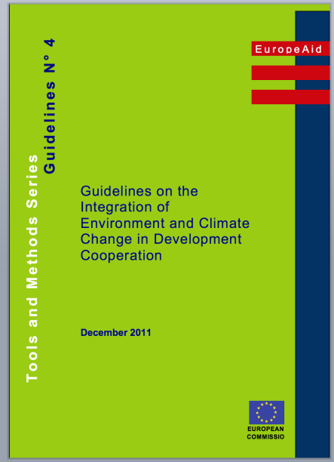
Key stages in EIA and CRA
Screening – is it necessary ? (during identification phase)
Scoping – What shall be done and how
Study
Management plan – mitigating actions
M and E – Does it work
Stakeholder participation is required.
Notes:
The competent authority makes the final decision.
Expansion
Examples:
Groupwork / discussion

Slide 33
Keystage 1 – Screening
Is there a legal requirement for an EIA?
Would an EIA or CRA fit a policy commitment?
Annex 7 – project lists and questions
Are there significant climate issues?
Project EIA and CRA classes:
  A – significant impacts expected – EIA/CRA required
  B – some uncertainty, further analysis necessary
  C – no significant impacts – EIA/CRA not required
33
Notes:
Is there a legal requirement under national legislation for an EIA to be conducted ?
Would an EIA be recommended in conformation with a policy commitment?
Annex 7 – project lists and questions
Project EIA classes:
A – significant impacts expected – EIA required
B – some uncertainty, further analysis necessary
C – no significant impacts expected – EIA not required

Slide 34
Key stage 2 - Scoping
The Scoping study
project and its alternatives
constraints
legal and institutional framework
stakeholders
project-environment interactions
scope of the study
methodology
time frame
costs
means
Stakeholder participation is required.
Notes:
The competent authority makes the final decision.
Expansion
Examples:
Groupwork / discussion

Slide 35
Key stage 3 – The study
3. Study
Identification of significant environmental impacts (project and possible alternatives)
Identification of opportunities
Evaluation of the identified impacts and opportunities
Mitigation/optimisation measures and recommendations, incl. Environmental Management Plan (or Climate impact mitigation plan)
Account of residual impacts
Stakeholder participation is required.
Notes:
The competent authority makes the final decision.
Expansion
Examples:
Groupwork / discussion

Slide 36

Key stage 4 – Impact evaluation
Characterised with various criteria
  Direct or indirect, positive or negative
  Temporary or permanent; short-, medium-
  or long-term
  Continuous or sporadic
  Reversible or irreversible
  Degrees of magnitude
  Impacts that can or cannot be mitigated …
Notes:
Taking into consideration the local context, the sensitivity of the environment, the opinions and values of those concerned, etc.
Expansion
Examples:
Groupwork / discussion

Slide 37
The Environmental Management Plan
Details of the proposed mitigation measures
Identification of parties responsible for implementation
Identification of parties responsible for monitoring and control
Ideally, cost estimates of the proposed measures
Notes:
Expansion
Examples:
Groupwork / discussion

Slide 38
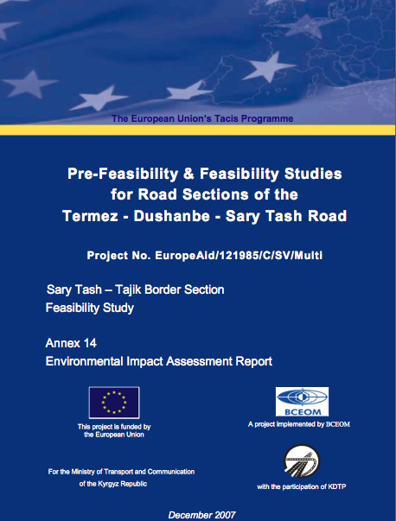
EIA example : Kyrgyzstan road EIA

Slide 39
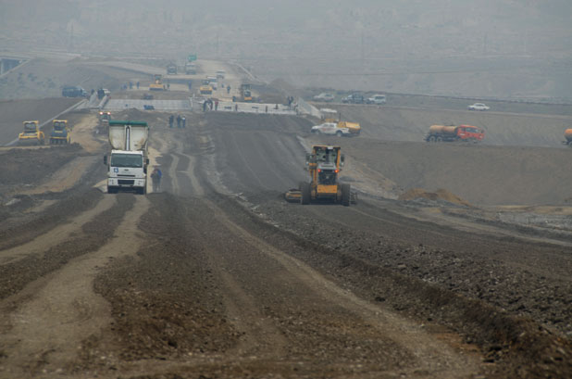
Environmental Management Plan, EMP
Notes:
Expansion
Examples:
Groupwork / discussion

Slide 40
Environmental Management Plan, EMP
Kyrgyzystan road construction/conversion example
Potential impact | Mitigation | Resp. | Cost
Soil erosion | Progressive re-vegetation | Contractor | 37,000
 | Minimize size of cleared areas | Contractor | n/a
Soil contamination, chemicals | Safe storage with concrete floor | Contractor | 15,000
Air pollution | Dust suppression measures | Contractor | 15,000
Exploitation of local resources | Forbidden felling of trees | Contractor | n/a
Disruption of roadside commercial activities | Install temporary access to affected properties | Contractor | n/a
Notes:
Expansion
Examples:
Groupwork / discussion

Slide 41
EIA in practice
Use consultants independent from those carrying out technical feasibility studies
EIA results should be used to adapt and finalise the project’s technical design
Ideally, the EIA should precede financial and economic analysis, to allow:
Consideration of final project design
Inclusion of environmental mitigation costs (in financial analysis)
Possibly the valuation of some environmental externalities (in economic analysis)
41
Notes:
The EIA must be based on sufficient technical information (draft technical design)
Expansion
Examples:
Groupwork / discussion

Slide 42
Social aspects of EIA
The social effects are important and must be analysed as well as biophysical aspects
Social and environmental aspects should be considered together because of their interdependence
Various groups (women, minorities, ...) are frequently not equally effected by environmental changes
Notes:
Expansion
Examples:
Groupwork / discussion

Slide 43
Strategic Environmental Assessment (SEA)
Analysing the positive and negative environmental consequences of proposed policies, plans and programmes
Ensures that environmental (incl. biodiversity and CC) considerations are taken into account, alongside social and economic considerations, as early as possible in the policy and planning process
Notes:
A study analysing the positive and negative environmental consequences of proposed policies, programmes and strategic interventions
Compared with the EIA (Environmental Impact Assessment – for individual projects), applied at a higher decision-making level
Ensures that environmental considerations are taken into account, alongside social and economic considerations, as early as possible in the policy and planning process

Slide 44

Big Wins – SEA Rwanda
Sugar Sector
Scoping with stakeholders:
No effective soil erosion control
Policy neglecting existing soil erosion control measures
No water balance prepared, excessive abstraction
Limited local capacity for environmental management
Political neglect of maintenance of forested areas
Weak regulatory framework
Inadequate monitoring and evaluation
Notes:
New slide

Slide 45
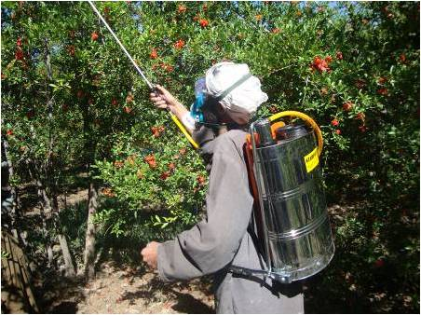
Rwanda Sugar Sector
Soil and water conservation
Nutrient management
Crop and rarity selection
Pest and disease management
Monitoring and evaluation
Institutions outside the
agro-sector:
20 recommendations
Notes:
New slide

Slide 46
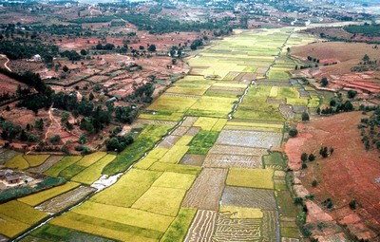
SEA vs. EIA: a different focus
Policy, Plan, Programme
Strategic Environmental Assessment – SEA
Project
Environmental Impact Assessment EIA
Notes:
Should be carried out for all PPPs that are likely to produce significant negative impacts on the environment during implementation
SEA “has the potential to make the world a greener and more liveable place”.
“It also has the potential to be a dreary and resource- intensive formality, applied in a grudging minimalist fashion by people who just hate having to do it, adding further to some great useless administrative burden – so again we have to make the case and ensure that SEAs are done and used ….
Compared with the EIA (Environmental Impact Assessment – for individual projects), applied at a higher decision-making level
© Bruno Locatelli

Slide 47

SEA: a more recent tool than EIA
EU Directive of 2001 (1985 for EIA)
  2000+ SEAs undertaken in EU each year
Some experience in EU development aid
  Indian Ocean - Coastal tourism
  Maldives – Regional development strategy
  Mauritius, Tanzania, Belize, Jamaica,
  Trinidad & Tobago, Zambia – sugar
  sector reform
  Mali – Transport sector programme
  Ghana – National Development Plan
  Guyana – Sea defences
Notes:
Not all partner countries have adopted SEA legislation
Se de sidste års – dækker geografisk og sektorielt

Slide 48
Key stages in an SEA
Screening
Scoping
Baseline “business-as-usual” situation
Stakeholder participation
Identification of env’l, CC, GE opportunities and constraints of the PPP and alternatives
Identification of elements that may conflict with or hinder env. policy objectives
Conclusions and recommendations for formulation of preferred and improved alternative
Monitoring, performance indicators
SEA report
Notes:
Applications of SEA: some examples
‘Macro’ policies : e.g. poverty reduction strategies; agricultural subsidy reforms; public sector reforms; privatisation policies; trade policies
Sector strategies and programmes : e.g. water sector; waste management; transport infrastructure; rural development
Sub-national strategies : e.g. coastal zone management; urban development plans; regional development plans

Slide 49
Screening for SEA – does it add value?
An SEA is recommended if the sector is environmentally “sensitive”
  Infrastructure (incl. transport)
  Water & sanitation
  Energy
  Waste
  Agriculture, food security and rural development
  Regional and land use planning
  Environment and sustainable management of natural resources
See screening questionnaire in Annex 3 of the Guidelines
Notes:
Expansion
Examples:
Groupwork / discussion

Slide 50
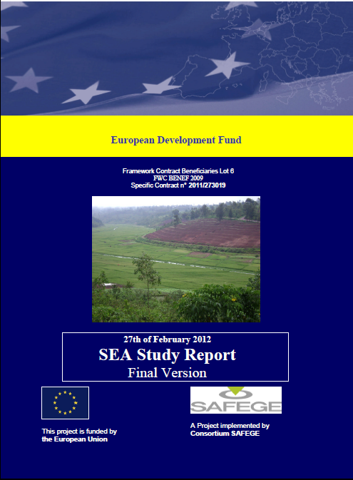
Rwanda 2012
SEA of
Agricultural
Sector
120 pages
180 pages annexes
>120 stakeholders consulted
Notes:
Expansion
Examples:
Groupwork / discussion

Slide 51
Rwanda SEA
Key Issues
Scoping with stakeholders:
No effective soil erosion control
Policy neglecting existing soil erosion control measures
No water balance prepared, excessive abstraction
Limited local capacity for environmental management
Political neglect of maintenance of forested areas
Weak regulatory framework
Inadequate monitoring and evaluation
Notes:
New slide

Slide 52
Rwanda SEA
Recommendations to Rwanda
Soil and water conservation
Nutrient management
Crop and rarity selection
Pest and disease management
Monitoring and evaluation
Climate change
Institutions outside the
agro-sector:
20 recommendations
Notes:
New slide

Slide 53
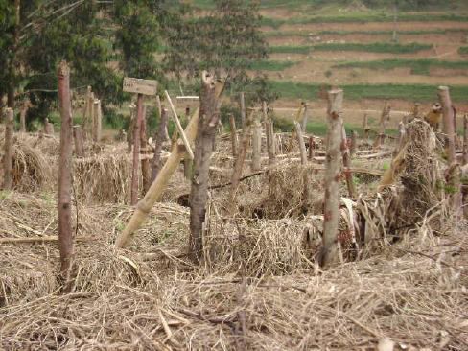
Rwanda SEA
Recommendations to the EC
Performance indicators
  No. of farmers assessing nutrient needs
  Ha. of arable land under agro-forestry
  No. of farmers exposed to
  Farmers Schools
  Etc.
Policy dialogue with non-agro
institutions
SPSP to rural feeder roads
Etc.
Notes:
New slide

Slide 54

SEA Ownership - Zambia Sugar Strategy
Workshop – Key stakeholders
Purpose: Draft ToR for the SEA
Awareness of SEA
Ownership from EC, GOZ and stakeholders
Promotion of bio-ethanol
But no distilling industry
And no regulatory framework
SEA Recommendations:
Funds for capacity building of env. authorities
Environmental guidance and standards for the sector
Notes:
The scoping phase has proved extremely useful to identify the key environmental aspects related to the sector and sector strategy. This has allowed focusing the SEA Study on those aspects that are really important.
It is tempting to advance long-lists of ‘key issues’ that should be assessed in the SEA Study. However, this undermines the role of scoping.
Still not well applied for General Budget Support – BUT IT SHOULD BE!!!! (KEY TO MAINSTREAMING)
SEA awareness amongst EC staff dealing with GBS is limited
Not always joint ownership of SEAs
Value of SEA depends on the partners’ commitment and knowledge - so need to lobby, make the case, raise awareness, etc

Slide 55
Initiatives & approaches for policy, planning and implementation
Strategic Environment Assessment
Fiscal Reform and Charges
Initiatives
Policy and
Planning
Initiatives
Implementation
Others
Environment Impact Assessment
Social Protection Instruments
Public Env. Expenditure Review
Decision Making under uncertainty
Green Innovation
Certification Sustainable Prod.
Sustainable Public Procurement
Labour Markets and Income
Framing policies
Green accounting
Payment for Env. Services
Notes:
Expansion
The main point here is to show that there are many tools and approaches and the resources can point to more
Examples:
Groupwork / discussion

Slide 56
Operations cycle
Programming
CEP/ /PEA/ other
National Indicative Programme
Evaluation
Closure, Follow-up, Future Dialogue
Identification
CBA
CEA
SEA
CRA
EIA Screen
other
Evaluation
Fin. Audit
Policy dialogue
ID Fiche Financial
Proposal
EIA
SEA
Other
Implementation
Formulation
CBA
CEA
EIA
SEA
CRA
Other
Monitoring, Medium Term Review
Action Fiche
Notes:
Expansion
Examples:
Groupwork / discussion

Slide 57
Module 5 – recap main messages
There are many tools available for environmental and climate change improvement of programs and projects
TEEB provides a picture of the value of eco-systems and biodiversity
Cost-effectiveness analyses are often useful to find best alternative option
Cost-benefit analyses provide a picture of the socio-economic impact of programs
Comprehensive ENV and CC tools include EIA, SEA and CRA with relatively identical tool structures: Screening; scoping; study; action plan
Notes:
EC steps and other donors : slides 2-4 + optional slides to go into detail
EC cycle of operations: slides 5,6
Relevance of political economy: slides 7 +optional slides to go into detail
CSP: slides 8
Example of Indonesia CEP: slides 9,10
Rio markers and trends in aid: Slides 11,12

Slide 58
Resources
SEA
Strategic Environmental Assessment Task Team - OECD
http://www.seataskteam.net/
SEA – DG ENV
http://ec.europa.eu/environment/eia/sea-legalcontext.htm
CRA
Climate Risk Assessment Methodology – WB
http://climatechange.worldbank.org/content/note-3-assessing-climate-risk
EIA
Open Education Resource on EIA – UNEP
http://www.unep.ch/etb/publications/enviImpAsse.php
Studies of EIA Practice in Developing Countries – UNEP
http://www.unep.ch/etb/publications/compendium/introMat.pdf
EIA in Developing Countries - An Overview – Wood
http://www.sed.man.ac.uk/research/iarc/ediais/pdf/Wood.pdf

Slide 59
Climate Change and Environmental Degradation Risk and Adaptation Assessment - CEDRA
A structural approach to identifying possible impacts of climate and environmental change
Step 1 Mapping
Step 2 Science
Step 3
Commu-nity
Step 4
Risk as-sessment
Step 5
Adapta-tion
Step 6
Compi-lation
Step 7
Lasting change
Notes:
Expansion
Examples:
Groupwork / discussion

Slide 60
CEDRA Key Tools
Step 1
Mapping
Step 2
Science
Step 3
Community
Map locations
Physical and socio economic factors
Causes/impacts, problem tree
Question identification
Stakeholder and information source identification
Information gathering
Stakeholder analysis
Research and consultations
Focus group discussions
Community mapping
Seasonal calendars
Ranking matrixes
Capacities and empowerment
Step 4
Risk assessment
Step 5
Adaptation
Step 6
Compilation
Step 7
Lasting change
List impacts, CC/ENV
Assessing risks
Participatory assessment
Prioritising response
Consult experts
Address Gender
Explore options
Choose options
Strengthen projects
Complete assessment
File the assessment
Write an action plan
Challenge action plan
Plan and conduct workshops
Update assessments
Ensure impact on project design and strategic plans
Plan to develop local record keeping
Notes:
Expansion
Examples:
Groupwork / discussion

Slide 61
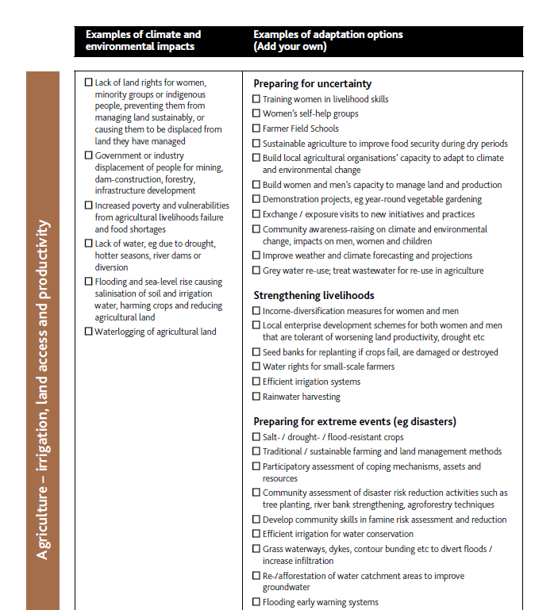
CEDRA Key Tools
Step 1
Mapping
Map locations
Physical and socio economic factors
Causes/impacts, problem tree
Question identification
Notes:
Expansion
Examples:
Groupwork / discussion

Slide 62
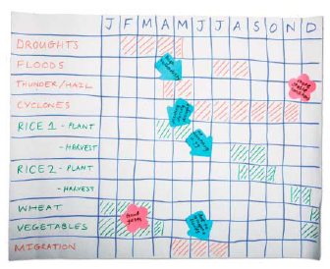
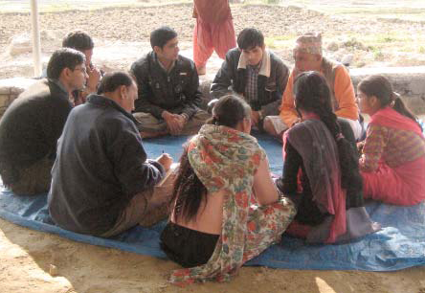
CEDRA Key Tools
Step 3
Community
Focus group discussions
Community mapping
Seasonal calendars
Ranking matrixes
Capacities and empowerment
Notes:
Expansion
Examples:
Groupwork / discussion

Slide 63
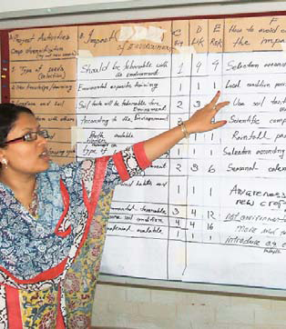
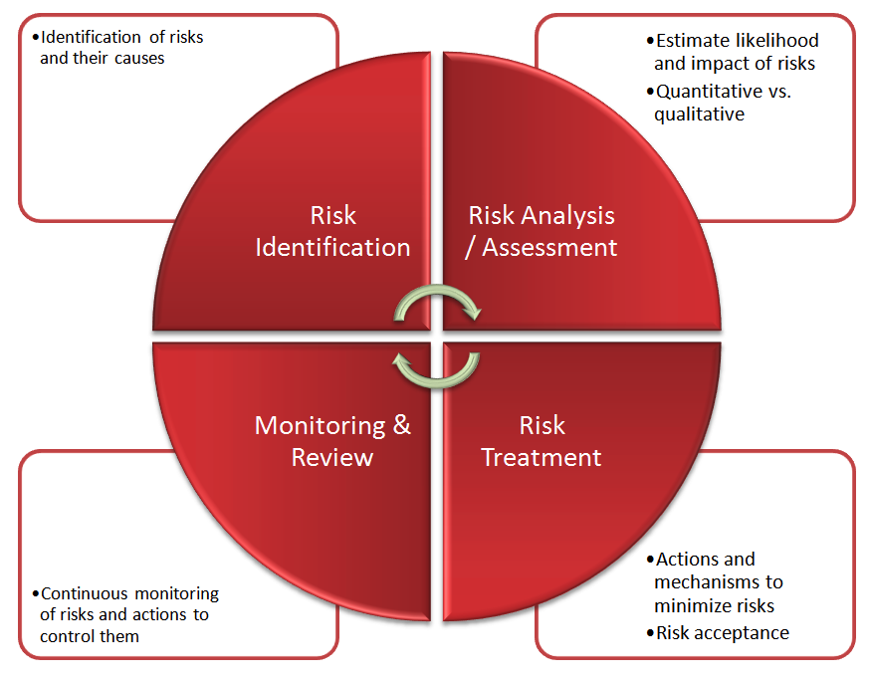
CEDRA Key Tools
Step 4
Risk assessment
List impacts, CC/ENV
Assessing risks
Participatory assessment
Prioritising response
Notes:
Expansion
Examples:
Groupwork / discussion

Slide 64
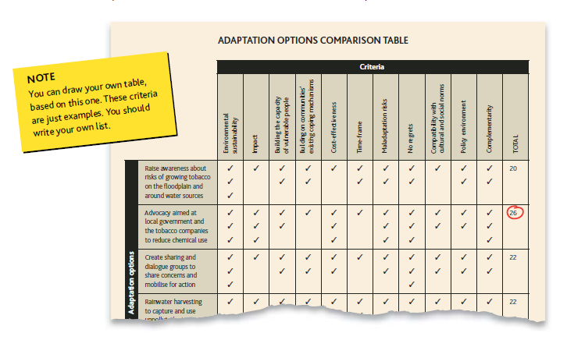
CEDRA Key Tools
Step 5
Adaptation
Consult experts
Address Gender
Explore options
Choose options
Strengthen projects
Notes:
Expansion
Examples:
Groupwork / discussion

Slide 65
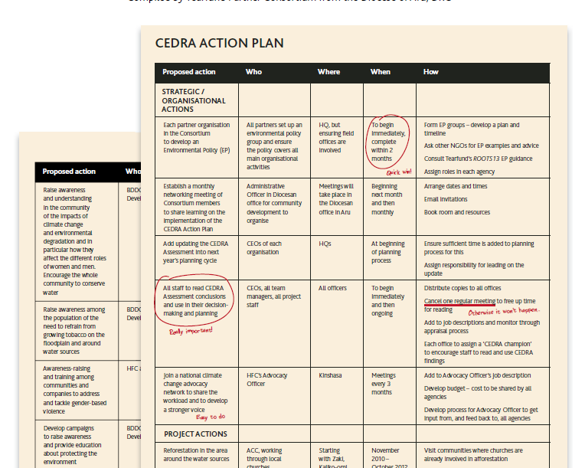
CEDRA Key Tools
Step 6
Compilation
Complete assessment
File the assessment
Write an action plan
Challenge action plan
Plan and conduct workshops
Notes:
Expansion
Examples:
Groupwork / discussion

