Slide 1
Environment and climate change in development cooperation
Exploring definitions and concepts – Module 1

Slide 2
Structure
  Definitions
  Concepts
    Environment
    Climate change
    Green economy
    Sustainable development
    Integration /mainstreaming

Slide 3
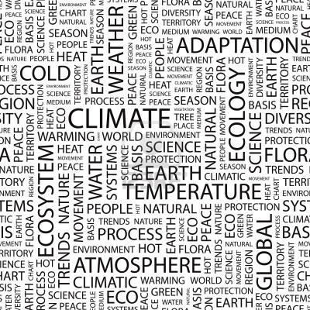
Activity 1: Climate change & Environment & Green Economy & Sustainable development -
What do all the terms mean ?
Notes:
Expansion
Examples:
Groupwork / discussion:
Glossary exercise

Slide 4
Concepts
Sustainable development
Integration
What is meant?
What have we learnt?
Drivers & barriers
Organisations
EC approach
Environment
What do we mean by environment?
Ecosystem services approach
Climate change
What is climate change?
Consequences
Where do we stand?
How to address?
Green economy
Principles
Examples in practice
Transition

Slide 5

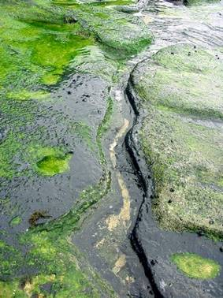
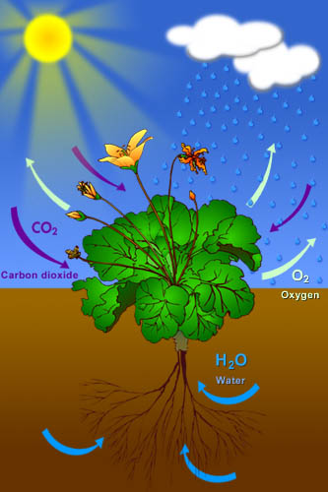
Concepts: Environment
  What do we mean by environment?
  What is the ecosystems services approach?
Notes:
© State of Victoria (Department of Education & Training), 2000
Expansion
Brundtland report: Environment is where we live – and development is what we do to improve where we live – but where we live is not just what we can see, not just our immediate surroundings – it also involves others. Development will not always improve where we live even for ourselves let alone others
Examples:
Groupwork / discussion:

Slide 6
The environment?
Write on up to 3 cards what environment means for you
Rainforest
Climate change
Fish stocks
Waste management
Greenhouse gases
Pollution
Biodiversity
Energy
Water resources
Transport
Environmental health
Multilateral agreements
Ecology
Air quality
Endangered species
Noise pollution
Cultural heritage
Carbon trading
Clean Development Mechanism
Recycling
Desertification
Polluter pays
Green Parties
Soil conservation
Ozone layer
Green taxation
Eco-tourism
Protected areas
Organic production
Urban issues
Eco-activists
GMOs
Religion
etc.
© Bruno Locatelli, 2005
Notes:
Expansion
It means a lot to different people – no clear definition
Examples:
Groupwork / discussion:
Here it can be useful to ask people to write down what they thing is meant by environment ...then compare to the list – main point: it means many different things.

Slide 7
Ecosystem services
Supporting
Nutrient cycling
Soil formation
Primary production…
Provisioning
Regulating
Cultural
Source: Millennium Ecosystem Assessment (2005) – Living Beyond Our Means: Natural Assets and Human Well-being, Statement from the Board, p.7
Notes:
Expansion
It is chaotic but we can also bring structure to how we think about the environment – it is not just where we live today but it also involves longer term processes that affect the future environment and MDGs/sectors (see OECD guidance)
Provisioning - Food, freshwater, wood & fibre, fuel, …
Regulating – climate, flood, disease, water purification
Cultural – aesthetic, spiritual, educational, recreational
Examples:
Groupwork / discussion:

Slide 8
Concepts Climate change
What is climate change?
What are the consequences?
Where do you stand?
How to address climate change?

Slide 9
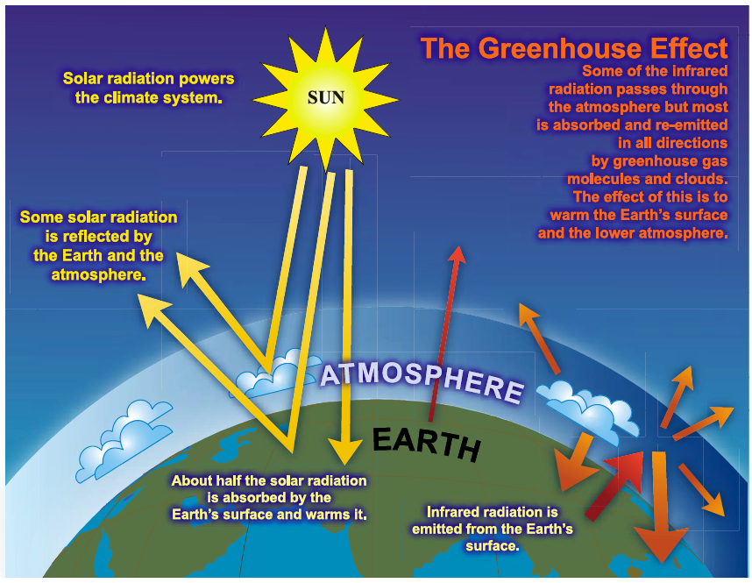
The (enhanced) greenhouse effect
Source: IPCC WGI Ch.1 (Somerville et al., 2007a, p. 115)
Notes:
Expansion
Examples:
Groupwork / discussion

Slide 10

Consequences
Changes is average conditions – warmer, wetter, drier, average sea levels etc.
Changes in climatic extremes – Heat waves, droughts, precipitation, floods, storm surges, fires etc
Abrupt changes and ‘singular’ hazards – circulation changes, ecosystem collapse, glacial lake outbursts etc.
Impacts on – Water, food security, health, infrastructure etc.
Notes:
Expansion
Note uncertainty – we will return to sector impacts later
Namibia example – variability is higher 1900-1950 than since 1950 (Raison 2013)
Changes in average conditions
Warmer, wetter, drier, higher sea levels - changes in growing seasons, viable ranges of crops, ecosystems, pests, diseases; greater evaporation, changes in water availability, land loss
Changes in climatic extremes
Heat waves, droughts, precipitation, floods, storm surges, fires; changes in storm tracks & behaviour - changes in disaster risks
“Abrupt” changes and “singular” hazards
Circulation changes, ecosystem collapse, glacial lake outbursts, arid-humid transitions - rapid & slow onset disasters
Impacts on
Water, food security, health, infrastructure, energy, natural resources, livelihoods, migration, conflict, growth, trade, etc
Examples:
Groupwork / discussion

Slide 11

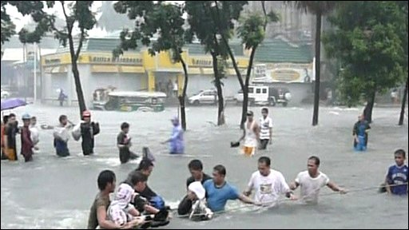
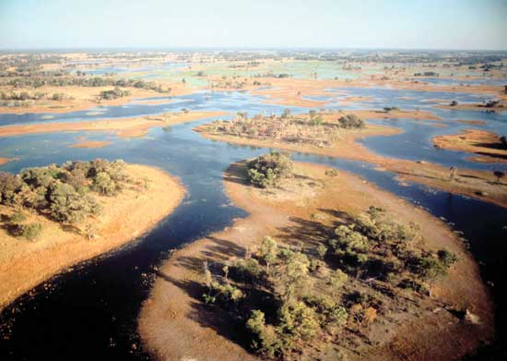
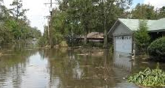
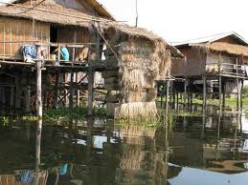
Consequences & conceptual terms
Low exposure
Exposure
Sensitivity
High exposure
Impact
Adaptive Capacity
Vulnerability
Higher sensitivity
”Lower” sensitivity
High impact
Low impact
Low adaptive capacity
High adaptive capacity
High Vulnerability
Notes:
Expansion
Examples:
Groupwork / discussion

Slide 12
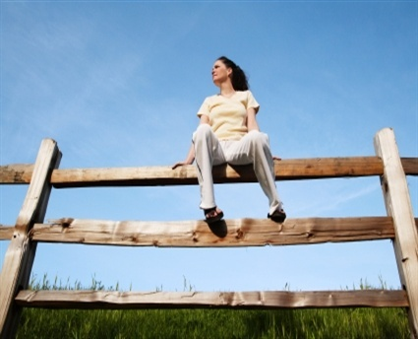
Activity 2 - Global Warming Quiz - Where do you stand ?
1.Ignorance:- “Global Warming? Climate Change? What’s that?”
2.Agnosticism: “I’m quite confused. Arguments are contradictory. We can’t know.”
3.Denial: “I don’t care. Do not constrain my freedom to act as I like!”
4.Acknowledgement: “Climate Change is a potential problem, but too distant in the future to worry about.”
5.Consciousness: “Climate Change is definitely a problem that needs addressing once the recession is over.”
6.Action: “Global warming needs urgent global agreement and immediate mitigation & adaptation actions. If so, less than 2°C temperature rise is still manageable.”
7.Concern: “Reactions are too slow. A rise of less than 2°C is probably no longer feasible. Warming may well become uncontrollable; food and water increasingly scarce.”
9.Fatalism:“Life on earth is doomed. Our planet won’t recover: it will die.”
8.Worries :“Whatever we do, mean temperature will reach at least 5°C above present. Populations will decline: some people may survive in the extreme north.”
Notes:
Expansion
Examples:
Groupwork / discussion
This would be an interactive part – people would go and stand with the view that reflects their position bests (the 9 views would be put as cards at different points around the room). It could also be the basis for role play if one wanted one group to persuade another group (perhaps after the more detailed slides on CC)

Slide 13
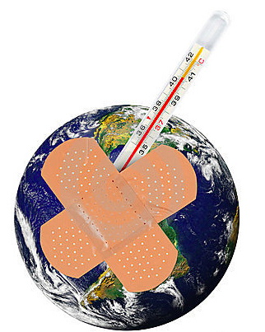
Addressing climate change (1)
Aim for 2º C
Mitigation, low-carbon development
Plan for 4º C
Adaptation
Notes:
Expansion - See UNEP global emissions report 2012
Climate change represents one of the greatest challenges but also an inordinate opportunity to catalyse a transition to a low carbon, resource-efficient Green Economy.
This report informs Governments and the wider community on how far a response to climate change has progressed over the past 12 months, and thus how far the world is on track to meet wider goals.
The pledges associated with the Copenhagen Accord of 2009 are the point of departure for this report. What might be achieved in terms of limiting a global temperature rise to 2° C or less in the twenty-first century and in terms of setting the stage for a Green Economy? And what remains to be done—what is the gap between scientific
reality and the current level of ambition of nations? The analysis focuses on where global emissions need to be in around 10 years time to be in line with what the science says is consistent with the 2° C or 1.5° C limits, and where we expect to be as a result of the pledges.If the highest ambitions of all countries associated with the
Copenhagen Accord are implemented and supported, annual
emissions of greenhouse gases could be cut, on average, by around 7
gigatons (Gt) of CO2 equivalent by 2020.
Without this action, it is likely that a business-as-usual scenario would
see emissions rise to an average of around 56 Gt of CO2 equivalent
by around 2020. Cuts in annual emissions to around 49 Gt of CO2
equivalent would still however leave a gap of around 5 Gt compared
with where we need to be—a gap equal to the total emissions of the
world’s cars, buses and trucks in 2005.
That is because the experts estimate that emissions need to be around
44 Gt of CO2 equivalent by 2020 to have a likely chance of pegging
temperatures to 2° C or less.
However, if only the lowest ambition pledges are implemented, and if
no clear rules are set in the negotiations, emissions could be around
53 Gt of CO2 equivalent in 2020—not that different from business as
usual—so the rules set in the negotiations clearly matter.
This report, the result of an unprecedented partnership between
UNEP and individuals from 25 leading research centres, underlines the
complexity of various scenarios.
The Emissions Gap Report emphasizes that tackling climate change is
still manageable, if leadership is shown. In Cancun action on financing,
mitigation and adaptation need to mature and move forward—
supported perhaps by action on non-CO2 pollutants such as methane
from rubbish tips to black carbon emissions.
Above all, Cancun must demonstrate to society as a whole that
Governments understand the gaps left by Copenhagen. But at the
same time remain committed to counter climate change while
meeting wider development goals.
Achim Steiner,
UN Under-Secretary-General,
UNEP Executive Director
Examples:
Groupwork / discussion

Slide 14
Addressing climate change (2)
Mitigation
Reducing emissions that drive climate change
Industrialised and rapidly industrialising country focus
Transition to low carbon economy
Clean Development Mechanism (CDM)
Reducing Emissions from Deforestation and Forest Degradation (REDD)
Forest Law Enforcement Governance and Trade (FLEGT)
Adaptation
Improving resilience to climate change and its impacts
All countries, particularly poor, vulnerable, LDCs and SIDS
Importance of mainstreaming
Emerging funds (e.g. adaptation fund)
Global Climate Change Alliance
Notes:
Expansion
(Geoengineering) – would not mention here in detail but in principle includes:(Geoengineering) – would not mention here….
Compensate for emissions - carbon removal, solar radiation management
Speculative, untested, potential impacts, longer term
Mirrors in space ...
Compensate for emissions - carbon removal, solar radiation management
Speculative, untested, potential impacts, longer term
Mirrors in space ...
Examples:
Groupwork / discussion

Slide 15
Linkages – REDD and FLEGT
REDD FLEGT
Reduced Emission / Deforestation / Degradation
Illegal logging / deforestation
DDD Focused Legislative Reform (process dev. & implementation)
Good governance
Participation, law enf., legisl. reform
Local community rights, tree tenure, carbon rights, benefit sharing
Improved community access to resources
Carbon stock conservation & Enhancement, SFM
Sustainable Forest Management
Private sector participation in REDD projects
Responsible and Viable Timber Industry
VPA Communication strategy
REDD Communication Strategy
VPA wood tracking systems
REDD MRVs for Stock data
Notes:
Expansion
(Geoengineering) – would not mention here in detail but in principle includes:(Geoengineering) – would not mention here….
Compensate for emissions - carbon removal, solar radiation management
Speculative, untested, potential impacts, longer term
Mirrors in space ...
Compensate for emissions - carbon removal, solar radiation management
Speculative, untested, potential impacts, longer term
Mirrors in space ...
Examples:
Groupwork / discussion

Slide 16
Concepts green economy
Principles
Sector examples
Transition opportunities and challenges

Slide 17
Green Economy Principles
(Based on UN DESA 2012)
Type | Principles
Economic | Recognizes natural capital and values Integrated in economic development and growth models Internalizes externalities Promotes resource and energy efficiency Creates decent work and green jobs
Environmental | Protects biodiversity and ecosystems Invests in and sustains natural capital Recognizes and respects planetary boundaries and ecological limits Advances international environmental sustainability goals (e.g. MDG 7)
Social | Delivers poverty reduction, well‐being, livelihoods, social protection and access to essential services Is socially inclusive, democratic, participatory, accountable, transparent, and stable Is equitable, fair and just – between and within countries and between generations

Slide 18
Sustainable Development =
Green Economy?
Economic
Development
Inclusive
Growth
Green
Economy
Social
Development
Environmental
Sustainability
Source:Poverty Environment Partnership

Slide 19
Key Elements of a Green Economy Transformation
Value of natural capital
Appropriate economic regulations and incentives
Appropriate environmental regulations and law enforcement
Sustainable production and consumption patterns
Fair distribution of income and social standards
Investment in training and environmental education

Slide 20
EXAMPLES OF GREEN ECONOMY SECTORS
RENEWABLE ENERGY
GREEN BUILDING
CLEAN TRANSPORTATION
WATER MANAGEMENT
WASTE MANAGEMENT
LAND MANAGEMENT
Solar, wind, geothermal, wave, biogas
Energy and water efficiency construction, Green products and building materials
Electric and hybrid vehicles, public transportation, car share, biking
Water recycling, low water landscaping, integrated water management
Recycling and management of waste, toxics remediation, Brownfield clean-up, sustainable packaging, zero waste
Sustainable and organic agriculture, soil stabilization, afforestation, reforestation and sustainable forest management, habitat conservation

Slide 21

EXAMPLES OF GREEN ECONOMY PRODUCTIVE SECTORS AND MARKETS
AGRIBUSINESS,
COSMETICS, PHARMACEUTICAL
BIODIVERSITY MANAGEMENT
FURNITURE, BUILDING
MATERIAL, …
TOURISM
PACKAGING, PLASTICS,
MANUFACTURING
BUSINESS SERVICES
Organic food, natural food additives, wild collected products (biodiversity products), …
Payment for ecosystem services, Access Benefit Sharing, PPP for the management of protected areas, ecosystem restoration
Certified timber and timber related products,
Sustainable tourism, eco tourism,
Bioplastics and biodegradable plastics,
Recycling industry, remanufacturing, …
Energy audits, environmental management systems, carbon / ecological foot-printing, sustainability reports…

Slide 22
Concepts integration
What is integration / mainstreaming?
What have we learnt so far?
What are the drivers and barriers?
Integration and organisation

Slide 23
Concepts: Integration/mainstreaming
The process of systematically integrating a selected value/idea/theme into all domains of development co-operation . A process aimed at transforming ideas and practices (EC)
  Country, regional and multi-country programmes
  At all stages in the cycle of operations
  With all aid delivery methods
  Using a variety of tools and approaches

Slide 24
What have we learnt so far?
  Integration is not easy as a concept to grasp
  A focus on ”tools” alone is not enough
  Political economy, drivers of change, incentives crucial
  Progress is [painfully] slow
  Integration is a long term and continuing process
  Upstream (awareness,policy); downstream (implement)
  Reacting to opportunities not just challenges
Notes:
Expansion
Examples:
Need to reference the examples of success: energy efficiency – waste to energy – reducing non-revenue water – in the 1970s europe was under a mountain of litter – example of Jenny Donohue / Australia – example bottle rotating by the weir – Kuznets Curve (on
Groupwork / discussion:
Ask: who here feels comfortable with what integration/ mainstreaming means? – is anyone in doubt?
Mainstreaming integrating – are they the same?

Slide 25



Integration: drivers and incentives
  International commitments/ policy/ regulation/ planning
  Leadership/ demand/ culture/norms
  Disasters/ awareness
  Climate – environmental funding/ targets
Notes:
International commitments
Policy, legislation and regulations
Planning processes e.g. NAPA – relevant at sector level?
Leadership – linked to stakeholder values
Stakeholder demand – often led by a charismatic leader
Consumer behaviour – throughout the value chain
Cultural and traditional norms
Disasters – highly visible (Nairobi river/ trade villages Vietnam)
Self evident and self realised awareness of the need/benefits
Climate – environmental funding
Budget allocation and targets

Slide 26
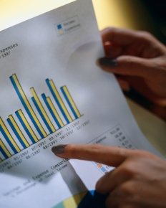

Integration: barriers and disincentives
  Data & capacity
  Political factors/ culture/Competing priorities
  Disconnect between losers and gainers
  Vested interests – gains
Notes:
Expansion
Even in a single project there might be losers and gainers from integrating environment – e.g. In a sewerage treatment project the residents of the town will be paying for the treatment (losers) but the downstreamers users will be benefitting (gainers). In Korea they have experimented with systems where the downstream town pays for the treatment of the upstream town. The stronger the disconnect between gainers and losers the more difficult it might be to integrate environment/ climate change – it will be less obvious and more work will be needed to get both sides togehter and see the wider picture.
Since there would be less information on them slides 16 and 17 could be merged with the drivers in one column and the barriers in a second column
Examples:
Groupwork / discussion:
Activity – could ask for reflections on examples – e.g. Why divert money to environment and climate instead of boreholes

Slide 27
Effective integration and organisations
  Application of a safeguard mechanism – a ‘tool’ – needs to be complemented by an integrated and systematic institutional development approach that realises the potential of environmental assets and recognises the limits.
  But before we get that far…
  What about the EU and EU Delegations themselves?
  Is there:
  Clear environmental vision and leadership?
  Strategy and systems for environmental mainstreaming?
Notes:
Expansion
This is followed by a next slide
Examples:
Groupwork / discussion:

Slide 28
Effective Mainstreaming
Institutional factors of importance
Incentives; sharing of expriences and good practices;
stakeholder participation
Political commitment; Champions
Resources
Analysis of constraints; Objectives;
Road Map
Political will &
Leadership
Goals; Policies; plans
Culture
Strategy
Capacity strengthening; level of awareness, skills and capacity
Vision
Systems
Staff
Cross sectoral + cross level coordination; monitoring
Structure
Clear mainstreaming responsibilities
Effective
mainstreaming
Notes:
Expansion
Applying the slide to DEVCO
Political, Environmental, Economical and Social Factors
….
Examples:
Groupwork / discussion:

Slide 29
Finding the entry points and making the case
Mainstreaming env /cc into policy and planning processes
Meeting the implementation challenge
Preliminary assessments
Understanding env/ CC–development linkages
Understanding the science
Understanding env /climate-related uncertainties
Collecting country-specific evidence and influencing policy processes
Mainstreaming CC in (sub)national and sector policies, strategies, programmes
Budgeting and financing
Mainstreaming env/CC in the budgetary process
Mainstreaming env/ CC in monitoring systems
Performance assessment frameworks
Raising awareness building partnerships
National consensus and commitment to environment / climate- friendly development
Costing, assessing and selecting environment and CC adaptation and mitigation options and measures
A model for integrating
Supporting policy measures
National, sector and sub-national levels
Strengthening institutions and capacities
Needs assessment
Working mechanisms
Strengthening institutions and capacities
Learning by doing
Strengthening institutions and capacities
Mainstreaming
as standard practice
Engaging stakeholders and coordinating within the development community
Adapted from: UNDP-UNEP (2009) Figure 3.1, p. 15
Notes:
Expansion
What would be done in EC development cooperation can support country-led environmental and climate change mainstreaming (please refer to other course)
This model has a primary use for core mainstreaming in the sense of helping a country to mainstreaming environment and climate change and green economy into all sectors – aspects of it also have a relevance for mainstreaming environment and climate change into a project or sector suppported by the EC.
Where there is a credible national effort at mainstreaming – EC cooperation in a particular can be most constructive by linking to those efforts and providing additional support for their work in the particular project/ sector...or in the case of budget support by linking to the national set of environment/climate change indicators.
Examples:
Groupwork / discussion:
This slide could be available as a poster to be used as a reference on flow through the workshop

Slide 30
Module 1- Recap of main messages
Environment – a term that means different things to different people – environment is where we live, development is what we do to improve where we live
Climate change – both mitigation and adaption – exposure/ sensitivity/ impact/ adaptive capacity/ vulnerablity
Green economy - sector examples – what government can do to promote and stimulate the green economy
Integration – a complex concept – need to understand drivers and barriers – institutions matter
Notes:
Introduction to the course: slides 1-3
Definitions: slides 4-11
Concepts: 12-37
Slides 12- 23 Integration Unpacking what we mean by mainstreaming and what we have learnt so far, dirvers and barriers, what it means for organisations, the UNDP_UNEP model of mainstreaming
Slides 24-30 Climate change Unpacking what we mean by climate change , the consequences and how to address them, working out where we stand, concepts behind some of the terminology
Slides 31-38 Green economy Unpacking what we mean by the green economy and the links with mainstreaming of environment and climate change

Slide 31
Resources
Guidelines on the Integration of Environment and Climate Change in Development Cooperation – EU
Climate Change Sector Scripts – EU
Capacity4Development
http://capacity4dev.ec.europa.eu/public-environment-climate/documents
Integrating Climate Change Adaptation into Development Co-operation – Policy Guidance (OECD)
Global Climate Change Alliance
http://www.gcca.eu
International Institute for Environment and Development (IIED)
http://www.environmental-mainstreaming.org
UNDP-UNEP Poverty-Environment Initiative
http://www.unpei.org
Notes:
56. We affirm that there are different approaches, visions, models and tools available to each country, in accordance with its national circumstances and priorities, to achieve sustainable development in its three dimensions which is our overarching goal. In this regard, we consider green economy in the context of sustainable development and poverty eradication as one of the important tools available for achieving sustainable development and that it could provide options for policy making but should not be a rigid set of rules. We emphasize that it should contribute to eradicating poverty as well as sustained economic growth, enhancing social inclusion, improving human welfare and creating opportunities for employment and decent work for all, while maintaining the healthy functioning of the Earth’s ecosystems.

Slide 32
Optional slides

Slide 33
Definitions: Sustainable development - Environment
Sustainable development is development that meets the needs of the present without compromising the ability of future generations to meet their own needs (Brundtland Commission)
Environment includes all those biophysical resources and conditions on which human lives and activities depend (EU guidelines No4)
Notes:
Expansion
Definitions of environment are often linked to Environmentally sustainable development

Slide 34
Definitions: Climate change
Climate change is ‘a change
of climate which is attributed directly or indirectly to human activity that alters the composition of the global atmosphere and which is in addition to
natural climate variability observed over comparable time periods’ (UNFCC)
Notes:
Expansion
Examples:
Groupwork / discussion:

Slide 35
Sustainable development
Still valid but green economy insight can inject new impetus by focusing on the importance of right economic models and decisions to reach environmental sustainability and social development
Economy
Sustainability
Social dimension
Environment
Notes:
Expansion
Examples:
Groupwork / discussion:

Slide 36
Definitions: Green economy
Transition to a green economy is a process of reconfiguring businesses and infrastructure to deliver better returns on natural, human, & economic capital investments while at the same time reducing green house gas emissions, extracting and using less natural resources, creating less waste and reducing social disparities (OECD)
A green economy is one that results in “improved human well-being and social equity, while significantly reducing environmental risks and ecological scarcities” (UNEP 2010)
Notes:
Expansion
Here one can also refer to Rio outcome document – the Future We Want
Integration is one approach which can contribute to green economy. Green economy also requires dedicated programs at the macro, sector and local levels, both in terms of policy reforms and private sector led initiatives. Refer to new course (one day introduction)
Examples:
Groupwork / discussion:
Is Green economy a form of integration?
What are the definitions in this country?

Slide 37

Integration tools and approaches
General Approaches include:
broad tactics (raising issues and /getting heard, e.g. campaigns)
institutional change (strategic approach);
more micro instruments and analytical methods (e.g. for gathering information, planning and monitoring);
consultation and engaging stakeholders;
more informal, voluntary and indigenous approaches
Notes:
Expansion
General approaches – examples from ENVIRONMENTAL MAINSTREAMING IN PLANNING AND DECISION-MAKINGApproaches and Challenges
Barry Dalal-Clayton IIED3rdAstana International Economic Forum 1st July 2010
Examples:
Groupwork / discussion
General Approaches include:
broad tactics(ways of raising issues and making a case/getting heard, e.g. campaigns, lobbying)
promoting/enabling institutional change (strategic level approaches);
specific (more micro) instruments, technical tools and analytical methods (e.g. for gathering information, planning and monitoring);
methods for consultation and engaging stakeholders;
range of more informal, voluntary and indigenous approaches

