Slide 1
Environment and climate change in development cooperation
The EU perspective – module 3

Slide 2
Structure
Why integrate? The policy basis
EU programmes and flagship initiatives
Green Diplomacy Network
EU working together

Slide 3
Environmental integration in EC development policy
Q Why should we integrate the environment and climate change in EC development co-operation activities?
A Because specific policy commitments have been made to this effect, which are reflected in:
EUs founding Treaties & policies
Regulations & Guidelines that govern EC development cooperation
Multi-lateral agreements and development agenda
Notes:
Expansion
Examples:
Groupwork / discussion

Slide 4

Stepping up integration – the policy basis
Communication on Rio 2012
Agenda for Change; 20% target 2011
Guidelines on Environment and Climate Change in Development Cooperation 2009
Development Cooperation Instrument 2006
European Consensus on Development 2005
Paris Declaration 2005
ACP-EU Partnership agreement Cotonou 2000/20
MDG #7 Environmental Sustainability 2000
Amsterdam Treaty 1997
Convention on Biodiversity; Convention to Combat Desertification; Framework on CC and Kyoto Protocol 1992
Maastricht Treaty 1992; Single European Act 1987
Notes:
Expansion
Examples:
Groupwork / discussion

Slide 5
Agenda for change: making the links
Recognises the links between environment and natural resource management and poverty reduction and growth
Development is not sustainable if it damages the environment, biodiversity and natural resources and increases the exposure/vulnerability to natural disasters.
[EU development policy] should contribute to improving the resilience of developing countries to the consequences of climate change
EU development policy should promote a ‘green economy’ that can generate growth, create jobs and help reduce poverty by valuing and investing in natural capital

Slide 6
Agenda for change: highlighting sectors
Highlights sectors relevant for ENV and CC – Agriculture and Energy
Good governance, in its political, economic, social and environmental terms, is vital for […] development
Promote and support political, economic, social and environmental policy reforms in partner countries
Reduce developing countries' exposure to global shocks such as climate change, ecosystem and resource degradation, and volatile and escalating energy and agricultural prices, by concentrating investment in sustainable agriculture and energy
Tackle inequalities, in particular to give poor people better access to land, food, water and energy without harming the environment

Slide 7

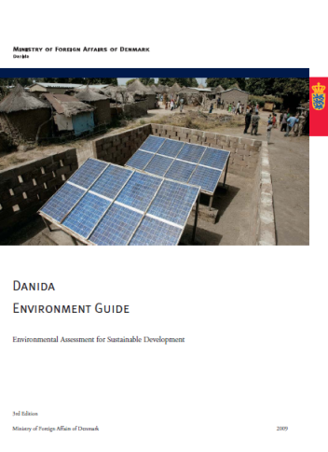
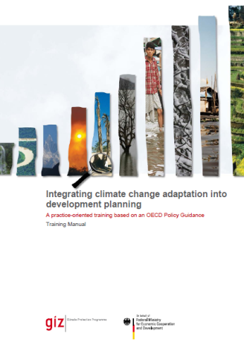
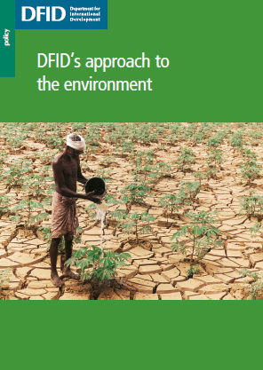
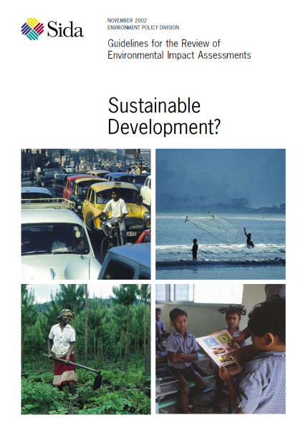
What are other (EU) donors doing?
Mainstreaming tools and methods
Computer-based decision support tools
Notes:
Expansion
Examples:
Groupwork / discussion

Slide 8
EU Instruments, Initiatives and Facilities
Thematic programmes
Environment and Natural Resources Thematic Programme (ENRTP) (to be replaced in 2014)
Global Public Goods and Challenges Programme (GPGC)
Some flagship initiatives
Global Climate Change Alliance+ (GCCA+)
Forest Law Enforcement, Governance and Trade (FLEGT)
SWITCH TO GREEN
EU Biodiversity for Lives Initiative (EUBLI)
Investment Facilities (climate windows)
Partnership instrument (climate is a priority)

Slide 9
Green Diplomacy Network (GDN)
Using diplomatic networks promote environmental integration
  Uses EU’s diplomatic resources in support of environmental objectives (outreach and listening)
  Shares experiences on how Member States are integrating environmental concerns in diplomacy
  Support local informal green diplomacy networks in third countries between EU Embassies and Delegations
Focuses on topics related to EU’s external relations, such as climate change, biodiversity, land degradation and renewable energy
http://eeas.europa.eu/environment/gdn/index_en.htm
Notes:
Expansion
Examples:
Groupwork / discussion
http://eeas.europa.eu/environment/gdn/index_en.htm

Slide 10
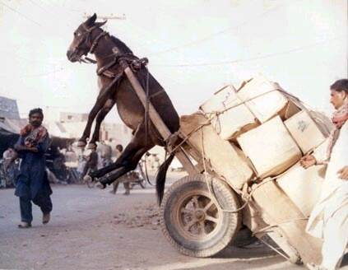
Integration
Are there limits on how far and how fast to encourage partners to integrate?
A strategic approach –
Ambition level should be realistic, more trips
Harmonise and work together

Slide 11
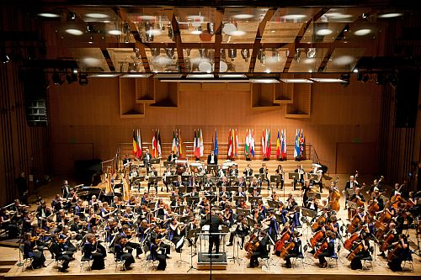
EU working together
Notes:
Expansion
Basically convey message that the EU "orchestra" is loud and strong and composed of a wide array of complementary instruments. Challenge: Bringing this together – "same hymn sheet" etc…
Examples:
Groupwork / discussion

Slide 12
Module 3 – recap main messages
EU is committed to environment and climate change mainstreaming
Other donors are also taking similar actions
EU contributes in a number of ways - Green Diplomacy Network – Research
Wide array of EU actors – use them, involve them

Slide 13
Resources
EU Green Diplomacy Network
http://eeas.europa.eu/environment/gdn/index_en.htm
Rio+20 - UN Conference on Sustainable Development: The Future We Want
Partners in civil society...just a few
IUCN -One of the international NGOs much involved in environment, climate change and green economy
WWF - Biodiversity: the magic of our planet!
Oxfam A safe and just space for humanity
Other partners... just a few
Sida – environment and climate change help desk
NCEA - Netherlands Commission for Environmental Impact Assessment

Slide 14
Optional slides

Slide 15
Communication for Rio - Climate change policy future prospects
Increasing emphasis on green economy, within and outside Europe.
Renewed interest on CC in development policy.
Priorities for external actions: building capacity for mitigation, adaptation, technology, mainstreaming.
Immediate adaptation needs.
For the long term: leverage private sector and mobilise international carbon markets – increasing role for green technologies and innovative financing mechanisms to promote the green economy

Slide 16
        Joint statement by Janez Potočnik and Ida Auken on the Rio+20 Declaration
        “Today the world has indicated that we must move towards sustainable development, and the inclusive green economy is a central pathway to achieve this. The EU has remained committed and constructive throughout the negotiations, and has spoken with one ambitious voice. We are pleased that this delivered results. However, we recognize that Rio is just the beginning and a range of activities have to be followed through at international level.”
         Sustainable Development Goals
RIO+20

Slide 17
EU cooperation and climate change (1/4)
Climate change in the context of development cooperation, COM(2003) 85 final (11.03.2003) + related Action Plan
Support for climate change adaptation
Support for mitigation efforts
Support for capacity development

Slide 18
Agenda for change: making the links
Recognises the links between environment and natural resource management and poverty reduction and growth
Development is not sustainable if it damages the environment, biodiversity and natural resources and increases the exposure/vulnerability to natural disasters.
[EU development policy] should contribute to improving the resilience of developing countries to the consequences of climate change
EU development policy should promote a ‘green economy’ that can generate growth, create jobs and help reduce poverty by valuing and investing in natural capital

Slide 19
EU cooperation and climate change (2/4)
Building a Global Climate Change Alliance between the EU and poor developing countries most vulnerable to climate change, COM(2007) 540 final (18.09.2007)
Adaptation to climate change
Reducing emissions from deforestation
Enhancing participation in the Clean Development Mechanism
Promoting disaster risk reduction (DRR)
Integrating climate change into poverty reduction efforts

Slide 20
EU cooperation and climate change (3/4)
Towards a comprehensive climate change agreement in Copenhagen, COM(2009) 39 final (28.01.2009)
“To meet the 2°C objective, (…) developing countries, as a group, will need to limit the rise in their GHG emissions (…) to 15-30% below baseline by 2020”
“All developing countries, except least developed countries (LDCs), should commit to adopting low-carbon development strategies by the end of 2011”
Innovative financing mechanisms will have to be set up to support the implementation of adaptation and mitigation measures by developing countries (e.g. Adaptation Fund, proposed Global Climate Financing Mechanism)

Slide 21
Communication on “Effective and transparent delivery of climate finance in developing countries” (4/4)
Provides a framework for EU Climate Change support on:
EU response as one
Principles for delivery
Reporting of financial support
Alignment to aid effectiveness principles
Focuses on:
Progress in support to negotiations
Issues related to delivery of climate finance and mitigation
Notes:
This document provides a framework for European support to climate change by establishing principles in the delivery, reporting and monitoring of climate finance, ensuring the alignment of EU support to agreed aid effectiveness principles and proposing reinforced EU coordination mechanisms. It addresses some key issues of concern to developing countries and in particular it proposes a reinforced focus on Renewable Energies in Africa.
Focuses on:
Key issues where progress will help advancing discussions in view of the next round of climate negotiations in Cancun.
It complements existing strategies and commitments, primarily focused on adaptation, by addressing issues related to delivery of climate finance and mitigation

Slide 22
EU treaties and policies
The Single European Act, 1987 - Establishes the legal basis for a community-wide environmental policies and formulates the objective of integration into other policies
Maastricht Treaty, 1992 - establishes the principle of integration of environmental aspects into all community policies (article: 130R/174)
Amsterdam Treaty, 1997 - makes the principle of environmental integration into all community policies a guiding principle of the EU

Slide 23
Rio 1992 conventions
Desertification Convention
To combat desertification and mitigate the effects of drought, supported by international cooperation & partnership in the
framework of an integrated
approach, to contribute to sustainable
development
Biodiversity Convention
To conserve biological diversity.
To use biological diversity in a
sustainable fashion
To share the benefits of biological diversity fairly and equitably
Climate Change Convention
To achieve stabilization of greenhouse gas
concentrations in the
atmosphere at a level that would prevent dangerous anthropogenic interference with the climate system.

Slide 24
European Consensus on Development (2005)
“Protection of the environment must be included in the definition and implementation of all Community policies, particularly in order to promote sustainable development”
“Strengthened approach to mainstreaming – the Commission will re-launch this approach, making systematic and strategic use of all resources at its disposal”
“Strategic environmental assessments and gender-equality impact assessments will be carried out on a systematic basis, including in relation to budget (‘greening the budget’) and sector environmental aid”
“The and the sustainable management of natural resources” becomes one of the areas for community action
Development Cooperation Instrument
Article 22 – Adoption of annual action programmes
“4. Appropriate environmental screening shall be undertaken at project level including environmental impact assessment (EIA) for environmentally sensitive projects, in particular for major new infrastructure. Where relevant, strategic environmental assessments (SEA) shall be used in the implementation of sectoral programmes. The involvement of interested stakeholders in environmental assessments and public access to results shall be ensured.”

Slide 25
Cooperation instruments: Cotonou 2000-2020
ACP-EU Partnership Agreement
Establishes the principle of mainstreaming three "cross-cutting" themes into all areas of co-operation:
gender equality
environmental sustainability
institutional development and capacity building
Art. 32 - Environment and natural resources
“1. Cooperation on environmental protection and sustainable utilisation and management of natural resources shall aim at:
(a) mainstreaming environmental sustainability into all aspects of development cooperation and support programmes and projects implemented by the various actors
(b) building and/or strengthening the scientific and technical human and institutional capacity for environmental management for all environmental stakeholders”

Slide 26
Multilateral framework: the Millennium Development Goals (2000)
MDG 7: “Ensure environmental sustainability”
Integrate the principles of sustainable development into country policies and programmes and reverse the loss of environmental resources
Reduce biodiversity loss, achieving, by 2010, a significant reduction in the rate of loss
Halve, by 2015, the proportion of people without sustainable access to safe drinking water and basic sanitation
By 2020, to have achieved a significant improvement in the lives of at least 100 million slum dwellers

Slide 27
Multilateral framework: Paris Declaration on Aid Effectiveness (2005)
Commitments to:
Deepen and continue harmonisation efforts with regard to environmental impact assessment (EIA)
Strengthen the application of EIA and more systematically use common procedures
Develop and apply common approaches for strategic environmental assessment (SEA) at the sector and national levels

Slide 28
Policy Basis
MDGS – notably no. 7
- Integrate SD in country policies
- Reduce biodiversity loss
- Access to safe drinking water and sanitation
PARIS DECLARATION - 2005
§§ 40 – 41 Harmonised approach to environmental assessments (EIAs and SEAs)
EUROPEAN CONSENSUS ON DEVELOPMENT – 2005
“Strategic Environmental Assessments will be carried out on a systematic basis, including in relation to budget (‘greening the budget’) and sectoral aid.”

Slide 29
Policy Basis and Programming
AGENDA FOR CHANGE (2011)
  Good governance – environment
  “Development is not sustainable if it damages the environment”
  CSR (i.e. private sector)
  environmental policy reforms
  global challenges & shocks; resilience
  Highlights sustainable agriculture and energy sectors
  Should promote “green economy”
  PROGRAMMING GUIDELINES (extensive references to AfC)
  20% for climate related actions – EU BUDGET
  Analysis of Development Plans (CEPs); MIPs (SEAs)
Notes:
Note that WB have CEAs to complement / replace CEPs and UNDAF may also contain similar analysis

Slide 30
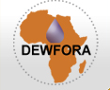



CATALYST 2011-2014
► identify and share the best of knowledge and practices related to natural hazard and disaster risk reduction (NH/DRR), including adaptation
►provides Capacity Development for Disaster Risk Reduction and Adaptation in Central America and the Caribbean, Asia and Africa
FP7 Contribution: € 0.8m
www.catalyst-project.eu
DEWFORA (2010-2013):
► Improved drought early warning and forecasting to strengthen preparedness and adaptation to droughts in Africa
19 partners, of which 8 from African countries
FP7 Contribution: € 3.5m
www.dewfora.net
Healthy Futures (2011-2014)
► Better understanding of links between environment and vector-borne infectious diseases
► Improved modelling & vulnerability assessments to support decision-making
15 partners, of which 7 from Eastern Africa
FP7 Contribution: € 3.4m
www.healthyfutures.eu
I-REDD+ (2011-2014)
► Quantifying GHG emissions and removals in tropical forests and peatlands
► Governance of REDD and developing and testing MRV systems.
► Assessing the benefits and costs of REDD+ policies for livelihoods of local communities.
14 partners, of which 6 from Asia and Africa
FP7 Contribution: € 3.2m
www.i-redd.eu
Notes:
Expansion
Examples:
Groupwork / discussion

Slide 31


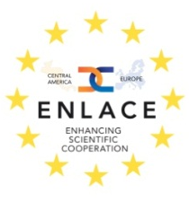
FP7 Capacities Program: examples
Platforms for International Cooperation (INCO-NETs) in Latin America and the Caribbean
EULARINET (2008-2012)
EU–Latin American Research and Innovation Networks
  19 Partners: 11 from Europe + Colombia, Uruguay, Brazil, Chile, Nicaragua, Argentina, Mexico
  Biodiversity and Climate Change amongst identified priorities
EUCARINET (2010-2014)
Fostering EU-Caribbean Research and Innovation Networks
12 Partners: 5 from EU +Guyana, French Guyana, Cuba, Netherlands Antilles, Jamaica, Dominican Republic
ENLACE (2009-2013)
Enhancing Scientific Cooperation between the EU and Central America
15 Partners: 7 from EU + Costa Rica, Guatemala, Mexico, Panama, Honduras, Panama, Nicaragua

