Slide 1
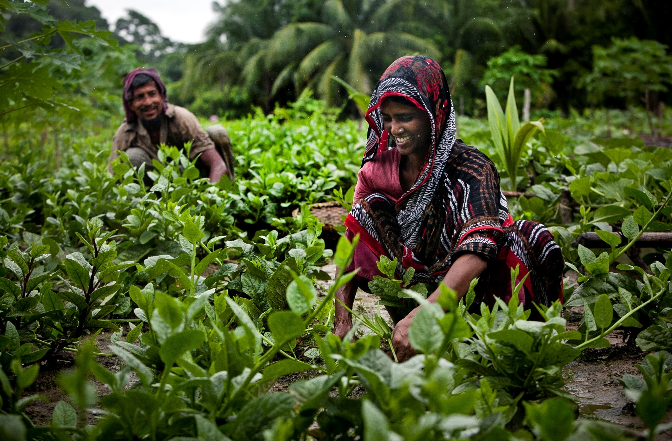

Agriculture and Nutrition Extension Project ANEP
Photo credit: iDE/ Allison Joyce
EC, Brussels, 22 January, 2014

Slide 2

International Development Enterprises
Founded in 1982 iDE currently operates 12 country programmes in Asia, Africa, and Latin America Delivered more than 250 projects in market and private sector developed valued at over $150 million in over 20 countries worldwide Funding from more than 90 donors, including USAID, the Bill and Melinda Gates Foundation, DFID, CIDA, and the World Bank Recipient of over 10 international development and design awards since 2004 Employs over 700 staff worldwide
Mission to create income and livelihood opportunities for poor rural households.
iDE is focusing on:
Product design and innovation
Technology commercialisation
Market systems development
Working in agriculture, water and sanitation, access to finance, and energy and environment.

Slide 3


EU FUNDED
Contract: DCI-FOOD/2011/261-122 signed 16/12/2011
3 years (Dec 2011- Dec 2014)
Nepal and Bangladesh

Slide 4
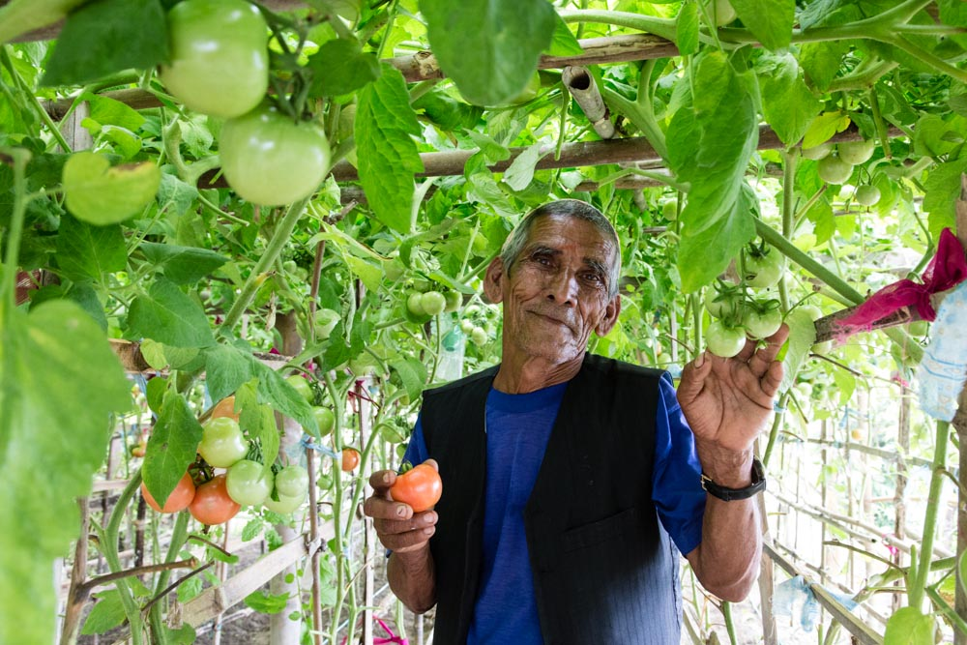


ANEP Specific Objectives
Improve the food security and nutrition of smaller households by introducing & facilitating the adoption of productive & environmentally sustainable agricultural technologies which improve beneficiaries' livelihoods
Contribute to creating/improving market linkages to improve food & nutritional security of both rural producers & urban consumers
Photo credit: iDE
This project is funded by
The European Union

Slide 5
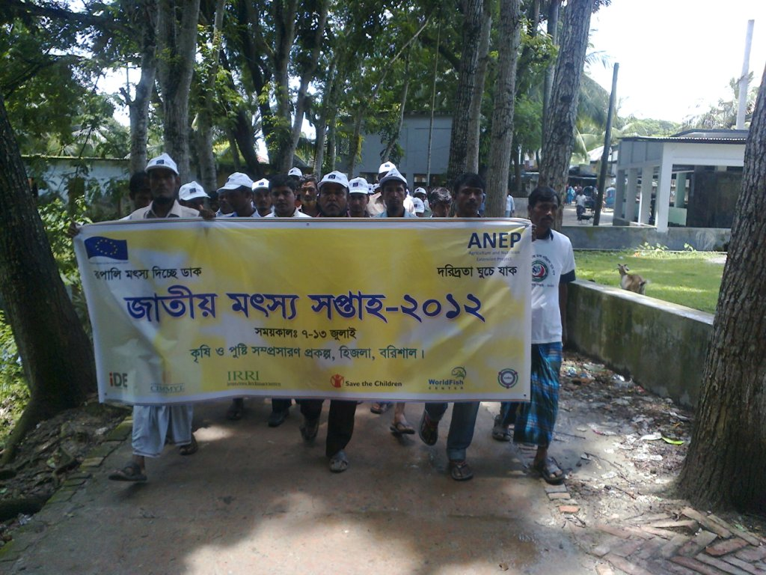
Main Focus of ANEP
Funded through the EU Technology Transfer for Food Security in Asia (TTFSA) Program, ANEP seeks to improve the food security and nutrition of poor and vulnerable households through:
Sustainable Production
Technology Transfer
Market Linkage
Nutrition
Photo credit: iDE
This project is funded by
The European Union

Slide 6
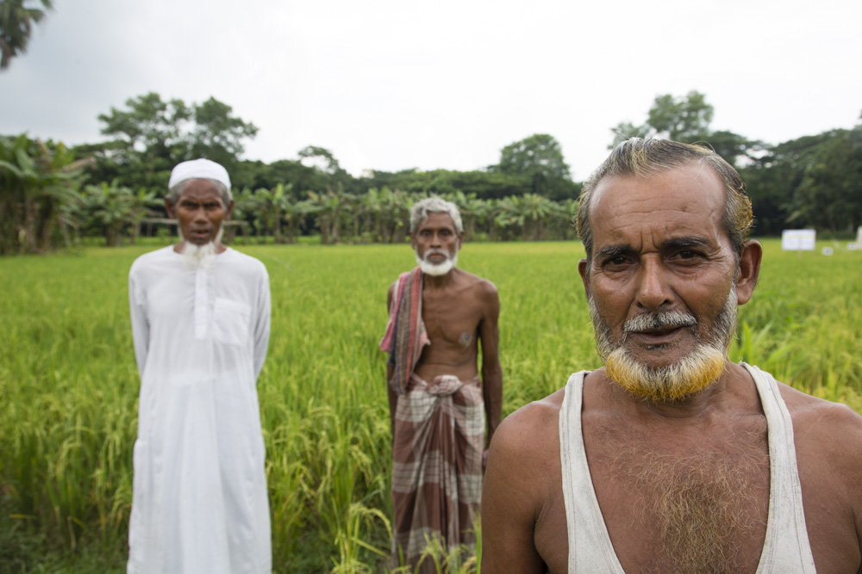




ANEP is multi-disciplinary
Bringing world-class research in agronomy and agro-technologies from the international centres
Deploying nutrition education techniques
Implementing by building the capacity of local organizations
Ensuring greater efficiency, effectiveness and sustainability through the market-development approach
Photo credit: iDE/ David Graham
This project is funded by
The European Union

Slide 7
ANEP in Nepal
A market-based approach to rural development
This project is funded by
The European Union

Slide 8
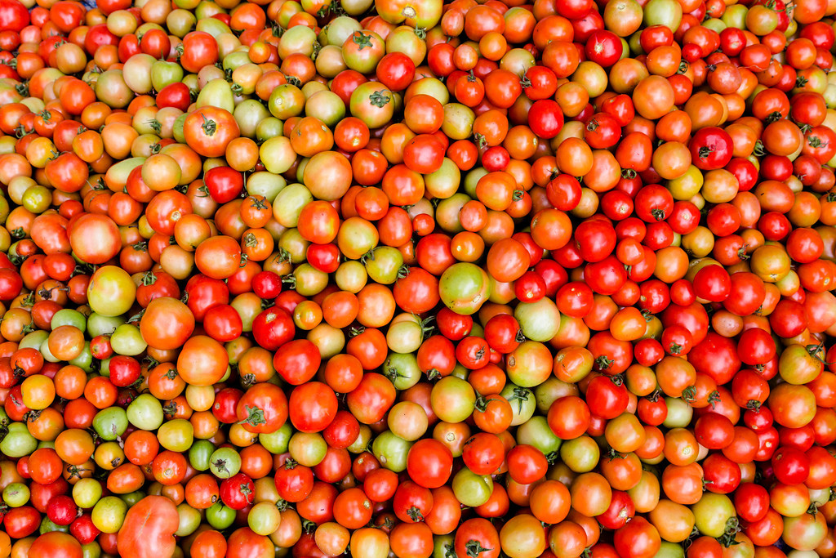
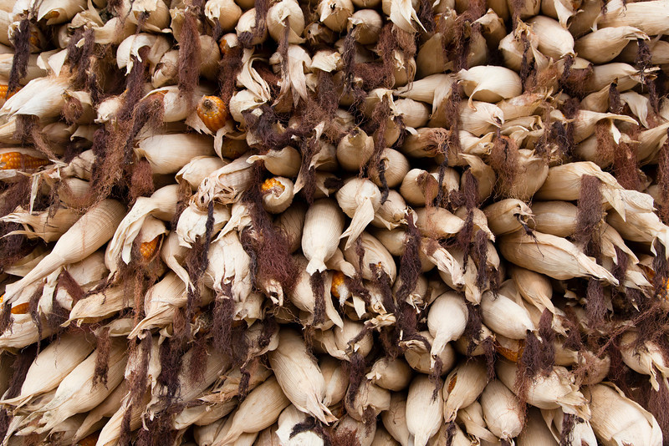
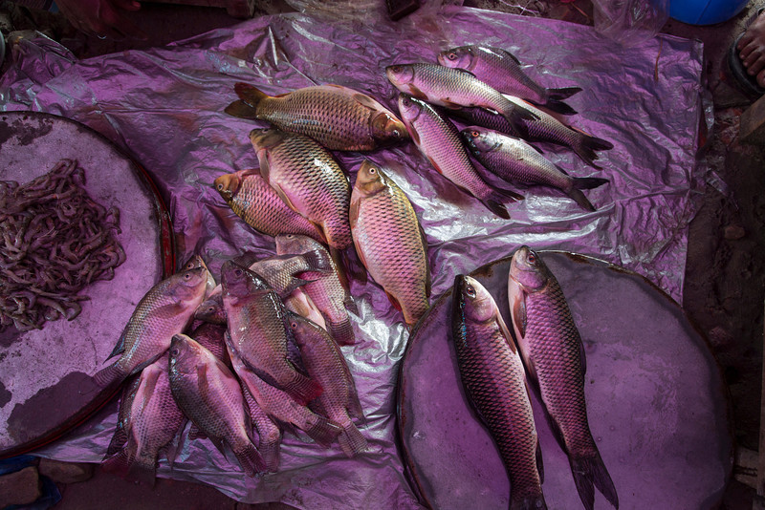
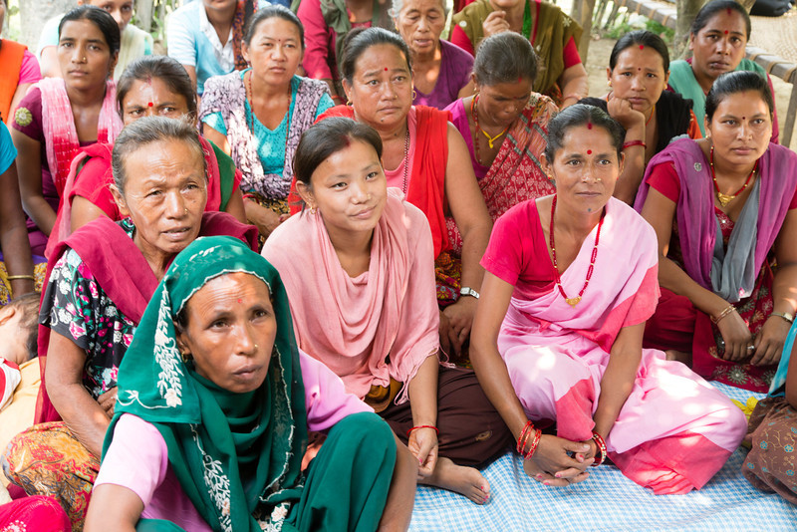
Project Components
Vegetables
Cereals
Fish
Nutrition
Notes:
Vegetable
Cereal food grain (rice, maize) and legume crops (lentil)
Carp polyculture with small fish
Nutrition & health

Slide 9
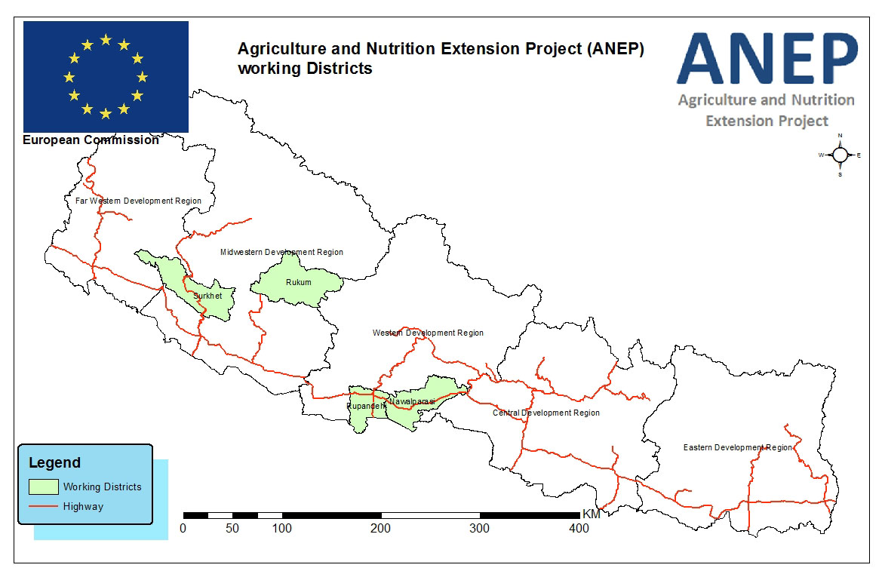
Project Districts
Notes:
Project Districts and Component
Project districts:
Rupandehi and Nawalparasi (2 terai districts)
Surkhet and Rukum (2 hill districts)
Components:
(a) vegetable, cereal, fish & nutrition component
Rupandehi
Nawalparasi
(b) Vegetable seed component
Surkhet
Rukum

Slide 10
Project Households
Household Category | Nepal
Rural HH | 16,000
Core HH | 3,000
Value Chain HH | 13,000
Urban HH | 3,000
Seed HH | 1,000
TOTAL | 20,000
This project is funded by
The European Union

Slide 11
Component Households Targeted
Component | Nepal
Rural Core HH
Vegetable | 2,394
Cereal | 2,400
Fishery | 600
Rural Unique HH | 3,000
Rural Value Chain HH | 13,000
Urban HH | 3,000
Seed HH | 1,000
TOTAL HH | 20,000

Slide 12
Reached (Year 1 & 2)
Pocket | VDC (#) | Group (#) | HH Regd. (#) | Female (#)
Rural Core
Gopigunj | 5 | 42 | 986 | 711
Ramgram | 6 | 44 | 1145 | 828
Dhakdhahi | 6 | 41 | 975 | 829
Total | 17 | 127 | 3,106 | 2,368 (76.2%)
Urban Core
Ramgram |  | 35 | 854 | 854
Bhairahawa |  | 5 | 126 | 126
Butwal |  | 48 | 1113 | 1112
Total |  | 88 | 2,093 | 2,092 (100%)
Value Chain HH Seed Household TOTAL | 11 28 | 321 47 563 | 8,074 1,094 14,367 | 990 (13%) 660 (60%) 6,110 (42.5%)

Slide 13
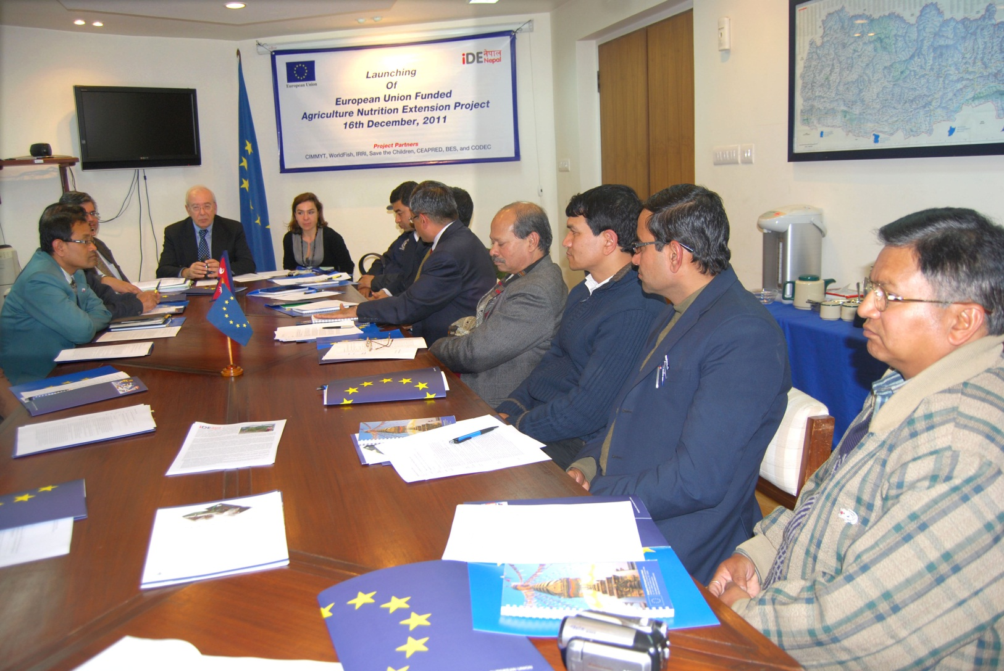
Launch Meeting

Slide 14
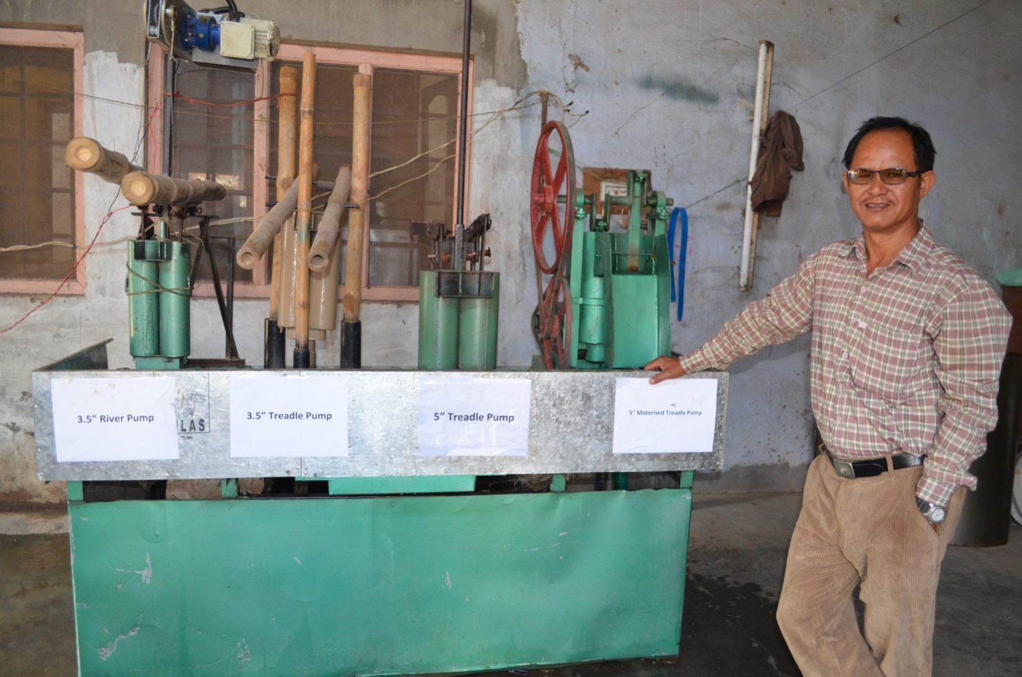
New Thapa Engineering, Bhairahawa

Slide 15
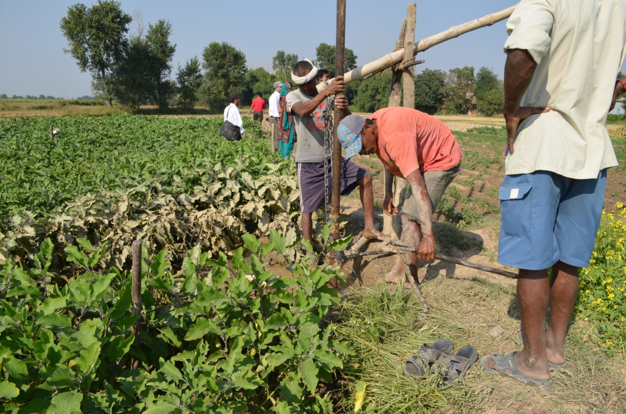
Micro Irrigation Technology installation
Devgaun, Mahuwari, Nawalparasi

Slide 16
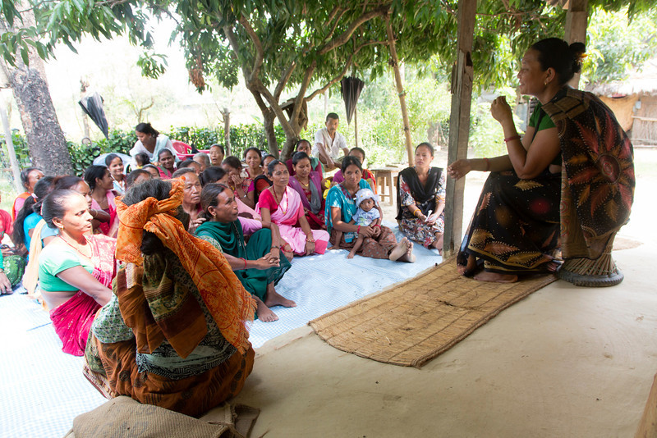
Nutrition & Health activities
Notes:
Nutrition education training of trainers
Nutrition education session to farmer groups
Growth monitoring under 2 years children
Healthy baby competition
Nutition Training of Trainers (Tot)

Slide 17
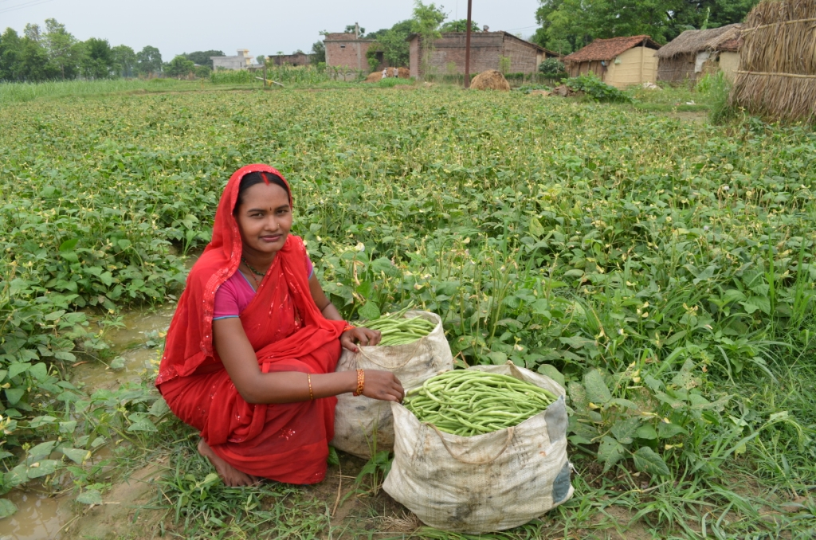
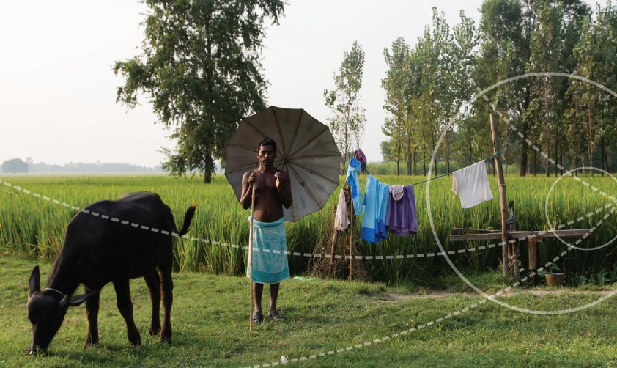
Vegetable activities
Notes:
Market led production planning
Nursery raising training
Off-season vegetable cultivation training
Kitchen garden training
Integrated Pest Management (IPM) technology training
Kitchen garden / crop variety / IPM technology demonstration
Micro irrigation technology (MIT) promotion

Slide 18
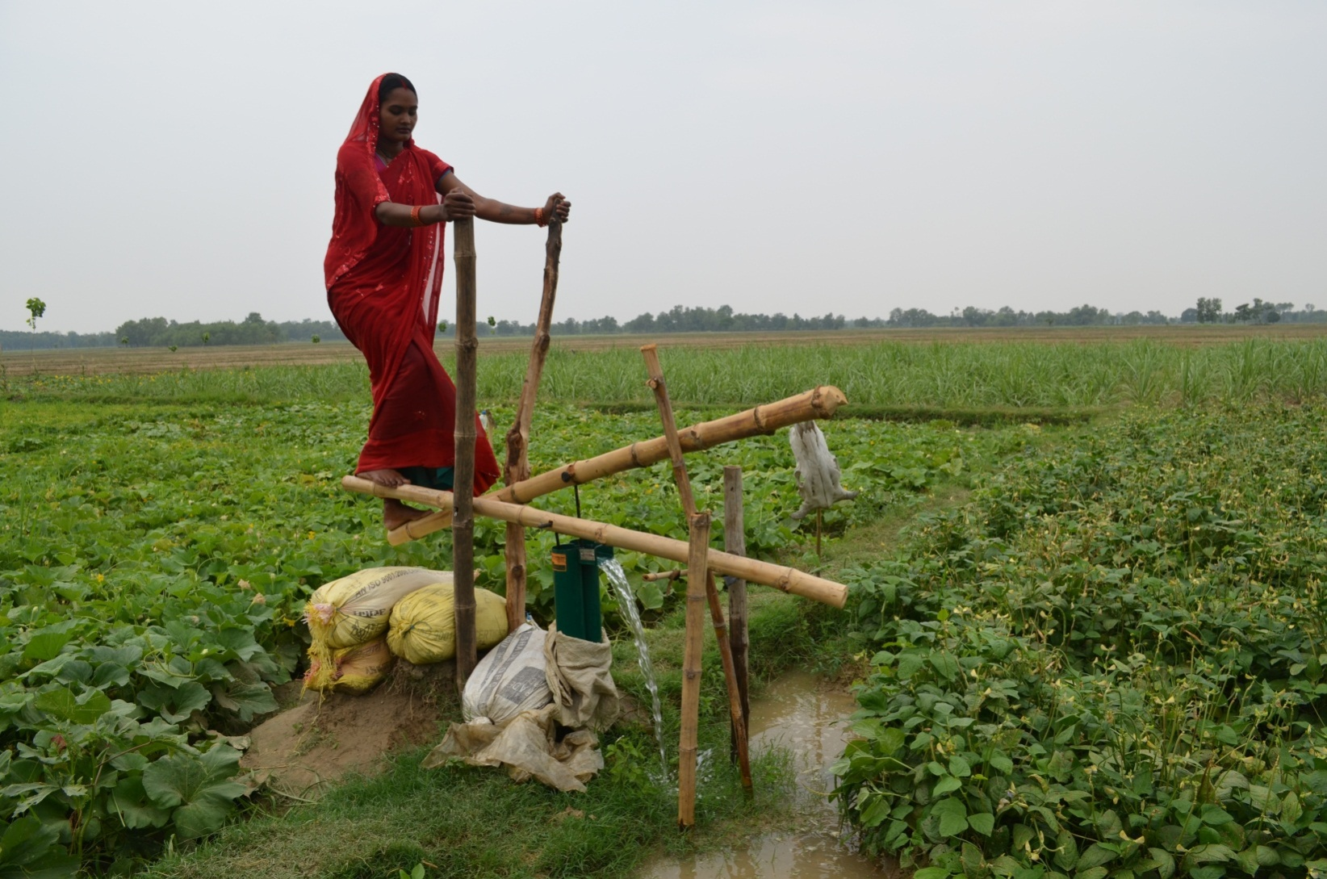
Vegetable farm with treadle pump
Devgaun-3, Phulbariya, Nawalparasi

Slide 19
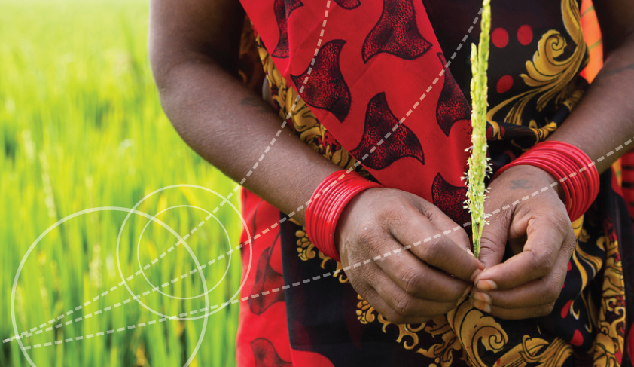
Cereal activities
Notes:
Scale up farm mechanization
Efficient nutrient management training and demonstration
Extension of best technology/practices (zero tillage, short duration / stress tolerant variety, weed management)
Efficient water management
Seed storage

Slide 20
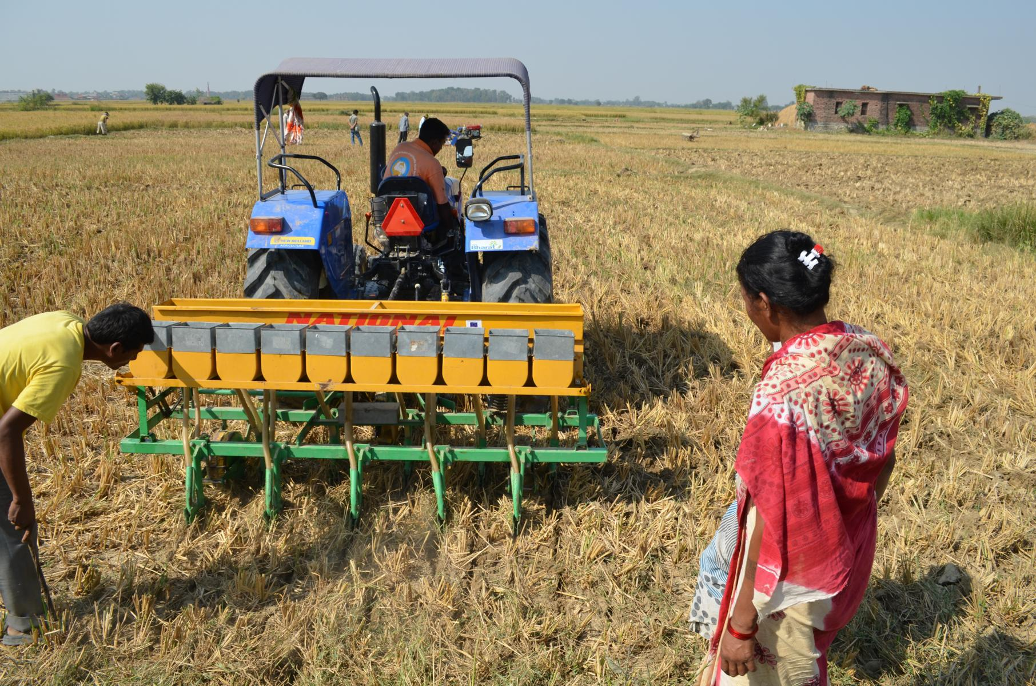
Zero tillage lentil seed drill sowing
Prasauni, Basantapur, Rupandehi,

Slide 21
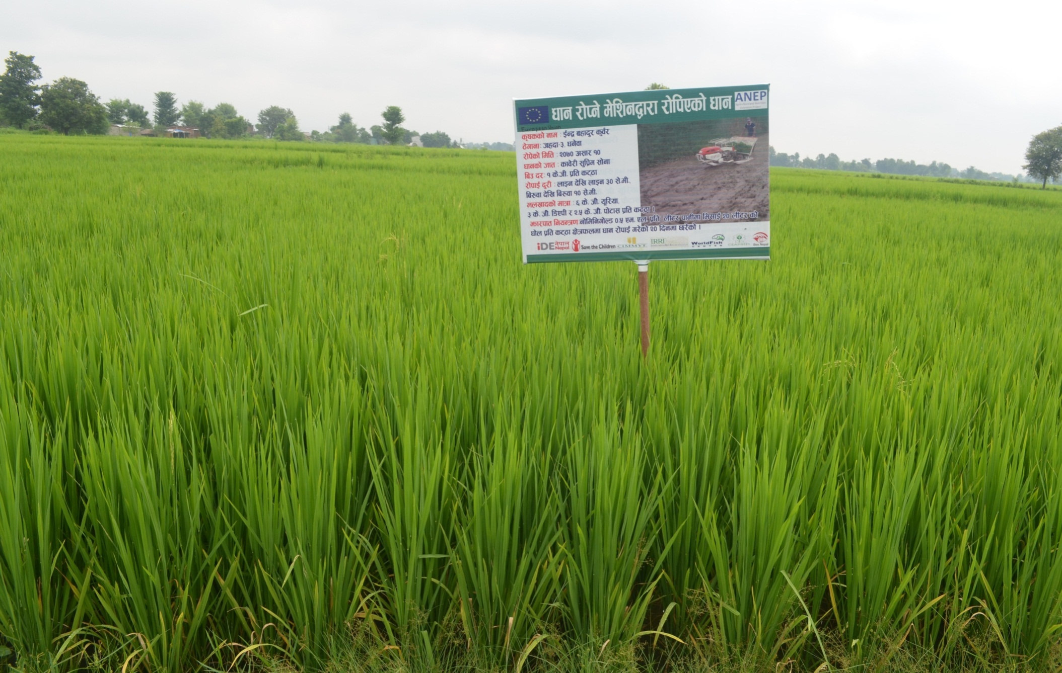
Mechanically transplanted rice
Jahada, Nawalparasi

Slide 22
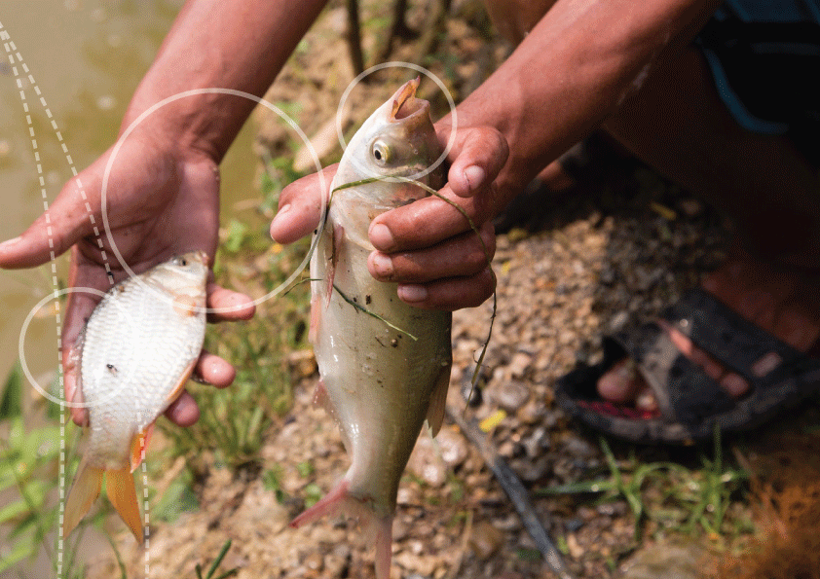
Fish activities
Notes:
Pond construction
Capacity building training
Pond dike vegetable cultivation training

Slide 23
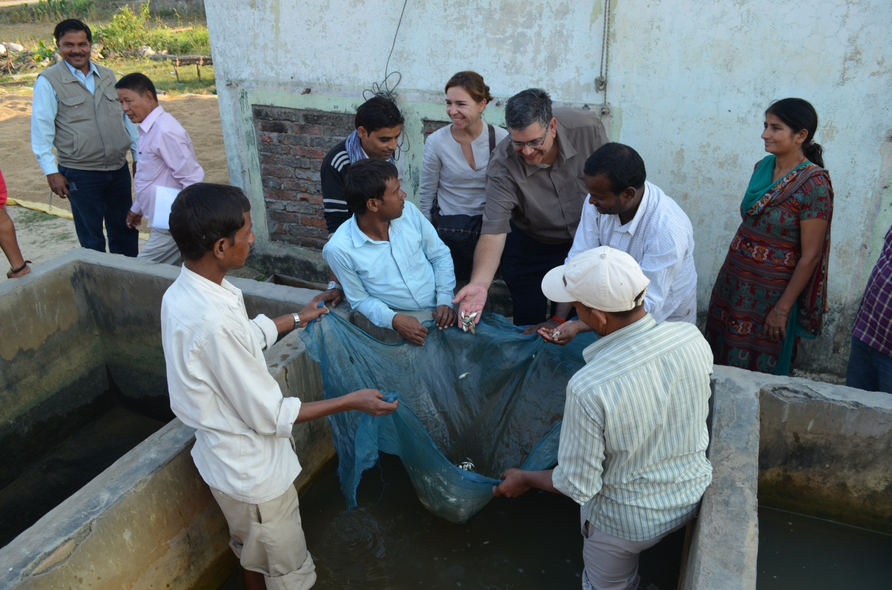
Fish hatchery and nursery
Pali, Nawalparasi

Slide 24
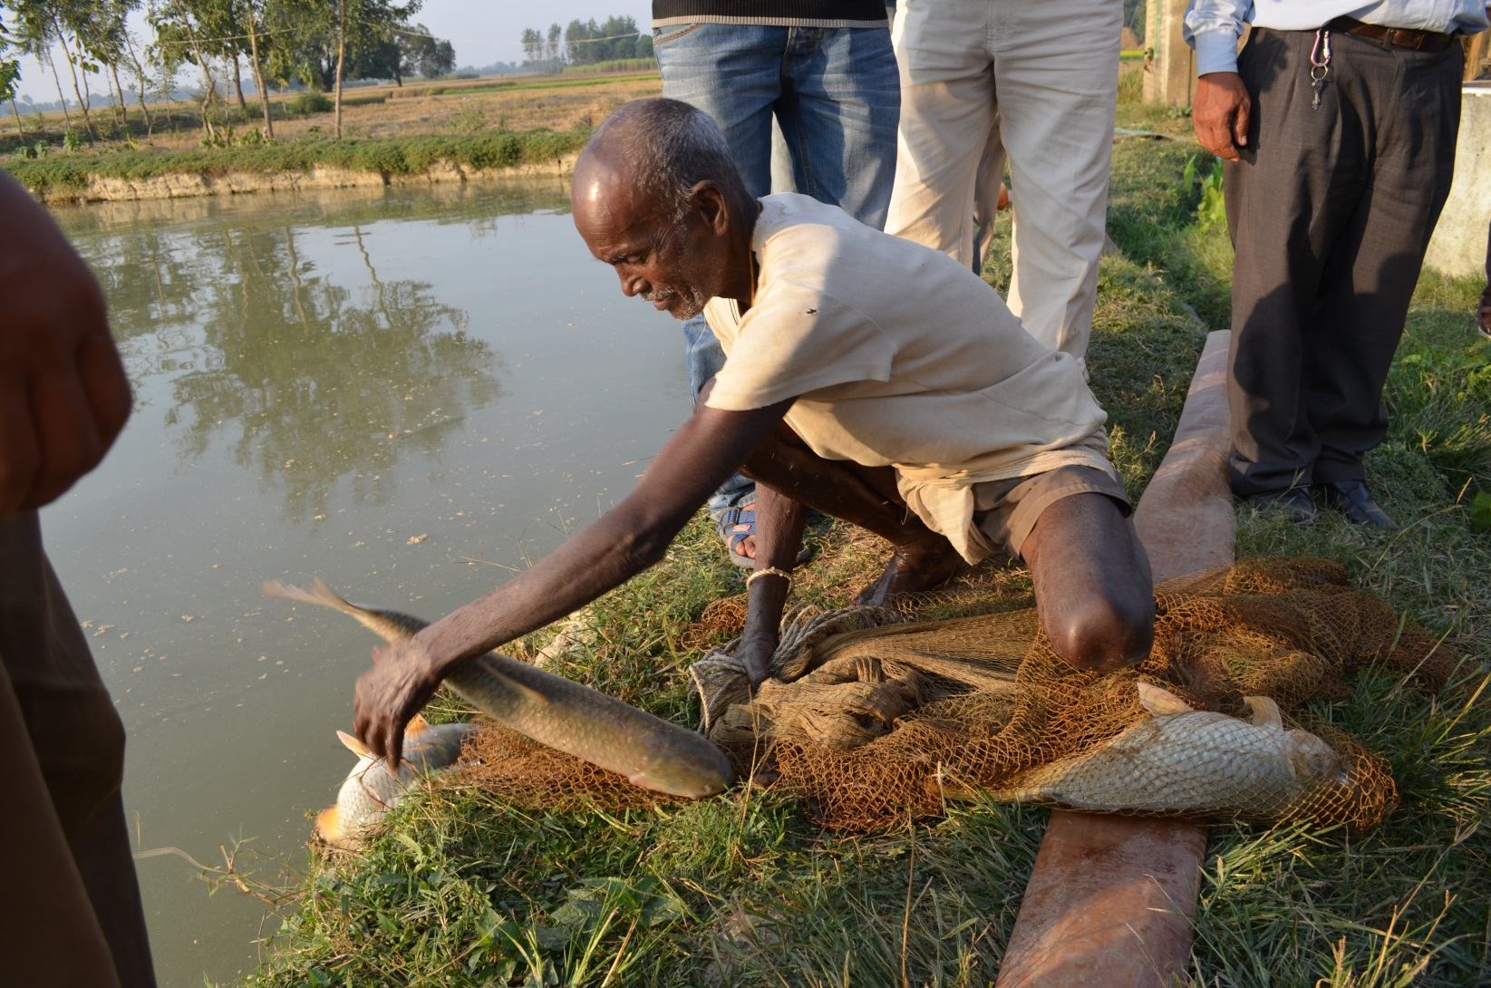
Brood at Fish hatchery and nursery
Pali, Nawalparasi

Slide 25
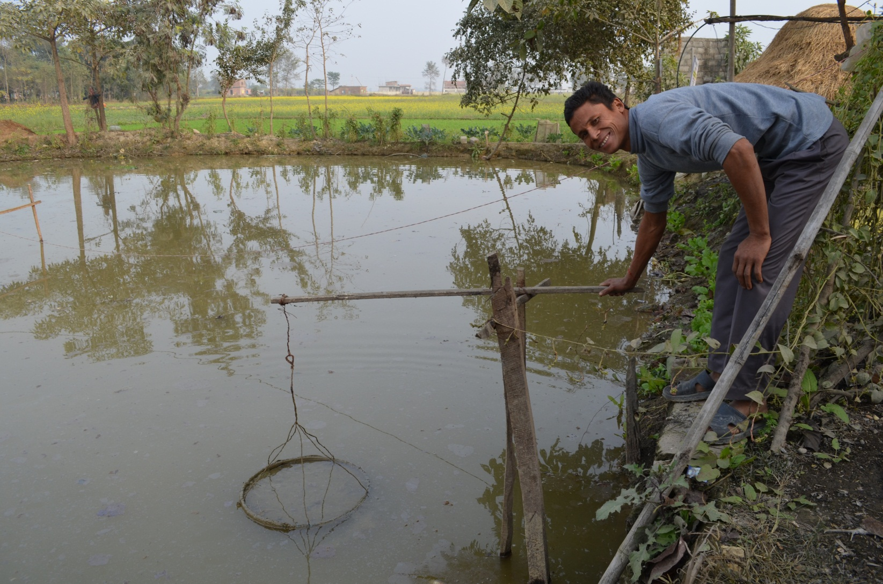
Feeding tray used on fish pond
Devgaun, Patkhauli, Nawalparasi

Slide 26
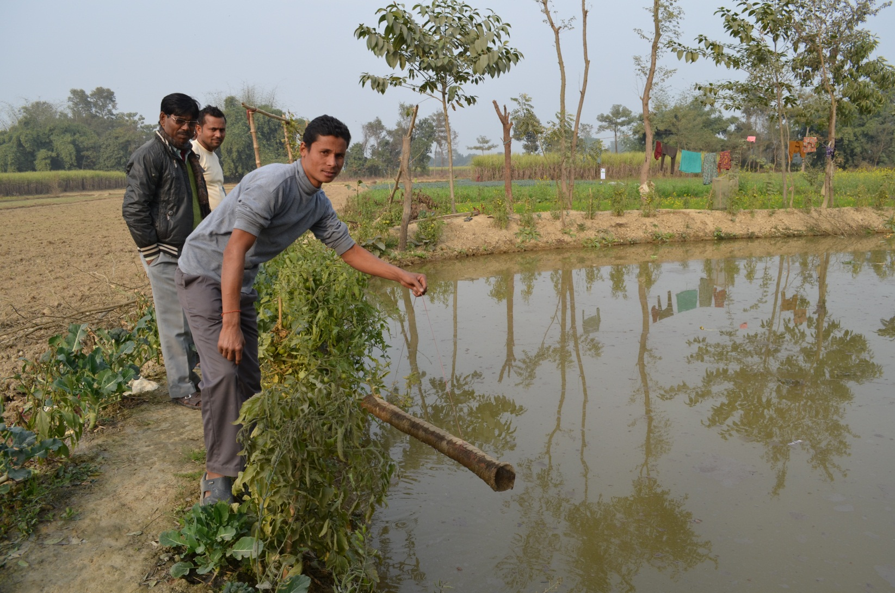
Snake Trap
Devgaun, Patkhauli, Nawalparasi

Slide 27
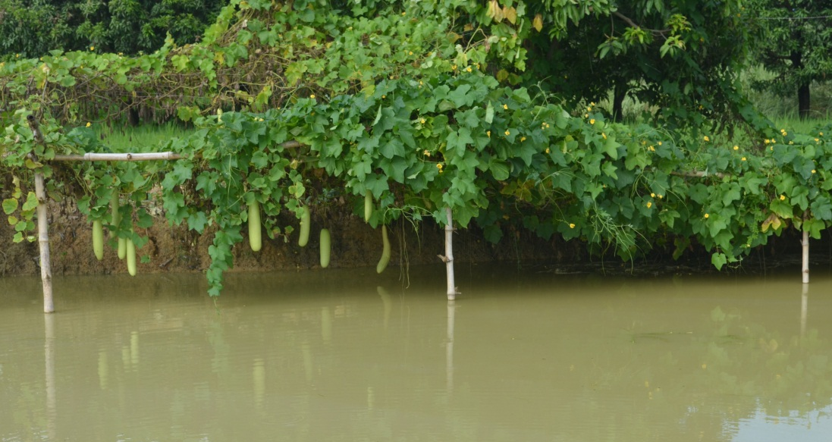
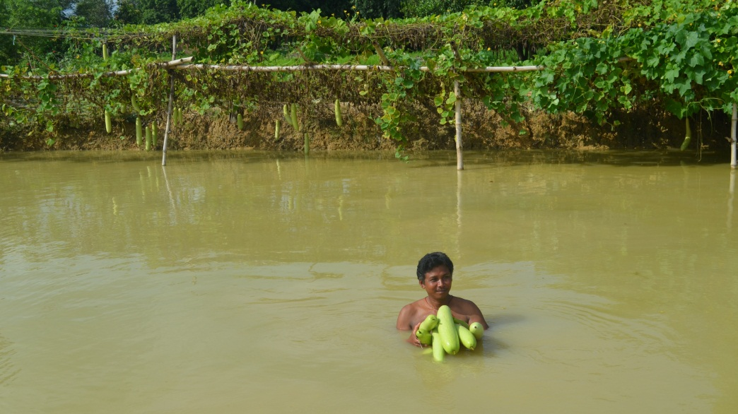
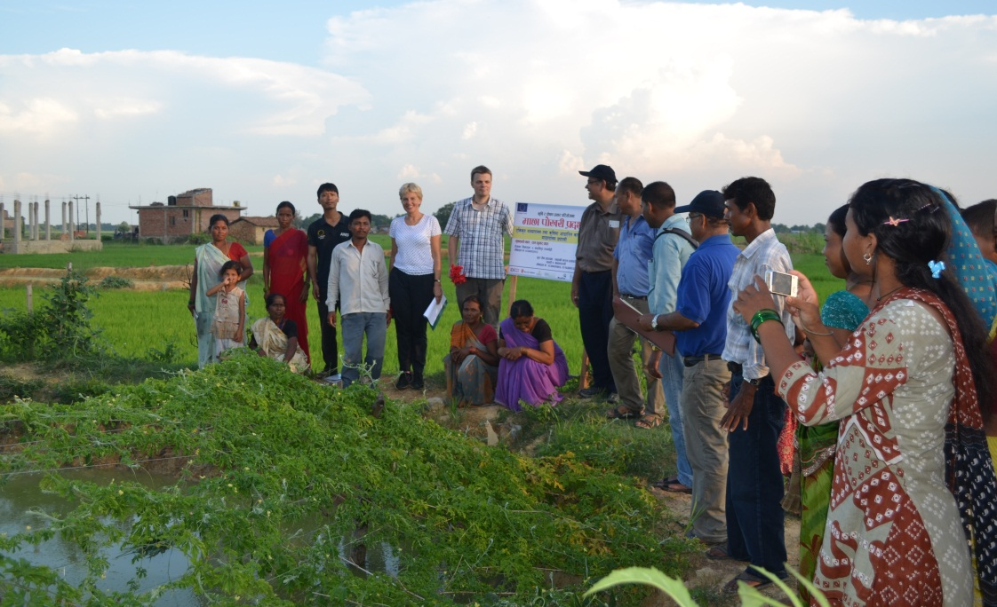
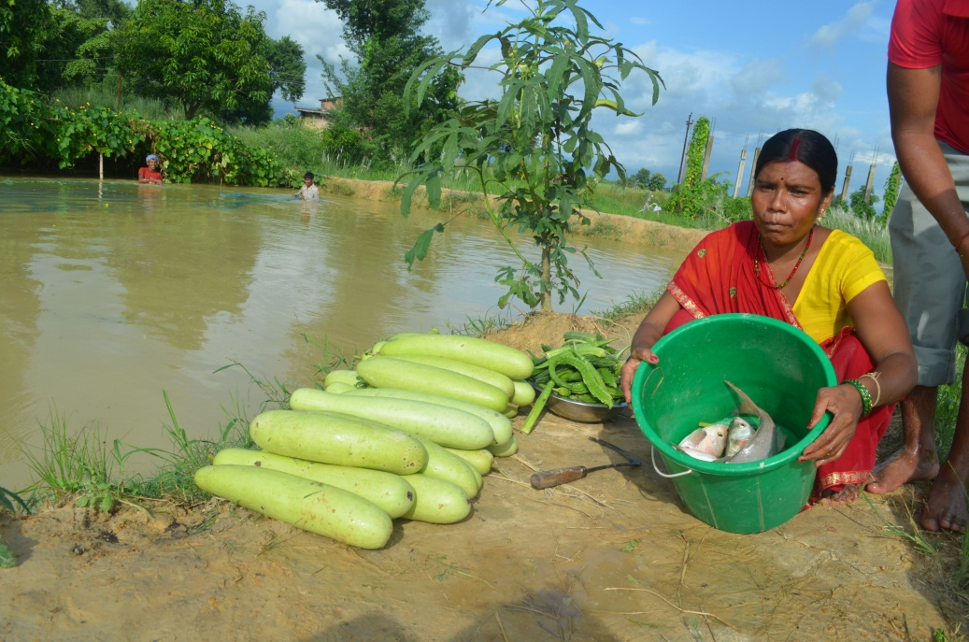
Pond Dyke Vegetable Cultivation

Slide 28
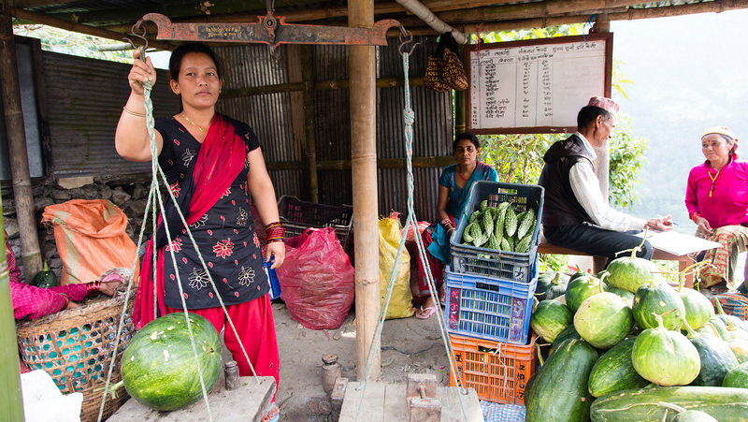
Market development
Notes:
ANEP is uniquely strengthening marketing and planning committees running collection centers to make strong crop calendar recommendations to members that include high-value and integrate food crops. And provide detailed technologies recommendations for timing, variety, plant protection (IPM), irrigation/micro irrigation, agronomic practices, and post harvest.
Collection center have been developed and associated with Marketing Planning Committee.

Slide 29
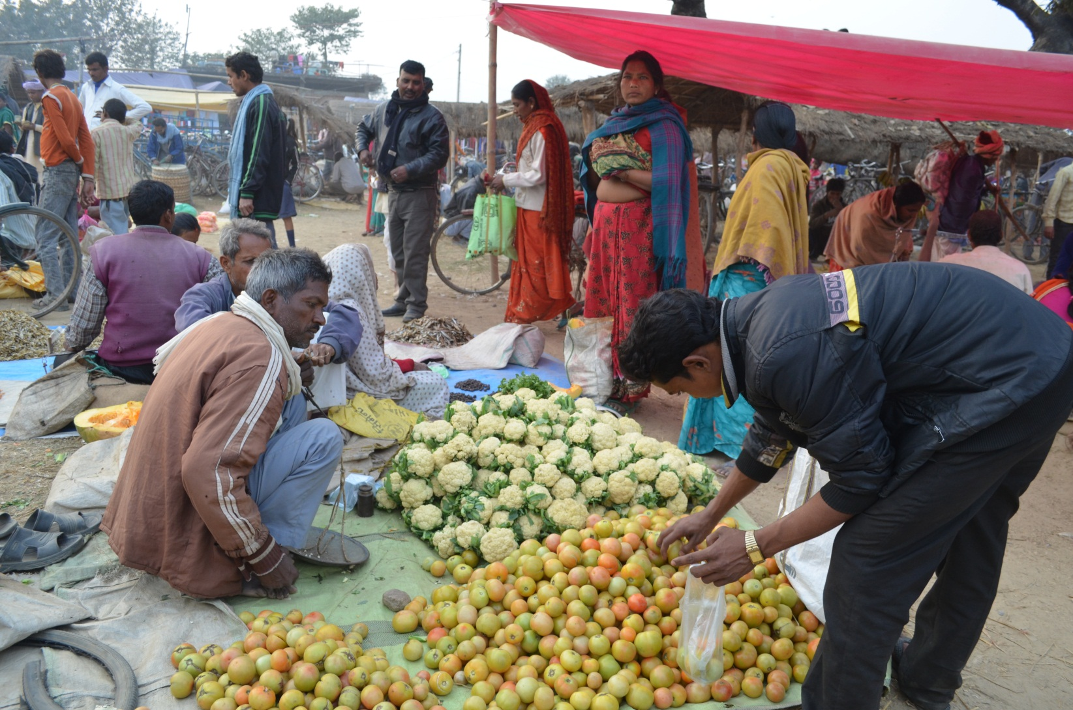
Vegetable Hat Bazaar
Ramgram, Nawalparasi

Slide 30
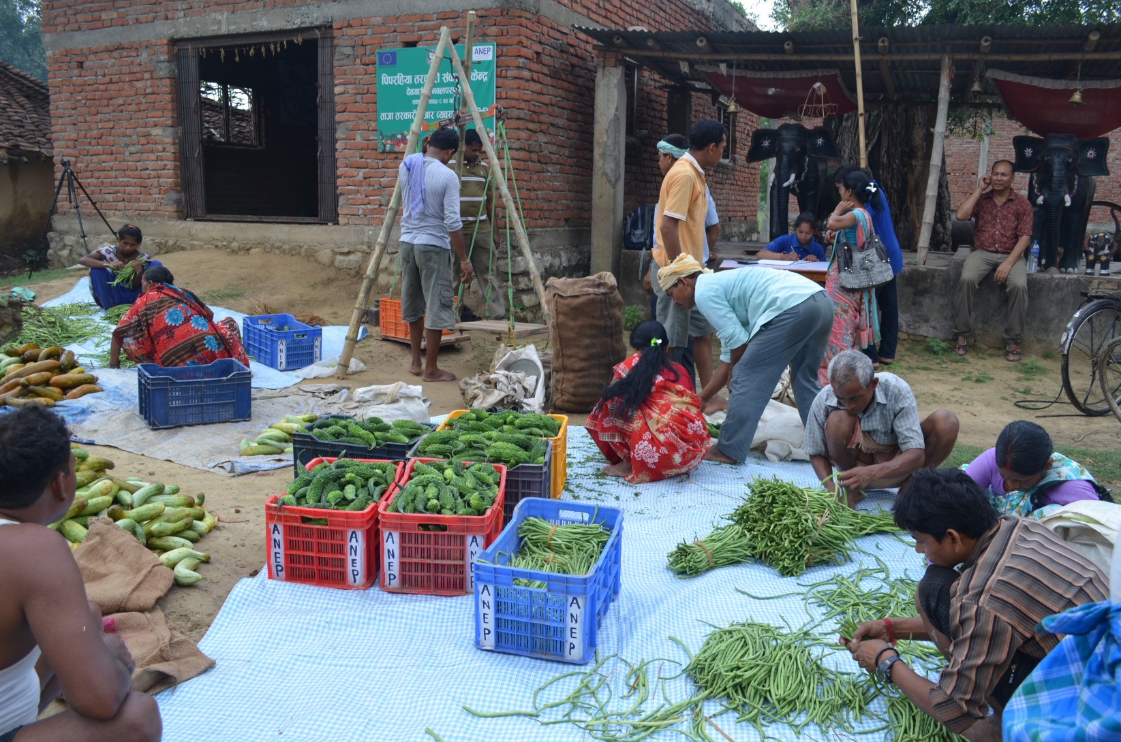
Marketing Planning Committee
Devgaun -9, Piprahiya, Nawlaparasi

Slide 31
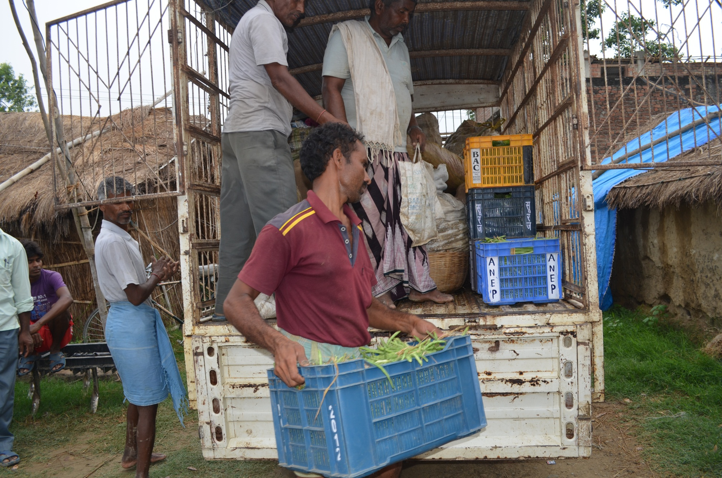
Traders from Marketing & Planning Committees

Slide 32
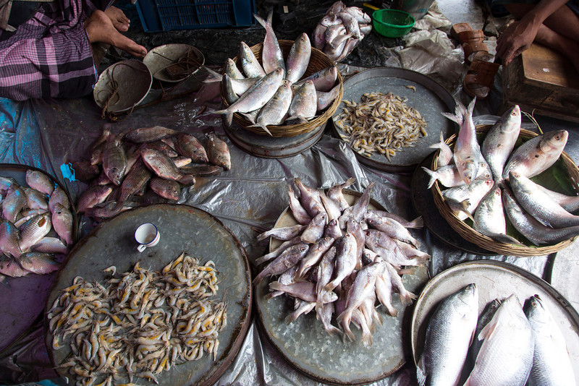
Fish Market

Slide 33
Seed activities
Notes:
Vegetable seed quality control training
Post harvest training
Market management training
Hybrid tomato seed production training
Crop specific training
MPC/ cooperative strengthened and supported for seed marketing
Plastic house demo conducted for seed production tomato hybrid

Slide 34
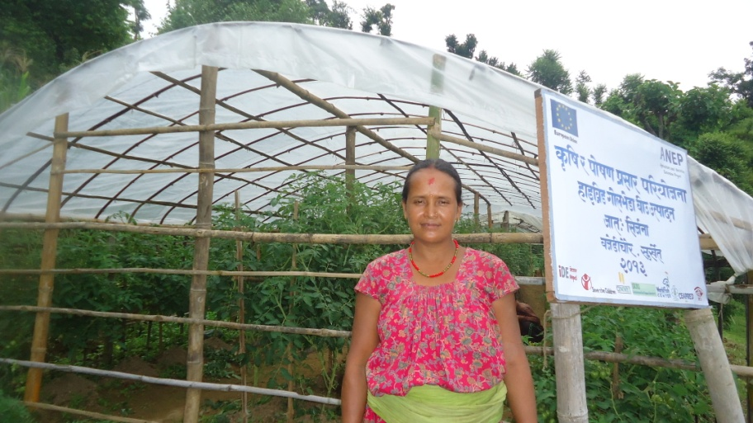
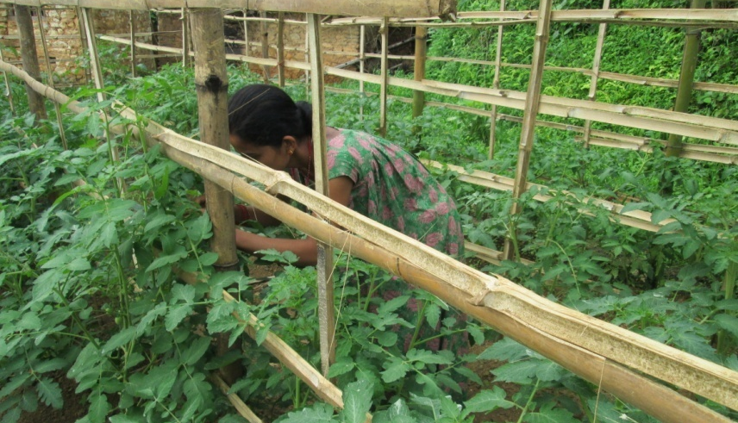
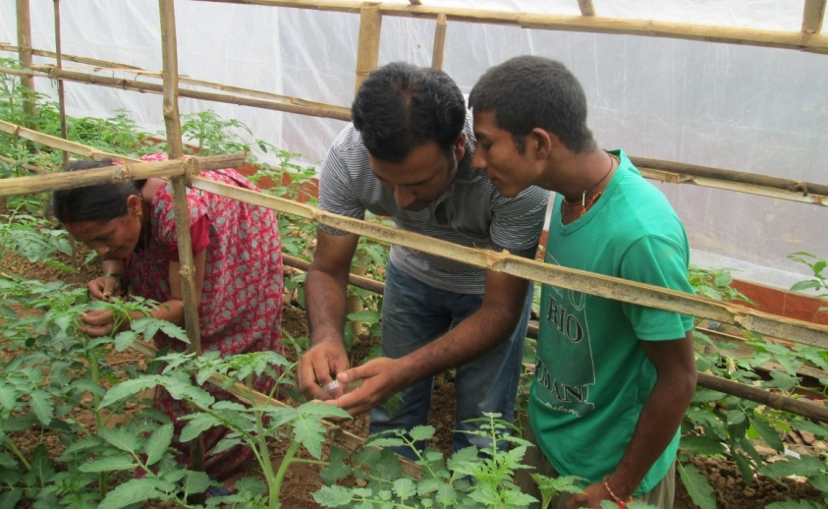
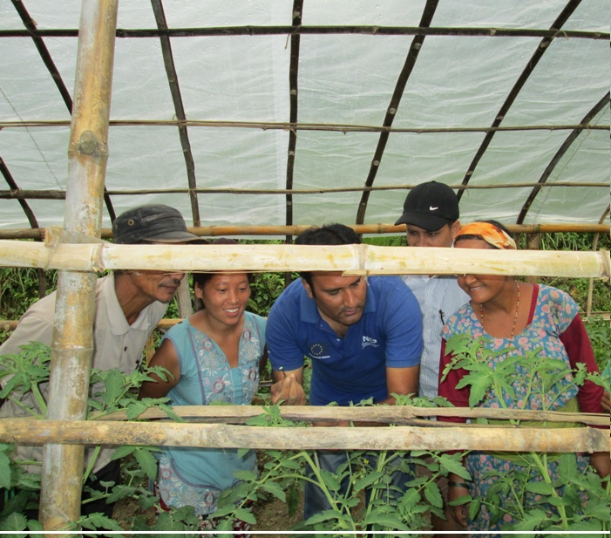
Hybrid Seed Production

Slide 35
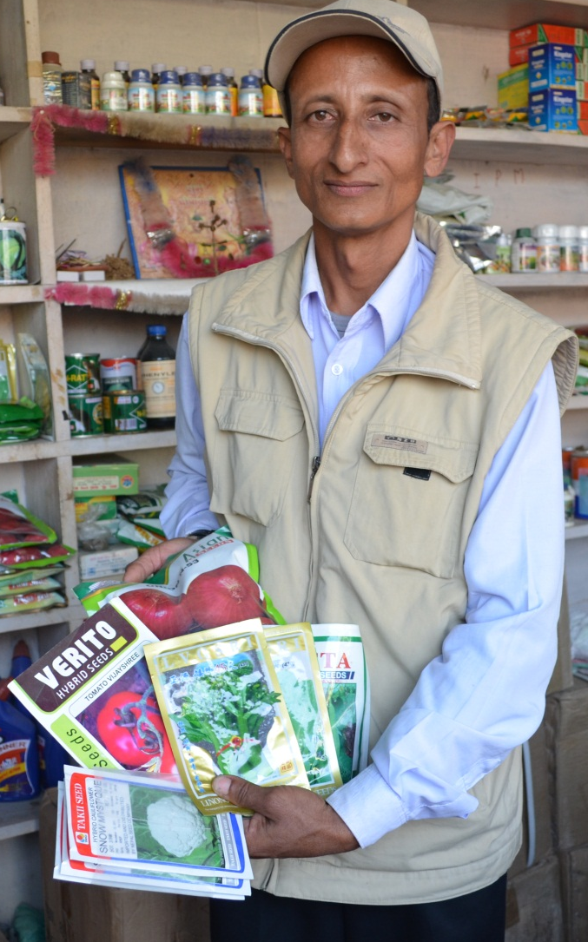
Challenge Fund
Implemented through agro-vets.
Community business facilitators (CBFs) are developed for business promotion. CBFs are associated with the challenge fund implementer. They promote their business in the community on a commission basis.

Slide 36
Opportunities
High unmet demand
Inadequate Technical Knowledge
Income earning potential
This project is funded by
The European Union
Notes:
High unmet demand of vegetables, cereals, legumes and fish due to less number of farmers involved in vegetable, cereals, legumes and fish farming
Poor and marginalised farmers have inadequate technical knowledge about new and improved technologies, and this lack leads to low production.
Small farmers are able to earn income from vegetable production in a short period.
Opportunities to link vegetables, cereals, fish farming with district’s high malnourished affected families.

Slide 37
Lessons Learnt
Development of crop calendars through collection centers is very important
Farmer exposure visits play a vital role in the dissemination of the new technologies
Match fund can be generated from VDCs
Well trained service providers are needed for efficient use of machinery in cereals and legumes cultivation
Assured markets resulting from collection centers encourage farmers to expand their cropped area
This project is funded by
The European Union
Notes:
Development of crop calendars through collection centers with variety/technology for the cropping system is very important.
Farmer exposure visit play a vital role on the dissemination of the new technologies
Well trained service providers are needed for efficient use of machinery in cereals and legumes cultivation.
Match fund can be generated from VDCs through regular coordination among line agencies.
Assured markets resulting from collection centers encourage farmers to expand their cropped area

Slide 38
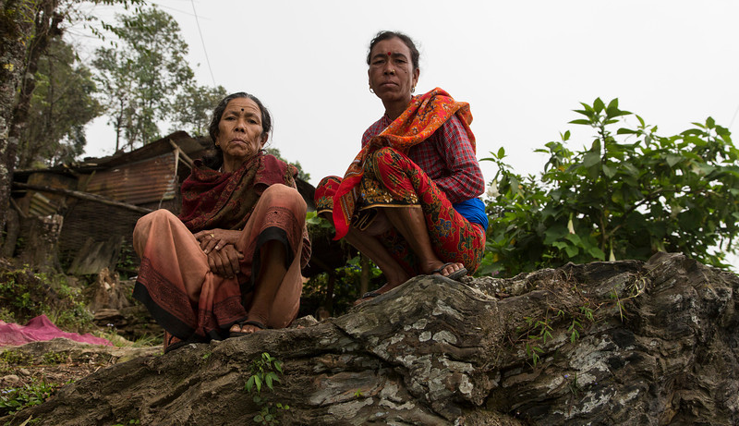
Impact
Notes:
Income of farmers is in the growing trend. Currently the average additional annual income has reached Euro 155 per hh from vegetable and Euro 645.63 from fish.
Existing dysfunctional GoN built CC became functional because of PMCA activities which helped to build up trust and relationship among PMCA actors
Farmers have realized the importance of nutritious vegetable and started growing nutritious vegetable on kitchen garden in their backyards.
Farmer of Sikthan Mr. Shiva Tharu established a biogas plant by selling vegetable.
Food consumption behavior has changed through nutrition class, like consumption and use of iodine, leafy vegetables.
Practice of preparing and using home based super flour (Sarbottam Pitho) for their children is increasing

Slide 39
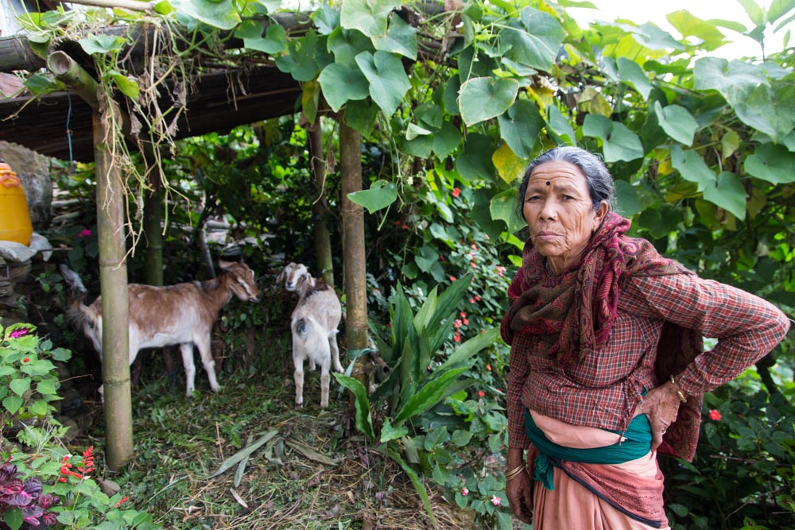
Sustainability
This project is funded by
The European Union
Notes:
Local farmer institutions are developed and registered: groups, collection centers and plans on way to develop cooperatives
Private sector developed and strengthened
Partnership and coordination with government agencies

Slide 40
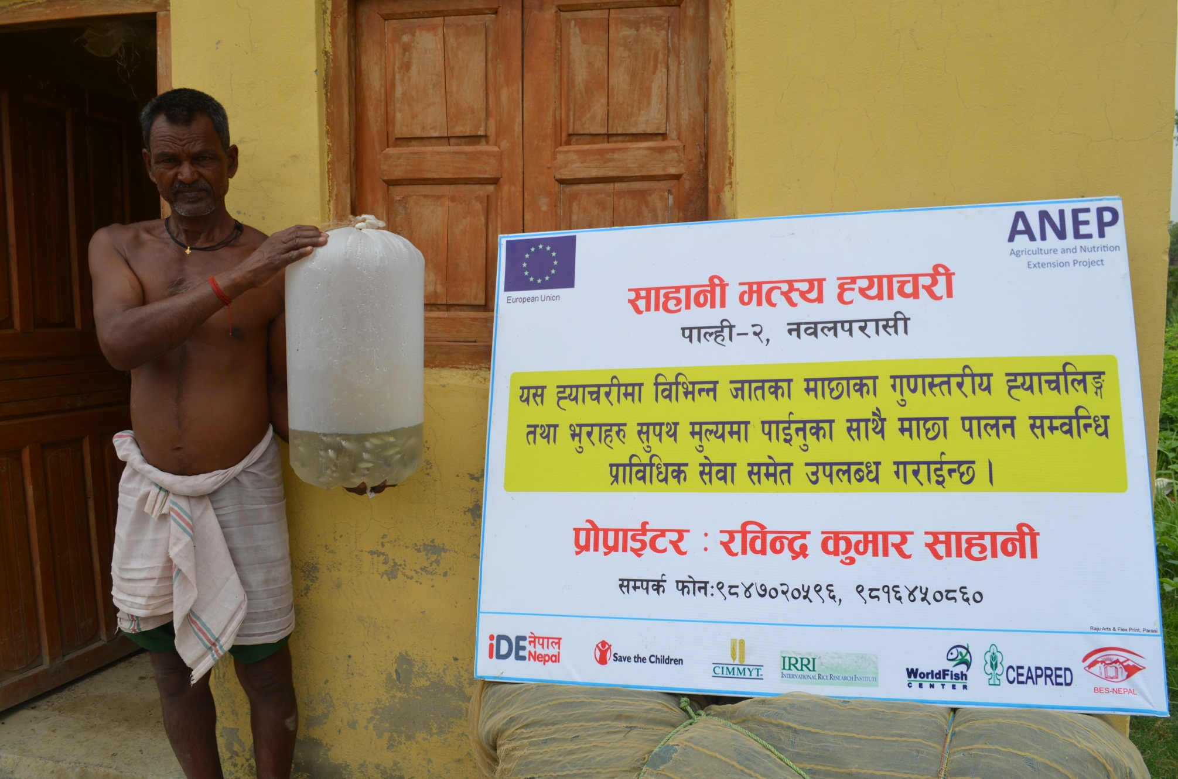
Visibility

Slide 41
ANEP in Bangladesh
A market-based approach to rural development
This project is funded by
The European Union

Slide 42
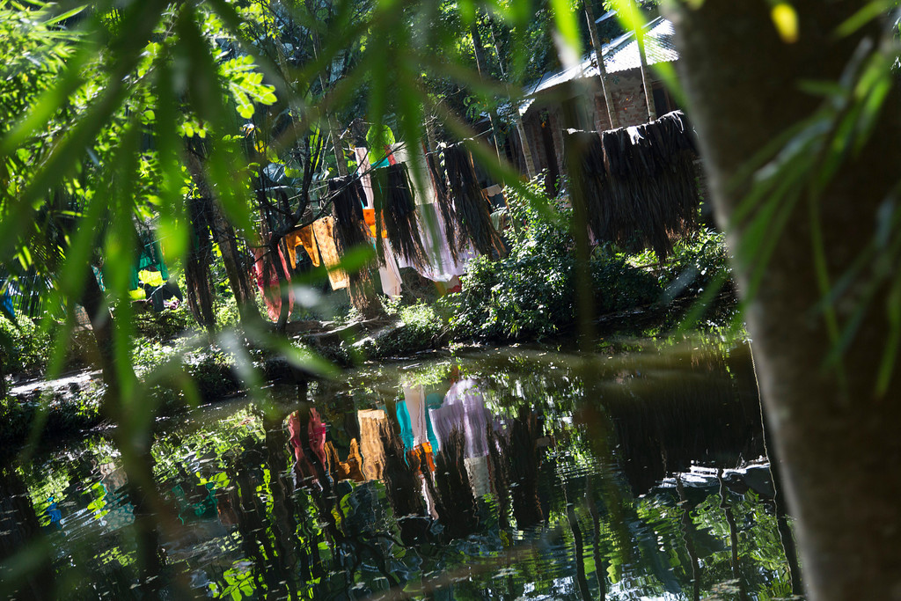
Why Bangladesh?
This project is funded by
The European Union
Notes:
Some of the lowest indicators of nutrition and health in Asia - 45% stunting in Bangladeshi children
Smallholders in Bangladesh need access to improved agricultural technologies and markets
In the case of vulnerable communities the private sector has not established adequate input supply and output marketing systems, resulting in low productivity and reduced market opportunities

Slide 43
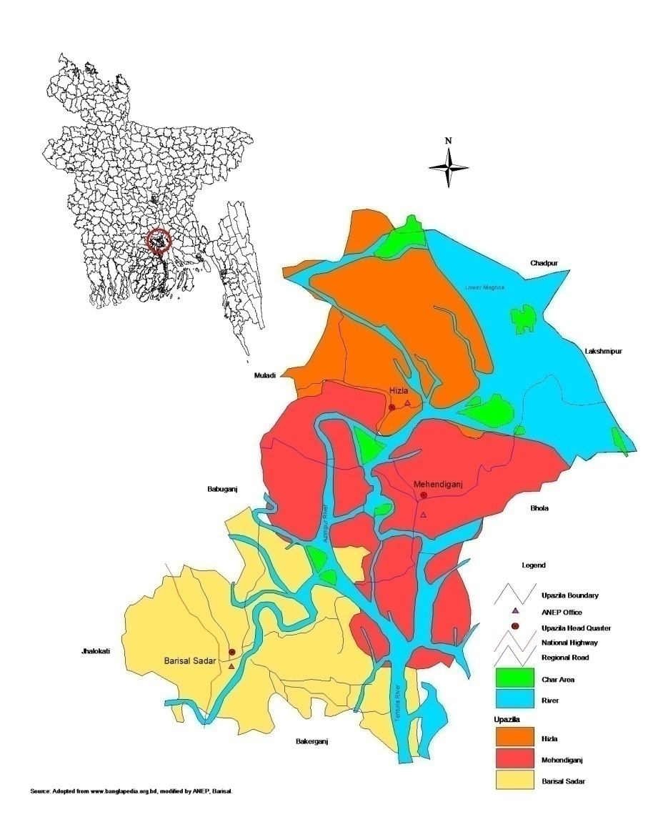
ANEP works in the southern costal belts of Bangladesh
Riverine area
3 upazillas of Barisal Division
Rural - low lying land and chars (islands) in the lower Megna river
Urban - peri-urban areas of Barisal City (500,000 approx).
5,000 rural and 5,000 urban HHs directly
30,000 HHs through VCs
Photo credit: iDE
This project is funded by
The European Union
Notes:
Riverine area of southern Bangladesh
3 upazillas of Barisal Division
Rural - low lying land and chars (islands) in the lower Megna river
Urban – peri-urban areas of Barisal City (500,000 approx).
The ANEP in Bangladesh is seeking to reach 5,000 rural and 5,000 urban HHs directly and 30,000 through VCs

Slide 44
A holistic approach to food security
Social mobilization
Rural Producer Households
Social mobilization
Nutrition Education for households with:
Pregnant women
Lactating mothers
Children under 5
Technology transfer through PSAs in:
Aquaculture
Field crops
Vegetable
ANEP
Nutrition
Private Sector Actors (PSAs)
ANEP Production
Nutrition Education for:
Pregnant women
Lactating mothers
Children under 5
Adolescent Girls
Creating and developing sustainable market linkages for both rural producers and urban consumers and the development of grass-roots institutions.
Urban Households
Social mobilization

Slide 45
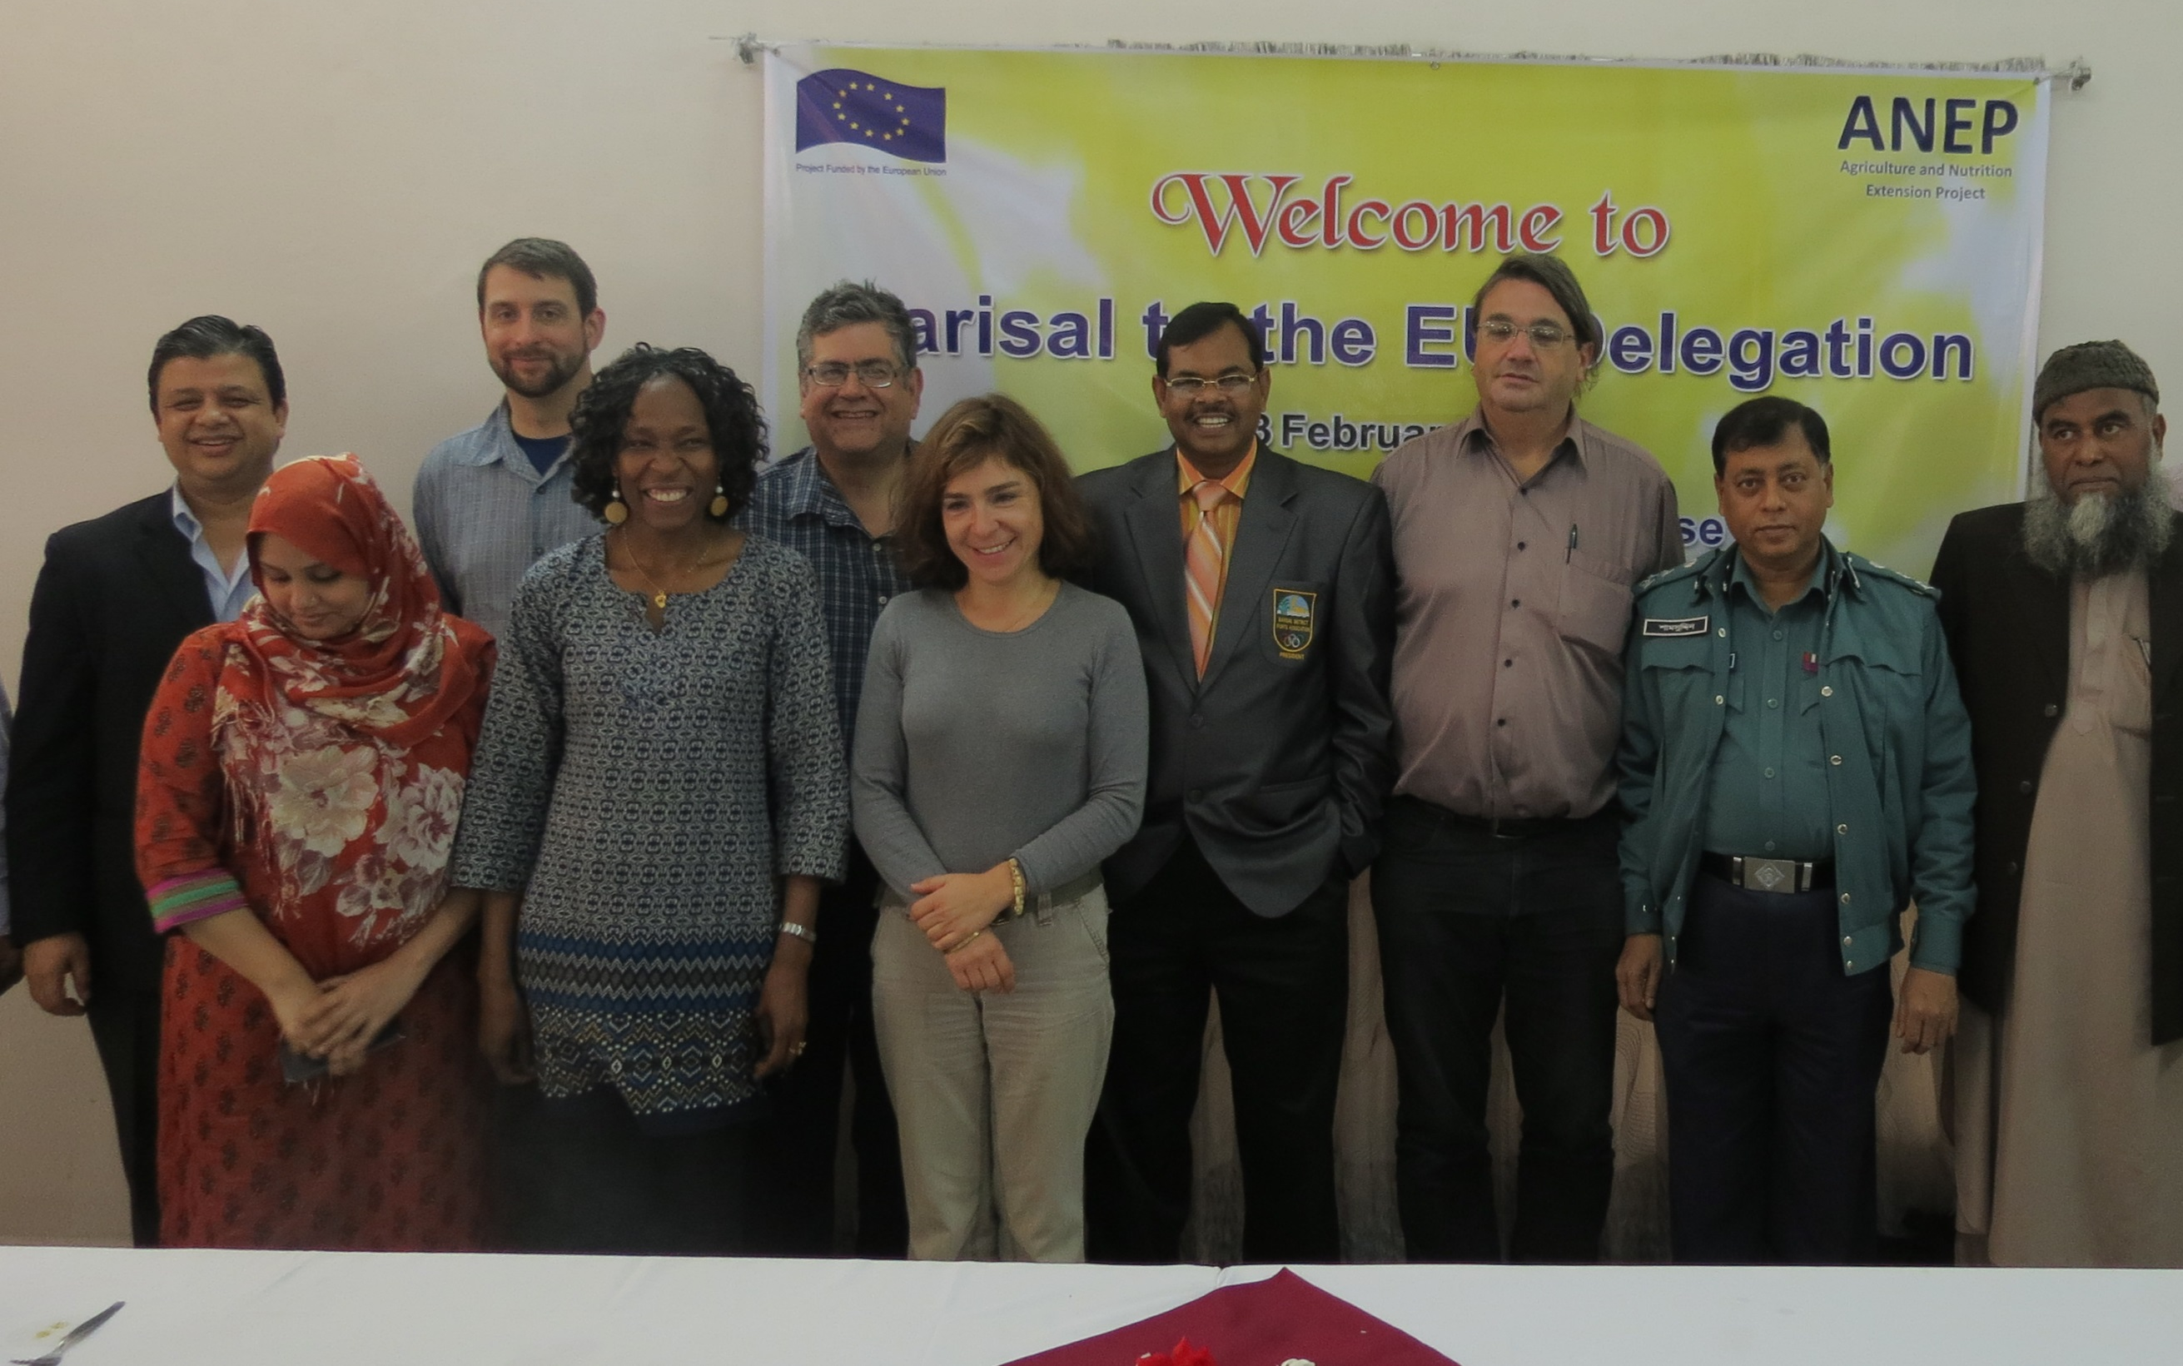
EU Delegation visit to ANEP
This project is funded by
The European Union
Notes:
Innovations in the ANEP
Developing local business strategies
The development of interactive nutrition messaging practices combines with commercial rural-urban linkages for nutritious foods
The mobilisation and capacity building of market actors through participatory market-chain approach (PMCA);
The market strategy being taken to improve and connect local maize farmers to a large source of demand from processing factories in a nearby area;
The business approach to commercialize technologies such as the Axial Flow Pump (AFP) through local service providers (LSPs)
The management and coordination systems have enabled the team to function efficiently and effectively

Slide 46
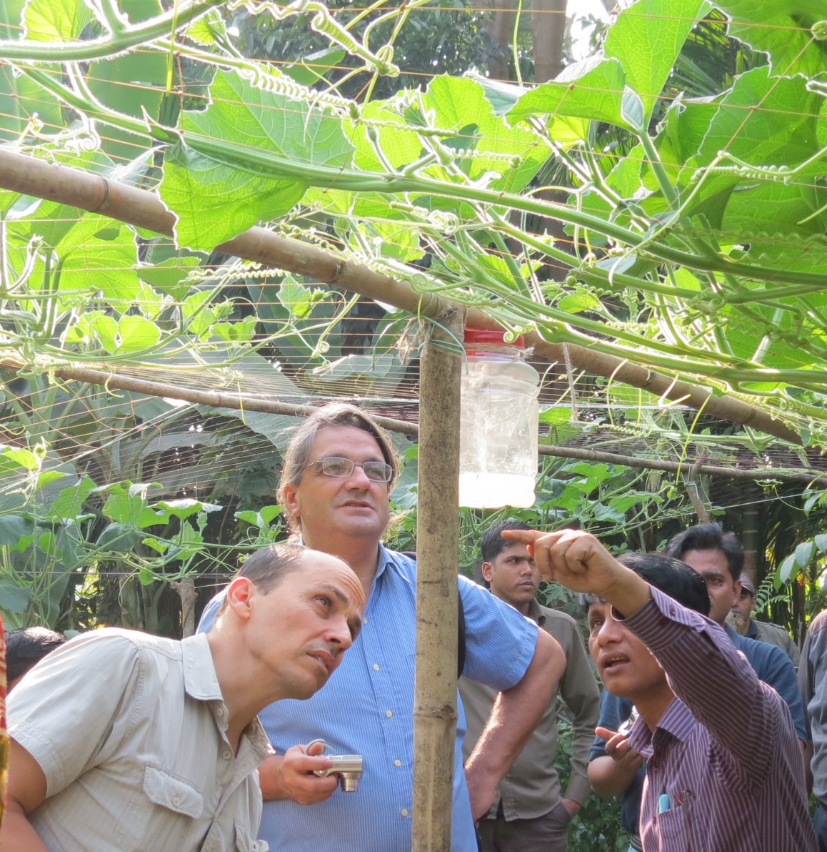
The management and logistics not only of the visit but the project generally are excellent, and we feel the project is making great headway in ensuring close cooperation between the consortium partners and with local government agencies in Barisal. The approach towards generating small-holder commercial strategies from the ‘ground-up’ was demonstrated well and appears to be a highly innovative means of supporting farmers to make better business decisions in cooperation with the local private sector. We will be following the progress of ANEP closely’
Joao Anselmo, Attaché Food Security,
EU Delegation to Bangladesh.
This project is funded by
The European Union
Notes:
EU visit to ANEP in Bangladesh:
February 2013

Slide 47
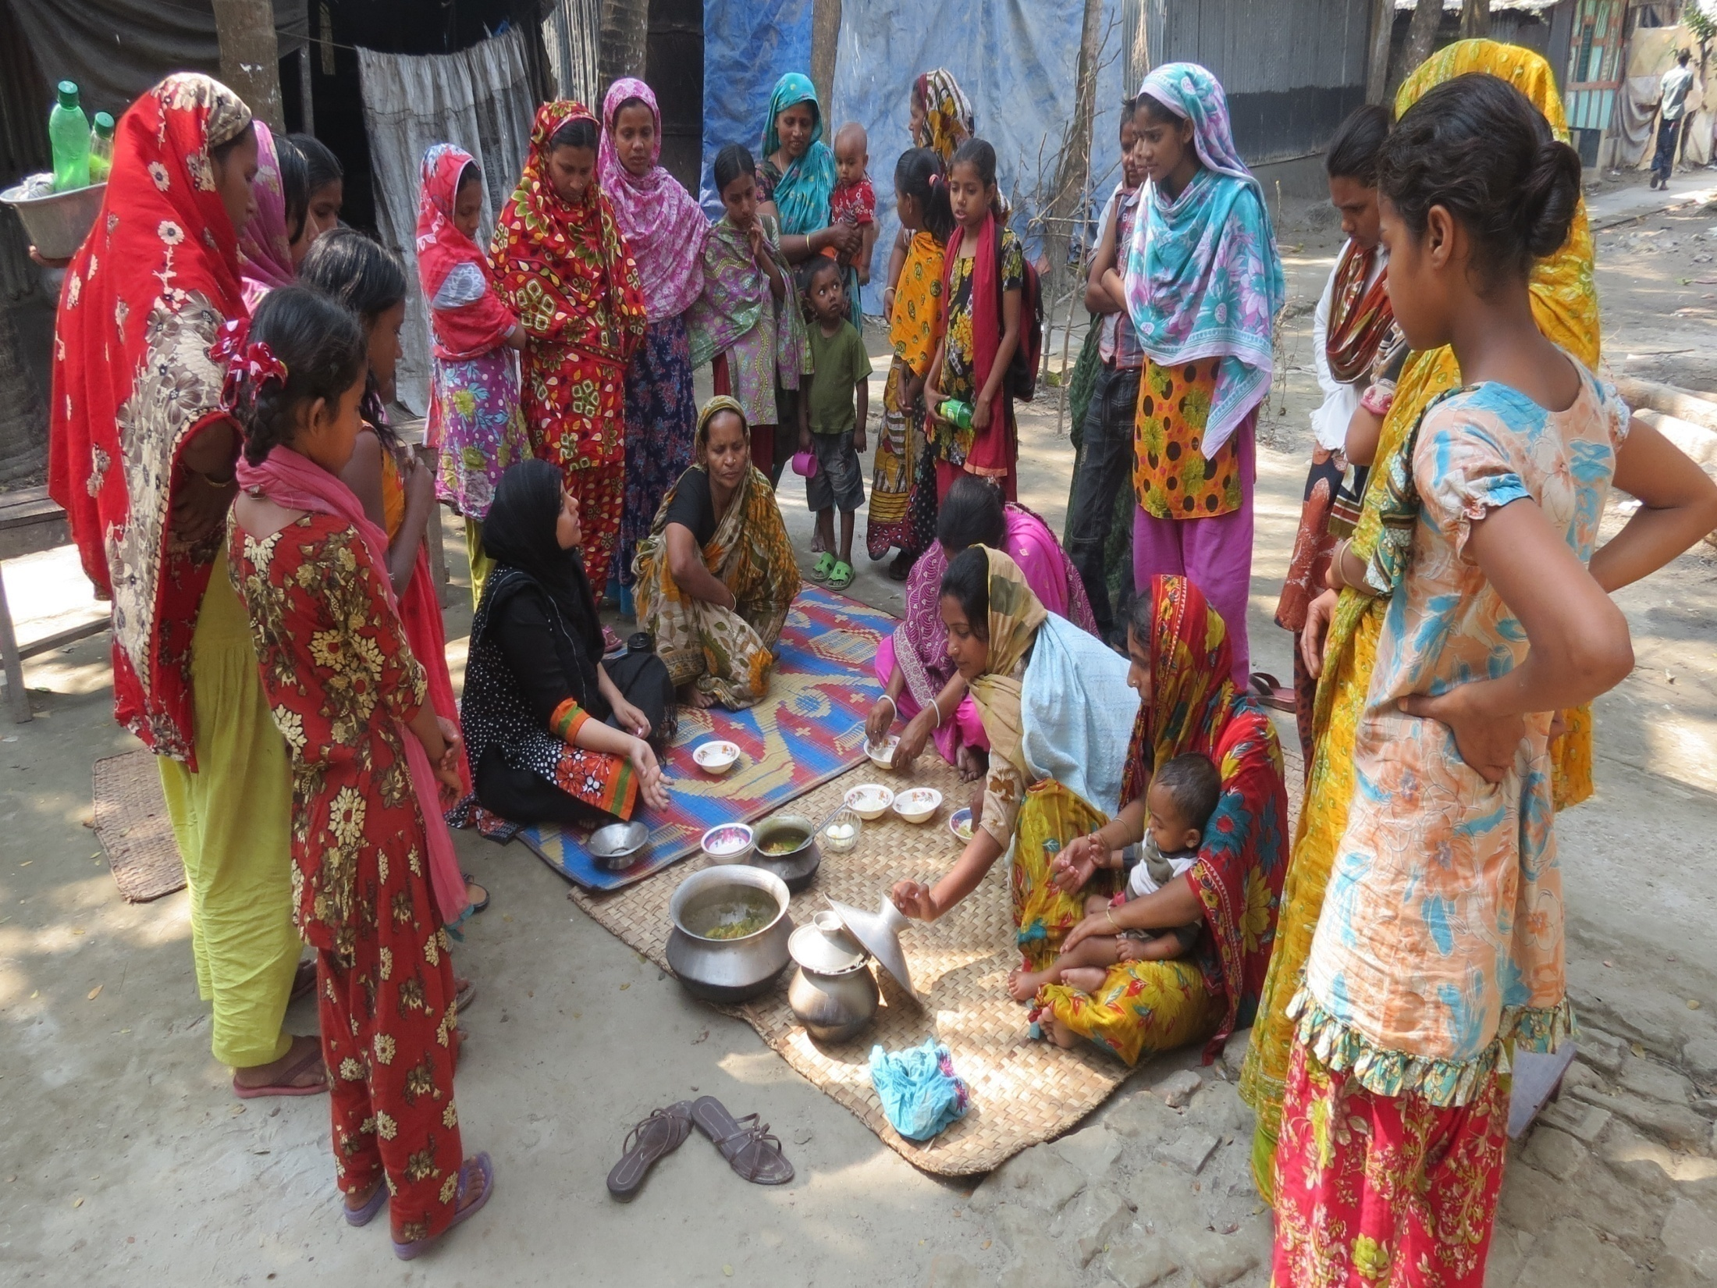
ANEP in Bangladesh: Some Lessons
This project is funded by
The European Union
Notes:
Embedding good management and quality assurance systems is vital
Ongoing communication between partners with PMC meetings quarterly led by field managers
Outcome monitoring has been undertaken to calculate outreach of enterprises supported through program activities
Bangladesh ANEP MRM team will be sharing the outcome monitoring tools and methodology with the Nepal team.

Slide 48
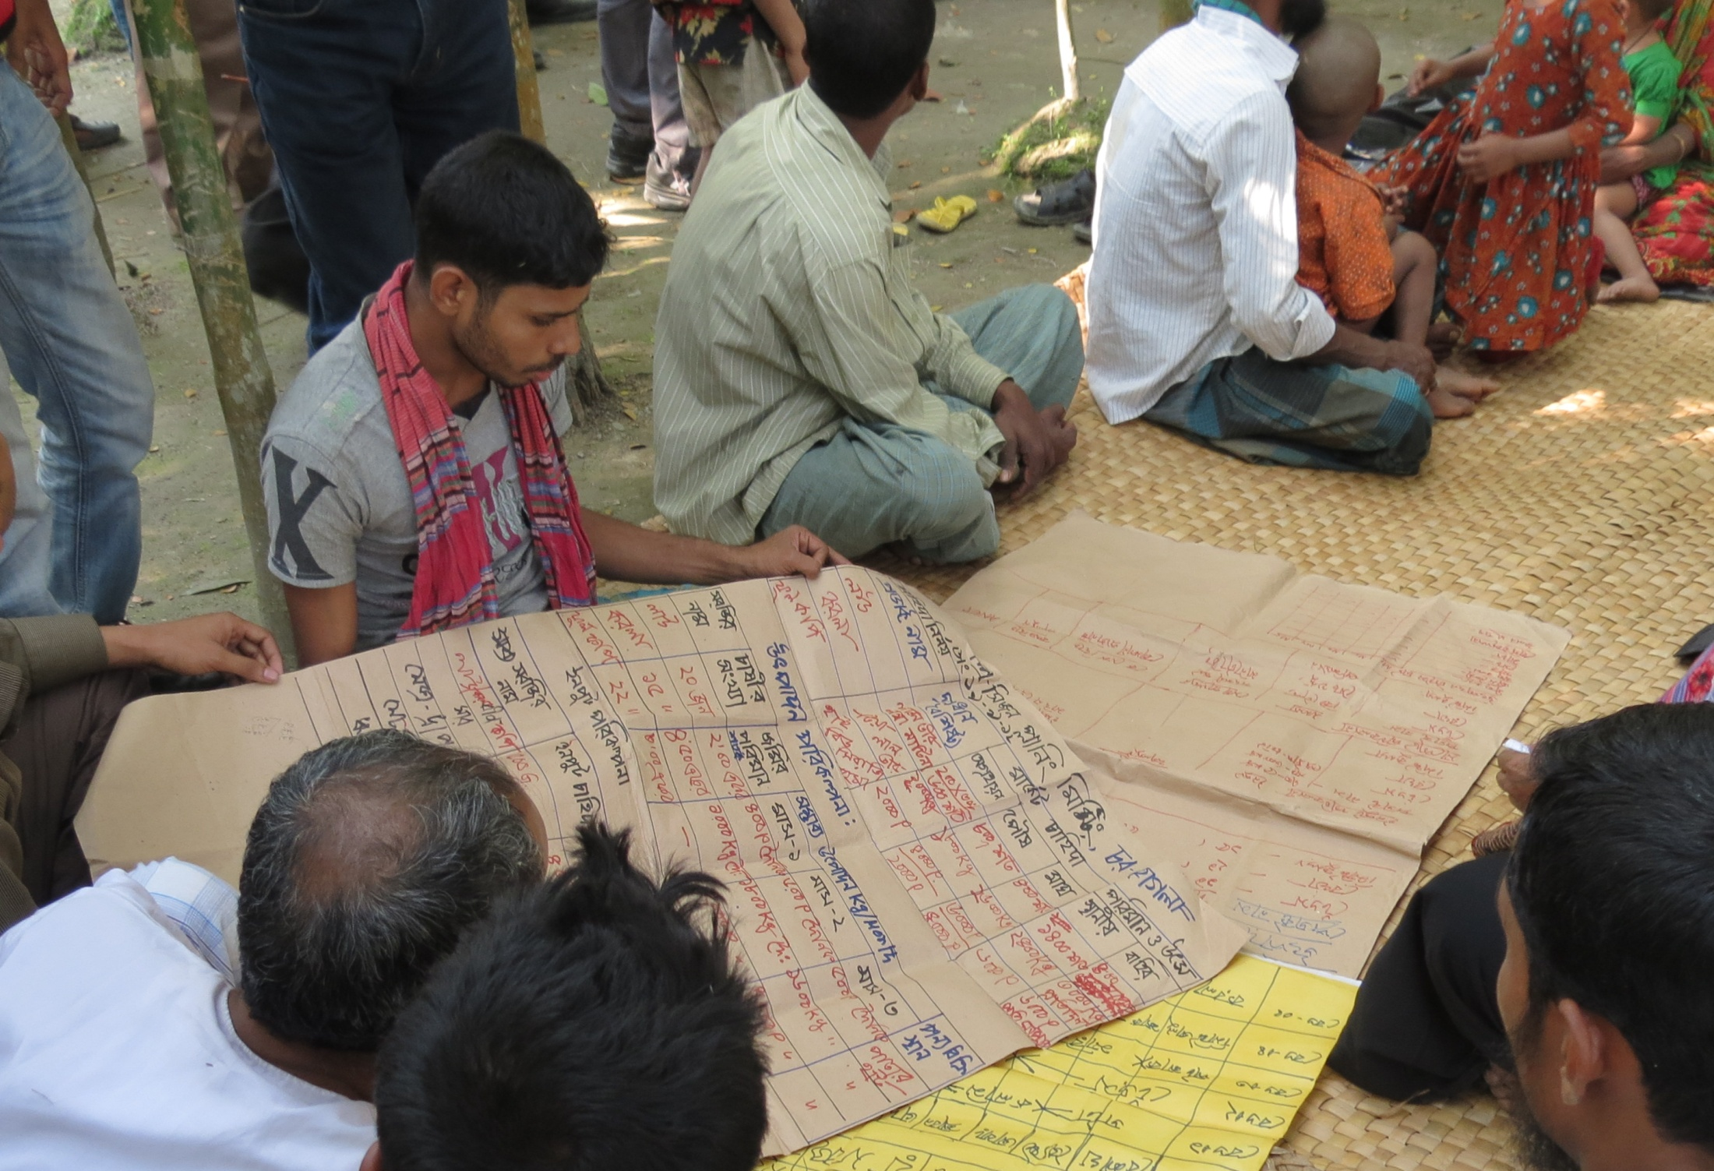
Generating Availability through Participatory Production & Sales Planning Linkages
Photo credit: iDE
This project is funded by
The European Union

Slide 49
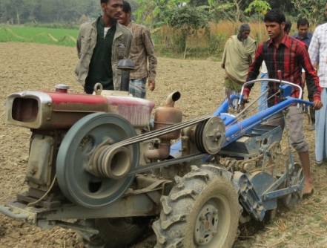
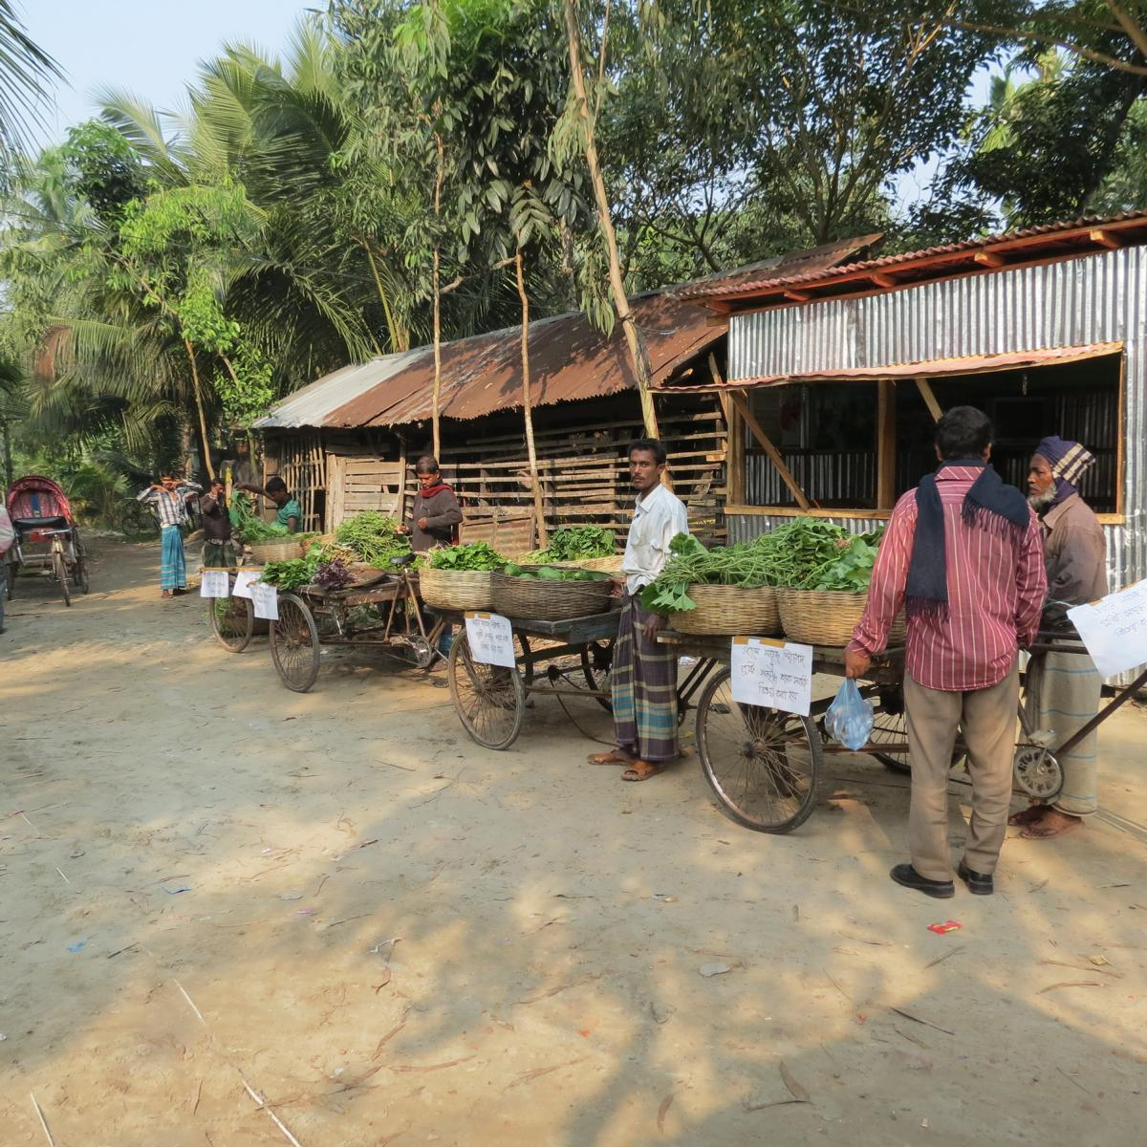
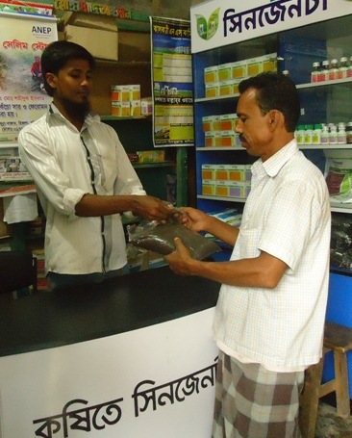

Production & Sales Planning Meeting (PSPM)
Providers of productivity-enhancing services
- Technology (bed-planting, tilling, sowing, fertilizer application etc)
Agro-veterinary/agronomic
advisory services
Financial service providers
Who are the rural stakeholders...?
LSPs
PSPM
Local existing retailers of improved inputs
Buyers of
harvest
IMAs
IMAs
Rural Producers
OMAs
OMAs
LSPs

Slide 50

Production & Sales Planning Meeting (PSPM)
Collaborative development of Production and Sales Plans (PSPs), informed by demand-side information from OMAs
PSPs provide information on constraints for particular production strategies, informs further programming requirements from ANEP
PSPM
IMAs
Rural Producers
OMAs
LSPs

Slide 51

Improving Access through rural-urban linkages to enable greater access to nutritious foods
Photo credit: iDE
This project is funded by
The European Union

Slide 52





Rural-urban links to enabling greater access to nutritious foods
Who are the urban stakeholders...?
Local Govt.
Market/land owners
FM
Imams and comm. leaders
Local politicians
Local politicians
Imams and comm. leaders
Low income urban
consumers
Mobile Traders
Local Govt.
Market land owner

Slide 53








Rural-urban links to enabling greater access to nutritious foods
Pushti-mela or Farmers’ markets...
Point of Sale with ‘healthy’ messages for mobile traders to promote nutritious foods
Entertainments which attract urban consumers to whom the farmers and mobile traders can sell fresh produce
FM
Imams and comm. leaders
Local politicians
Low income urban
consumers
Mobile Traders
Local Govt.
Market land owner
Entertainment choices to reinforce nutrition messages from the NE sessions

Slide 54

Changing strategy according to field realities is essential
This project is funded by
The European Union
Notes:
Focus on ‘winners’ – in Bangladesh Mechanisation, Maize marketing, and away from areas we are unlikely to achieve impact for ANEP goals (AWD, Cage culture).
Linking maize production in our target communities with processing plants in the local vicinity.
Renewed focus on PSPM across all sub-sectors – not only to ensure PSA-led implementation and the creation of viable business plans (with local ownership) but also in the follow-up technical trainings, and ultimate sustainability through market actors

Slide 55
Mid-term Evaluation of the Technology Transfer for Food Security in Asia Programme
Partnerships approach (p.27) – ‘The ANEP project comes closest to the original intention, having a good mix of research and development-oriented partners, and integrating them effectively’
Use of the most effective organisations (p.28-29) – ‘ANEP is the only action that really appears to be working with a wide range of effective organisations – not only limited to the partner organisations, but also including strong links with private sector organisations from very large multi-million euro agricultural processing and mechanisation companies, through sales networks of agricultural input suppliers, to relatively small traders’.
Effectiveness and potential from impact (p.33) - ‘Effectiveness: The project undertakes a wide range of technology adaptation/ demonstrations and studies the results carefully. There is a Monitoring and Results Measurement programme which provides regular information including actual costs and returns for the beneficiaries, so firstly it is known already that many technologies are being used successfully and secondly management can respond quickly where issues are identified. The guiding principle of ANEP is to make markets work for the poor, but it is the only TTFSA action to have developed an urban nutrition programme. This appears to be a highly effective project.
Impact: Beneficiary numbers are high, both in Bangladesh and Nepal. [...] The association with major industries, for instance in supply of agricultural machinery and anticipated soon in the purchase of maize, will lead to wider impact through increased availability/ market demand respectively.
This project is funded by
The European Union

Slide 56
THANK YOU
Photo credit: iDE/ Allison Joyce
EC, Brussels, 22 January, 2014

