Slide 1
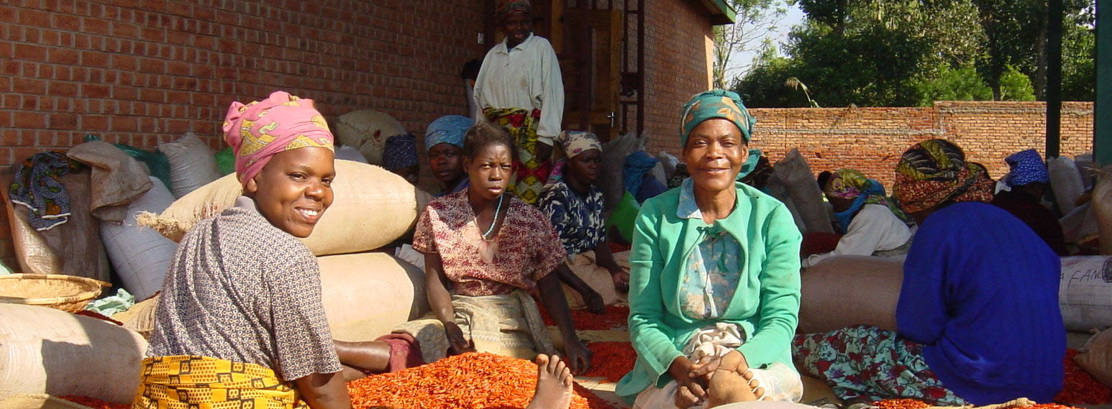
Road Map on EU+ nutrition joint programming

Slide 2
Why nutrition in Ethiopia?
Figures Ethiopia
8th World highest prevalence of Stunting: 44,4% in 2011
Wasting prevalence hovers 10-12% since 2000
67% of the adult population in Ethiopia suffered from stunting as children.
30 M people under the food poverty line and 12 M people food insecure
The annual costs associated with child undernutrition is equivalent to 16.5% of GDP^{(*)}.
Priority for the GoE: National Nutrition Program (NNP) $ Gaps
Entry point for resilience building programmes
We all work on nutrition… from different sectors
(*) Cost of Hunger report (AU/NEPAD/UNECA/WFP)

Slide 3
Why EU+ joint action in nutrition?
Coherent and cohesive response to ET challenges & NNP
Improve harmonisation
Complementarity
Scaling up action & increasing effectiveness
Avoiding duplication (same interventions, often same partners)
Joint advocacy and positions
Sharing of resources (expertise, trainings, etc.)
Geographical
Sectoral
Financial instruments (flexibility, timing, etc.)
Added value (access to GoE or to regional level, presence on the field, etc.)
Notes:
Complementarity: E.g. Flexibility of Irish Aid for covering gaps, mobilizing resources
Scaling up actions: reducing fragmentation
Duplication: we finance often the same partner (UNICEF) for similar activities. Maybe Irish Aid giving to someone else
Sharing resources: NAS at the service of MS, training on nutrition sensitive interventions

Slide 4
Phases
Notes:
Draft proposal
In evolution till having a joint strategy

Slide 5
Planning
2 levels of involvement
Defining EU+ Nutrition Group
Situation analysis
  Casual analysis of undernutrition in ET
  Joint mapping of nutrition specific and sensitive interventions (present & future)
  Gap / Opportunities analysis
Facilitator
Focal points
Notes:
Sound causal analysis of undernutrition in Ethiopia: different in different regions. Sometimes it's poverty, sometimes it's diversity of the diet, etc. We'll built on already existing analysis (NNP, Demographich and Health Survey in ET, etc.)
Mapping: Keeping what already exist (MoH, etc.) and trying to build something sustainable beyond a picture of the situation

Slide 6
Planning (cont.)
Strategic Priorities
  Main reference National Nutrition Program
  Common results framework
  Division of responsibilities
EU+ Nutrition Joint Strategic Response
Strengthening the political commitment and good governance at federal and decentralised levels
Scaling up nutrition actions
Building the knowledge-base on nutrition
Notes:
Good Governance: supporting national strategies, policies, legal framework, capacity building, etc. Joint advocacy: Ambassadors & technical level. Influencing NNP & GTP2
Scaling up nutrition actions: nutrition sensitive and specific. Strategy towards flagship programs, link towards humanitarian, etc.
Knowledge base: research, creating evidence, etc. specially in other areas than health
Division of responsibilities: matrix of responsibilities

Slide 7
Joint Action Framework
Joint EU+ Nutrition Action Framework
  Framework for interventions.
  Implementation
  Present & Future
  Different programming cycles: Alignment
  Dynamic
  Strategic and technical support for identification & Formulation
Joint: flagship programs, delegated cooperation, pool funds
Bilateral interventions

Slide 8
Accountability
Resource tracking (based on SUN)
Results Monitoring
Evaluation
Communication and visibility

Slide 9
Resources
Facilitation: Task Force EUD?
Technical Assistance financed by EUD
Alternatively: TA financed by a MS
Support from UNICEF (under SHARE-EUD contract)
EU+ Nutrition Core Team

Slide 10
Timing
Outcome | Completion Date | Responsibility
Identify Membership of EU+ Nutrition Group | End February 2014 | HoC group
Select (initial) Nutrition Core Team | End-Feb 2014 | EU+ Nutrition Group
Identify Facilitator of EU+ Nutrition Group | Beginning March 2014 | EU+ Nutrition Group
Update the Roadmap | Beginning March 2014 | TF of Facilitator
Notify GoE of the EU+ Nutrition Group | Mid- March 2014 | Facilitator
Causal Analysis | May-June 2014 | EU+ Nutrition Core Team + Consultancy
Joint Mapping Analysis | May-June 2014 | EU+ Nutrition Core Team + Consultancy
Gap Analysis | July 2014 | EU+ Nutrition Core Team + Consultancy
Situation Analysis | July 2014 | EU+ Nutrition Core Team + Consultancy
Common Nutrition Strategy | End August 2014 | EU+ Nutrition Core Team + Consultancy

Slide 11
Timing
Outcome | Completion Date | Responsibility
Advocacy Framework | End August 2014 | EU+ Nutrition Core Team + Consultancy
Results Framework | End September 2014 | EU+ Nutrition Core Team + Consultancy
Assessment of C/Advantage | End August 2014 | EU+ Nutrition Core Team
Review of Core Team | Mid-September 2014 | EU+ Nutrition Core Team
Matrix of Responsibilities | End September 2014 | EU+ Nutrition Core Team + Consultancy
EU+ Nutrition Group Action Plan 2015-2020 | June 2015 | EU+ Nutrition Core Team + Consultancy
Resource Tracking systems established | June 2015 | EU+ Nutrition Core Team
Results Monitoring capacity established | June 2015 | EU+ Nutrition Core Team
Nutrition Brief | June 2014 | EU+ Nutrition Core Team
EU+ Group Annual Report | March 2015 | EU+ Nutrition Core Team

Slide 12
Open questions
How far do we want to get?
Role of the GoE in the process. When? How?
Link with humanitarian interventions
Should the membership of the EU+ Nutrition Group be open to others?
  How can we maximise complementary with the SUN movement?
  Others

Slide 13
Next steps
Identification of MS endorsing the approach
Identification of MS part of the EU+ nutrition core group
Comments, improvement of the Roadmap for EU+ joint programming on nutrition
Endorsement of the Roadmap
Creation and first meeting of the EU+ nutrition group
Informing the GoE on this initiative

