Slide 1
Supporting change through
Capacity Development
Module 6
Designing the change process

Slide 2
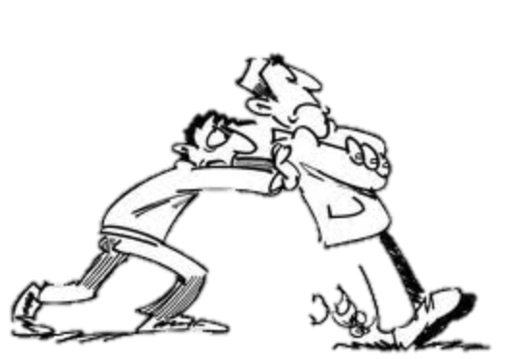

Before talking about design: how do people change
Intention
Want to
Behaviour
Able to
Results
Situation
Have to

Slide 3
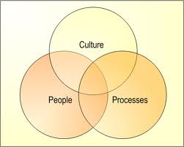
This Module
Discusses design considerations for supporting a capacity development and change programme
Considers what strategies can be used
Considers what inputs
can be applied
Considers the respective
roles

Slide 4
CD/ Change Process
Contextual factors beyond influence
Contextual factors and actors within influence
Capacity
Recurrent inputs
Outputs
Outcomes
Wider impact
CD processes
Internal resources
CD support
Notes:
Change design focuses on the CD processes that intend to create improved organisational/sector capacity. A proper design is based on a hypothesis how the Cd processes will lead to improved capacity and better outputs: a theory of change

Slide 5

Theories of Change
  About How to arrive at Capacity Results?
      From the WHAT to the HOW….
      A strategy to get from where we are to where we want to be?
  Highlights our understanding of how change happens – what it will take to deliver results.
  Builds on insights from earlier diagnostic work and dialogue.
      Political economy, incentives and opportunities for change
      Change readiness, ownership and demand for support
      The nature of the capacity challenge; simple or transformational, supply side or demand side
      Single organisation or multiple entities and stakeholders
      What has worked before and possible role for external assistance

Slide 6

Questions to ask
  How to engage: How directive, how facilitative?
  What opportunities for Quick Wins: versus longer processes?
  Where and with whom best to engage and what mix: selecting “action fields”?
  What inputs required: What combination is appropriate?
  Roles and responsibilities of Partners: Who does what?
  What kind of programme implementation arrangements: Leadership, oversight and accountability?

Slide 7
Complexity and Capacity
Far From Agreement | Complex |  | Chaotic
▲ ▲ ▲ | Complicated | Complex
Close to Agreement | Simple | Complicated | Complex
 | Close to Certainty | ►►► | Far From Certainty

Slide 8
Understanding the connections between inputs and outcomes
Simple
e.g.
Single Business Process
Complicated
e.g.
Organisational change
Complex
e.g.
State Building
Post-Conflict
Planned
Incremental
Emergent
Attribution
Contribution
Justification, ‘Hope’
Sector reform
The more complex, the more moments for reflection and adjustment
Notes:
The lines between the three are not clear-cut, the main message is that when designing change you will need to see which parts are relatively easy and which ones are likely to be rather complex to deal with. Differs per situation. If more complex. more moments for reflection, monitoring and adjustments are needed.

Slide 9
Analysing four “action fields” for promoting change
 | Focus on the ‘functional-rational’ dimension | Focus on the ‘political’ dimension
Focus on factors within the organisation(s) | 1. Getting the job done | 2. Getting the power right and accommodating interests
Focus on factors in the external environment | 3. Creating an ‘enabling environment’ for doing the job | 4. Forcing change in the internal power relations

Slide 10
Questionnaire results:
Colours of change

Slide 11
Colour images
Yellow | Same wavelength = change Difficult to predict
Blue | Rational design Management forces change
Red | Management attention Soft aspects
Green | Trial and error Ownership and support
White | Change is autonomous Outside influence no effect

Slide 12
Main orientation
Yellow | Bring key players together and come to a consensus of best feasible solution.
Blue | Analyse situation and rationally plan for the pre-determined result. Implement accordingly.
Red | Provide incentives and motivate for a ‘best fit’ between people and organisation.
Green | Create awareness and systematically develop joint learning opportunities. Coach for results.
White | Create space for self-organised change. Remove blockages, promote energy.

Slide 13
Criteria for effect/success
Yellow | Mutual interests, consensus, a ‘good deal’, no (more) resistance.
Blue | Results achieved, plan has been implemented, clear responsibilities.
Red | People feel connected/at home/taken serious, good atmosphere and cooperation, proud.
Green | Staff experiment and ask for feedback, want to learn, good experiences are shared.
White | People adapt to new situations, organise themselves outside formal structure, energy.

Slide 14
Ideals and pitfalls
Yellow | I = mutual interest is primary P = no real action (only on paper)
Blue | I = everything can be controlled and managed P = relationships and emotions are neglected
Red | I = the right man in the right place P = resisting staff and powerful structures
Green | I = anything can be learned P = rules and assignments also work
White | I = progress will emerge by itself P = laissez-faire, chaos

Slide 15
Will not work when ...
Yellow | Weak leaders, too much dissent, no urgency or ambition
Blue | Very dynamic environment, difficult to acquire expertise, unclear conditions and means
Red | Staff do not wish to take responsibility, leaders cannot provide trust, little in common
Green | Little understanding towards change, hidden conflicts, no safety, leaders not accepted
White | Little dynamism and confrontation, no confidence/guts, too dependent

Slide 16
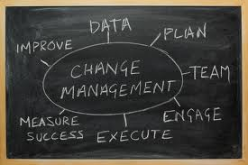
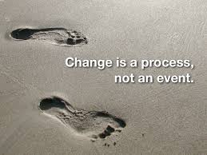
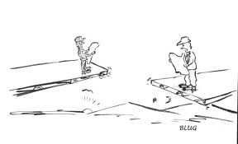
Conclusions for working on your change plan

Slide 17
Three types of change
Dramatic change
Provides impulses
Provides gradual order
Area of
revolution
Systematic change
Area of
reform
Area of rejuventation
Organic change
Provides enthusiasm

Slide 18
Time and degree of difficulty for different levels of change
ORGANISATIONAL OR GROUP BEHAVIOUR
INDIVIDUAL BEHAVIOUR
DEGREE OF
DIFFICULTY
ATTITUDE
KNOWLEDGE
TIME

Slide 19
Consider at the start:
  How to support internal drivers of change
  How to link with, relate to and build on previous or existing initiatives
  What is happening in other parts of the system and how these interventions might interact with them
  How interventions can be followed up for sustainability
  What to do first – sequencing
  In all this: work first with individuals and their relations, then the systems behind them

Slide 20



Actors and roles
Initiators
Sponsors
Protagonists
Antagonists
Drivers
Implementers
‘Victims’

Slide 21
Analysing four action fields for promoting change
 | Focus on the ‘functional-rational’ dimension | Focus on the ‘political’ dimension
Focus on factors within the organisation(s) | 1. Getting the job done | 2. Getting the power right and accommodating interests
Focus on factors in the external environment | 3. Creating an ‘enabling environment’ for doing the job | 4. Forcing change in the power relations
Notes:
Taken from EU CD Methods – Institutional Assessment and CD p21

Slide 22
 | Hard capacity needs | Soft capacity needs
Institu- tional | Formulation of enabling legislation Establishing necessary institutions to oversee legislation enactment and implementation (sector) results framework | Public awareness campaigns Lobbying and advocacy with political decision makers Creating sector consensus
Organisat-ional | Development of policies and procedures Development of strategic and operational plans ICT infrastructure | Facilitation of conflict resolution Leadership development programme Introduction of reflective learning practices
Individual | Training to upgrade technical skills | Creating a results orientation
Notes:
Intervention

Slide 23
Selecting a balanced set of interventions
NGO
support
Skills
development
Learning
programme
Ministry
capacity
Sector
coordination
Trade
regulations
Legal
framework
Education
system
Etc., etc.
Lesson learned:
Technical skills, laws, procedures or policies are rarely, if ever, enough on their own. Behaviour, attitudes and informal structures are usually as important
No single tool can provide the answer to a complex need
Notes:
Comprehensive assessment and analysis of context will show that opportunities will arise for capacity development in all types of EC support, for example Budget Support,
and in TC for other purposes, for example working with learning processes to develop capacity around specific activities like policy development.
When such opportunities are recognised they should be integrated into the design by:
Ensuring stakeholders understand the opportunities and give their support
Integrating capacity objectives into operational plans
Formulating activities to achieve both development results and capacity results
Selecting appropriate interventions

Slide 24
Who Does What – the partner country?
  Focus first on what the partner country will bring to the process.
      the change management responsibility; leadership
      the practical actions the partner will do (time, money, logistics, staff, activities)
  Only then consider need for external support including that of the Commission

Slide 25
What External Partners can bring
  Many roles: advice, knowledge-ideas, funding, hands on deck, linkages, mentorship, sounding board?
  Think beyond TC/TA: consider if other instruments can help e.g. NGO support, budget support, facilitate dialogue, twinning, (regional) knowledge exchange, peer support, pilots-experimentation
  Inputs without an influencing or engagement strategy are likely to be ineffective

Slide 26
And be aware of your and your partner’s colour
Yellow
Blue
Red
Green
White

