Slide 1
PFM II
PFM Reform
INTRODUCTION

Slide 2
PFM Reform: Course Objectives
  To provide tools for understanding, analyzing and sequencing budgetary reform
  To introduce the importance of and rationale for sequencing and scheduling PFM reforms
  The material is focused on the instruments and processes to manage reform, and not on public policy itself
  The debate is centered around the public finance management at the level of the cenral administration

Slide 3
Course outline
Day 1: Approaches to PFM reform
Day 2 : PFM sub-systems and prioritization amongst them
Day 3: Change management – Reform sequencing issues – Case study

Slide 4
Day 1: Approaches to PFM Reform
  Module 1.1. PFM objectives and budgetary approaches
  Module 1.2. Why reform PFM systems? Why sequencing?
  Module 1.3. The starting point: assessing PFM systems
  Module 1.4. Conditions for successful reform

Slide 5
Approaches to PFM reform
Module 1.1
PFM objectives and budgetary approaches

Slide 6
Module 1.1: Objectives
  Fiscal reforms aim at enhancing systems of PFM according to their objectives.
  In this module, after a brief reminder of the definition of PFM, will look at the objectives of PFM and the broad guidelines to budgetary approaches

Slide 7
Module 1.1. Outline
  What is PFM ?
  Objectives of PFM
  Budgetary approaches and provision of public services
  Hierarchy amongst PFM objectives

Slide 8
Public Finance Management (PFM)
  OECD DAC 2009 Definition of PFM:
  “PFM includes all components of a national budget process… including strategic planning, medium-term expenditure framework, annual budgeting, as well as revenue management, procurement, controlling, accounting, reporting, monitoring and assessing, audit and external supervision.“

Slide 9
PFM encompasses all public administrations
Public administrations include:
  Central government
  State government in federal countries
  Local government
  Social security funds, that are sometimes considered as a separate sub-sector
Public sector also includes corporations and quasi-corporations controlled by the government units
Notes:
Government units
have legislative, judicial, or executive authority ;
provides goods and services on a nonmarket basis
redistribute income and wealth
finance their activities mainly by means of taxes and other compulsory transfers
The course will deal with the finance of the general government. With a focus on the central government, but there is a module on decentralisation

Slide 10
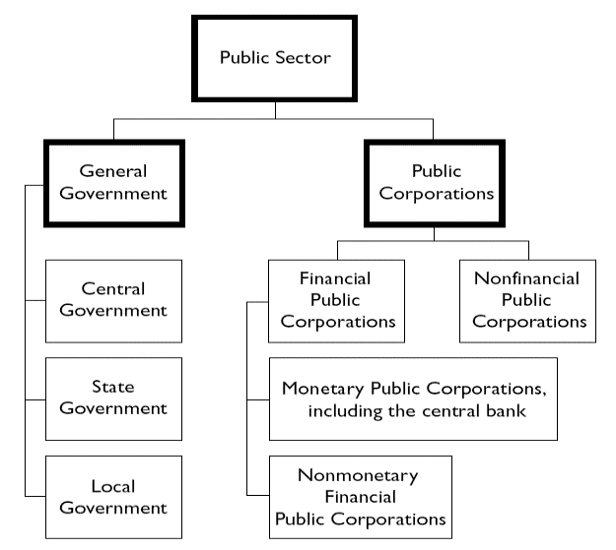
Administrations encompassed in PFM
Source: Government Finance Statistics (GFS). IMF
Notes:
Public sector comprises
Public administrations
Central, state, local collectivities, social security)
These public administrations have legislative, judiciary of executive powers. They provide non merchant goods and services, raise taxes, redistribute income (cf. IMF/GFS)
Corporations and quasi-corporatoins controlled by the public administration
NB This course deals mainly with the central government.

Slide 11
The purpose of Public Finance Management
PFM is an instrument used to implement public policies.
  Public policies: e.g. growth, poverty reduction, macroeconomic stability, etc.
  Instruments for implementing public policies: PFM, regulation, public corporations
PFM must, as much as possible, be in line with the objectives of public policies.
As an instrument, PFM is in part independent from public policies’ objectives, but only in part
  Approaches that are adopted regarding PFM are in part influenced by societal choices and public policy objectives

Slide 12
Module 1.1. Outline
  What is PFM ?
  Objectives of PFM
  Budgetary approaches and provision of public services
  Hierarchy amongst PFM objectives

Slide 13
Approaches to PFM
  “Traditional” approach
  Focused on integrity, consistency, ethics of public service
  Pre-eminence is given to respecting procedures, & to implementing performance tests in budget management
  “Modern” approach: focuses on:
  formulation & planning of public policies
  performance in conduct of activities

Slide 14
The objectives of PFM
’Traditional’ approach:
financial compliance (budget discipline)
/compliance to the law
Three objectives of ‘modern’ approach
1. Aggregate fiscal discipline
2. Strategic allocation of resources in compliance with public policy objectives
3.Efficient delivery of public services

Slide 15
Process of public service provision & aspects of performance
The concept of performance
Effectiveness (fulfil objectives) & efficiency (be productive) – take into account quality

Slide 16
The societal dimension
Aids in achievement of PFM objectives, but also represents societal values
Accountability/ Responsibility / Liability: two aspects: reporting & ensuring accountability to Parliament & citizens
Being receptive
Promoting democratic values
Transparency (IMF Manual on Fiscal Transparency)
  Precision concerning roles & responsibilities
  Unrestricted public access to information
  Transparency in preparation & implementation of the budget, as well as all related information
  Independent safeguard of integrity

Slide 17
Relations between the different objectives and dimensions (1)
Essential to take into account risks of complementarity & conflict between objectives & dimensions
Complementarity, examples:
Being accountable to Parliament strengthens control
Without fiscal discipline, provision of public goods may be wasteful
Conflict, examples:
More flexible management may improve performance, but alter control system
Increasing power of Parliament may affect overall budgetary discipline
Poorly designed measures to improve financial discipline may have negative effects on performance

Slide 18
Relations between objectives and dimensions (2)
Care should be taken to find optimal set of measures that will enable moving towards one or more objectives, without moving away from another
Optimal composition of a set of objectives depends on the context of each country

Slide 19
Avoiding schematisation
The depth & method of taking into account interdependencies between objectives & societal dimensions generally leads to consideration of various methods of achieving these objectives
For example, while setting an objective of ‘financial discipline’, emphasis may be on:
  ‘hard’ control or on transparency of controls & absence of any arbitrariness
  Compliance with budgetary authorizations, whether initial or revised, or on sole compliance with initial budgetary compliance, given that budget revisions are of small scale (credibility of budget as per PEFA)

Slide 20
Module 1.1. Outline
  What is PFM ?
  Objectives of PFM
  Budgetary approaches and provision of public services
  Hierarchy amongst PFM objectives

Slide 21
Budgetary approaches
1. ‘Traditional’ budgeting: focused on inputs & means
Strengths
  Ensuring basic processes
  Building a culture of discipline
Weaknesses
  As a general rule, little consideration is given to public policies and their results
  Often, heavy bureaucratic processes
Notes:
Focus on economy, controls and due processes. The MOF may perform tight control on spending

Slide 22
Budgetary approaches: result-oriented
2. ‘Result-oriented’ Budgeting: focus on output /effectiveness &/or outcome/efficiency
Strengths:
  Reflect the actual objective of budgeting
Weaknesses:
  Require solid institutional frameworks
  Effectiveness depends on country context
Notes:
Budgeting for results
Aimed at better achieving the 3 objectives of PFM
Different orientations depending on the focus: output/efficiency or outcome.
Various procedures and institutional arrangements are related to these approaches e.g.
Programme budgeting
Contractualist approaches
Creation of “arm’s length public agencies” accountable on results
However their effectiveness depends on the country context.

Slide 23
Budgetary approaches
‘Traditional’
Aims at saving money
‘ROM’, ‘programme/performance budget’
Aims to achieve performance
Notes:
GBO: Gestion du Budget par Objectifs: approche de gestion fondée sur des résultats mesurables devant répondre aux objectifs et aux indicateurs préalablement définis.
GAR: Gestion Axée sur les Résultats
ROM: Result Oriented Management

Slide 24
Module 1.1. Outline
  What is PFM ?
  Objectives of PFM
  Budgetary approaches and provision of public services
  Hierarchy amongst PFM objectives

Slide 25
Hierarchy amongst PFM objectives (1)
Objectives of PFM are interdependent, but:
Maintaining an adequate level of fiscal discipline (probity, consistency) is a necessary condition to safeguarding other objectives
Without fiscal discipline, there is no accounting/accountability, public policy choices may not be respected and there is no efficiency
Without overall budgetary discipline it does not make sense to prioritize, and provision of public services is disorganized (e.g. Generation of arrears)

Slide 26
Hierarchy amongst PFM objectives
The following hierarchy can be defined:
First: Budgetary discipline
Then: Aggregate fiscal discipline
Then: other objectives,
  2. strategic allocation of resources;
  3. Efficient provision of public services
  Is there a hierarchy between objectives 2 & 3?

Slide 27
Hierarchy amongst PFM objectives and budgetary approach
The note on ‘Best practices on sequencing of reforms’ links objectives of PFM to budgetary approaches
Budget Discipline: traditional budget
Aggregate Fiscal Discipline: Traditional budget with an emphasis on macro-economic control
Efficiency & Effectiveness: emphasis on results
The Note uses the term efficiency rather than strategic allocation of resources to avoid mixing up political & managerial dimension of resource allocation

Slide 28
Frameworks for looking at PFM
  Good Practice Note on Sequencing PFM Reforms, , Jack Diamond 2012

Slide 29
Key messages
This module identified the main objectives of PFM: Budgetary discipline, aggregate fiscal discipline, strategic allocation of resources, efficient provision of public services.
Improving the performance of a budgetary system aims at enabling a greater fulfilment of its objectives
• Satisfactory fiscal discipline is a necessary condition for achieving its other objectives

