Slide 1
PFM domains & sequencing of reforms
Module 2.4
External control, legislative & regulatory framework, IT issues

Slide 2
Day 2: Sub-systems of PFM and prioritsing reforms
Module 2.1. Expenditure Classification, budget Preparation and the MTEF
Module 2.2. Expenditure and accounting cycle
Module 2.3. Program/Performance budget
Module 2.4. External control, legislative and regulatory framework and IT (information technology)issues
2

Slide 3
Module 2.4
Two sub-modules:
  External Control (External Auditor, Parliament): Aims to put forward general principles and identify essential functions
  The information system: Aims to identify key questions to examine during the process of increasing computerisation

Slide 4
Module 2.4. Key Points
External control
  External audit
  Parliament
Legislative and regulatory framework
Information systems

Slide 5
External Audit
Undertaken by Supreme Audit Institution (SAI: Court of Audit, Court of Finances, National Audit Office, etc.)
Key point is the independence of the SAI should (must!) be guaranteed by the constitution according to International Organization of Supreme Audit Institutions (INTOSAI )

Slide 6
Basic Principles - INTOSAI
Legislative & regulatory framework must be established
Independence of SAI members
Financial independence of SAI (adequate human & financial resources)
All public finance operations to must be covered
Unrestricted access to information
Right & obligation to present reports
Freedom to decide content & scope of publication of audit reports
Effective implementation of recommendations

Slide 7
Different types of Audit
Compliance audit: assessing extent to which legal & administrative requirements are followed; integrity & suitability of administrative, financial & management control systems
Financial audit: review of financial statements & accounting systems which underlie them
Performance audits: assesses management & operation performance of government programs & MDAs to evaluate effectiveness & efficiency with which program or organization uses resources

Slide 8
End-of-year Accounts
End-of-year accounts are first submitted to the SAI, then to parliament (often with significant delays)
La loi de règlement (French System)
  Administrative account (Authorising Officer) & management account (Accountant)
  Report by Court of Audit/finance with certificate of compliance (or not)
  Major weaknesses
    Long delays;
    Administrative & management accounts are often incomplete & difficult to compare

Slide 9
The Basics
General Principles
Functioning SAI, independent, covering all financial transactions and public money, qualified accountants & use of standards consistent with INTOSAI
Regularity Audit
End-of-the-year account Audit
Public reports of SAI
Respect of the recommendation by the executive
A parliamentary commission examines SAI reports

Slide 10
PI-29. Annual financial reports
This indicator assesses extent to which annual financial statements are complete, timely, & consistent with generally accepted accounting principles & standards. This is crucial for accountability & transparency in the PFM system. It contains 3 dimensions & uses M1 (WL) method
29.1. Completeness of annual financial reports
29.2. Submission of reports for external audit 29.3. Accounting standards

Slide 11
PI-30. External audit
This indicator examines the characteristics of external audit. In contains 4 dimensions & uses M1 (WL) method
30.1. Audit coverage and standards
30.2. Submission of audit reports to the legislature
30.3. External audit follow-up
30.4. Supreme Audit Institution independence

Slide 12
The Parliament
Allow sufficient time for Parliament to discuss the Finance Act
Submission of audited accounts within 10 months of end of fiscal year (cf. PEFA PI-29.2) & PI-31.2)
Gradually reinforce capacity of parliament: Importance of Public Accounts Committee

Slide 13
PI-18. Legislative scrutiny of budgets
This indicator assesses nature & extent of legislative scrutiny of annual budget. It considers extent to which legislature scrutinizes, debates, & approves annual budget, including extent to which procedures for scrutiny are well established & adhered to. The indicator also assesses existence of rules for in-year amendments to budget without ex-ante approval by legislature. It contains four dimensions & uses the M1 (WL) method
18.1. Scope of budget scrutiny
18.2. Legislative procedures for budget scrutiny
18.3. Timing of budget approval
18.4. Rules for budget adjustments by executive

Slide 14
PI-31. Legislative scrutiny of audit reports
This indicator focuses on legislative scrutiny of audited financial reports of central government, including institutional units if (a) they are legally required to submit audit reports to legislature or (b) their controlling unit must answer questions & take action on their behalf. It has 4 dimensions & uses M2 (AV) method
31.1. Timing of audit report scrutiny
31.2. Hearings on audit findings
31.3. Recommendations on audit by legislature
31.4. Transparency of legislative scrutiny of audit reports

Slide 15
Key messages
An independent external audit of the Executive with adequate capacity is an essential element of a good PFM system
Priority should be given to regularity audits & in particular to year-end audit
The draft Finance Act must be tabled in Parliament at least two months before the beginning of the year
Year-end audited accounts of year n-1 must be submitted to Parliament with the Finance Bill for year n +1

Slide 16
Module 2.4. Key Examined Point
External Control
  External Audit
  Parliament
Legislative and regulatory framework
Information systems

Slide 17
Legislative and Regulatory framework
Constitution
[Organic] Budget Act (or Public Finance Management Act, Budget Framework Law, etc.)
Other laws and regulations
  Audit Act
  Fiscal responsibility law
  Territorial Authorities Financial Act (French system)
  Decree on Public Accounting
  Financial regulations
Notes:
Organic Law is a law that ‘grows’ out of the constitution – ie is required by the constitution and is in that sense one step below the constitution. They may require specific majorities in parliament to be amended. Rights laws etc. It is also a comprehensive law (albeit subject to detailed defining regulations etc). It sets binding principles for the full cycle. Anglo Saxons don’t have the, - they depend on regulation / series of laws etc.

Slide 18
Key points of the legislative framework
Provide a framework for parliamentary authority
Establish responsibilities (Countries in transition: strengthen the powers of the Minister of Finance)
Define principles of sound fiscal management
Define reporting obligations

Slide 19
Organic laws governing financial laws: Key Elements
General principles (Unity, Universality, transparency)
Concepts and definition
Scope of Budget
General principles for accounting & budget classification
Budget authorisation
Budget calendar
Execution & revision of the budget
Debt and liabilities
Roles and responsibilities
Relations with local communities
External Audit
Sanctions

Slide 20
Questions to be considered before reforming legislative & regulatory framework
What is the existing framework?
Is it respected?
If not, why?

Slide 21
Key Messages
  The legislative and regulatory framework must follow the basics discussed
  The first step is an organic law establishing principles for budget management and distribution of responsibilities
  It should be checked whether the existing legislative and regulatory framework is implemented

Slide 22
Module 2.4. Key Points examined
External control
  External Audit
  Parliament
Legislative and regulatory framework
Information Systems

Slide 23
Information Management Systems
Management information is necessary
  For scheduling, implementation and surveillance;
  For the MoF & sectoral ministries
Not a mere collection of statistical data
  Financial & Physical Information
  Dashboard
  Must be available quickly in order to enable to take decisions
It is not only IT, but may be useful to classify, sort & publish data in various formats.

Slide 24
Integrated Financial Management System
“Heart” of the accounting system (General Accounting)
  Setting standard exchanges between systems
  Covers all financial transactions
Other Systems:
  Budgetary module: Accounting & budgetary control
  Preparation of budget
  Treasury management
  Debt management
  Revenue
  Management modules for managers

Slide 26
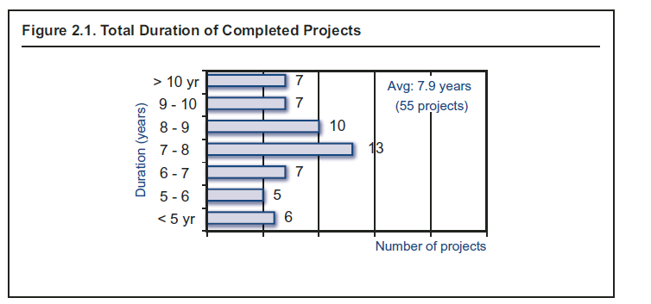
In practice (1)
A large majority of the integrated systems are only partially implemented
Yet, the implementation process is time consuming
Dener: WB 2011

Slide 27
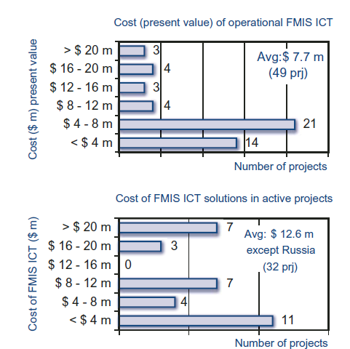
In practice (2)
The average cost of the World Bank projects is US$ 7.7 million
Dener: WB 2011

Slide 28
Software Package or in-house development?
Enterprise Resource Planning(ERP)
  SAP, Oracle financials, etc.
  Less complex: Free Balance
Theoretical benefits of ERP
  No need to develop, setting that parameters suffices
  Improved data security: Less risk of bugs, facilitates after-sales services and documentation, etc.
Disadvantages
  Harmonization of ERP systems can be a mammoth task and requires a lot of time, planning, and money
  Reduced appropriation
28

Slide 29
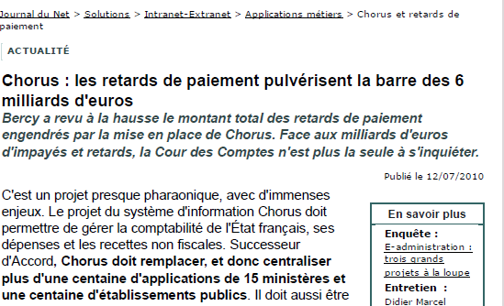
An integrated system : CHORUS- France
Chorus : Court of Auditors points out….While cost was estimated in 2006 as 1.01B Euros for 2006-2015 period, State Financial Data (ASFD) has updated its forecast because “adaptation cost of departmental systems has been estimated as €220 million & that of environment, which Chorus estimated to be €280 million, bringing the total project cost of €1.5B."

Slide 30
Tanzania – A partially-integrated but functional system
According to IMF study, computerized budget management system in Tanzania is one system that gives satisfactory results
This system has led to ad hoc development in Tanzania: not fully integrated – missing are:(i) payroll & human resource management system, (ii) budget preparation system, (iii) computerized tax administration systems (iv) 21 sub-treasuries & regional ministries
30
Notes:
March 2005
According to the World Bank, Tanzania is the “most successfully implemented system in an Anglophone African country”
Started with MoF and 10 ministries. Also second IT system.

Slide 31
Should an ERP dictate procedure?
Proponents of ERP suggest review budgetary procedures & adapt to a ERP: enables reduction in cost of setting the parameters
This approach should be avoided
Questionable procedures should not be computerised
BUT computerization must take into account the existing, ongoing reforms and administrative culture

Slide 32


‘GIGO’
Computerisation should not substitute for establishment of proper procedures to create a robust system
Computerisation does not ensure integrity and regularity

Slide 33
Preparing a computerization project
Define the scope of the project
Prior review of the procedures (ex. Budgetary Classification)
Examine capacity constraints, ensuring political engagement
Choose the options (ERP, development)
Modalities of progressive extension to national territory and ministries
Project management apparatus
Budget & Funding
Change management

Slide 34
Sequencing (1)
Basics: A manual system, a precise budget classification, chart of accounts, well defined procedures.
Subsequently, choosing implementation approach based on the existing system, planned reforms, etc
  Scope of ERP: In general, at least accounting & expenditure. But, starting with an auxiliary system such as payroll can provide with a better cost-benefit ratio
  Territorial coverage: An exhaustive territorial coverage can take time
The procedure MUST be functional with or without computerisation

Slide 35
Sequencing (2)
Choosing the implementation process….
  Technical aspects
    ERP or application development?
      Choice of ERP if ERP varies
    National network or separate database?
Change management
  Organisation and management of the project
  Training
  Other aspects of human resource management.

Slide 36
Key Message
Computerisation provides important support to management
But it carries risks, which increase when:
  The project is more complex
  The ability of local officials to critically evaluate all the aspects of the project is limited
  The project is led or strongly influenced by external consultants
  Political support is insufficient
Integrated systems based on ERP can be very expensive and risky
36
Notes:
The UK has suffered a string of disasters in implementing e-Governance projects. The Child Support Agency; the Home Office’s accounting system; the Passport Office; Connecting for Health; tax credits; benefits smart cards are all memories which the IT industry would rather forget. The National Audit Office concluded its review of IT procurement by saying that “the history of failure of major IT-enabled projects has been characterised by overspends, delays, poor performance and abandonment of projects at major cost” (NAO, 2003).
Average public sector wage costs in Africa can be one-tenth or less than those in the West; average ICT costs can be two to three times higher. E-Governance and automation using modern IT technology therefore results in replacing cheap civil servants with costly IT (Heeks 2002).
“attempts to computerise an entire government accounting system within a few years were doomed either to failure or to dramatic cost and time overruns.” UN (1991) Government Financial Management in Least Developed Countries Pg 17

