Slide 1
INTRODUCTION TO
PUBLIC FINANCE MANAGEMENT
Module 3.2: Treasury Management

Slide 2

Treasury Management: Simulation Game
Set-up:
- 5 players: Treasury, 3 line ministries and capital market
- Authorized budget of €11,9 billion (revenue and expenditure)
- Credible budget: sufficient revenue, no need for cash rationing
- Cash is released in quarterly tranches based on Cash Plan

Slide 3
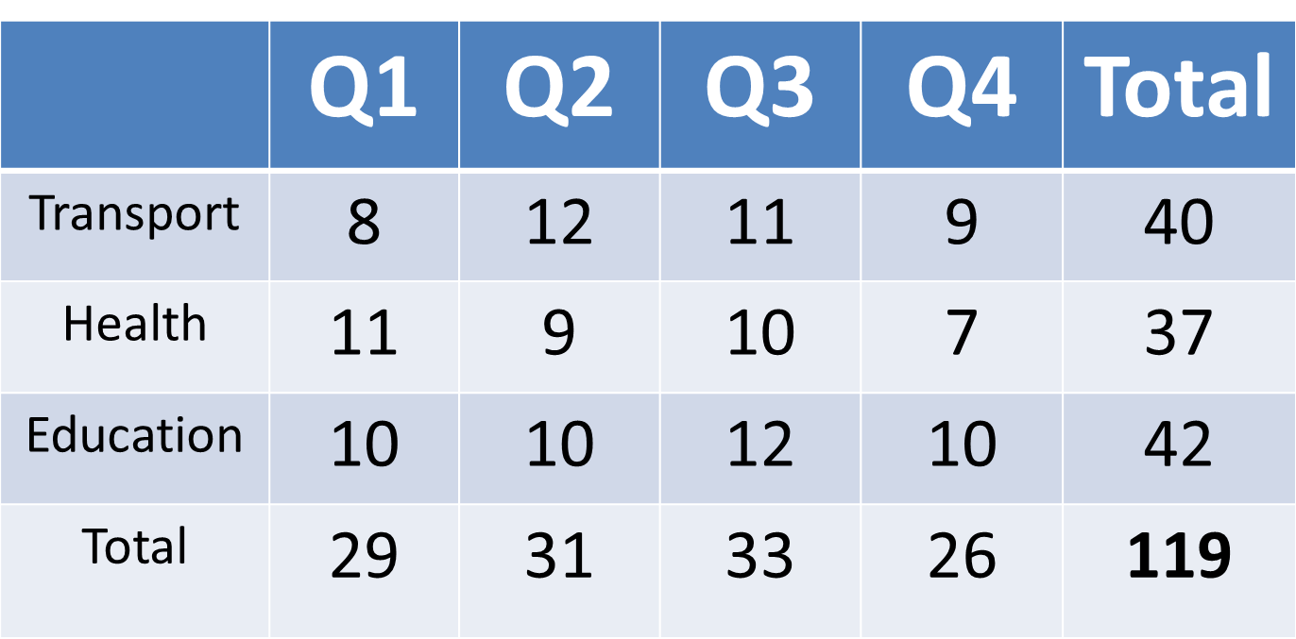
Cash Plan (in hundred million Euro)

Slide 4
Treasury Management: Simulation Game
Rules of the game:
Each ministry gets cash releases and spends according to Cash Plan
‘Serious events’ might happen during the year
Three simulations:
1. No Treasury Single Account (TSA) and no transparency
2. TSA introduced (+ full transparency)
3. Also with domestic capital market (interest rate 25%)

Slide 5
Module outline
Definition and objectives
Treasury Single Account
Problems with poor cash management
Efficient Cash Management
Cash flow forecasting
Debt Management

Slide 6
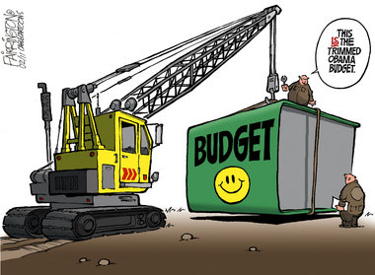
Definitions and objective
  What is treasury management?
  Process of efficiently managing the financial resources (cash and debt) required to execute budget
Treasury Management
Cash Management
Debt Management

Slide 7


Definitions and objectives
Cash management:
  Avoid disruptive cash rationing
  Avoid payments arrears
  Support smooth financing of expenditure plans: use cash and minimise short-term borrowing costs

Slide 8
Definitions and objectives
Smoothing expenditure plans

Slide 9
Definitions and objectives
Cash Management:
Optimise use of cash resources: surplus cash invested in interest-earning financial assets
Conduct cost-effective borrowing operations
Consistency with the monetary policy

Slide 10
Module outline
Definition and objectives
Treasury Single Account
Problems with poor cash management
Efficient Cash Management
Cash flow forecasting
Debt Management

Slide 11
Treasury Single Account (TSA)
Definition of Treasury Single Account:
A bank account or a set of linked bank accounts used for all/most government transactions.
In case of linked bank accounts, these must be on the basis of ‘zero balance’: no idle balances... excess cash ‘swept’ back into TSA on close of daily business.

Slide 12
Treasury Single Account
Advantages
  No more idle balances in MDA bank accounts
  Cash balances in TSA invested in interest earning financial assets
  TSA facilitates accounting control through bank reconciliations
  TSA facilitates timely & comprehensive accounting statements/reports, which, in turn, facilitate cash flow forecasting

Slide 13
Treasury Single Account

Slide 14
Treasury Single Account
On-going reform in many countries…
In many countries several MDA bank accounts are prevalent;
Idle cash balances are likely to result in lower interest earnings and higher interest expenses through unnecessary borrowing;
Even with TSA, donor-funded project accounts are often kept outside the TSA and the Treasury controls;
Resistance to TSA – bank accounts enable budget ring-fencing;
TSA reform may require strong political commitment.

Slide 15
Module outline
Definition and objectives
Treasury Single Account
Problems with poor cash management
Efficient Cash Management
Cash flow forecasting
Debt Management

Slide 16
Problems with poor cash management
Macro-economic instability: revenues unpredictable & liquidity shortfalls leading to in-year budget disruptions.
Unpredictable in-year reallocations between MDAs.
Payments arrears accumulate; MDAs enter into spending commitments that may be consistent with approved budget, but not supported by cash availability.

Slide 17
Problems with poor cash management
Cash rationing; a means of controlling expenditure according to cash availability…
It is opposite of efficient cash management - likely adverse impact on service delivery;
Danger of institutionalisation after need has gone
NB: Budget support useful if predictable; unpredictable budget support leads to same problems as unpredictable revenues

Slide 18
Module outline
Definition and objectives
Treasury Single Account
Problems with poor cash management
Efficient Cash Management
Cash flow forecasting
Debt Management

Slide 19
Efficient cash management
Principles of Cash Management
One Account
Idle cash deposited
Efficient Cash management
On time payments
Donor funding on time
Cash Invested
(short term deposits)

Slide 20
Efficient Cash Management
How to do this?
A pre-condition: sound budget preparation;
Weekly/monthly cash flow forecasting (revenue & spending);
One unit in charge - cash management unit;
Treasury Single Account (TSA);
Link with debt management – recording, monitoring of borrowing and interest payments.

Slide 21
Module outline
Definition and objectives
Treasury Single Account
Problems with poor cash management
Efficient Cash Management
Cash flow forecasting
Debt Management

Slide 22


Cash flow forecasting
Monthly Revenue & Expenditure Forecasting
Ministries
Departments
Cash
Management
Unit
Annual budget
Agencies
Sub National

Slide 23
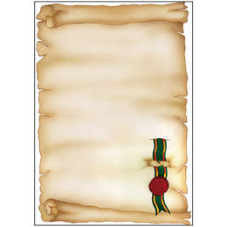
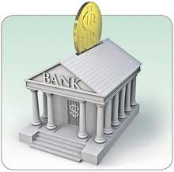
Cash flow forecasting
Warrant
Cash
Management
Unit

Slide 24
Cash flow forecasting

Slide 25
Cash flow forecasting
Cash plans should be updated monthly and announced in advance to:
  Spending units (MDAs);
  The domestic financial market, if used for borrowing.
Used in preparing borrowing plans:
  Do they take into account effectively procurement plans?

Slide 26
Module outline
Definition and objectives
Treasury Single Account
Problems with poor cash management
Efficient Cash Management
Cash flow forecasting
Debt Management

Slide 27

Debt Management
Loan financing options:
  Take into account floating/fixed interest rate options, maturity, grace period, currency.
  Seek concessional loan options at low interest rate, long grace and repayment periods.

Slide 28
Debt Management
Loan Guarantees
Government needs clear strategy for issuing guarantees to guard against contingent liabilities becoming actual liabilities.
Include guarantees to sub-national governments, state owned enterprises & private companies.

Slide 29


Debt management
Debt management information system help comprehensiveness, accuracy, timeliness…
  IT packages:
  DMFAS (UNCTAD)
  CS-DRMS (Commonwealth)

Slide 30
Treasury management – diagnosis
PI-21 in PEFA 2016 assesses the ‘predictability in the availability of funds to support service delivery’
  Includes four dimensions:
Extent and frequency of consolidation of the central government’s cash balances.
Extent to which cash flows are forecast and monitored.
Information on in-year information to Ministries, Departments Agencies on ceilings for expenditure commitment.
Significance of in-year budget adjustments.

Slide 31
Treasury management – diagnosis
  Also, PI-13 assesses the ‘management and reporting of debt and expenditure arrears’
  Includes four dimensions:
Domestic and foreign debt data recording and reporting;
Systems for contracting loans and issuance of guarantees;
Preparation of a debt management strategy;
Stock and monitoring of expenditure arrears.

Slide 32
Key Messages
Efficient cash management recognises the opportunity costs of cash:
  minimises idle cash held by government bodies;
  increases certainty that payments are made properly by the due date;
  avoids recourse to cash rationing.
Improving cash management entails:
  preparing regular cash forecasts;
  an effective Treasury Single Account.
Cash and debt management must be closely linked.

