Slide 1
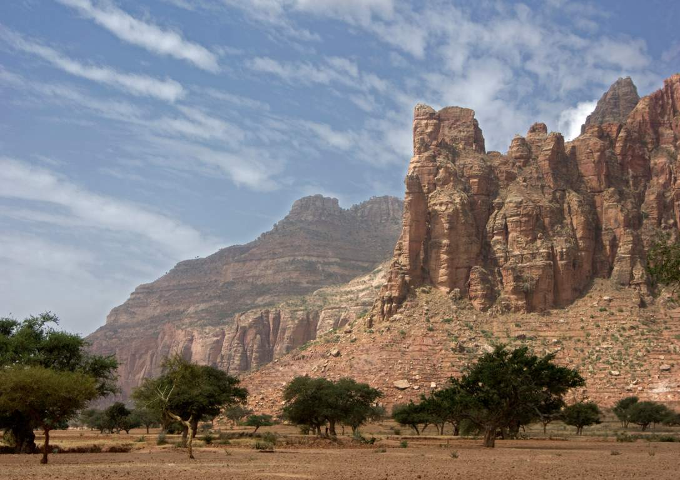
Building Resilience in Ethiopia
EU strategy for 2013 and beyond
Johan Heffinck
(ECHO ETHIOPIA)

Slide 2
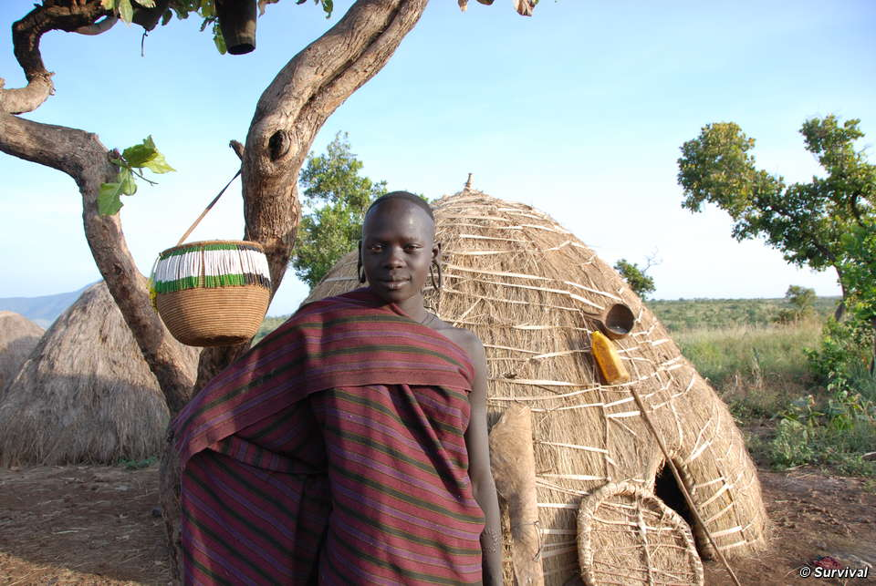
New approach to drought response
  Based on the critical premise that the way we have approached recurrent humanitarian crises is not cost efficient and should be changed

Slide 3
Evolution of EU Strategy
FROM
Nutrition centred
Often short term
Mostly on curative side
Pure humanitarian /life saving
Often installing parallel systems
Working in isolation
Stop and go
TO
Multi-sectoral with nutrition and food security as entry point
Nutrition sensitive and specific
Middle to long term commitment
Curative and preventive
Humanitarian and development integration
Cooperation with GOE woredas/zones/regional or federal
Stay and get ready for next drought

Slide 4
Basic Resilience Building Model (humanitarian part)
Improved basic
Services:
nutrition, health,
WASH, education
Livelihoods support
(AGR and livestock)
but also
diversification
of livelihoods
Nutrition and food security status of individuals and households
Community GAM and stunting rates
Peaks of seasonal malnutrition rates flattened out
Nutrition is input and outcome
Safety nets for
most chronically
vulnerable groups
DRM
Preparedness to
shocks

Slide 5
Crucial Elements to Keep in Mind
Meaningful operational coordination
in geographic clusters
Consortium of partners offering an
integrated approach across sectors
Taking fully on board
the GOE policies
Strong local ownership and leadership, on
national, regional and grassroots level
Cooperation with flagship programmes
Crisis modifier
Continuity and diversity of funding
Targeting the most vulnerable drop-outs…
equity versus growth model

Slide 6
Basic Resilience Building Model – Policy Environment
CPP, IGAD
NNP
Improved basic
Services:
nutrition, health,
WASH, education
GTP
Livelihoods support
(AGR and livestock)
but also
diversification
of livelihoods
Nutrition and food security status of individuals and households
Community GAM and stunting rates
Peaks of seasonal malnutrition rates flattened out
Nutrition is input and outcome
SP policy
CRGE
Safety nets for
most chronically
vulnerable groups
DRM
Preparedness to
shocks
DRM policy

Slide 7
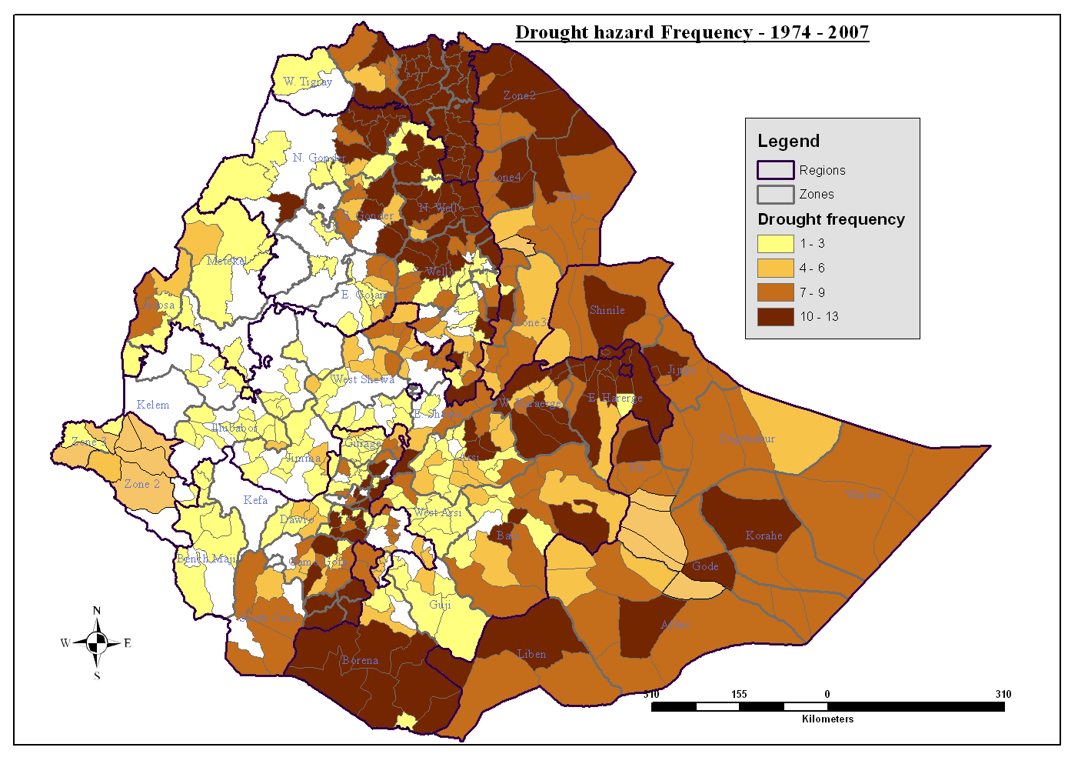
Drought Hazard Frequency (1974 – 2007)

Slide 8
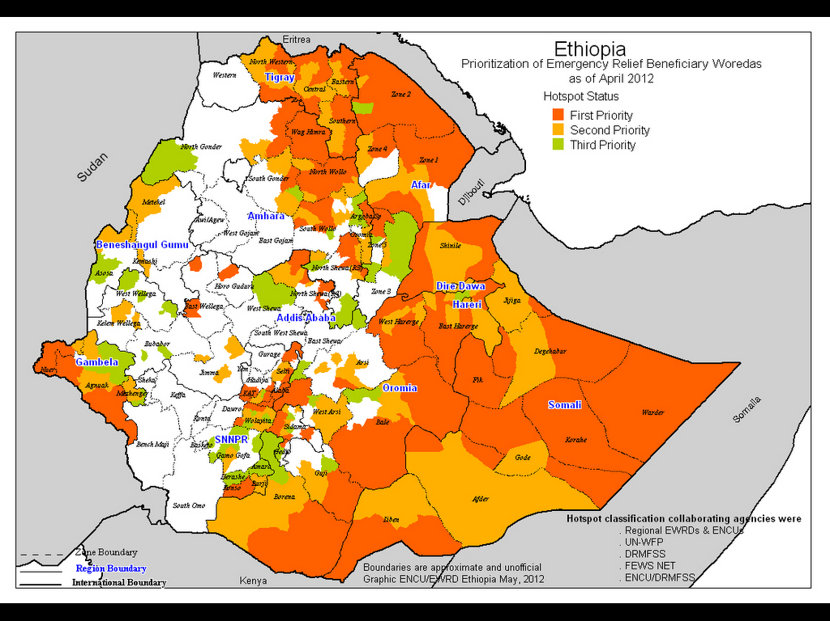
Hot-Spot Map of Ethiopia 2012

Slide 9
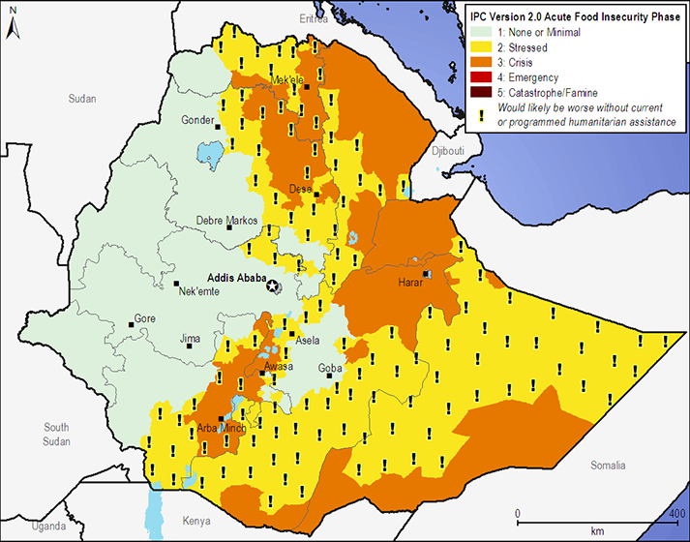
IPC tool (Fewsnet)
(Jan. – March 2013)
(April to June 2012)

Slide 10
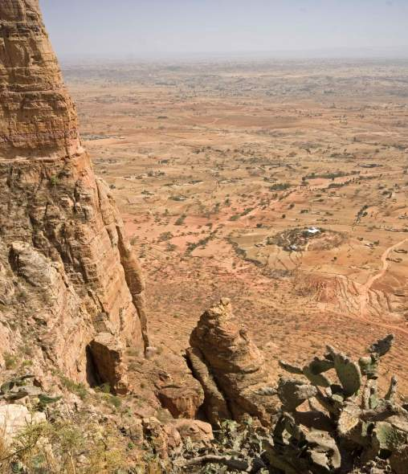
Selection of 'EU Resilience Clusters'
8 areas identified (clusters of districts) / 34 districts in total
Covering > 2.5 M people with 74,000 people avg per district) ~ 12 M people in Ethiopia who are drought exposed
Selection based on historic needs and ECHO’s partners presence in the past
Homogeneity of livelihood features (common risk analysis)
Notes:
As resources are limited, the approach focuses on 7 highly food insecure and drought prone areas where partners come together in geographical clusters (consisting of 2 to 7 woredas)
Estimated to assist over 2M people, corresponding to approximately 10-15% of the people recurrently affected by natural disasters
The selection criteria of clusters:
- Areas where ECHO has been repeatedly responding in emergency mode i.e. areas which experience recurrent droughts and nutrition related emergencies;
- Historic needs over the last 20 to 30 years and presence of ECHO partners in the recent past;
- Areas with homogeneity of livelihoods so that a common strategy can be developed for the entire area of the cluster
Since 2014, both financing tools (ECHO/HIP and DEVCO/SHARE) are contributing to the overall programme and the selection of geographic clusters has been revised to operate the resilience building programme over the middle to long term (from SHARE into 11th EDF).

Slide 12
Articulation of Support Instruments
Source | 2012 |  | 2013 |  | 2014 |  | 2015 |  | 2016
 | 1 | 2 | 1 | 2 | 1 | 2 | 1 | 2 | 1 | 2
ECHO
If Stability
10th EDF B
11th EDF
Notes:
After the big 2011 drought in the Horn of Africa, EU financial support has been mobilised from various sources. While humanitarian support has been provided throughout, it has gradually reduced in size. At the same time, development support has picked up. First through an allocation from the Instrument for Stability (€ 13.7 million) which supported livelihoods in (conflict-prone) pastoralist areas. Subsequently through an additional allocation of € 50 million from the EDF (B-envelope funding) which supports the Risk Financing Mechanism of the Productive Safety Net Programme (PSNP), as well as nutrition, livestock disease control, and livelihoods. This will be followed by further support to various aspects of resilience under the 11th EDF for which (at least) € 110 million has been earmarked.
Both the B-envelope and the 11th EDF will provide support to the 'Resilience Clusters'.

Slide 13
Cluster programme design process
Situation and context analysis
Livelihood and wealth profiling analysis
Joint Risk analysis
Mapping existing operations and Gap analysis
GOE policies, programmes
and activities
Joint planning for
implementation
Contingency planning and
Pre-positioning of stocks
Crisis Modifier
Coordination structures
Joint M&E framework (1 per 18 months for cluster)
LL and good practice on joint action
Common 3 year outcome level logical framework
Project linked (18 months) logical frameworks
Results framework with timeline
Proposals for joint applied research topics
Joint
Strategy development
Impact measurement
How will you
go about it?
Cluster guide
for all partners
working in the cluster
What is the
situation?
What do you
want to do?

Slide 14
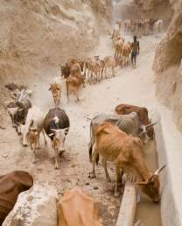
Challenges
  Need to re-calibrate the role of the humanitarian assistance to integrate chronic humanitarian needs in line with GOE policies and with longer term goals of DRR & resilience building
  Joint programming between humanitarian and development – common understanding of underlying causes
  The road to resilience building requires short and long term “vision, commitment and funding”.
  Importance of leadership and mainstreaming of resilience building in GoE policies and management structures

Slide 15
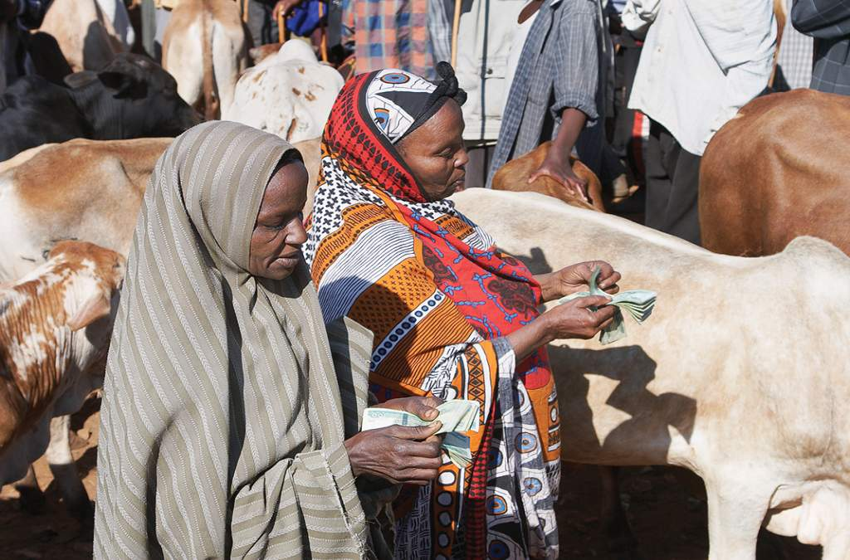
Thank you …
Photographs – Andy Catley, Kelly Lynch and Cathy Watson

