Slide 1
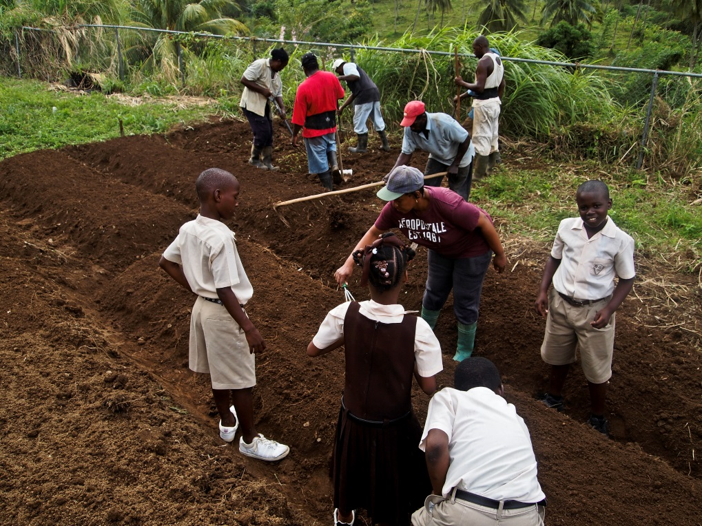

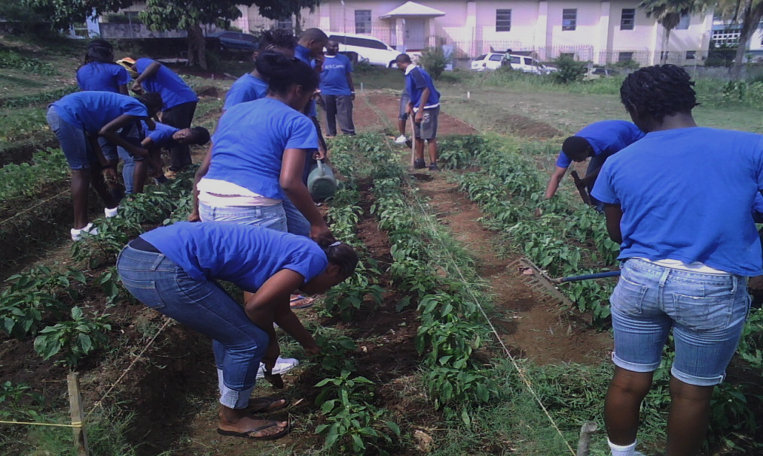
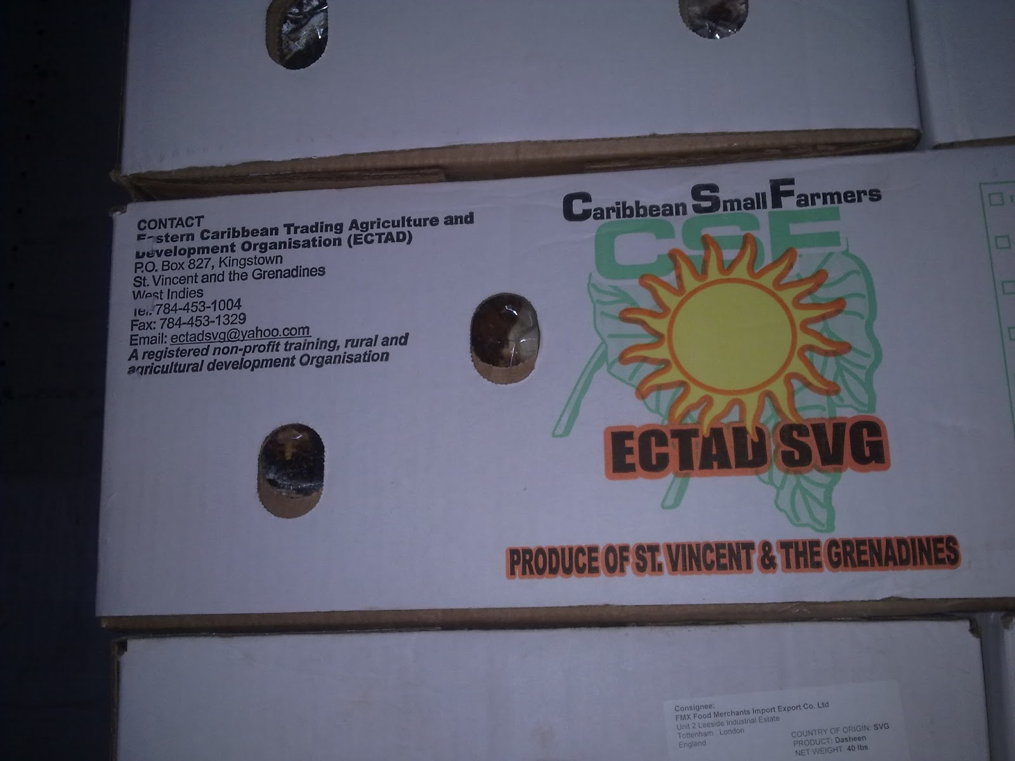
The Caribbean Farmers Network experiences in enhancing resilience for food an nutrition security
Addis Ababa, Ethiopia,
15th May 2014

Slide 2
Overview of Food Security
According to FAO Policy Report 2006, “Food security exists when all people, at all times, have physical and economic access to sufficient, safe and nutritious food to meet their dietary needs and food preferences in order to lead a healthy and active life”
In CaFAN, we believe that building resilience in food and nutrition security implies having a right action-oriented favorable policy environment, being able to develop systems to cope with shocks such as:
  increased food prices, natural disasters, social and political upheavals, climate change, competition, competing for resources, inequality in the food distribution system, etc

Slide 3
Main points for presentation
Practical programs of how small farmers in the Caribbean work together with governments and institutions to deal with the issue of resilience in food and nutrition security;
CaFAN’s methodology and focus on small farmers;
The enabling policy environment
Collaboration between actors (Agricultural Institutions)
Market access linkages
Efforts to cope with disaster risk management and climate change
Recommendations

Slide 4
CaFAN Background
CaFAN operates a system of farmers clusters/groups and organisations with a focal point in each country.
CaFAN comprises farmers organisations in 15 Caribbean countries. CaFAN has over 30 farmers organisations who have a combined membership of over 500,000 famers . Member countries: Antigua and Barbuda, Bahamas, Barbados, Belize, Dominica, Grenada, Guyana, Haiti, Jamaica, Montserrat, St. Kitts/Nevis, St. Lucia, St. Vincent and the Grenadines, Suriname and Trinidad and Tobago.
The mission of CaFAN is to “enhance Caribbean food and nutrition security, foreign exchange earnings and foreign savings by repositioning agriculture through the capacity building of farmers and the institutional strengthening of farmers organizations”.

Slide 5
Focus on Small Farmers/Families
95% of CaFAN’s farmers have 5 acres or less. Most small famers are locked into the production of food and are in it for long-term.
Small farmers represent a key platform for social and economic stability making them viable businesses that will help to promote increased employment, curtailing rural to urban migration, reduce poverty and creating greater food and nutrition security.
Groups of small farmers/small farm-families benefit from a market instead of a single individual and have a multiplier effect at the community level impacting many instead of a few.
Large farmers will always have better access to resources, financing, technical support and government influence. Small farmers on the other hand, must work in groups and clusters to get the same respect and impact. For example, 20 farmers together with 3 acres have an impact capacity of 60 acres as a single unit. However, results have shown that the output from these farmers working together is 2-3 times that of a single person working with 60 acres.

Slide 6
CaFAN Small Farmers Classification
To ensure social stability in most of our countries we need to ensure that our farmers do not fall into the unemployment category as it will have serious social implications in terms of crime and security.
The purpose of CaFAN’s small farmer classification is so that Government policies and our work programmes can be more focused and result oriented.
CaFAN has classified farmers in the Caribbean into three categories
(1) Commercial farmers
(2) Part-time commercial farmers
(3) Subsistence emerging farmers.

Slide 7
Farmers Classification
Category 1: Commercial farmers are full-time farmers and produce commodities on a commercial scale. They pay attention to various training courses provided and are typically the main beneficiaries of extension services. They will be the main stay for any commercial marketing program for farmers within a small farm market access program.
Category 2: Part-time commercial farmers generally have a job outside of farming. 50% or less of their time are spent farming. They have the same interest as Category 1.
Category 3: Subsistence emerging farmers represent the vast majority of farmers.
  Most of the production of subsistence farmers are used for family and local consumption while some may be filtered into the commercial market and for export.
  They provide the labour supply to Category 1 and Category 2.
  As they gain more experience and training, they emerge into Category 1 or 2.

Slide 8
The Caribbean Policy Environment
CaFAN has been working with the CARICOM Secretariat and other regional actors and supporters of agriculture such as CTA, FAO, CARDI, IICA, OECS and the UWI to ensure an enabling environment for resilience in food and nutrition security.
CARICOM has a Community Agriculture Policy (CAP) which comprises 5 pillars. Two of the main pillars, the Regional Food and Nutrition Security (RFNS) which is a policy that is activated and Youth and Rural Modernization (YRM) which was lobbied for by CaFAN.
CaFAN sat on both drafting committees and were able to bring the farmer perspective. We are now working with our members and partners to ensure that these policies are put into actions.
For the period 2012-2013, a number of Youth consultations were conducted by CaFAN where recommendations were made for the effective implementation of YRM pillar.

Slide 9
The Caribbean Policy Environment
CaFAN also sits on the Technical Working Group on Agriculture Risk Management in which we are looking at different ways of mitigating disaster risk. Part of our strategy is to focus on selected crops that can withstand a disaster such as roots and tubers.
CaFAN is working with its partners to see how best it can help to take agricultural policies from paper to action;
CaFAN, through national consultations has focused on the “eat what you grow, grow what you eat” concept to get the population involved since the responsibility of food is not just for the farmer but for everyone;
Backyard/ home/ school gardens are encouraged for local consumption and to promote interest in food.

Slide 10
Actions towards resilience in Food Security
CaFAN works to secure sustainable and profitable market access to ensure small farmers get a higher share of the products added value and ensure consumer satisfaction and fair price.
The closer CaFAN members get to the market/consumer by eliminating a lot of the middle persons, the more affordable the food will be become.
Our members are engaged in production for the local, regional and extra regional markets, which is necessary to create the necessary investments in agriculture.
One Strategy of CaFAN is to hold Buyer Grower Forums which is an action to stimulate local and regional markets, i.e. to bring together producers and buyers into a forum to discuss how best they can work together to meet each other in the selling and buying of produce, eliminating a lot of the middle persons. The forum has been a very successful tool held at the national and regional levels.

Slide 11
CaFAN clustering methodology
CaFAN has been clustering its farmers into groups to allow for better training and capacity building, for greater output of production and to gain economies of scale;
CaFAN farmers also share labour through a “Swap Labour” or Labour sharing approach which highlights and demonstrate the positive relationships among farm families and communities who work together to achieve the same objectives.

Slide 12
What CaFAN is lobbying and working towards
A need for research to enhance resilience for food and nutrition security within the region and this can be done through CARDI.
To set up Climate-smart business farms in each of our member countries that will be used for research and practical demonstrations.
As part of our strategic plan, we are working towards building a disaster risk and climate smart management plan with support from our partners
The important roles played by farmers need to be cemented into the minds of the people and that is why CaFAN is promoting that we upgrade World Food Day to include Farmers and Fisher-folks;
recommended by FAO consultations.
We are lobbying for Government policies to be more focused and result oriented and this will ensure their success, and farmers representatives and youth need to be a part of the process; To do this they need to ensure budgetary allocation to agriculture as

Slide 13
What CaFAN is lobbying and working towards
Encourage polices that strengthen the role of youth and women in agriculture..
Agricultural policies should focus on the protection of the environment thereby providing monetary incentives to farmers to continue to farm in a more environmentally friendly manner.
There needs to be a commitment to support capacity building and strengthening of farmers organisation and voluntary clustering of small farmers to gain economies of scale.
Capacity of farmer’s organizations must be built with special focus on small farmers, especially for improved farmers linkages to profitable markets.
Note: Imagine the ramifications if 500,000 – 1 million small farming families fall deep into poverty. Think of the rippling effect this would have on the population.

Slide 14
Partners & Collaborators
Caribbean Agricultural Research and Development Institute
Caribbean Community (CARICOM)
Caribbean Development Bank
Caribbean Disaster Emergency Management Agency (CDEMA)
CHF/ CIDA funded PROPEL
COADY International Institute,
COLEACP/PIP
Food and Agriculture Organization of the United Nations (FAO-UN)
Global Forum for Rural Advisory Services
Inter-American Institute for Cooperation on Agriculture (IICA)
International Fund for Agricultural Development (IFAD)
Ministries of Agriculture
Organization of the Eastern Caribbean States (OECS)
Sol Carib
Technical Centre for Agricultural and Rural Cooperation (CTA EU-ACP)
University of the West Indies
World Farmers Organisations

Slide 15
